Slide 1

Fantasy Maps

Slide 2
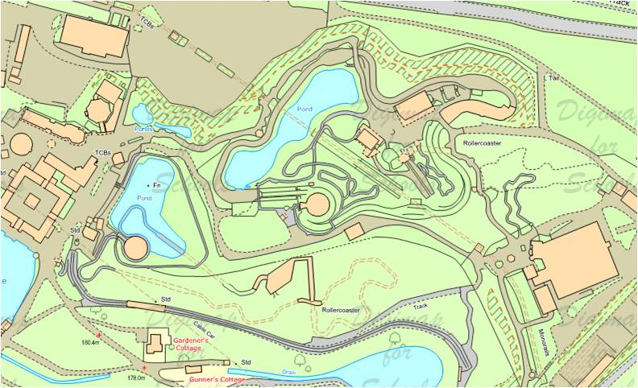
What features would your map show?
A theme park with a roller coaster and aerial ropeways?
Alton Towers

Slide 3
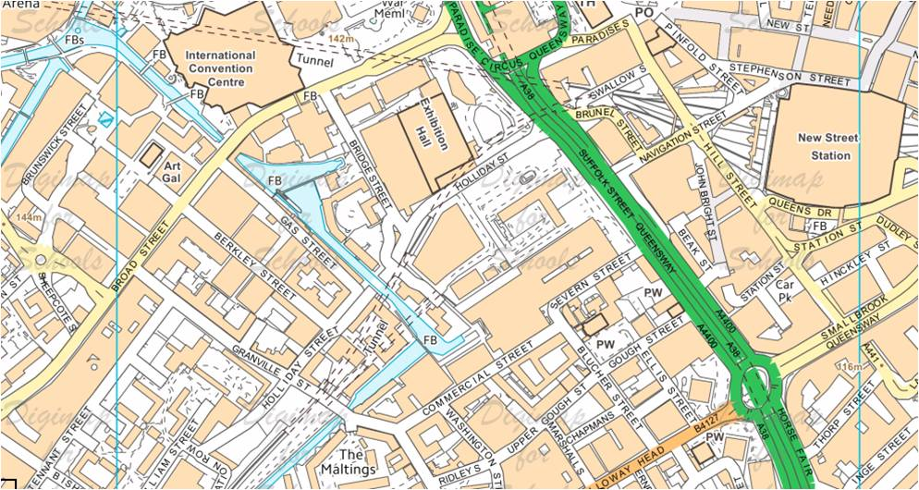
A busy shopping centre with station, canal and exhibitions?
Birmingham

Slide 4
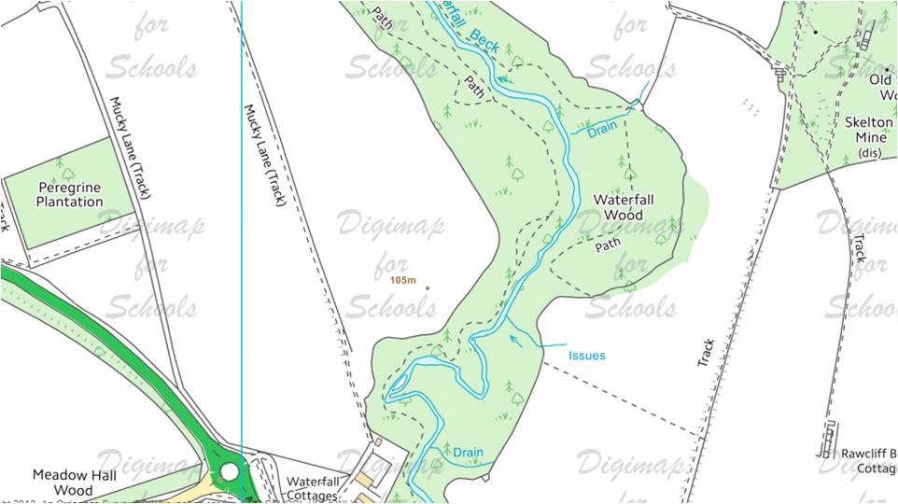
Somewhere for peaceful forest walks with waterfalls?
Near Guisborough, Cleveland

Slide 5
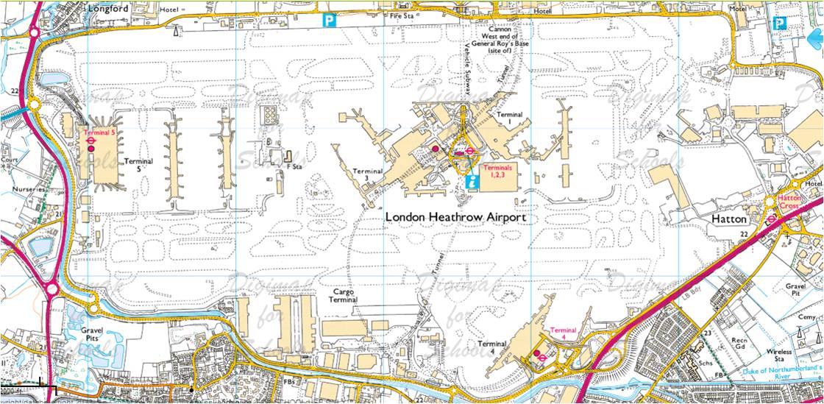
A bustling airport where you could watch the planes take off?
Heathrow Airport

Slide 6
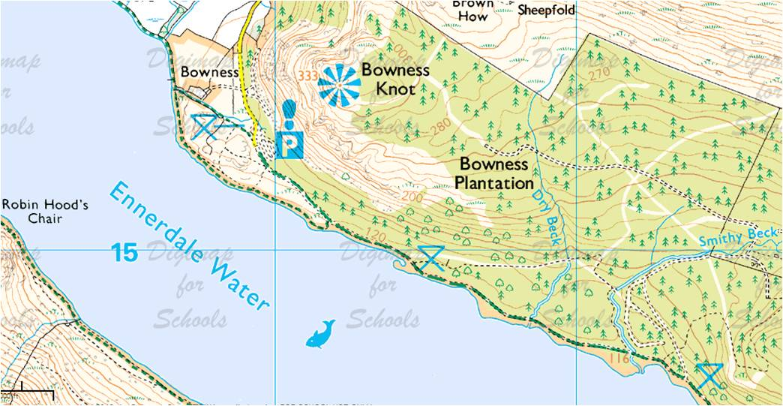
Tracks to explore beside a lake and places to picnic?
Lake District

Slide 7
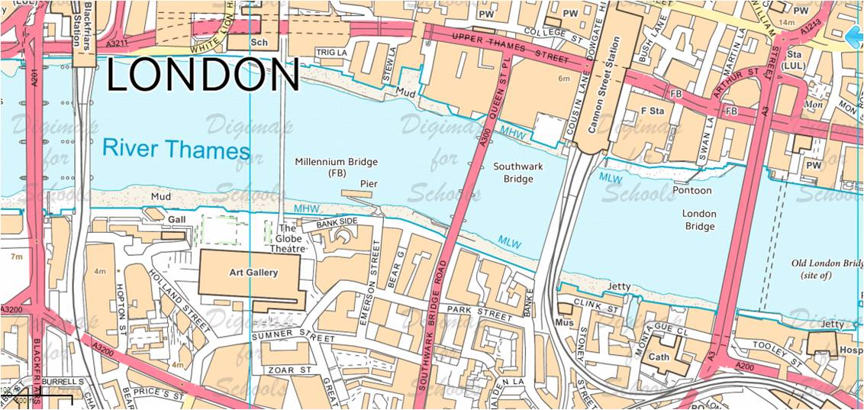
A boat trip through the heart of a city, beneath amazing bridges?

Slide 8
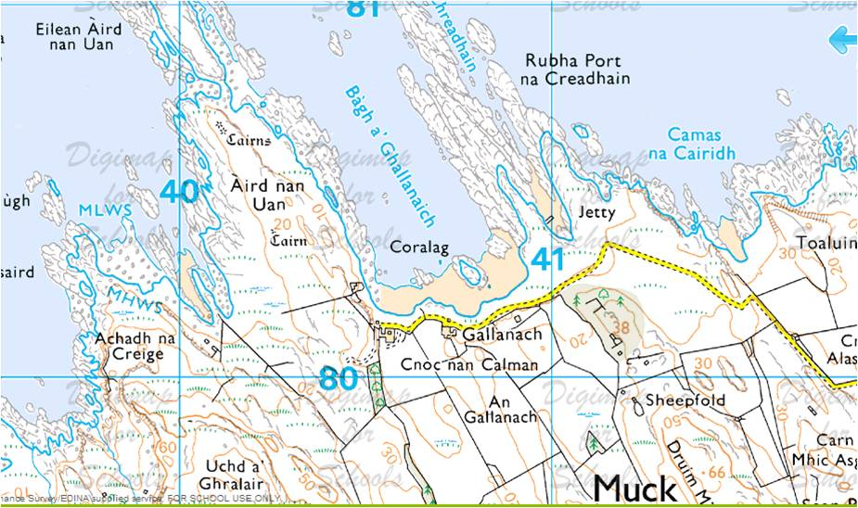
A remote island with rugged coastline and sandy beaches?
Isle of Muck

Slide 9
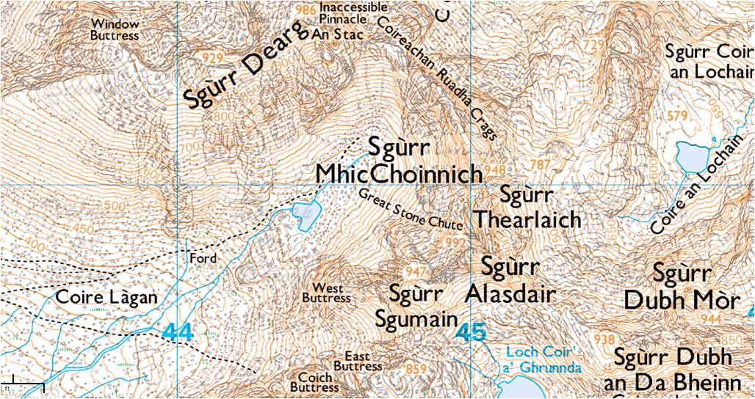
Mountains to climb and summits to reach?
Cuillin Hills, Isle of Skye

Slide 10
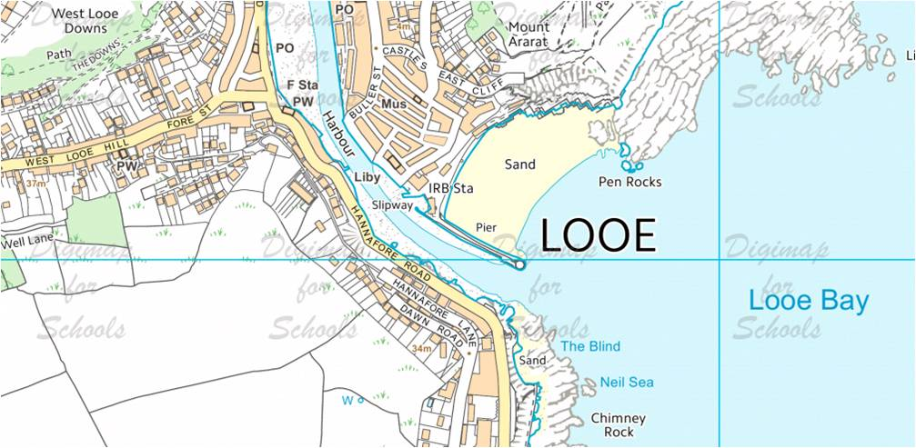
A pier to watch boats from as they arrive in the harbour? Rocks to scramble over?

Slide 11
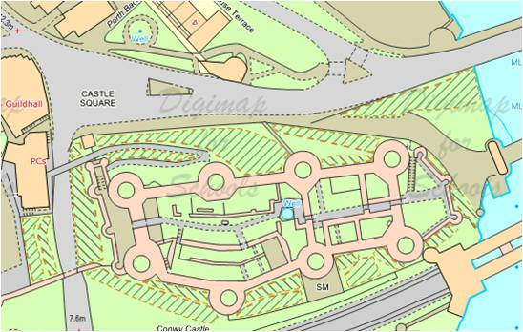
A castle where you could go back in time and explore?
Conwy Castle

Slide 12
What would your fantasy place look like?
Mysterious mountains
Forgotten forest
Summer Sands
Tricky track
Secret Sea
Rogue River
Vvv vvv vvv
Lost Lake
Vvv vvv vvv
What kind of landscape would it show?
Skyscrapers? Glaciers?
Caverns?
Castles?
Funfairs?
Vvv vvv vvv
Vvv vvv vvv
Moorhen Marshes
Wild woods
Vvv vvv vvv
Can you make a Key?
Vvv vvv vvv
Vvv vvv vvv
Notes:
Useful to explore children’s use of relevant vocabulary and their understanding of landscape features. This could also be a 3D fantasy place – or a sustainable place. For example, what would your vision of your school grounds in the future look like? What knowledge of effective landscapes would you draw on and why? Who would it be designed for? Lots of possibilities.

