Slide 1
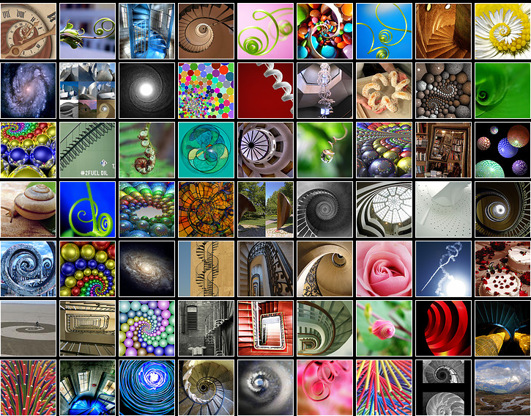
spirals

Slide 2

A spiral winds in a continuous curve round a point.

Slide 3
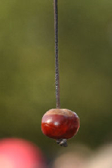
Notes:
Conker on a string

Slide 4
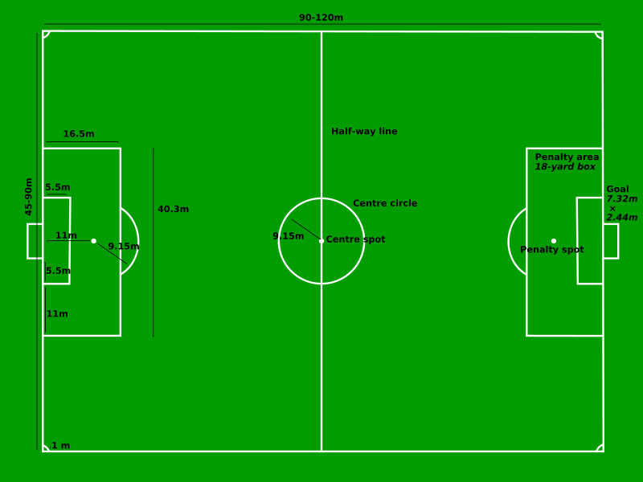
Notes:
Football pitch. Radius of the centre circle 9.15 metres or 10 yards.

Slide 5
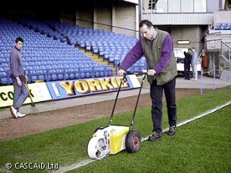

Slide 6
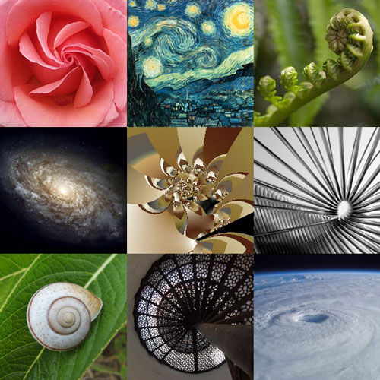
Some spirals are man made.
Others are found in natural things such as plants and animals.

Slide 7
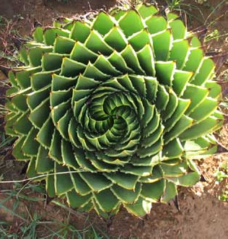
Notes:
This plant is called a spiral aloe.

Slide 8
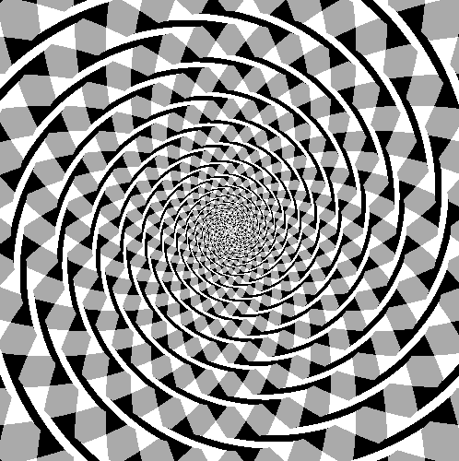
Notes:
Spiral Art

Slide 9
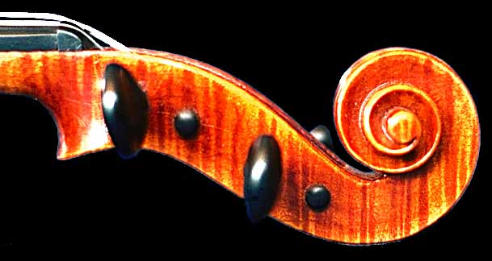
Notes:
Violin scroll

Slide 10
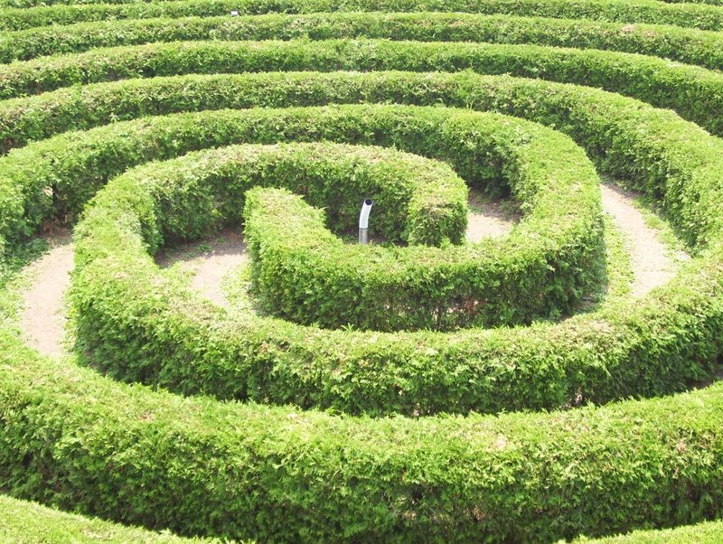
Notes:
Spiral maze

Slide 11
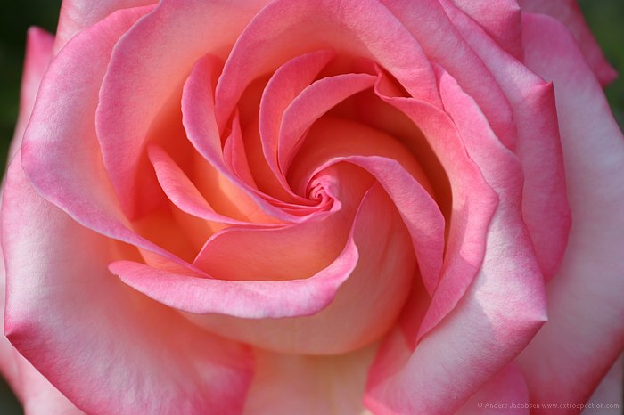
Notes:
Rose spiral

Slide 12
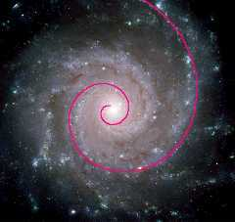
Notes:
The Pinwheel Galaxy is in the Ursa Major constellation. It is 25 million light years from earth. It is a giant spiral disk of stars, dust and gas and is 170,000 light years across - nearly twice the diameter of the Milky Way Galaxy.

Slide 13
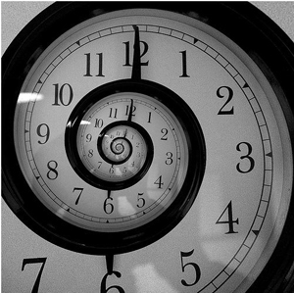
Notes:
A spiral clock

Slide 14
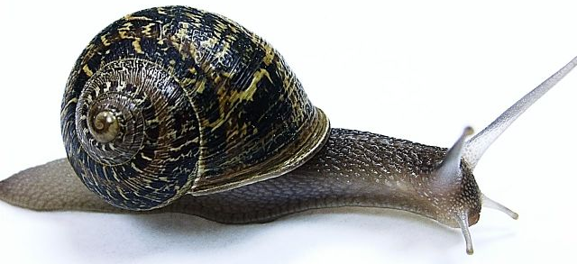
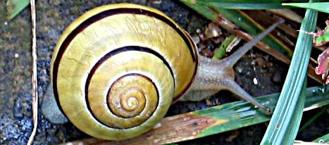
Notes:
Snails

Slide 15
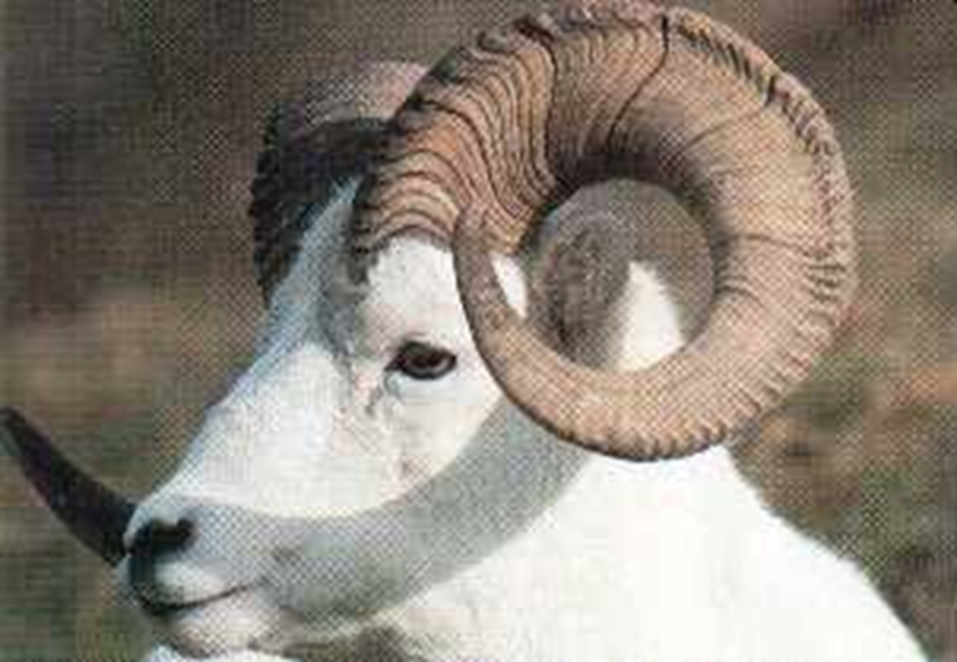
Notes:
Ram’s hord

Slide 16

Notes:
Spiral art.

Slide 17
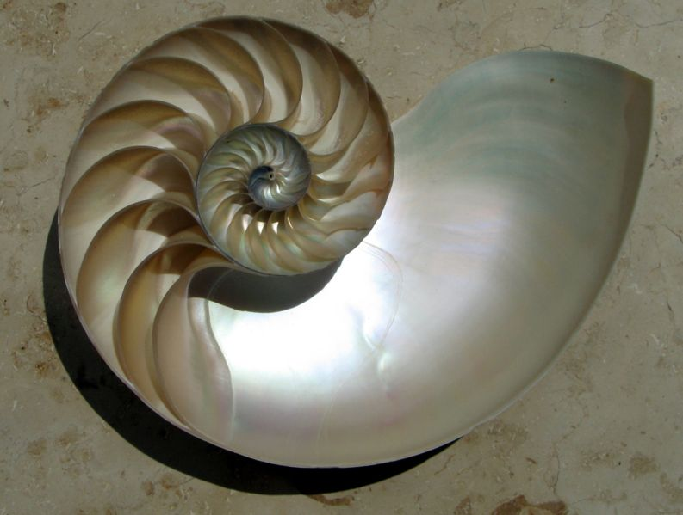
Notes:
The chambered nautilus is a sea creature that belongs in the same class as the octopus. Unlike the octopus, it has a hard shell that's divided into chambers. As the nautilus matures and grows, it periodically seals off the shell behind it and creates a new, larger living chamber. The shells of adults may have as many as 30 chambers. This growth process yields an elegant spiral structure, visible when the shell is sliced to reveal the individual chambers. This spiral is linked to a number drawn known as the golden ratio.

Slide 18
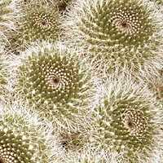
Notes:
Cactii

Slide 19
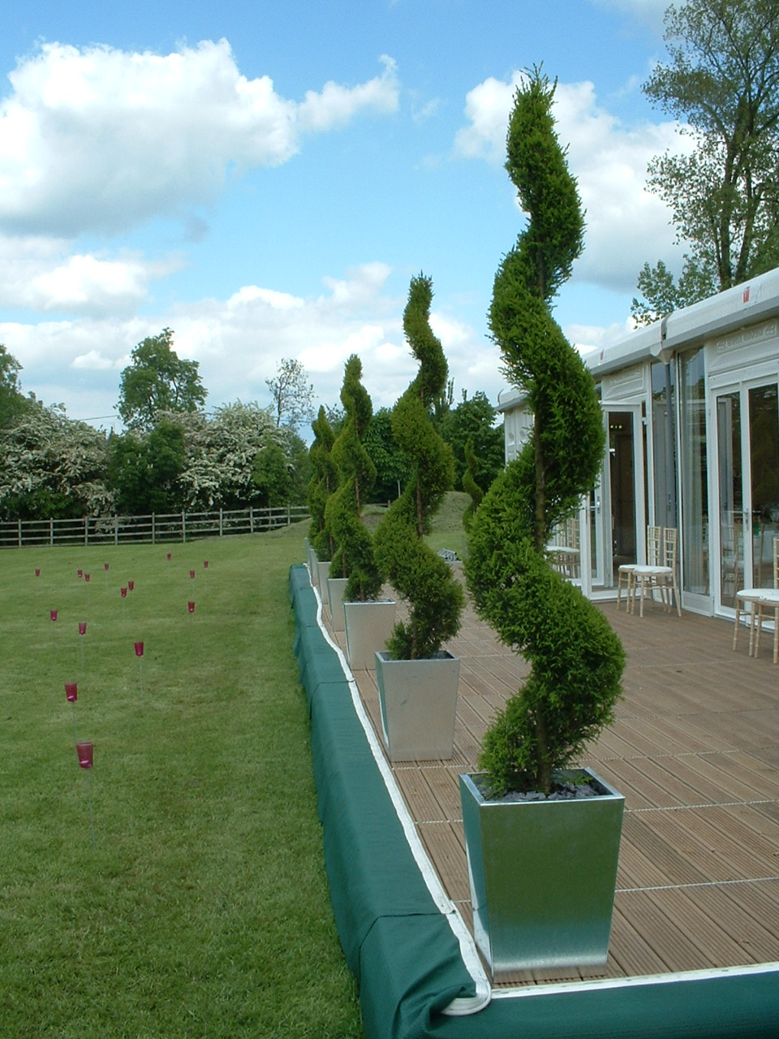

Slide 20
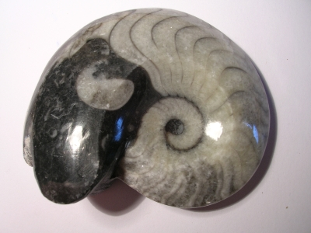
Notes:
Fossilised goniatite – an extinct sea creature related to the squid.

Slide 21
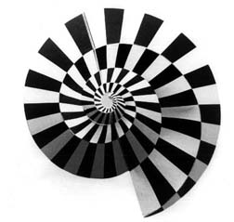
Notes:
Spiral art

Slide 22
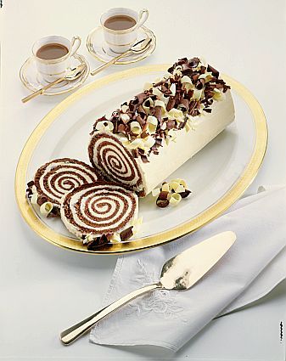
Notes:
Chocolate Swiss roll.

Slide 23
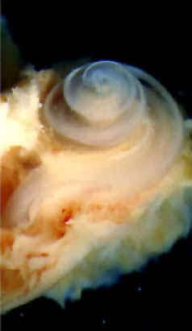
Notes:
The cochlea inside a human ear.

Slide 24
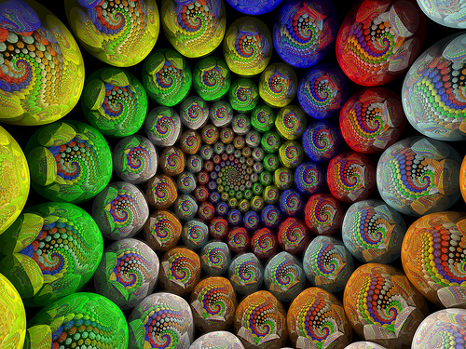
Notes:
Spiral art

Slide 25
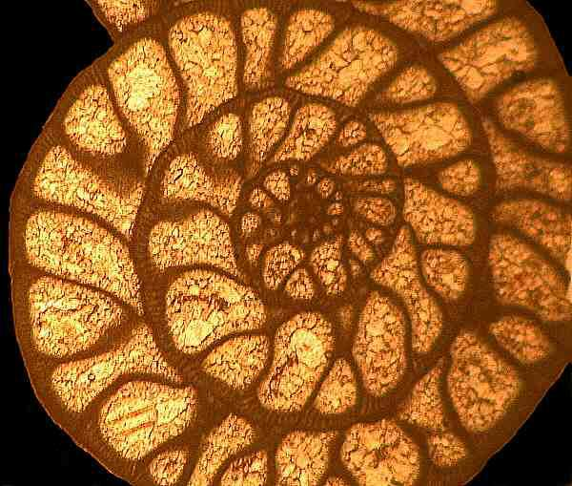

Slide 26
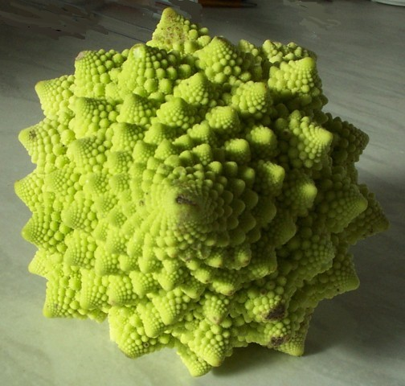
Notes:
Romanesque cauliflower

Slide 27
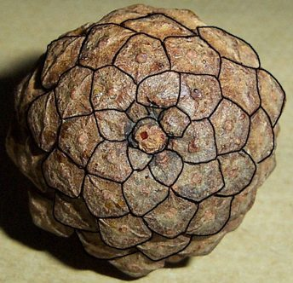
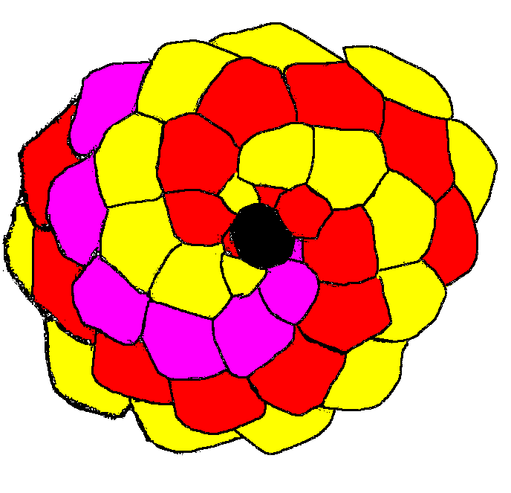
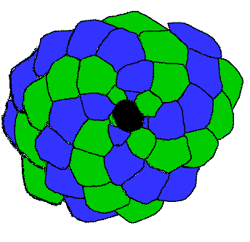
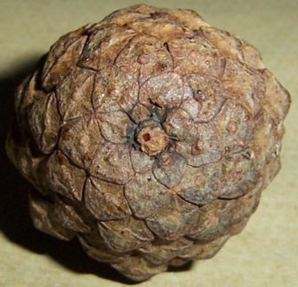

Notes:
Pine cone with slides showing spirals

Slide 28
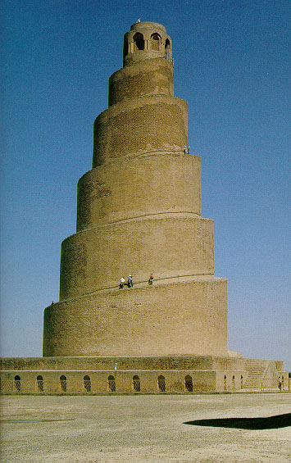
Notes:
The great mosque at Samarra in Iraq completed in 852 AD.

Slide 29
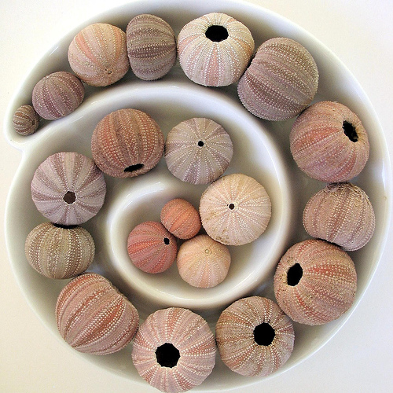
Notes:
Sea urchin shell spiral

Slide 30
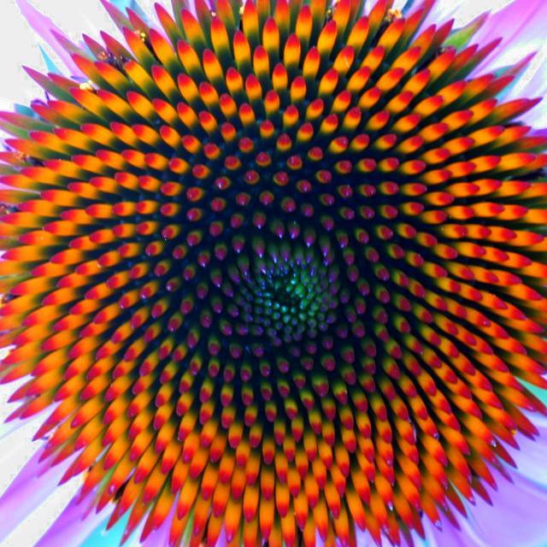
Notes:
Coneflower

Slide 31

Notes:
Spiral art

Slide 32
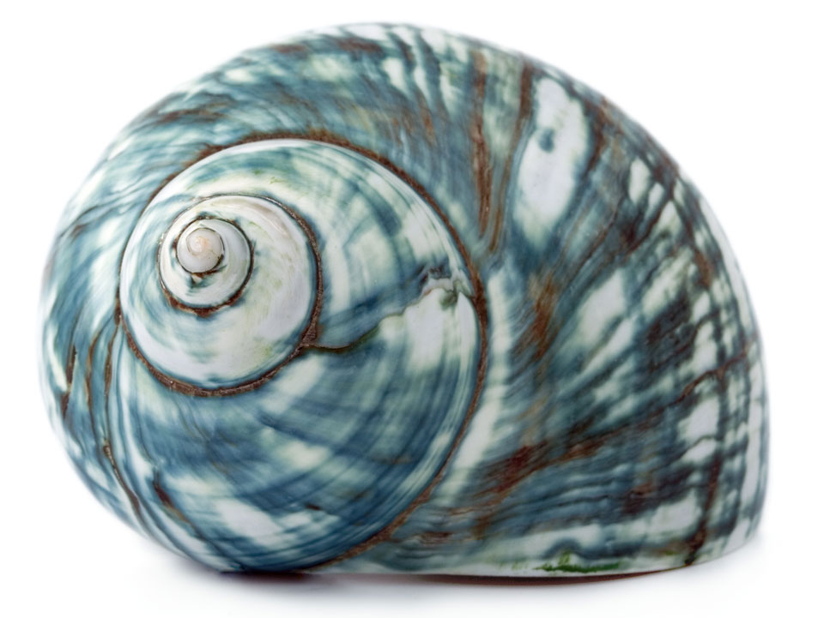
Notes:
Sea shell

Slide 33
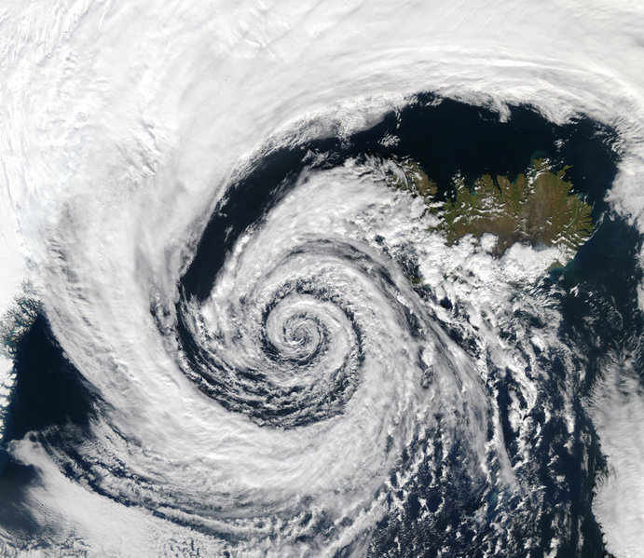
Notes:
Low pressure system over Iceland filmed from a satellite.

Slide 34
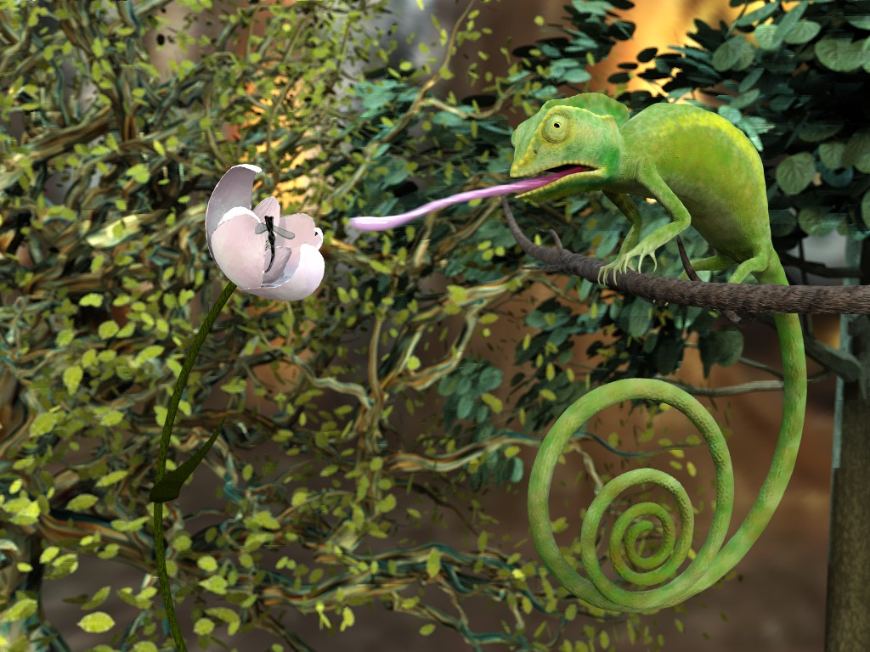
Notes:
Cameleon

Slide 35
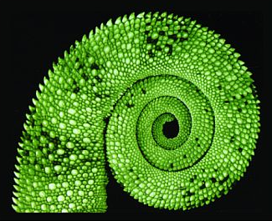
Notes:
Chameleons tail

Slide 36
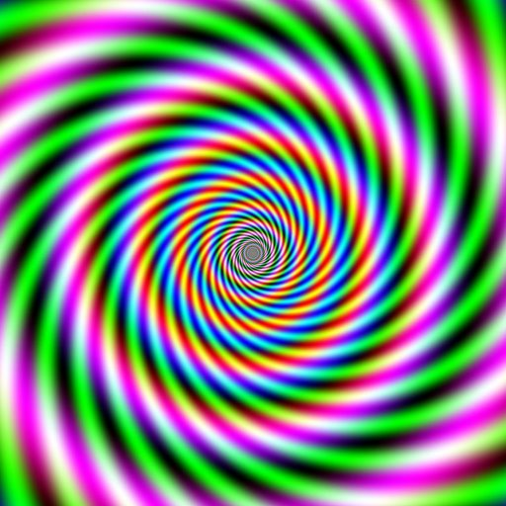

Slide 37
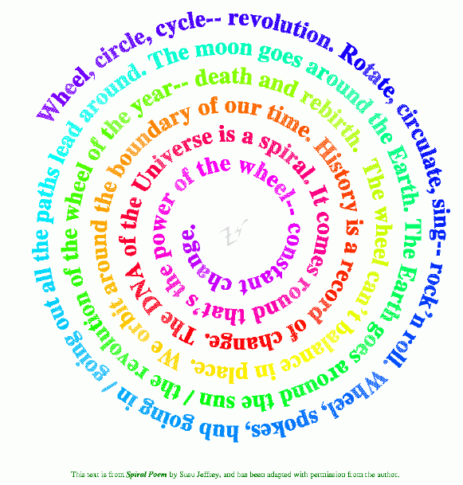
Notes:
Spiral poem

