Slide 1
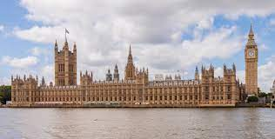
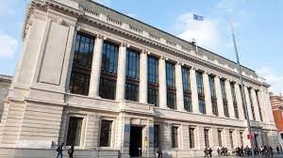
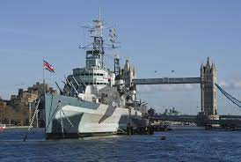
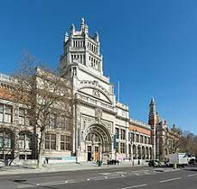
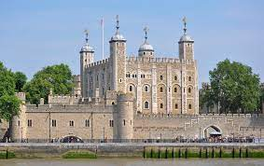
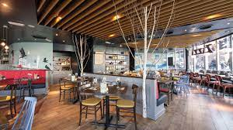
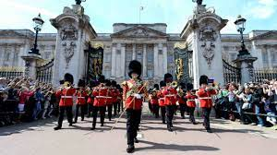

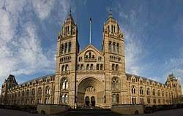
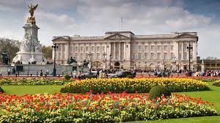
We’re going to London!
Year 6 residential 18th May– 20th May 2026

Slide 2
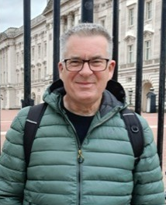
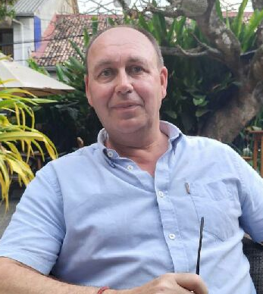
Key information:
Who is going?
Mrs Woollam
Mrs Harrison
Mr Bundy
Mr Woollam (Mrs Woollam’s husband and former police inspector)
Mr Stancliffe (Chair of Governors and former headteacher)
Pre-visit checks:
Mrs Woollam and Mrs Harrison have completed pre-visits, including travelling the routes to be used

Slide 3
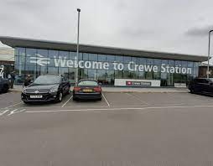
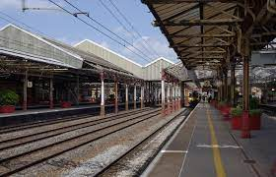
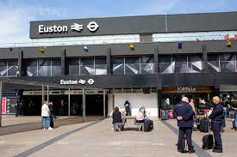
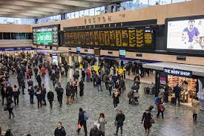
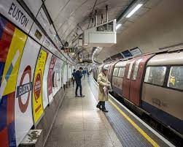
Day 1 – Monday 18th May
Arrive at Crewe Station at 8am (Western Road entrance, opposite B&Q)
Depart Crewe Station at 8.32am
Arrive at Euston Station at 10.09am and use the tube to get to London Bridge.
The children will need to be able to carry their bags (their day-bag and their luggage), including up and down stairs and on the escalators.

Slide 4
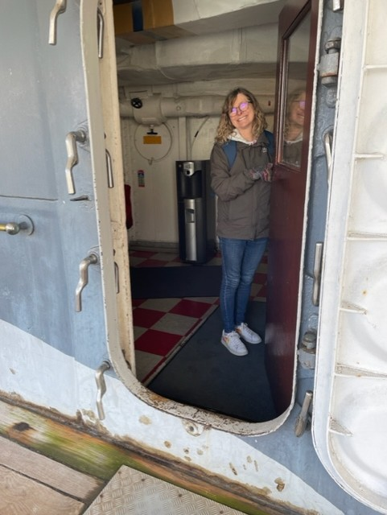
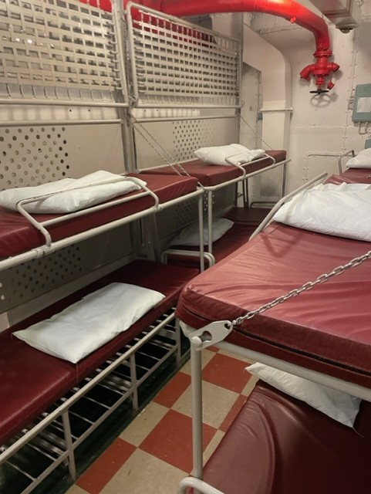
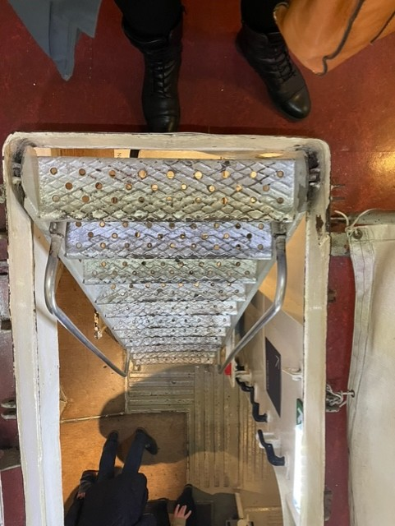
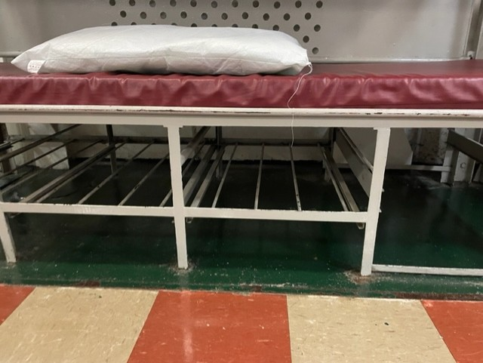
Walk from Tower Hill Tube Station to HMS Belfast and drop off our luggage, leaving us with just our day bags.
Visit The Tower of London, including a tour and
eat our home-provided packed lunch.
Visit St Paul’s Cathedral and complete a tour, including the Whispering Gallery.
Tea at Zizzi’s (pre-ordered)
Back to HMS Belfast to settle in
Ready for bed at 9.30/10pm – bunk beds! (Chaperone on board all night for security).

Slide 5
Day 2 – Tuesday 19th May
Up, dressed and ready for breakfast at 7.30/8 o’clock (toast with butter and jam, cereal, fruit)
A morning of museums – this could include The Science Museum, The Natural History Museum, and The Victoria and Albert, depending on time spent in the various exhibitions. We hope to visit at least two.
Packed lunch (organised by staff) to include a cheese or ham bap, fruit, crisps, small chocolate/snack bar

Slide 6
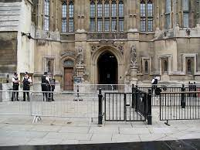
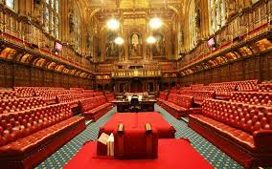
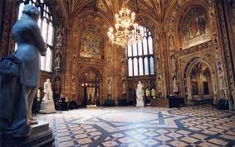
Afternoon:
Tube to Westminster
Visit The Houses of Parliament and sightseeing and exploration of local area
Walk along Southbank, taking in the sights including the London Eye and street performers.
Return to HMS Belfast for tea via The Globe– children will pre-order
Evening activities on and around the ship

Slide 7
Day 3 – Wednesday 20th May
Up, dressed, packed and ready for breakfast at 7.30 o’clock
Tube to Euston Station to drop off bags at the secure hold
Visit Westminster for the Changing of the Guards ceremony, sightseeing and exploration of the surrounding area, including a walk to Buckingham Palace and hopefully Downing Street.
Visit Trafalgar Square to see Nelson’s Column and the National Gallery.
Pre-ordered hot lunch at Pizza Express

Slide 8
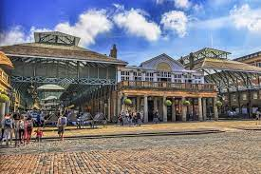
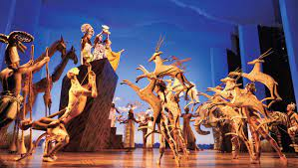
Afternoon:
Walk through Covent Garden to the Lyceum Theatre to watch The Lion King
Tube to Euston Station and collection of bags
Train home at 6.33pm, arriving at Crewe Station at 8.09pm
Tea on the train, provided by staff (as Tuesday lunch)
Staff collapse in a heap!

Slide 9
Thursday 21st May
Registration will remain open until 10.30 am to allow the children a lie-in.
Children are welcome to arrive from the normal time, however.

Slide 10
Need to know:
Children will wear bright blue caps whenever we are travelling and when we are in public spaces. This is so we can see our full school group at all times. We choose these over high-vis vests as so many other school parties are in high-vis vests during our visit; our caps stand out! They will also wear a silicone wristband with our school name and phone number on.
HMS Belfast is open to the public during the daytime. When it closes, a full security check is undertaken before we are allowed to return, to ensure no-one remains on the ship. The concierge/chaperone stays on the ship in separate quarters overnight, and there are exterior security checks during the night, conducted by the security team.
Children are allocated into small groups (approx. 1:5 or 6), and they will stay in these groups each time we travel (including walking), as well as at key points during the visit, for example, when exploring the museum.

Slide 11
Kit List:
To be included inside the overnight bag – no suitcases and children must be able to carry these comfortably whilst walking at pace:
Sleeping bag (let us know if you do not have one in case we can source one for you)
Pillow case
Hand towel
Flannel
Soap
Toothbrush
Toothpaste
Deodorant (no aerosols)
Hairbrush/comb
Hair bobble(s) for long hair
Pyjamas
2 changes of top/T-shirt
Underwear
Socks
Layers, eg zip tops - one change maximum
Strictly no sweets or snacks for midnight feasts
Carrier bag for dirty/wet clothes
Please make sure all items of clothing are named and that your child packs their bag with you so that they know what they have brought.
They must be able to re-pack their own bag, including their sleeping bag (please practise!), for our return. Please also make sure children can tie their own laces!
Last year, Mountain Warehouse at Affinity/Freeport offered 20% discount a few weeks before the residential, in case any parents needed to buy anything. They just asked for proof that the child attended Highfields). I will try to organise this again nearer to the time.

Slide 12
In the rucksack for during the day:
2 x refillable bottles (both full for day 1, no fizzy drinks)
Lunch (please ensure this is in a disposable bag rather than a lunch box)
Plenty of snacks for day 1 - please consider the weather so we haven’t got lots of mess with melted chocolate. NO SNACKS FOR DAY 2 OR 3 AND STRICTLY, NOTHING FOR SECRET MIDNIGHT FEASTS – WE DO NOT WANT EXTRA, FOUR-LEGGED VISITORS IN OUR SLEEPING QUARTERS!
Book/puzzle book for on the train
Small packet of sweets for the journey
Also:
Lightweight waterproof coat with a hood
Trainers (not Crocs/pumps/Converse style, as we will be doing lots of walking – they must be comfortable and worn in)
Sun cream
Everything the children bring must be in 2 bags – their day bag (rucksack/backpack) and their overnight bag. Sleeping bags MUST be in their overnight bag and not attached.

Slide 13
Electronics, including mobile phones and smart watches, must not be brought on the residential.
Children can bring a disposable camera or a cheap digital camera, but these will remain the responsibility of the child at all times and we will not be able to replace them if they are lost or broken.
Medication:
All medication must be handed to a member of staff on Friday 15th May, with the exception of any medication that is needed over the weekend; this should be provided on the morning of 18th May, but you will need to arrive at Crewe Station by 7.50am to do this handover. We should be made aware during the week before the visit if this needs to happen and this should be the exception, being avoided if at all possible. I will keep an eye on SeeSaw over the weekend of 16th/17th May just in case there are any updates to this. We will take inhalers from school. Medication must be named with dosage details clearly identified,
Travel sickness tablets should be taken as per the instructions.

Slide 14
Any general questions?
Please contact me individually if you have a questions specific to your child

