Slide 1
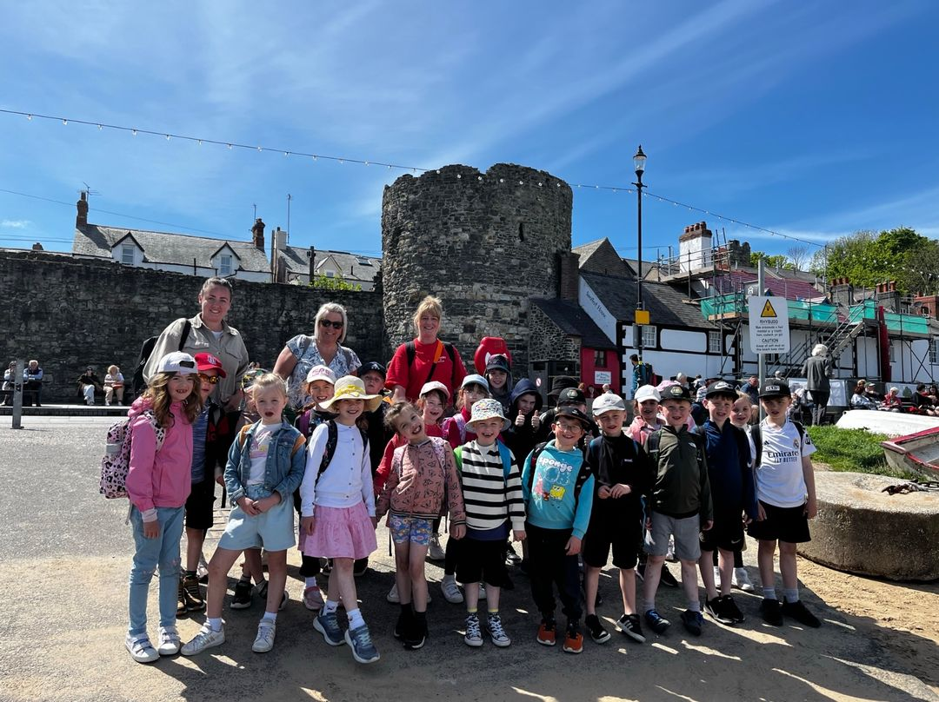
Llandudno 2026
Year 2
Residential

Slide 2
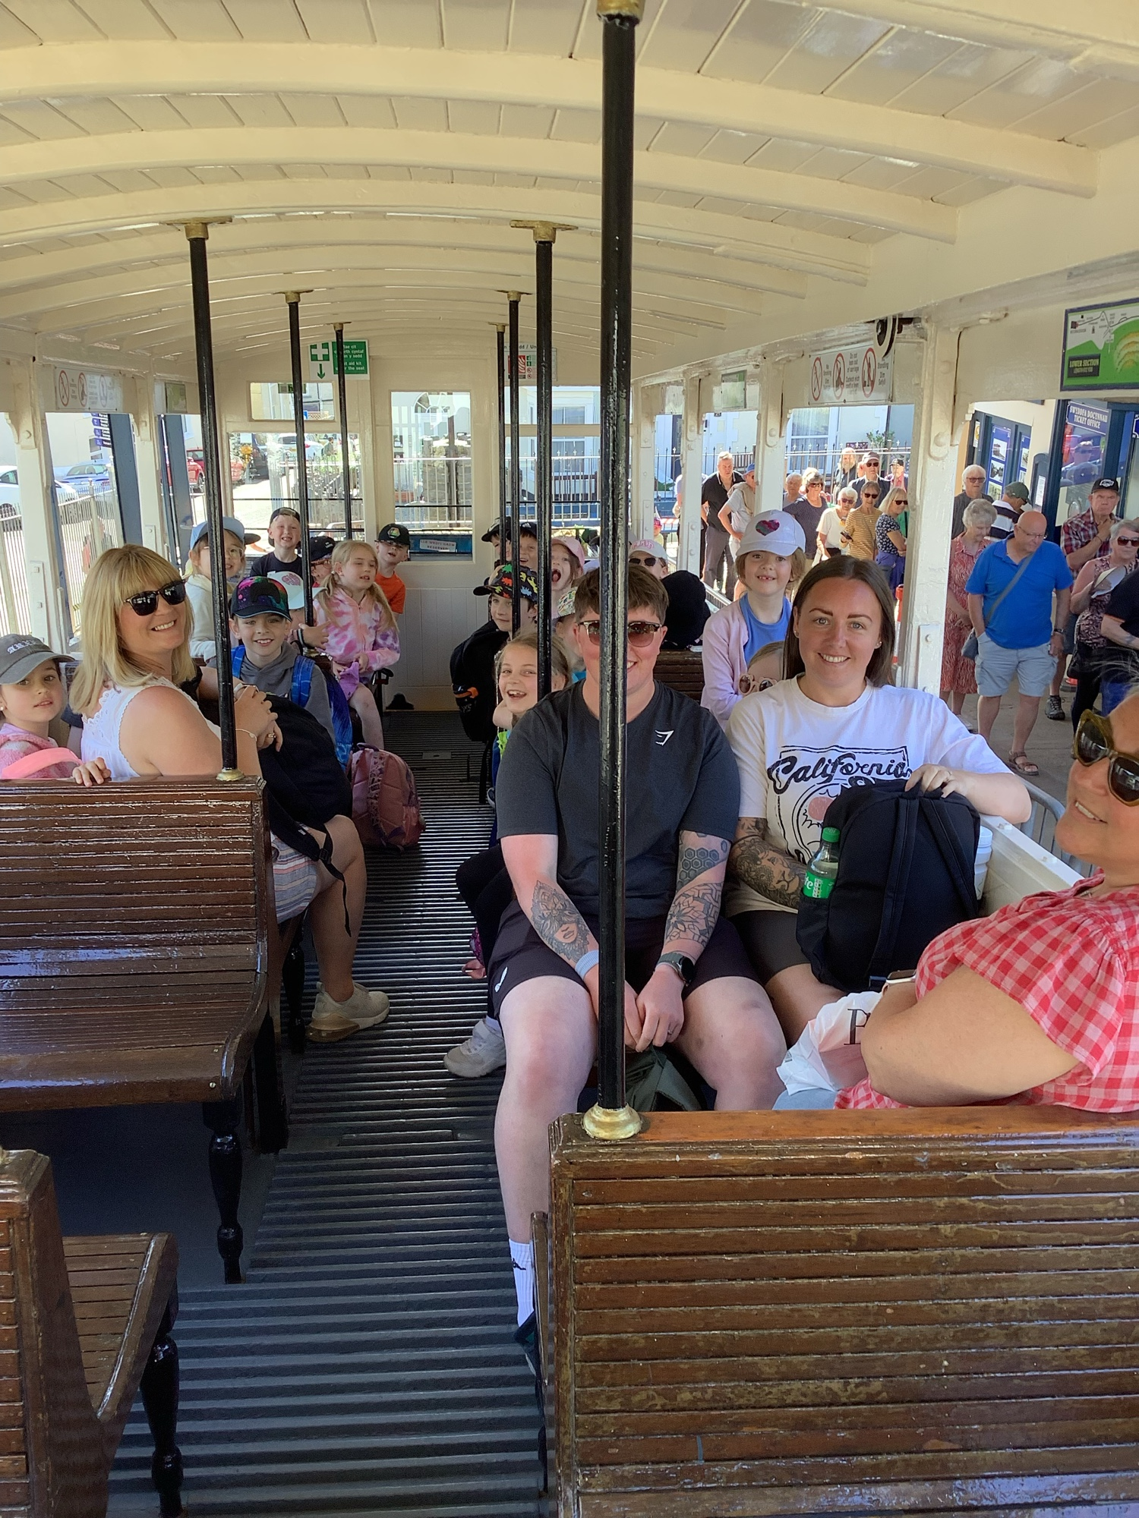
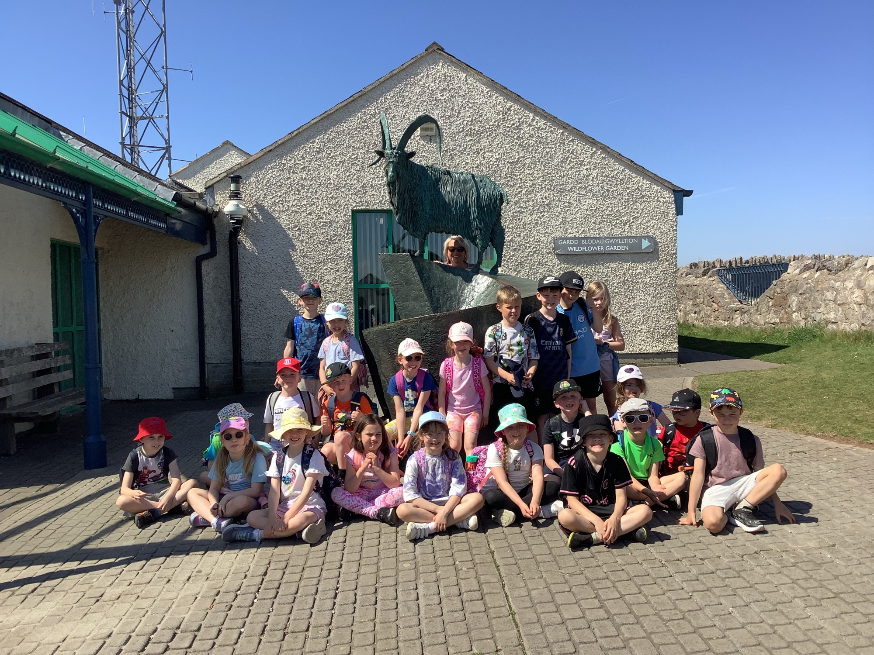
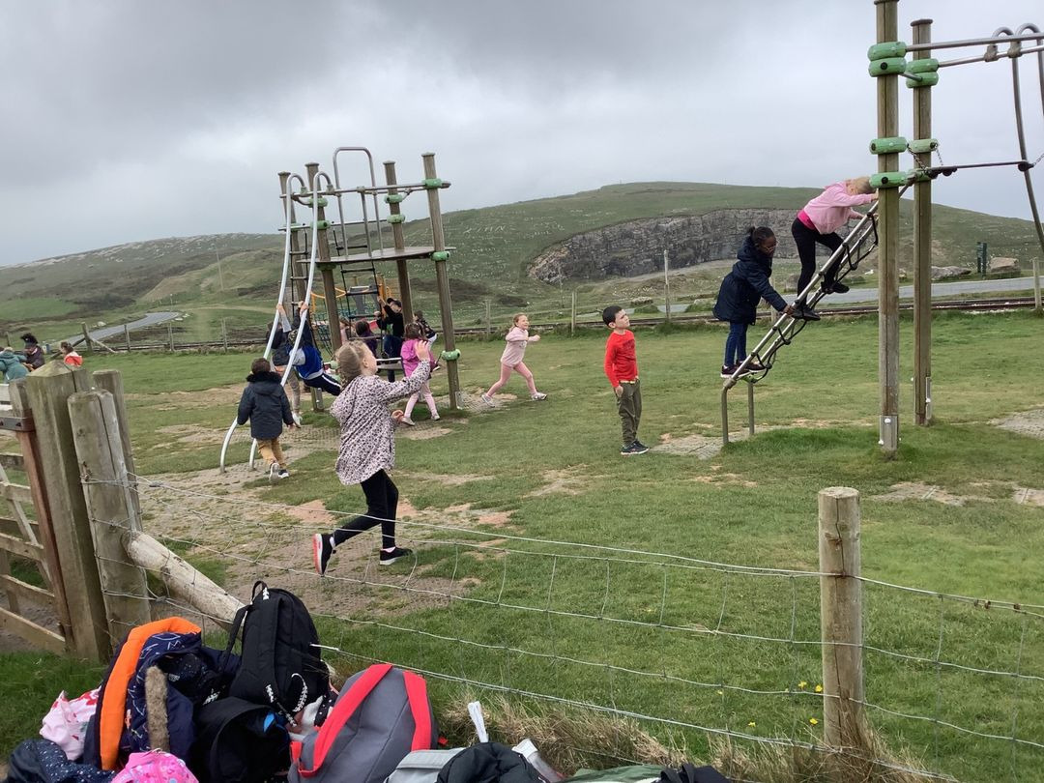
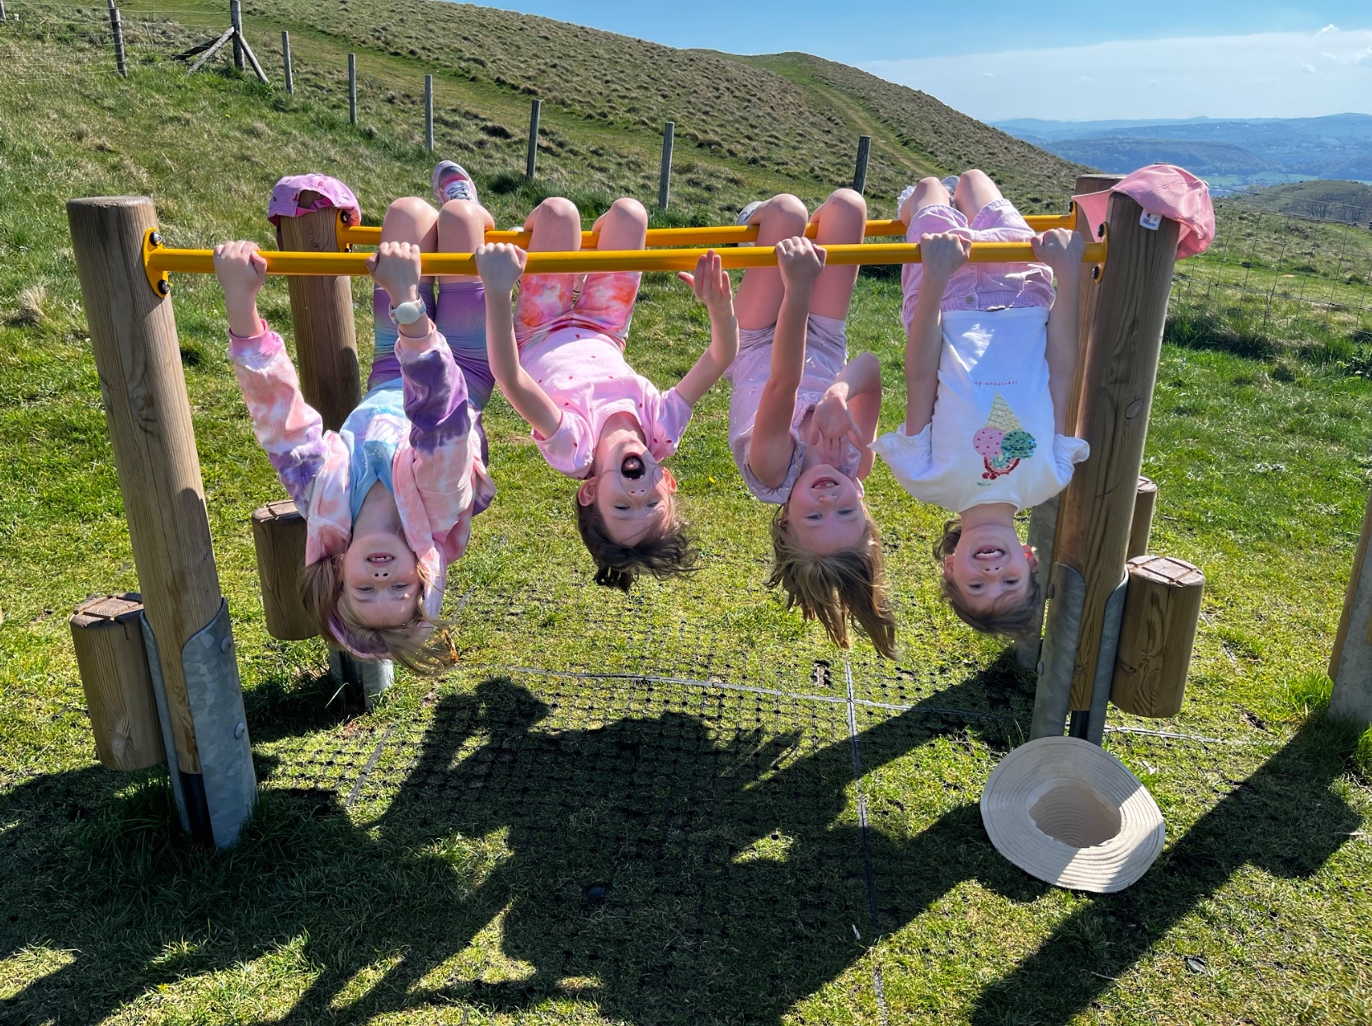
Day 1
Up the Orme on a tram and a play on the park at the top
Arrive at school by 8.10 latest, leave cases outside the hall, enter school through classroom door to register, leaving school at 8.30am prompt.
10.40 am Tram ride up the Great Orme.

Slide 3
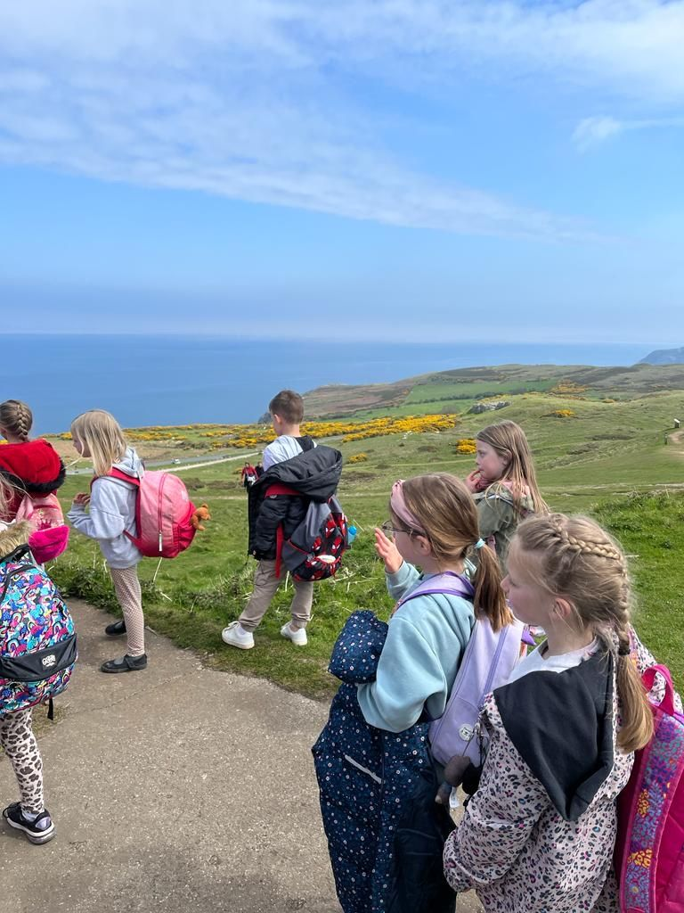
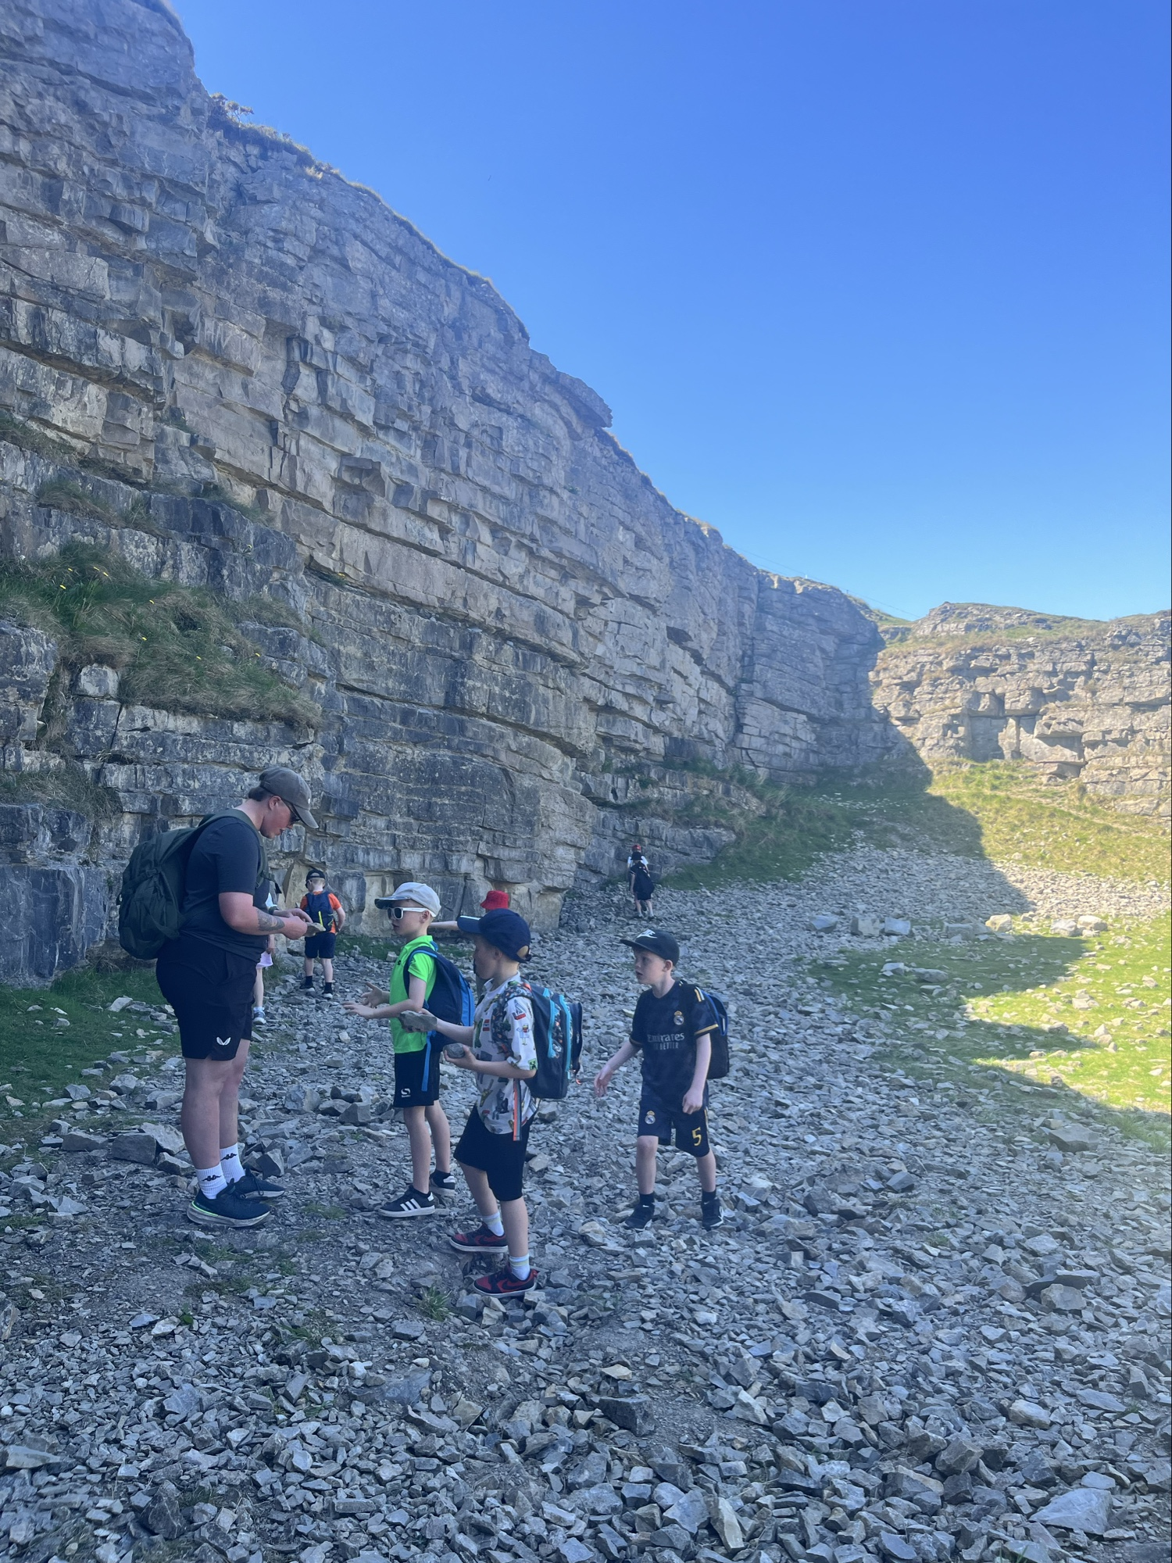
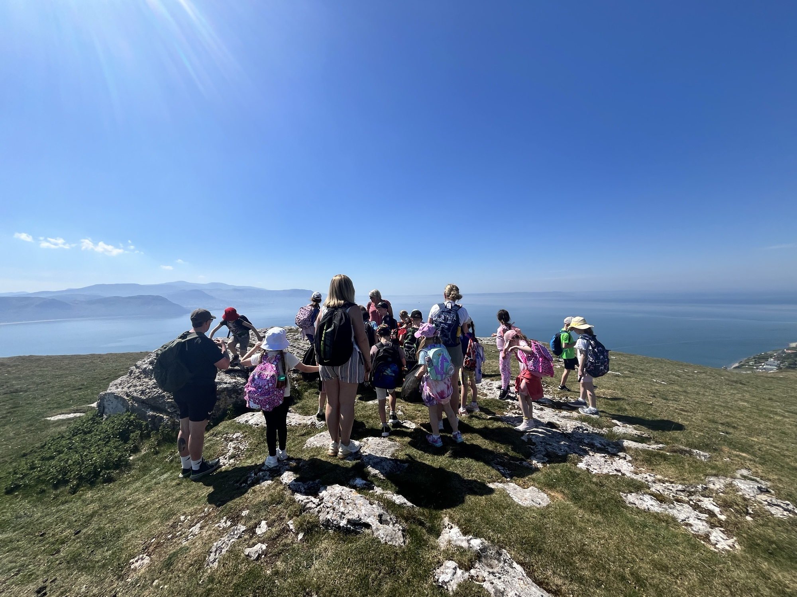
Fossil hunting before lunch
Looking out to sea from the summit

Slide 4
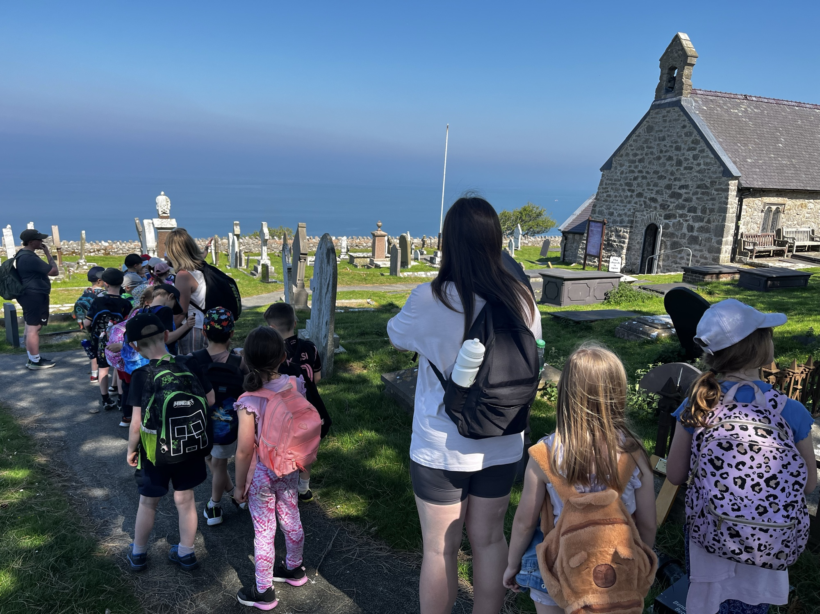
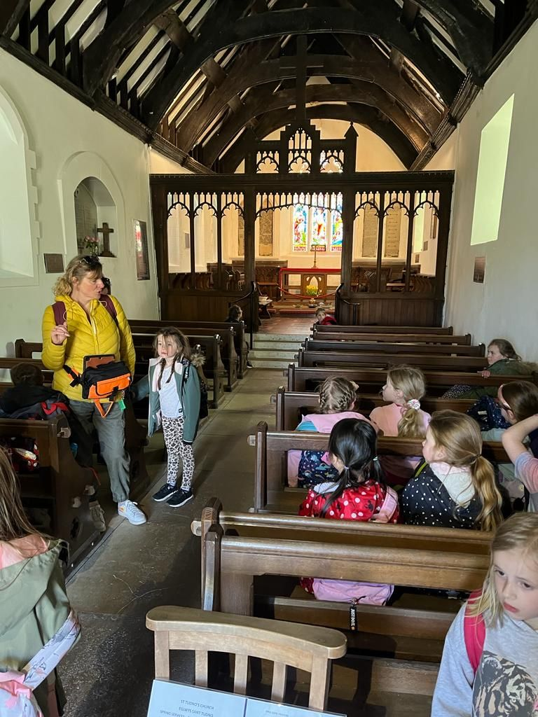
A walk down to St Tudno’s church

Slide 5
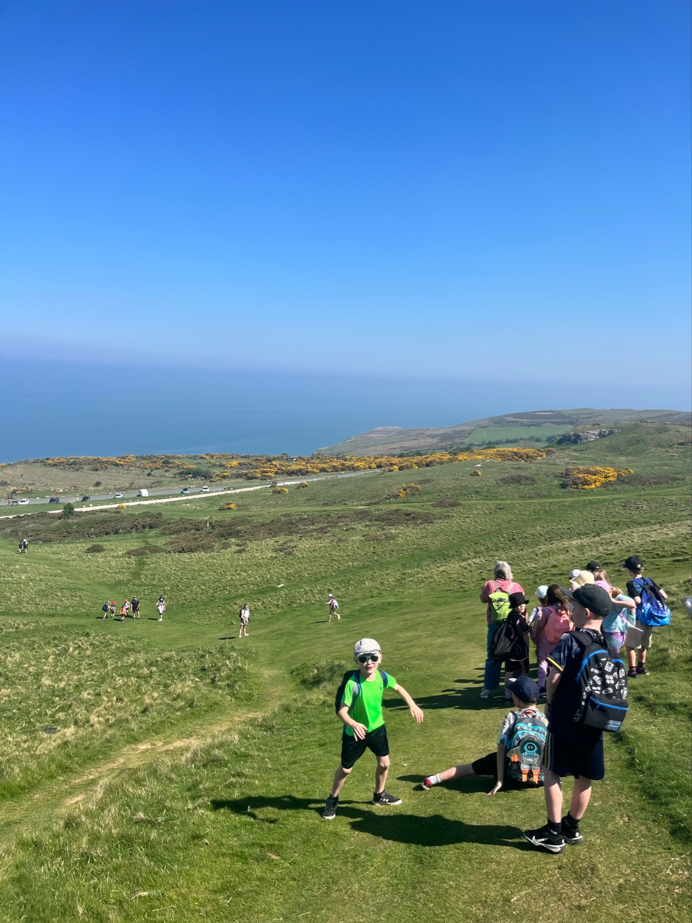
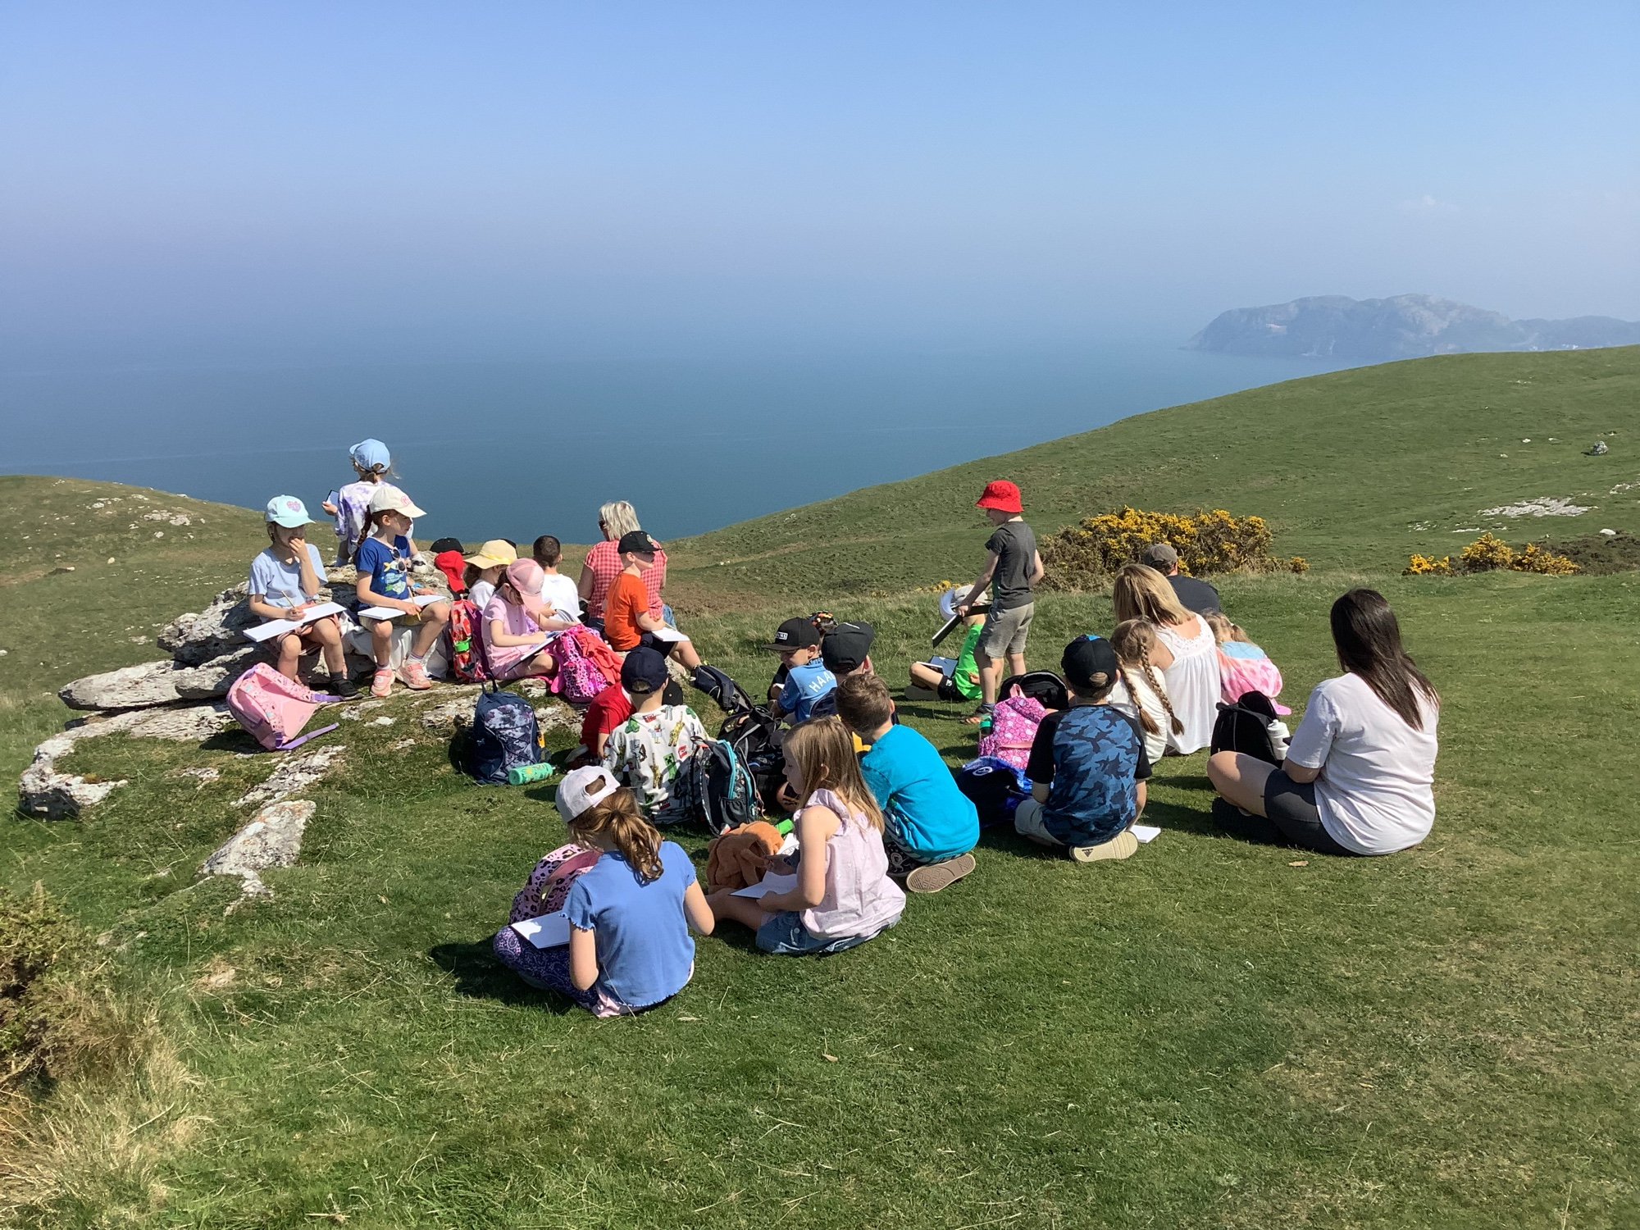
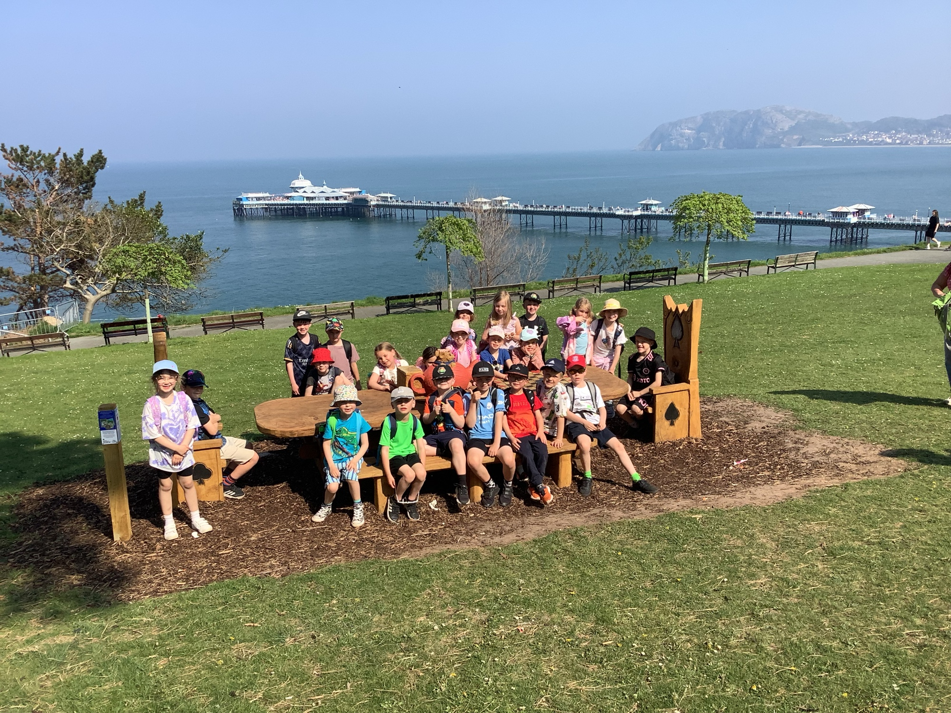

Slide 6
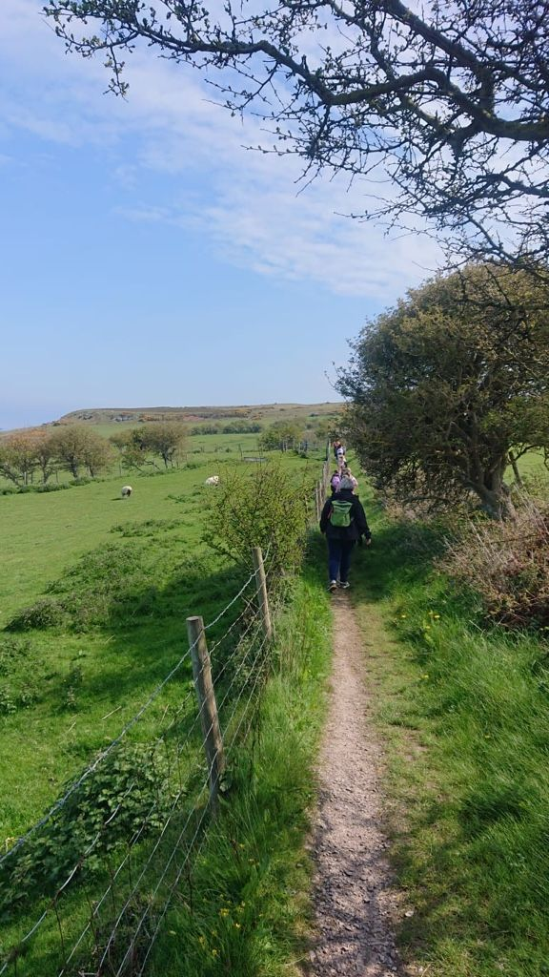
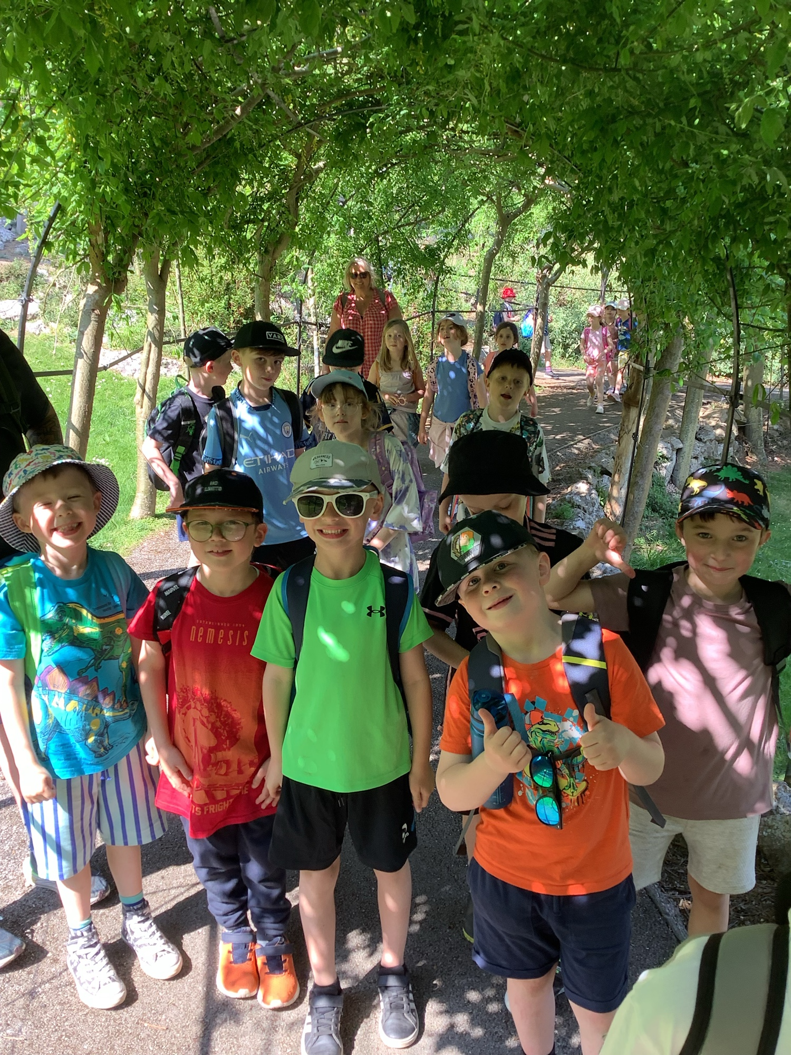
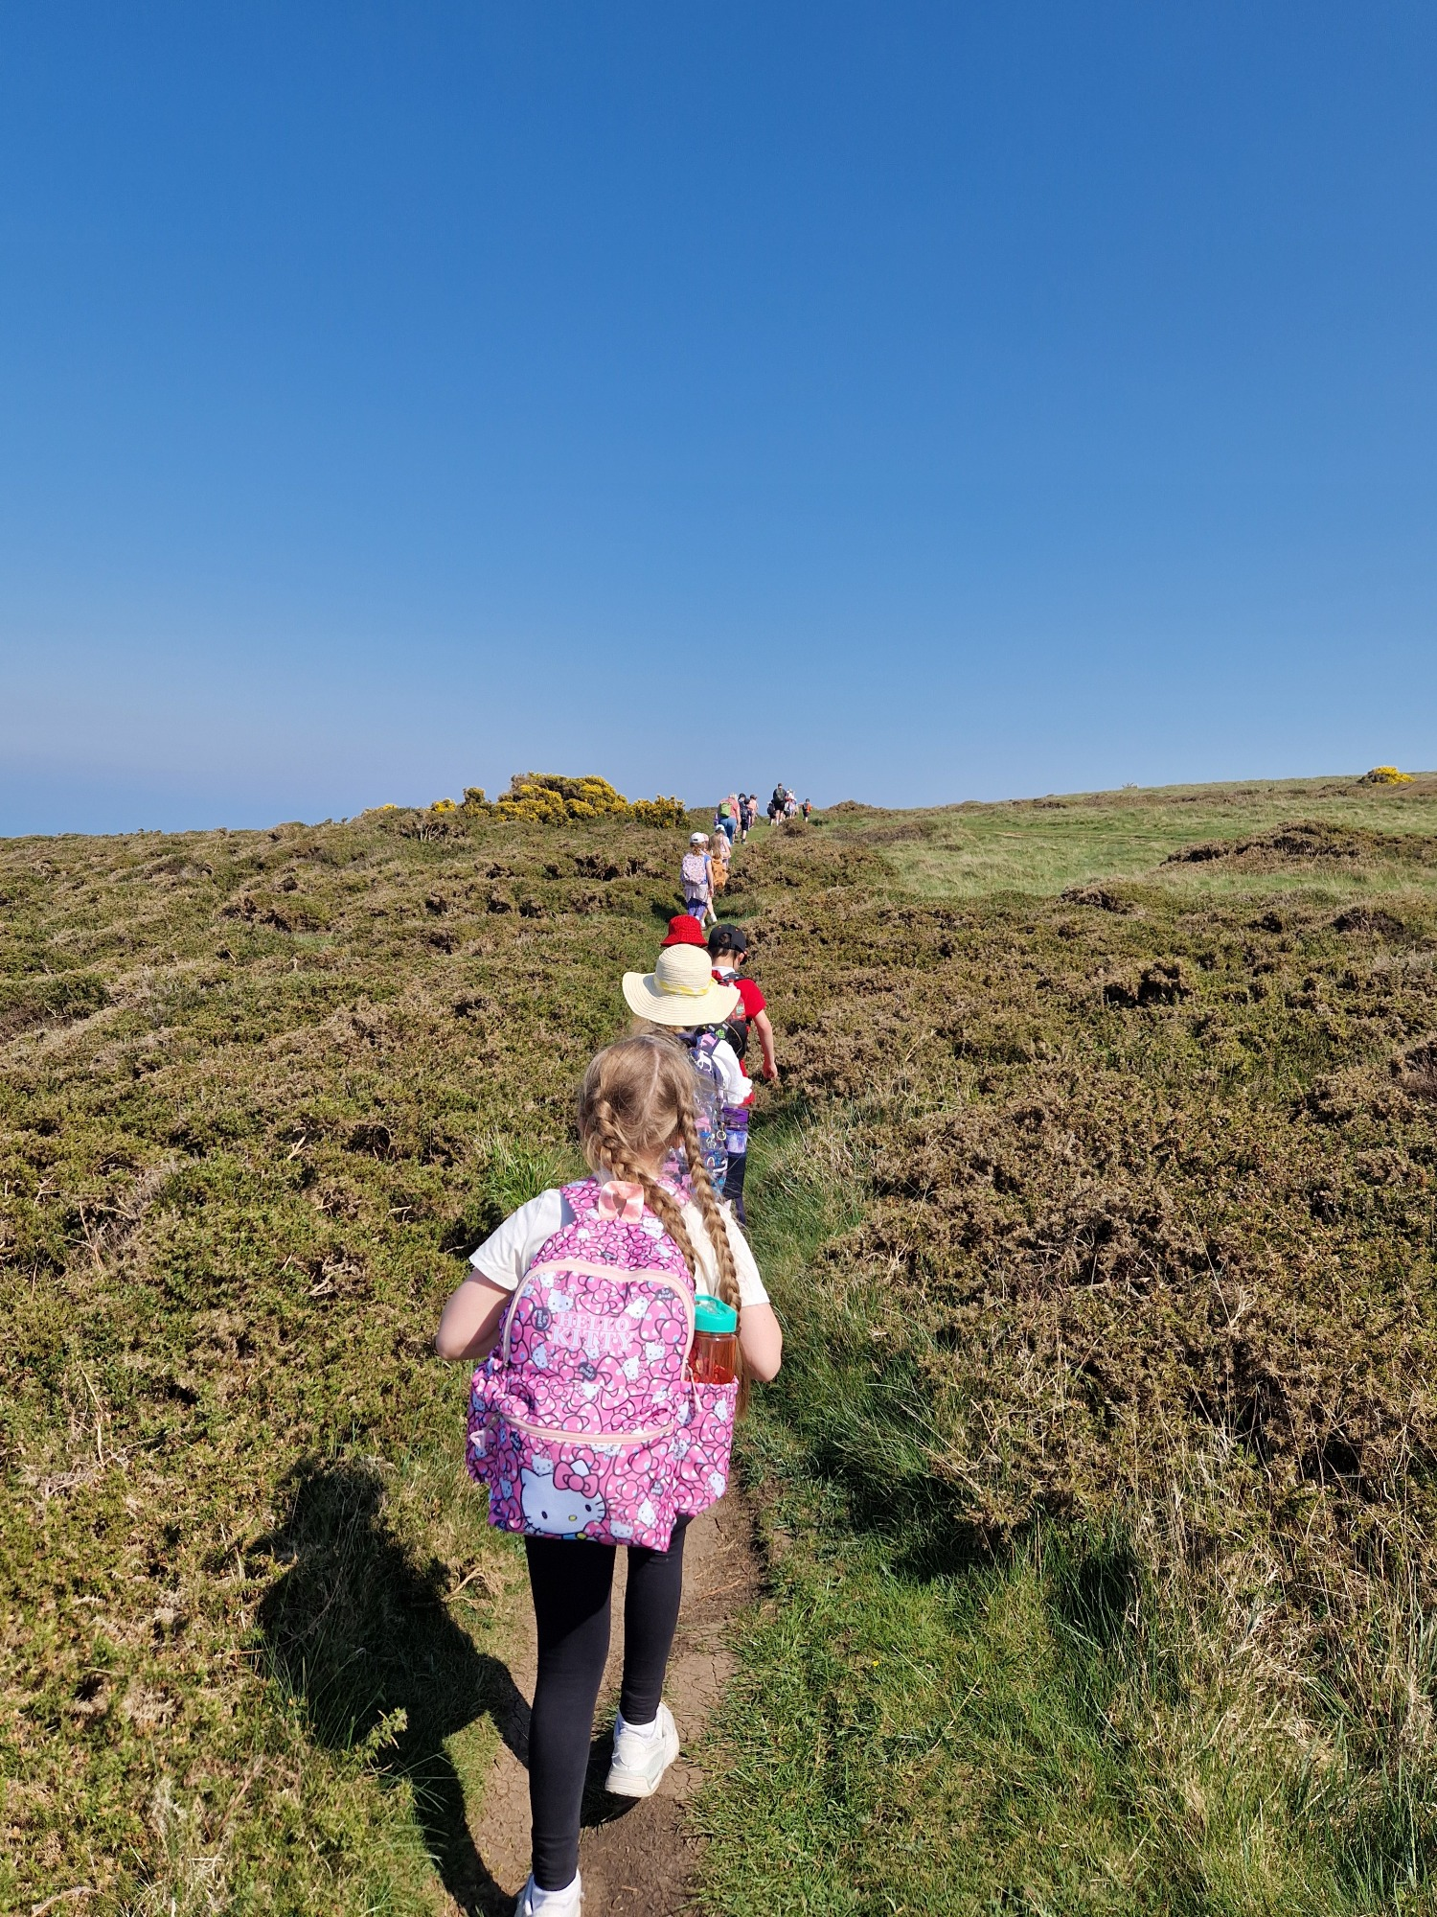

Slide 7
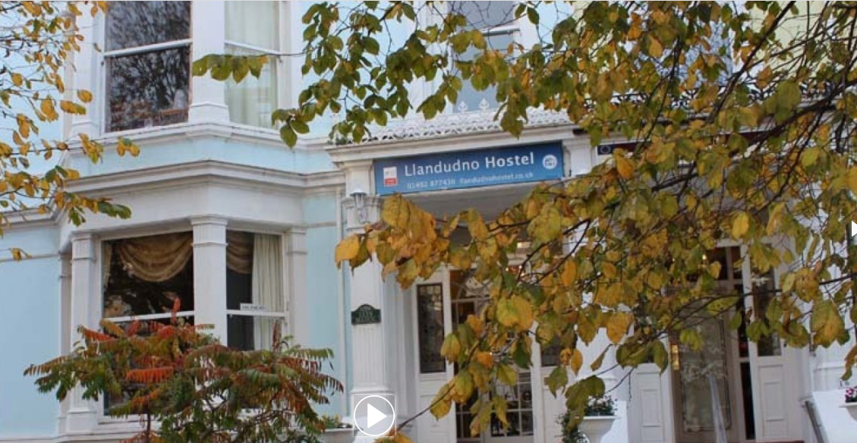
https://llandudnohostel.co.uk/

Slide 8
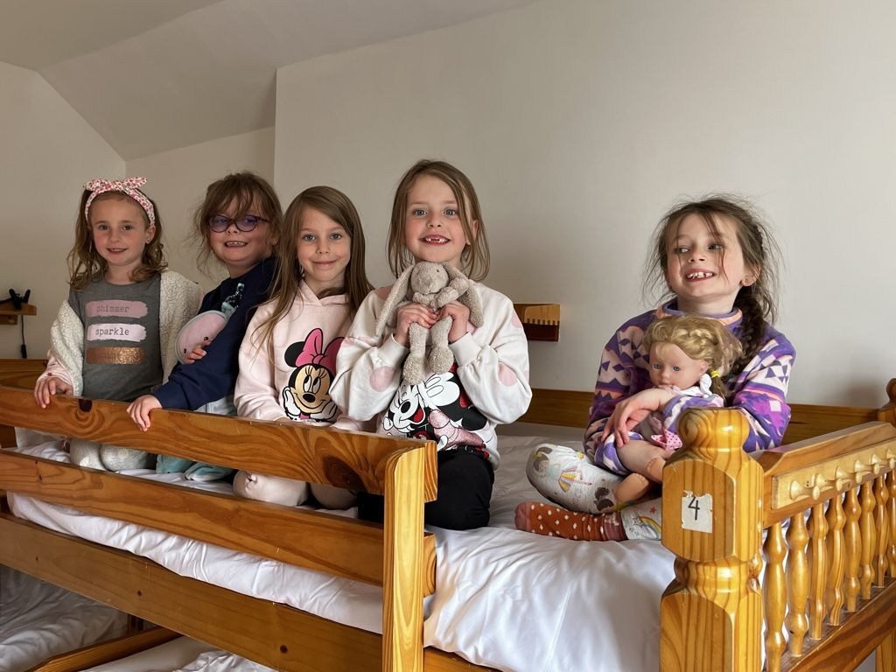
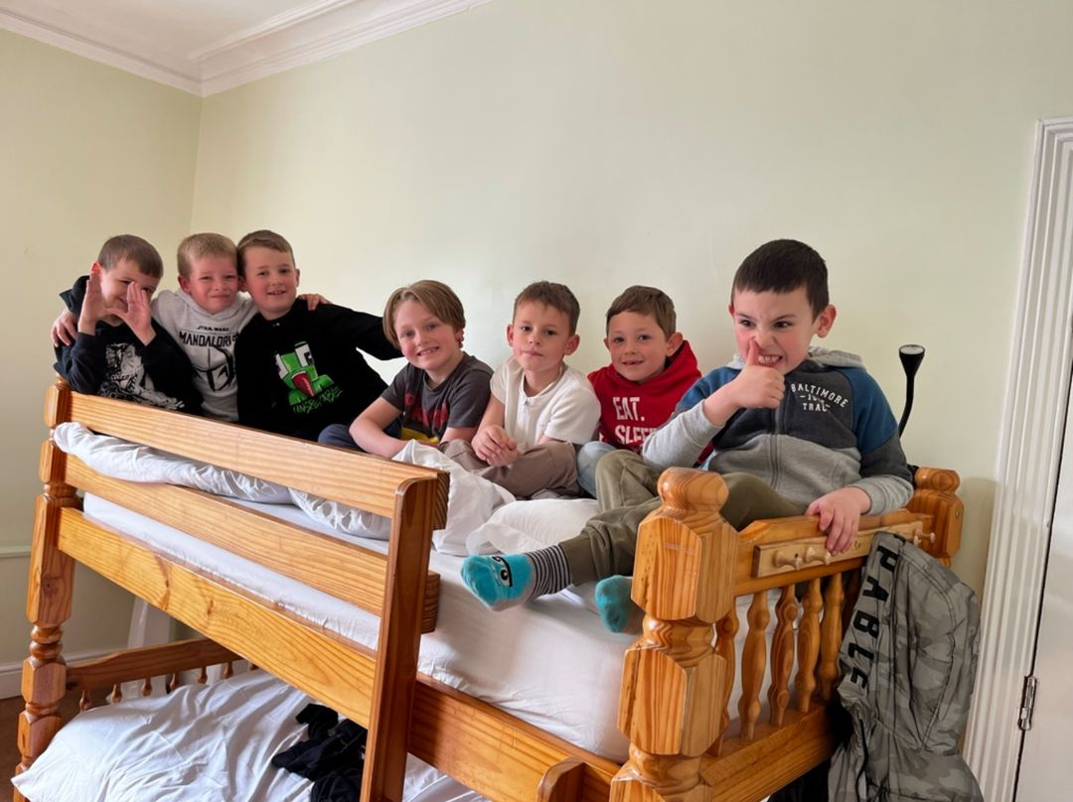
Meet the coach at 1.30 for a short coach journey to the Llandudno Hostel
Rules, safety, fire drills & room allocation, drop off bags
Walk to the seafront, sandcastle building and games on the beach (timing subject to the tide)
Return to hostel to hand wash. Eat at a restaurant or in the hostel.
Choosing our beds at Llandudno Hostel

Slide 9
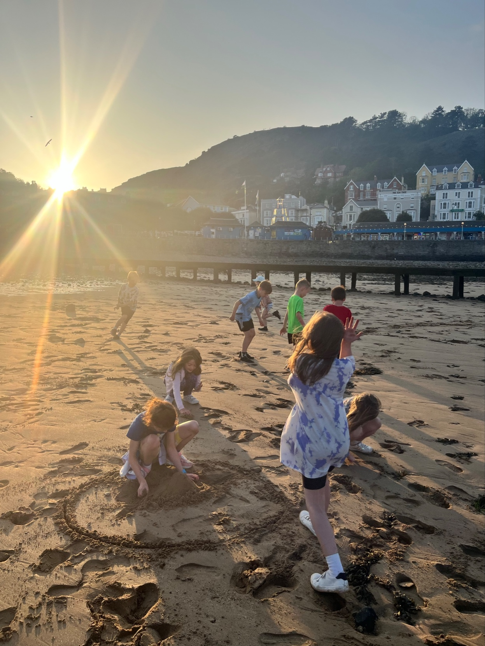
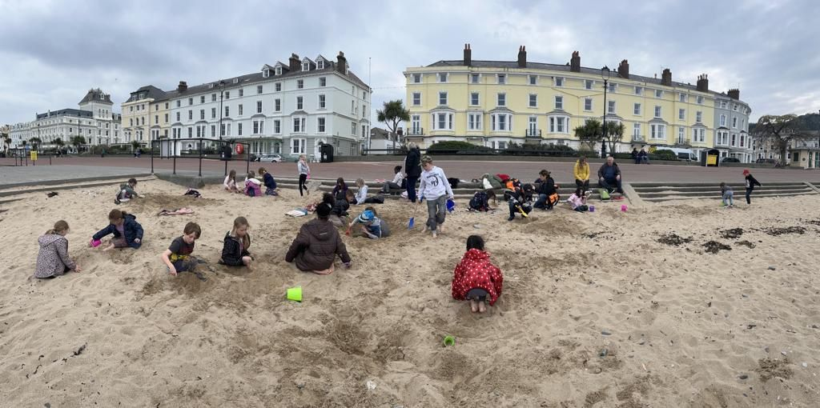
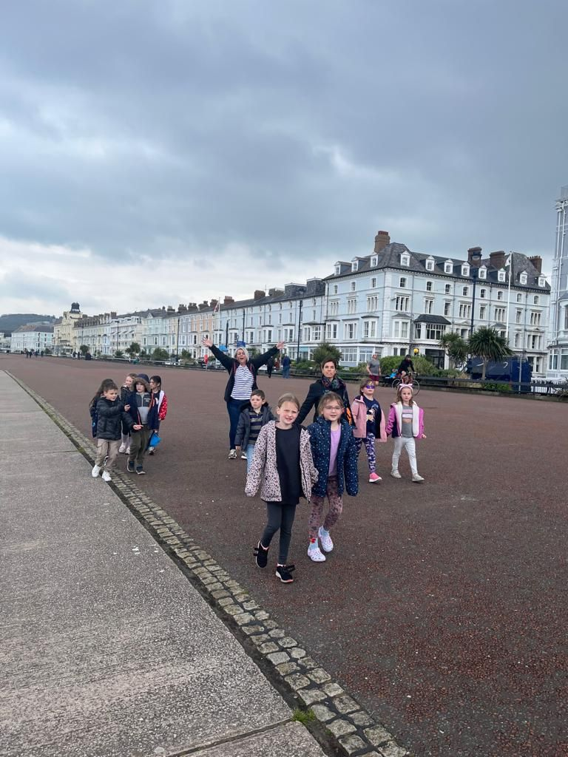
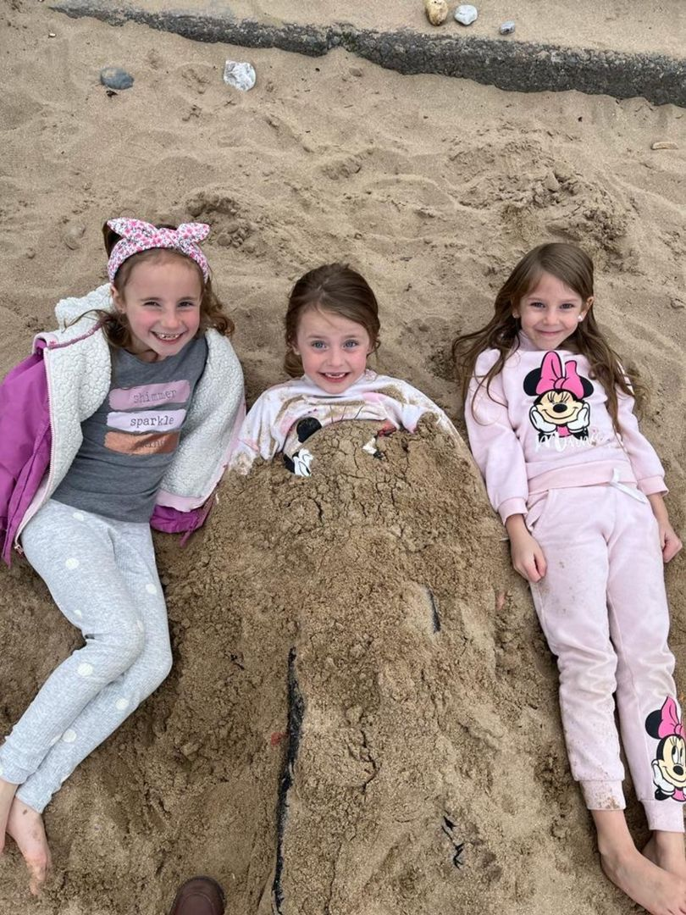
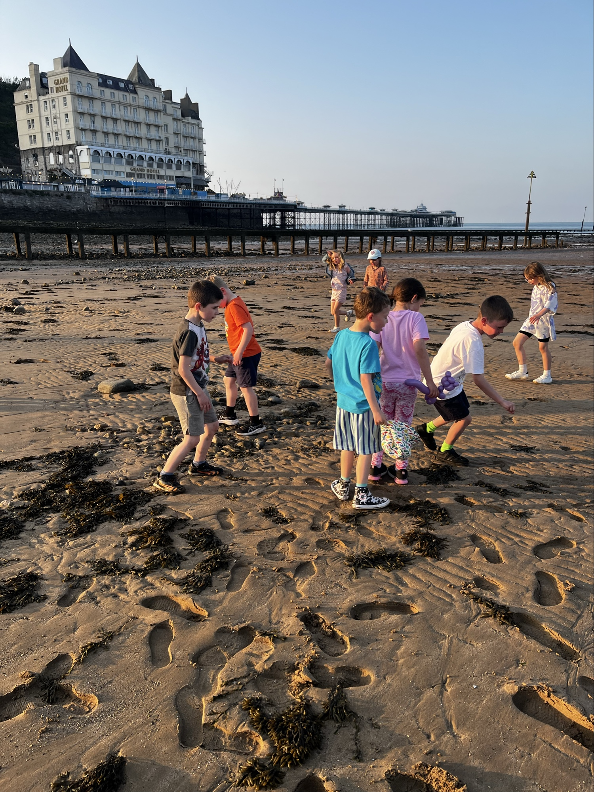
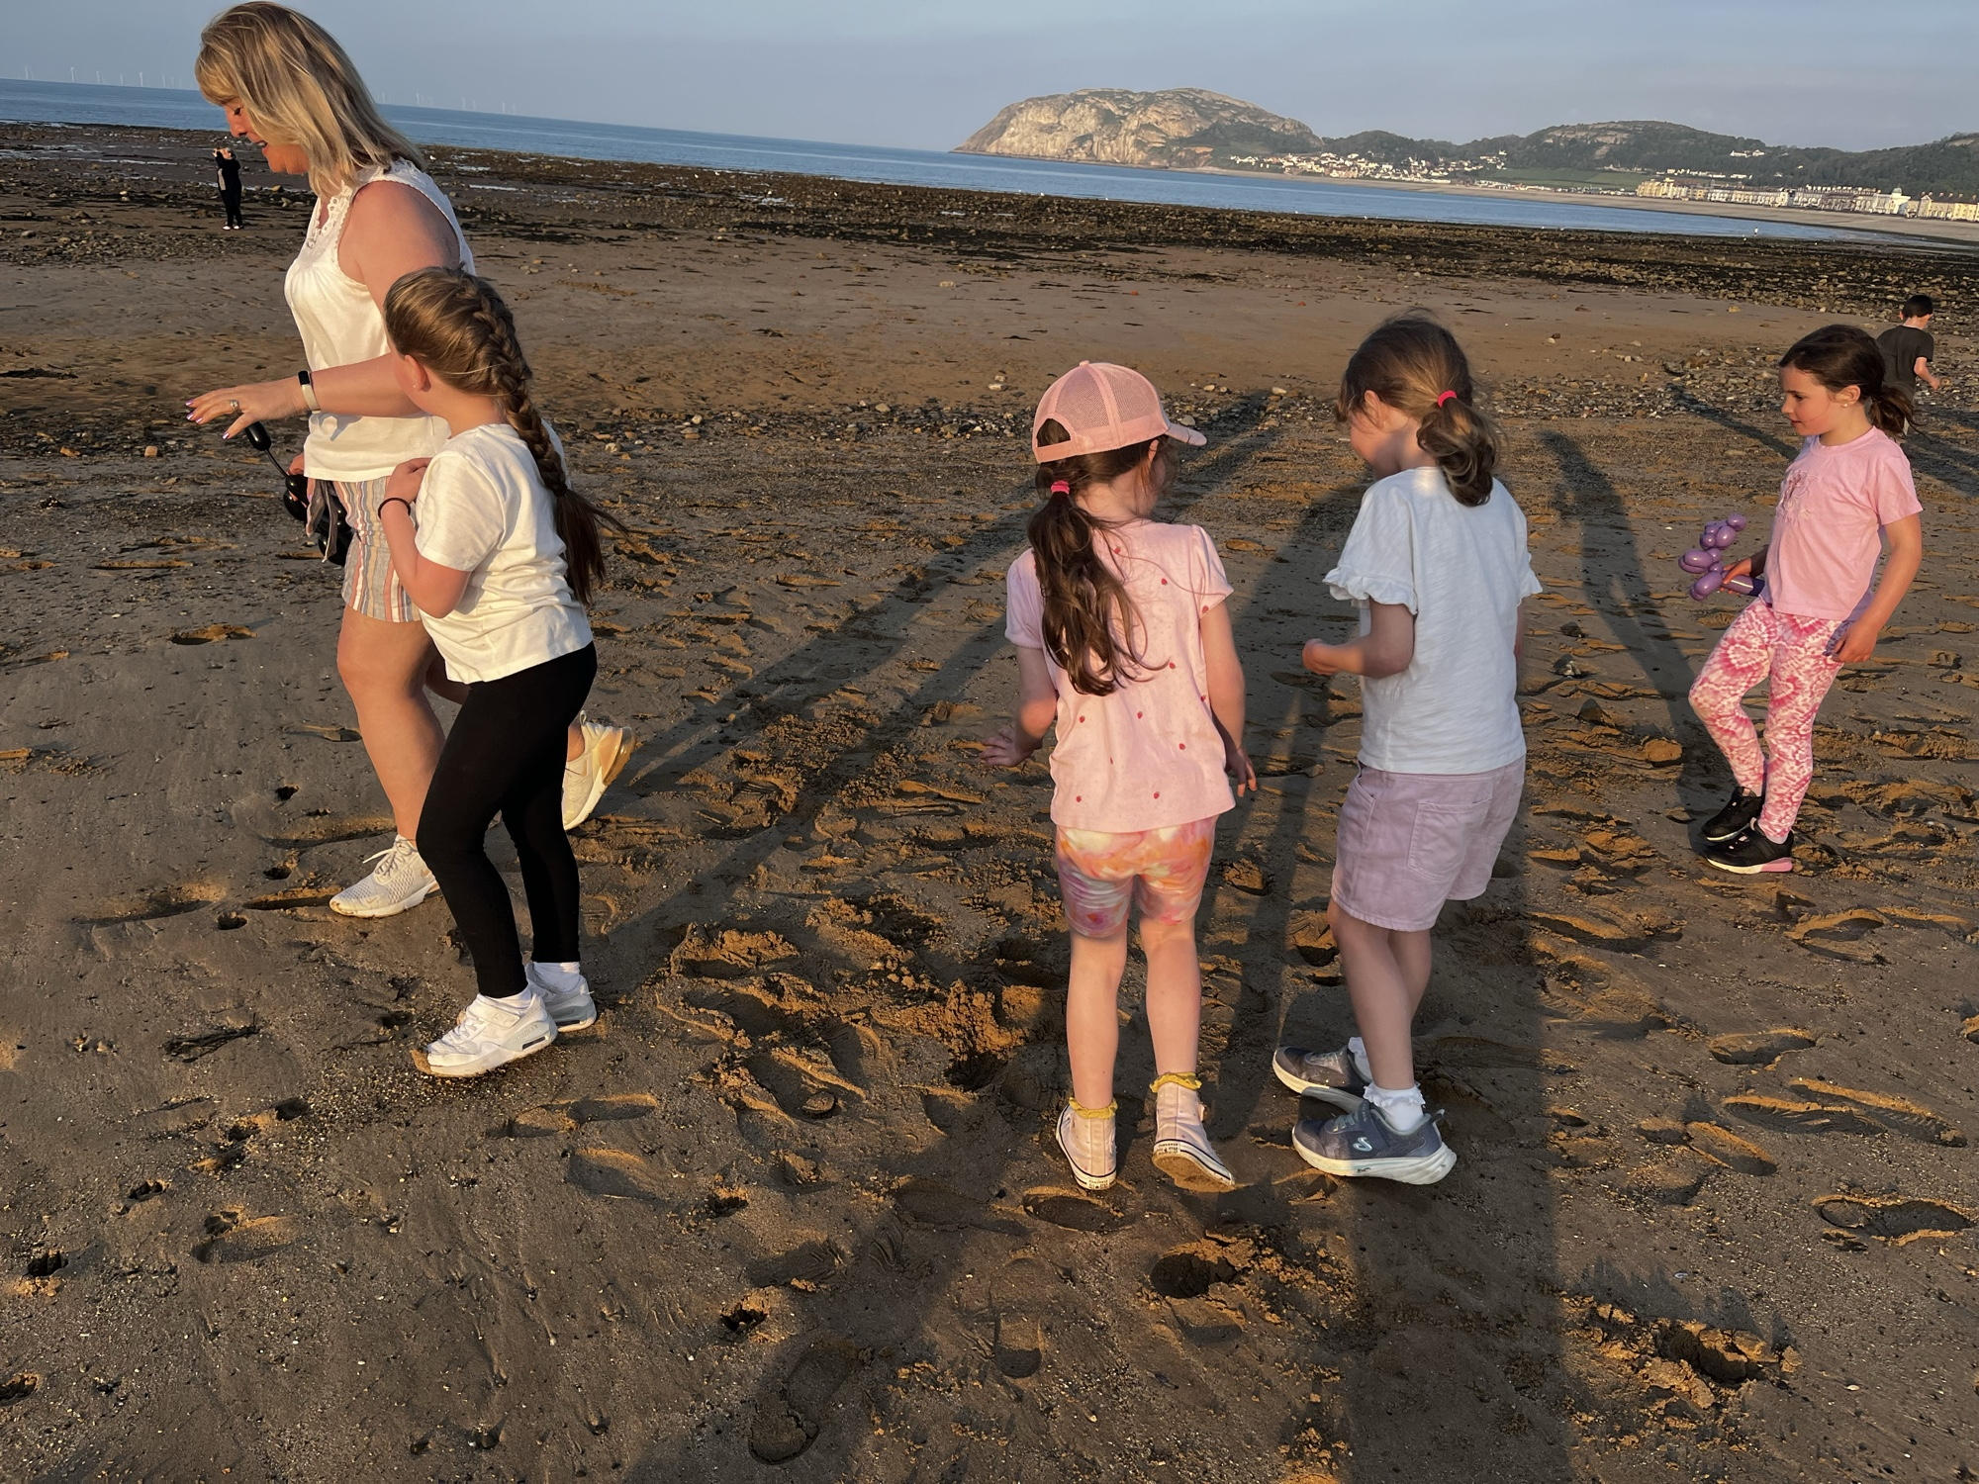
Playing on the beach

Slide 10
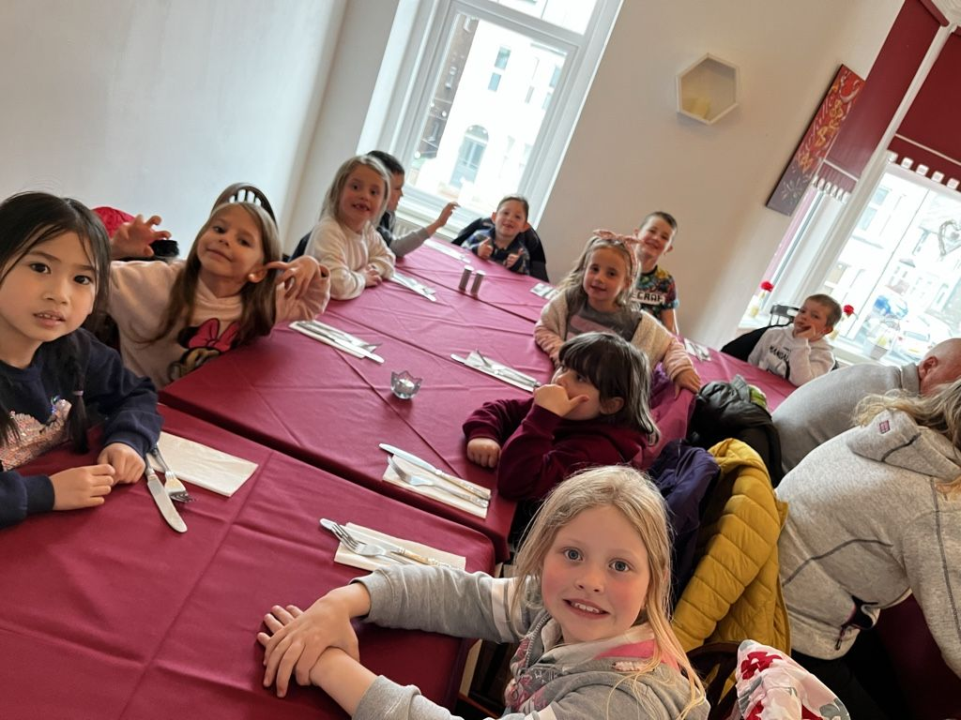
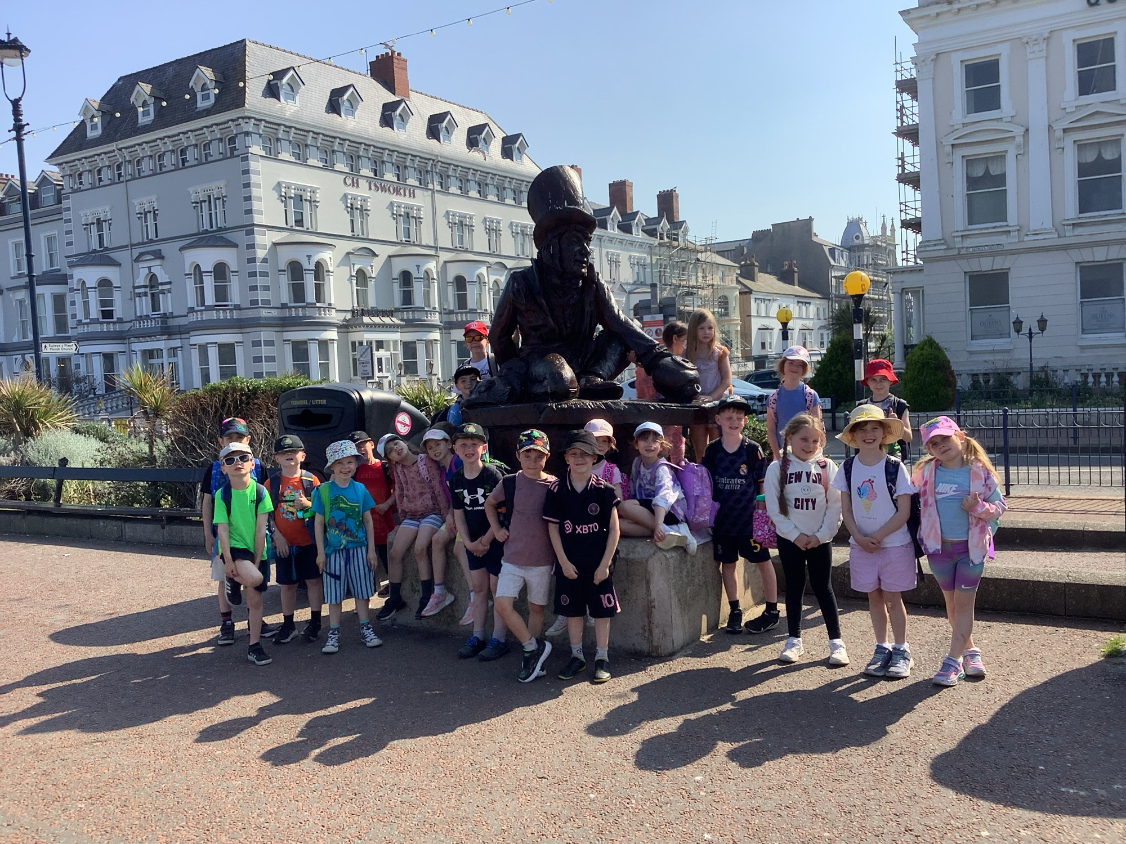
A restaurant in town for dinner followed by a walk on the promenade or the pier.

Slide 11
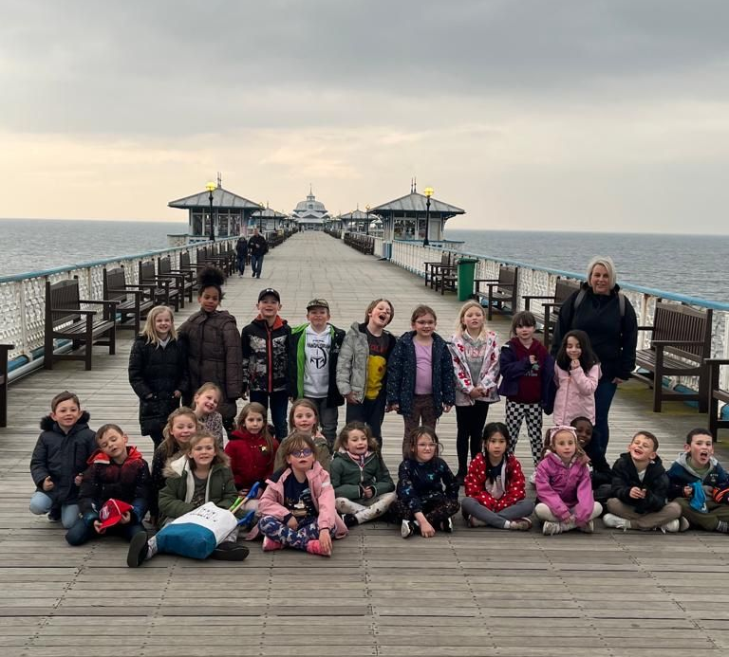
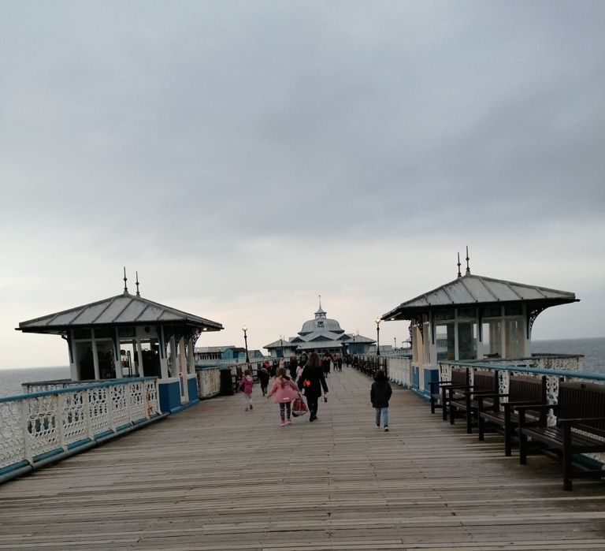
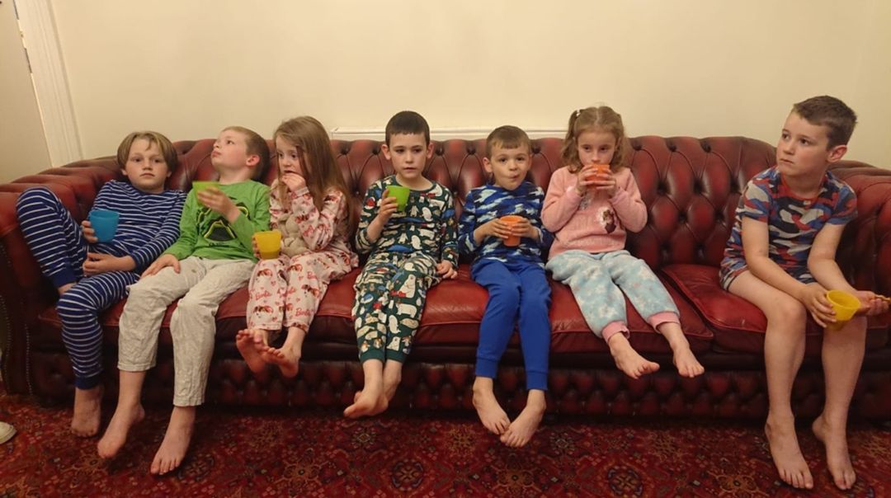
On the pier before hot chocolate and biscuits at bed time

Slide 12
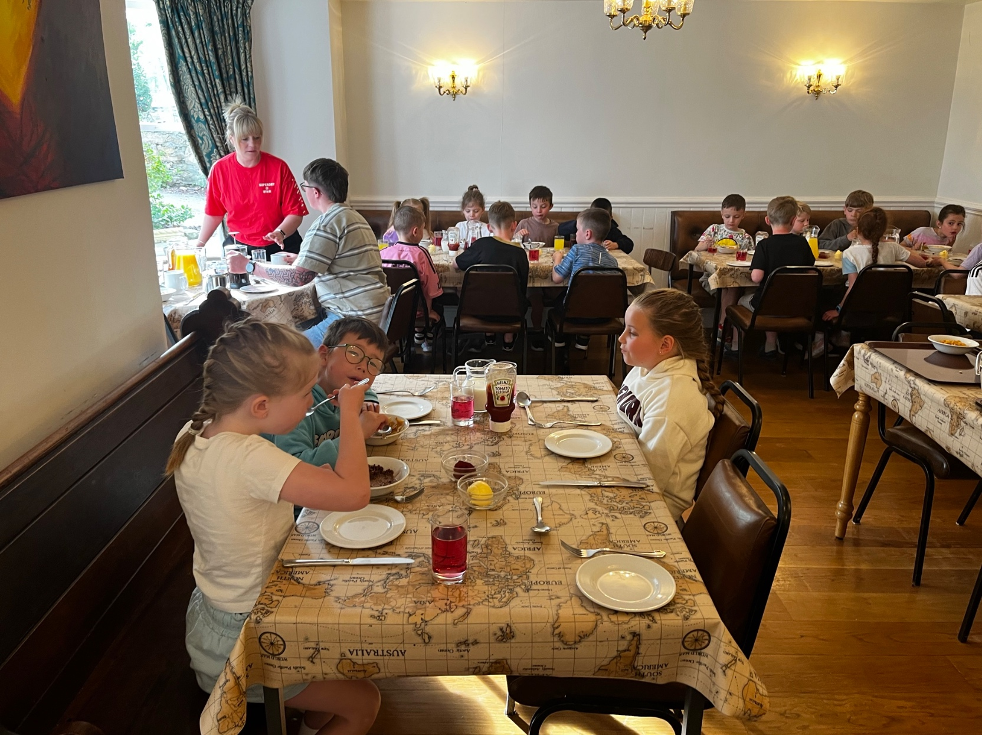
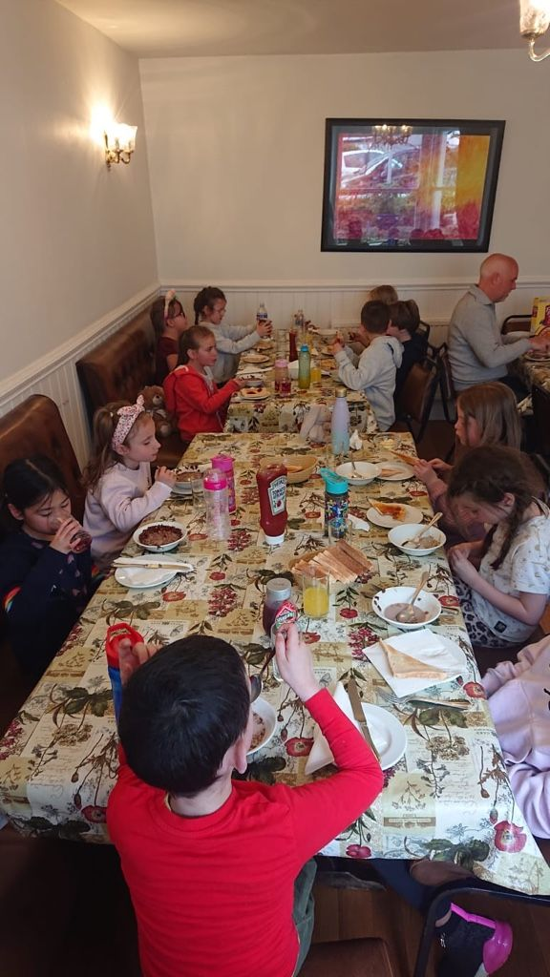
Day 2
Cooked breakfast
7am Wake up, pack up
Breakfast in the dining room. Cooked breakfast, toast and cereals. Unlimited toast and cereal.
Day 2 lunch – Bap, crisps, chocolate bar, fruit & drink.

Slide 13
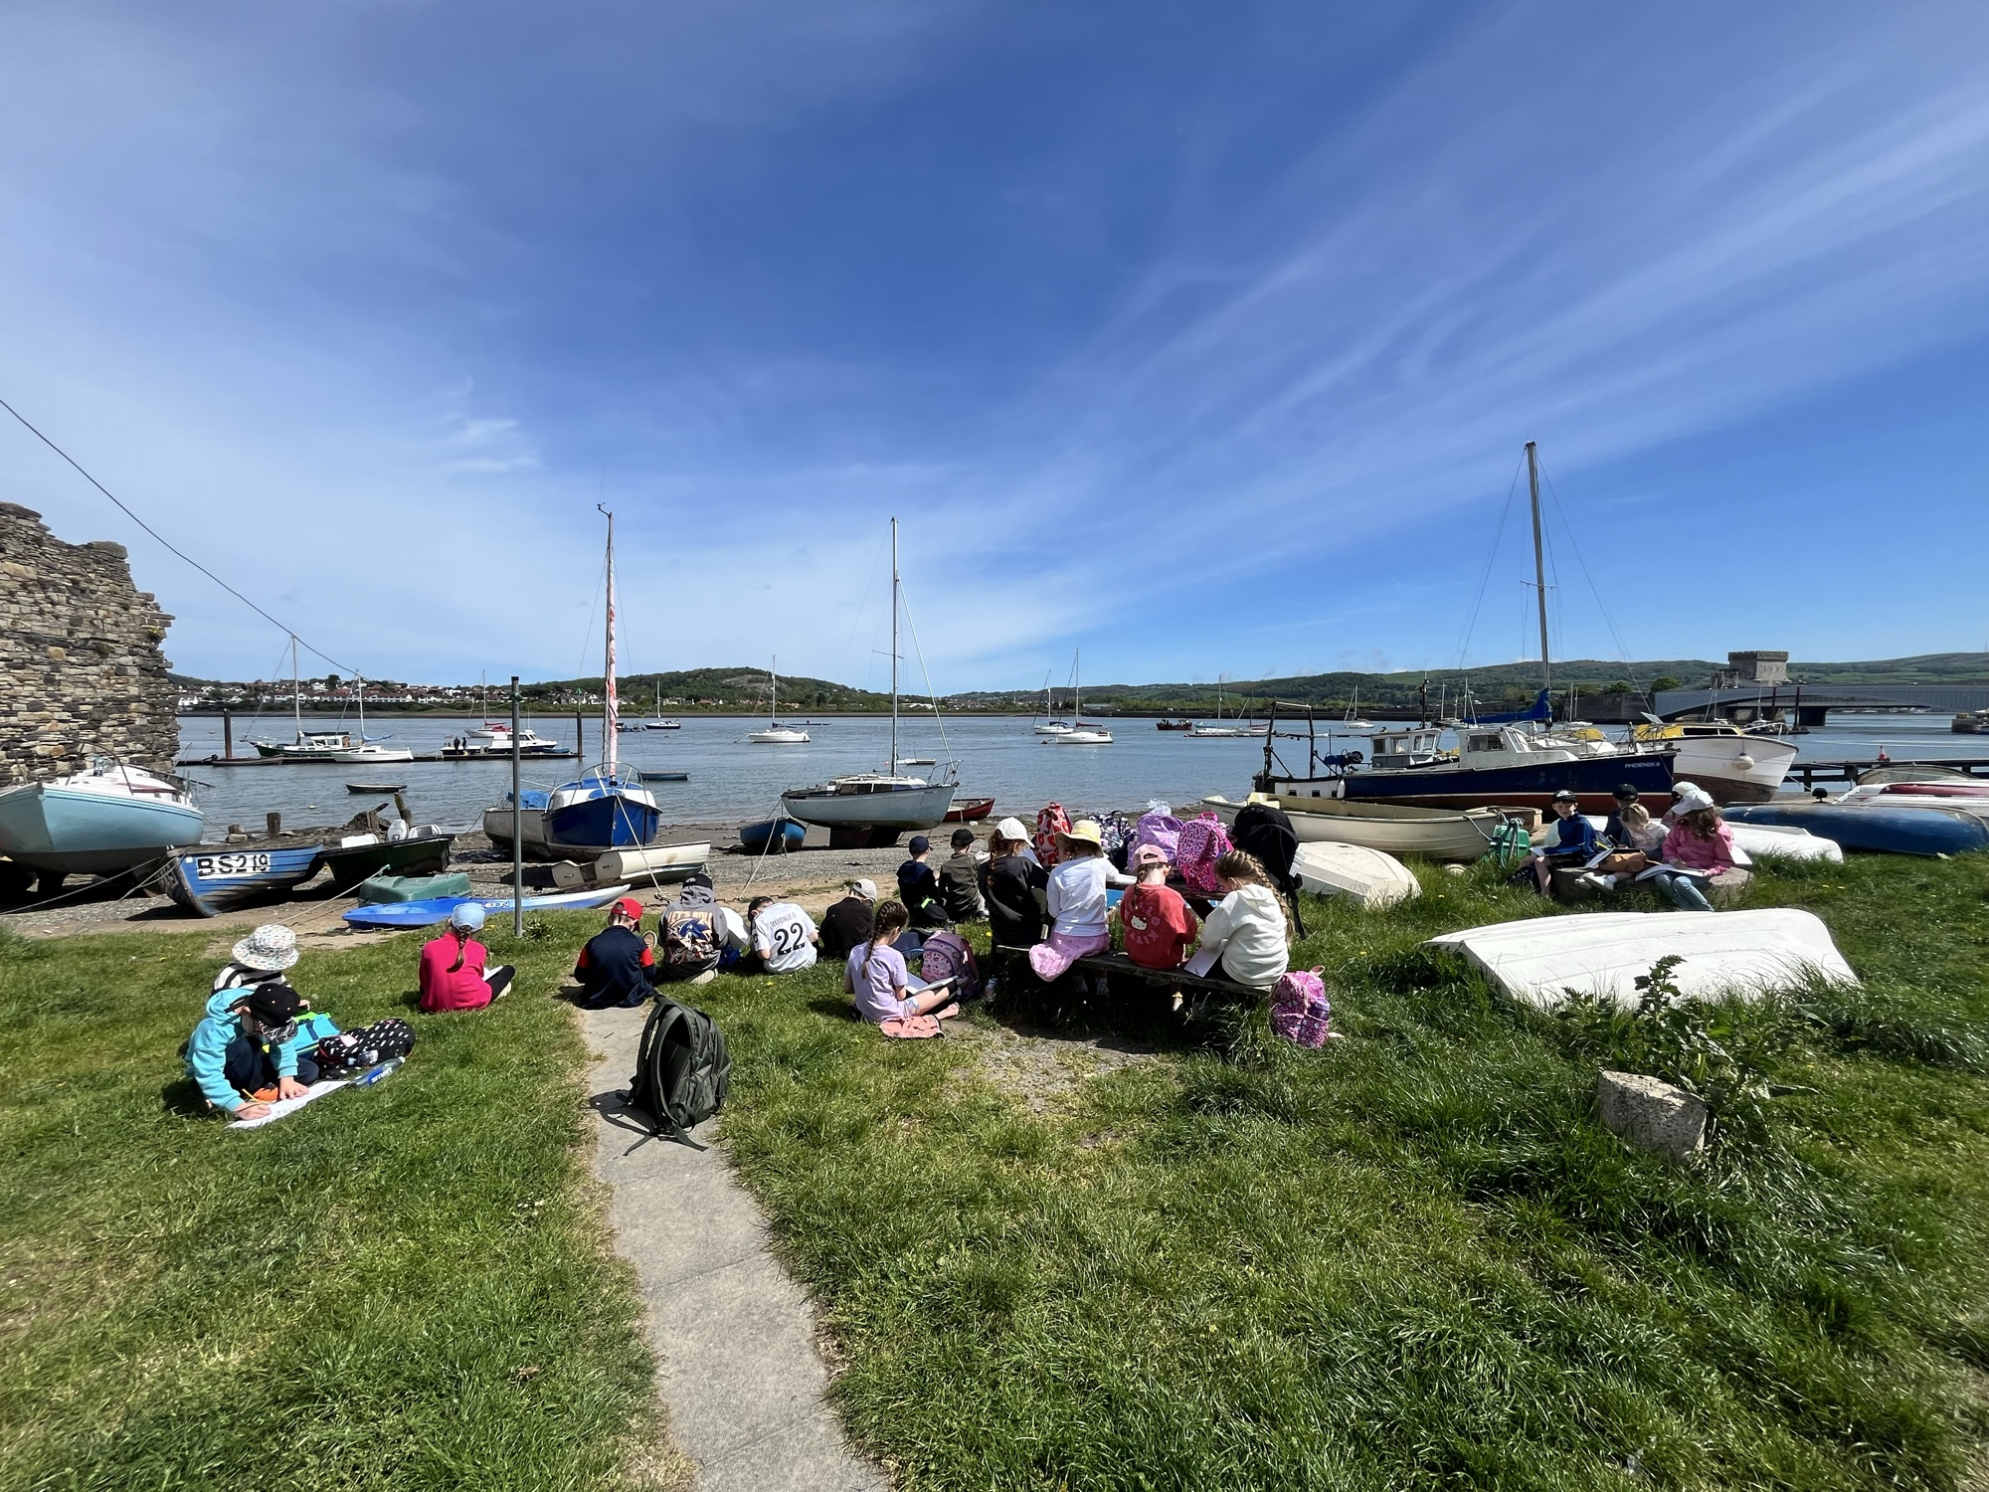
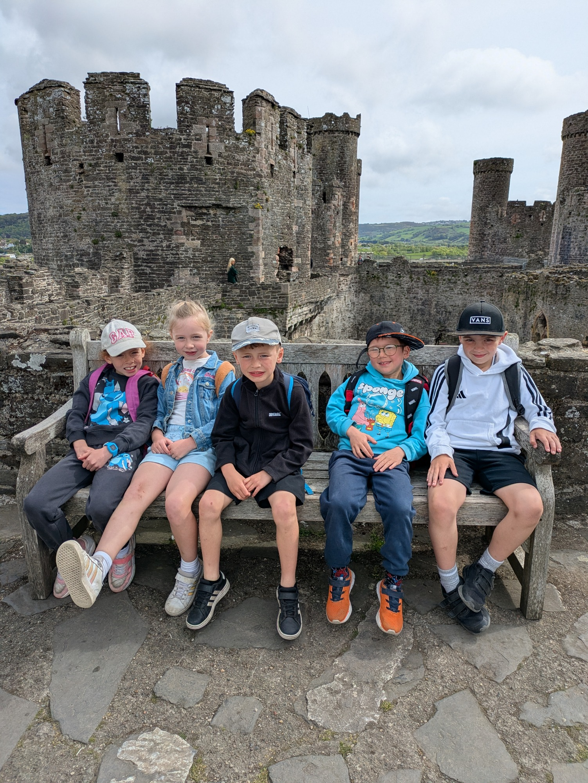
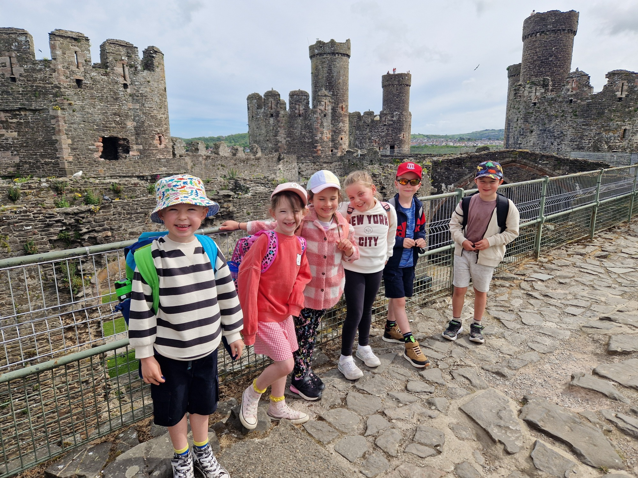
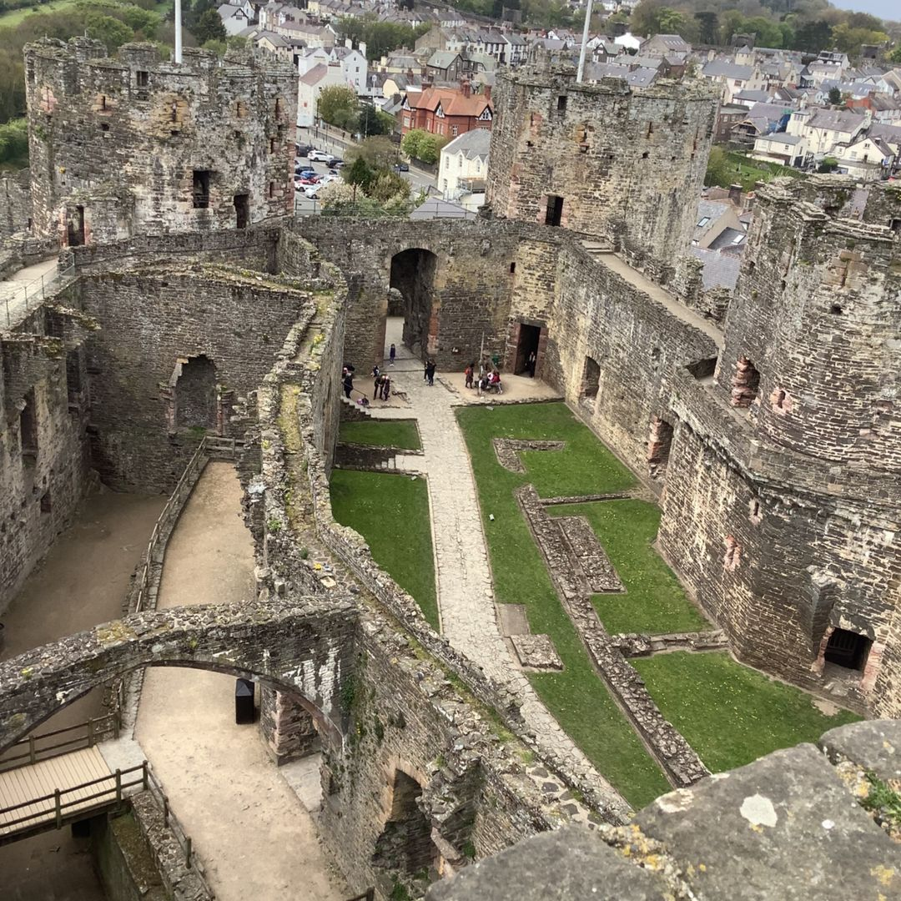
Day 2
Conway Castle
Arrive at Conwy Castle for a tour at 10.30am
11.00 am walk along the castle walls then onto the sea front to see the smallest house

Slide 14
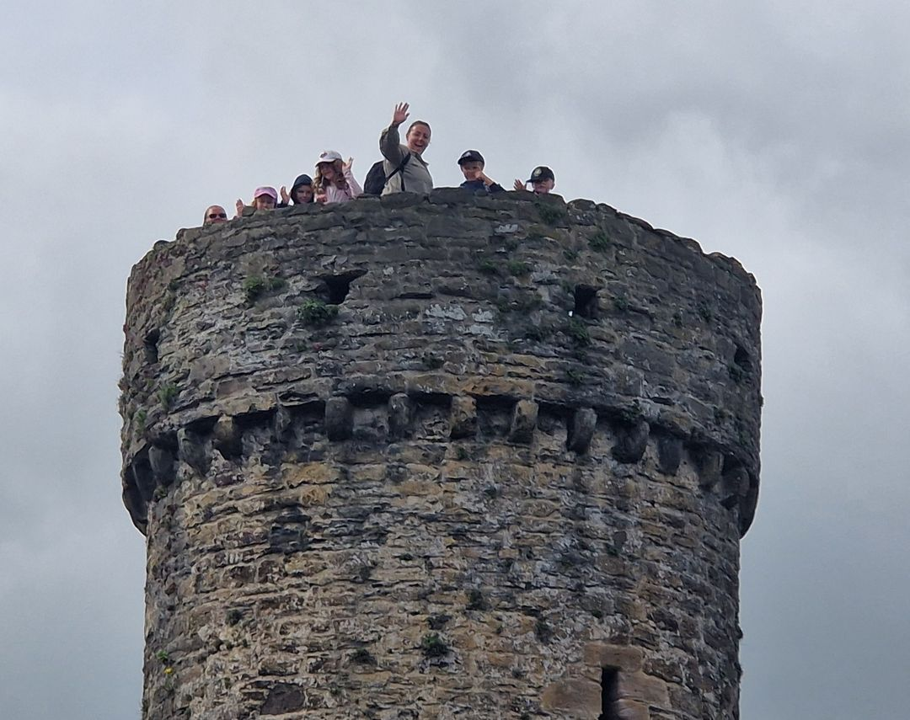
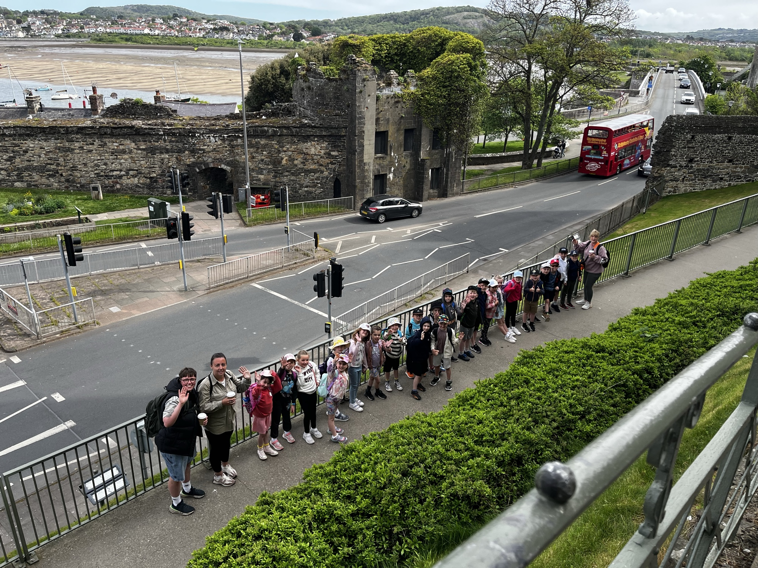
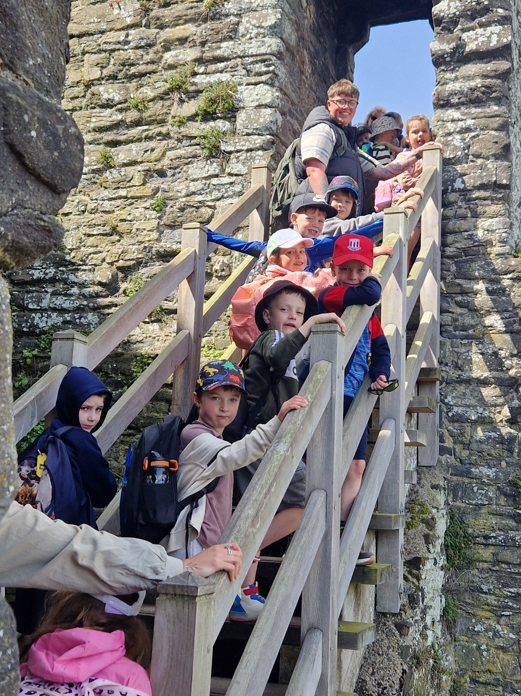
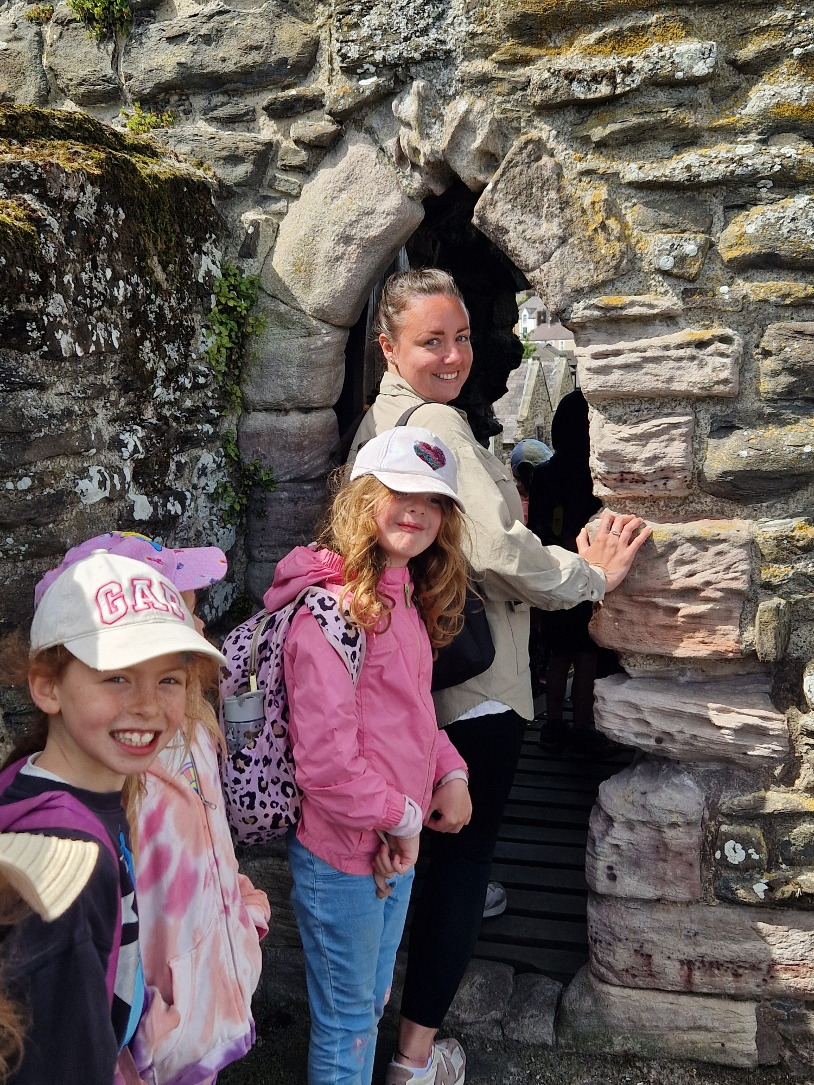
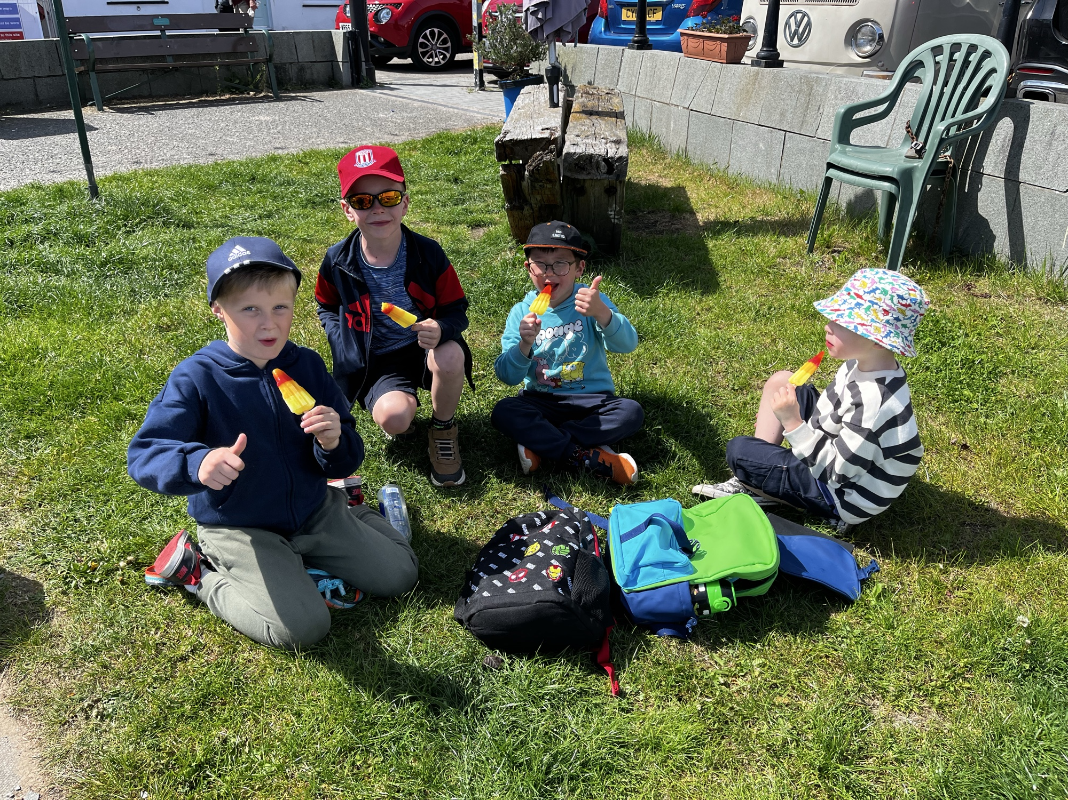

Slide 15
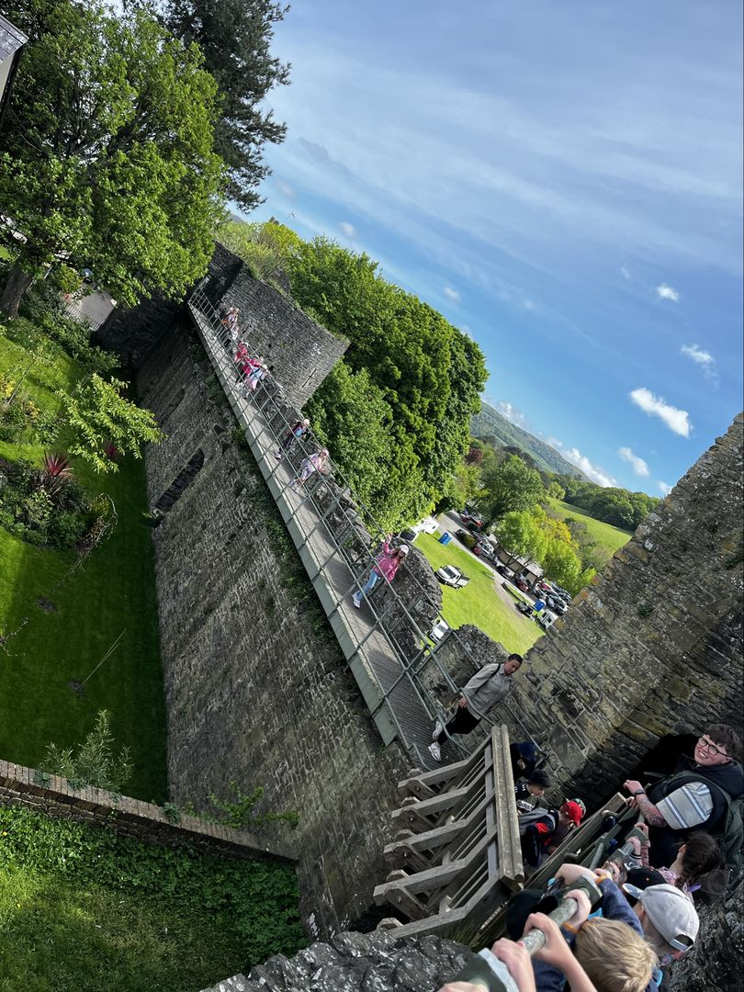
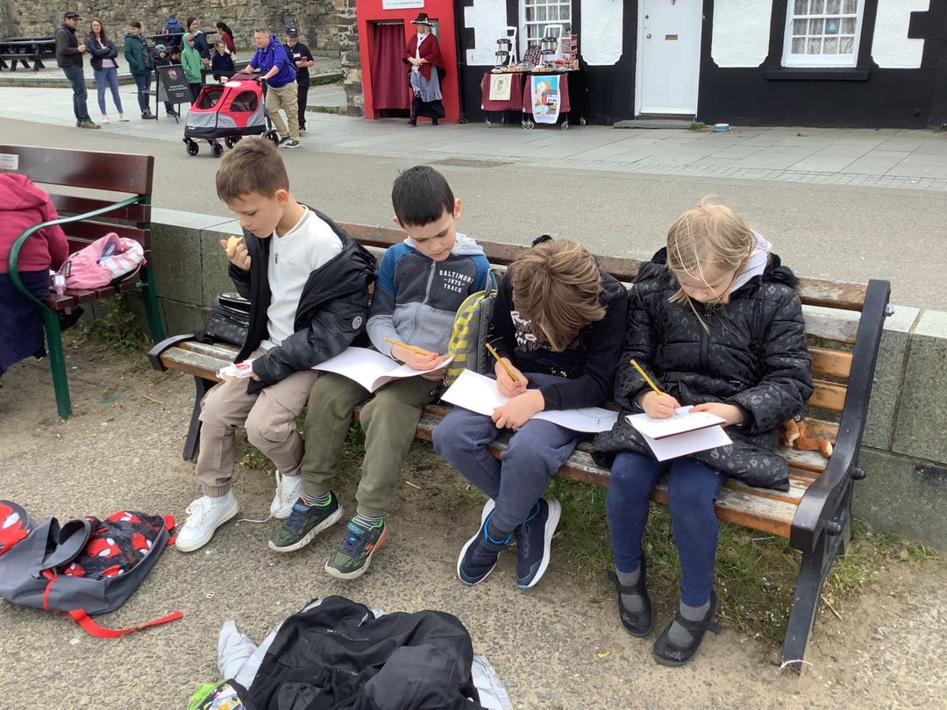
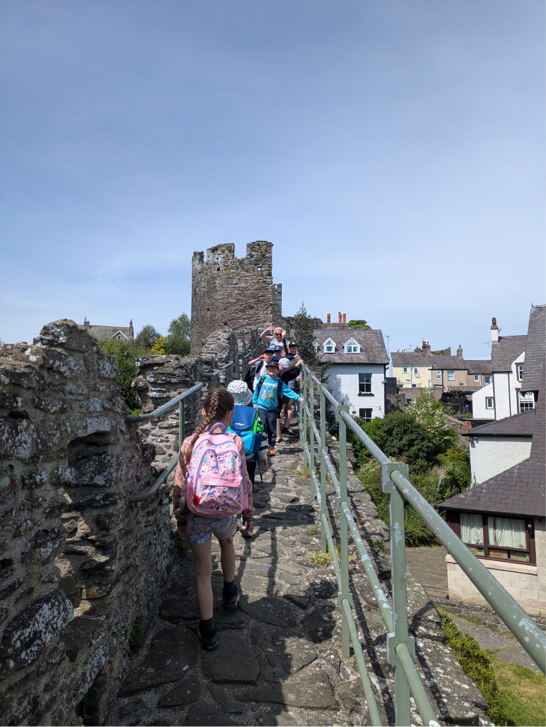
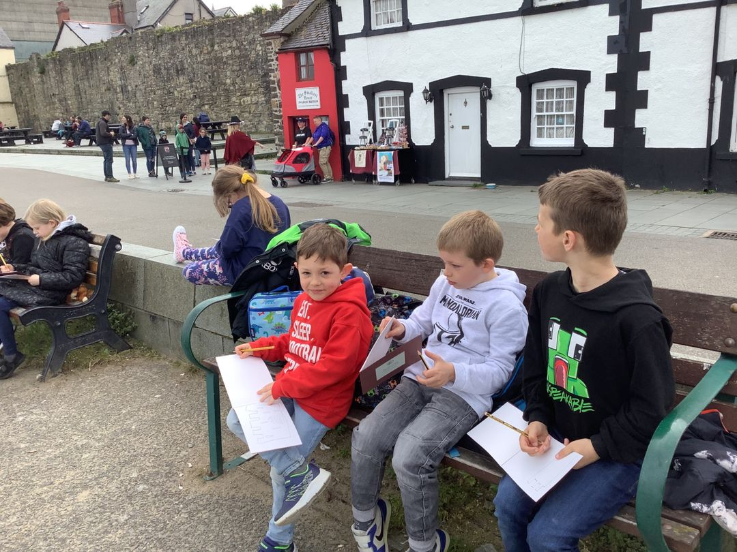
Walking and sketching

Slide 16
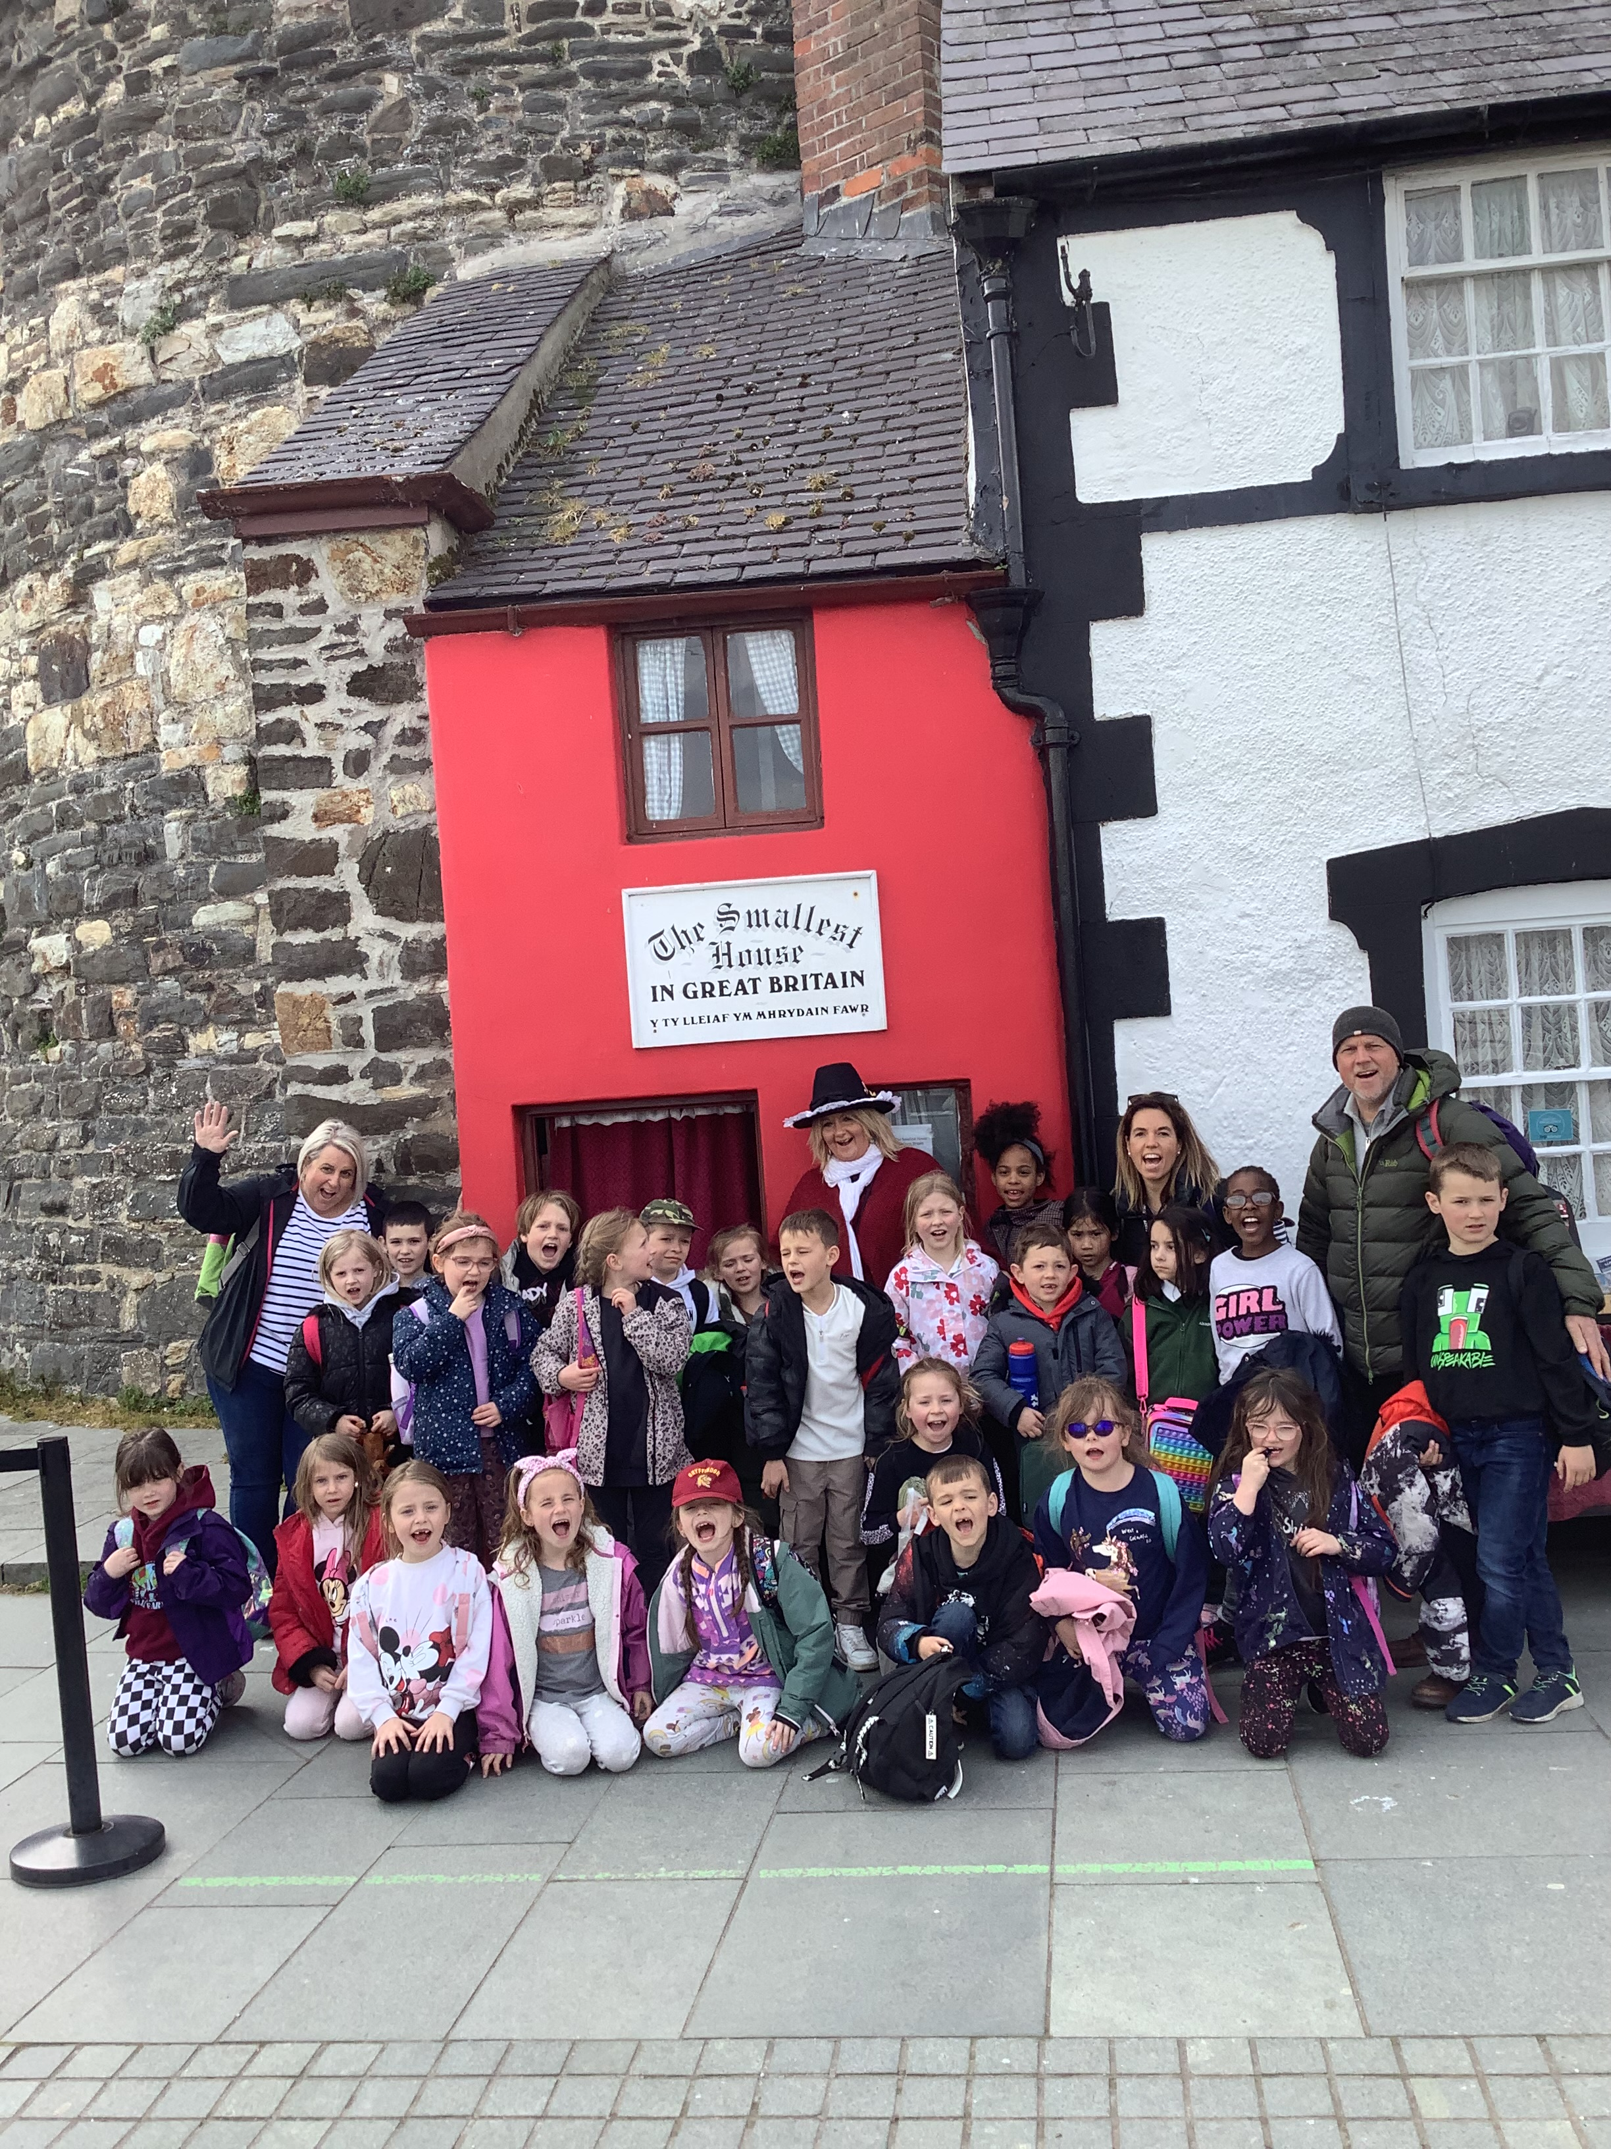
The smallest house
Lunch outside the Smallest House – some benches with a lovely sea view, if weather is bad we have a space reserved with the local pub next door.
Time for castle sketches
Walk back to Conwy Castle using the town route.

Slide 17
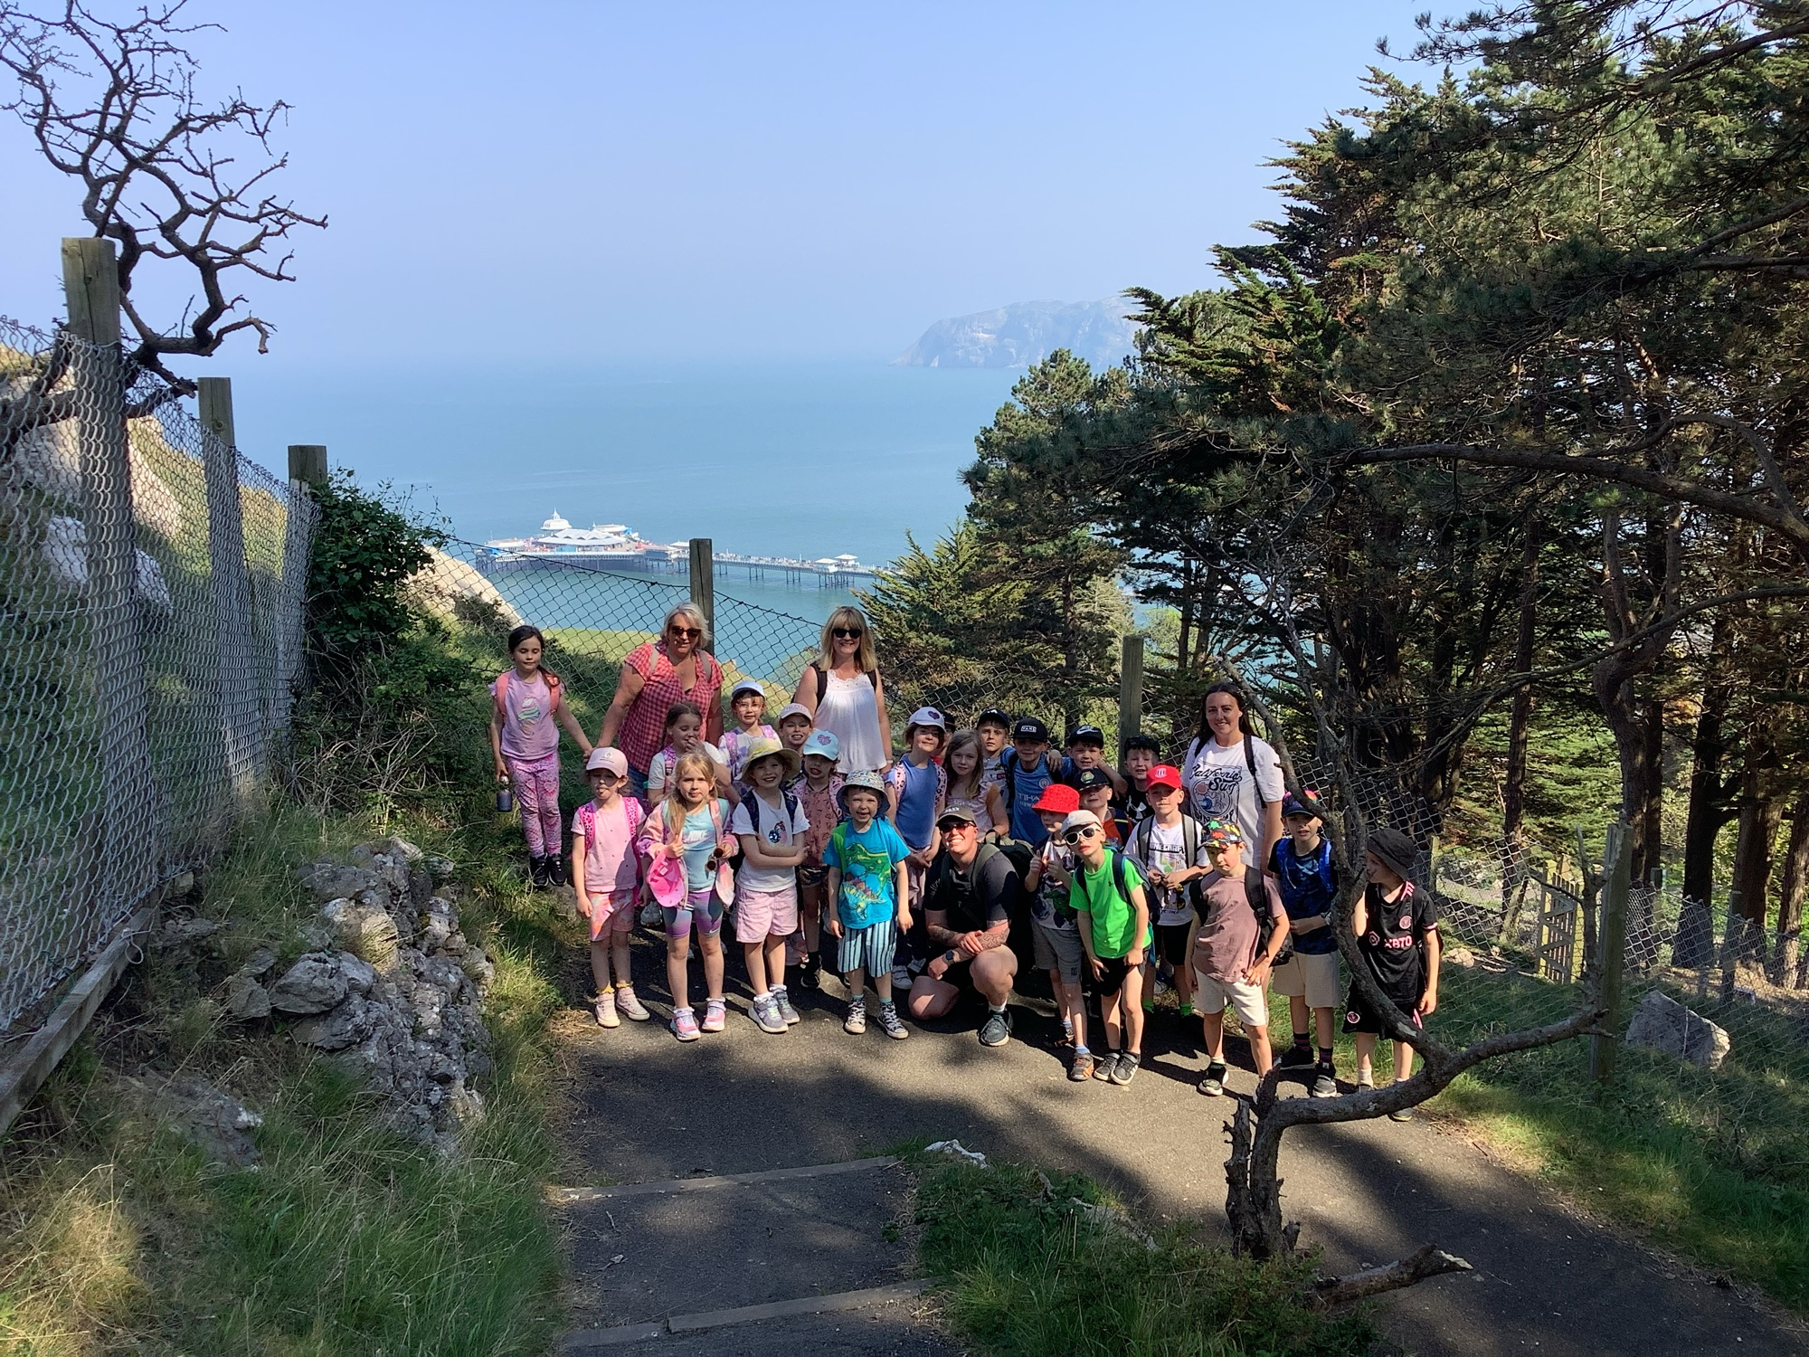
Staffing
Mrs Harry
Mrs Woollam
Mr Hocknell
Mrs Ellis

Slide 18
Important Notes
This will all be sent out nearer the time of the trip so please do not worry about this now
Luggage (as small as possible please)
A backpack to carry lunch and their sketchbook
Please pack luggage together with your child – so they recognise their belongings!
Please name all their belongings
Carrier bags for washing etc.
Small pack of wet wipes is a good idea in their backpack
Sun tan lotion/sun hat (backpack)
Waterproof coat with hood
Wellies in a named carrier bag with bucket & spade
Medicines to be handed in by Wednesday 26th April
No money needed
Asthma medication will be carried by adults – if this is not in school already this needs to be in by Wednesday 29th April
Please do not hand me medicines or other on the morning of the trip there is an awful lot for me to remember.
No electronic games, phones or tablets.
Leaving at 8.30am on Thursday 30th April (in school by 8.10)
Returning approximately 5.30pm on Friday 1st May
Packed lunch needed for Thursday (This can be provided by school)
2 refillable plastic bottles
Breakfast will be catered for by Llandudno hostel
Evening meal TBC
Day 2 pack lunch provided by hostel
Please do not send your child with sweets or snacks for a midnight feast

