Slide 1


Communication Support at
The Birches Specialist Support Primary School
Siobhan Jeffrey and Yasmin Li
Speech and Language therapists
11th October 2021

Slide 2
Aims
To introduce the Speech and Language therapists
To talk about how we work in school
To share models of language and communication development
To demonstrate some of the resources used across our school

Slide 3





How we work
Notes:
We see the child at the centre - and also see the environment they are in and the people they are with as the most important factor in supporting communication skill i.e. a joined up approach
We work with class teams to support children’s communication skills.
This involves assessing skills within the classroom setting, setting targets and supporting class teams to achieve these targets.
We work with school to create a total communication environment.
Where needed we offer individual and/or group sessions to specific pupils who are in need of support.
We offer training to all staff to empower them to meet their pupils’ communication needs

Slide 4
The Wave Approach
Wave 3
  Joint target setting
  Individual assessment
  Individual input
  Statutory assessments
Majority of input will be waves 1 and 2
Wave 2
  Group interventions delivered by therapists and school staff e.g. LEGO, Social skills , SPOT
Wave 1
  Whole school strategies e.g. total communication, sensory needs
  Training for staff
  Parent/carer workshops
Notes:
Wave 1 e.g. signing, whole staff training, parent information sessions
Whole school visuals e.g. objects of reference, visual timetables, in-task schedules
Total communication tips e.g. poster of the 4 Ss (Say less, Stress, Slow, Show)
Working with SLTeam: meet regularly, feedback on classroom observations and recommendation, joint strategy planning and prioritisation of SALT time
Wave 2 e.g. PECS, intensive interaction, creating communication opportunities
Groups – lego, functional communication, joint OT/ SLT groups, language groups
Wave 3 e.g. individual assessments and programmes, joint target setting with school staff
Feeding and swallowing input
Input into EHCP via annual reviews – inclusion of most recent SLT advice/ targets
Liaison with EY services in clinic – aware of overview of needs

Slide 5

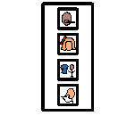
COMMUNICATION
Many of our students have:
Limited understanding
and are
Non-verbal communicators with limited language and vocabulary
Some have good verbal skills but poor understanding which is further reduced when anxious so visual support is still necessary.
LIMITED LANGUAGE AND MAKING USE OF VISUALS IS VITAL

Slide 6



Total Communication
We use a range of means to support children to understand and communicate:
the physical environment,
gestures and signs
objects, pictures and symbols
written words
Notes:
Add in a list

Slide 7
Functional Communication
Reasons
Why?
Who?
Means
Opportunity
When?
Notes:
When assessing and providing advice and targets for your child we use this model of communication
Means: the way we communicate. Can you think of the different ways we communicate?
Reasons: the child needs a reason to communicate. Can you think of different reasons to communicate?
Need all three to be successful communicators

Slide 8
Reasons = Why we communicate
Reasons
Greeting
Socialising
Expressing - pain, likes, dislikes
Give instructions
Indicate pleasure
Wants/needs
Give/Receive information
Clarification
Get attention
Comment
Acknowledging (yes, thanks)
Protests (no)
Notes:
Multi-modal communication – we all use different means of communication. Introducing signing to support this.
Focus on different reasons to communicate – not just nouns
OPPORTUNITIES
Down to the communication partners (i.e. you) to create opportunities by:
Modelling signs
Pausing
Sabotage
Responding

Slide 9
Means = How we communicate
Main means: understanding & using
language
speech
signs/gestures
symbols/pictures
reading/writing
Non-verbal means:
body language
facial expression
Pointing
Paralinguistic means:
intonation
rate
pitch
tone
fluency
Notes:
Multi-modal communication – we all use different means of communication. Introducing signing to support this.
Focus on different reasons to communicate – not just nouns
OPPORTUNITIES
Down to the communication partners (i.e. you) to create opportunities by:
Modelling signs
Pausing
Sabotage
Responding

Slide 10
Communication Opportunities
Give choices
Put things out of reach
Miss out steps of a sequence
Making the most of communication opportunities
Sabotage
Do the unexpected
Have fun!
Notes:
We will need to create opps to teach children commmunication skills/practise skills
Give choices – model this
Model not giving cutlery
Give choice - item in box – need to request help

Slide 11
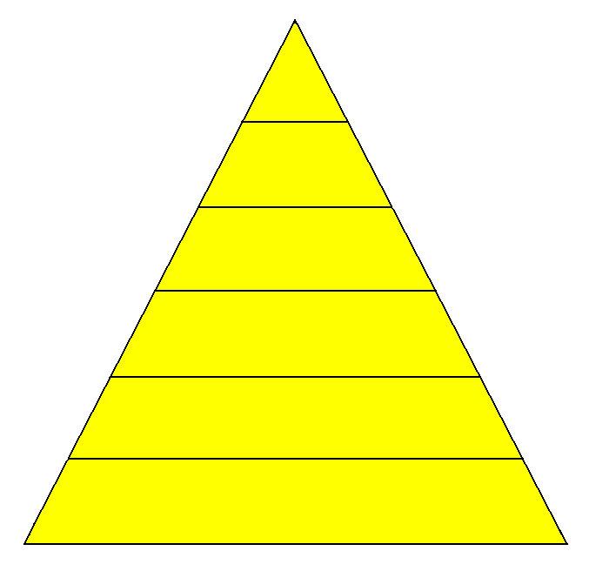
How Language Develops
Speech sounds
Skills at the bottom have to be in place before the skills above them can develop
Talking
Understanding
Play
Looking and listening
Adult – child interaction
Notes:
When assessing and providing advice and targets for your child we look at their skills across the building blocks of language
Discuss examples of how children may present.

Slide 12
Resources and strategies
to support communication
Key fobs Intensive interaction
First/then Interaction strategies - Include, Interpret, Imitate, Intrude
Visual timetables
In-task schedules
Choice board PECS (Picture Exchange Communication approach)
Communication boards
and books Language bags
Communication aids Objects of reference bags
e.g. iPad, Liberator, switches
Notes:
Check language is the same as later slides

Slide 13




Promoting Understanding
Language strategies to support understanding
reducing language - keep your language short and simple
add stress to key words - Emphasise the important words and
instructions
slow down – Speak slowly and clearly
Show alongside word – Use visuals to support what you say

Slide 14
Intensive Interaction
What is it?
  An approach that involves the person with another individual
  interact - ‘to act upon each other’
Notes:
What does it mean to you?

Slide 15
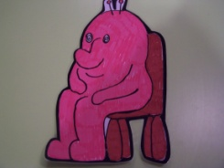
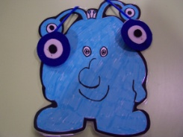
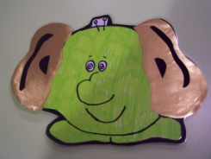
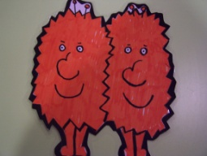
Social Use of Language Programme
This uses characters to represent active listening strategies
Moby The Monster – Good sitting
Looking Luke – Good looking
Listening Lizzie – Good listening
Timmy and Tommy – Good sharing and taking turns

Slide 16

Gestures & Signing
Early gesture
Keyword signs
In Manchester special schools we use Sign Supported English.
This means:
We always speak as we sign
We only sign key words
We keep words in the order in which we say them

Slide 17




Visuals
Traffic light key fobs. Some classes have added their own photos. Everyone in school needs to wear a key fob and use it.
Stop
Wait
Nearly done (“Nearly”)
Go/ok
Please make sure you use the visuals to support what you say.

Slide 18
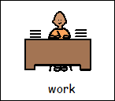
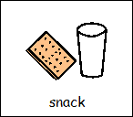
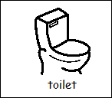
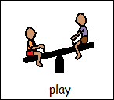
Schedules / Visual Timelines
Schedule
These can be used for the whole class or individually. The timeline or schedule helps pupils to see what is next and so to make sense of their day.
Pupils with learn better when they can see a picture or a photograph. It helps them to understand because they can see it and it is there for longer than words. They find it harder to understand spoken words. It often helps pupils’ understanding if you sign key words too.
Timeline

Slide 19
First/Then
First
Then
First/then cards are used to show pupils that something they like is coming but first they need to do something they’re not so keen on.
They are also a way of showing pupils what is next and can be used with a schedule or timeline.

Slide 20
Pictures & Symbols
Can be used to support both
Understanding
Expressive communication
Introduce at home by placing on the item or location
Keep another set on a choice board or in a book
Notes:
Talk about how to use these

Slide 21






Colourful Semantics

Slide 22


PECS
Some children have PECS books and use this system to make requests. PECS means “Picture Exchange Communication System” and is a specific communication system.

Slide 23
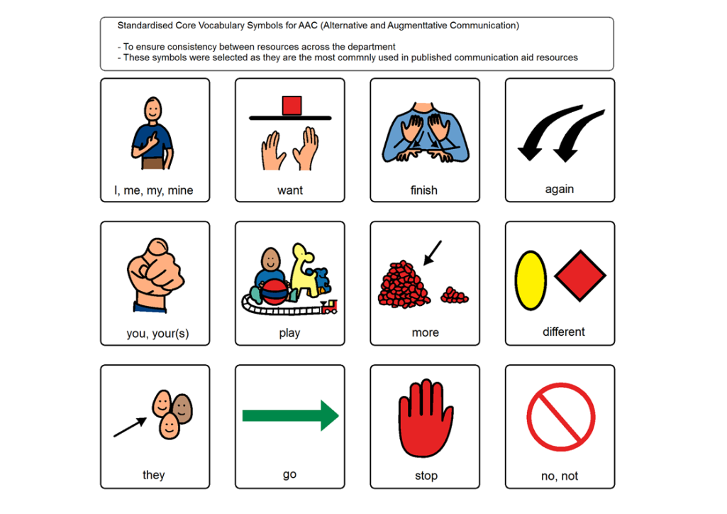
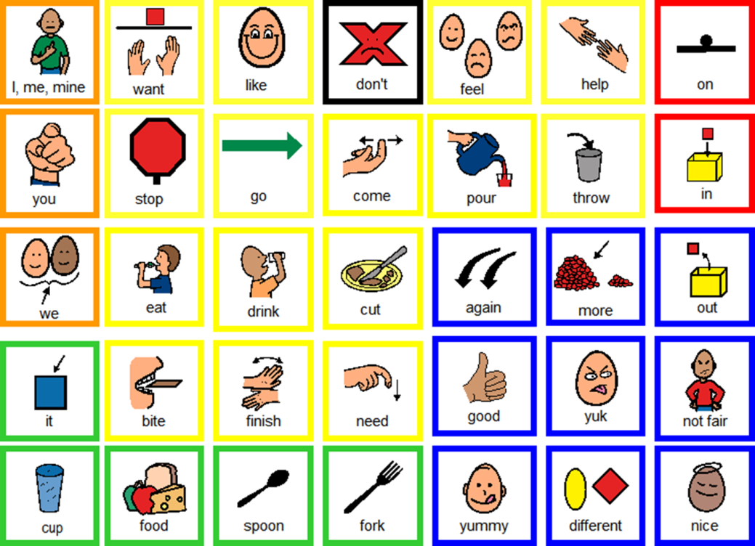
Communication Boards
Notes:
Activity mats/language mats/topic boards/Aided Language input
Activity mats/language mats/topic boards/Aided Language input
Great way to model spoken language through symbols across a range of learners/communication levels

Slide 24
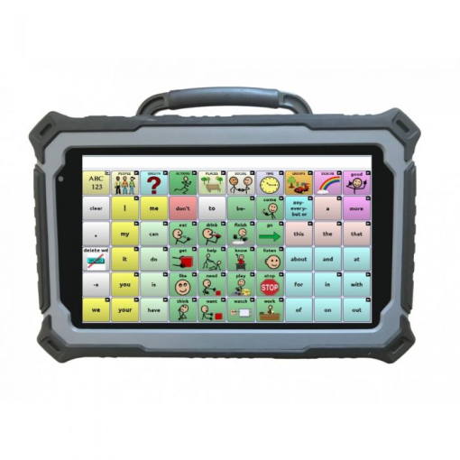
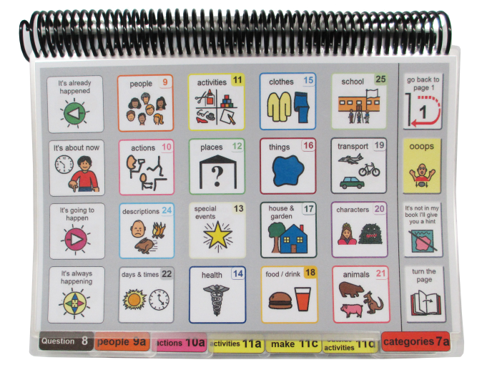


Communication Aids
We may recommend individual communication aids assessments and will work jointly with you across school and home
If you feel a student needs a more individualised communication system please come and talk to us
Notes:
A small number of students may have indiviualised communication systems

Slide 25
Feeding & Swallowing
All waves - mainly 1 and 3
  Observations and assessment
  Modelling strategies
  Problem solving with staff
  Individual Programmes – placemats
  Joint working

Slide 26

Any Questions?

