Slide 1


Welcome to Year 4!
Moving Up and Transition Day

Slide 2

Meet Miss Forshaw
Hello! I am Miss Forshaw, and I am so excited to be your teacher next year. We are going to have a fantastic time together!
🤯
Fun fact
My favourite subject is Art, and I love reading fiction books!

Slide 3
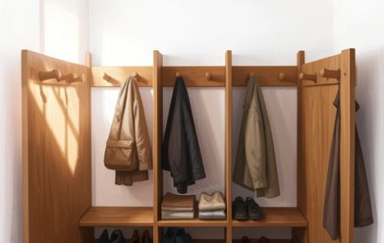
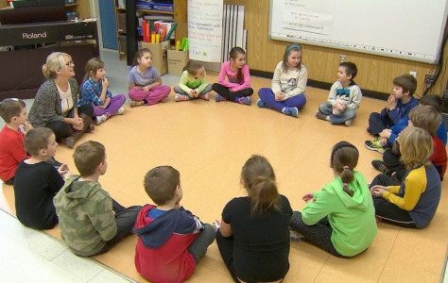
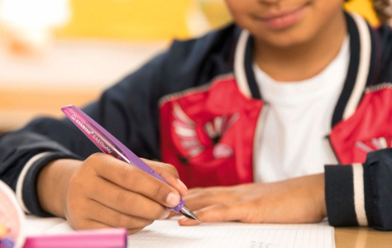
Today's Goals
New Routines - Find our desks and where our pegs are.
Get to Know Each Other - Meet new classmates and our teacher.
Year 4 Skills - Practice our best handwriting for the new year.

Slide 4

Feeling Excited?
A New Adventure
Transition day is like a 'sneak peek' at the future. It's normal to feel a bit nervous, but mostly it's about making new friends and discovering new things!
🔑
Key point
In Year 4, we get to do more independent projects and even go on swimming and play an instrument!

Slide 5
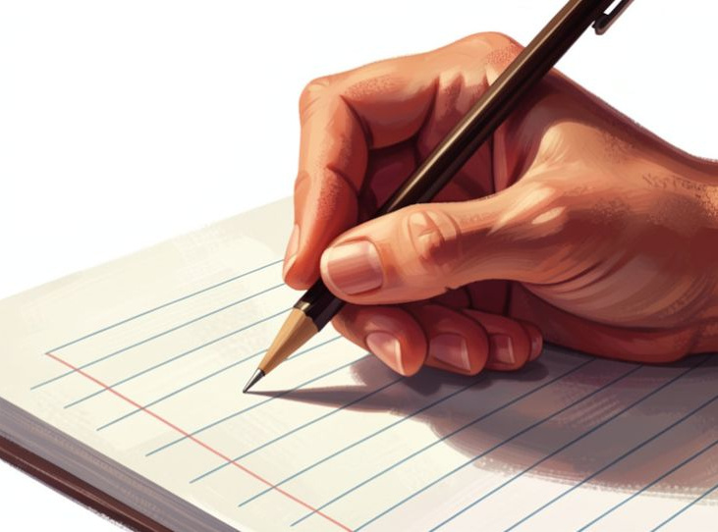
Handwriting Practice
Let's show Miss Forshaw our best Year 4 joined-up writing. Remember to keep your letters on the line!
The Golden Rules
Keep the 'ascenders' tall (t, l, h, b, d)
Keep the 'descenders' below the line (y, g, p, j, q)
Check your spacing!

Slide 6

New Classroom, New Rules
Every classroom has its own way of doing things. In Year 4, we focus on being Kind, Ready, and Safe.
🧠
Remember
Always listen when someone else is talking. We are a team!

Slide 7

Your Turn: My Hopes
On your piece of paper, I'd like you to write one thing you are excited about for next year.
🔍
Example
I am excited to play in the school football team and learn how to paint like Van Gogh!

Slide 8
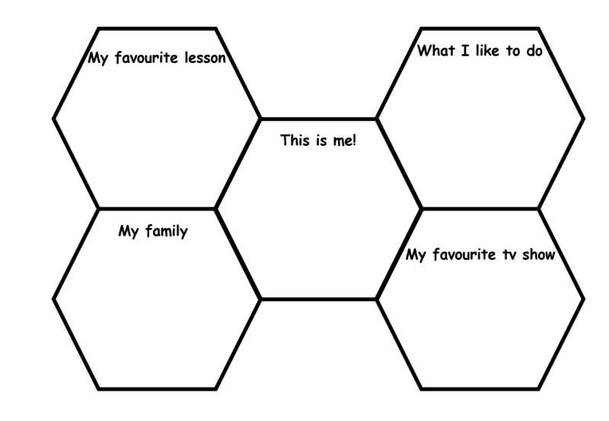
All About You!
I want to learn about you! Let's find out what makes you special.
Favourite Things - What is your favourite tv show, who is in your family, or hobby?
Super Skills - What are you really good at doing?

Slide 9
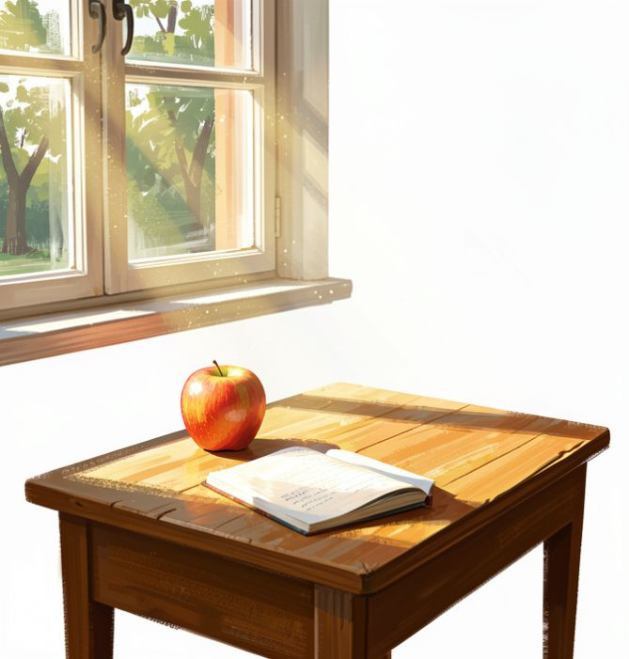
See You Soon!
You're Ready!
You've done a brilliant job today. I can already tell that this class is full of superstars.
Enjoy your summer holidays, and I will see you in September for our big start!

