Slide 1
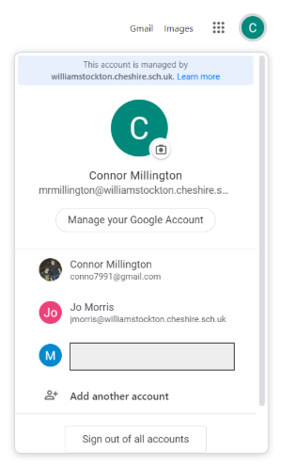
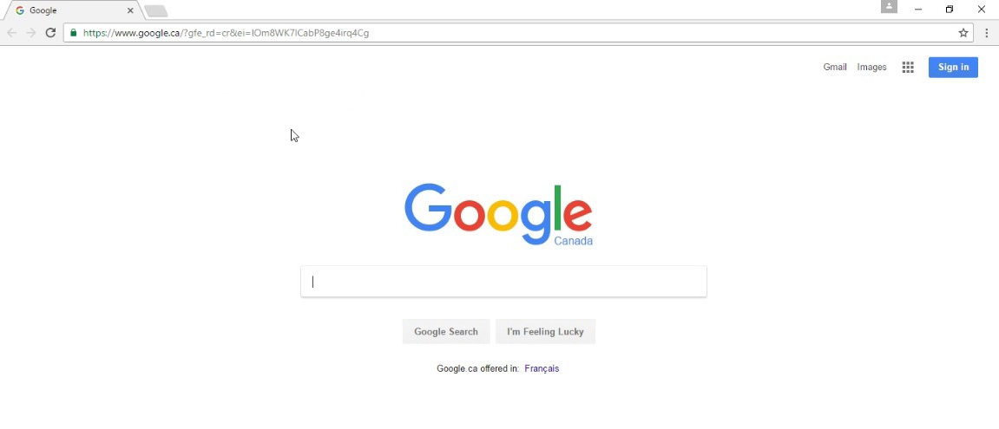
Step 1: You need to sign in to Google.
First, open Google Chrome homepage.
If you have not created an account already, click here.
This will be where account options are found. (Top right of Google Screen).
To add another account, click here.

Slide 2
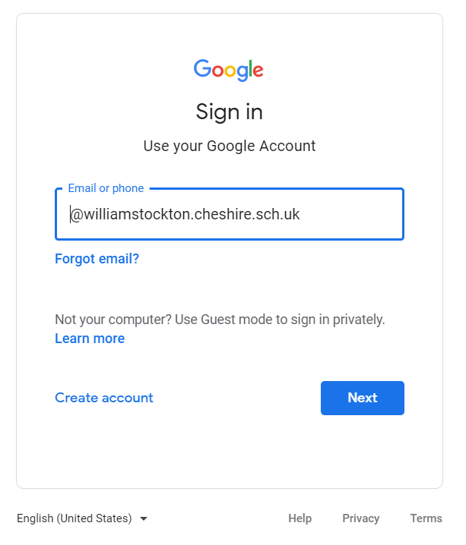
Your child will have their own William Stockton login:
All logins will have this at the end of their address.
Example login:
JohnS@williamstockton.cheshire.sch.uk

Slide 3
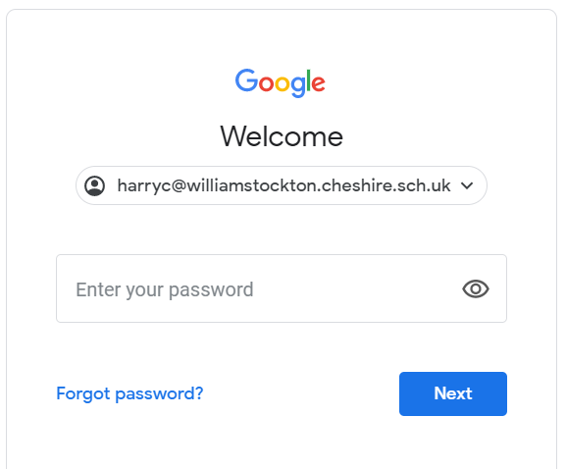
After inputting the email address...
Your child will have their very own password.
This goes here.
If you would like the text that you type to be visible, click here.

Slide 4
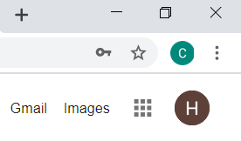
Success?
You’ll know that you’ve successfully logged in if you see an initial here. (Top right corner)

Slide 5
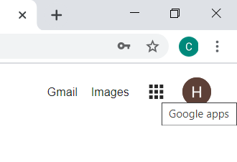
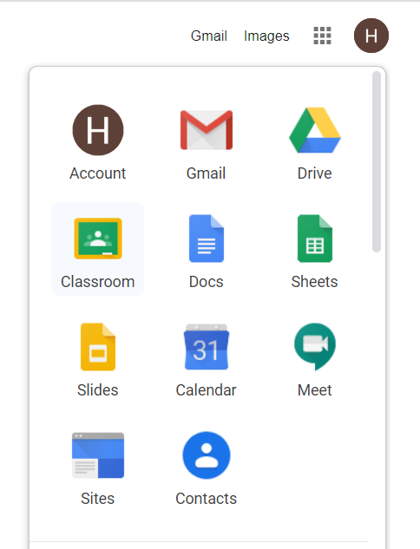
Step 2: Find your classroom...
Next to your initial, you will need to click on the Google apps button.
Here is where you can click on the ‘Classroom’ app.

Slide 6
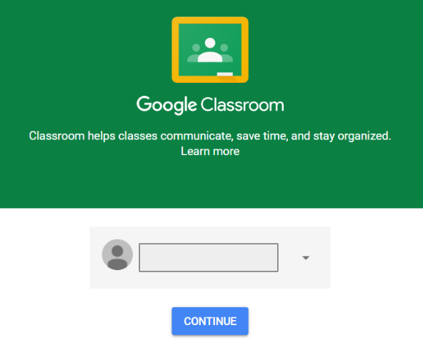
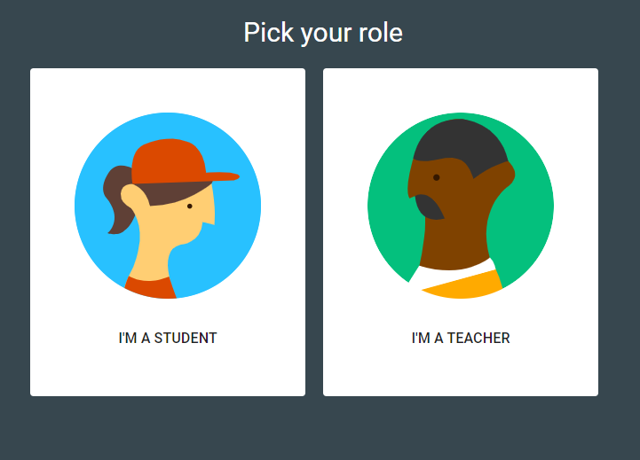
Step 3: You’re in!
Then click, ‘I’M A STUDENT’
Name hidden.
Click continue...

Slide 7
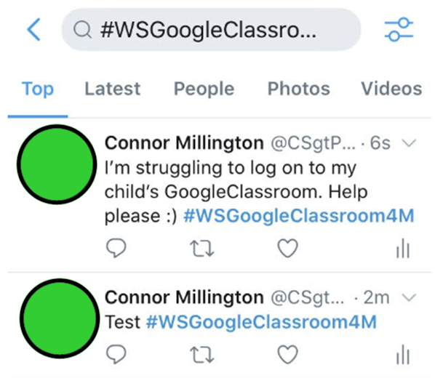
If you’re having any difficulty with Google Classroom, you can send queries via twitter using...
#WSGoogleClassroomN
#WSGoogleClassroomRD
#WSGoogleClassroomRG
#WSGoogleClassroom1W
#WSGoogleClassroom1C
#WSGoogleClassroom2H
#WSGoogleClassroom2B
#WSGoogleClassroom3L
#WSGoogleClassroom3/4M
#WSGoogleClassroom4M
#WSGoogleClassroom5W
#WSGoogleClassroom5/6W
#WSGoogleClassroom6F
...as the tag.
We will try our best to solve any issues you have with this new platform as and when we can.
Nursery
RD
RG
1W
1C
2H
2L
3L
3/4M
4M
5W
5/6W
6F
In the meantime, please feel free to use the material uploaded to the school webpage.

Slide 8
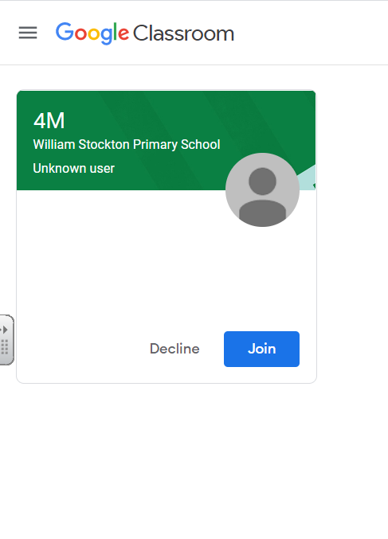
Step 4: Join the class! - ‘Accept the invitation’
Teachers will receive notification that you have successfully joined the classroom.
If you are struggling to do this, there is a unique code that your teachers have sent to you…
Unique codes are found on the Google Classroom Webpage
Then click ‘Join’.

Slide 9
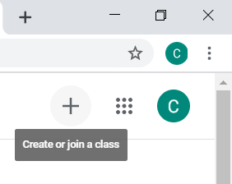
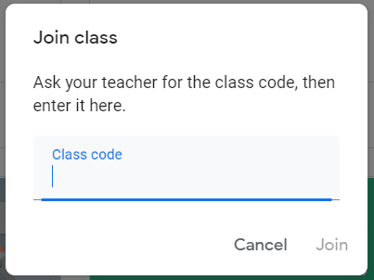
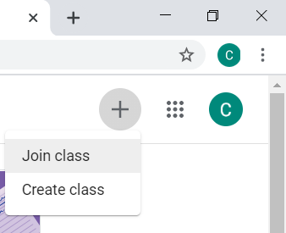
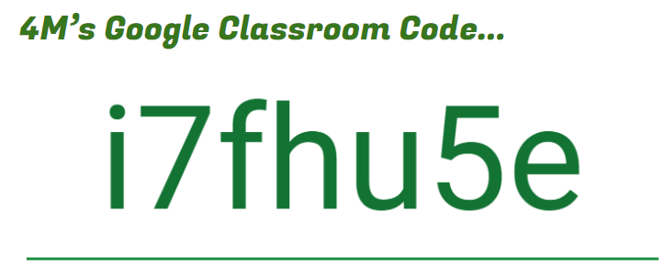
Step 4: Join the class! - Join with the unique Classroom code...
When signed in, click ‘join class’.
Then, you just need to type in your child’s unique classroom code.
(This can be found at the top of their classroom pages.)

Slide 10
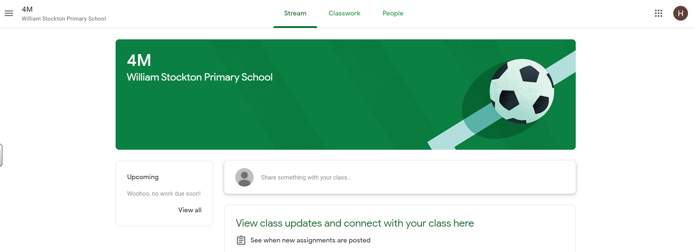
Your display will look like this.
Please frequently check the page for set work.

