Slide 1



Welcome Meeting
Thursday 18th June 2026

Slide 2
I am proud to say that Wimboldsley is one of the family of schools that are part of Concordia Multi Academy Trust. As Chief Executive Officer I am excited that you have chosen us at the start of your child’s educational journey. Our Trust prides itself on providing the highest levels of education to each and every child within our schools and we are confident that your child with thrive within Wimboldsley Community Primary School.
This is an exciting time for you and your family and we understand there may also be mixed emotions – joy, anticipation, and perhaps a touch of nervousness. Within our Trust, we strive to make the introduction to school as smooth and positive as possible for all of our new starters.
We are a vibrant and inclusive Trust, with a strong focus on nurturing young minds and fostering a love of learning. Our schools, including Wimboldsley, provide a stimulating and supportive environment where every child can flourish.
I look forward to meeting your little one and hopefully getting to know you over the coming years.
Chris Davis CEO

Slide 3

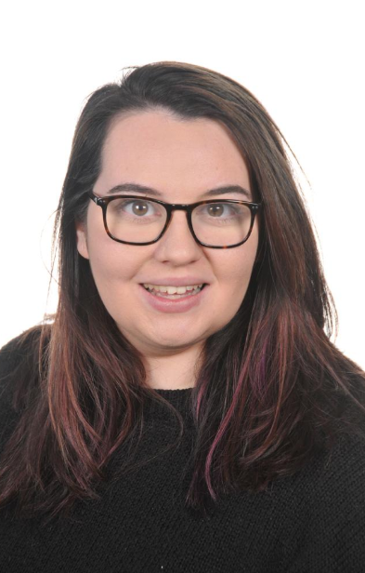

Our leadership team
Mrs S Macaskill: Head Teacher
Mrs C Hazeldine: Lead Teacher
Miss C Copley: SENDCO

Slide 4
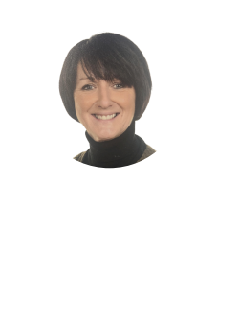

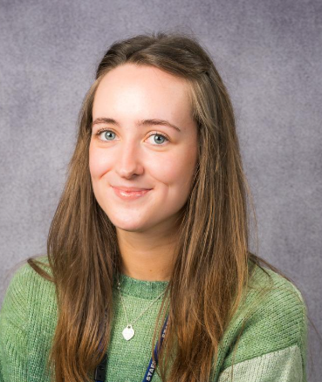
Team EYFS
Mrs McFerran
Higher Level Teaching Assistant
Mrs Wakefield
Teaching Assistant
Miss Smith
Class Teacher

Slide 5
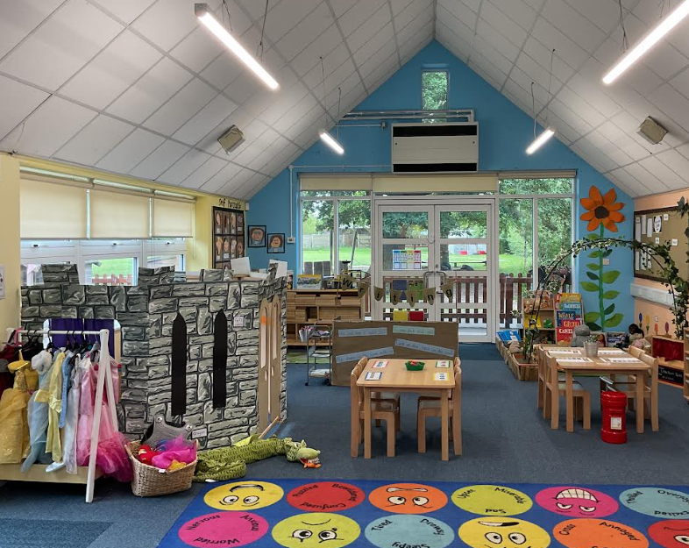
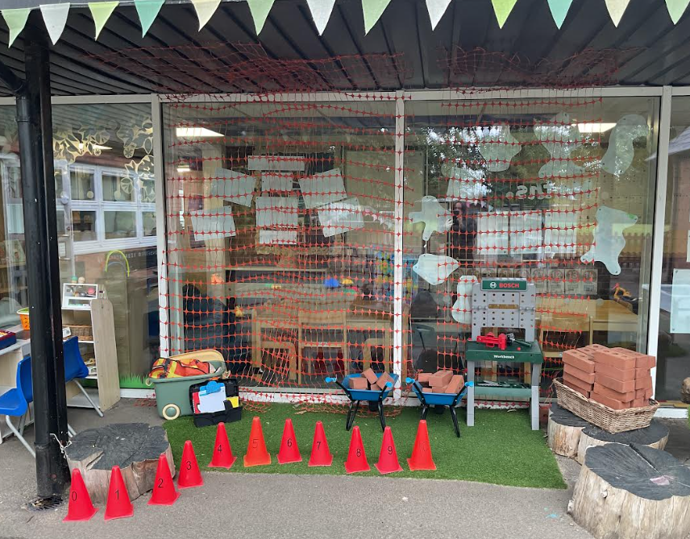
Acorn Class
17 Children

Slide 6






Our curriculum

Slide 7
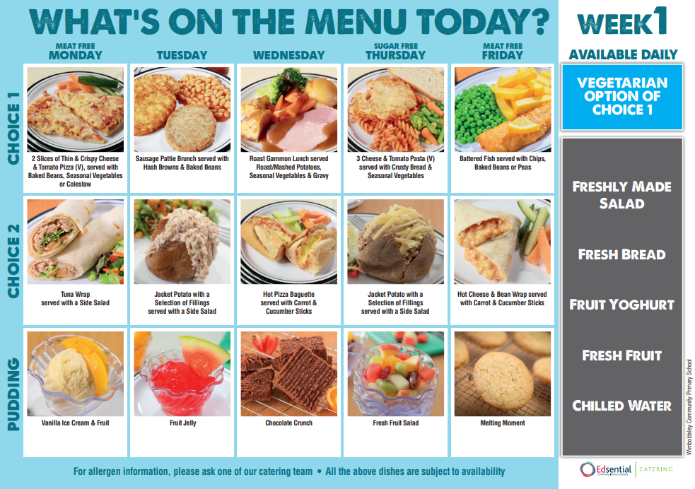
Snacks and lunch
As of September 2014, all children from reception class to year 2 are entitled to free school meals. We encourage all the reception children to have a school dinner.
Toast is offered as a mid morning snack and is currently charged at £5 for each half term
Children are also offered a piece of fruit and milk (until they turn 5) daily.
All children in Reception, Year 1, and Year 2 are eligible for Universal Infant Free School Meals regardless of income. However, if you meet the income-based criteria , it is important to register your child for free school meals. This allows the school to claim the additional Pupil Premium funding to support your child.
If you think your child qualifies, please contact the school office for assistance with the application process. Even if your child prefers packed lunches, registering ensures the school receives the funding to benefit their education.

Slide 8
Working together
Weekly EYFS newsletters sent via school spider which provides regular communication about learning
Monthly newsletter
Class assemblies
EYFS stop drop and read/write/count
Reading diaries
Parents evenings
Annual reports
Commitments from home positively support school

Slide 9
Ensure your child wears the correct school uniform and follows the school dress code. Ensure that your child attends school punctually every day during term time, unless there is a good reason for absence (e.g. illness).
Notify the school by email or telephone in the event of absence.
Support the school’s policies and guidelines on learning, behaviour, attendance and uniform. Attend parent/teacher meetings to discuss your child’s progress.
Read regularly at home
Keep the school informed of any changes in circumstances (i.e. address, phone number, emergency contacts etc-we must have 2 emergency contacts.)
Promptly inform the school of any concerns or problems that may affect your child’s learning, behaviour or happiness at school.
Support school in the teaching of safe and secure internet use at home.
Respect all members of the school community, abiding by the policy of zero tolerance towards rude and aggressive behaviour.
Regularly read information on the website and school communication

Slide 10
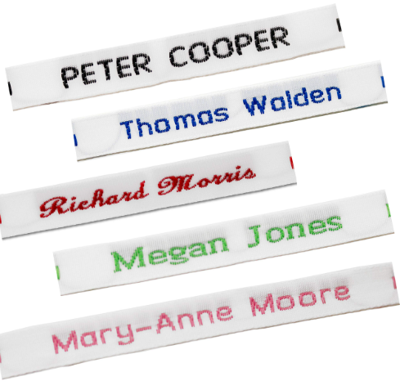
Getting school ready
The school uniform is as follows:
Blue Wimboldsley Jumper or Cardigan
Grey/Black Skirt or Trousers/Shorts
White/Blue Polo Shirt/Blouse
Blue Gingham Summer Dress
Black School Shoes (no trainers)
PE KIT – Drawer Sting PE Bag (we will let you know when this is needed)
Blue Wimboldsley T-Shirt
Black Shorts
Black Pumps/Trainers
If the weather is cold then children can bring tracksuits for PE lessons
Children should not wear nail varnish or jewellery except watches (not Smart watches) and stud earrings, which must be removed on PE days.
Extras:
Wallet School Book Bag
Water Bottle -water only
Our school uniform is available from: Clever Cloggs, Wheelock Street, Middlewich, CW10 9AE Telephone: 01606 835712
My Clothing - https://myclothing.com/wimboldsley-community-primary-school/7174.school
NAME LABELS ON EVERYTHING

Slide 11
Getting ready: Summer learning
Name writing
Using a knife and fork independently
Zipping up a coat
Sharing a story
Simple counting to 10 forwards and backwards
Going to the toilet independently
Establish a good routine
Talking about starting school with lots of excitement
Library packs available from your local library
Your child has a summer learning bag to take home with you tonight

Slide 12



Slide 13
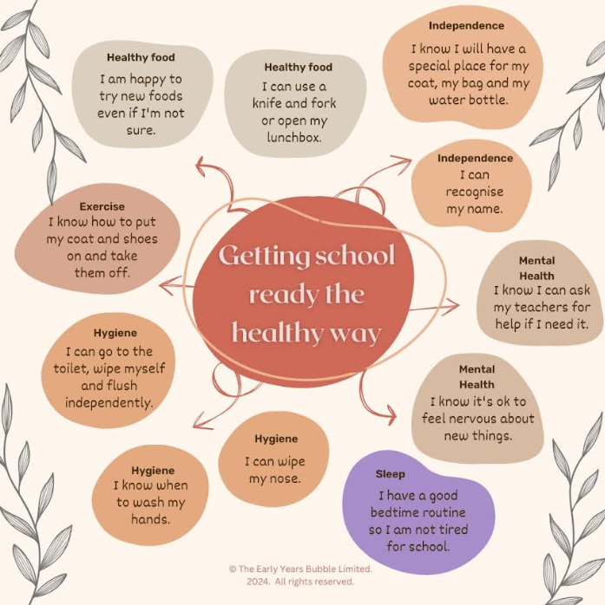

Slide 14
Pupil premium
Implications of the free school meals expansion on pupil premium
From the start of the 2026 to 2027 academic year, the Department for Education (DfE) is delivering an expansion to FSM eligibility to include all pupils from households in receipt of Universal Credit. There will then be 2 categories of FSM:
Targeted FSM, which continues to be based on the existing £7,400 income threshold
Expanded FSM, which will apply to meals only, covering pupils who do not qualify for Targeted FSM, but who are in households in receipt of Universal Credit
Purpose
The pupil premium grant provides funding to improve educational outcomes for disadvantaged pupils in state-funded schools in England.
Pupil premium is not a personal budget for individual pupils, and schools do not have to spend pupil premium so that it solely benefits pupils who meet the funding criteria. It can be used:
to support other pupils with identified needs, such as those who have or have had a social worker, or who act as a carer
for whole class interventions which will also benefit non-disadvantaged pupils
If

Slide 15

Safeguarding
School times:
8:30: Gates open, pupils can start arriving from this time
8:45: Register is taken, and morning session begins for all children in Acorn and Hazel classes
8:50: Gates close, register is taken, and morning session begins for all children in Horse Chestnut, Willow and Oak classes
3:15: End of the day for Acorn and Hazel class
3:20: End of the day for all children in Horse Chestnut, Willow and Oak classes.
Punctuality
Photograph permission
Drop off at the gate
Home time collection
First aid:
Please ensure you have accurately completed your data collection sheet
Please keep us updated!
Food allergies and intolerances
Edesential catering form to be completed asap

Slide 16

PTA

Slide 17
Transition 2026
Thursday 18th June 2026 17:00 pm | Welcome Meeting - Parents/Carers only in the school hall
Thursday 2nd July 15:40pm- 16:00pm | EYFS Open Classroom Parents/Carers to attend with children for ‘stay and play’ session. Siblings welcome
Thursday 9th July 15:40pm- 16:00pm | EYFS Open Classroom Parents/Carers to attend with children for ‘stay and play’ session. Siblings welcome
Thursday 16th July 2026 15:40pm- 16:00pm | EYFS Open Classroom Parents/Carers to attend with children for ‘stay and play’ session. Siblings welcome
Friday 10th July 2026 at 11:00am - 11:40am | EYFS Teddy Bears Picnic 2 Parents/Carers invited to attend with children. Don’t forget your teddy bear! School will provide some light snacks.
Friday 17th July 2026 14:00pm - 15:00pm | EYFS Classroom Visit Unaccompanied, children to be dropped off and collected from school gates.
Wednesday 22nd July 2026 lunchtime | School closes for summer break - Please ensure summer learning bags have been collected from the school office.
Thursday 3rd September 2026 9:00am - 11am | First Day at School Morning visit, unaccompanied
Friday 4th September 2026 9:00am - 12:15pm | Morning and Lunch at School
Monday 7th September 2026 8:45am - 15:10pm | Full time at school Drop off at school gates, collect from classroom at home time.
One size does not fit all, we will make adaptions for your individual child where needed.

Slide 18

Thank you so much for your time this evening
Contact details for school:
01606 832321
admin@wimboldsley.cheshire.sch.uk
https://www.wimboldsleyprimaryschool.co.uk/

