Slide 1
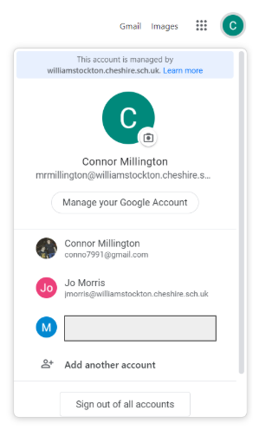
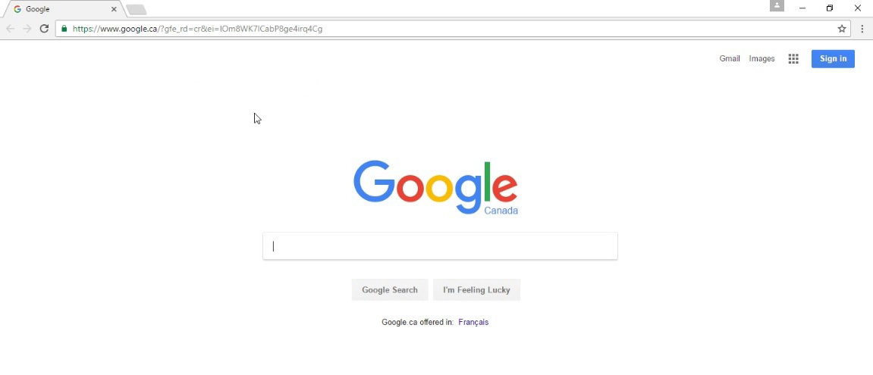
Step 1: You need to sign in to Google.
First, open Google Chrome homepage.
If you have not created an account already, click here.
This will be where account options are found. (Top right of Google Screen).
To add another account, click here.

Slide 2
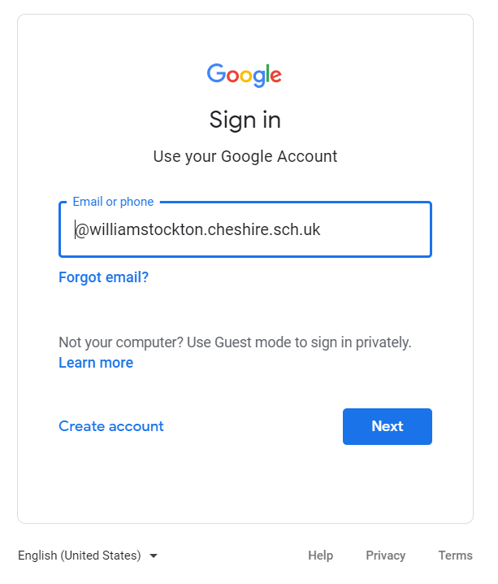
Your child will have their own William Stockton login:
All logins will have this at the end of their address.
Example login:
JohnS@williamstockton.cheshire.sch.uk

Slide 3
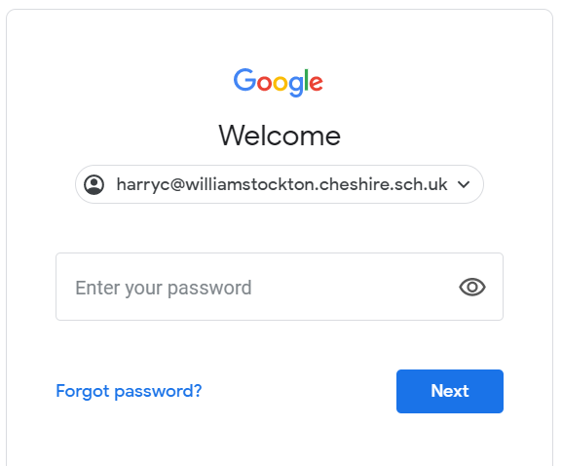
After inputting the email address...
Your child will have their very own password.
This goes here.
If you would like the text that you type to be visible, click here.

Slide 4
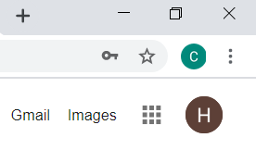
Success?
You’ll know that you’ve successfully logged in if you see an initial here. (Top right corner)

Slide 5
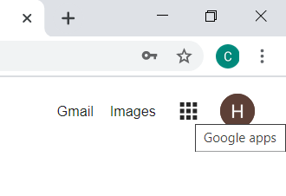
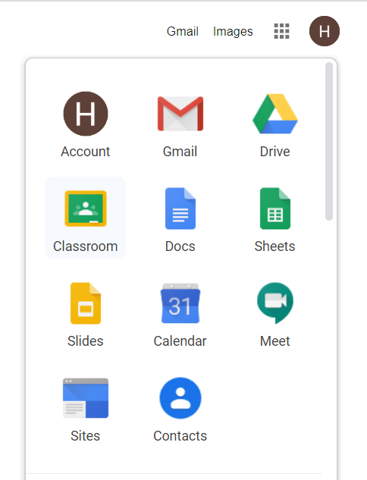
Step 2: Find your classroom...
Next to your initial, you will need to click on the Google apps button.
Here is where you can click on the ‘Classroom’ app.

Slide 6
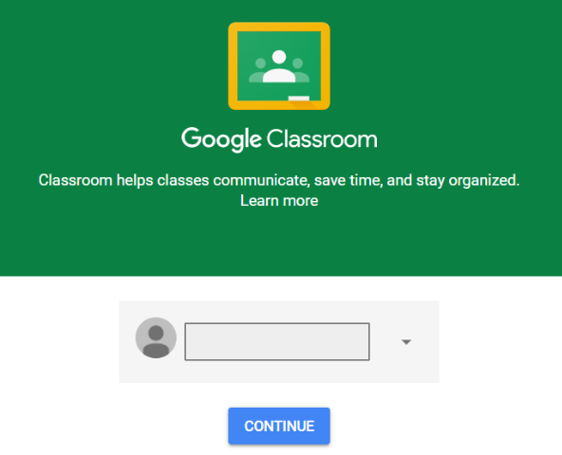
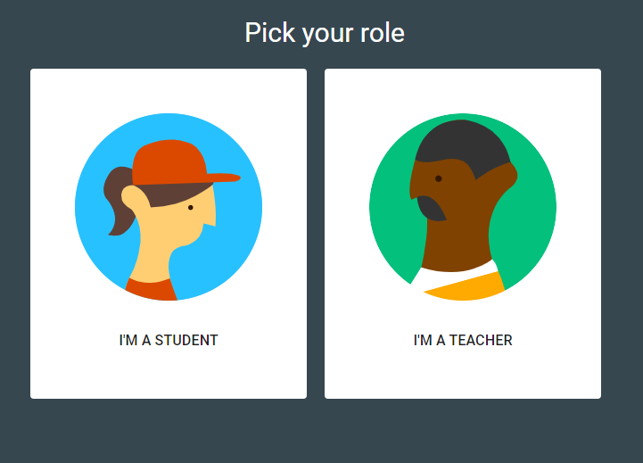
Step 3: You’re in!
Then click, ‘I’M A STUDENT’
Name hidden.
Click continue...

Slide 7
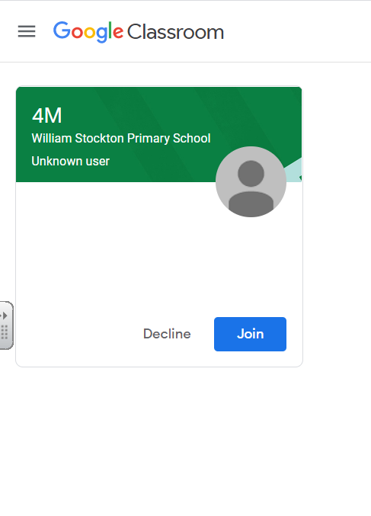
Step 4: Join the class! - ‘Accept the invitation’
Teachers will receive notification that you have successfully joined the classroom.
Then click ‘Join’.
If you are struggling to do this, there is a unique code that your teachers have sent to you...

Slide 8
Step 4: Join the class! -

Slide 9
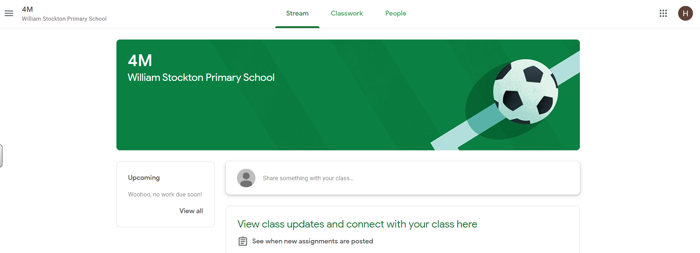
Your display will look like this.
Please frequently check the page for set work.

