Slide 2
Aim
Measure, compare, add and subtract capacity (l/ml).

Slide 3

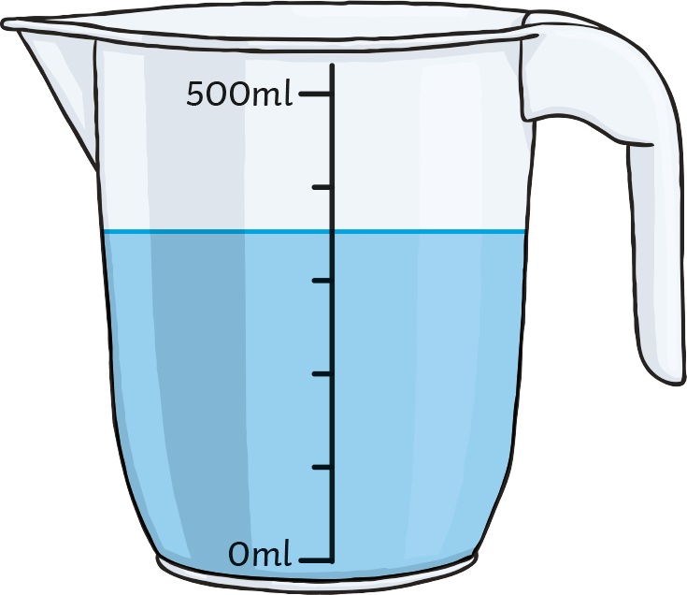
Measure Capacity in Millilitres or Litres
Diving
Intervals on Scales
What is each
interval worth?
What is the capacity of the container?
What is the
volume of liquid in the container?

Slide 4
Measure Capacity in Millilitres or Litres
Diving
Intervals on Scales
What is each interval worth?
There are 5 intervals between
0 and 500ml.
500 ÷ 5 = 100
Each interval is worth 100ml.
What is the capacity of the container?
The capacity of a container is the maximum amount of liquid it could hold.
The capacity of this container is 500ml.
What is the volume of liquid in the container?
The liquid covers 3 full intervals and half of the fourth interval.
3 × 100 = 300
½ of 100 = 50
300 + 50 = 350
The volume of liquid is 350ml.

Slide 5

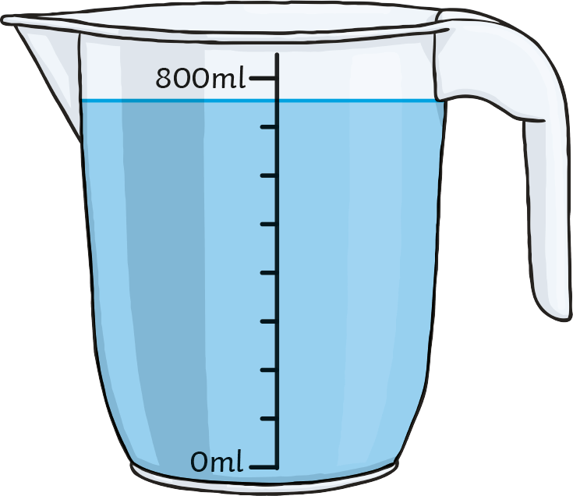
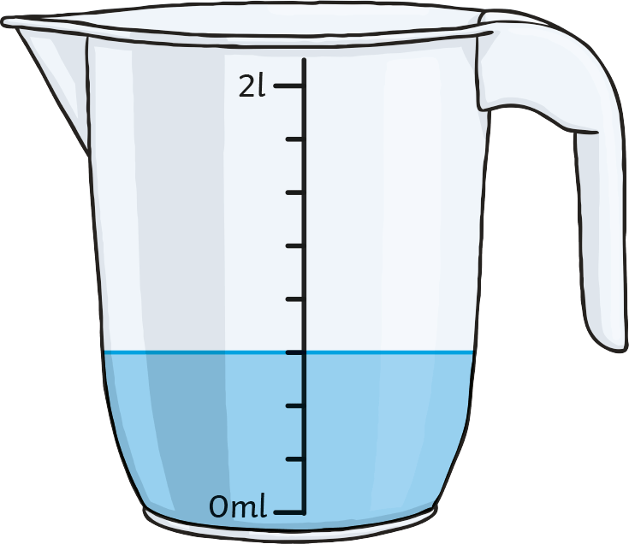
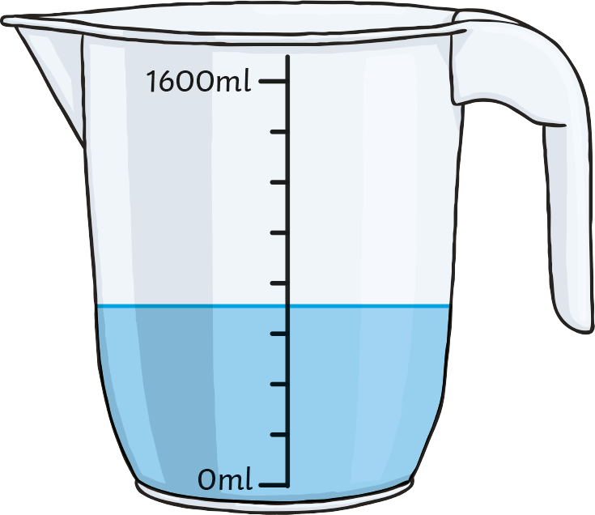
Measure Capacity in Millilitres or Litres
Deeper
Odd One Out
One container holds a different volume of water to the rest. Which one is it?

Slide 6
Measure Capacity in Millilitres or Litres
Deeper
Odd One Out
One container holds a different volume of water to the rest. Which one is it?
Each interval is worth 100ml.
The volume of liquid is seven intervals and one half interval.
The volume is 750ml.
Each interval is worth 250ml.
The volume of liquid is
three intervals.
The volume is 750ml.
Each interval is worth 200ml.
The volume of liquid is three intervals and one half interval.
The volume is 700ml.
The third container holds a different volume of water.

Slide 7

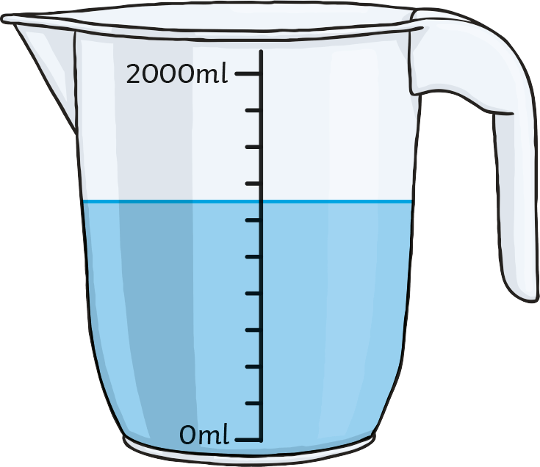
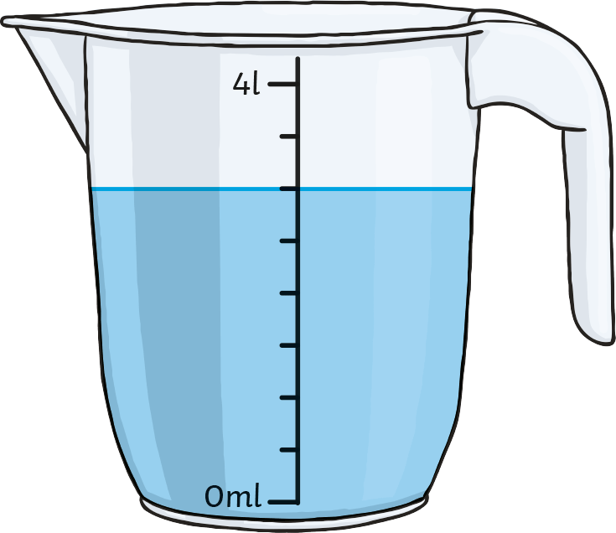
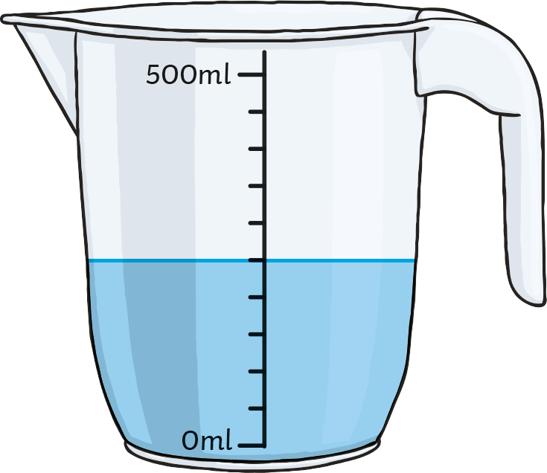
Measure Capacity in Millilitres or Litres
Deepest
Work It Out!
Which container is each child describing?
Container A
Container B
Container C
Sarah says, “My container has a capacity of more than 1 litre. It is three-quarters full.”
Codey says, “The volume of liquid in my container is exactly half the capacity.”

Slide 8
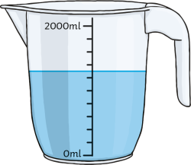
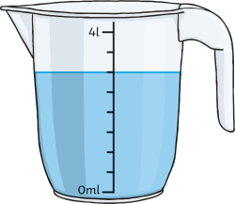
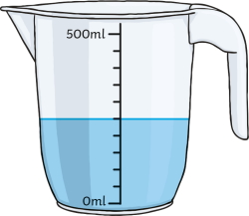
Measure Capacity in Millilitres or Litres
Deepest
Work It Out!
Which container is each child describing?
Container A
Container B
Container C
Sarah says, “My container has a capacity of more than 1 litre. It is three-quarters full.”
Codey says, “The volume of liquid in my container is exactly half the capacity.”
Containers A and B have a capacity greater than 1 litre.
Container B holds a volume of 3l, which is three quarters of 4l.
Sarah is describing container B.
Codey’s container must be half full. Container C has a volume of 250ml, which is half of its capacity of 500ml.
Codey is describing container C.

Slide 9
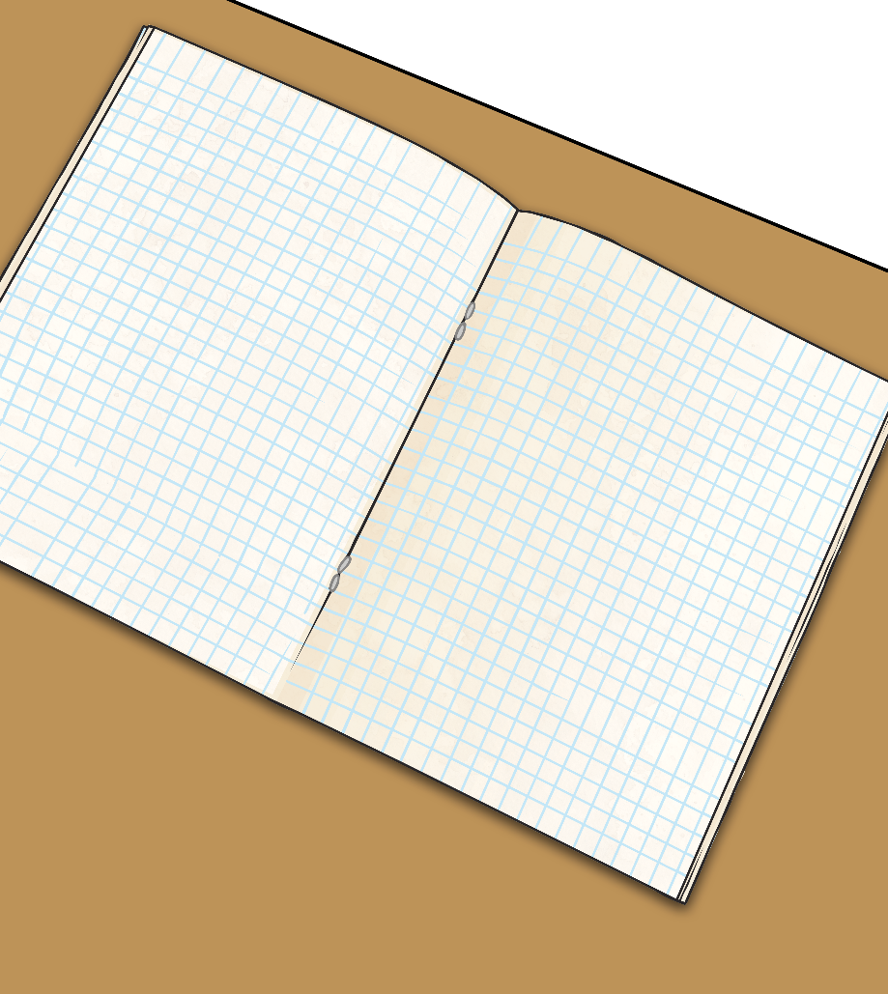

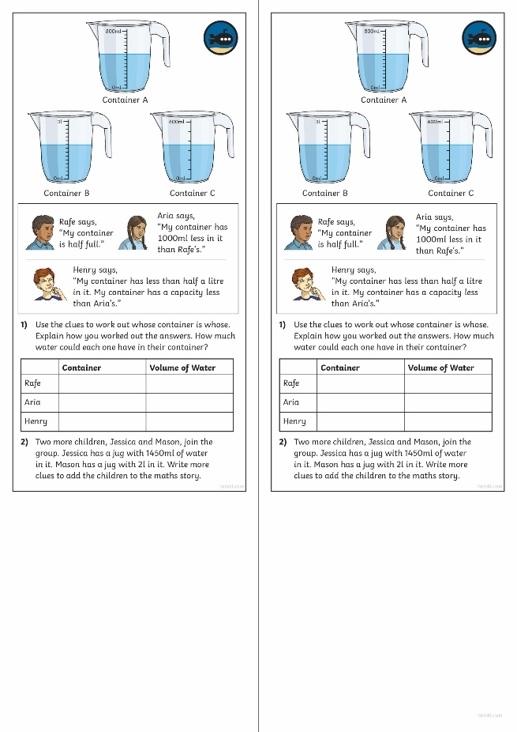
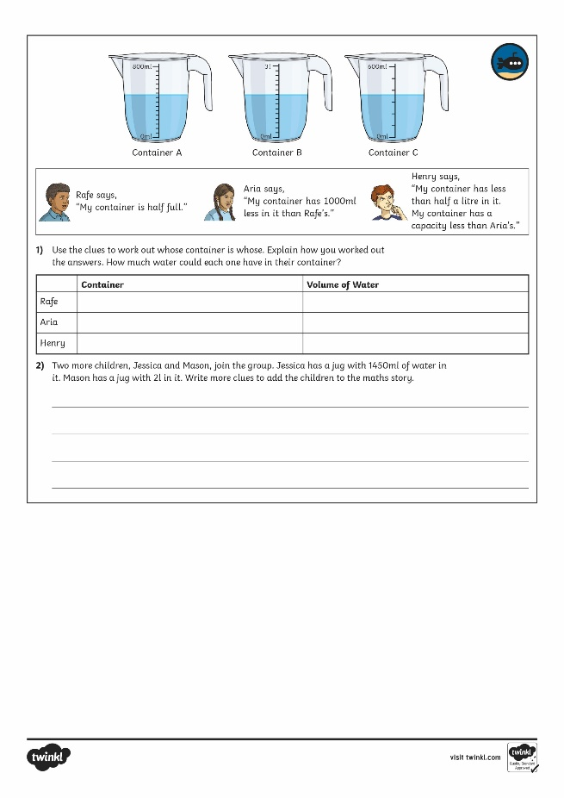
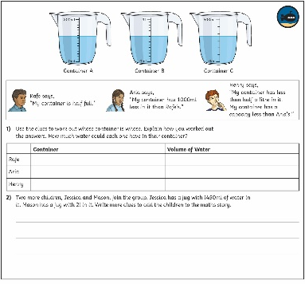
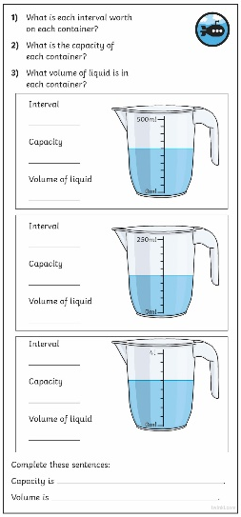
Measure Capacity in Millilitres or Litres
Dive in by completing your own activity!

