Slide 2
Aim
Measure, compare, add and subtract mass (kg/g).

Slide 3

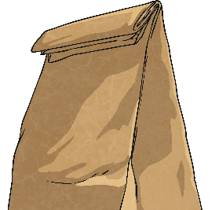
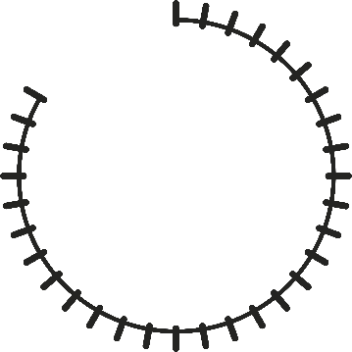

Add and Subtract Mass
Diving
What’s Left?
Aria works at the zoo. She bought a bag of food with a mass of 1kg 500g.
How much food is left?
Each interval is worth 50g. The pointer is showing 3 and a half intervals less than 1kg. 3 × 50 = 150 and ½ of 50 = 25.
150 + 25 = 175. 1000 - 175 = 825
There are 825g left.
How much food did Aria use?
0kg
1.5kg
1kg 500g is 1500g.
1500 - 825 = 675
Aria used 675g of food.

Slide 4
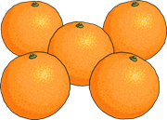
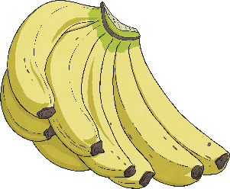
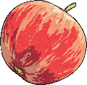
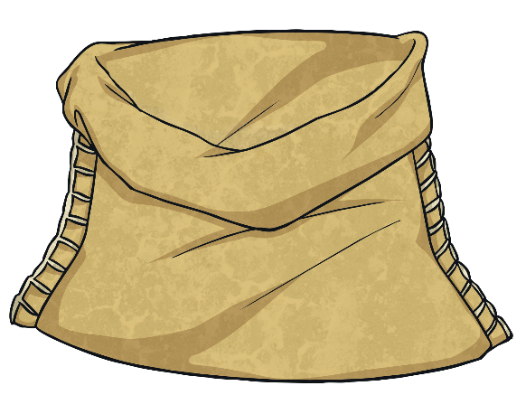


Add and Subtract Mass
Diving
What’s the Total?
Quinn put this leftover fruit into a bowl.
1kg 150g
1kg 90g
260g
What is the total mass of the fruit in the bowl?
1150
1090
+ 260
2500
1kg 150g is 1150g.
1kg 90g is 1090g.
1kg is 1000g so 2500g is 2kg 500g.
The total mass is 2kg 500g.

Slide 5

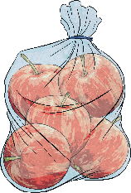

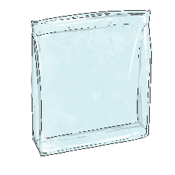



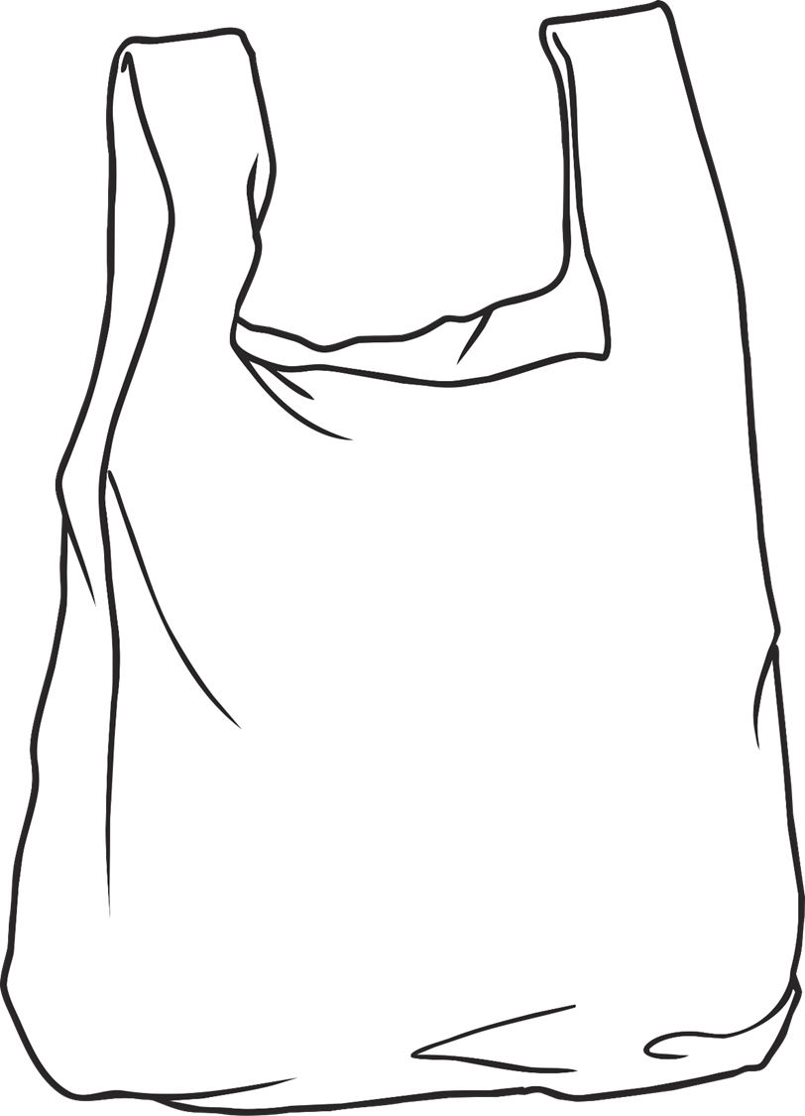
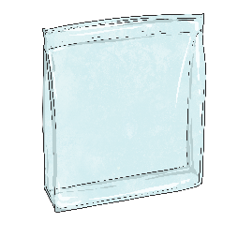














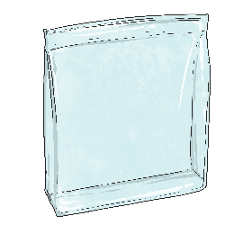






Add and Subtract Mass
Deeper
Too Much?
A bag can hold a mass of 3kg.
1kg 750g
1kg 200g
300g
Which combinations will break the bag and which will be OK?
1kg 200g + 1kg 200g = 2kg 400g
That is less than 3kg.
The bag will be OK.
1kg 750g + 1kg 200g = 2kg 950g
That is less
than 3kg.
The bag will be OK.
5 × 300g = 1500g
1kg 500g + 1kg 750g = 3kg 250g
That is more
than 3kg.
The bag will break.
3 × 300g = 900g
900g + 1kg 750g = 2kg 650g
That is less
than 3kg.
The bag will be OK.

Slide 6


















Add and Subtract Mass
Deeper
Too Much?
A bag can hold a mass of 3kg.
1kg 750g
1kg 200g
300g
Are there any combinations that
total exactly 3kg?
?
2 × 1200 = 2400
3000 - 2400 = 600
600 ÷ 300 = 2
2 bunches of bananas and 2 bags of oranges have a mass of 3kg.
?
?
3000 - 1200 = 1800
1800 ÷ 300 = 6
1 bunch of bananas and 6 bags of oranges have a mass of 3kg.
10 × 300g = 3000g
10 bags of oranges have a mass of 3kg.

Slide 7


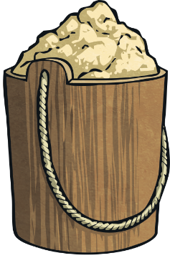





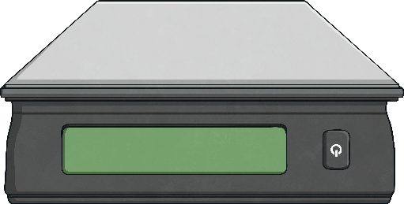
Add and Subtract Mass
Deepest
Work It Out!
Seb has forgotten to label the mass of the smaller bags.
Use the information shown to work out the mass of the smaller bags on each scale.
1kg
1kg
250g
1kg
250g
1¼kg
1kg = 1000g
¼kg is 1000g ÷ 4 = 250g
2000 - 1250 = 750
750 ÷ 3 = 250
Each smaller bag has a mass of 250g.
1kg = 1000g
2500 - 1000 = 1500
1500 ÷ 2 = 750
Each smaller bag has a mass of 750g.
2 × 1250 = 2500
3400 - 2500 = 900
900 ÷ 2 = 450
Each smaller bag has a mass of 450g.

Slide 8
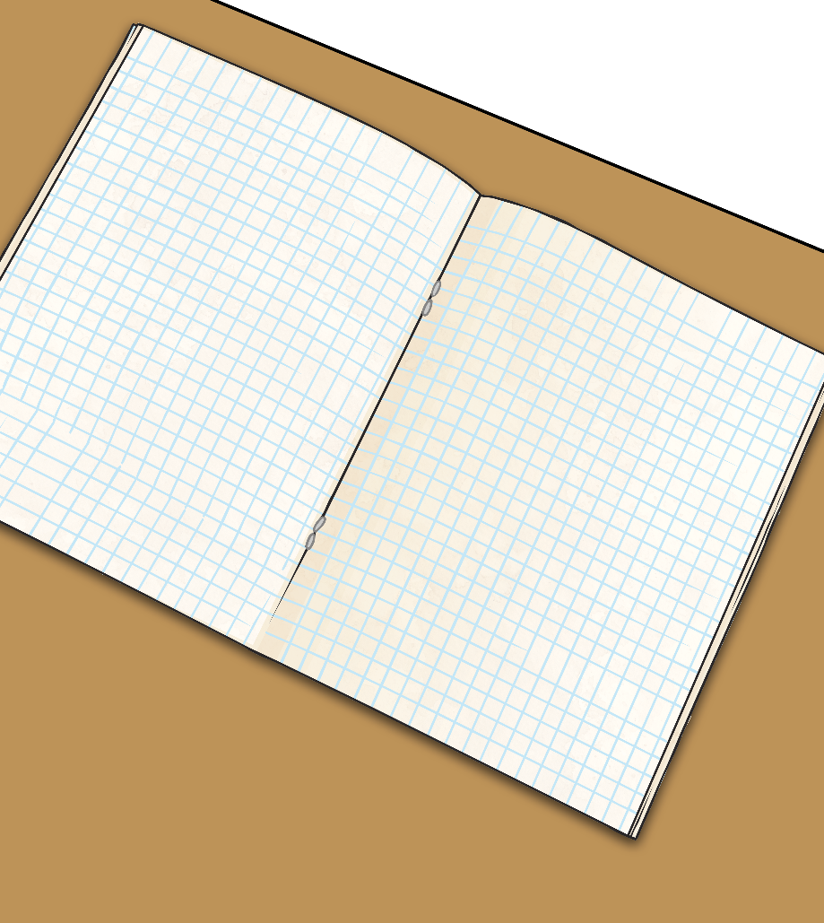
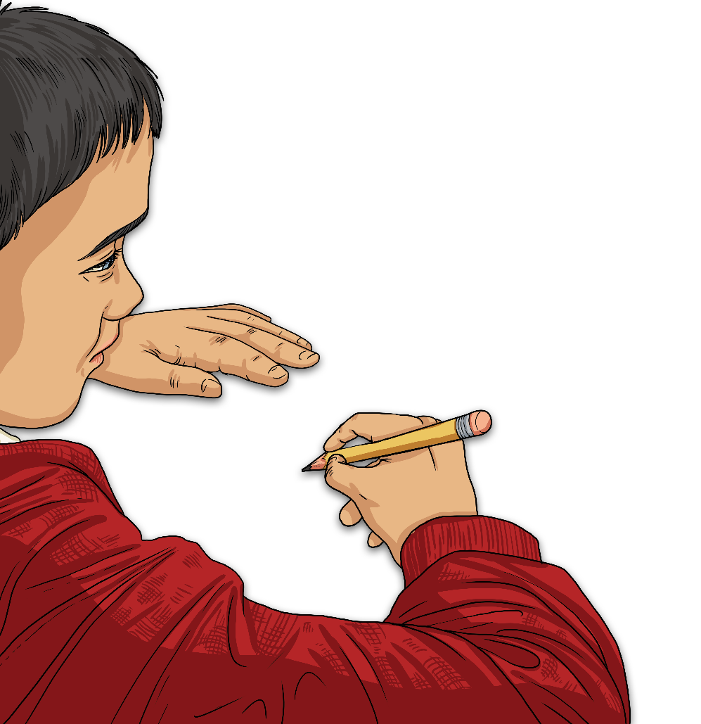
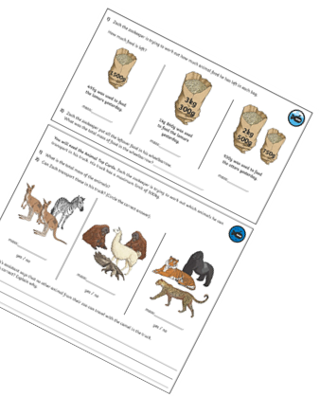
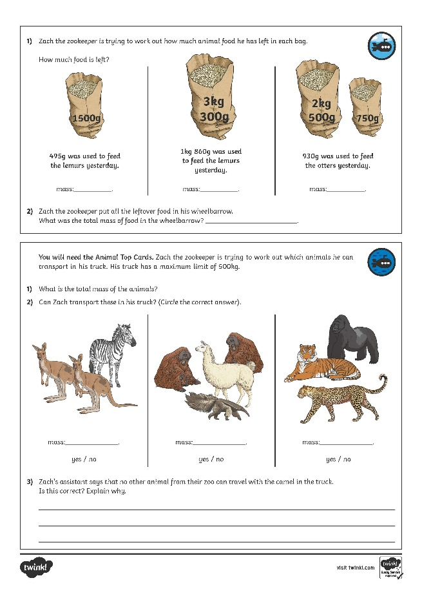
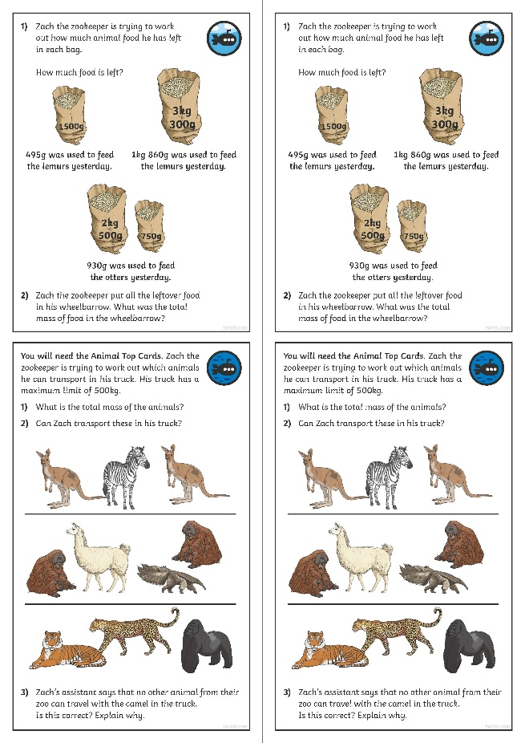
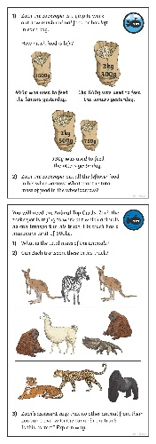
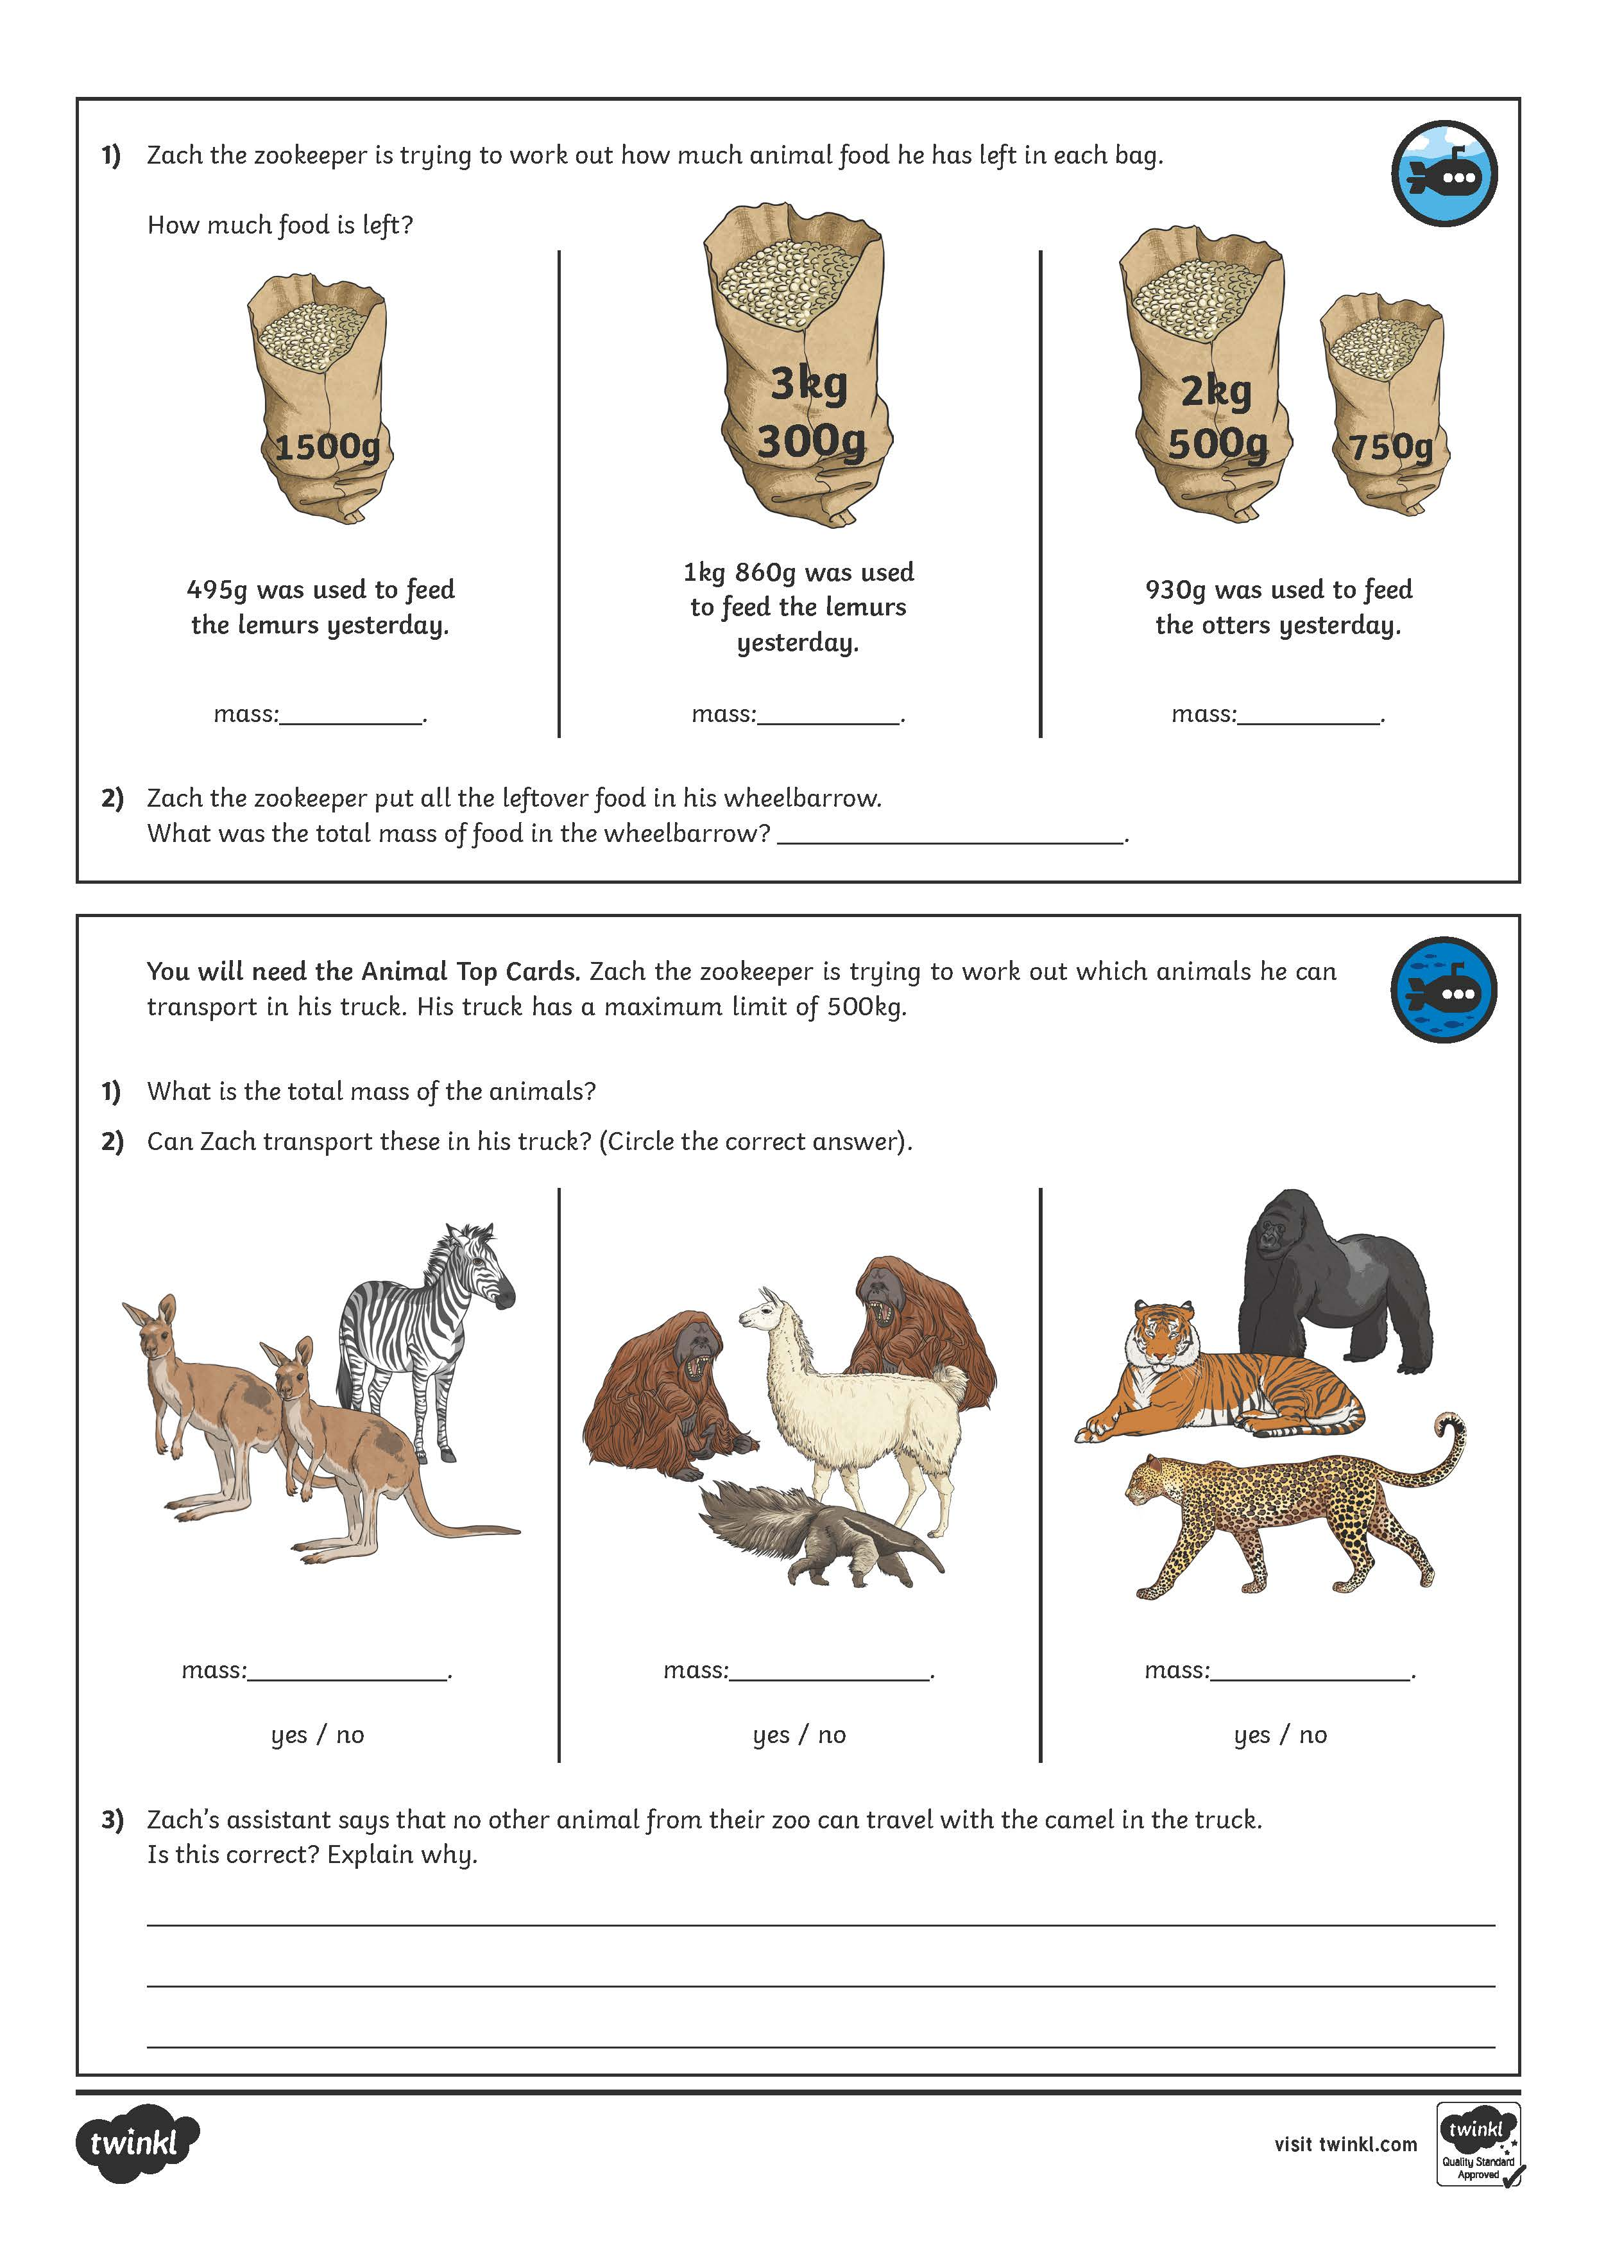
Add and Subtract Mass
Dive in by completing your own activity!

