Slide 2
Use <, > or = to complete these statements.
National Curriculum Objective(s)
Measure, compare, add and subtract mass (kg/g).

Slide 3

Compare Mass
Diving
Comparing Mass
Use <, > or = to complete these statements.
250g
250kg
1000g
1kg
2½kg
2400g
¾kg
600g
1kg 50g
1050g

Slide 4
Compare Mass
Diving
Comparing Mass
Use <, > or = to complete these statements.
< means ‘is less than’ or ‘is lighter than’.
> means ‘is greater than’ or ‘is heavier than’.
= means ‘is equal to’ or ‘is the same mass as’.
250g
<
250kg
Grams are lighter than kilograms.
1000g
=
1kg
1kg is the same as 1000g.
2½kg
>
2400g
2½kg is 2kg and 500g or 2500g.
Therefore, it is heavier than 2400g.
¾kg
>
600g
¾ kg is 750g, which is heavier than 600g.
1kg 50g
=
1050g
1kg 50g is 1000g + 50g, which is the same as 1050g.

Slide 5

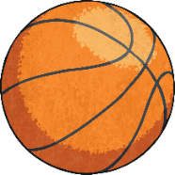

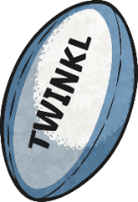

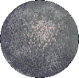
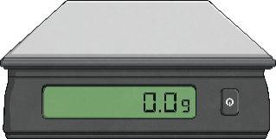
Compare Mass
Diving
Ordering by Mass
Sort these objects in order of mass from the lightest to heaviest.
625g
7kg 100g
58g
½kg
7¼kg

Slide 6

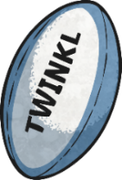



Compare Mass
Diving
Ordering by Mass
First, convert each mass to grams.
625g
7kg 100g
58g
7100g
½kg
7¼kg
500g
7250g
58g
500g
625g
7100g
7250g
Next, order those measurements from lightest to heaviest.
58g
625g
500g
7100g
7250g
Finally, match the objects to the newly ordered measurements.

Slide 7
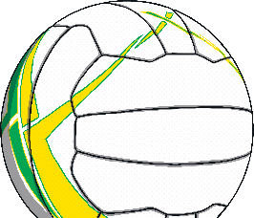
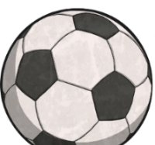

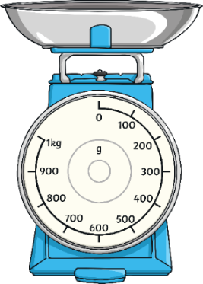
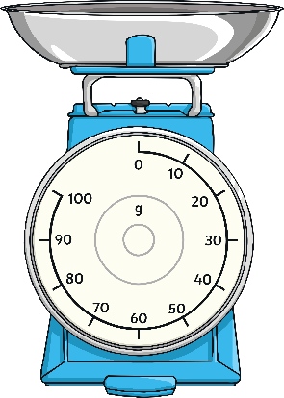
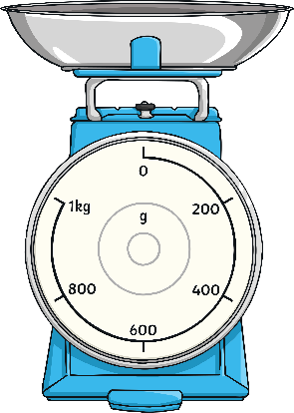



Compare Mass
Deeper
Who Do You Agree With?
Aasim, Howard and Emma are weighing different types of ball.
Which statements do you agree with? Explain why.
Explain what is wrong with any incorrect statements.
6kg
6kg
Aasim says, “The netball is lighter than the football because 450g is less than 500g.”
This is incorrect. Emma hasn’t looked at the units used. The football is 500g but the bowling ball is 6kg. 6kg is the same as 6000g.
Howard says, “The golf ball and the netball have the same mass because the pointer is at the same place for each ball.”
Howard says, “The golf ball and the netball have the same mass because the pointer is at the same place for each ball.”
Emma says, “The football is heavier than the bowling ball because 500 is greater than 6.”
Emma says, “The football is heavier than the bowling ball because 500 is greater than 6.”
Howard is incorrect. The intervals are different on the scales. The golf ball is 45g and the netball is 450g.
Aasim is correct.

Slide 8

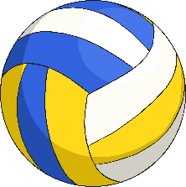
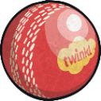

Compare Mass
Deepest
Who Do You Agree With?
Use the information shown to work out which sport each person plays.
Mila, Gurdeep, Lukas and Daisy are comparing the mass of their sports equipment.
125g
3kg 600g
375g
900g
plays cricket
plays bowling
plays volleyball
plays rugby
Mila’s ball has a mass of 900g.
900 × 4 = 3600
Lukas must play bowling.
Mila uses a ball with a mass between 500g and 2000g.
He must play rugby.
Gurdeep uses a ball with a mass of less than ¼ of 1kg.
¼ of 1kg is 1000 ÷ 4 = 250g. 125g is less than 250g.
Gurdeep must play cricket.
Mila uses a ball with a mass of more than ½kg but less than 2kg.
Gurdeep uses a ball with a mass of less than ¼ of 1kg.
Lukas uses a ball with a mass that is four times the mass of Mila’s ball.
Mila uses a ball with a mass of more than ½kg but less than 2kg.
Lukas uses a ball with a mass that is four times the mass of Mila’s ball.
This means that Daisy plays volleyball.

Slide 9



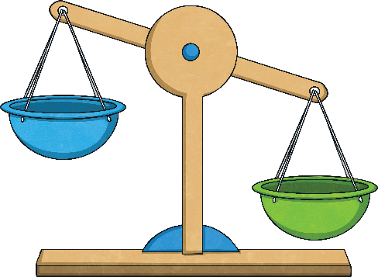
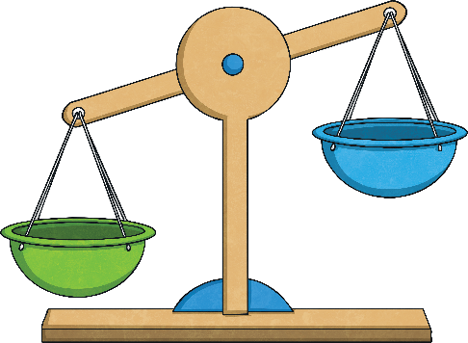
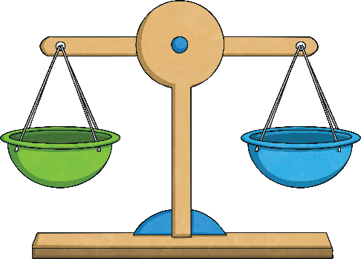





Compare Mass
Deepest
Who Do You Agree With?
These balls are placed onto a balance with some sets of equal weights. What can you say is true about the weights?
150g
600g
300g
Estimate how many weights would balance the scales.
The volley ball has a mass of 300g.
The mass of one weight is between 50g and 60g.
If the weight was 50g, 6 weights would be needed
(300 ÷ 50 = 6).
If the weight was 60g, 5 weights would be needed
(300 ÷ 60 = 5).
Between 5 and 6 weights would be needed to
balance the volleyball.
The ball has a mass of 150g.
The three weights are heavier than the ball.
150 ÷ 3 = 50.
Each weight must be heavier than 50g.
The ball has a mass of 600g.
The ten weights are lighter than the ball.
600 ÷ 10 = 60.
Each weight must be lighter than 60g.

Slide 10
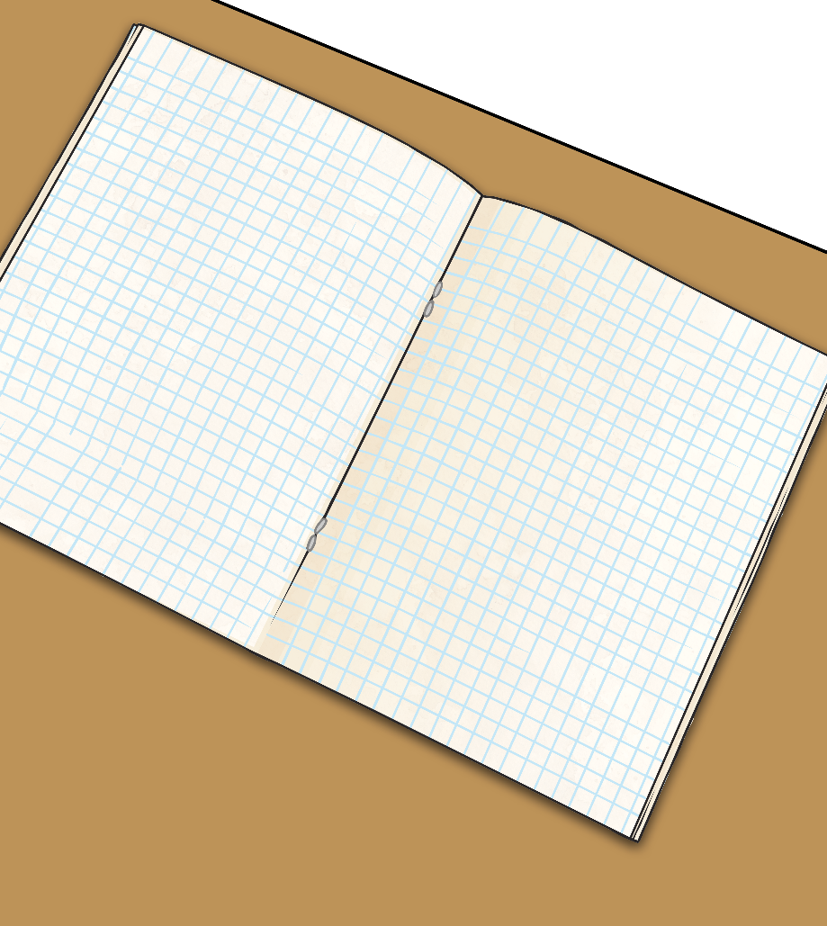
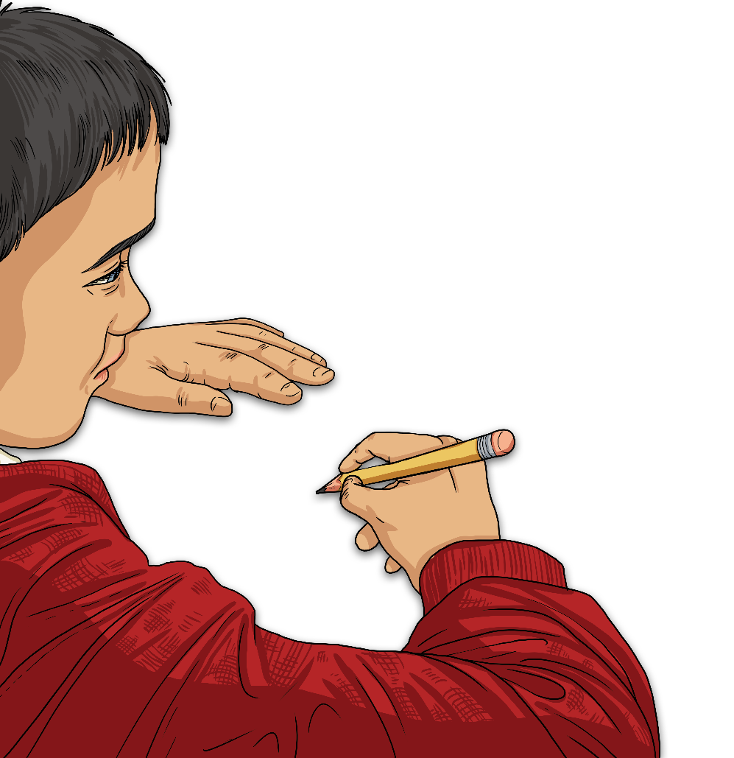
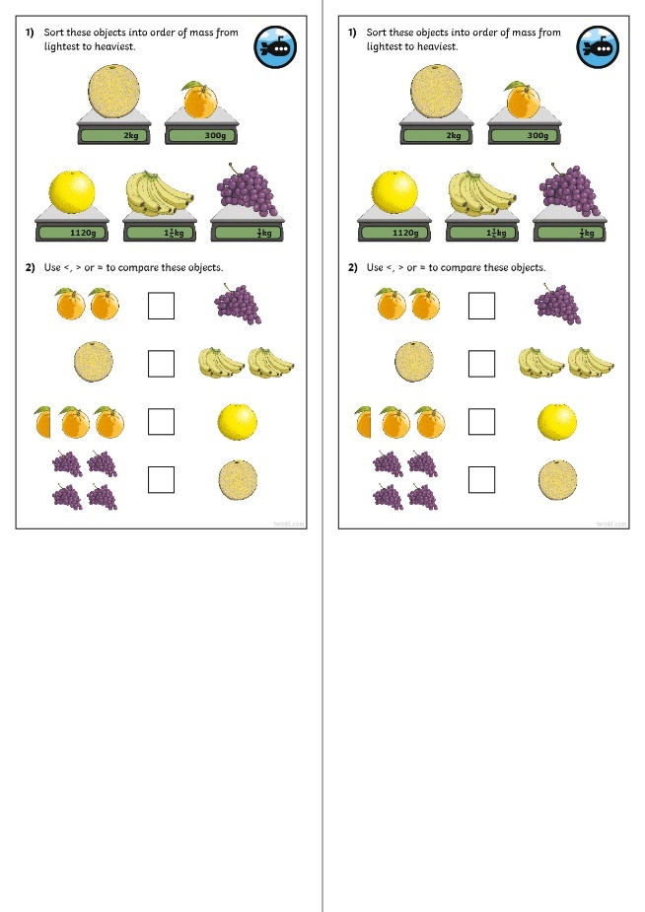
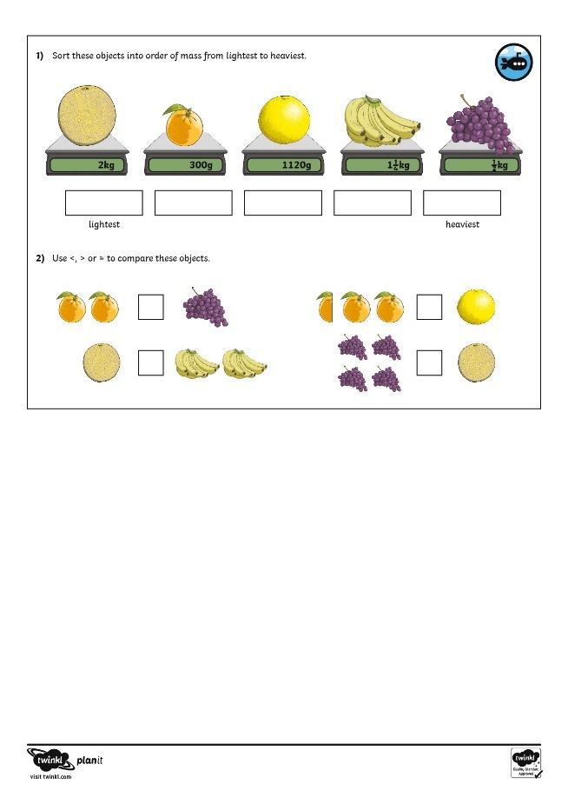

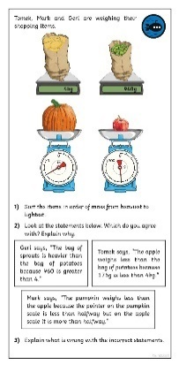
Compare Mass
Dive in by completing your own activity!

