Slide 2
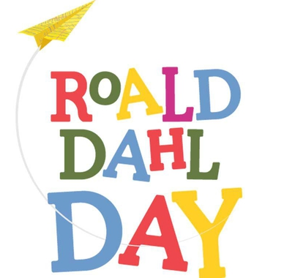
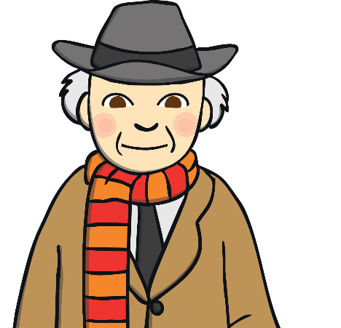
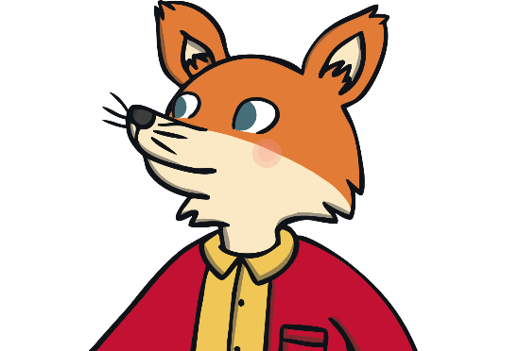
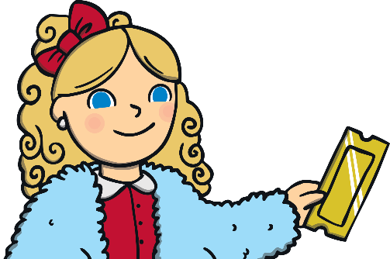
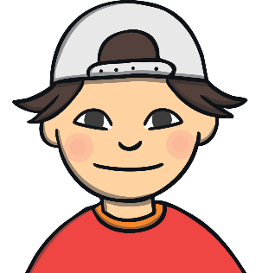
Roald Dahl Day
Who was Roald Dahl?
What type of stories did he write?
Have you read any Roald Dahl books?
What is Roald Dahl Day?

Slide 3
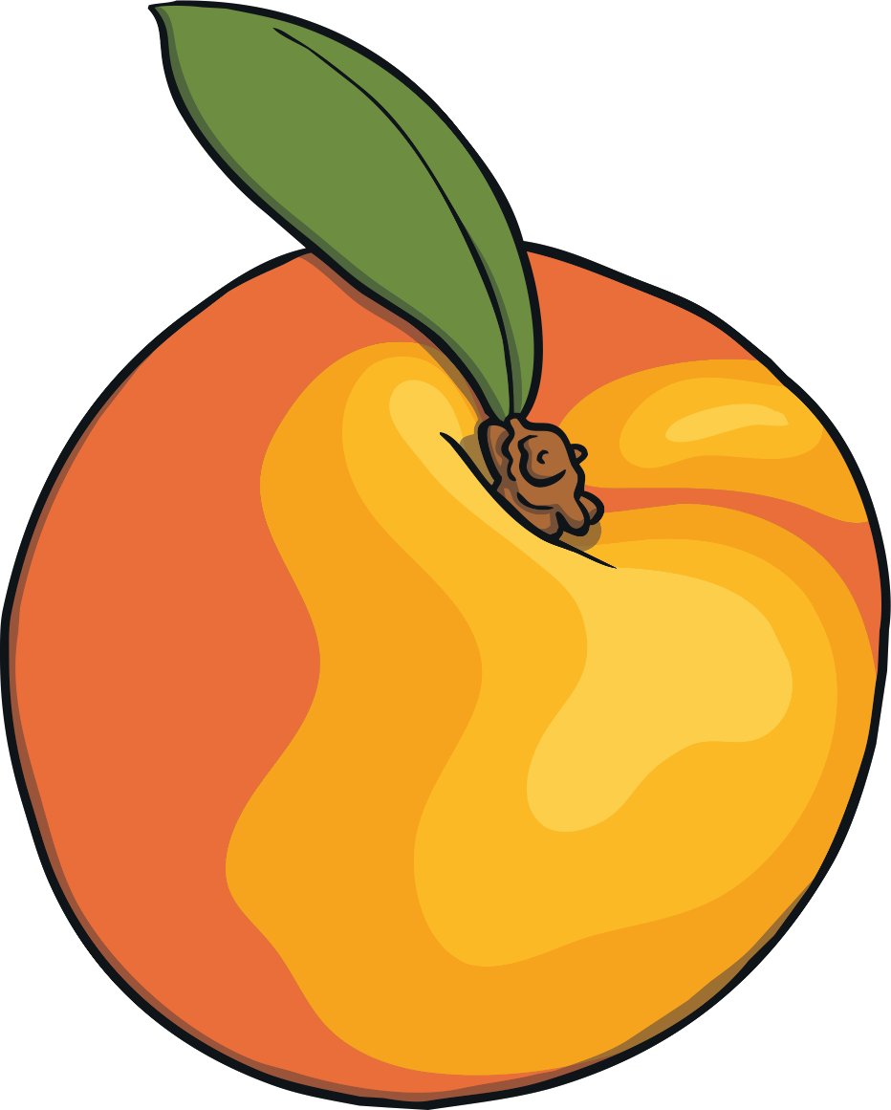
What is Roald Dahl Day?
September is Roald Dahl's birth month and, each year, we celebrate with a wonderful array of events centred around his birthday on 13th September.
2019 is the 13th annual Roald Dahl Day.
Roald Dahl Day events include parties, book readings and in-school celebrations including the Delicious Dress Up Day, held every year towards the end of September in aid of Roald Dahl's Marvelous Children's Charity.
Watch this video of a Roald Dahl Day event.

Slide 4
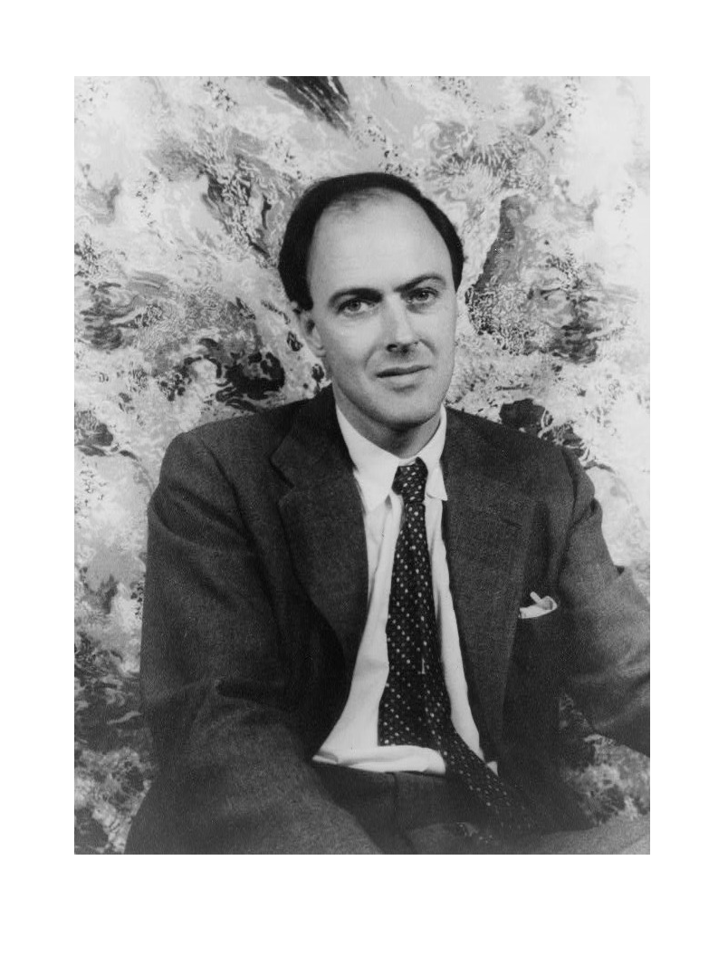
Who was Roald Dahl?
Roald Dahl (13th September 1916 – 23rd November 1990) was a British novelist, short story writer, poet, screenwriter and fighter pilot.
Dahl's short stories are known for their unexpected endings and his children's books for their unusual humour!
His works for children include James and the Giant Peach, Charlie and the Chocolate Factory, Matilda, The Witches, Fantastic Mr Fox, The BFG, George's Marvelous Medicine and The Twits.
His adult books include Tales of the Unexpected and My Uncle Oswald.

Slide 5
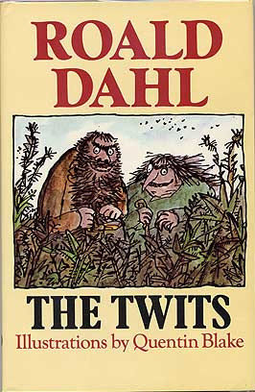
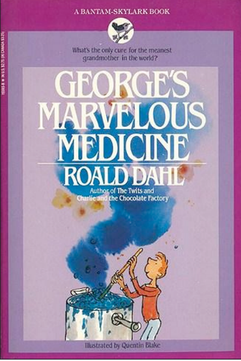
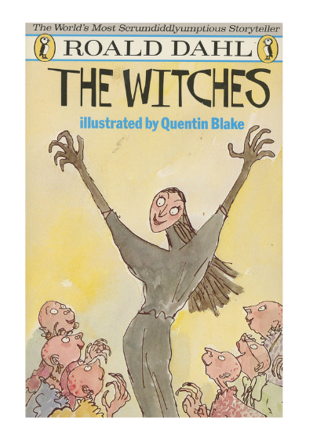
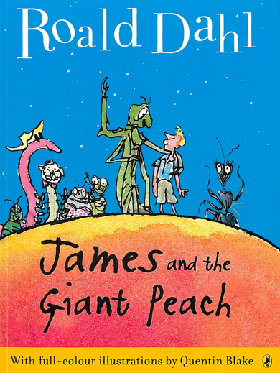
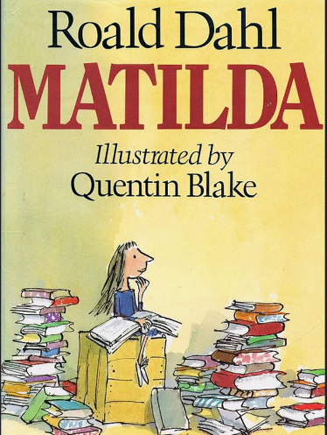
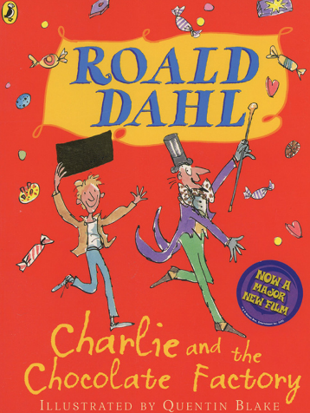
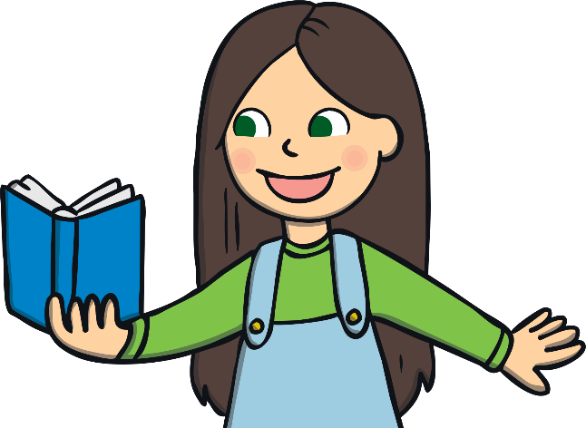
Why was Roald Dahl such a popular author?
Photo courtesy of Jonathan Cape
granted under creative commons licence attribution
Photo courtesy of AnnainCA (@flickr.com)
granted under creative commons licence attribution
Photo courtesy of roalddahl.com granted under creative commons licence attribution
Photo courtesy of Swallace99 (@flickr.com)
granted under creative commons licence attribution Cover Illustration © Quentin Blake
Photo courtesy of waletnatalie (@flickr.com)
granted under creative commons licence attribution Cover Illustration © Quentin Blake
Photo courtesy of Swallace99 (@flickr.com)
granted under creative commons licence attribution Cover Illustration © Quentin Blake

Slide 6
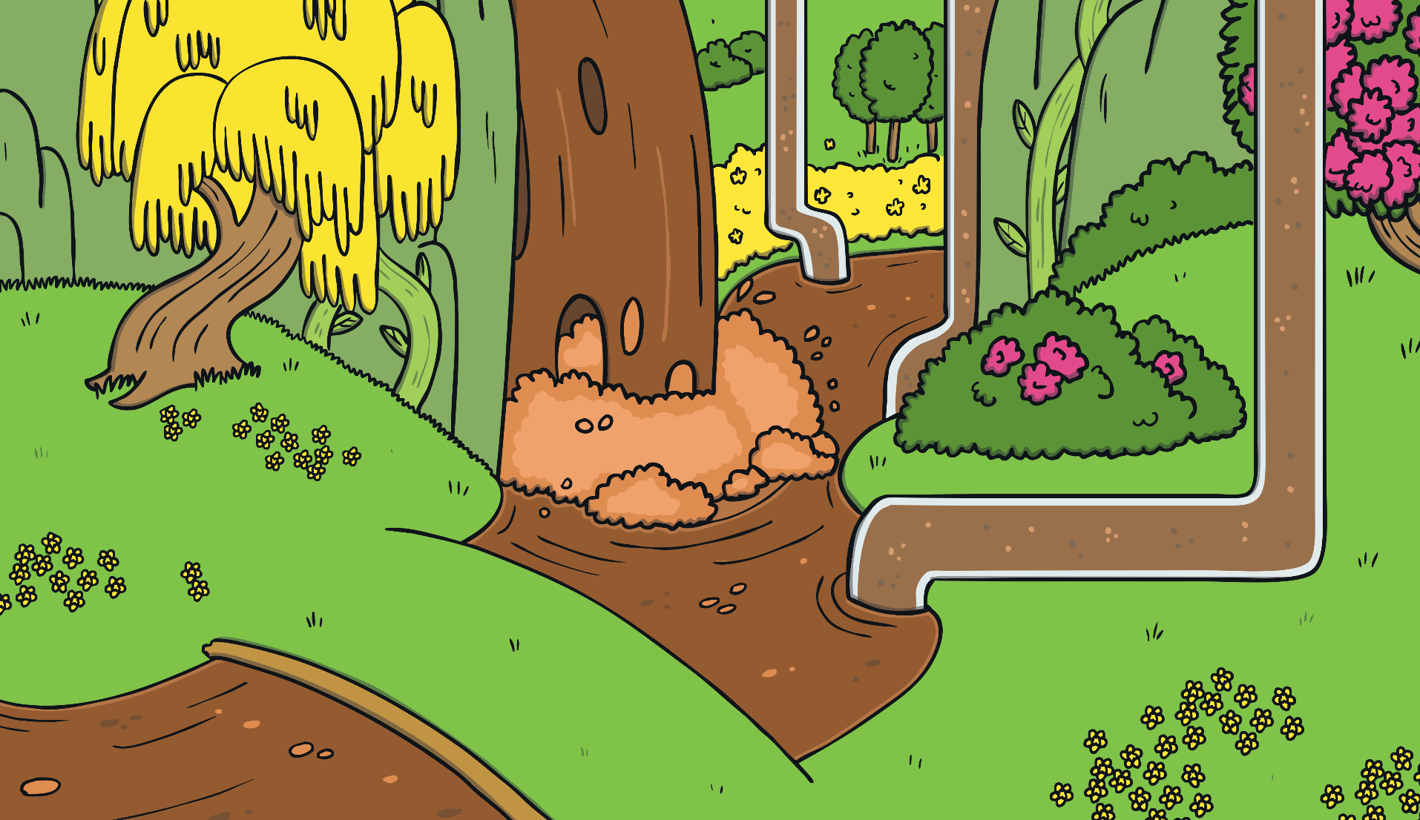
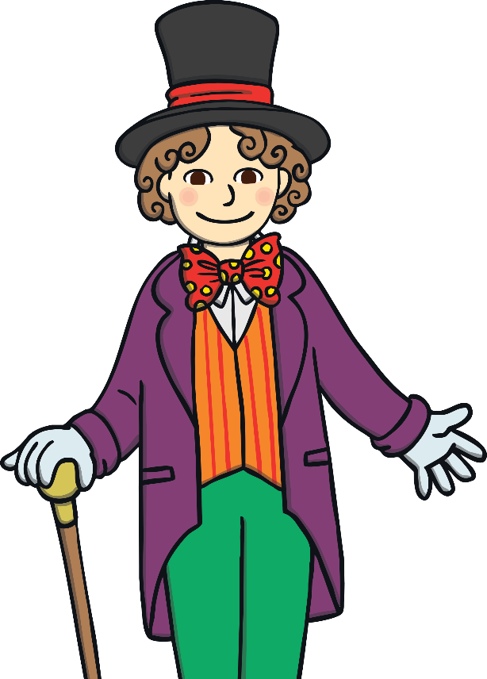
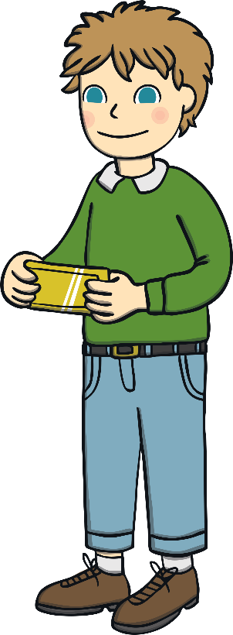
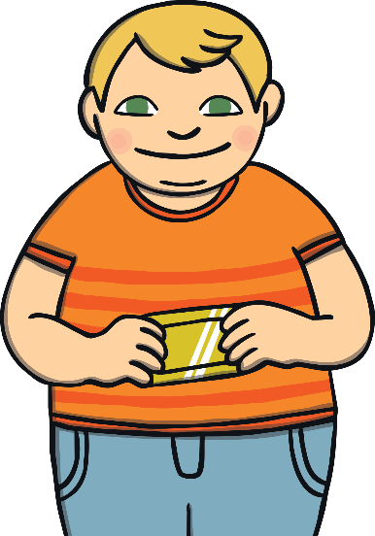
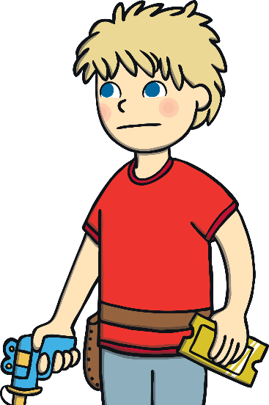
Why was Roald Dahl such a popular author?
His books have been translated into many languages and children from all over the world enjoy them.
His books have unusual names and are full of larger-than-life characters who are sometimes cruel, but they are always full of humour.
Roald Dahl has a unique way of writing children’s books.
Dahl's children's works are usually told from the point of view of a child.
They typically involve adult villains who hate and mistreat children, and feature at least one "good" adult.

Slide 7

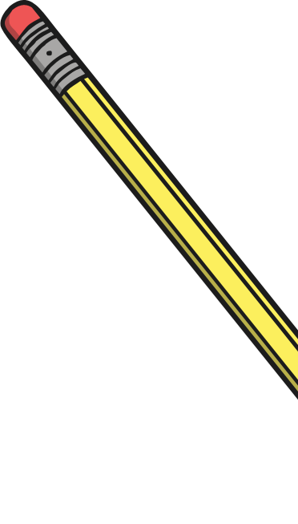

Roald Dahl
The Writer

Slide 8
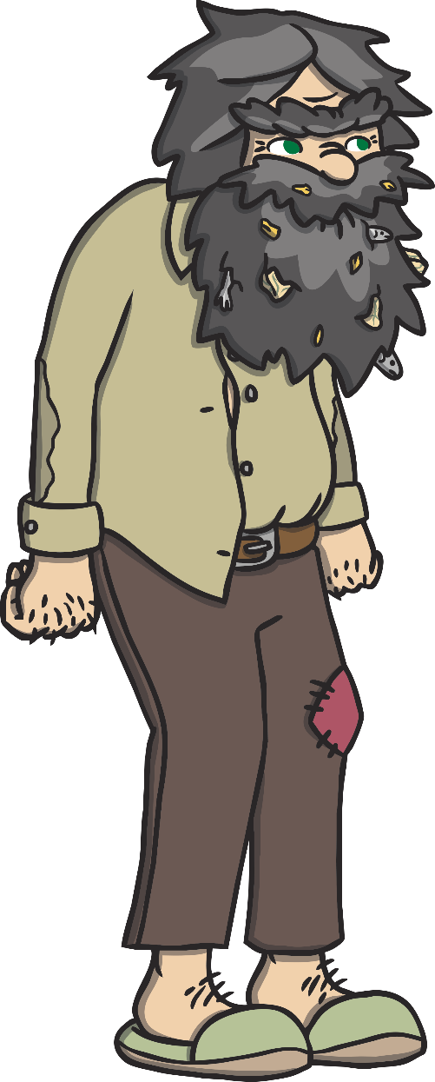
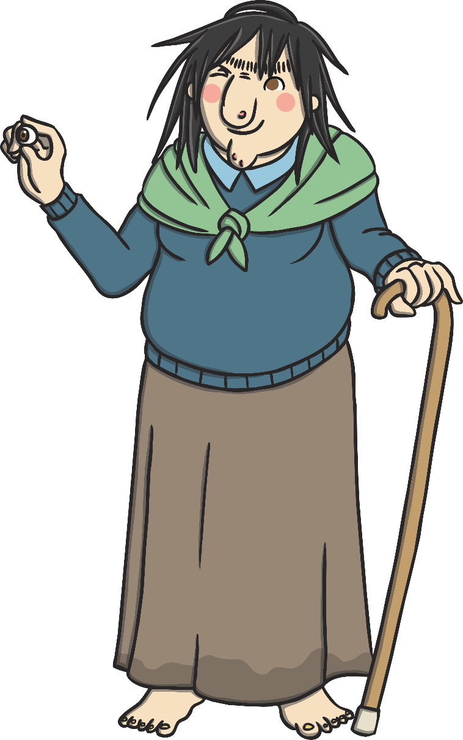
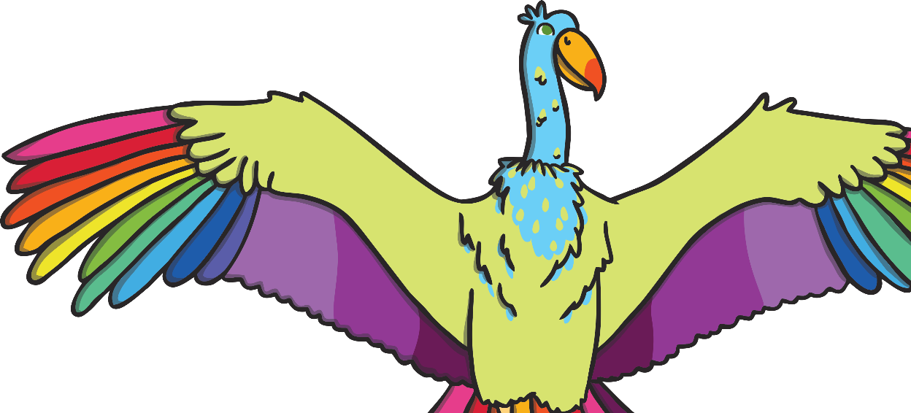
The Twits
Taking a bad situation and making it funny in a story is a great way to make real life things seem less sad.

Slide 9
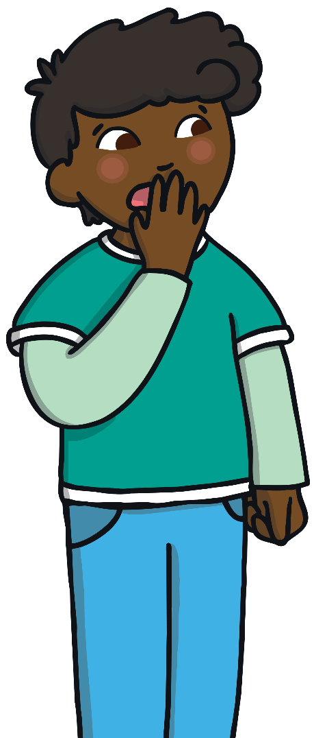
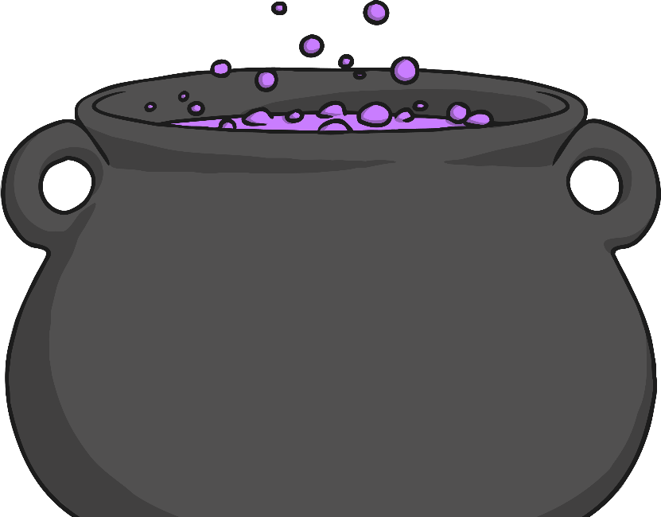
George’s Marvellous Medicine
Mixing up every day items in strange ways in stories can result in all sorts of funny ideas.

Slide 10
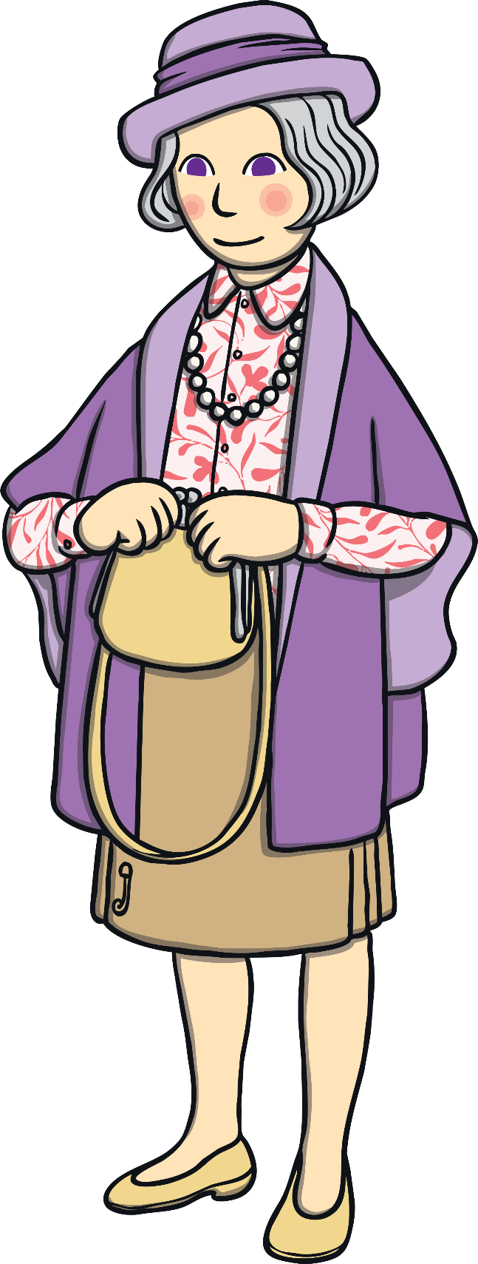
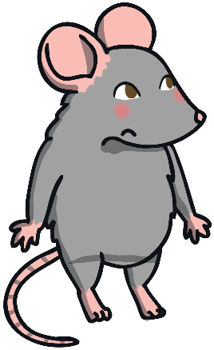
The Witches
Roald Dahl was very good at making normal things mysterious.

Slide 11
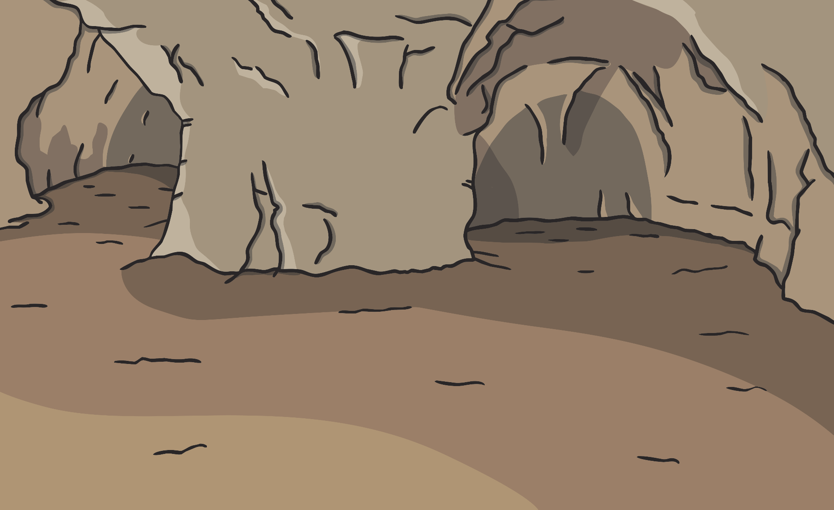
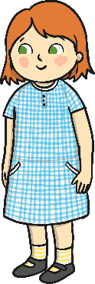
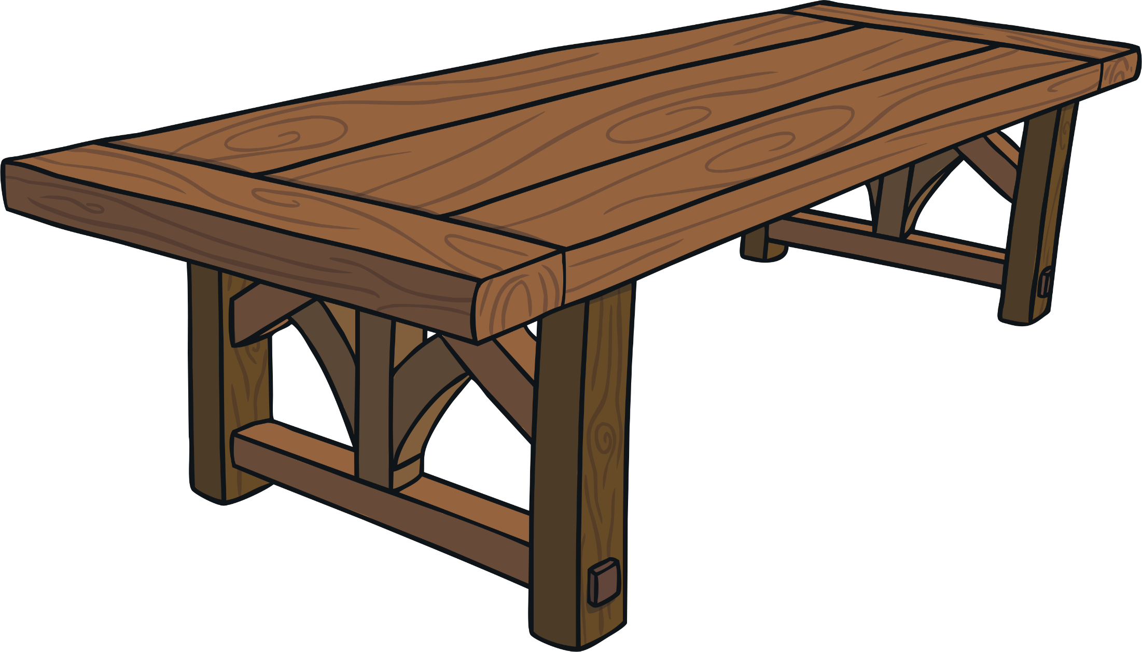
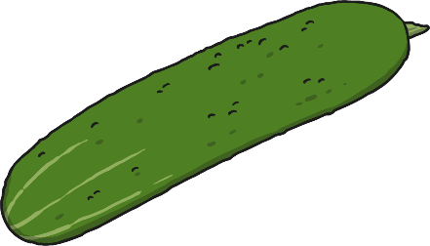
The BFG
Putting people you know into strange situations is a great way to start a story.

Slide 12
Roald Dahl
Famous Quotes
“Those who don't believe in magic will never find it.”
“You can write about anything for children as long as you’ve got humor.”
“Don't gobblefunk around with words.”
“Grown ups are complicated creatures, full of quirks and secrets.”
“A person who has good thoughts cannot ever be ugly. You can have a wonky nose and a crooked mouth and a double chin and stick-out teeth, but if you have good thoughts they will shine out of your face like sunbeams and you will always look lovely.”

