Slide 1


Maths
Statistics
Year One
Maths | Year 4 | Statistics | Solve Comparison, Sum and Difference Problems | Lesson 5 of 5: Pets Statistics

Slide 2

Pets Statistics

Slide 3
Aim
I can answer questions about data presented in bar charts and graphs.
Success Criteria
I can interpret and present data in tables, bar charts and graphs.
I can answer comparison, sum and difference questions about data.

Slide 4





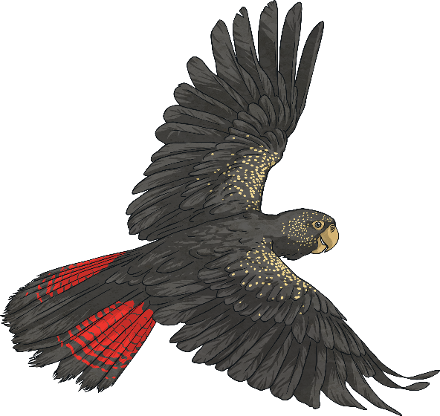
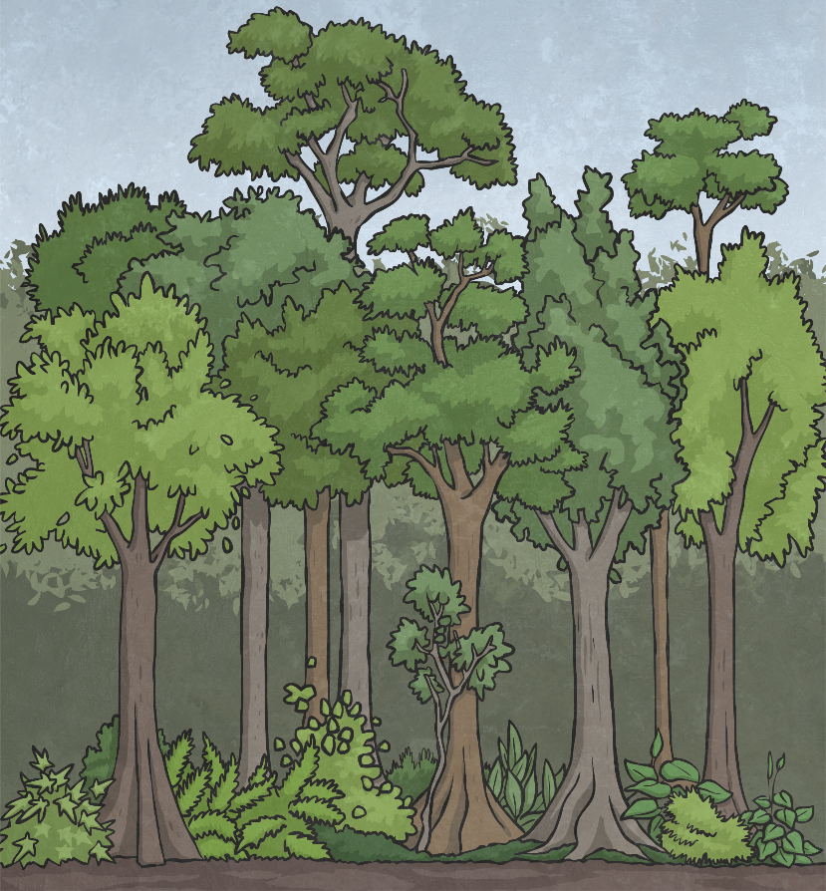
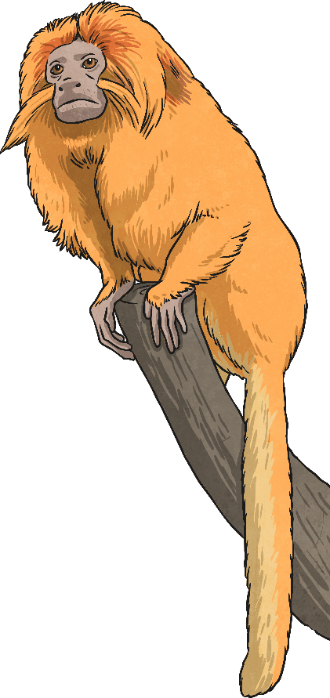
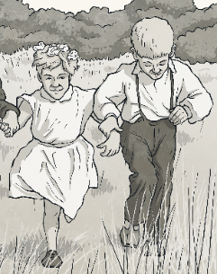

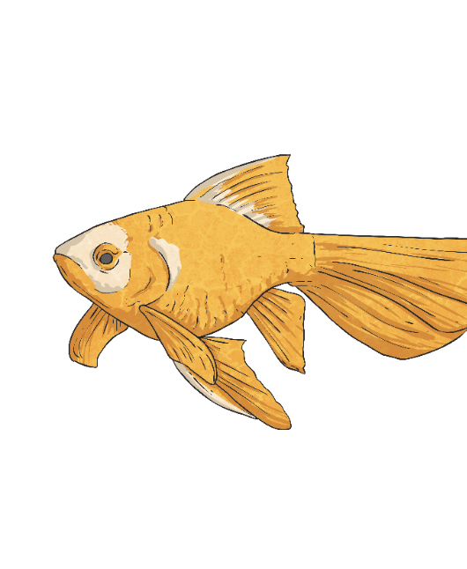

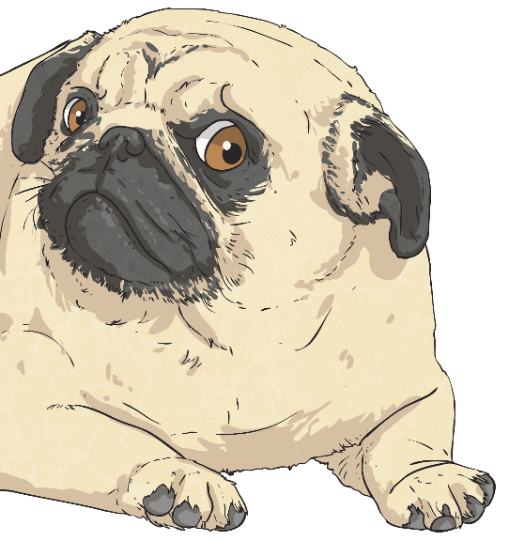
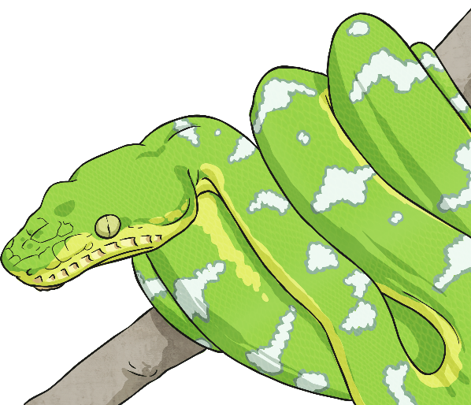



Pets Bar Chart Reveal
Choose a question to answer about the bar chart. Click on the box
once to check your answer and then again to reveal a part of the picture!
dog
Which pet do most children in Class 4 have?
fish and hamster
A Bar Chart to Show Class 4's Pets
Which two
pets are owned by sixteen children in total?
2
How many more children have a pet dog than cat?
20
18
10
16
How many more children have a pet dog than fish?
12
How many children selected ‘other’?
70
14
How many
pets do the children have altogether?
12
Number of Children
10
2
How many more children have a pet
fish than a hamster?
rabbit
8
Which pet
do the fewest children in Class 4 have?
11
How many more children have a pet cat than rabbit?
6
4
36
2
How many children in total have a pet cat or dog?
dog and rabbit
Which two
pets are owned by twenty-five children in total?
22
How many children in total have a pet fish, rabbit or hamster?
cat
dog
fish
rabbit
hamster
other
0
Pets

Slide 5





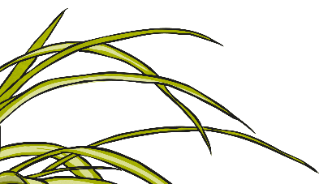
Pet Weights
In their science lessons, Class 4 have been
thinking about what animals and humans need to survive.
What is the difference in average weight between
a healthy guinea pig and rat?
What is the difference in average weight between
a healthy chihuahua and rat?
What is the average weight of a healthy cat?
What is the average weight of a healthy rabbit?
This led
to a discussion about looking after pets and how to make sure they are healthy and
happy.
First, the
children used
the Internet to
find out the average weight of different healthy pets.
A Bar Chart to Show the Average Weight of Common Pets
5.5
They presented
the data as a bar chart. Use the graph to answer these questions.
5
5.2kg
1.7kg
0.6kg
1.7kg
4.5
4
3.5
3
Weight in kg
2.5
2
1.5
1
0.5
0
cat
chihuahua
guinea pig
rabbit
rat
ferret
Pet

Slide 6




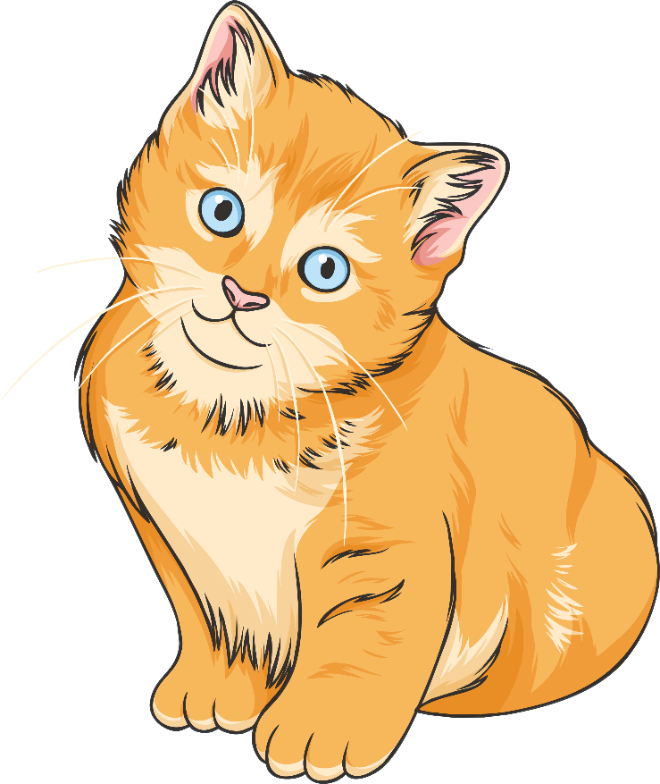
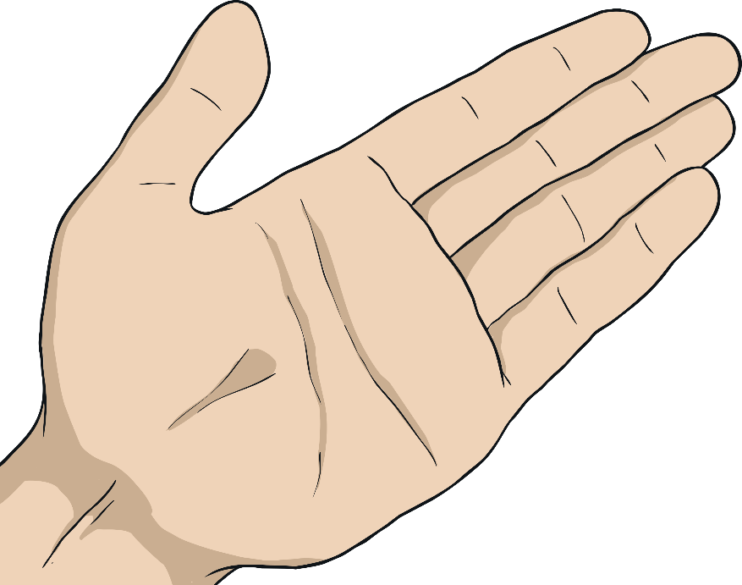
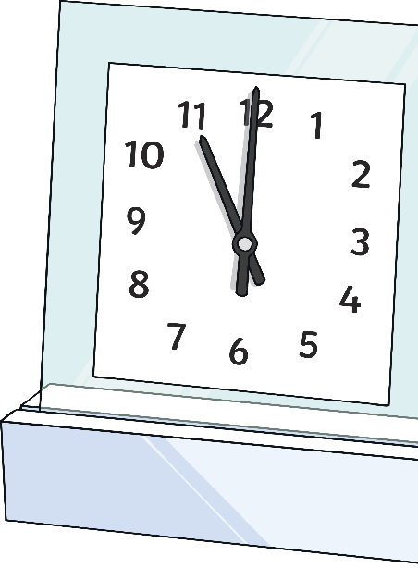
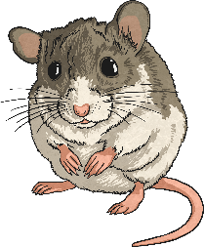

Kitten Line Graph
Next, Ms Jones shows the children a weight graph
which vets use to check if kittens are a healthy weight.
How much weight will a healthy kitten put on
between ten and fourteen weeks of age?
How many kilograms will a healthy kitten weigh at eight weeks old?
How many weeks old will a healthy kitten be when it weighs 2kg?
How many weeks old will a healthy kitten be when it weighs 0.6kg?
A Graph to Show the Healthy Weight of a Kitten Aged up to Twenty Weeks
5 and a half weeks old
0.8kg
0.5kg
Use the line
graph to answer these questions.
19 weeks
2.2
2.0
1.8
1.6
1.4
1.2
Weight in kg
1.0
0.8
0.6
0.4
0.2
0
1
2
3
4
5
6
7
8
9
10
11
12
13
14
15
16
17
18
19
20
Age in Weeks

Slide 7

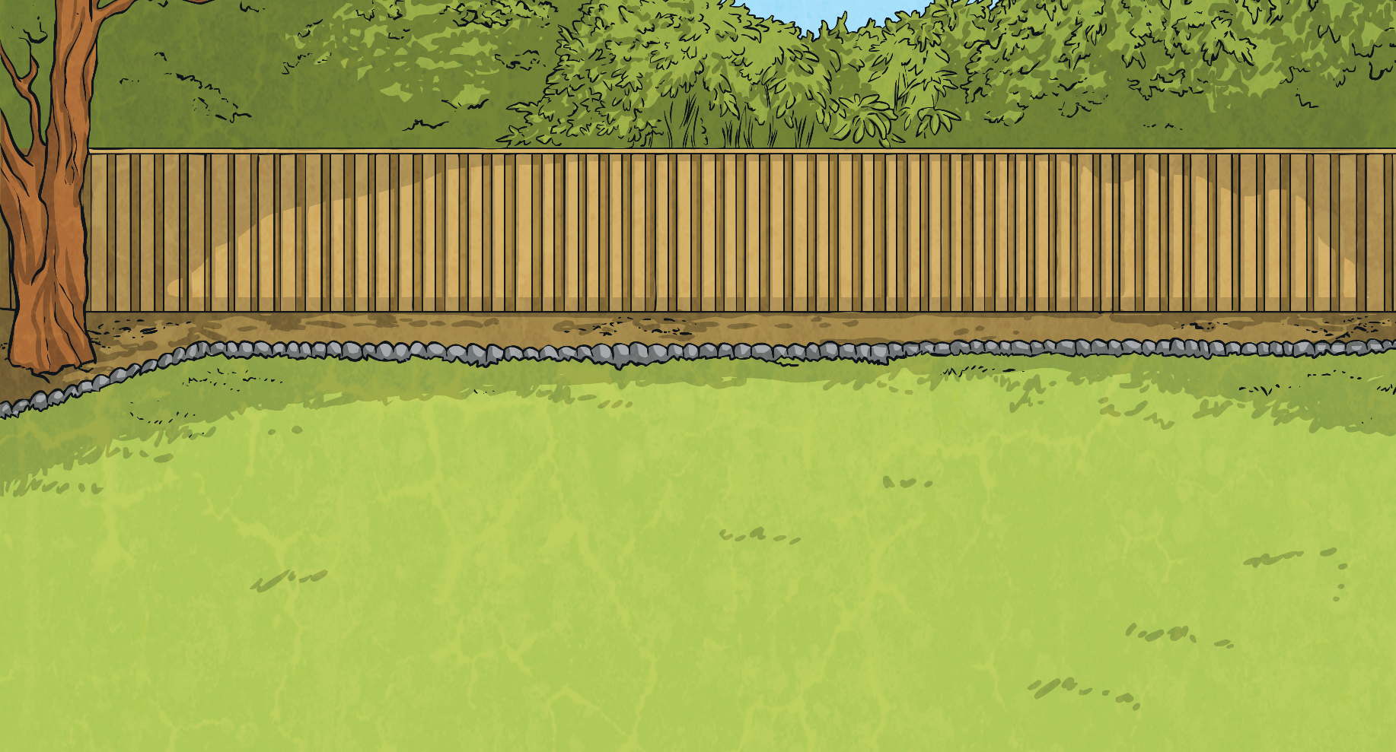
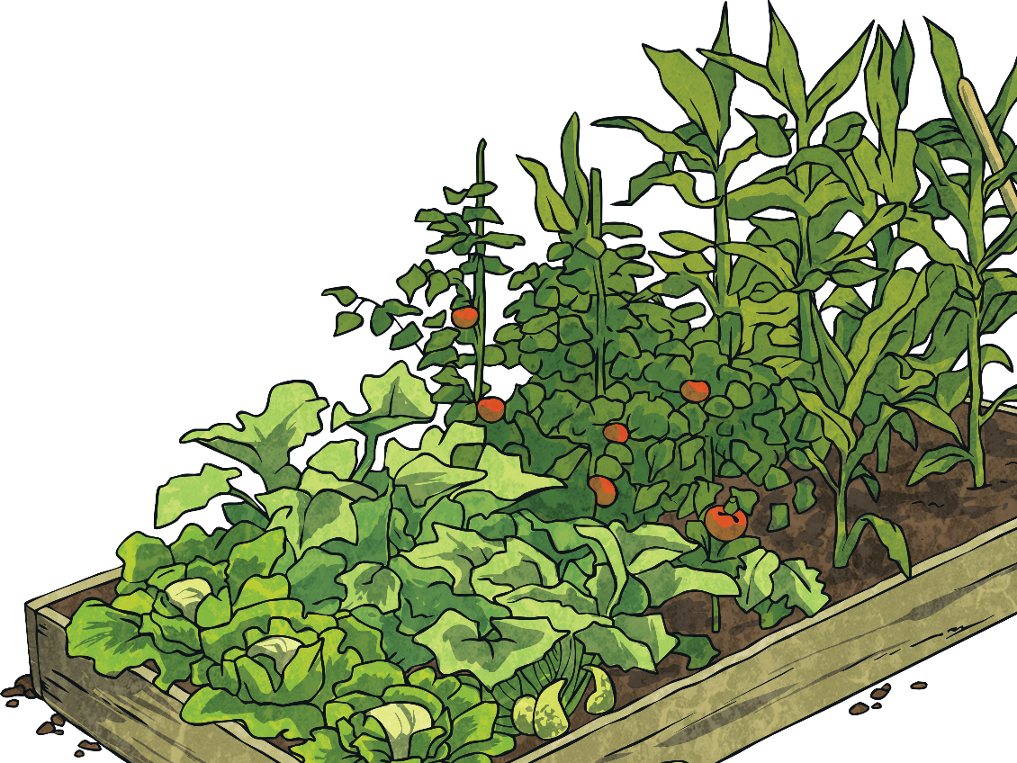
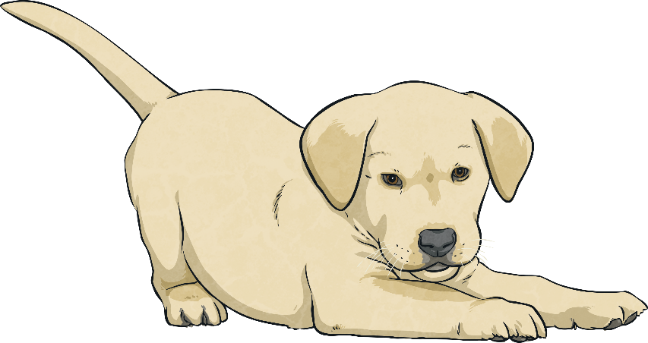

Puppy Weight Challenge
Finally, Ms Jones shows the children a weight graph which
shows the weight change of two puppies called Cookie and Rover.
A Graph to Show the Weight of Two Puppies
11
10
Puppy 1 (Cookie)
9
8
Puppy 2 (Rover)
7
6
Weight in kg
5
A graph that shows two sets
of data can be used to compare the data.
4
Write a question about the graph for your partner to answer.
3
2
1
0
1
2
3
4
5
6
7
8
9
10
11
12
13
14
Age in Weeks

Slide 8

Aim
I can answer questions about data presented in bar charts and graphs.
Success Criteria
I can interpret and present data in tables, bar charts and graphs.
I can answer comparison, sum and difference questions about data.

