Slide 1


Maths
Statistics
Year One
Maths | Year 4 | Statistics | Interpret and Present Discrete and Continuous Data Using Graphs | Lesson 5 of 5: Gardening Statistics

Slide 2

Gardening Statistics

Slide 3
Aim
I can interpret and present data using bar charts and time graphs.
Success Criteria
I can say if data is discrete or continuous.
I can collect data in tables.
I can interpret and answer questions about data presented in bar charts and time graphs.
I can present data in a bar chart or time graph.

Slide 4

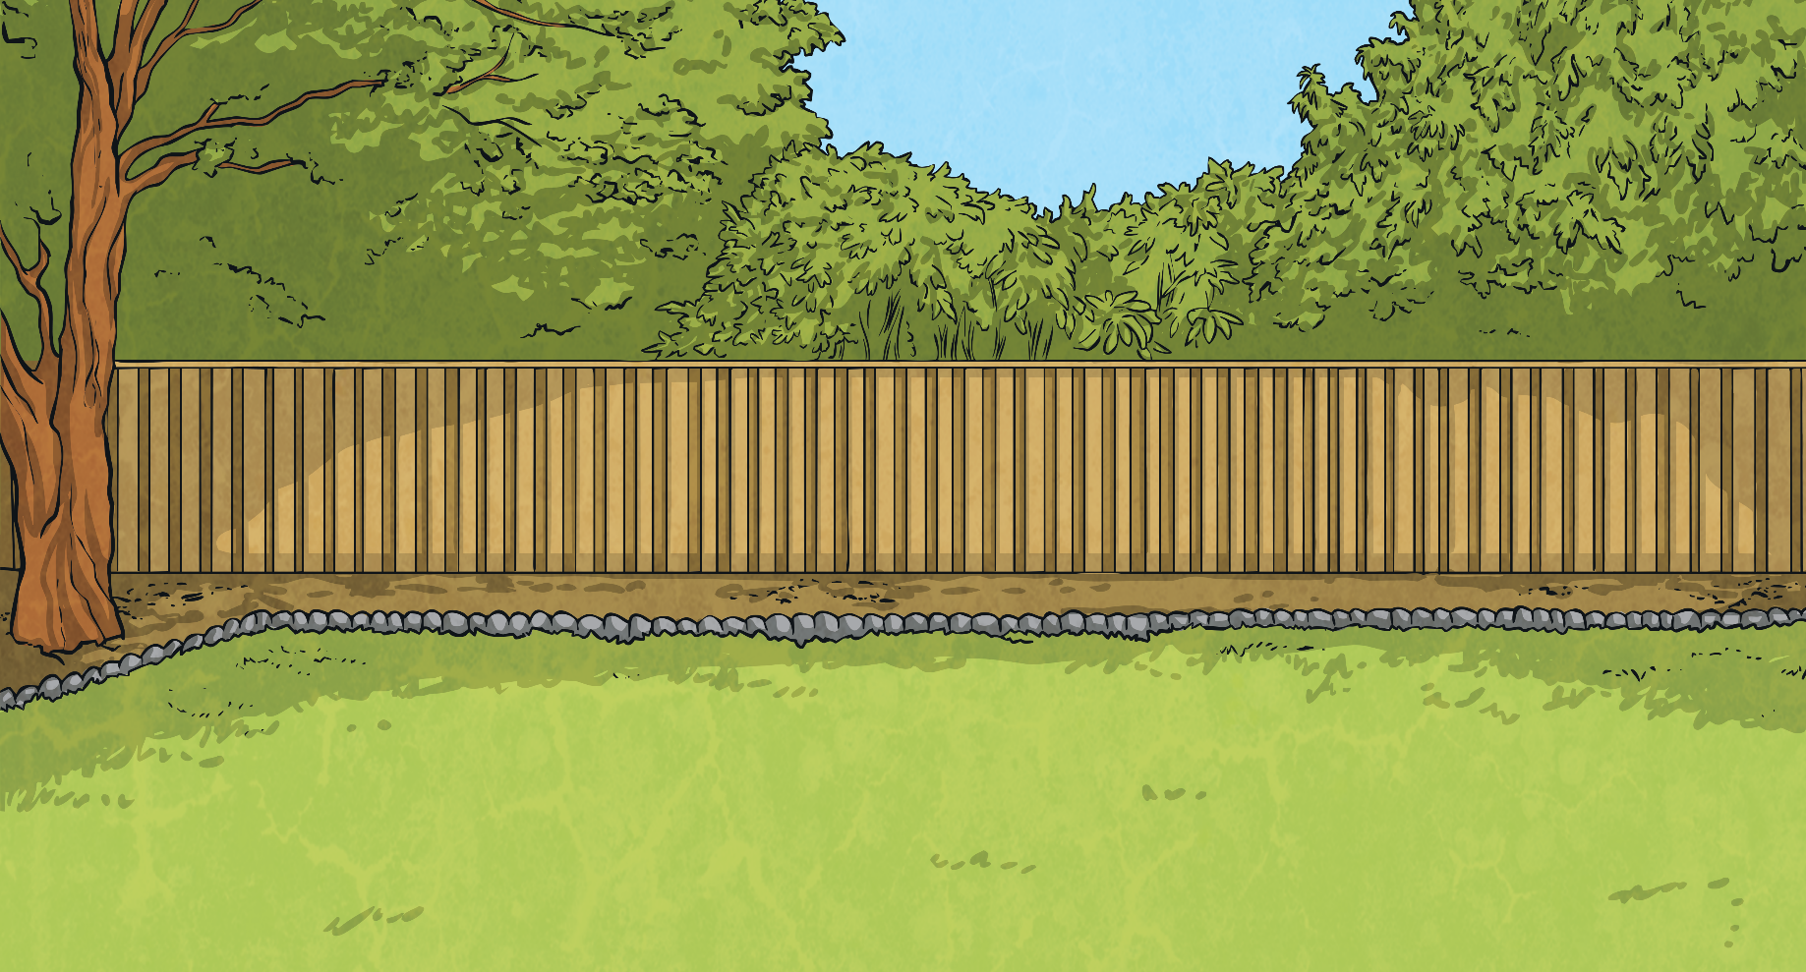

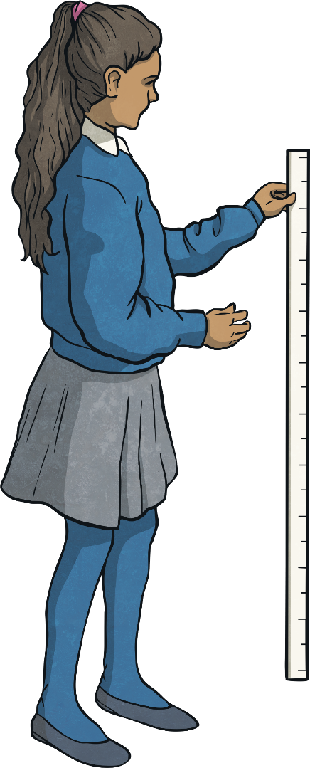



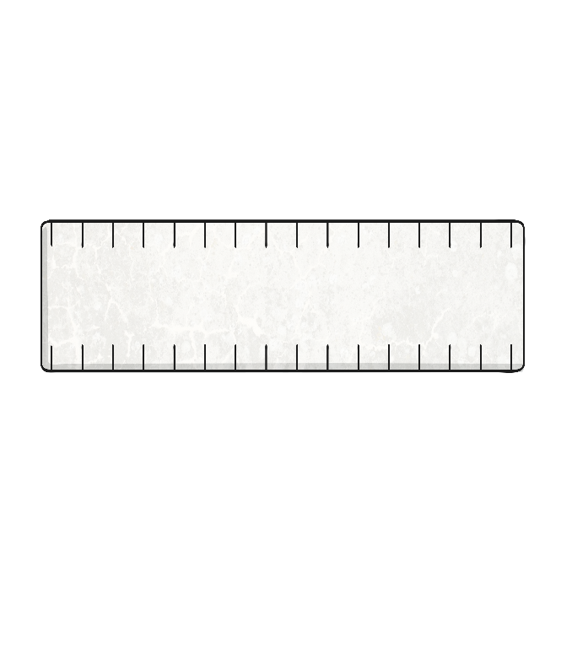
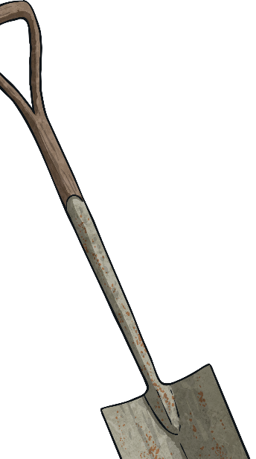

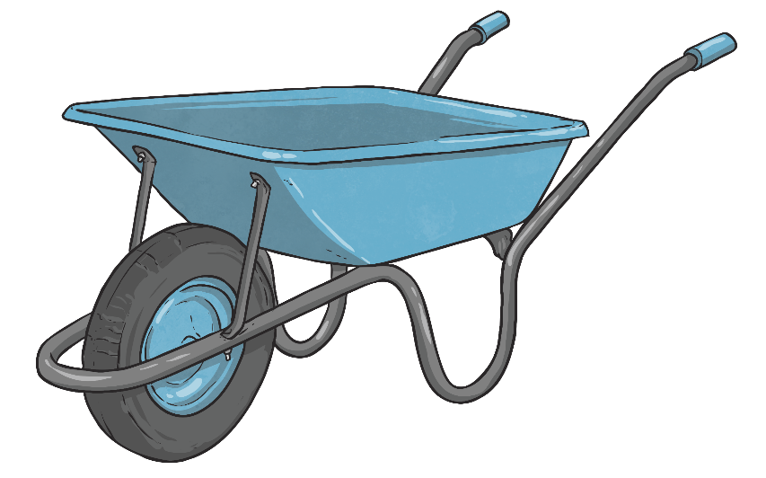
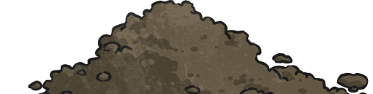
Sunflower Heights
Ms Jones runs an after-school gardening club for the children
in Class 4. Over the last term, they have been growing sunflowers.
Sunflower | Height in cm
sunflower 1
sunflower 2
sunflower 3
sunflower 4
sunflower 5
sunflower 6
68cm
53cm
82cm
83
69
82
73
40cm
54
81
72
68
53
49
71
67
80
41
48
48cm
52
79
70
66
51
40
47
69
65
78
39
46
72cm
50
77
68
64
49
38
45
67
63
48
76
37
44
66
62
47
75
36
43
65
61
46
74
35
42
64
60
45
73
34
41
63
59
72
33
Eli and Nikita use a metre stick to
measure the heights of the sunflowers.
Complete the table of data for Eli and Nikita.
58
44
32
40
62
43
31
39
30
38

Slide 5

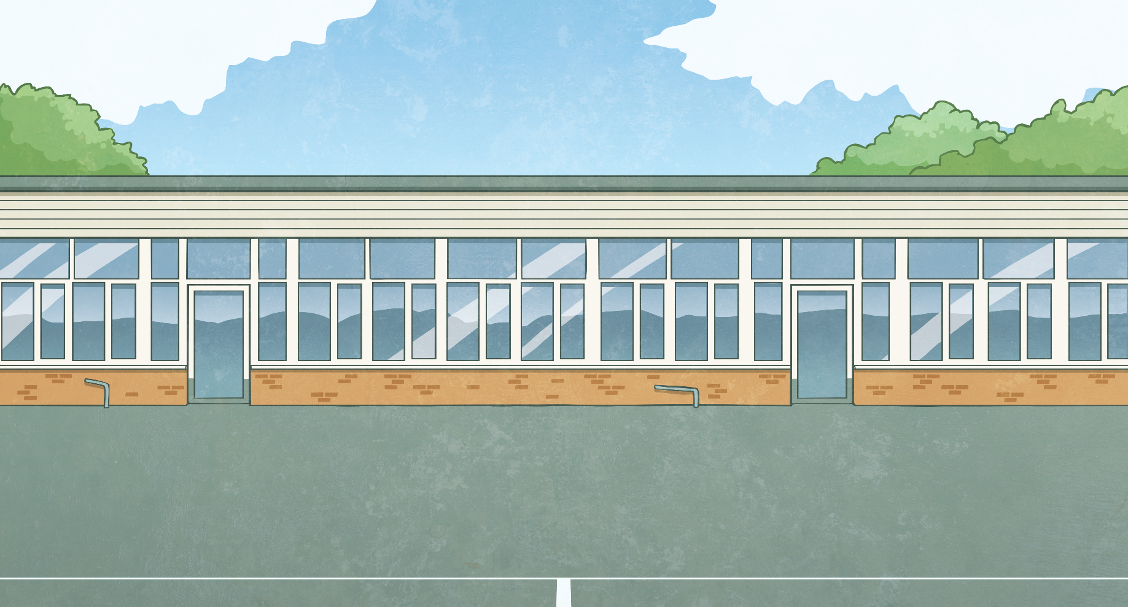
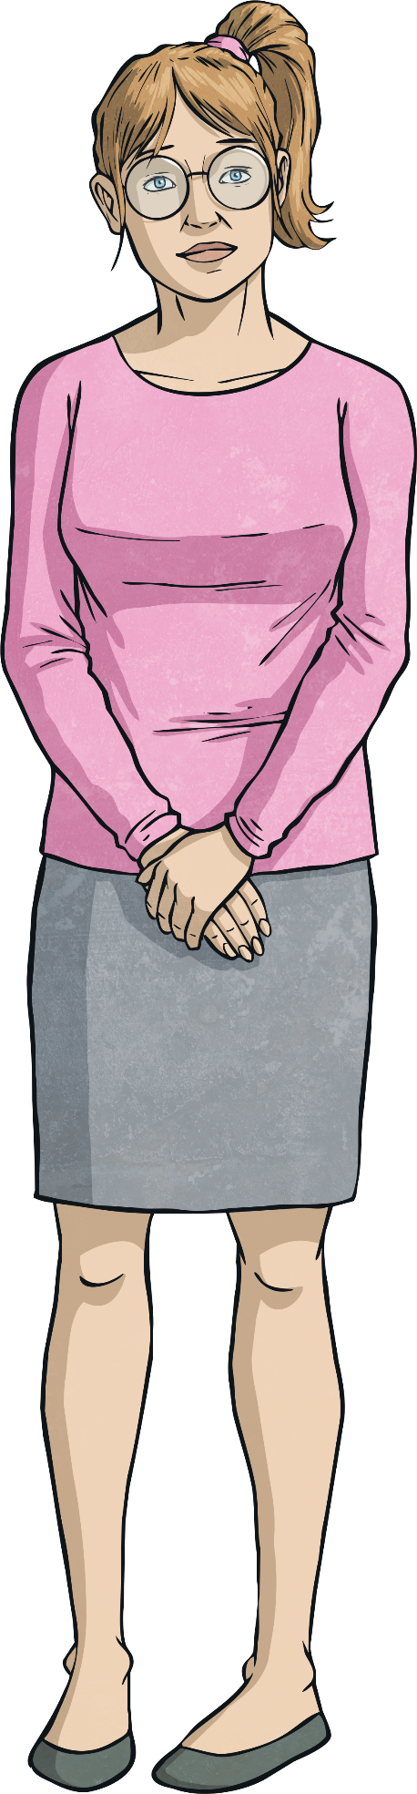



Sunflowers Presenting Data
Ms Jones asks Eli and Nikita to draw a graph
to compare the heights of the sunflowers.
How do you think they should present the data?
Sunflower | Height in cm
sunflower 1 | 68cm
sunflower 2 | 53cm
sunflower 3 | 82cm
sunflower 4 | 40cm
sunflower 5 | 48cm
sunflower 6 | 72cm
Instead, we
should draw a bar
chart so we can visually compare each sunflower’s height, which is
continuous data.
The heights of the sunflowers haven’t been measured over time so we don’t need to draw
a time graph.
However, they can’t agree which type of graph to draw. Eli thinks they should draw
a bar chart, but Nikita thinks they should draw a time graph.

Slide 6
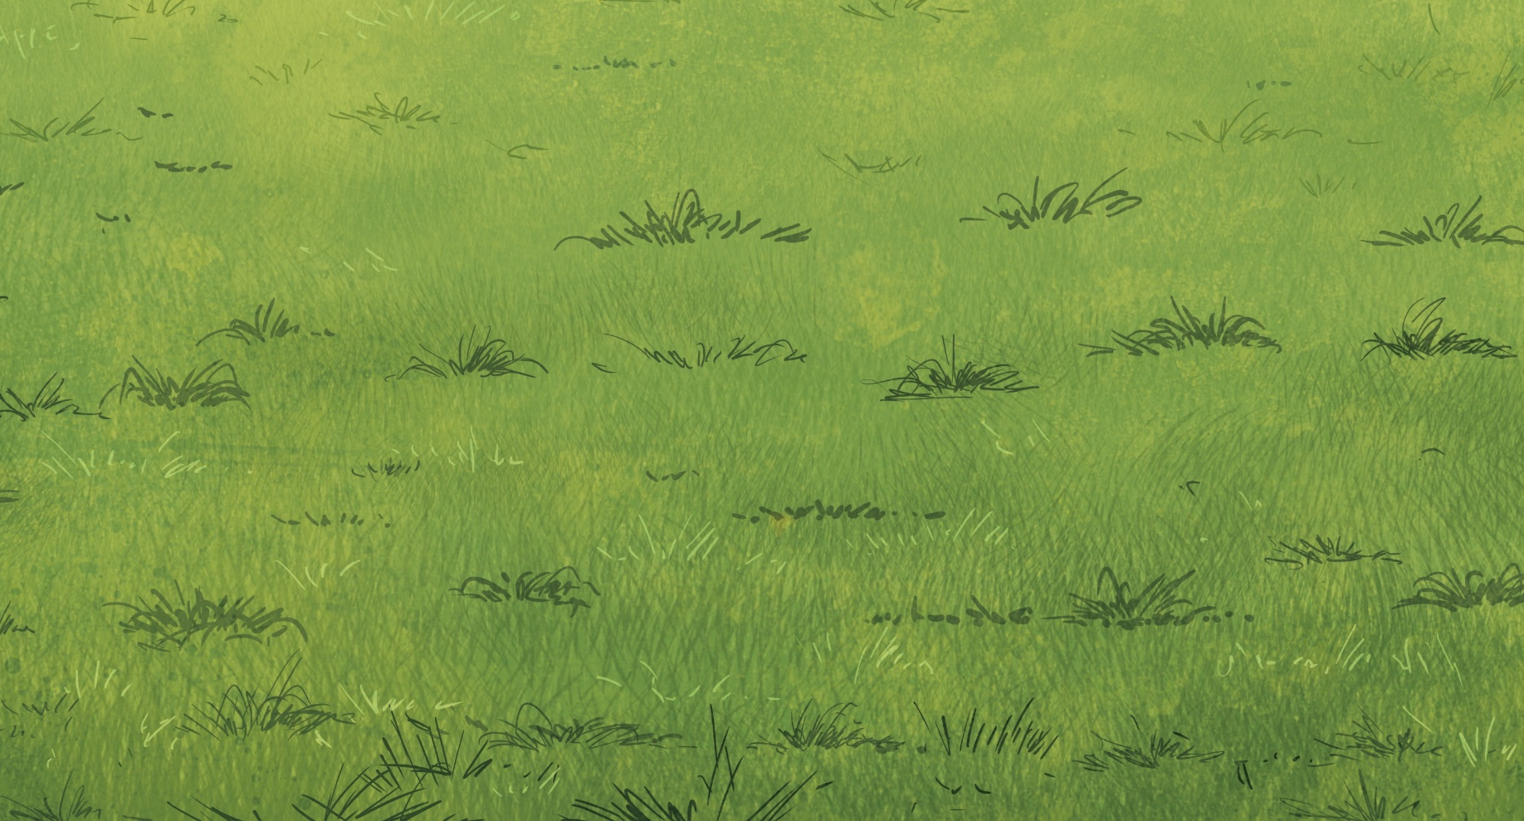


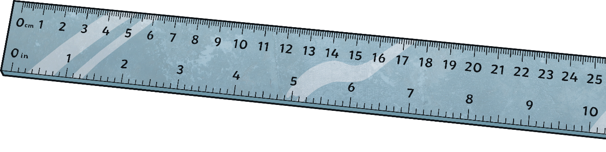
Sunflowers Presenting Data
Eli and Nikita write four questions about their bar chart.
Can you correctly answer them?
A Bar Chart to Show the Heights of the Sunflowers Grown by the Gardening Club
90
80
What is the difference in height between sunflowers 1 and 2?
70
What is the difference in
height between the shortest and tallest sunflower?
What is the combined height
of sunflowers
4 and 5?
What is the height of the tallest sunflower?
60
Height in cm
50
15cm
40
40cm + 48cm = 88cm
82cm
42cm
30
flower 1
flower 2
flower 3
flower 4
flower 5
flower 6
0
Sunflowers

Slide 7

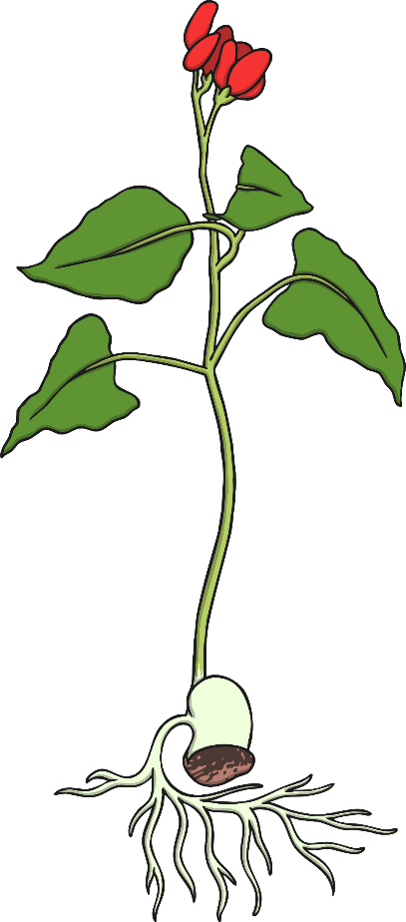
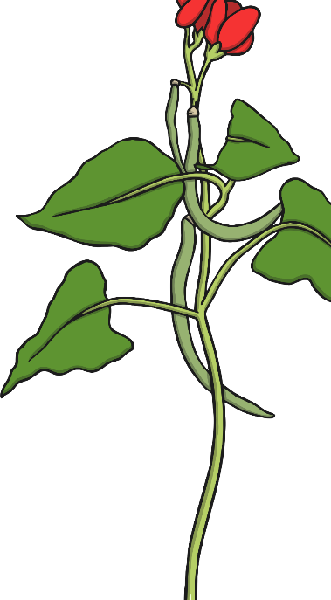
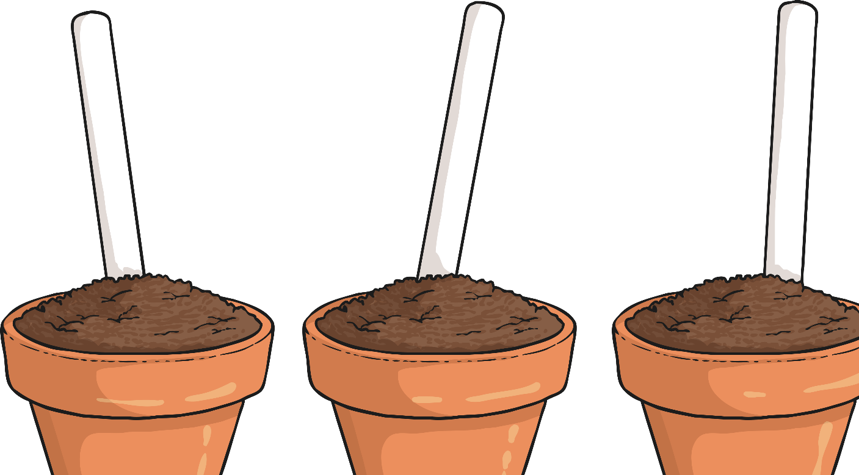
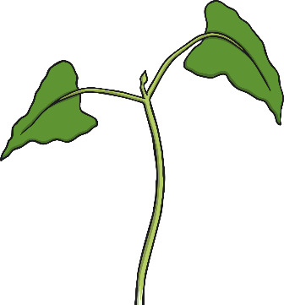
Growing Runner Beans
The gardening club have also been growing
runner beans in the school vegetable plot.
Day | Height in cm
1 | 0
2 | 1.2
3 | 1.8
4 | 1.8
5 | 2.4
6 | 2.8
7 | 4.6
8 | 5
9 | 5.8
10 | 6.4
11 | 7.4
12 | 8.4
13 | 9
14 | 10
Here is
the data they collected.
Every day for two weeks, Eli and Nikita have measured the height of one of the bean plants.
Ms Jones asks Eli and Nikita to present the data as a graph.
What type of graph do you think they should use to present their data?

Slide 8
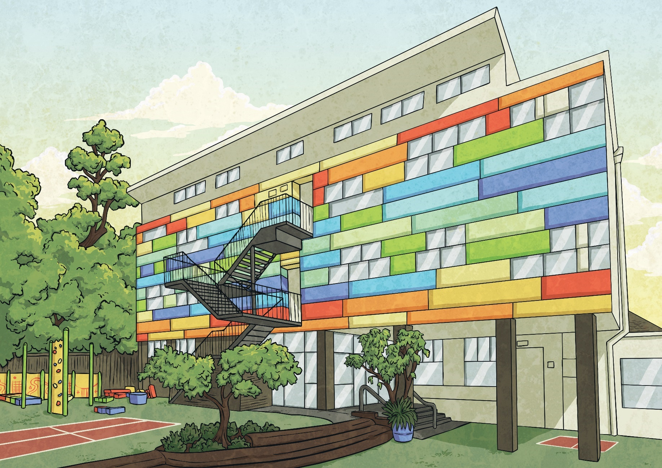
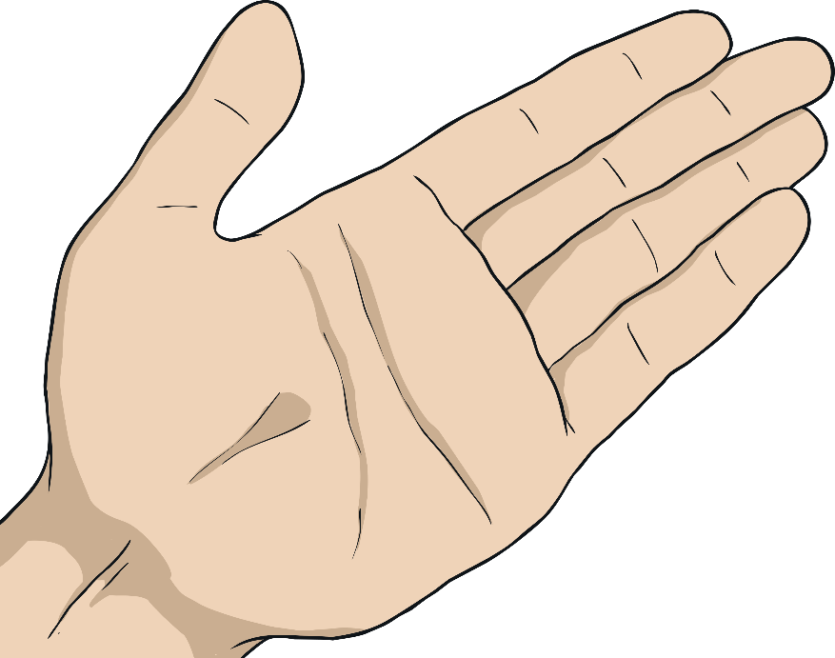
Growing Runner Beans
Over the two weeks, Eli and Nikita have been measuring
the height of the bean plant which is a continuous measurement.
Day | Height in cm
1 | 0
2 | 1.2
3 | 1.8
4 | 1.8
5 | 2.4
6 | 2.8
7 | 4.6
8 | 5
9 | 5.8
10 | 6.4
11 | 7.4
12 | 8.4
13 | 9
14 | 10
By plotting the
data on a time graph,
they will create a continuous line, which will show us how quickly or slowly the bean plant has been growing
over time.
We will be able
to use the line of the
graph to make approximate measurements of the height
of the runner bean plant at any time along the time
scale axis.
They have been
collecting this data
over time, so they can
present the data as a
time graph.

Slide 9
Time Graphs
Time is shown along the horizontal axis. Depending on the data,
this could be seconds, minutes, hours, days, weeks or months.
The measured continuous data is marked on the vertical axis.
The scale of this number line is chosen based on the data range.
A time graph must always have an underlined title explaining
what it shows and each axis must have a label explaining what it shows.
The continuous line created can be used to show the
height of the bean plant at any time during the two weeks.
Ms Jones shows the children how to draw a time graph.
A time graph has a horizontal axis and a vertical axis.
The data is plotted on to the time graph and joined with straight lines.
A Time Graph to Show the Height
of Bean Plants over Two Weeks
10
9
8
7
6
Height in cm
5
4
3
2
1
0
1
2
3
4
5
6
7
8
9
10
11
12
13
14
Time in Days

Slide 10
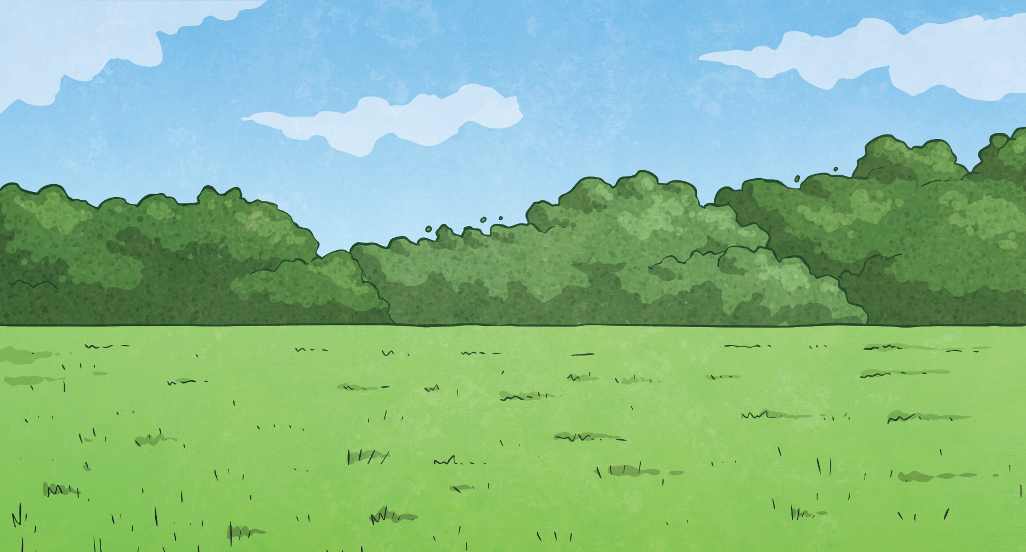
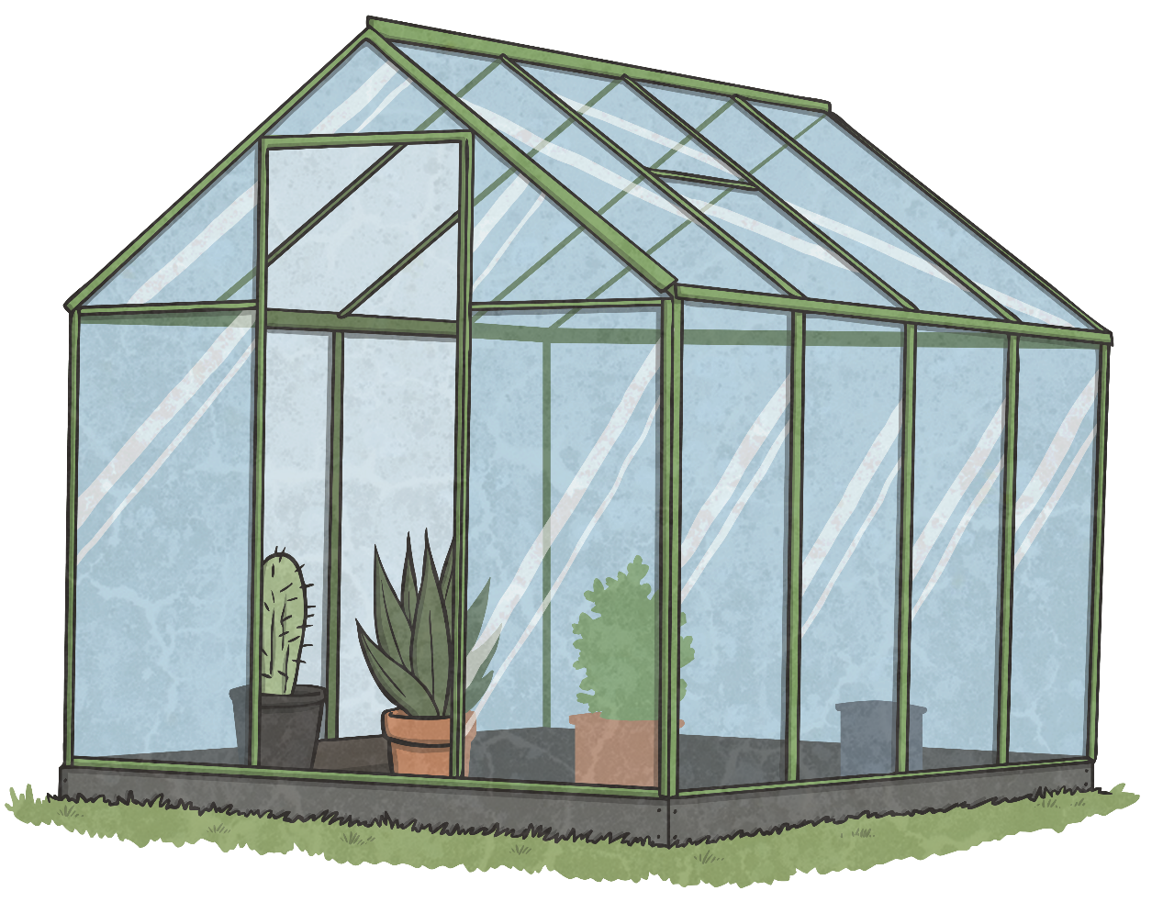
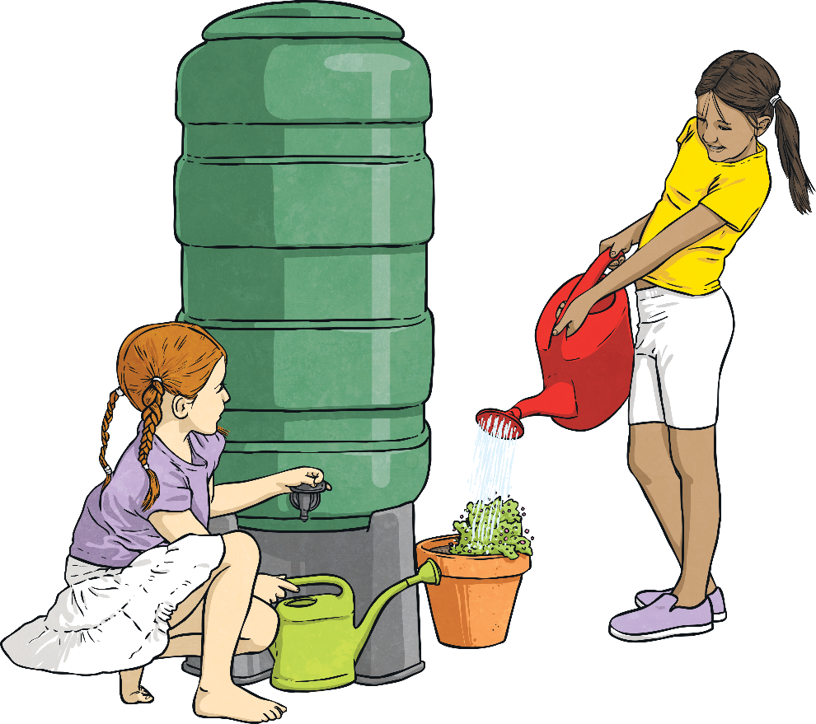
Bean Growing Questions
Can you answer these questions using data from the time graph?
A Time Graph to Show the Height
of Bean Plants over Two Weeks
How much
did the bean plant grow from day 3
to day 8?
5.8cm
During which
day did the bean plant reach
7cm tall?
3.2cm
Day 10
What was the height of the bean plant on day 9?
10
9
8
7
6
Height in cm
5
4
3
2
1
0
1
2
3
4
5
6
7
8
9
10
11
12
13
14
Time in Days

Slide 11
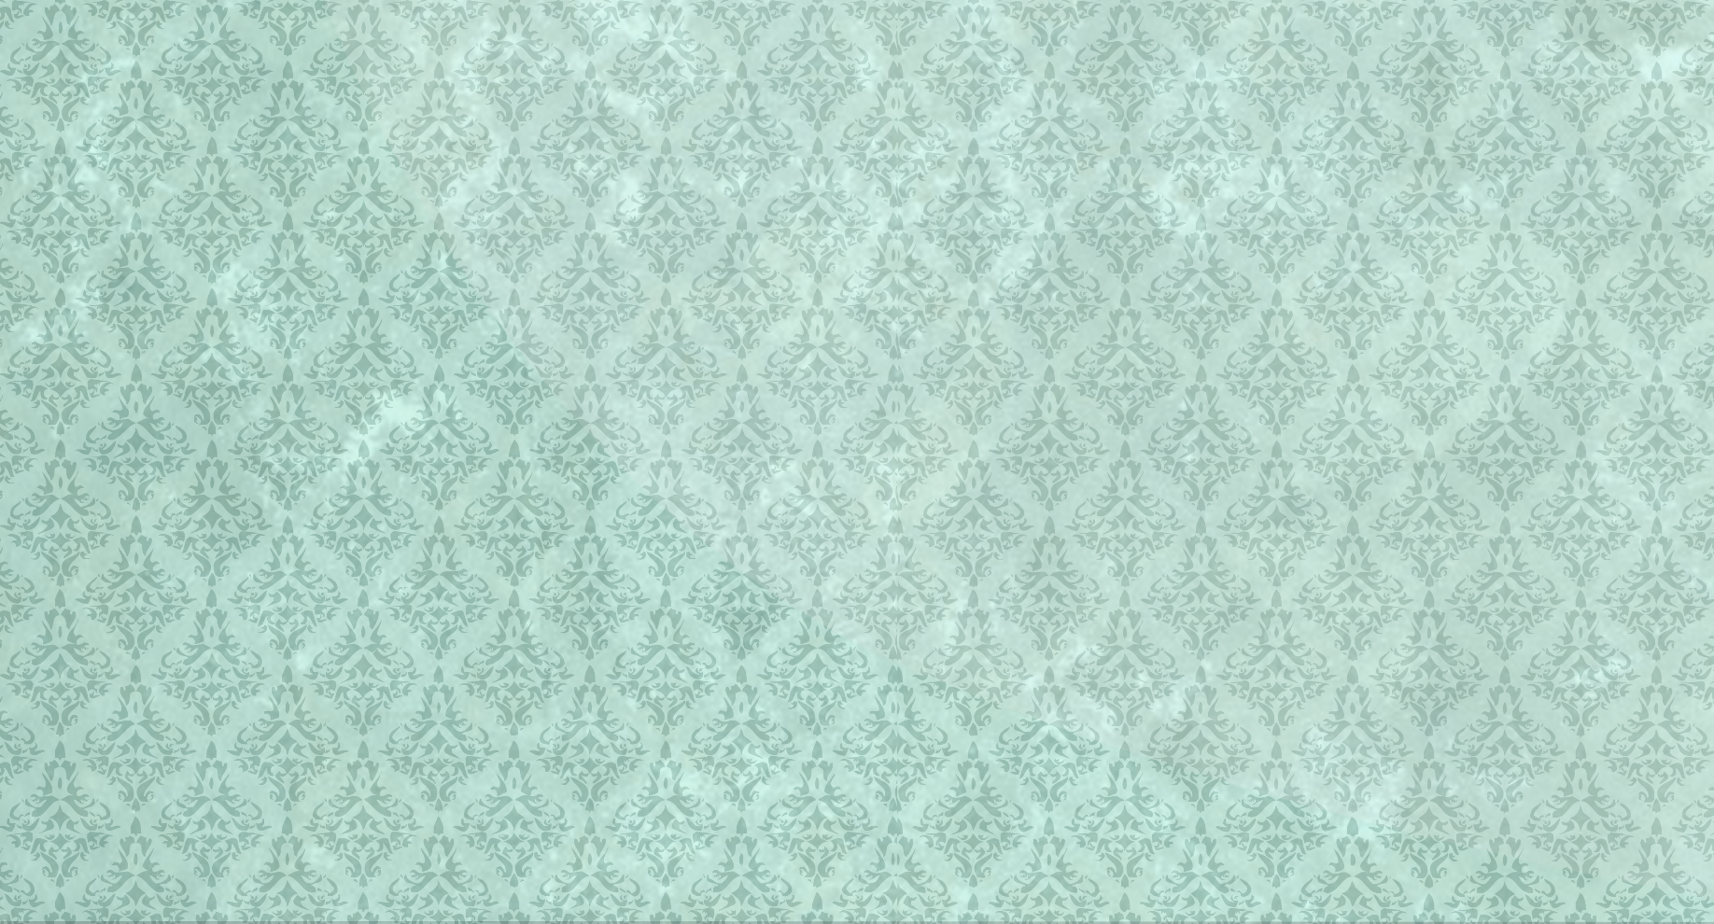
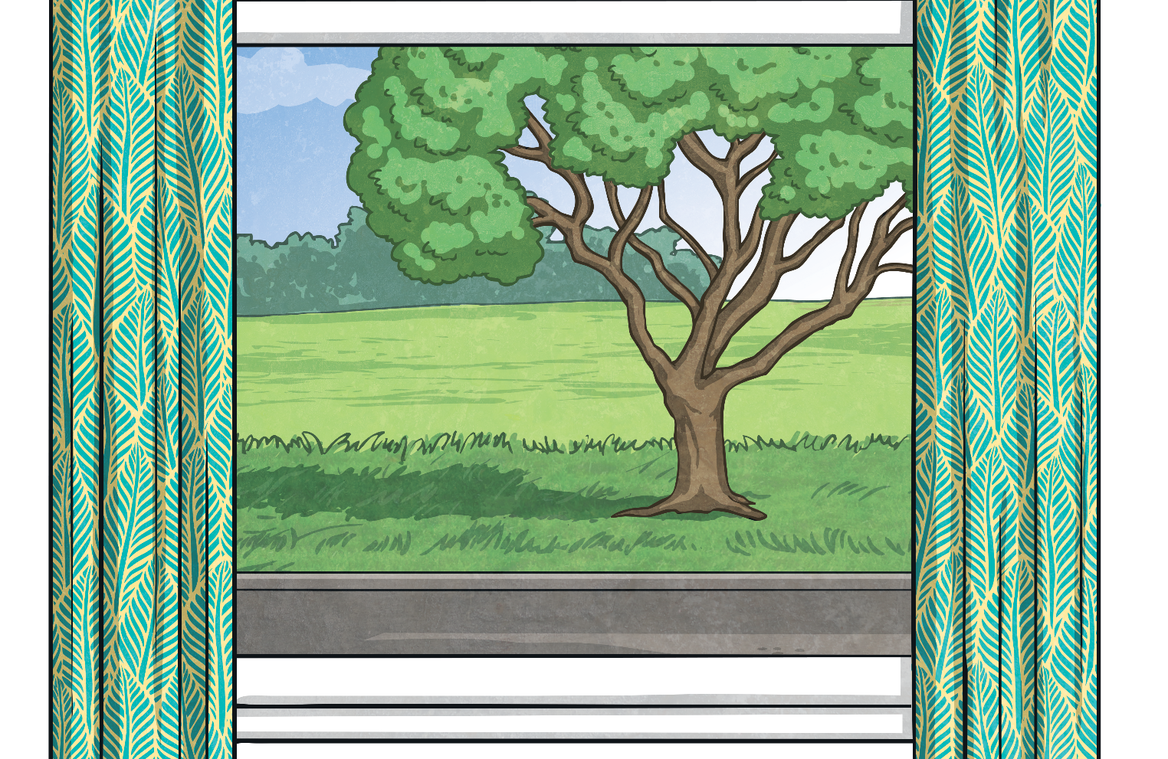
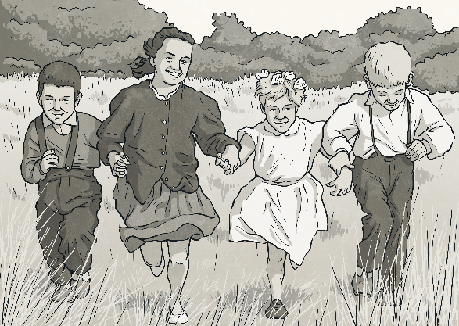


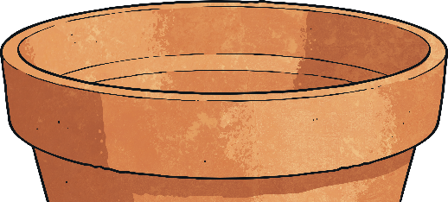

Strawberry Plant Challenge
Ms Jones shows the children this table of data, which shows
the heights of two different strawberry plants over one week.
How can Class 4 create a time graph which
shows the heights of both plants on the same graph?
A time graph showing two lines of data is used to compare two
sets of data that have been measured over the same amount of time.
Using this type of time graph, we can compare the
heights of both strawberry plants over the same time period.
A Time Graph to Show the Heights
of Two Strawberry Plants over a Week
4cm
38
37
36
Day | Height of Strawberry Plant 1 in cm | Height of Strawberry Plant 2 in cm
1 | 25 | 28
2 | 27 | 30
3 | 28 | 32
4 | 29 | 33
5 | 33 | 35
6 | 34 | 36
7 | 36 | 38
35
34
What was
the difference in height of the two strawberry plants on day 4?
33
32
Plant 1
Height in cm
31
30
Plant 2
29
28
27
26
25
24
1
2
3
4
5
6
7
Time in Days

Slide 12

Aim
I can interpret and present data using bar charts and time graphs.
Success Criteria
I can say if data is discrete or continuous.
I can collect data in tables.
I can interpret and answer questions about data presented in bar charts and time graphs.
I can present data in a bar chart or time graph.

