Slide 2
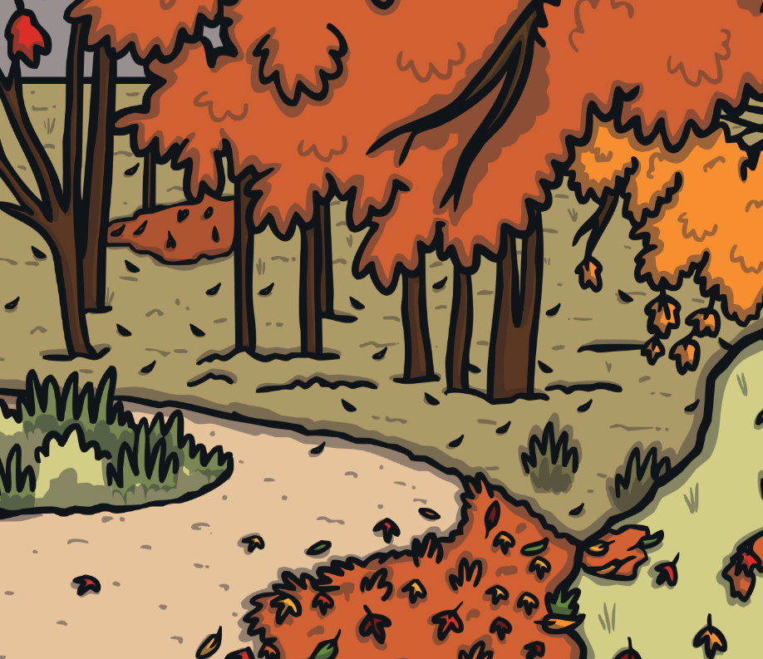
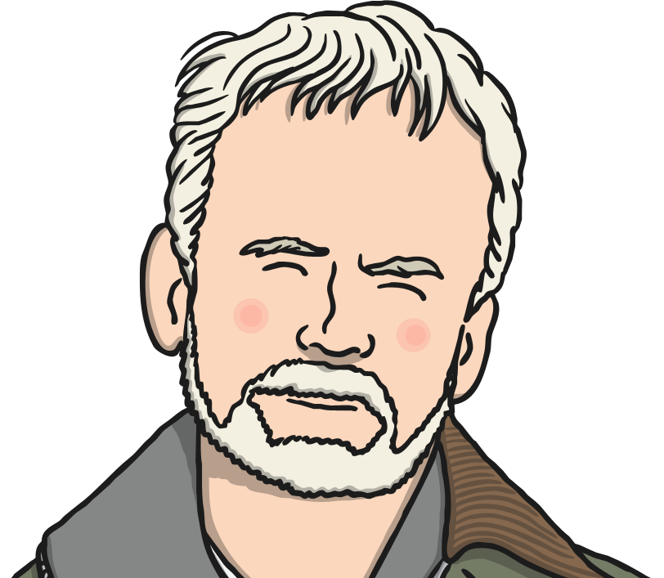
Who Is Andy Goldsworthy?
Andy Goldsworthy is a British artist, known for his sculptures and
photography. He is an environmentalist, which is someone who
wants to protect the environment around them.
Here are some facts about him:
born in 1956, in Cheshire;
grew up in Leeds;
studied art in Lancashire;
now lives in Scotland.
Did You Know?
When he was 13, Andy worked on a farm picking potatoes. He said this was good training for his work as an artist!

Slide 3
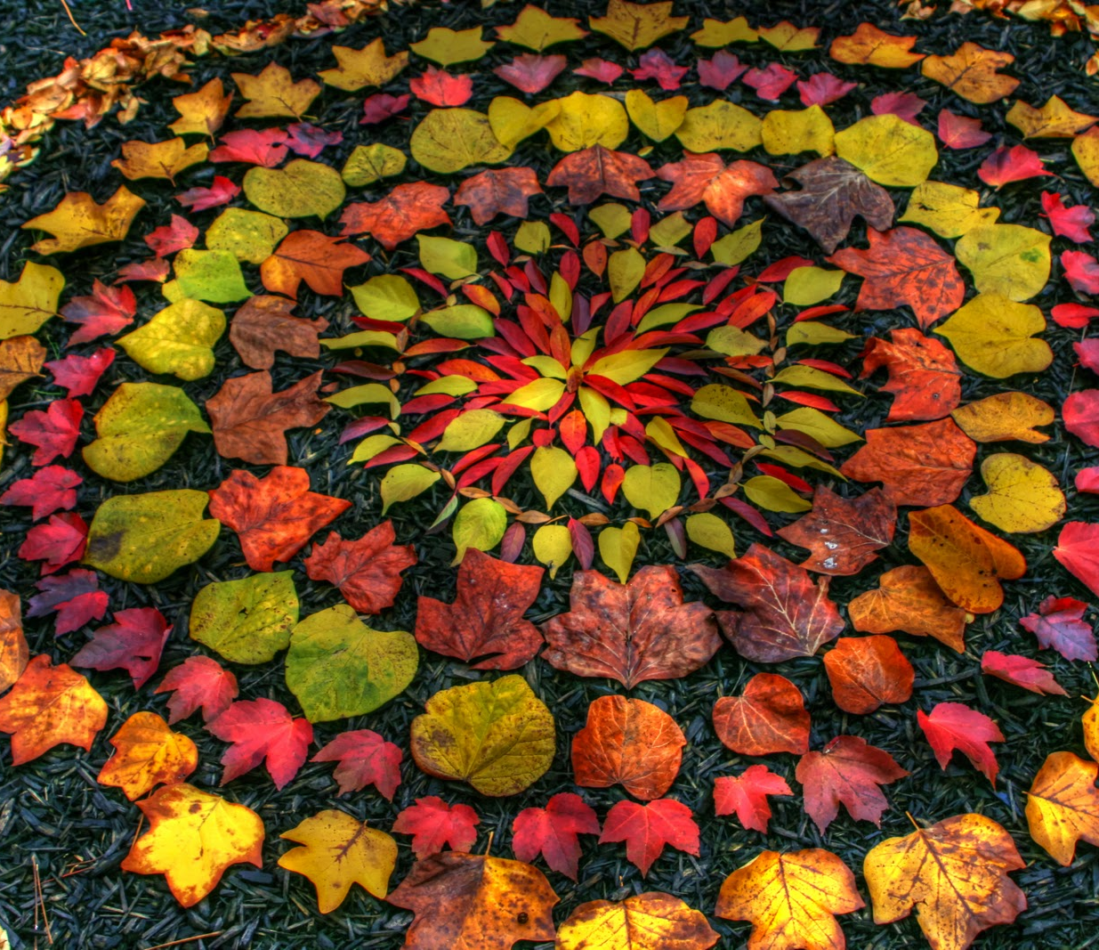
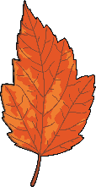
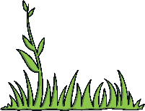
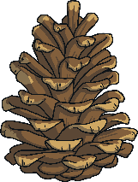

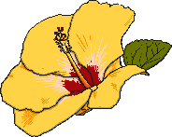
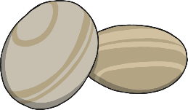
Land Art
Andy makes sculptures with natural materials on sites in the UK and around the world. He has made them in forests, fields, cities,
lakes and fields. They are known as land art.
Which natural materials can
you think of that he could use
to make sculptures?
leaves
twigs
pebbles
rocks
ice
flowers
grass
pine cones
Did You Know?
Andy has even used human hair and cow dung in his work!

Slide 4
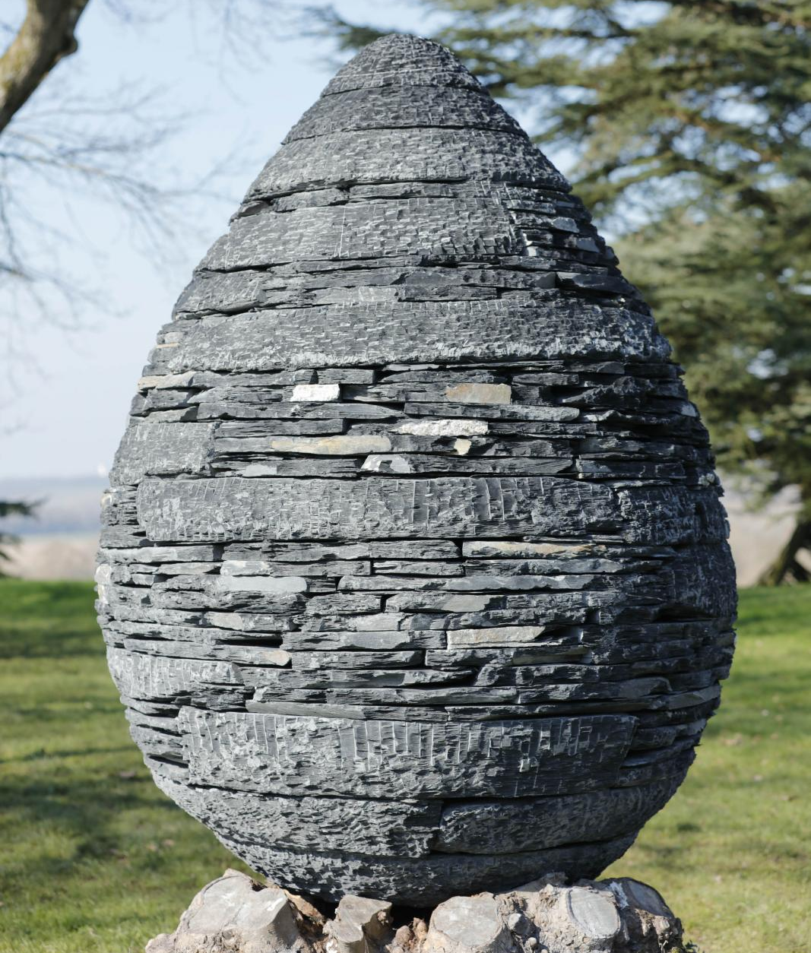
Who Is Andy Goldsworthy?
As well as making sculptures,
Andy takes photographs of his
work over time to show how they
change.
Talk About It
Why do you think his sculptures
change?
Did You Know?
Andy was given an OBE by the
Queen in 2000. This is a very
special award that the Queen gives
to only a few people each year.

Slide 5
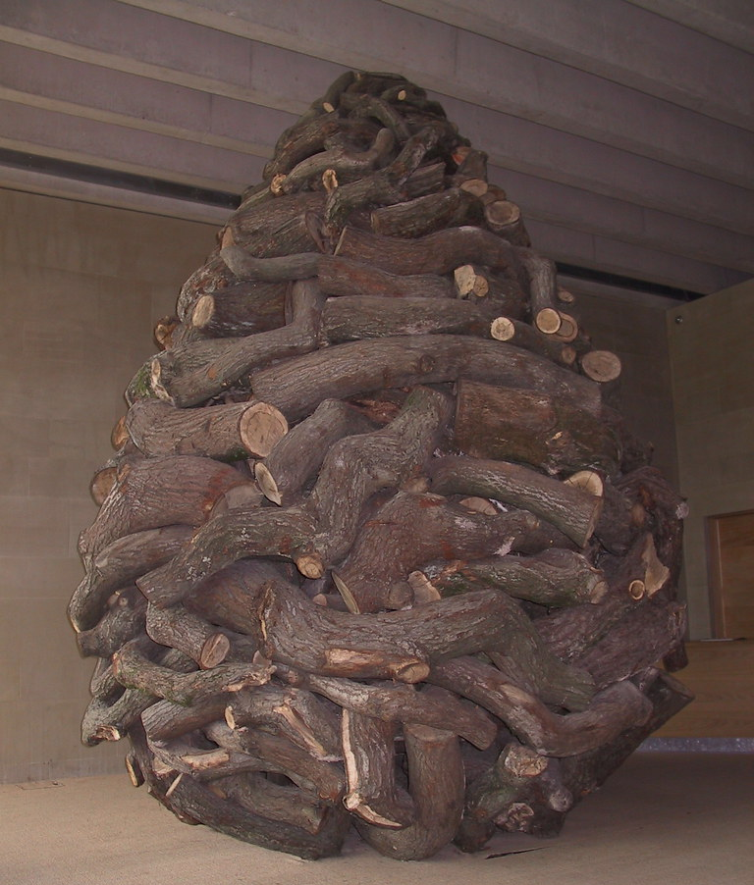
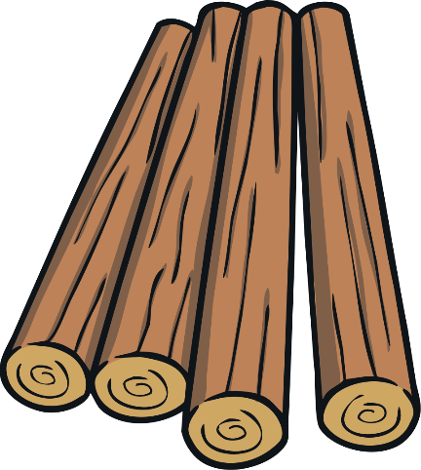

Which Natural Materials?
Talk About It
Which natural materials are
used in this sculpture by Andy
Goldsworthy?
wooden logs

Slide 6
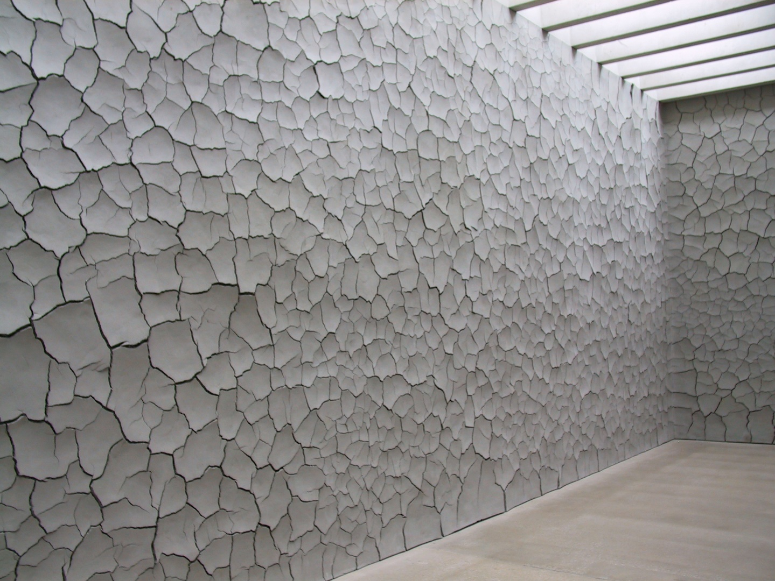
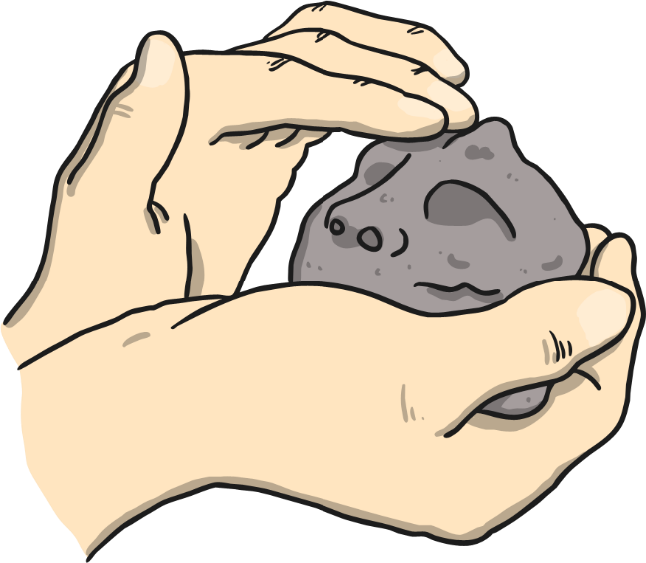
Which Natural Materials?
Talk About It
Which natural materials are used
in this sculpture by Andy
Goldsworthy?
clay and human hair

Slide 7
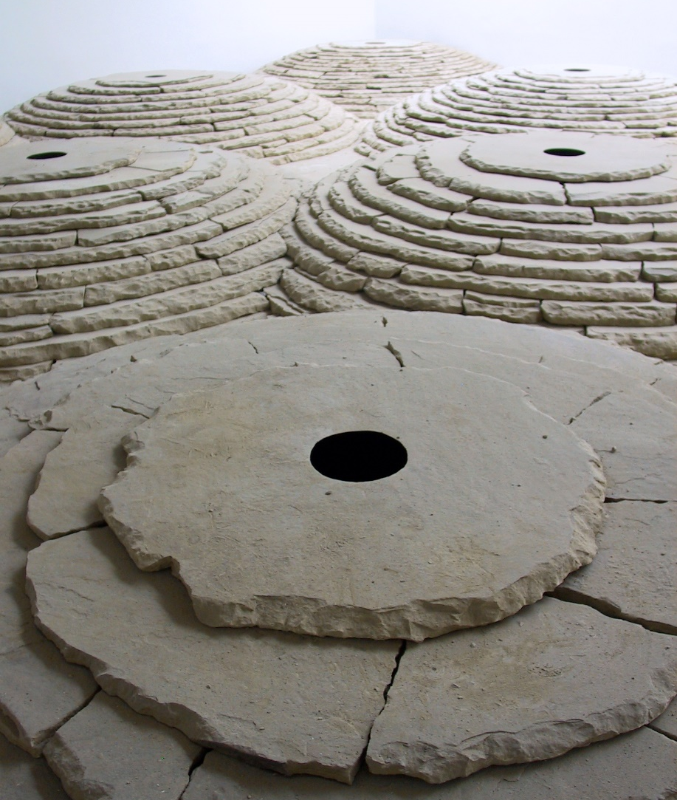
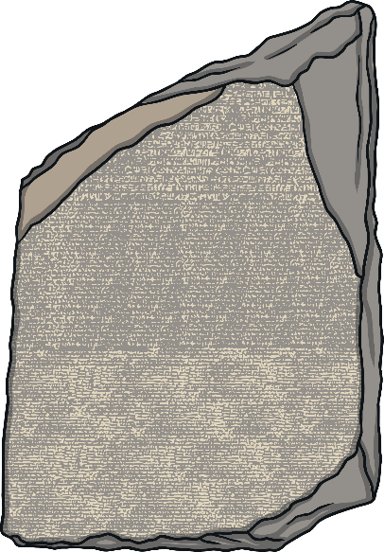
Which Natural Materials?
Talk About It
Which natural materials are used
in this sculpture by Andy
Goldsworthy?
stone

Slide 8
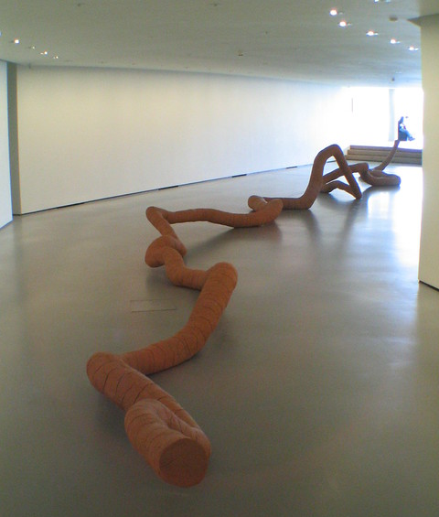
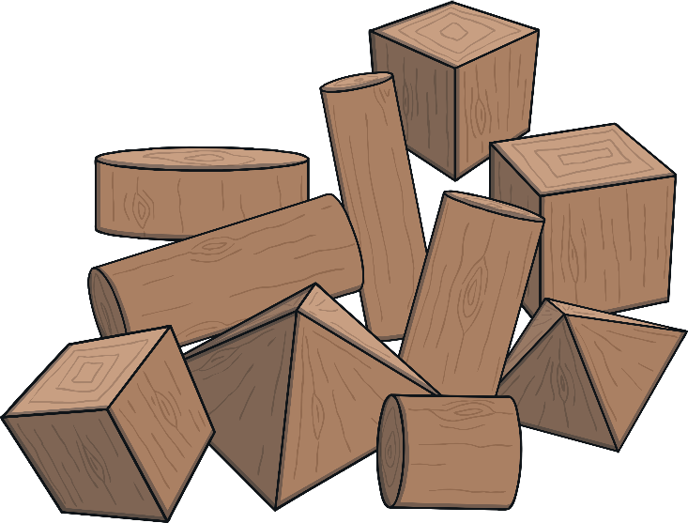
Which Natural Materials?
Talk About It
Which natural materials are used
in this sculpture by Andy
Goldsworthy?
wood and clay

Slide 9
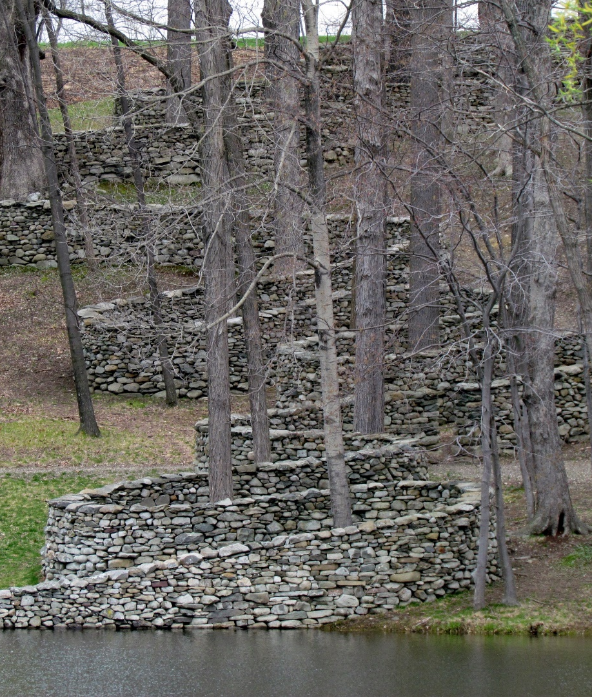
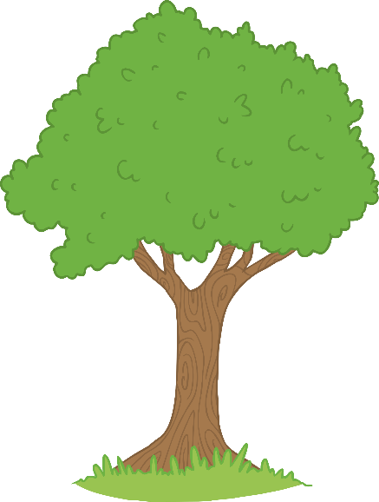
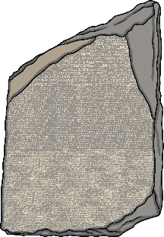
Which Natural Materials?
Talk About It
Which natural materials are used
in this sculpture by Andy
Goldsworthy?
stones and trees

Slide 10
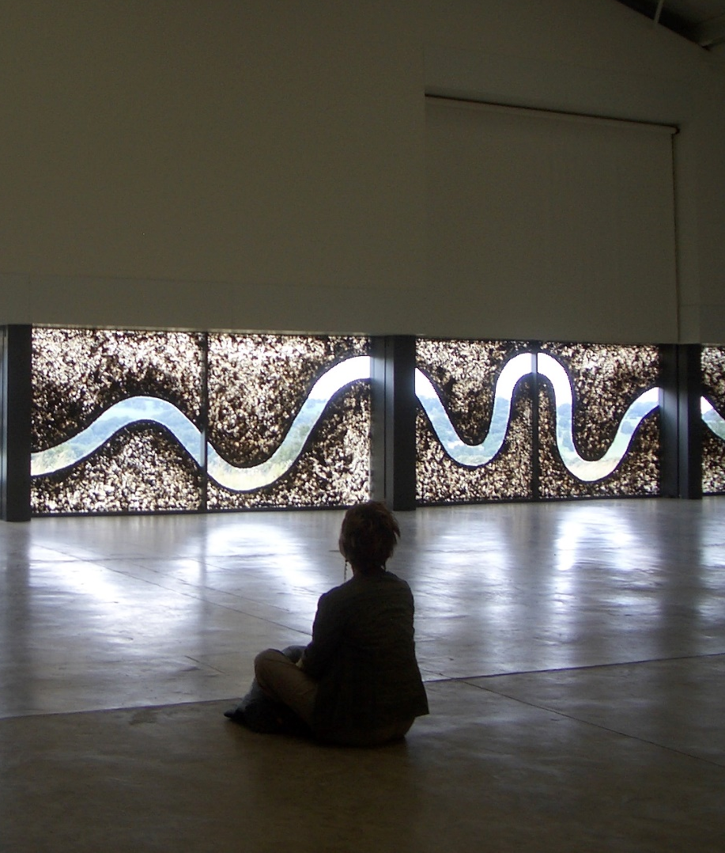
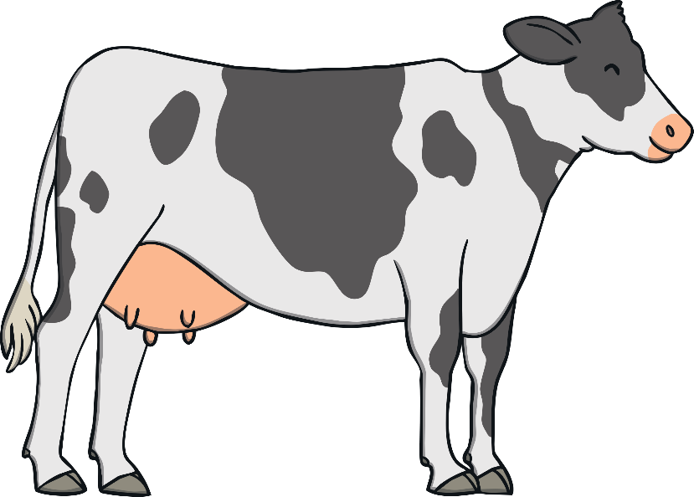
Which Natural Materials?
Talk About It
Which natural materials are used
in this sculpture by Andy
Goldsworthy?
cow dung!

Slide 11
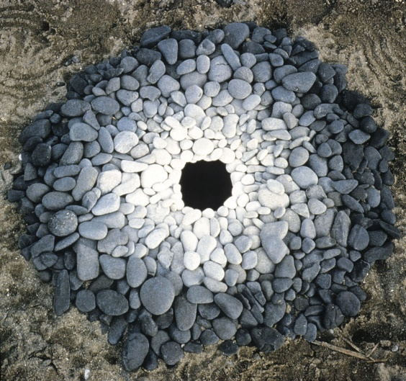
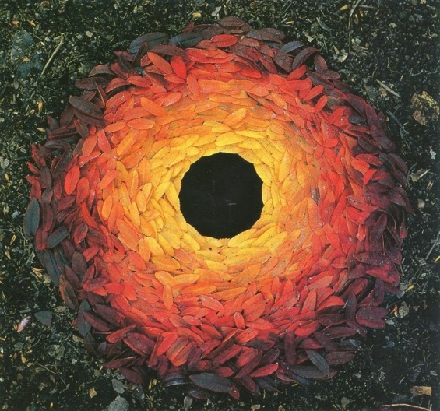
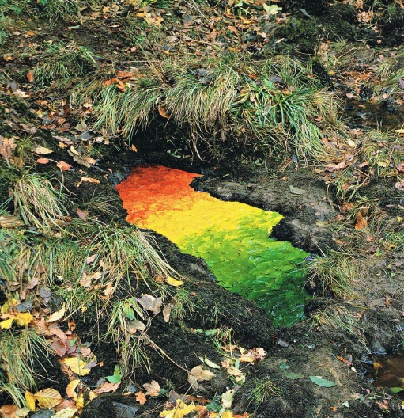
“We often forget that we are nature”
Andy Goldsworthy
Andy Goldsworthy’s art makes us think about
the world around us and how nature is art.
It reminds us of our connection to nature.
Talk About It
What do you think?

