Slide 1
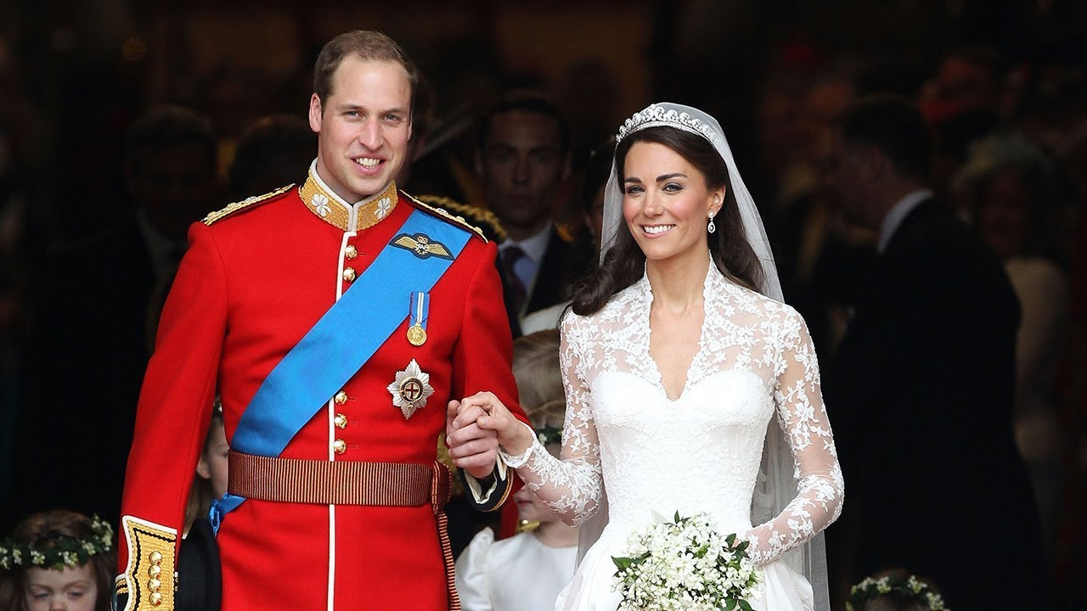

Royal wedding 2011
Prince William
&
Kate Middleton.
By Jacob Blakemore

Slide 2
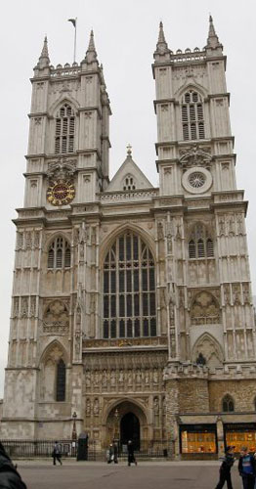
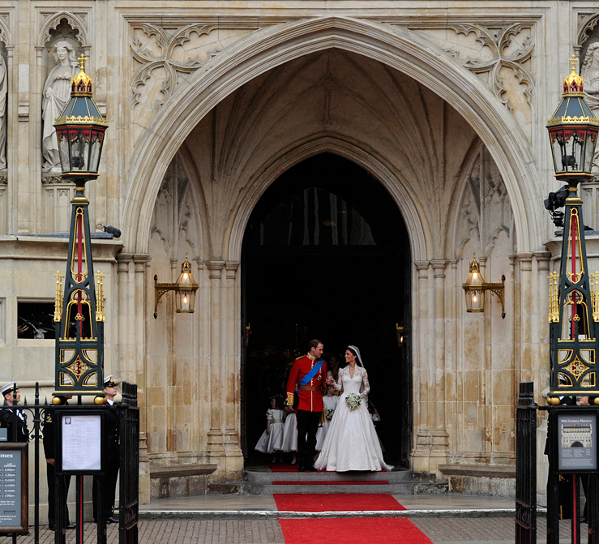
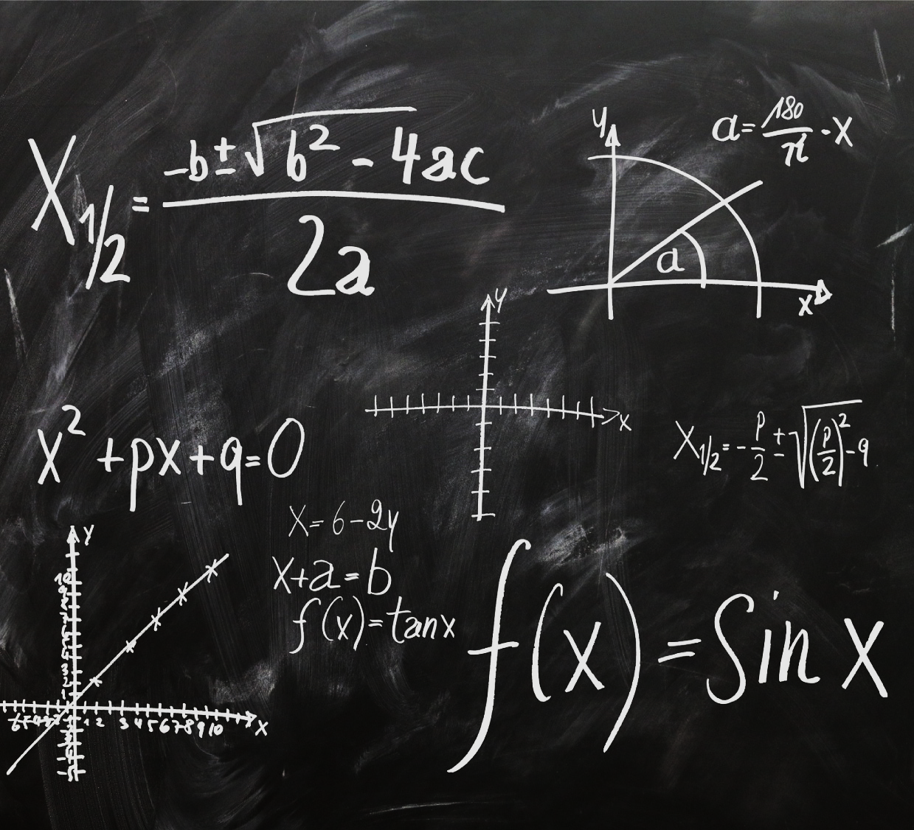
Westminster Abbey
On 29th April 2011
(which is the year I was born)
Prince William married his girlfriend Kate Middleton at Westminster Abbey, in London.

Slide 3
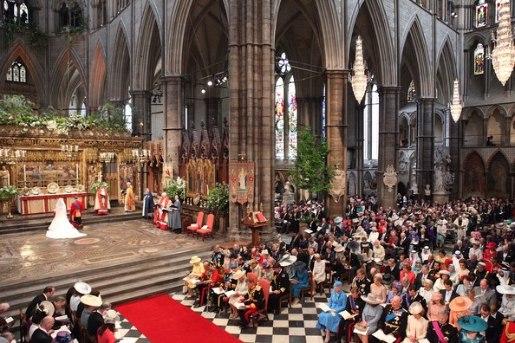
WESTMINSTER ABBEY
There were 2,000 people at their wedding.
And lots of people watched it on the television.

Slide 4
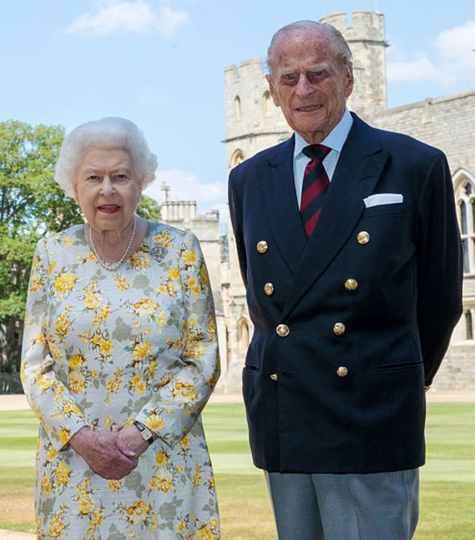
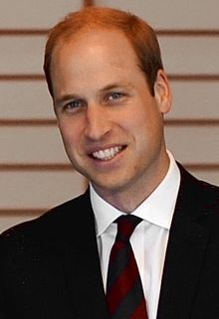

This is Queen Elizabeth and her husband prince PHILIP.
[YEAR]
Action
[YEAR]
Action
[YEAR]
Action
[YEAR]
Famous Event
This is PRINCE WILLIAM
HE IS SECOND IN LINE TO THE THRONE. After his dad prince Charles, he will be the king.

Slide 5
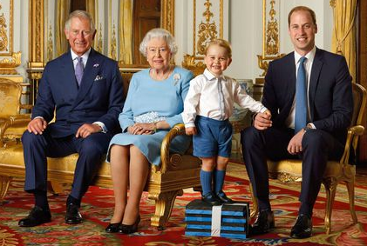
This is the queen and our
3 future kings
Explain this person’s role or involvement in the event.

