Slide 2



Diving into Mastery Guidance for Educators
Each activity sheet is split into three sections, diving, deeper and deepest, which are represented by the following icons:
These carefully designed activities take your children through a learning journey, initially ensuring they are fluent with the key concept being taught; then applying this to a range of reasoning and problem-solving activities.
These sheets might not necessarily be used in a linear way. Some children might begin at the ‘Deeper’ section and in fact, others may ‘dive straight in’ to the ‘Deepest’ section if they have already mastered the skill and are applying this to show their depth of understanding.
Diving
Deeper
Deepest

Slide 3
Aim
Solve simple measure and money problems involving fractions and decimals to two decimal places.

Slide 4

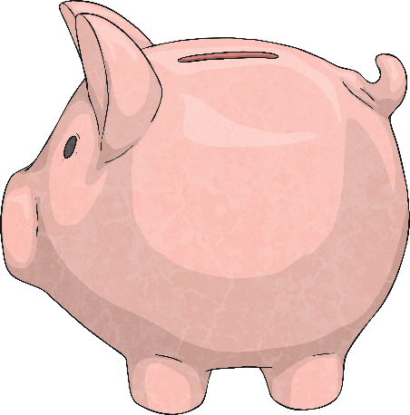
Four Operations
Diving
1
3
Tia has £24. She puts of this money into a savings account.
How much does she save? How much money does she have left?
Complete this bar model to help you calculate the answer.
£ .
24
£ .
£ .
8
16
Tia saved £8.
Tia had £16 left.

Slide 5
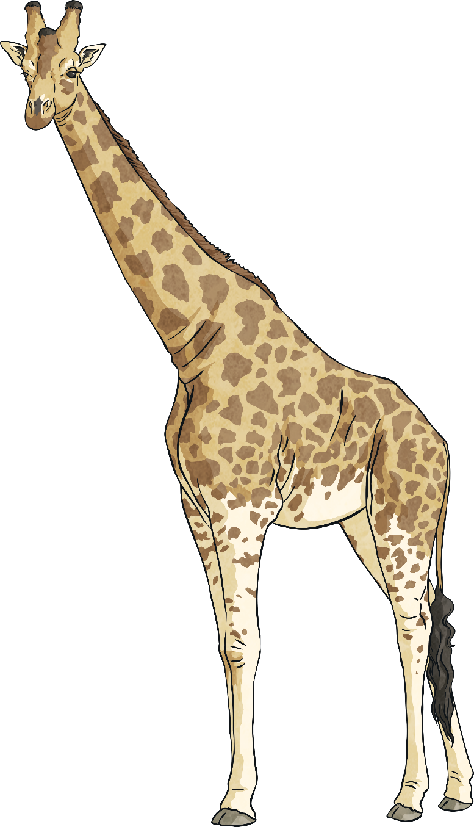
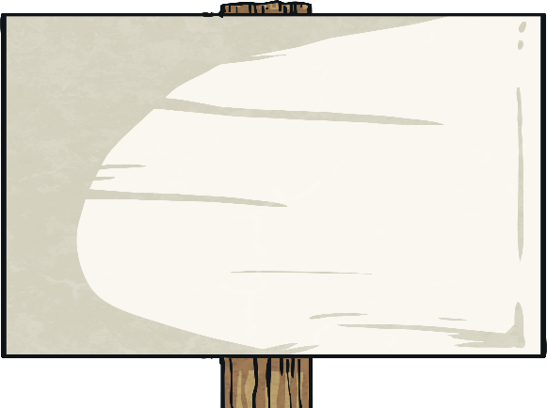
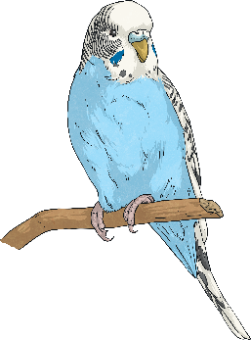
Four Operations
Diving
Here are the costs for entry to the zoo.
Adult | £6
Child | £4.30
How much does it cost for 1 adult and 2 children?
£6 + £4.30 + £4.30 = £14.60
How much change would they get from £20?
£20 - £14.60 = £5.40

Slide 6
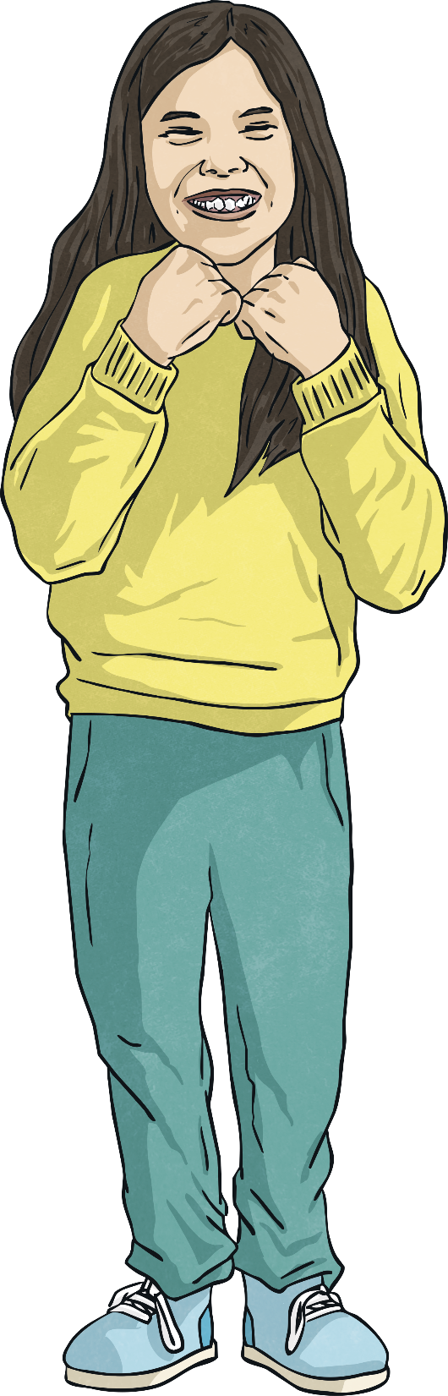
Four Operations
Diving
A shop has a sale. Everything is half price! This is what Toni bought.
Item | Sale Price | Full Price
game | £14
puzzle | £8
pen and pencil set | £4.20
£28
£16
£8.40
Complete the table to show the full price of
the items.
£26.20
How much in total did Toni pay?
How much would the items
have cost before the sale?
£52.40

Slide 7

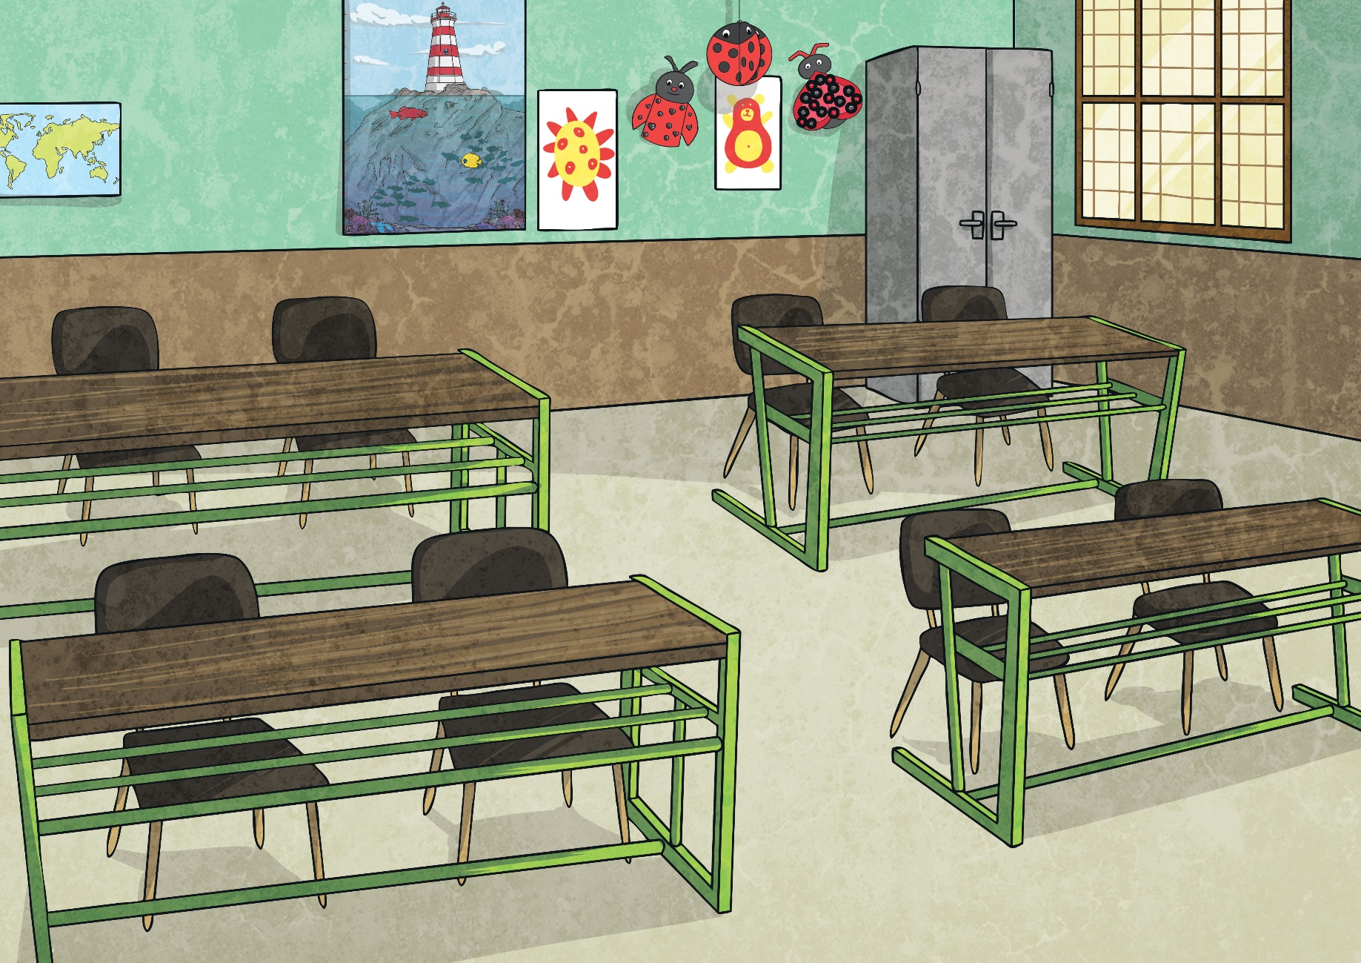
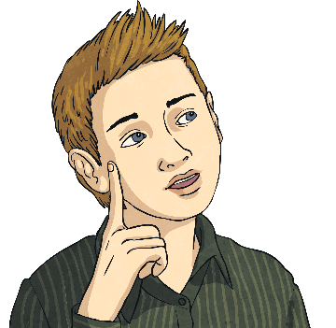
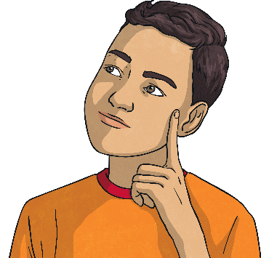
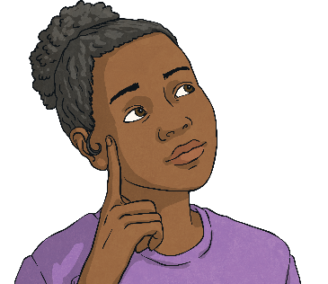
Four Operations
Deeper
Three children are comparing how much money they have collected for charity.
I have more than £8 but less than £12.
I have half the amount that Mo has.£10.
I have more than Sam but less than Mo.
Mo
Sam
Lou
Which of the following could be the amounts the children had collected? Tick or cross.
Mo | Sam | Lou
£9.40 | £4.70 | £5.20
Mo | Sam | Lou
£10.20 | £5.20 | £6.30
Mo | Sam | Lou
£11.30 | £5.65 | £8.90

Slide 8


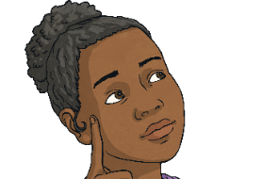


Four Operations
Deeper
I have more than £8 but less than £12.
I have half the amount that Mo has.£10.
I have more than Sam but less than Mo.
Mo
Sam
Lou
Mo | Sam | Lou
£9.40 | £4.70 | £5.20
Mo | Sam | Lou
£10.20 | £5.20 | £6.30
Mo | Sam | Lou
£11.30 | £5.65 | £8.90
Mo has more than £8 but less than £12.
Half of £9.40 = £4.70 so Sam has half of Mo’s amount.
£5.20 is more than £4.70 but less than £9.40 so Lou has more than Sam but less than Mo.
Mo has more than £8 but less than £12.
Half of £10.20 = £5.10, so Sam does not have half of Mo’s amount.
Mo has more than £8 but less than £12.
Half of £11.30 = £5.65 so Sam has half of Mo’samount.
£8.90 is more than £5.65 but less than £11.30 so Lou has more than Sam but less than Mo.

Slide 9
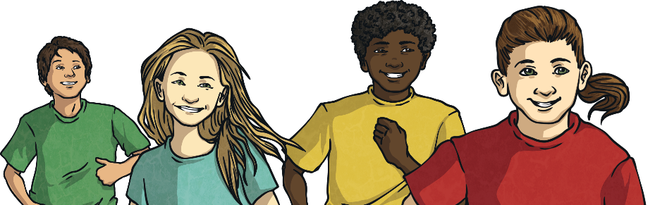
Four Operations
Deepest
A group of adults and children go to the cinema. It costs £4 for an adult’s ticket and £3 for a child’s ticket. In total, their tickets cost £22.
How many adults and how many children could have gone to the cinema?
Write all the possible groupings.
Use this table to help.
Can you see an amount from the adult column and an amount from the child column that add together to make £22?
 | Adult | Child
1 ticket | £4 | £3
2 tickets | £8 | £6
3 tickets | £12 | £9
4 tickets | £16 | £12
5 tickets | £20 | £15
£16 + £6 = £22 (4 adults and 2 children)
£4 + £18 = £22 (1 adult and 6 children)

Slide 10

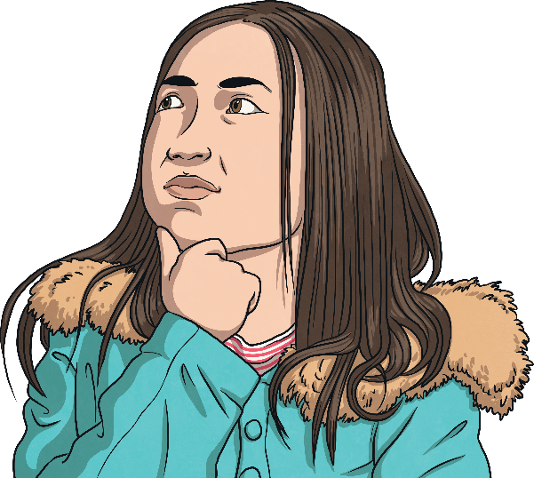
Four Operations
Deepest
I have chosen one of these amounts of money.
£2.70 | £11.36 | £4.26 | £5.92
£5.60 | £3.78 | £3.14 | £2.09
Work through these clues to find the amount.
The amount is greater than £3.
The amount is less than double £4.50.
Half of the amount is less than £2.
If you subtract 30p from the amount, the pounds digit would change.
For each clue, cross out any amounts which don’t fit.
What is the amount?
£3.14

Slide 11
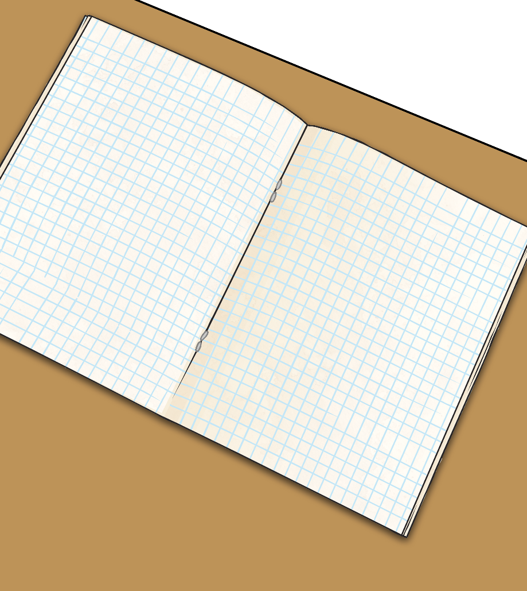
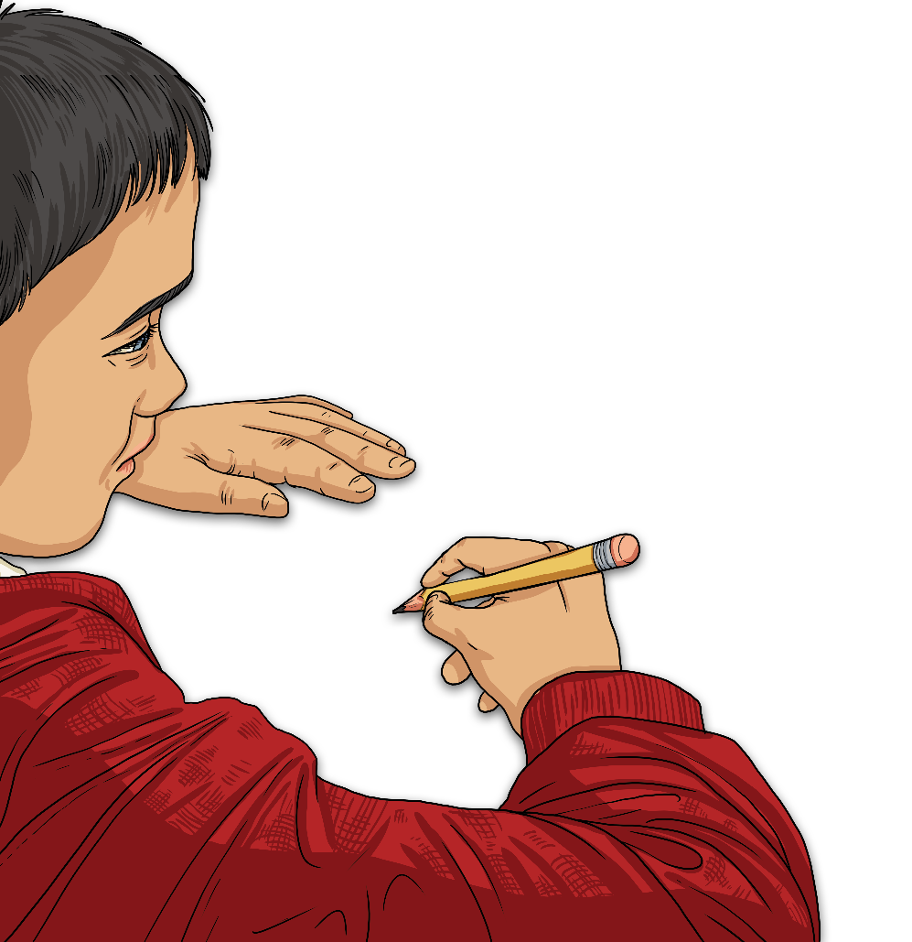
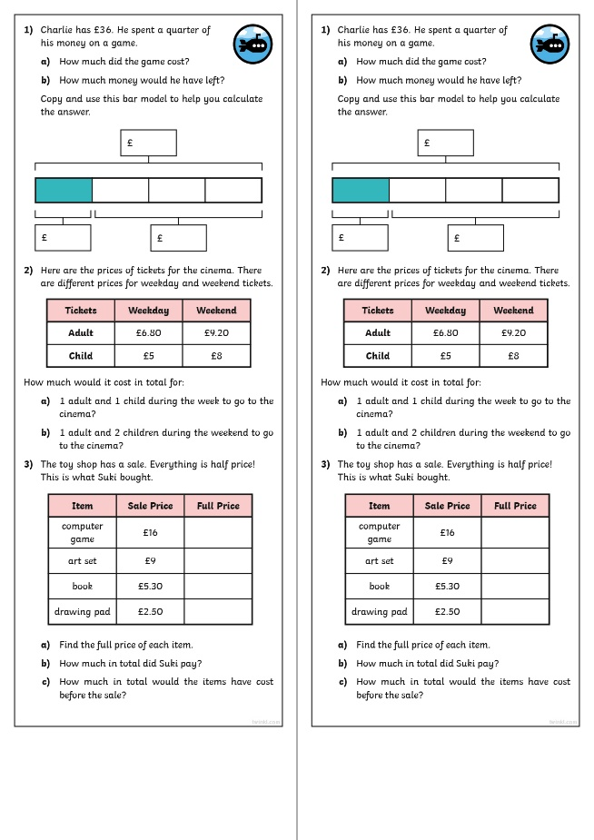
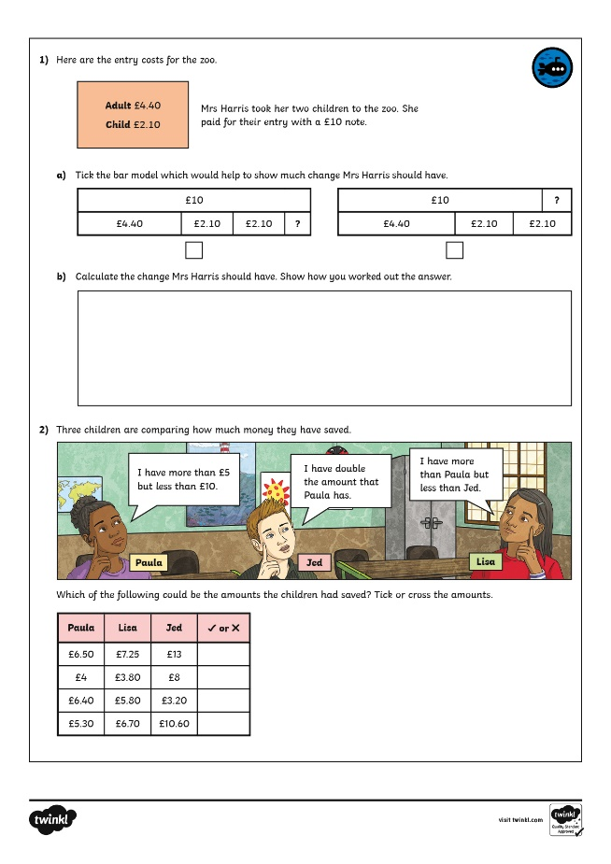
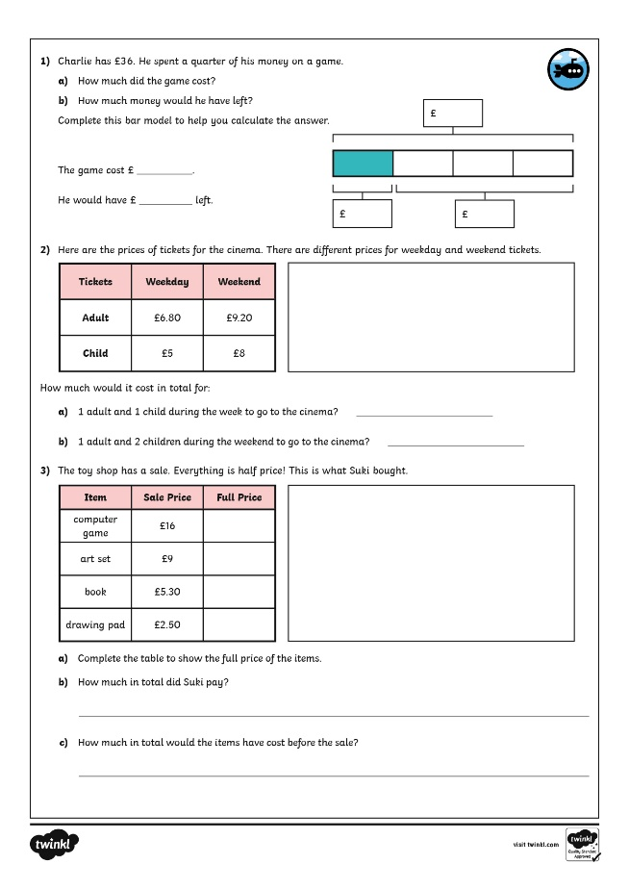

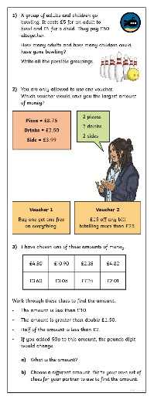
Four Operations
Dive in by completing your own activity!

Slide 12
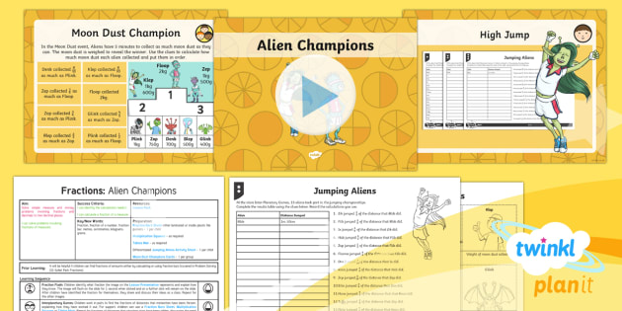
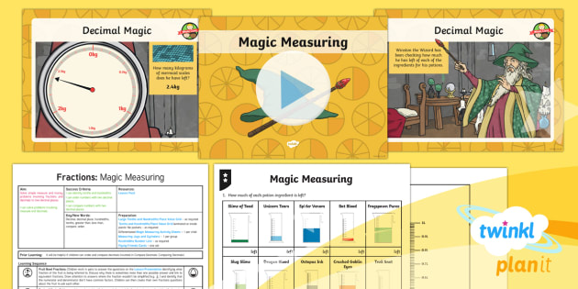

Need Planning to Complement this Resource?
National Curriculum Aim
Solve simple measure and money problems involving fractions and decimals to two decimal places.
For more planning resources to support this aim, click here.
Twinkl PlanIt is our award-winning scheme of work
with over 4000 resources.

