Slide 1
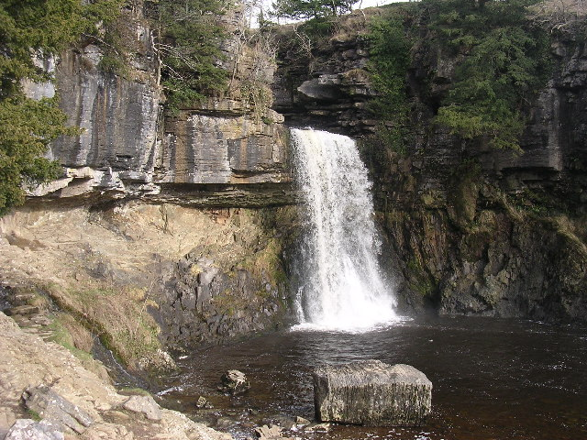
Florence Buckner
Year 4
Rivers Near My Home

Slide 2
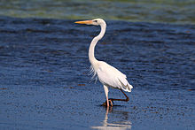
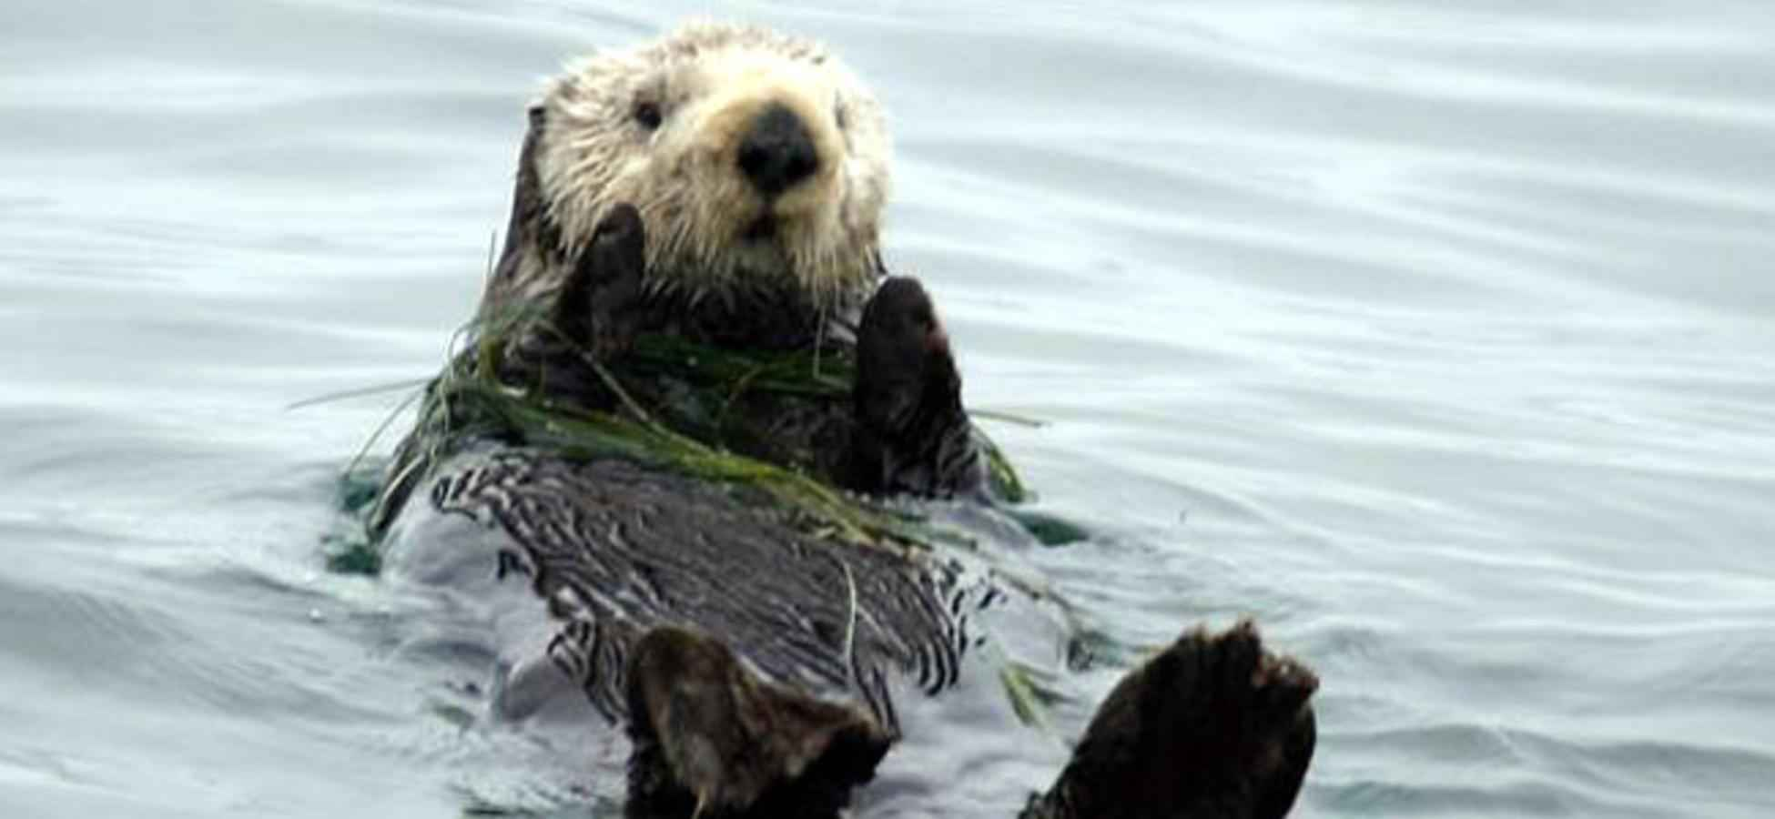
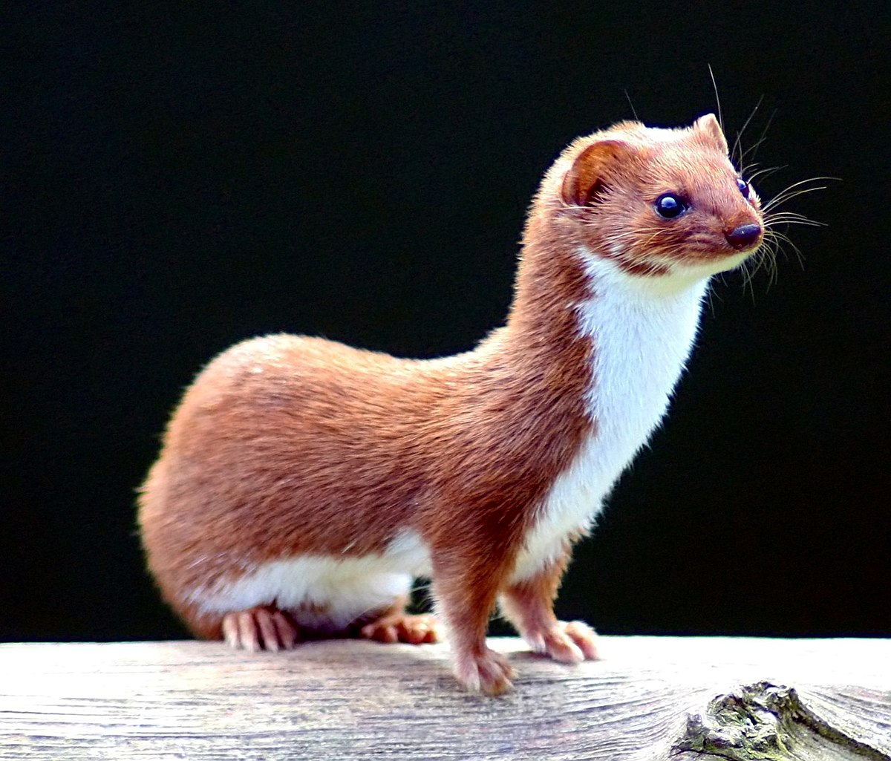
Animals That Live In Rivers Near me
Carp
Roach
Minnow
Otter
Badgers
Mink
Heron

Slide 3
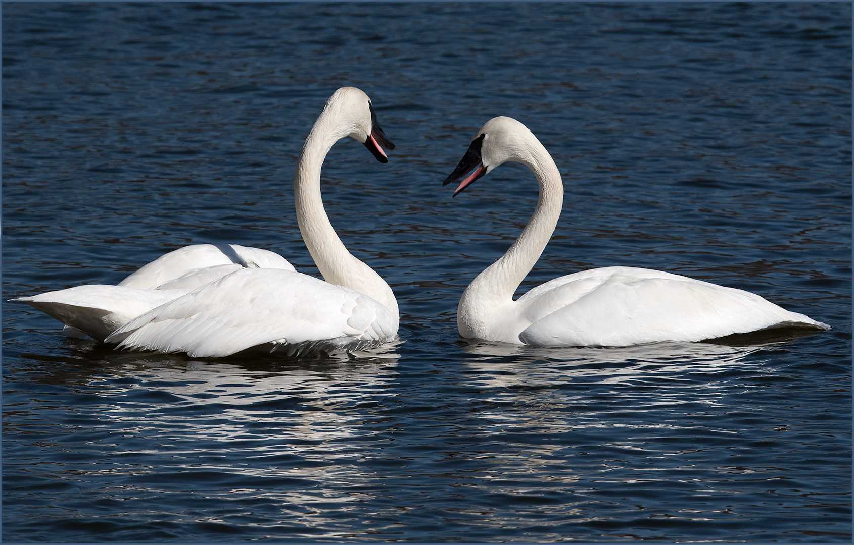
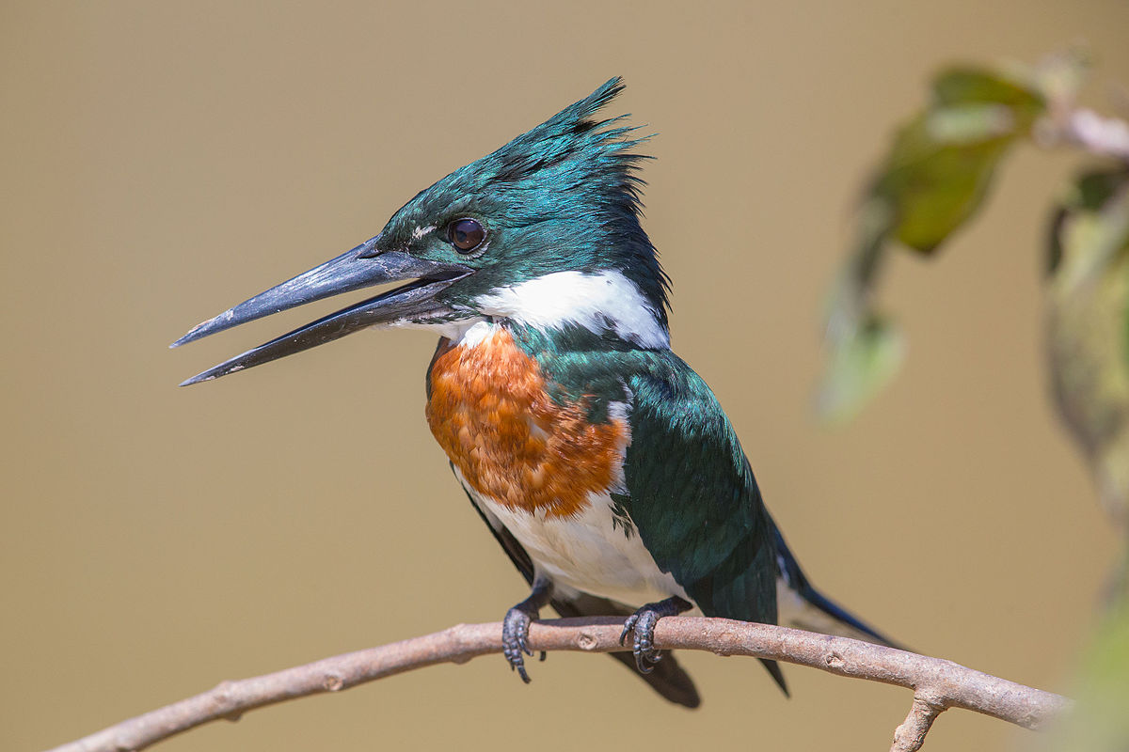
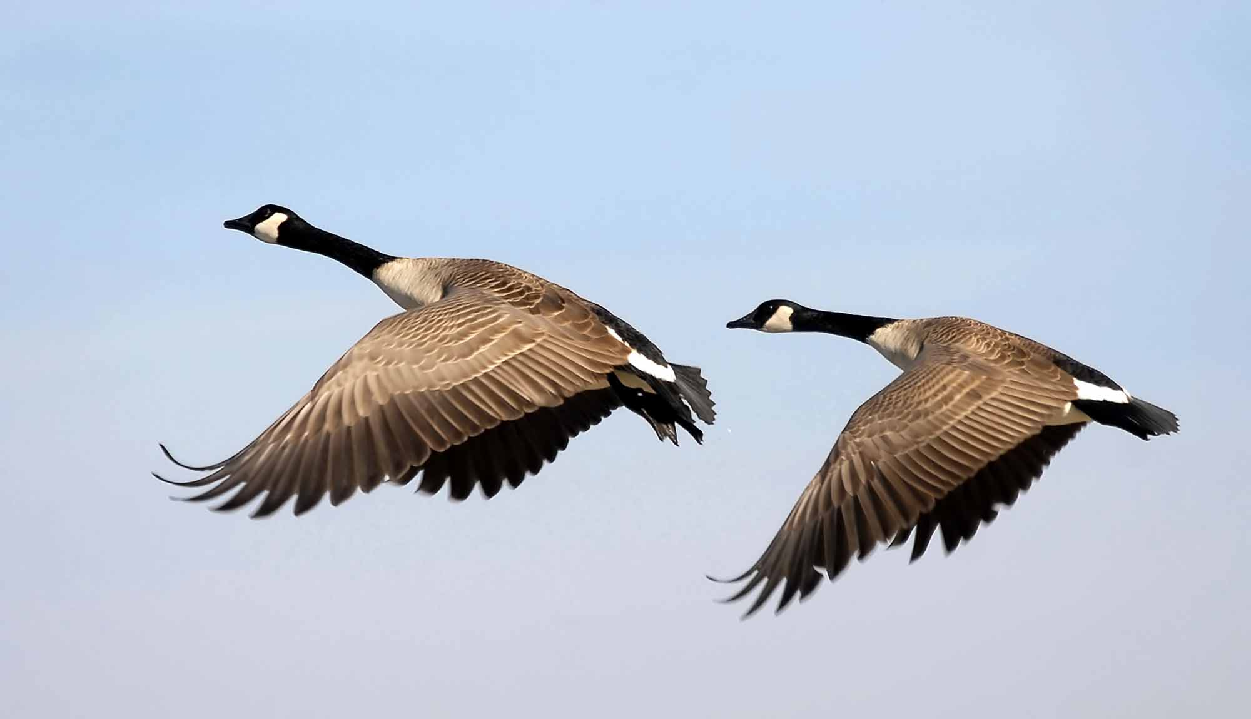
Birds That Live In the Rivers
Near Me
Swan
Ducks
Canada Geese
Kingfishers

Slide 4
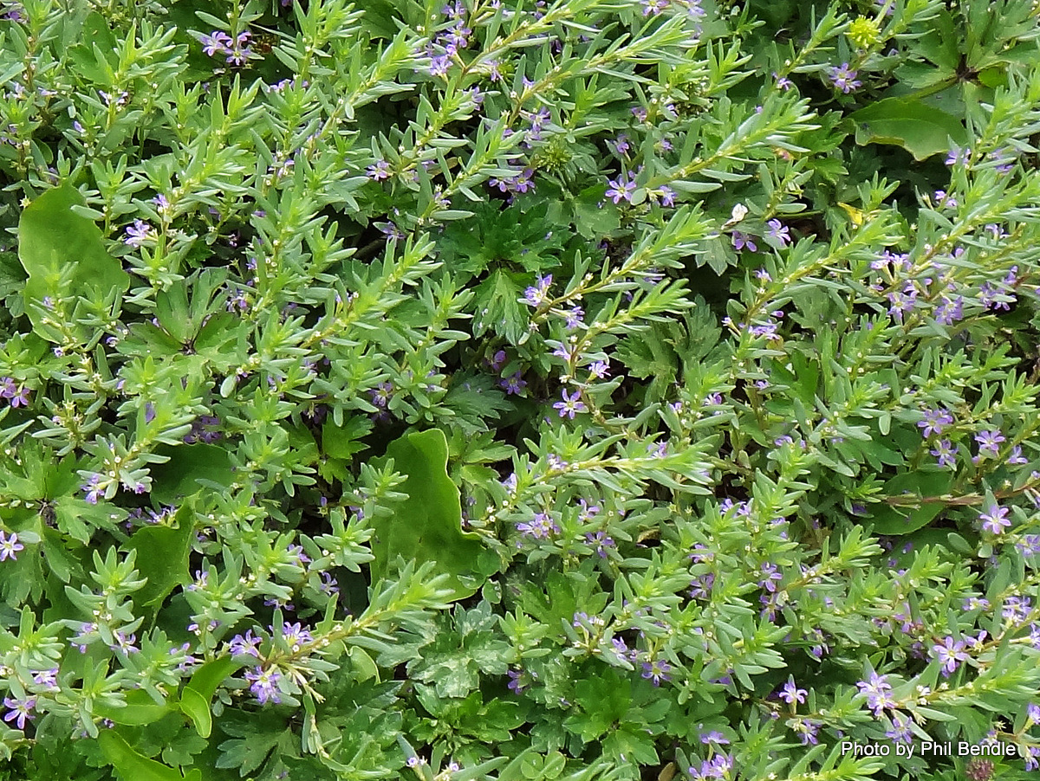
Plants Found In Rivers Near
Me
Wimping Willow
Fen Violet
Creeping Marshwot
Grass Poly

