Slide 2
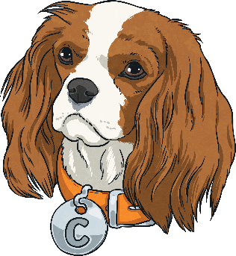
What Does Cassie the Commentator Do?
Cassie the Commentator helps you to:
Compare, contrast or comment on the text.
This means that she is there to help you to compare different parts of the text. Cassie also helps you to give your opinion about the text.
Cassie helps you to compare characters or events in a text. This means that you will need to think carefully about what you have read and use evidence from the text to support your answers.

Slide 3
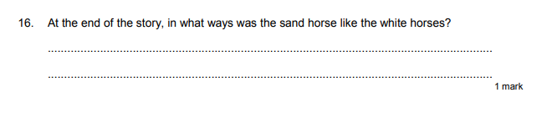
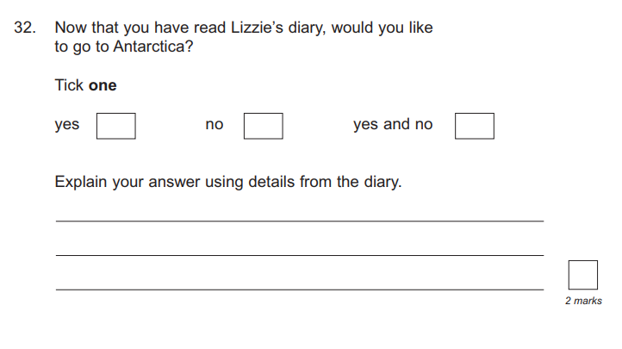
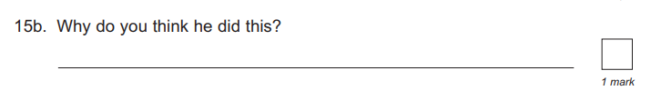
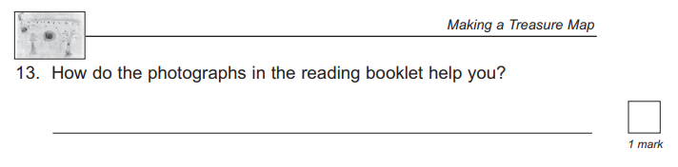
When Have We Seen
Cassie the Commentator?
Cassie the Commentator questions appear when someone wants to know your opinion or if somebody wants to check that you have understood changes in the text. Here are some examples:
Click on the image to find out more.

Slide 4

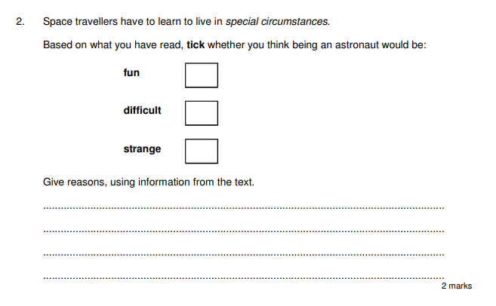
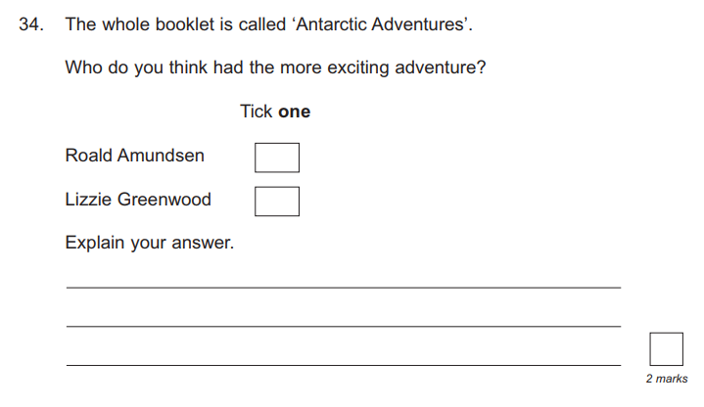
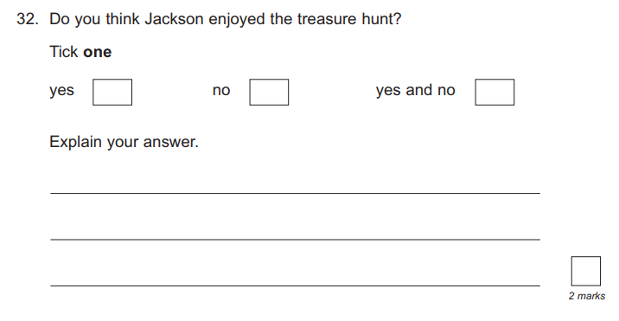
The ‘Your Choice’ Question
Back
This type of question will ask for your opinion.
For these questions, you must use your opinion to select and tick the correct number of boxes. Underneath, you must explain why you have chosen
that answer.

Slide 5
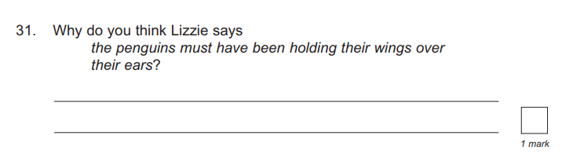
The ‘Why Do You Think’ Question
Back
This type of question will ask you to give your opinion about why you think something in the text has happened. These questions require a short answer. You will need to think carefully about the text before answering.

Slide 6
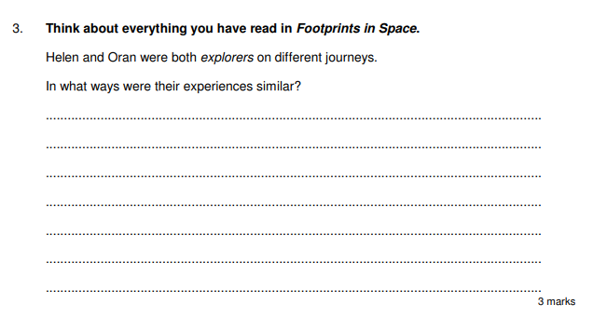
The ‘Compare’ Question
Back
This type of question will ask you to compare characters or events within the text.
Sometimes, you may be asked to say why characters or events were different.
Make sure to read the question carefully so that you know what you have been asked to compare.

Slide 7
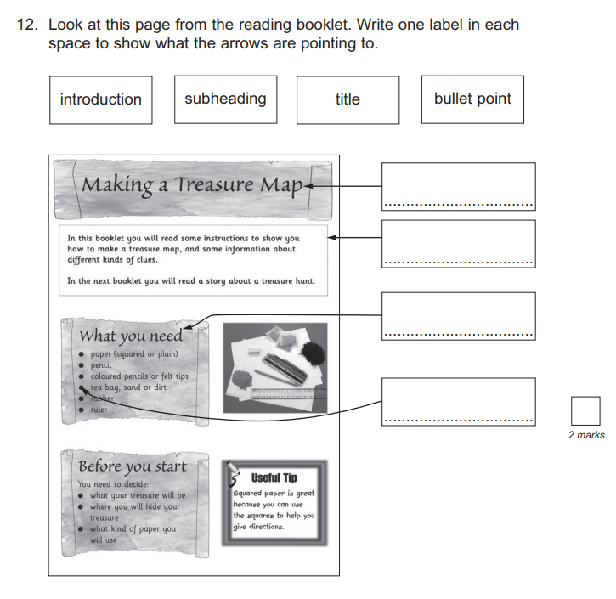
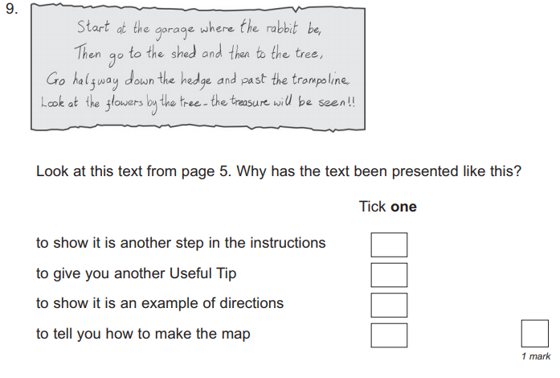
The ‘Layout’ Question
Back
This type of question will ask you to discuss the layout of a text and to think about how it is helping the reader.

Slide 8
What Might Cassie the Commentator Ask?
Cassie the Commentator might ask questions like these:
What is similar/different about…?
What do you think…?
Why do you think…?
Based on what you have read…
How has the author organised the text?

Slide 9
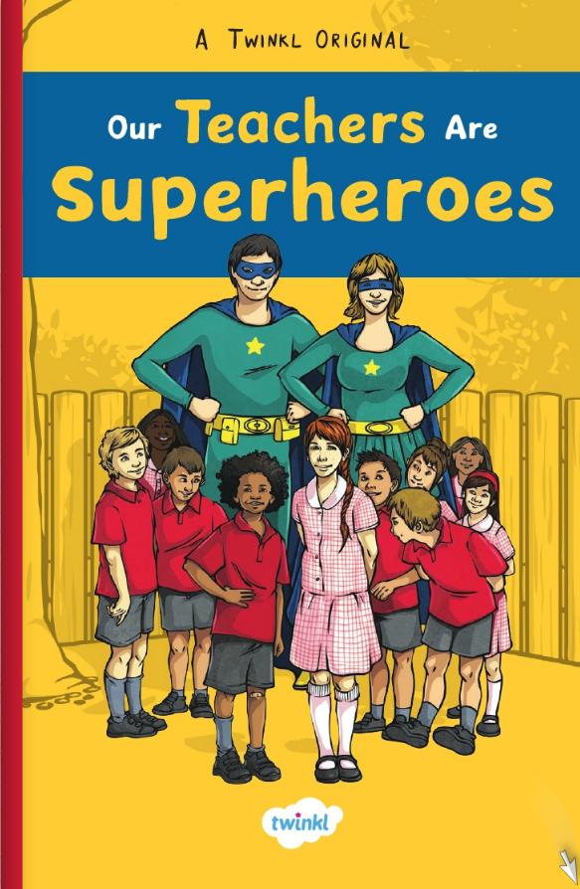
Let’s Explore Cassie the Commentator Questions Together
Read the extract from Our Teachers Are Superheroes and answer the questions as a class.
Click on the image to read the text.
Read the rest of the Our Teachers Are Superheroes story here.

Slide 10
Let’s Explore Cassie the Commentator Questions Together
Read the extract from Our Teachers Are Superheroes and answer the questions as a class.
Freya and Benji are good friends.
In what way are they similar to each other?
“Although I’m not sure that’s such a kind choice, Benji.”
Why do you think Mr Jay says this?
Do you think Benji is a good friend?
yes no maybe
Explain your choice using evidence from the text.
Chapter 1
Superpowers
Look at the beginning of the text. Why is the word Superpowers in bold?

Slide 11
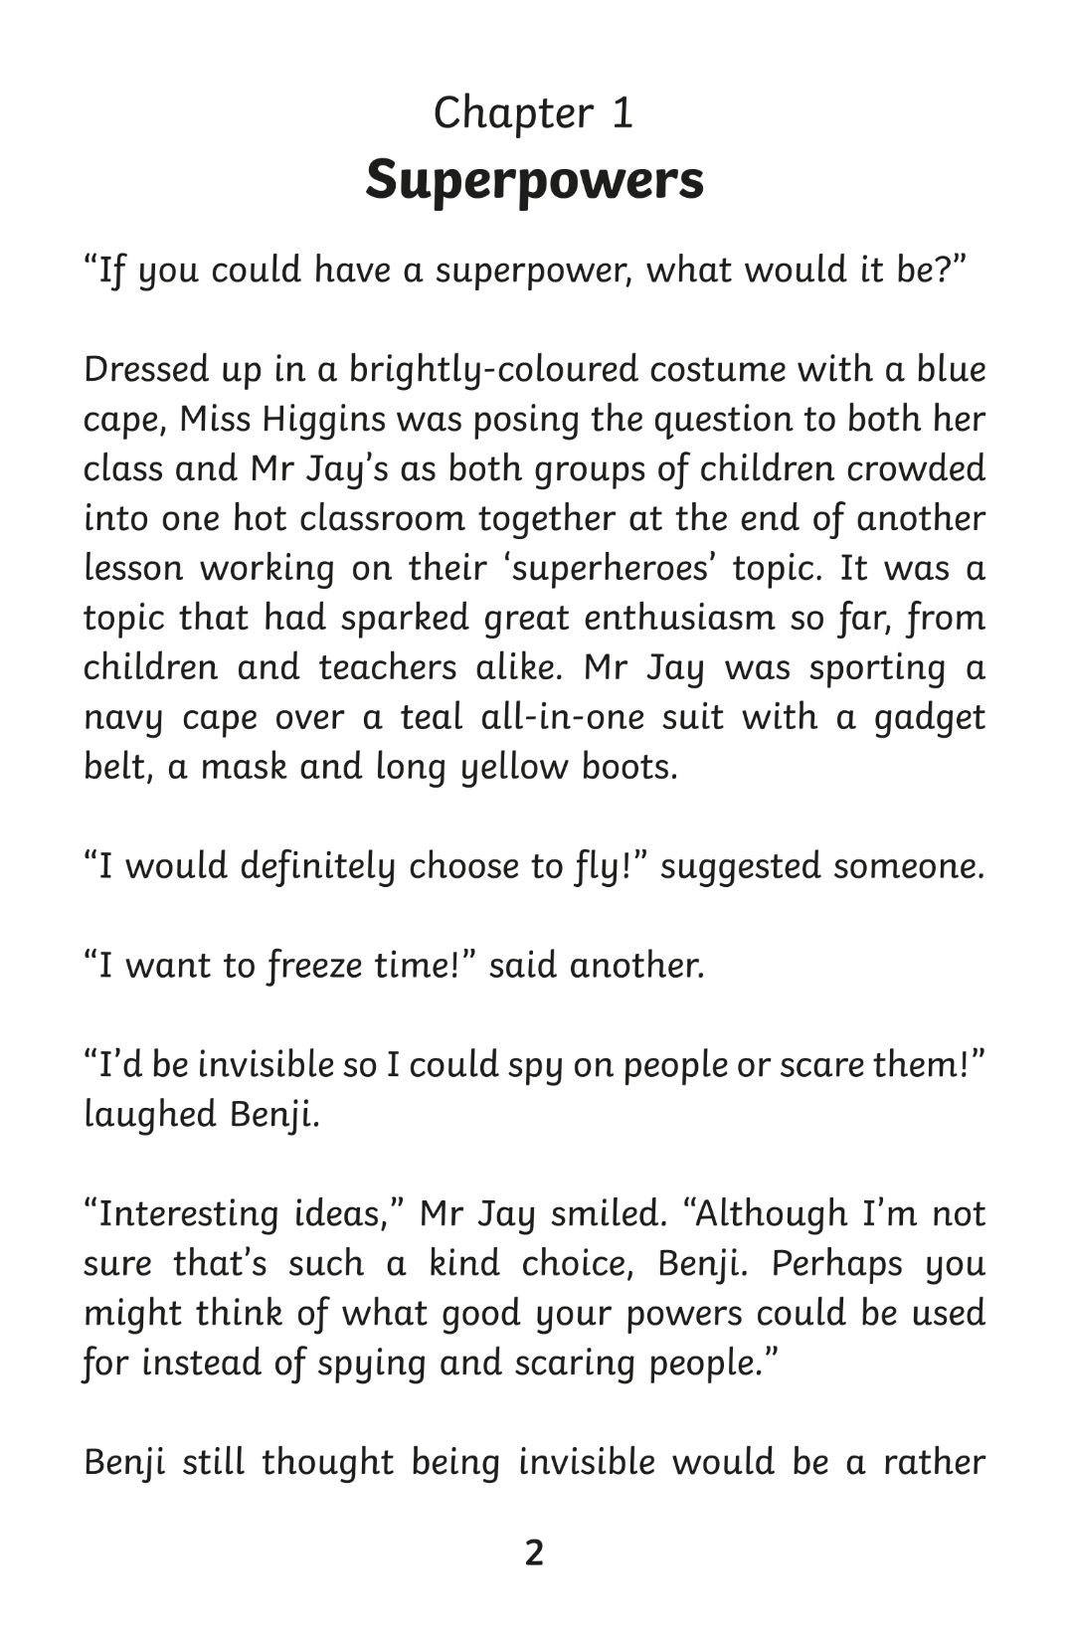
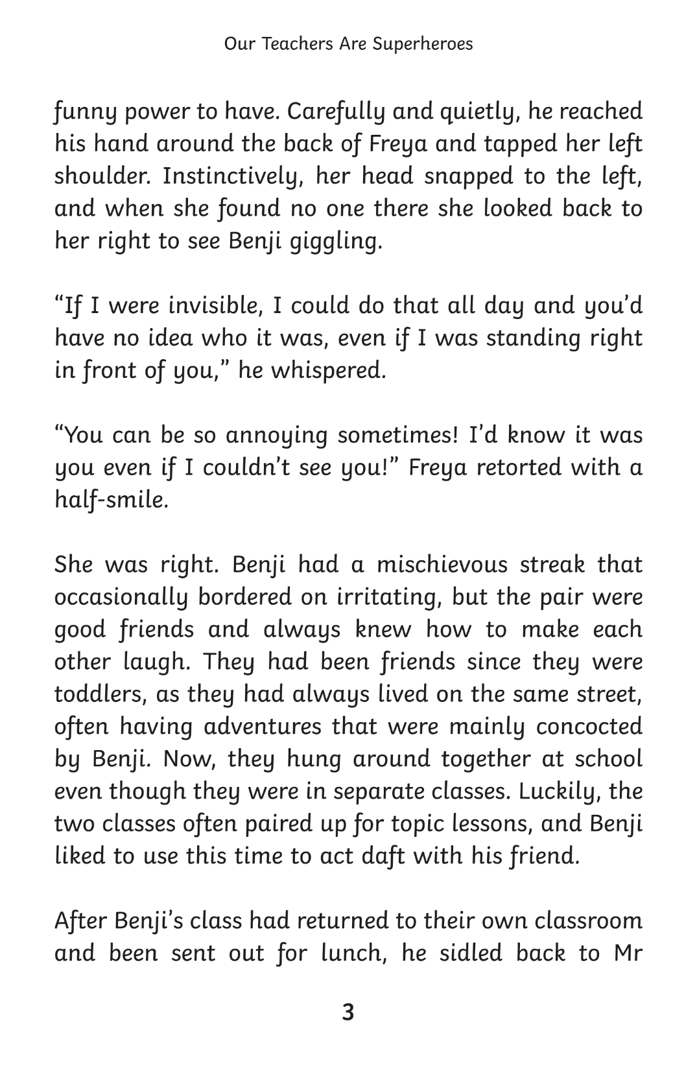
Go Back
Back

Slide 12
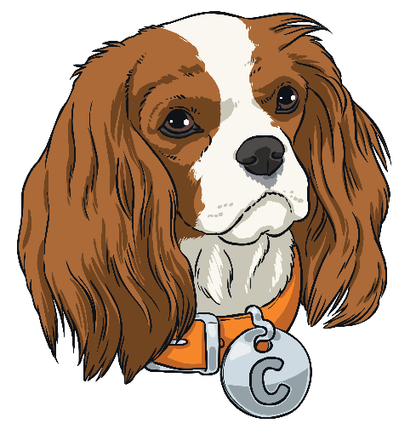
Summing Up Cassie the Commentator
Prove your understanding of what Cassie the Commentator does by answering the following questions:
What does Cassie the Commentator help you to do?
What sort of question might Cassie the Commentator ask?
What do you think Cassie the Commentator would give as her
top tip?

