Slide 2



Diving into Mastery Guidance for Educators
Each activity sheet is split into three sections, diving, deeper and deepest, which are represented by the following icons:
These carefully designed activities take your children through a learning journey, initially ensuring they are fluent with the key concept being taught; then applying this to a range of reasoning and problem-solving activities.
These sheets might not necessarily be used in a linear way. Some children might begin at the ‘Deeper’ section and in fact, others may ‘dive straight in’ to the ‘Deepest’ section if they have already mastered the skill and are applying this to show their depth of understanding.
Diving
Deeper
Deepest

Slide 3
Aim
Estimate, compare and calculate different measures, including money in pounds and pence.

Slide 4

Estimating Money
Diving
Find the cost of these items on the number line.
£3.35
£3.78
£3
£3.50
£4
Now round the cost of each item to the nearest pound.
=
£3.00
=
£4.00

Slide 5
Estimating Money
Diving
Estimate the total approximate cost of these toys.
£3.17
£6.81
£2.96
and
Approximate cost of giraffe + robot: £3 + £7 = £10
£12.75
£6.29
and
Approximate cost of scooter + car: £13 + £6 = £19

Slide 6

Estimating Money
Deeper
Ava has five purses with different amounts of money in each.
Decide whether each statement is true or false. Explain your answers.
A
B
C
D
E
£7.78
£8.49
£8.67
£7.46
£9.04
When rounded to the nearest pound, only purse E rounds to £9.
False. Purse C also rounds to £9.
False. A rounds to £8 and D rounds to £7.
Therefore, the approximate total is £15.
When rounded to the nearest pound, the approximate total of purses A and D is £14.
True. The approximate total of the money in all her purses is £41, so Ava will have enough money to pay for her £40 shopping.
Ava estimates that she can pay for her £40 shopping using the
money in all her purses.

Slide 7

Estimating Money
Deepest
Lily buys the same sandwich every day in her local shop.
Lily estimates that she has spent £24 on sandwiches.
£3.92
Round the price of the sandwich to estimate how many
days Lily bought this sandwich.
£3.92 is £4 to the nearest pound.
£24 ÷ 4 = 6
Lily has bought the same sandwich for 6 days.
Estimate how much Lily would spend if she
bought the same sandwich every day for 2 weeks.
2 × 7 = 14 days
14 × £4 = £56

Slide 8
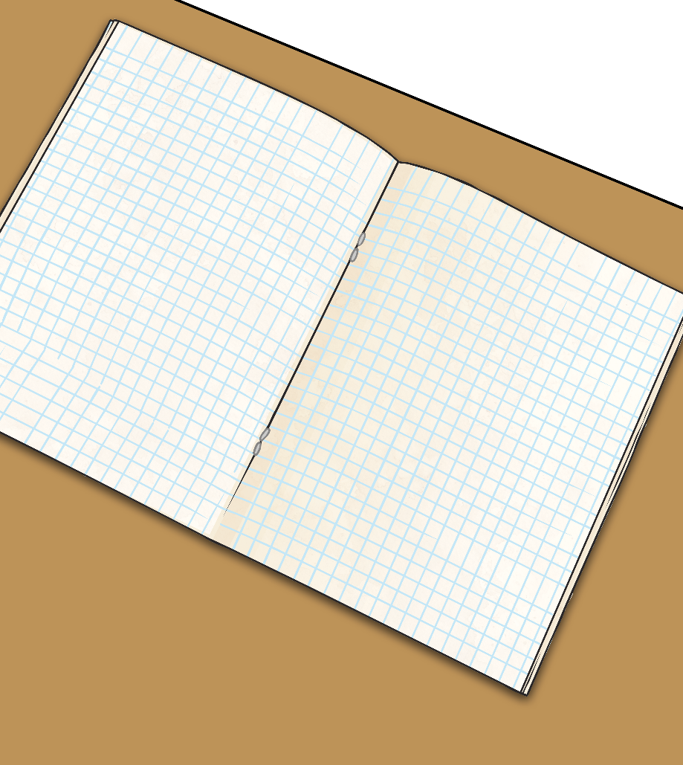
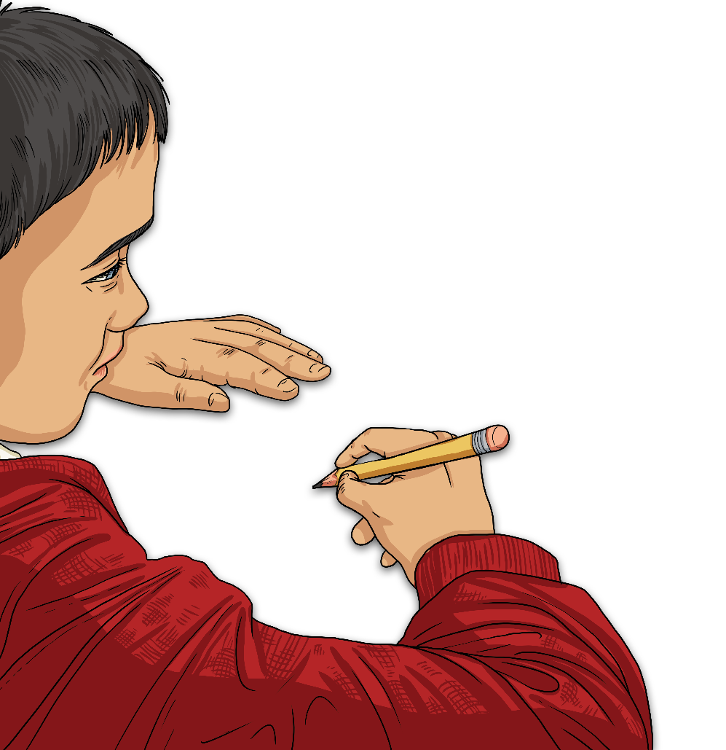
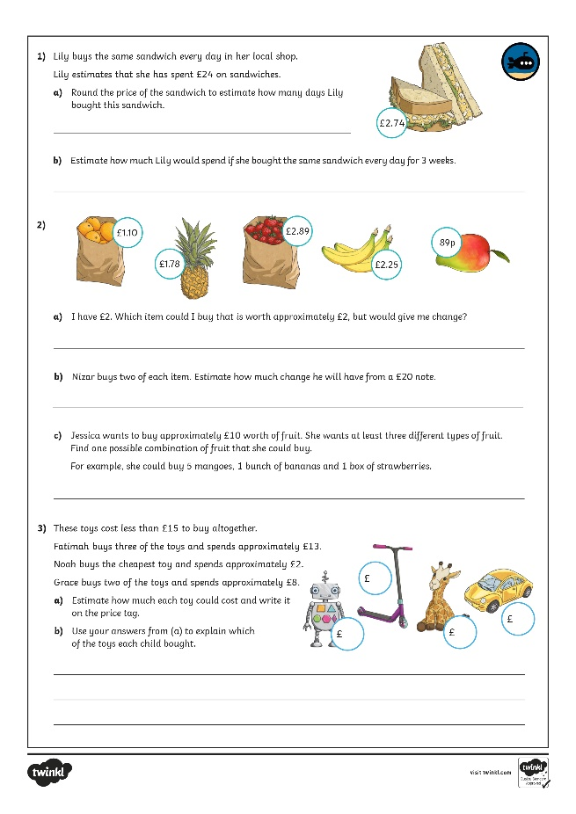
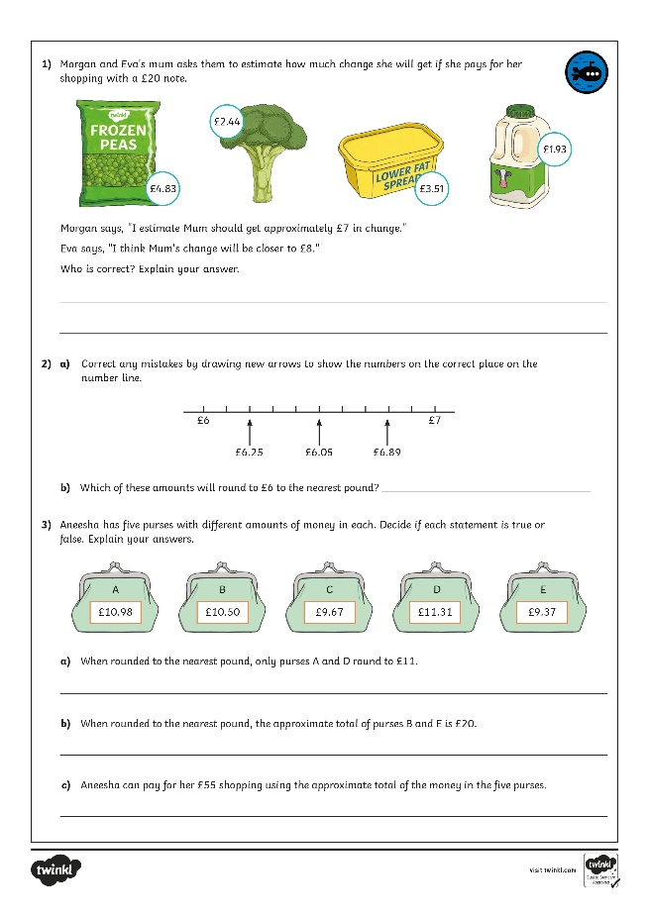
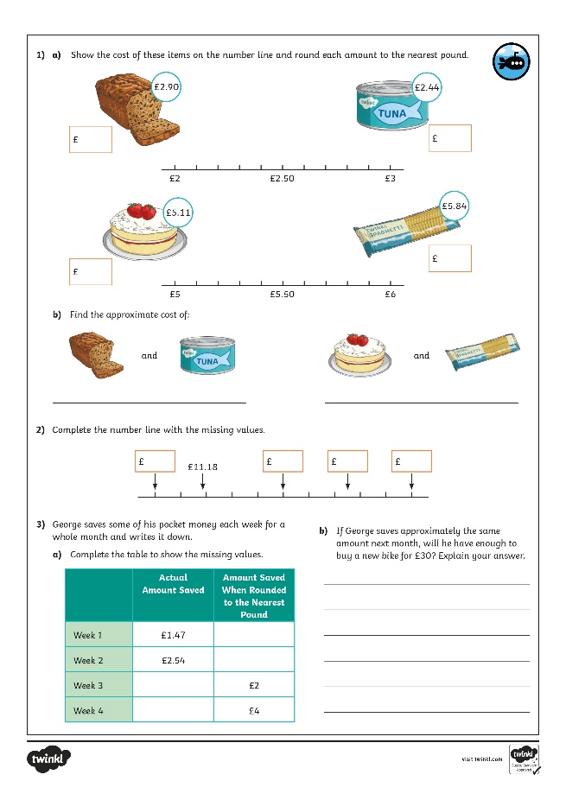
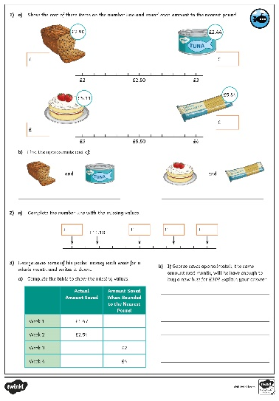
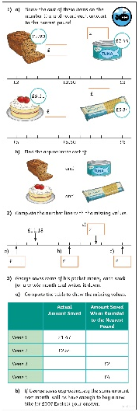
Estimating Money
Dive in by completing your own activity!

Slide 9
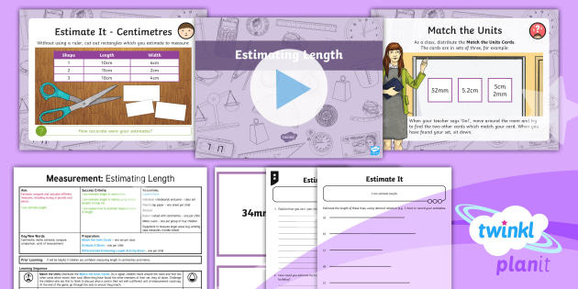
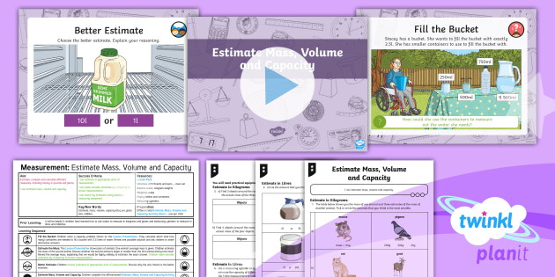

Need Planning to Complement this Resource?
National Curriculum Aim
Estimate, compare and calculate different measures, including money in pounds and pence
For more planning resources to support this aim, click here.
Twinkl PlanIt is our award-winning scheme of work
with over 4000 resources.

