Slide 2



Diving into Mastery Guidance for Educators
Each activity sheet is split into three sections, diving, deeper and deepest, which are represented by the following icons:
These carefully designed activities take your children through a learning journey, initially ensuring they are fluent with the key concept being taught; then applying this to a range of reasoning and problem-solving activities.
These sheets might not necessarily be used in a linear way. Some children might begin at the ‘Deeper’ section and in fact, others may ‘dive straight in’ to the ‘Deepest’ section if they have already mastered the skill and are applying this to show their depth of understanding.
Diving
Deeper
Deepest

Slide 3
Aim
Compare numbers with the same number of decimal places up to two decimal places.

Slide 4
Order Decimals
Diving
Write the numbers shown on the place value grid and put them in ascending order.
Ones | tenths | hundredths
1.05
Ones | tenths | hundredths
2.11
Ones | tenths | hundredths
1.12
In ascending order:
1.05
1.12
2.11

Slide 5
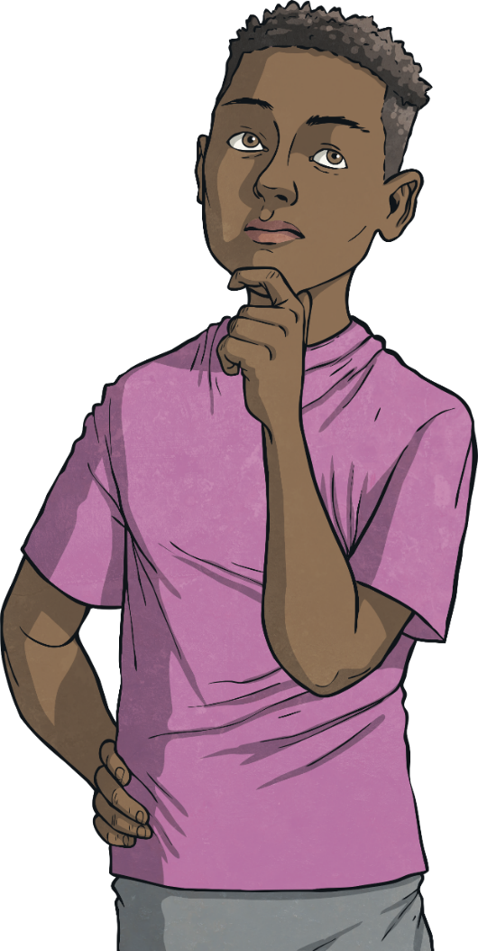
Order Decimals
Diving
Write the numbers in descending order:
6.3
34.6
3.04
In descending order:
34.6
6.3
3.04
Write the missing digits to make each statement correct:
9.22 > 8.17 > 8.13
2.71 < 3.29 < 4.03
4.18 > 4.09 > 4.03
There are many possible answers. For example:

Slide 6

Order Decimals
Deeper
In each set of numbers, one is in the wrong place. Spot this number and tell your partner where it should be.
In ascending order:
5.03
5.7
6.98
6.3
7.2
In descending order:
8.65
8.42
8.4
7.2
7.5

Slide 7

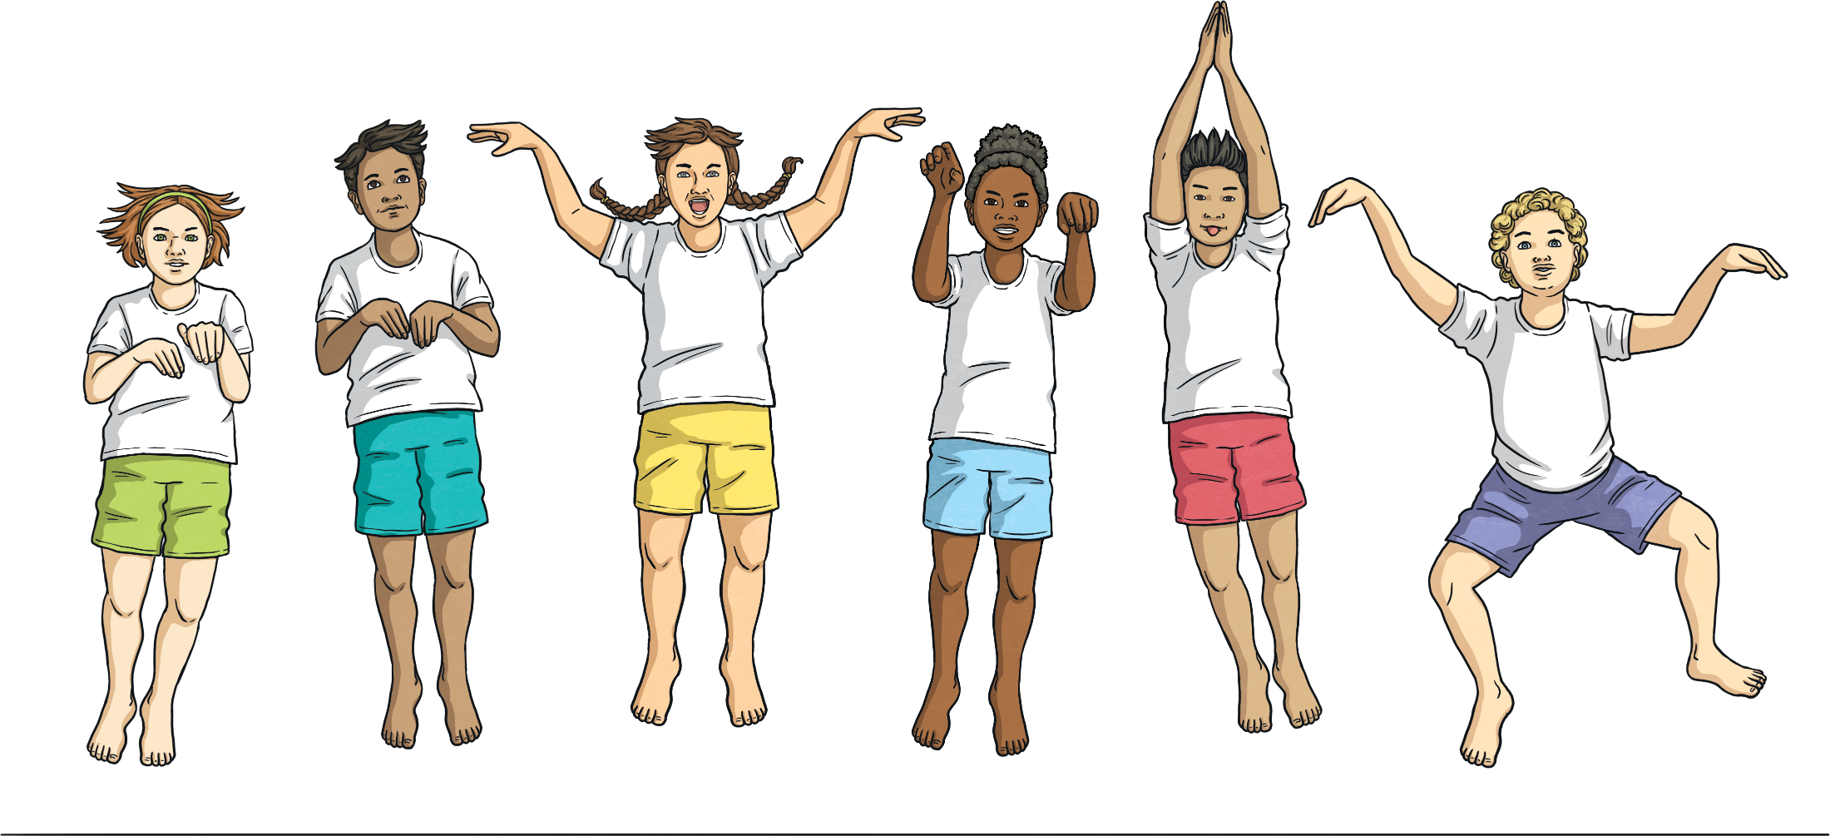
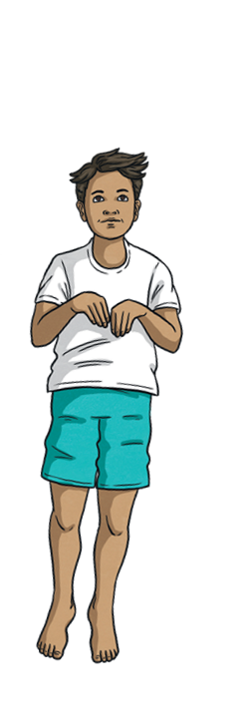
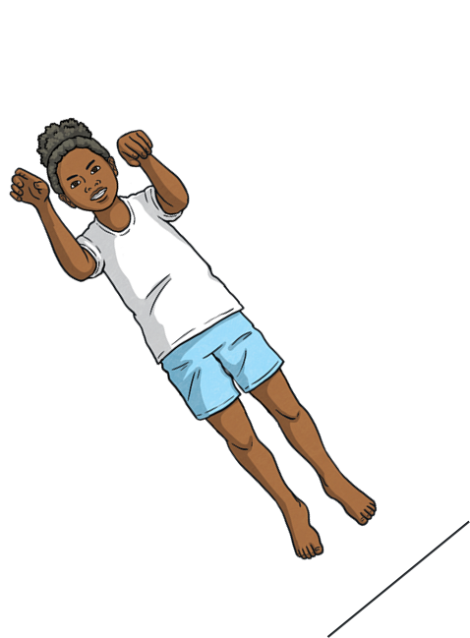

Order Decimals
Deepest
A group of children measured how far they could jump from a standing start. This table shows the distance they jumped:
Names | Distance
Bess | 2.45m
Kyle | 1.8m
Heena | 167cm
Kris | 1.05m
Betsy | 2.2m
Order the children in ascending order of the distance they jumped.
Kris
Heena
Kyle
Betsy
Bess

Slide 8
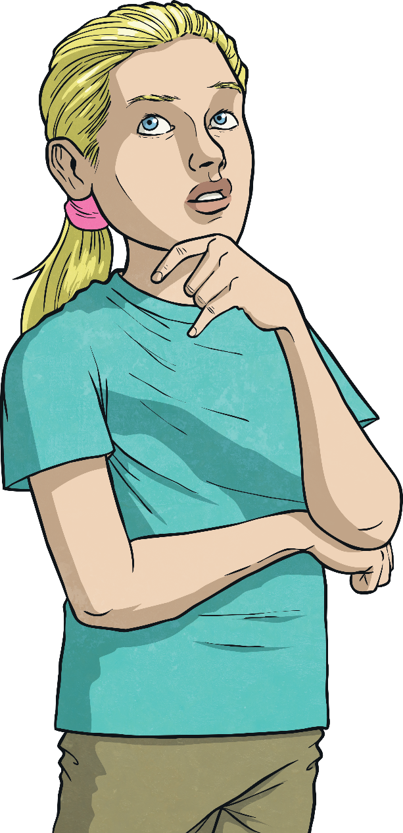
Order Decimals
Deepest
Using only the digits below, write four different numbers with one or two decimal places. Then, put them in ascending order.
1
2
3
3
3
4
4
5
6
6
7
There are many different answers.
Here is one solution:
2.76
3.4
5.33
6.14

Slide 9
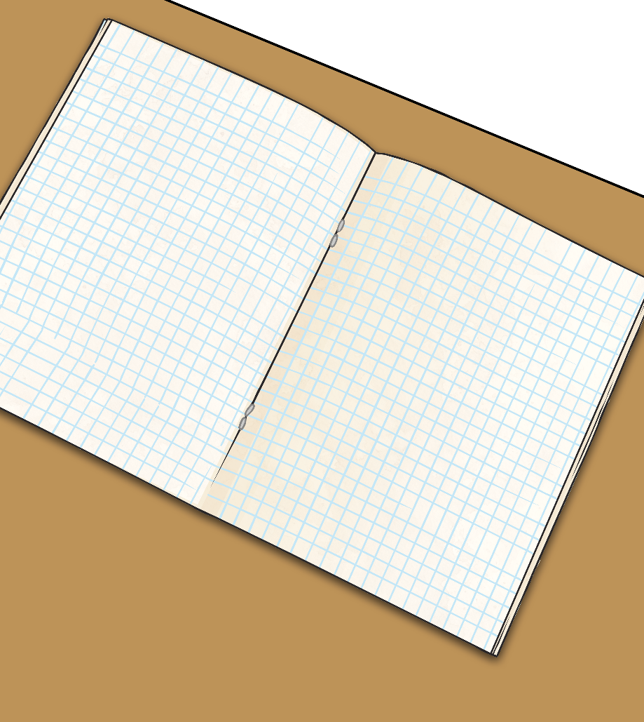
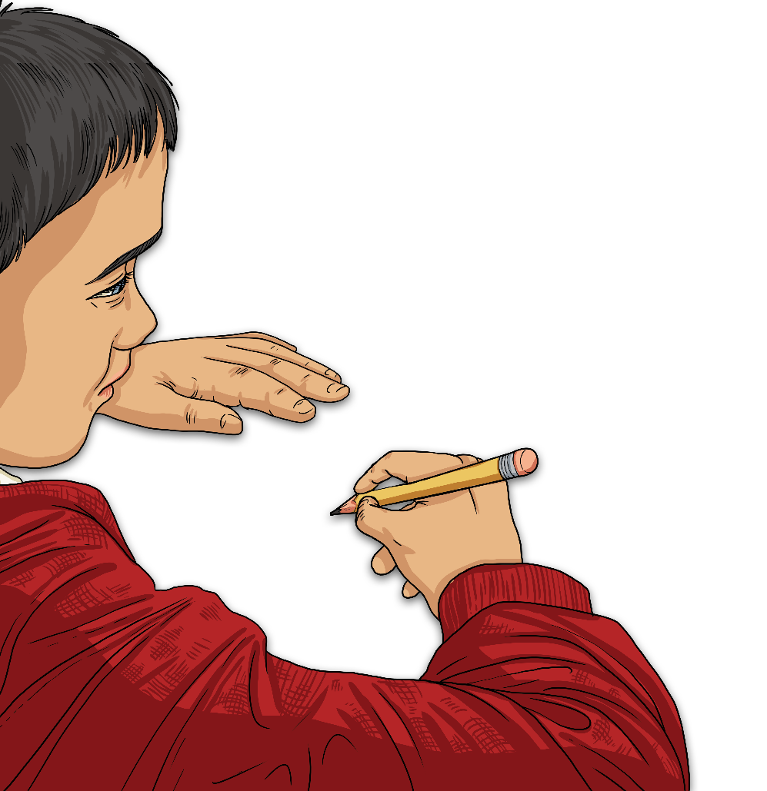
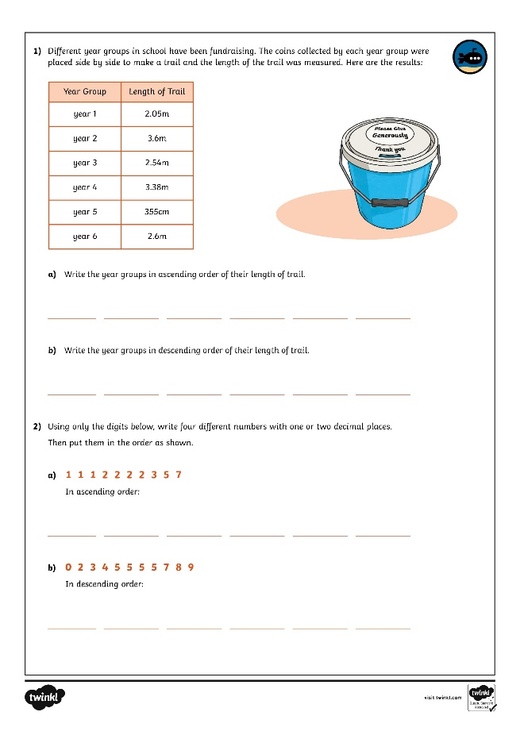
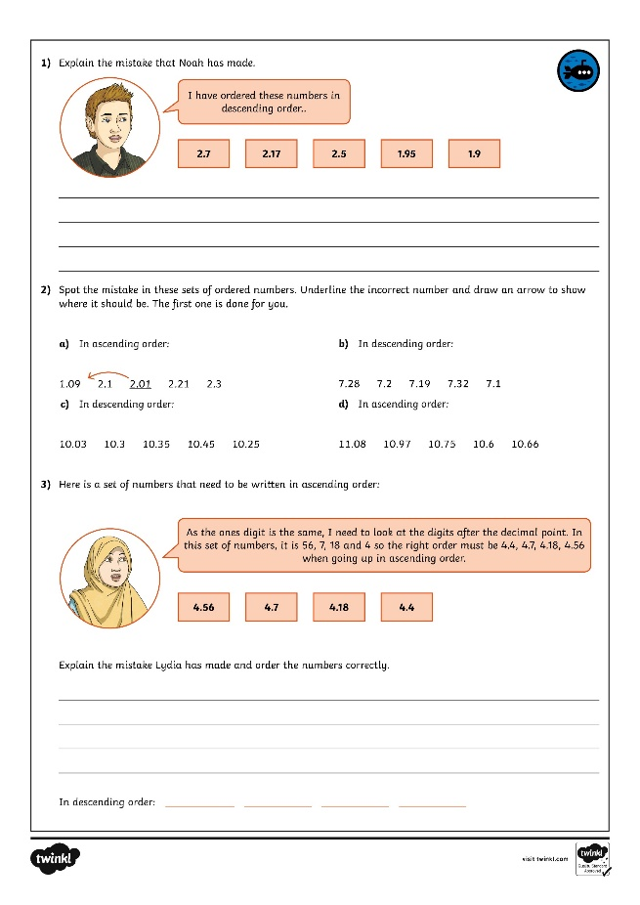
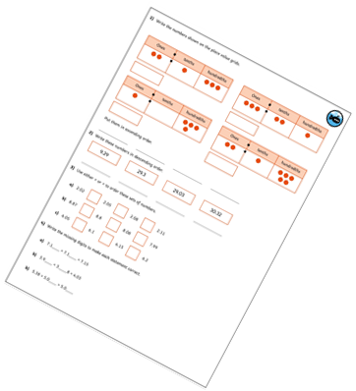
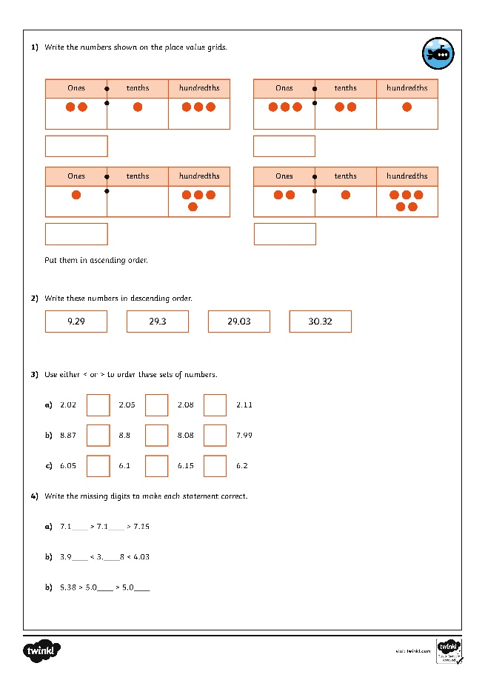
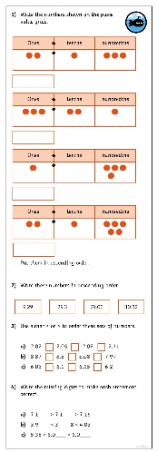
Order Decimals
Dive in by completing your own activity!

Slide 10
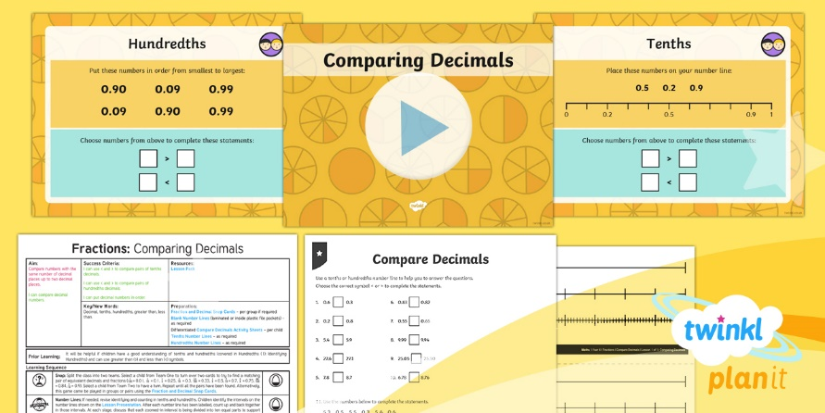
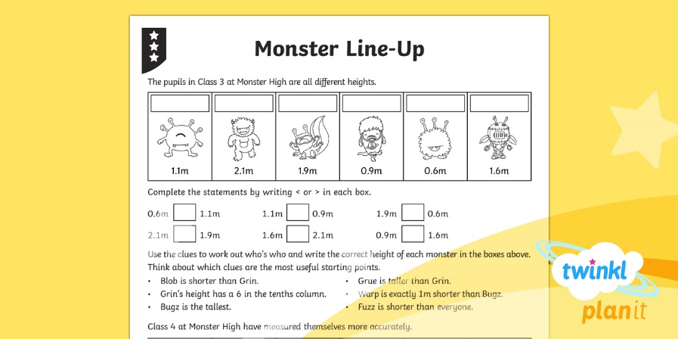

Need Planning to Complement this Resource?
National Curriculum Aim
Compare numbers with the same number of decimal
places up to two decimal places.
For more planning resources to support this aim, click here.
Twinkl PlanIt is our award-winning scheme of work
with over 4000 resources.

