Slide 2
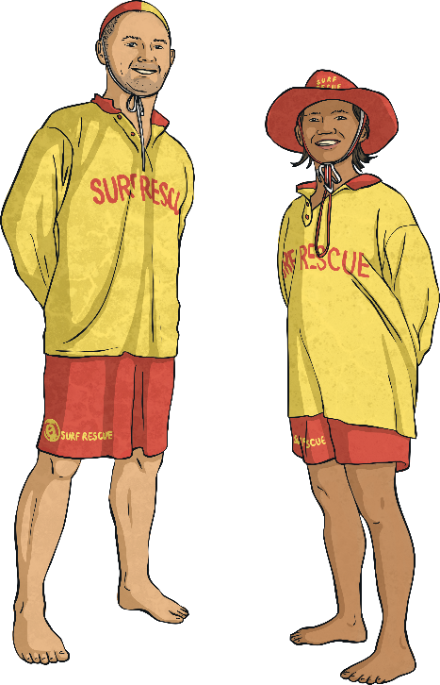
Water Safety
Tell your partner everything you know about staying safe in water.
0
30
30 second timer
There are lots of different ways we can make sure we are safe in any kind of area of water.

Slide 3

General Water Safety
Learning to swim is an important part of being safe in the water. Some people find this trickier than others. If you haven’t learnt to swim yet, or if you are still lacking in confidence, you should follow these rules:
Don’t go out of your depth (make sure you can stand up in the water).
Use appropriate buoyancy aids (this means things like armbands, floats or a woggle).
One way you can help keep other people safe is to recognise the signs of someone who is struggling in the water. They may call out for help but may be unable to do so. Someone in danger may be struggling to keep their head above water. If you think someone may be in danger, tell a lifeguard straightaway and if there isn’t a lifeguard, tell the nearest adult.

Slide 4
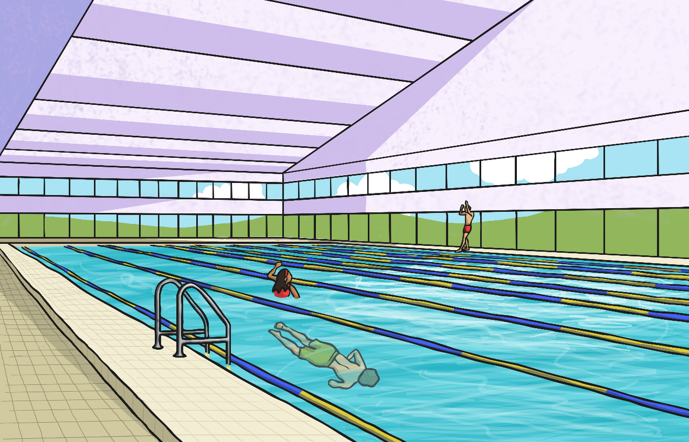
Swimming Pools
There are many ways to stay safe at the swimming pool. Firstly, check out the safety posters you will see all around the pool. These will give you lots of safety tips.

Slide 5
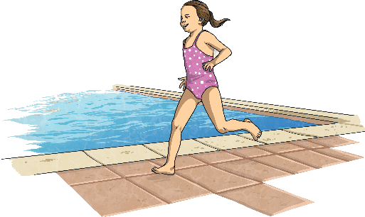
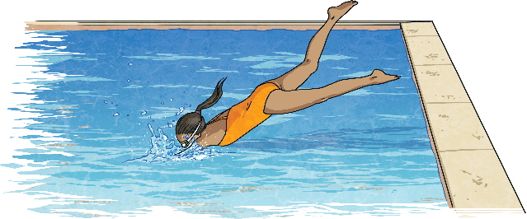
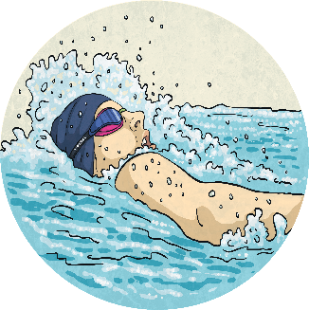
Swimming Pools
Don’t run around the poolside. The floor is wet and you could easily slip and land on the tiled floor.
Do not dive into a pool unless the signs say you can. Diving into water that is shallow can cause serious injury.
Unless you are a strong swimmer, don’t go out of your depth.

Slide 6
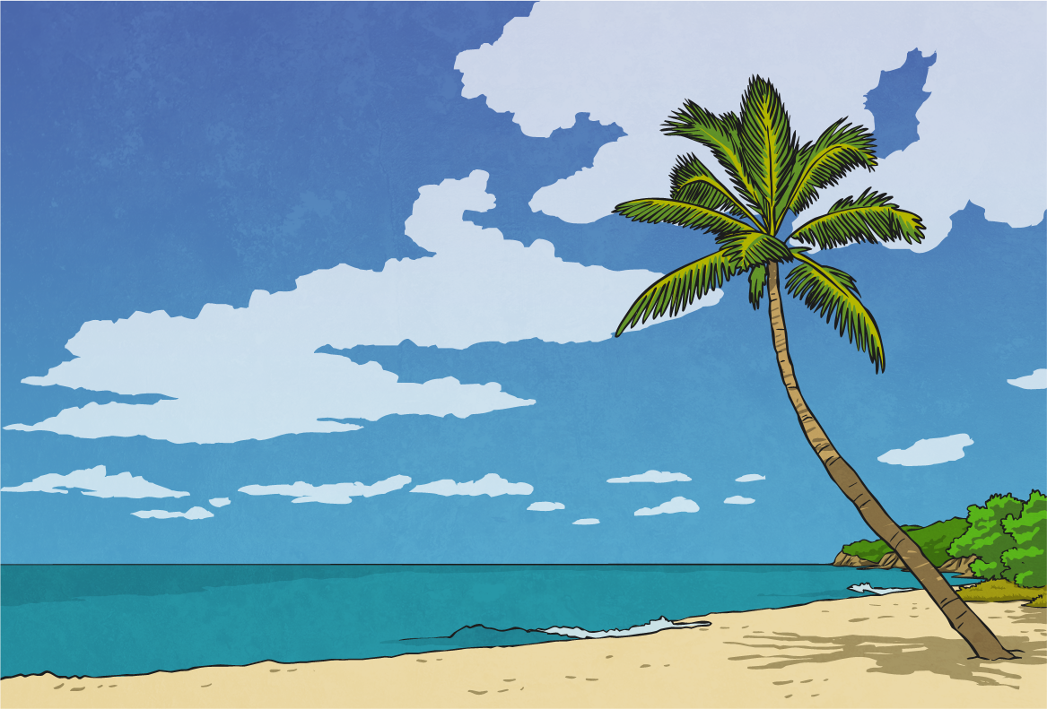
In the Sea
If you are swimming in the sea, the best place to swim is at a beach where there is a lifeguard. If you are swimming where there isn’t a lifeguard, it is important that you only go swimming when you are with an adult. Make sure you can be seen by your adult at all times.
Most beaches have safety information posters just like swimming pools. Make sure you read this information and keep to these rules.

Slide 7



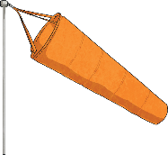
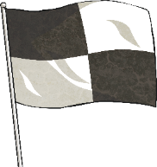
In the Sea
Many beaches have flags which will help you stay safe in the sea. Click to find out what each flag means.
Do not swim.
Take care when swimming here.
Dangerous wind conditions; do not use inflatables or a dinghy.
Swim between these flags.
Do not swim here as the area is being used by surfers.

Slide 8
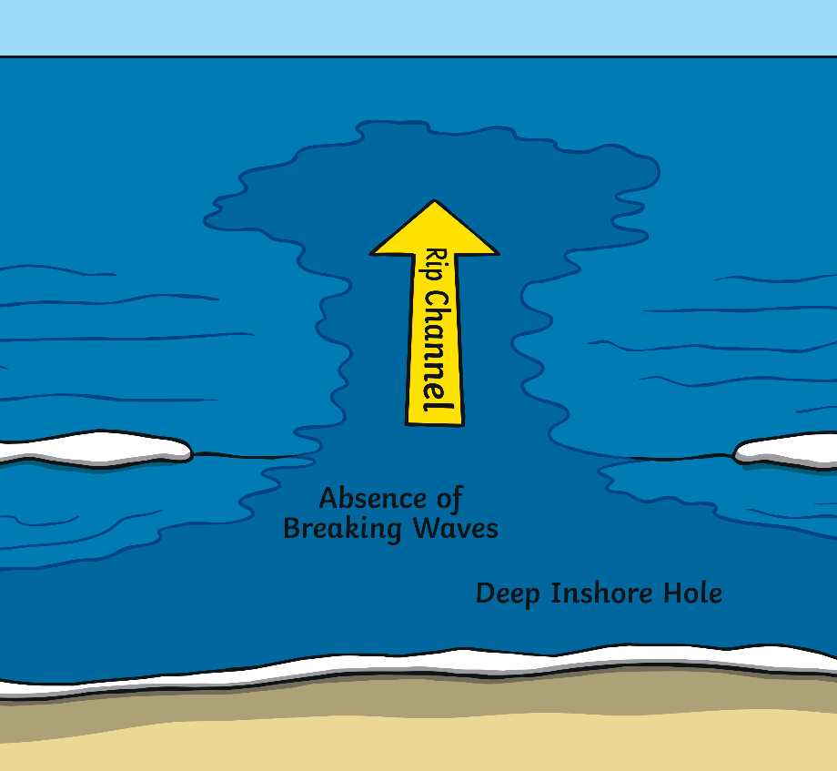
In the Sea
There are other ways to stay safe in the sea.
This shows a rip current. A rip current is a strong flow of water that can quickly carry a person far out to sea. You can often spot a rip current because it looks like a channel of water separate to the usual waves crashing on the shore.
If you get caught in a rip current, don’t try to swim against it. If you can stand up, wade through the water. If you are out of your depth, swim alongside the shoreline until you get out of the rip current.

Slide 9

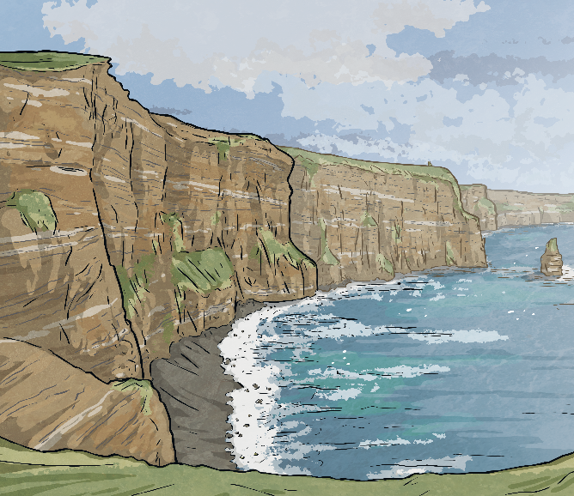
In the Sea
As fun as they seem, inflatables aren’t safe to use in the sea. It only takes one gust of wind to be blown far out to sea. The Royal Life Saving Society UK suggests that they are only used in confined water.
There is currently a trend for people to jump from big heights (such as cliffs) into the sea. This is sometimes called tombstoning. This is extremely dangerous. Jumping from a great height could cause injury on impact with the water. The depth of the water could be unknown, and jumping into shallow water could also cause injury. People have been seriously injured and even killed tombstoning.

Slide 10
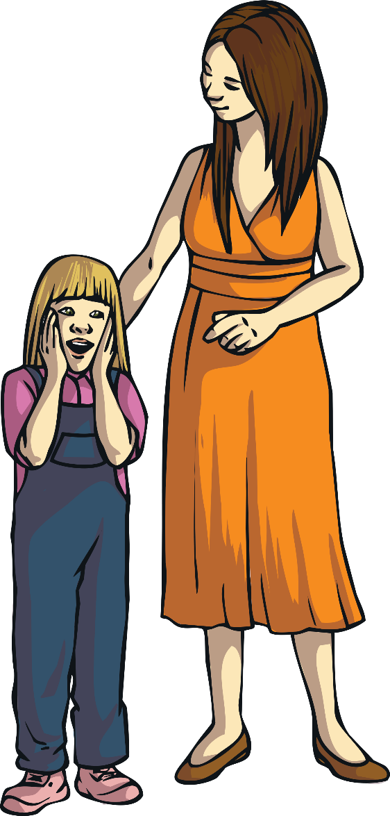
Other Open Water
Open water means any open body of water, such as ponds, lakes, rivers, canals or reservoirs.
There are ways to stay safe in open water:
Look out for warning or safety signs.
Do not swim unless you have an adult with you.
Do not enter very fast-flowing water.
On a very hot day, do not jump straight in to water. You could go into cold water shock. This is when your blood pressure increases. Some people have had heart attacks and died.
Get out of the water when you start to feel cold.
If you are doing an activity such as sailing, make sure you are wearing a life jacket.

Slide 11
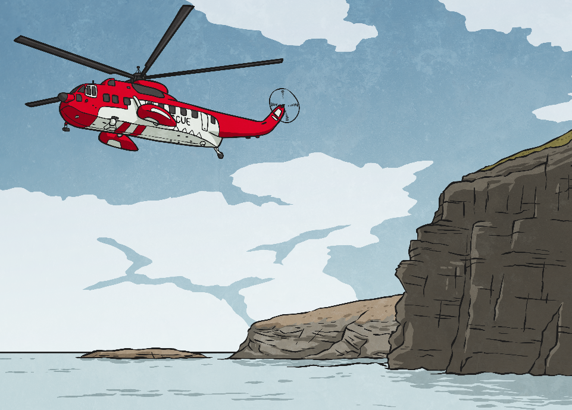
The Emergency Services
Talk About It
What are the emergency services?
Police
Fire service
Emergency medical services (ambulance)
If you are on the coast, another emergency service you can call is the coastguard.
All these emergency services can be contacted by phoning 999 or 112.

