Slide 1
Rivers
This power point will teach you all about rivers.

Slide 2
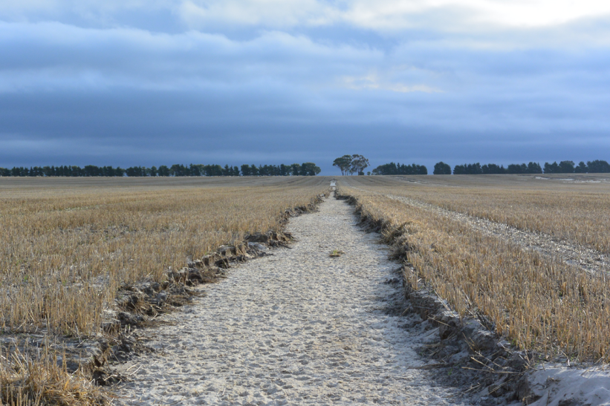
Erosion
Erosion is the geological process in which earthen materials are worn away and transported by natural forces such as wind or water

Slide 3
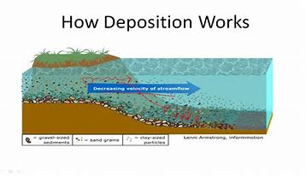
Deposition
Deposition is the process where material being transported by a river is deposited.

Slide 4
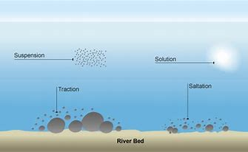
Transportation
Rivers transport material in four ways…
Solution: minerals are dissolved in the water and carried along in solution
Suspension: light materials are carried in the water
Saltation: small pebbles are moved downstream
Traction: large boulders are rolled along the river bed

Slide 5
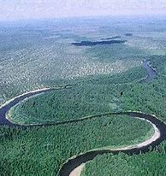
Meander
A winding bend or curve of a river

Slide 6
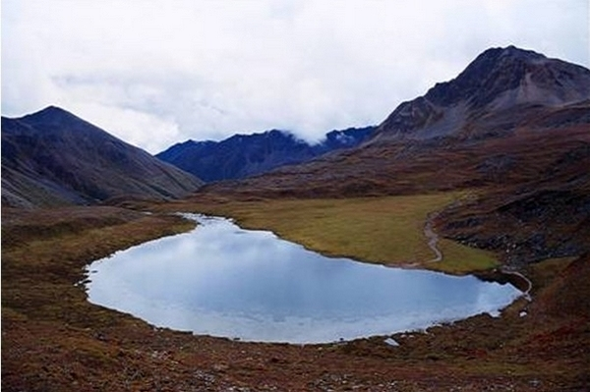
Source
The source of a river or stream is the original point from which it flows.

Slide 7
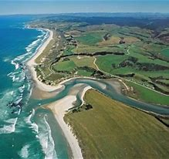
Mouth
The place where a river enters a lake, larger river or the ocean is called its mouth.

Slide 8
Nile
The Nile is the longest river in the world
The drainage basin of the Nile covers about 1 tenth of the whole of Africa.
Ancient Egyptians called the Nile the great river.
Only 22% of the river passes through Egypt.
It is 4,160 miles long.
It creates a fertile green valley across the dessert. This helps farming in Egypt.

