Slide 1
All about Rivers ☺
Year 4
Florence Buckner

Slide 2
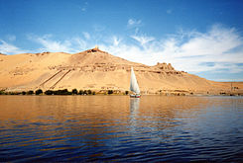
The Journey of a River
All Rivers have a upper middle and lower course .
The Beginning of a river when it flows quickly with lots of energy . This Is called A YOUNG RIVER
The MIDDLE of the rivers journey is when it gets windy and it will slow down . This will be Middle age
From the source of the mouth rivers run from the mountains to the sea . They are very FAST and Narrow at the start and get WIDER and SLOWER when they get to the MOUTH . When the river slows down and moves into the flat land

Slide 3
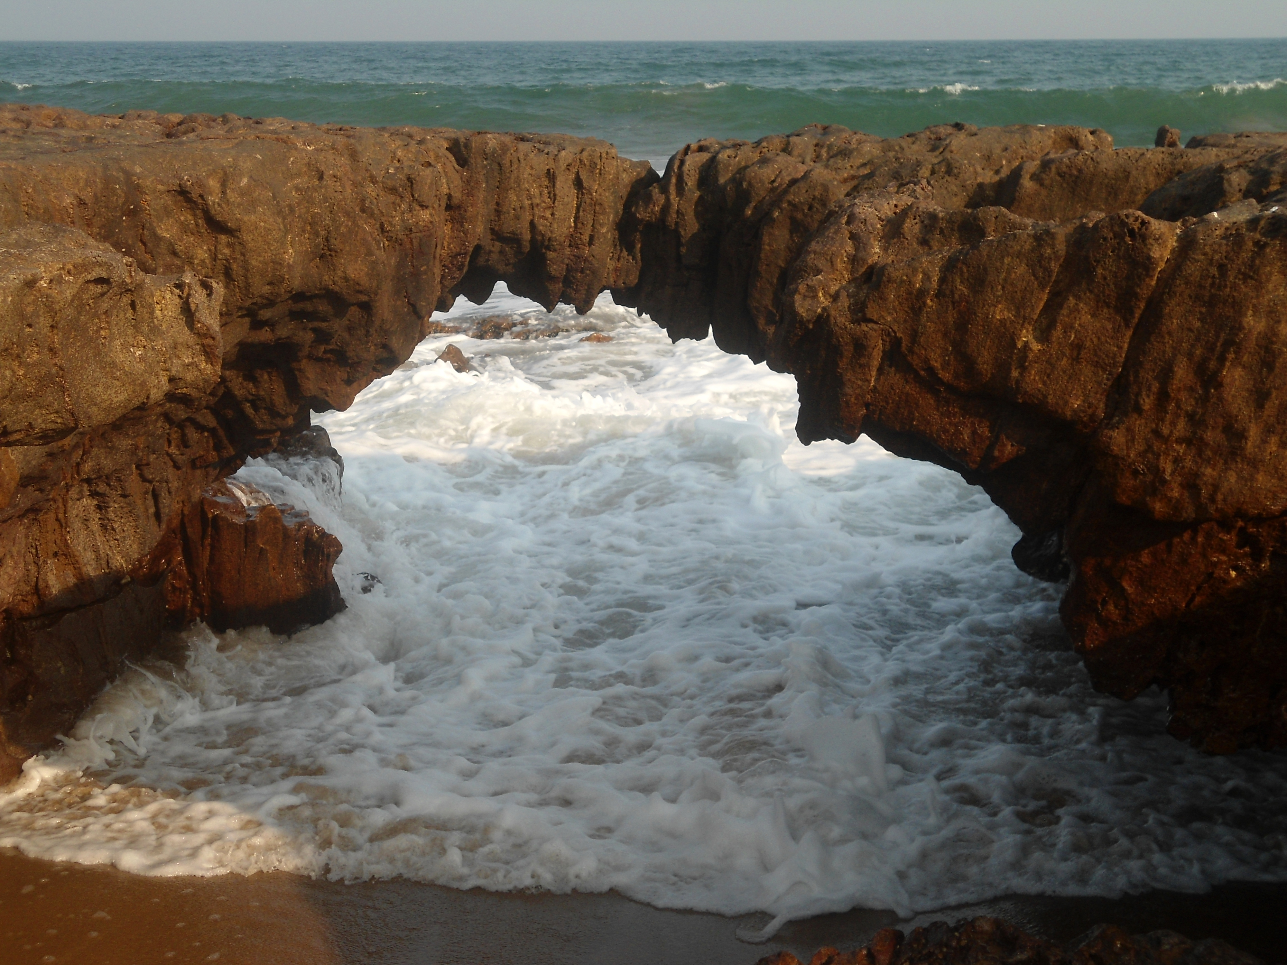
Erosion
The process of eroding is the slow and gradual destruction of something . This can be done by wind , water or natural AGENTS
This Photo by Unknown Author is licensed under CC BY-SA

Slide 4
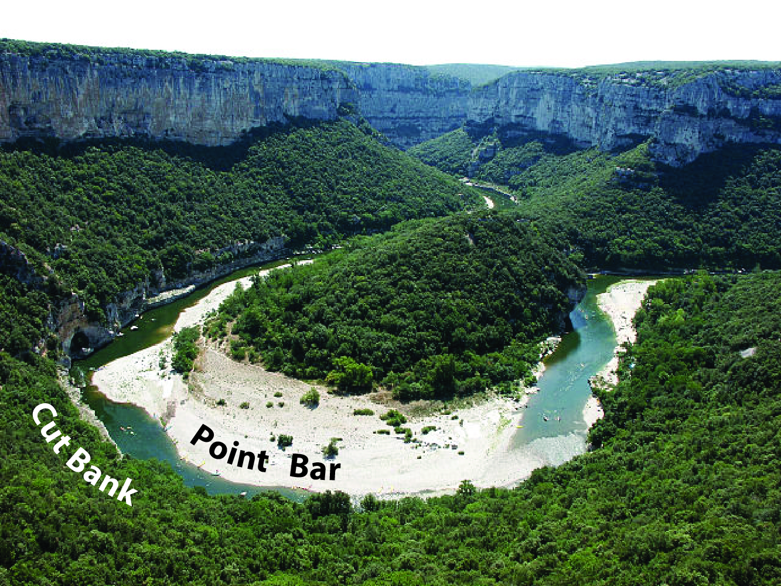
Deposition
This is when a river loses energy and enters a shallow area . It is when materials are being deposited
This Photo by Unknown Author is licensed under CC BY-SA-NC

Slide 5
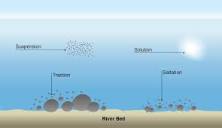
Transportation
Rivers Transport materials in four ways
Solution
Suspension
Saltation
Traction

Slide 6
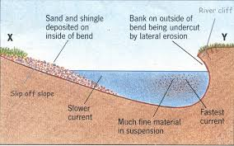
Meander
This is when a stream or river will swing from side to side as it flows across or swifts its channel within a valley

Slide 7
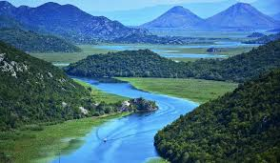
Source
The source of the river is from where it starts to flow .
This is the fastest point of the river journey

Slide 8
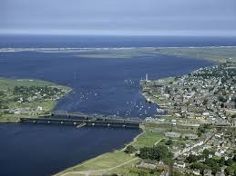
Mouth
A river mouth is the part of a river where the river debounces into another River

Slide 9
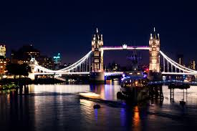
River Thames
The longest river in in England and the second longest river in united kingdom AFTER RIVER SEVEN
The length is nearly about 215 miles and it flows through southern England
Source – Gloucestershire
Mouth – Thames north Sea
Basin Size 12, 935 KM2
Discharge

