Slide 1
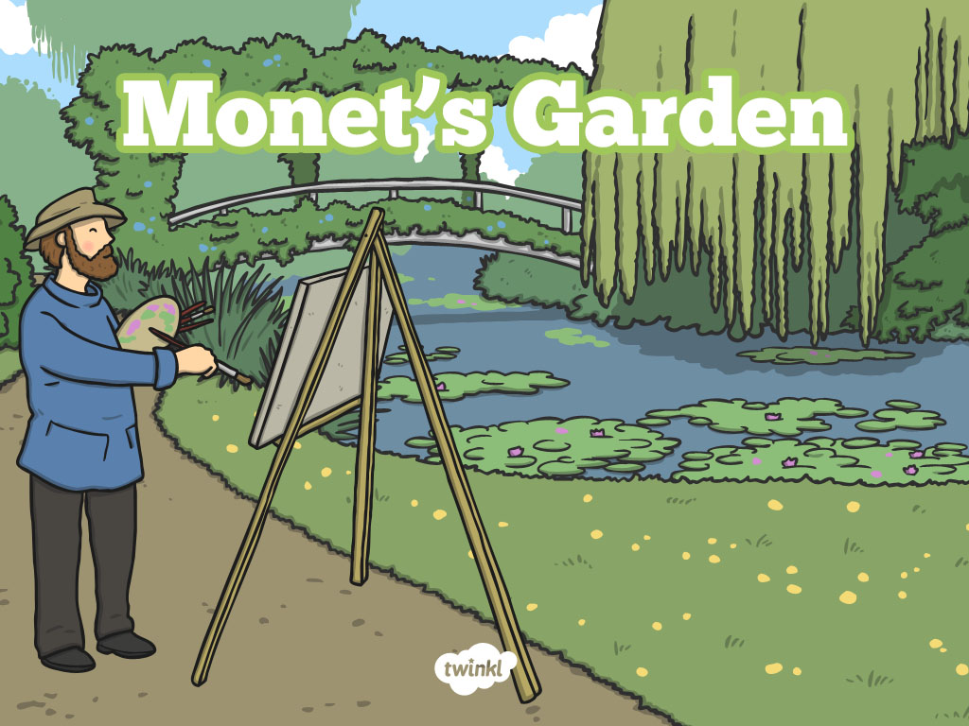

Slide 2
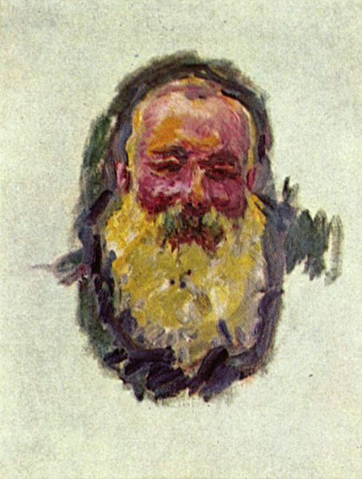
Claude Monet
Oscar-Claude Monet was a French painter, born in 1840.
He was a founder of French Impressionist painting.
The term “Impressionism” comes from the title of his painting, Impression, Sunrise.
He enjoyed painting in the outdoors, and painted landscapes at different times of day and in all kinds of weather.
He often painted the same scene more than once, to capture the changing light and different seasons.
Attribution - Photo courtesy of Joaquín Martínez (@flickr.com) - granted under creative commons licence - attribution

Slide 3

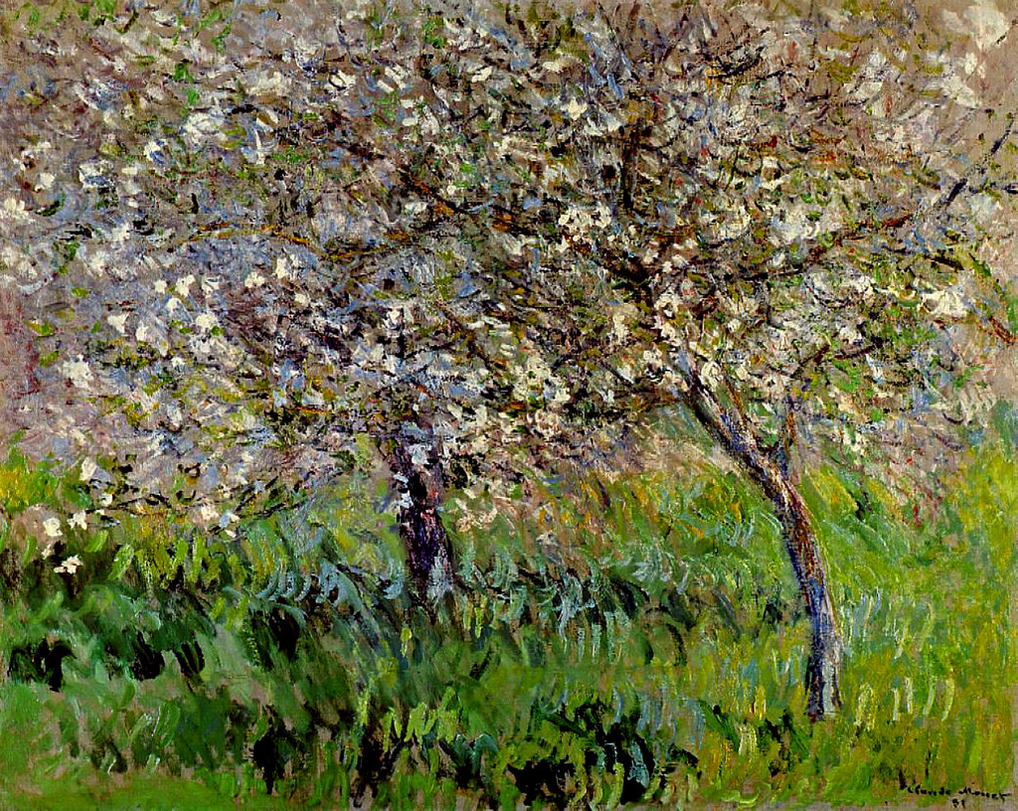
Close-up
Monet painted with bold brushstrokes.
Up close, Monet paintings can look messy, and it can be hard to tell what it is.
What do you think this could be a painting of?
Attribution - Photo courtesy of CarlosR38 (@flickr.com) - granted under creative commons licence - attribution

Slide 4
Apple Trees in Bloom at Giverny 1900-01
Close-up
Attribution - Photo courtesy of CarlosR38 (@flickr.com) - granted under creative commons licence - attribution

Slide 5
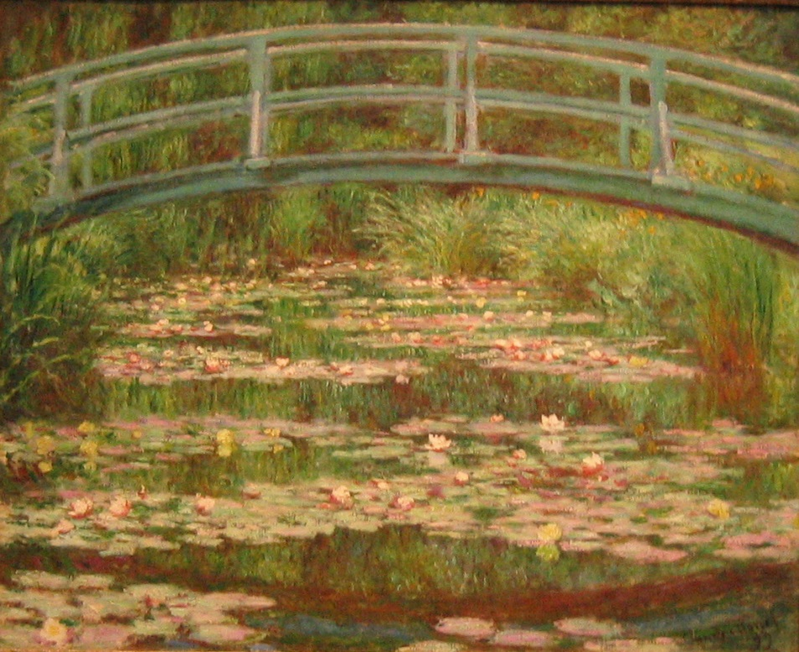
Giverny
In 1883 Monet moved to Giverny, where he bought a house with lots of land.
He created beautiful gardens, starting with lily ponds.
He enjoyed painting his large garden in different seasons.
Attribution - Photo courtesy of Micah MacAllen (@flickr.com) - granted under creative commons licence - attribution

Slide 6
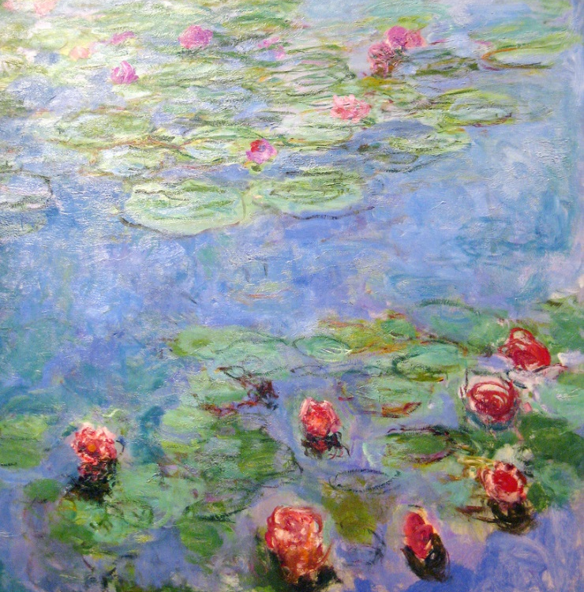
Giverny
Lily Ponds
In 1899, he began painting water lilies and continued to do so for 20 years.
His paintings of water lilies are his most well-known artworks.
Attribution - Photo courtesy of HarshLight (@flickr.com) - granted under creative commons licence - attribution

Slide 7
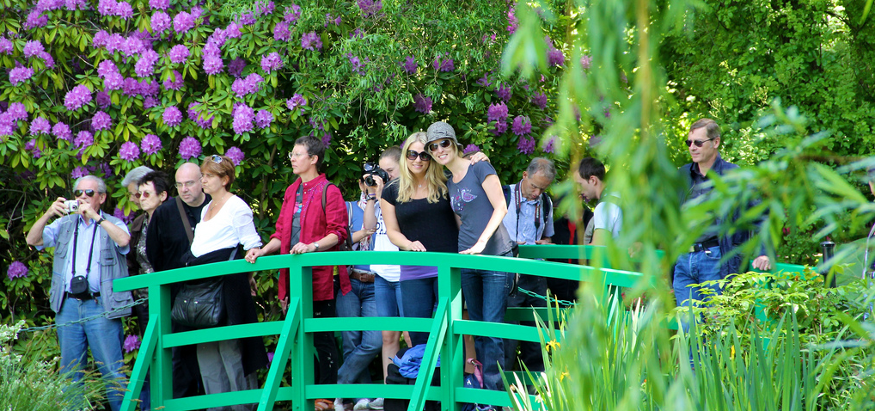
Giverny
Visiting Monet’s Garden
Monet’s garden is now open to the public and visitors come from all over the world to enjoy it.
Attribution - Photo courtesy of MJM Photographie (@flickr.com) - granted under creative commons licence - attribution

Slide 8
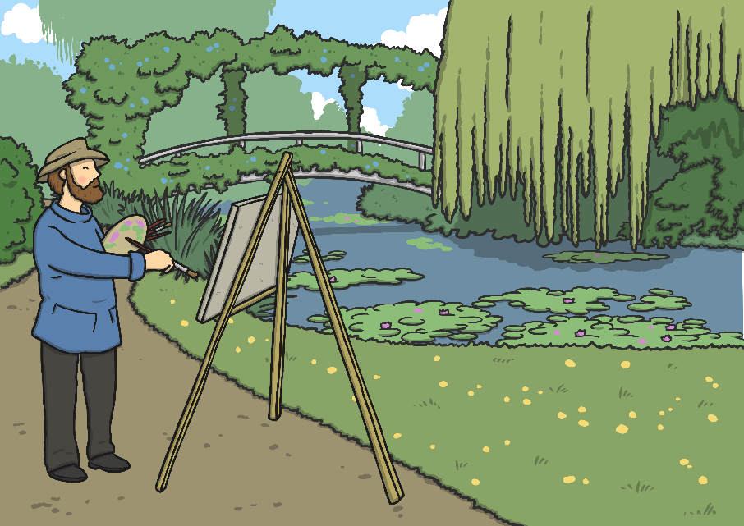
Looking at Paintings
Monet painted hundreds of paintings of his garden.
We’re going to look at some of these paintings.
Think about the colours that you can see.
Look at the brushstrokes that Monet used.
How do you think Monet felt when he was painting these pictures?

Slide 9
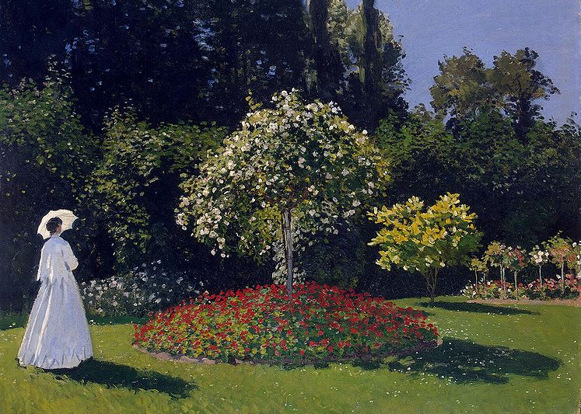
Woman in the Garden 1867
Looking at Paintings
Attribution - Photo courtesy of Joaquín Martínez (@flickr.com) - granted under creative commons licence - attribution

Slide 10
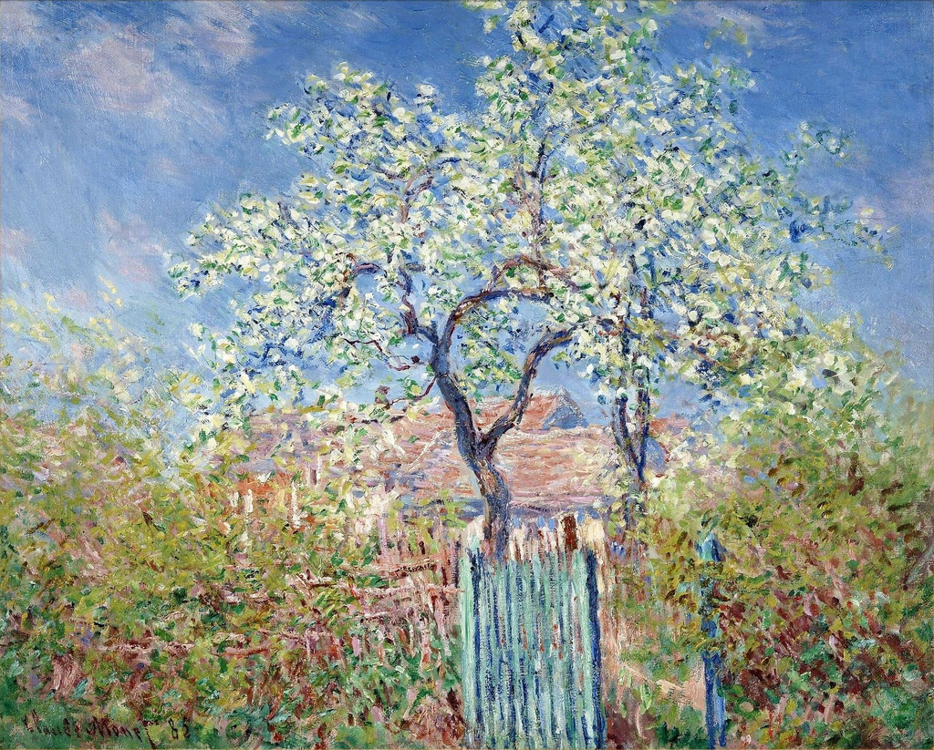
Flowering Pear Tree 1885
Looking at Paintings
Attribution - Photo courtesy of CarlosR38 (@flickr.com) - granted under creative commons licence - attribution

Slide 11
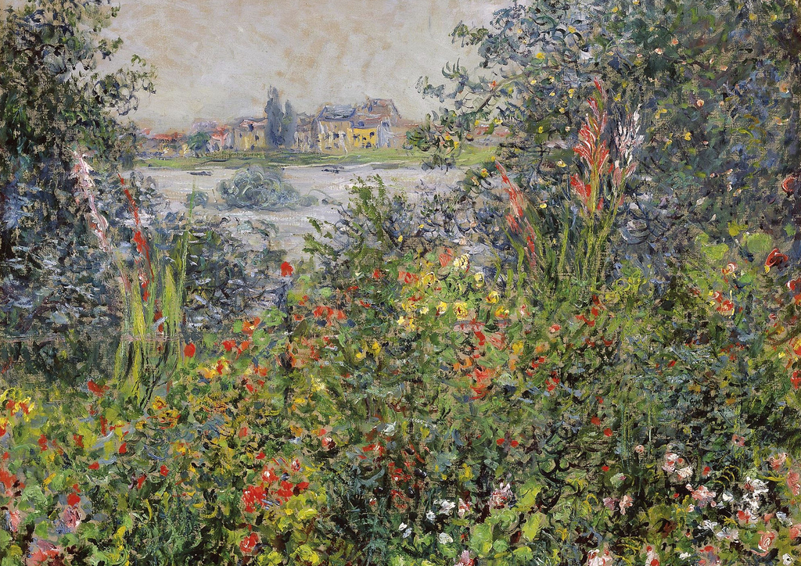
Flowers at Vetheuil 1881
Looking at Paintings
Attribution - Photo courtesy of CarlosR38 (@flickr.com) - granted under creative commons licence - attribution

Slide 12
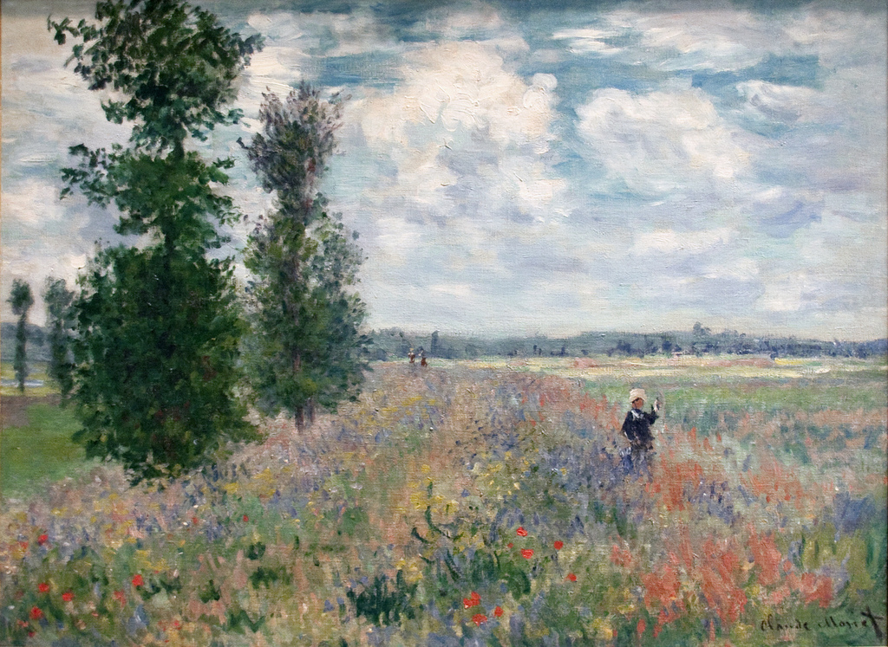
Poppy Fields near Argenteuil 1875
Looking at Paintings
Attribution - Photo courtesy of Tony Hisgett (@flickr.com) - granted under creative commons licence - attribution

Slide 13
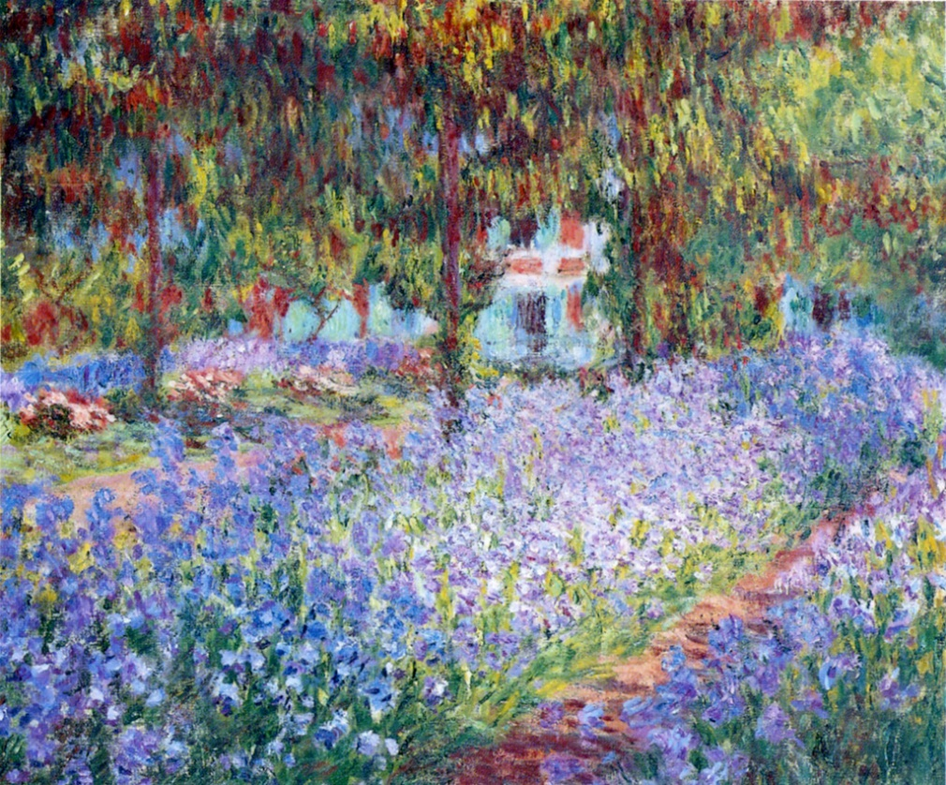
The Artist's Garden at Giverny 1900
Looking at Paintings
Attribution - Photo courtesy of Gary R. Caldwell (@flickr.com) - granted under creative commons licence - attribution

Slide 14
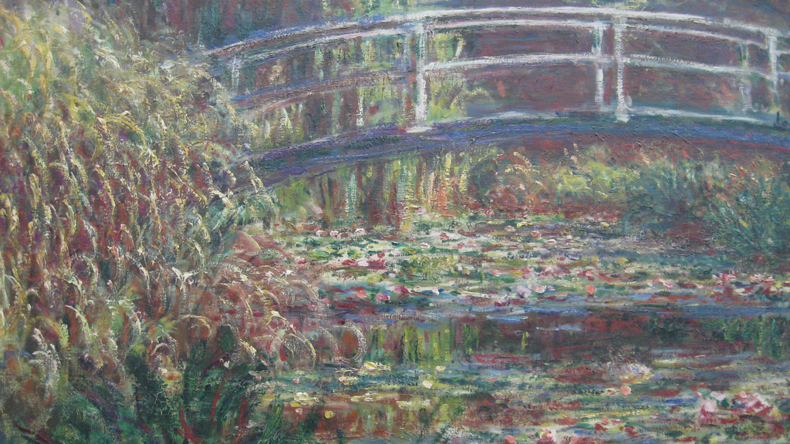
The Japanese Bridge 1900
Looking at Paintings
Attribution - Photo courtesy of Michela Simoncini (@flickr.com) - granted under creative commons licence - attribution

Slide 15
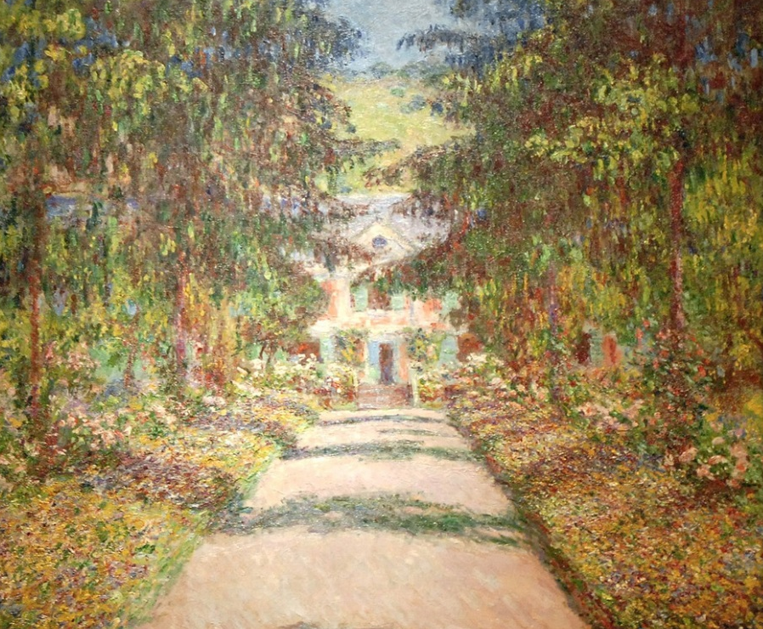
La Grande Allée à Giverny 1900
Looking at Paintings
Attribution - Photo courtesy of Jean-Pierre Dalbéra (@flickr.com) - granted under creative commons licence - attribution

Slide 16
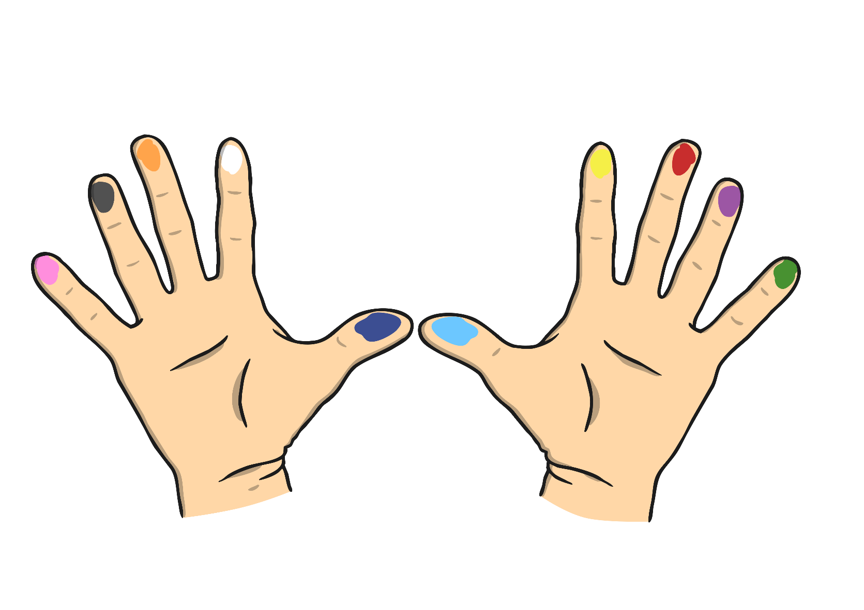
Paint Like an Impressionist
Impressionist Finger Painting
We are going to paint like Monet. We are going to use our fingers!

Slide 17

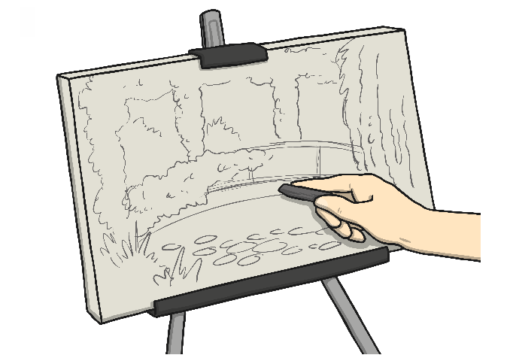
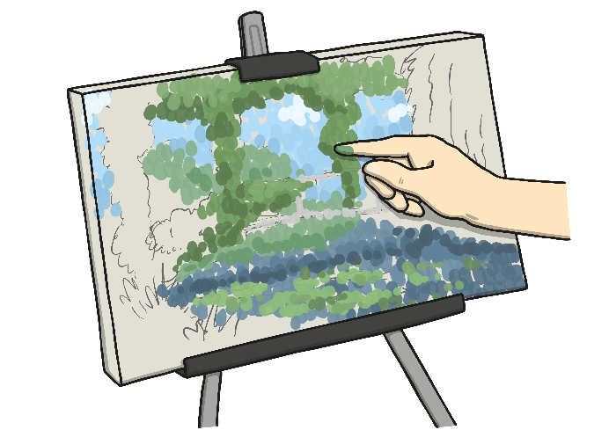
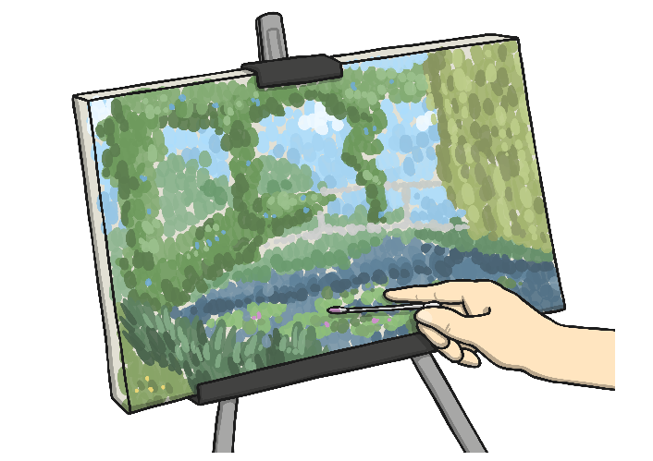
Today
Look at the photo of Monet’s garden. Look carefully at the colours.
Sketch a faint outline of your painting in pencil.
Dip the tip of your finger into the acrylic paint and dab it onto your picture.
Use a cotton bud to add smaller details, such as flowers.

Slide 18
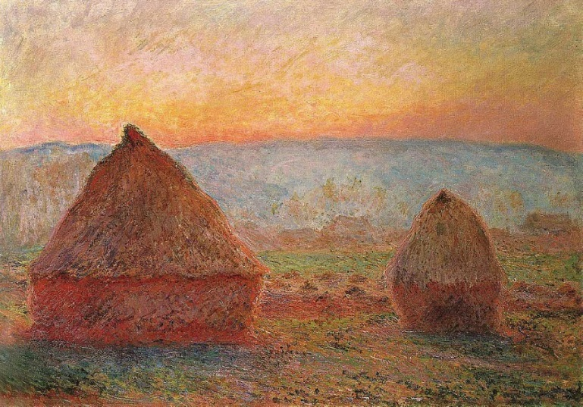
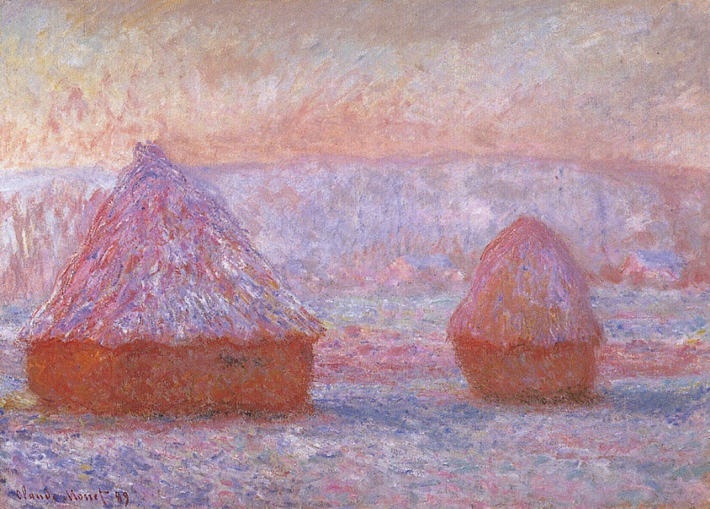
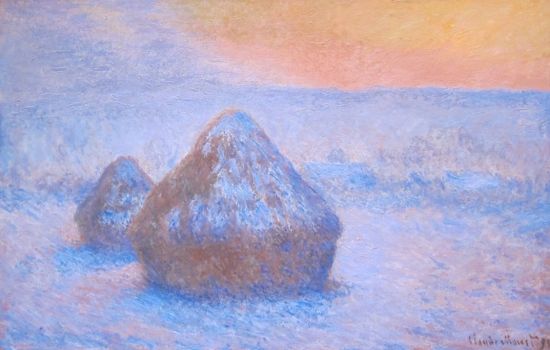
Looking Closely
Monet created these 3 very similar paintings of haystacks.
Can you see any differences between them?
Attribution - Photo courtesy of CarlosR38 and Sharon Mollerus (@flickr.com) - granted under creative commons licence - attribution

Slide 19

Aim
I can paint a landscape using colour and texture.
I can describe the work of the artist, Monet.
Success Criteria
I can use bright colours to paint a garden.
I can use my fingers to apply thick paint.
I can explain that Monet painted lots of pictures outdoors.
I can talk about the bright colours that Monet used in his paintings.

