Slide 1
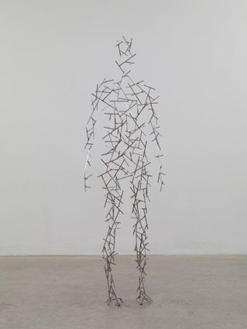
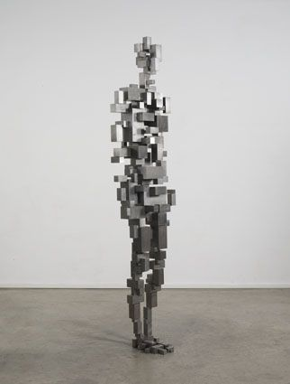
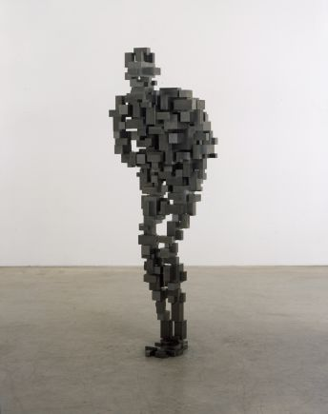
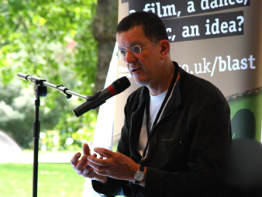
Figures
by
Antony Gormley

Slide 2
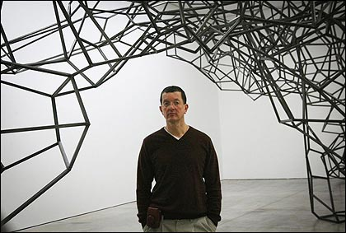
About Antony Gormley
Antony Gormley is probably the best-known sculptor in
Britain today. He was born in London in 1950 and was
one of seven children.
After studying Archaeology and History of Art at
Cambridge University, he went on to study fine art at the
Central School of Art and the Slade School of Art
in London.
He began working on
sculptures in 1973.

Slide 3
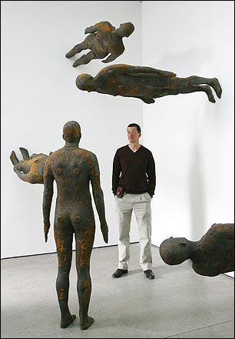
Figures
Antony Gormley has always been interested in the
human figure. He often uses his own body as a model
for his sculptures.
He works on life-size figures and sometimes figures
that are 10 times life-size!
Many of his sculptures are in public, outdoor spaces.
Here are some of his sculptures….

Slide 4
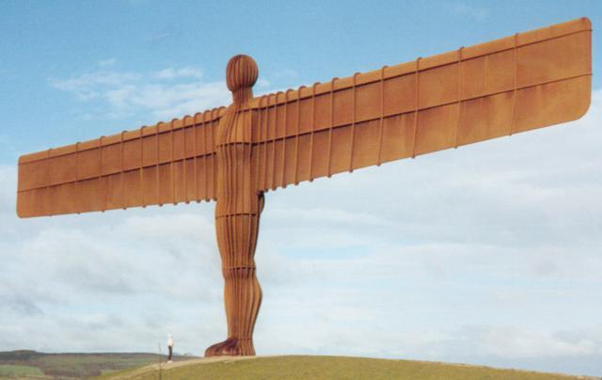
The Angel of the North
‘The Angel of the
North’, 1998
This is the ‘Angel of the North’. It is probably Gormley’s most famous piece. It has become a symbol of the North-East of England.
It stands high on a hill overlooking the East Coast Main Railway line and can be seen by the side of the A1 Motorway near Gateshead.
This massive sculpture is made of steel and weighs 200 tonnes and has 500 tones of concrete foundations so that it can withstand strong winds. It is 20 metres high (10 times life-size).

Slide 5
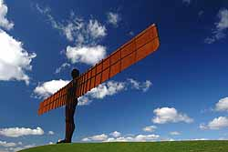
Antony Gormley said he wanted to :
“Make an object of hope at a painful time for the people
of the North-East…”
He was concerned about how so many people had lost their jobs
when the old mines and many factories had closed in the 1980s.

Slide 6
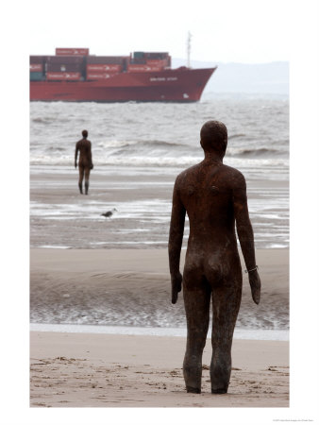
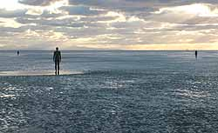
Another Place
‘Another Place’ consists of 100 cast iron figures standing gazing out to sea on Crosby beach, near Liverpool. These figures, all cast from the artist’s
own body, are spread out over a 3km stretch of the beach.

Slide 7
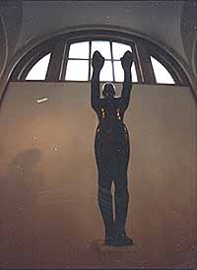
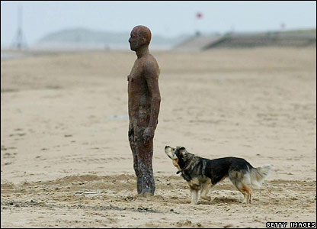
Each stands over 2 meters tall. As the tide comes in
the figures are partially submerged by the water.
A favourite local pastime has been to decorate the
figures with hats and clothes!

Slide 8
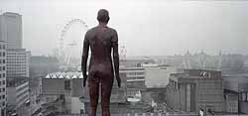
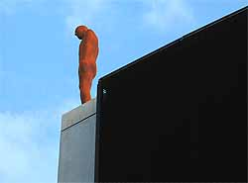
Event Horizon, 2007
This was a large-scale
project. Gormley made 31 life-size bronze male figures and placed them on the rooftops of important buildings across London such as the National Theatre, the Shell Centre and Waterloo bridge.
They were meant to advertise his exhibition at the Haywood Gallery, but have proved popular with people and may stay!

Slide 9
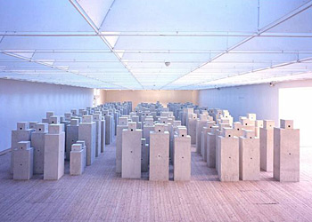
Other Sculptures
‘Allotment’ shows a collection of cube-like
figures.

Slide 10
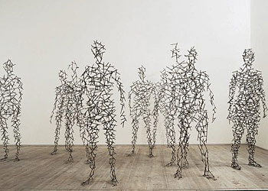
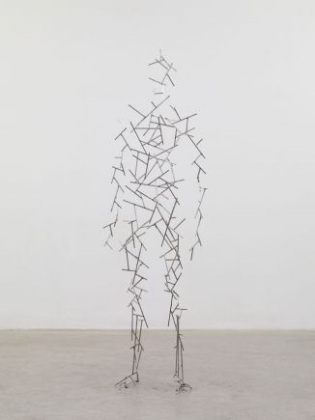
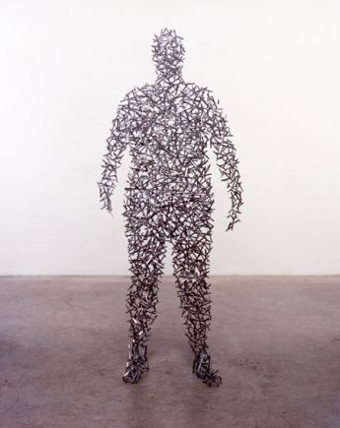
In ‘Domain Field’, Antony
Gormley used plaster moulds from the bodies of 284 volunteers to create his figures.

Slide 11
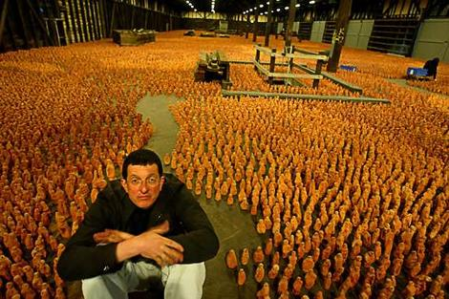

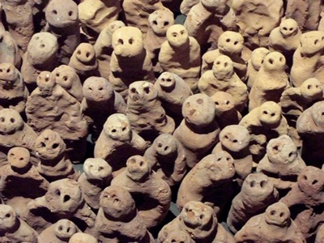
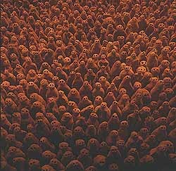
‘Field for the British Isles’ is one work
which doesn’t feature a mould of
Gormley’s body! It is a collection of
40,000 small clay figures!

Slide 12
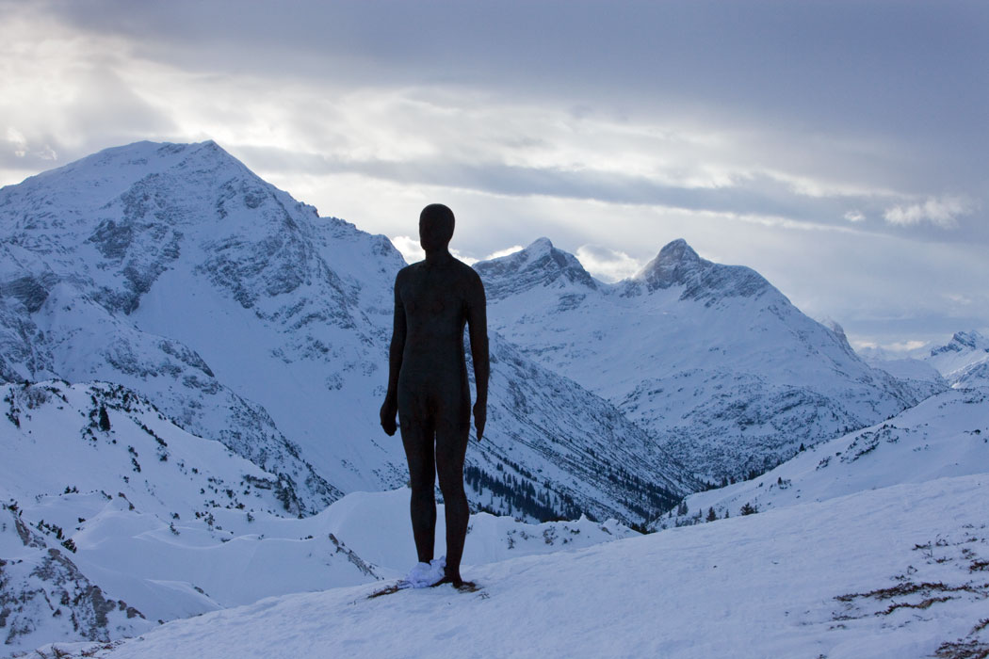
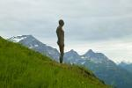
Antony Gormley continues to be interested in the human
Figure and his most recent work has been these large figures placed high up in the mountains in Austria.
Antony once said that “Art is the means by which we communicate what it feels like to be alive”.

