Slide 1

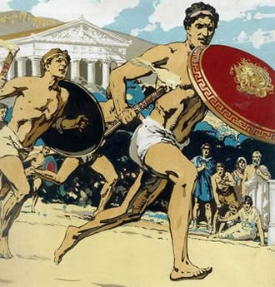
The Ancient Olympic Games
By Harry box

Slide 2
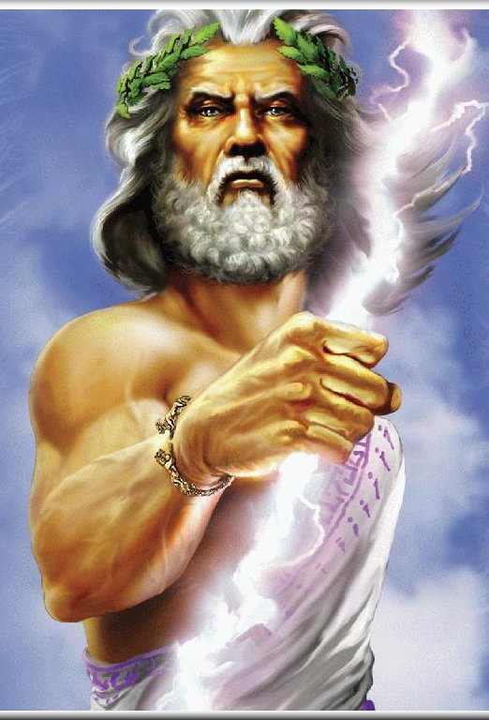
How did the Olympic games begin?
The Olympic Games took place in Olympia which is in the south west of Greece, over 2700 years ago. It took place every 4 years with around 50,000 people coming to watch. The Olympic Games were also a religious festival, in honour the king of gods Zeus.
Instead of getting a gold, silver or bronze medals you would get a wreath of leaves and a hero’s welcome when they returned home, they would also be seen to have been touched by the gods.

Slide 3

A sacred truce
Before the games began messengers announced a ‘sacred truce’, this meant all wars should be called off so the people going to the games could get there safely.
The main event was not the sport but a sacrifice that happened on the third day of the games this was when 100 oxen were sacrificed and burned on the alter of Zeus. The alter was made of left over ash of all sacrificed oxen and by 200AD, the ash stood 6 meters high!

Slide 4
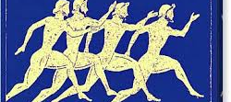
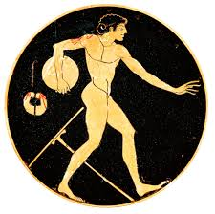
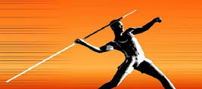
What sports took place at the Ancient olympics?
Running
Discus
Javelin
Running was the event at the Olympic games. If competitors tried to cheat they was disqualified and beaten. The hardest running race was called Hoplitodromos, which was when the competitors had to run wearing armour and carrying a shield.
Athletes would throw a very heavy metal flat disk.
Javelins were sharpened wooden sticks with a metal point on the end. Athletes would wind a leather band around the javelin which wold make it go further through the air, the band would unravel when the javelin was thrown.

Slide 5
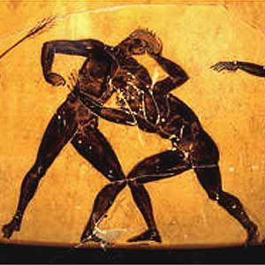
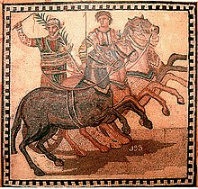
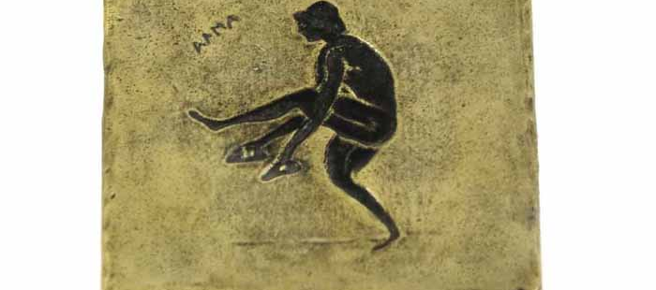
What sports took place at the Ancient olympics?
Long jump
Wrestling and boxing
Horse racing
The long jump is a competition to see who can jump the fairest across the sand pit
This was the first sport in the Olympic Games that was not a foot race. To win the wrestlers had to make their opponent fall to the ground.
One of most popular games. Only the rich people could buy horses to play the games . It would involve horses with chariots racing seven laps of a circus, the chariots could easily crash and the driver would often get injured.

Slide 6
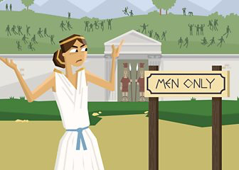
Women at Olympia
Married women were not allowed to join in or watch the games. Unmarried woman could watch the games. If married women were found at the games they would be given the death penalty. Women could still own horses in the chariot race but couldn’t watch them race. Unmarried women had a festival at Olympia every four years called Heraia, which was held in honour of Zeus’s wife.

