Slide 1
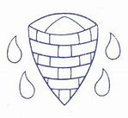


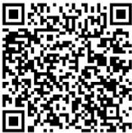

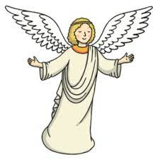
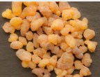
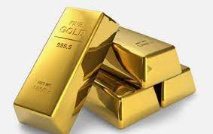
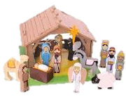
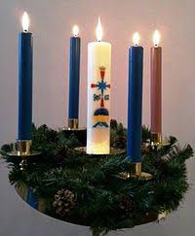
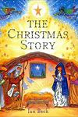

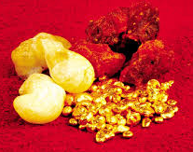
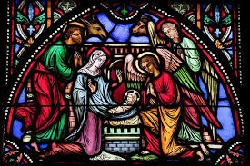
Religious Education
Year 1, Autumn Term: Christianity- Why is Christmas Celebrated by Christians?
Theme: Pride- Local Focus
Scan the QR code for the Unit Quiz
Key Vocabulary | Definition
5 Fingers | 1. Christianity, 2. Christian, 3. Bible, 4. Hebrew, Aramaic, Greek, 5. Church
Angel | Angels are powerful, smart spirits that obey God's commands and praise him with singing. They sometimes appear to humans in human form.
Frankincense | Frankincense is a white resin or gum. It is burned as incense which creates a sweet smell. Frankincense was often used in worship by the priests.
Gold | Gold is a precious metal. It is very valuable.
Myrrh | Myrrh is a resin which is from small thorny trees. Myrrh resin was used in ancient times as a perfume, an incense and a medicine.
Nativity | A picture, carving, or model representing Jesus Christ's birth.
Precious | If something is precious, it is of great value or worth.
Our Enquiry Questions:
What is meant by the idea of something 'precious'?
What happened before and after the birth of Jesus?
What was special about the gifts that were given to Jesus?
Why do Christians believe that Jesus was a gift from God?
RE Skills to Develop
I can talk about a practice from a religion.
I can retell a religious story using prompts. I know that it is from a sacred text and is special to some people.
I can talk about my own experiences and can link these to the communities to which I belong.
Key Artefacts, Symbols & Stories

