Slide 1


GoRead – Online Reading Diary
This year we are launching an online reading diary.
It has been highly reviewed by many parents from over 1000 schools so far as a much quicker, easier and more useful tool to track your child’s reading in and outside of school.
On the next few slides is a guide for how to set up your GoRead Parents account and how to link to your child.
If you have more than one child at High Street, this guide will show you how you can link all of your children into one account to make it even easier to record their reading.

Slide 2
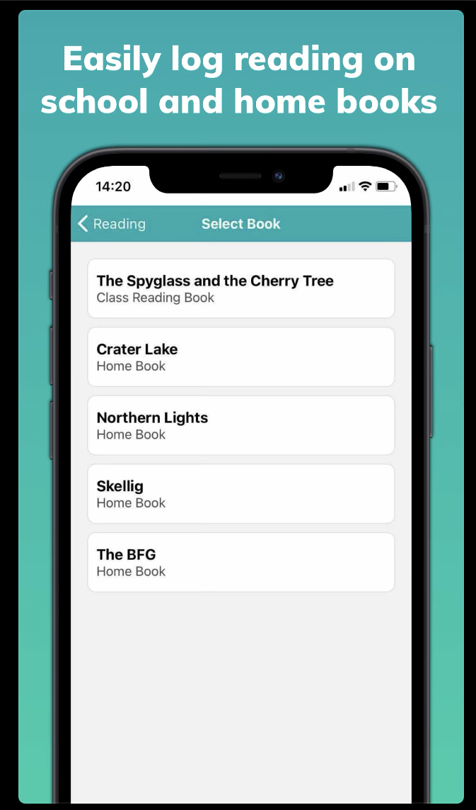
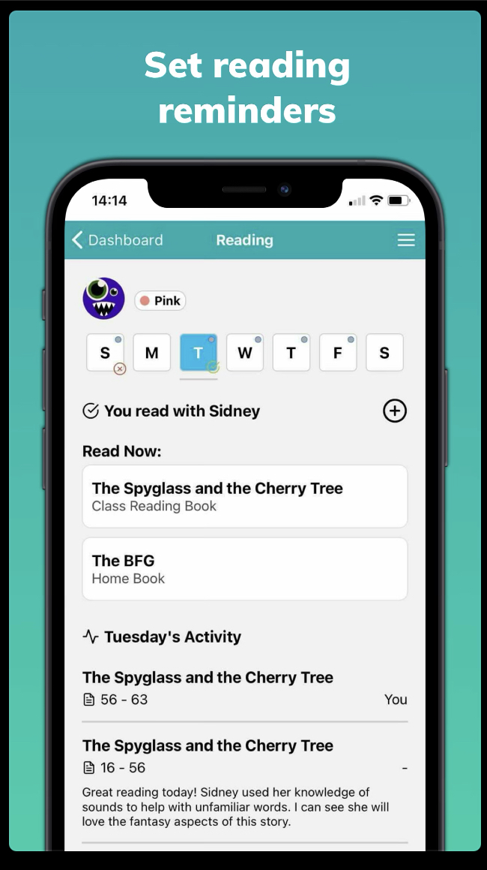
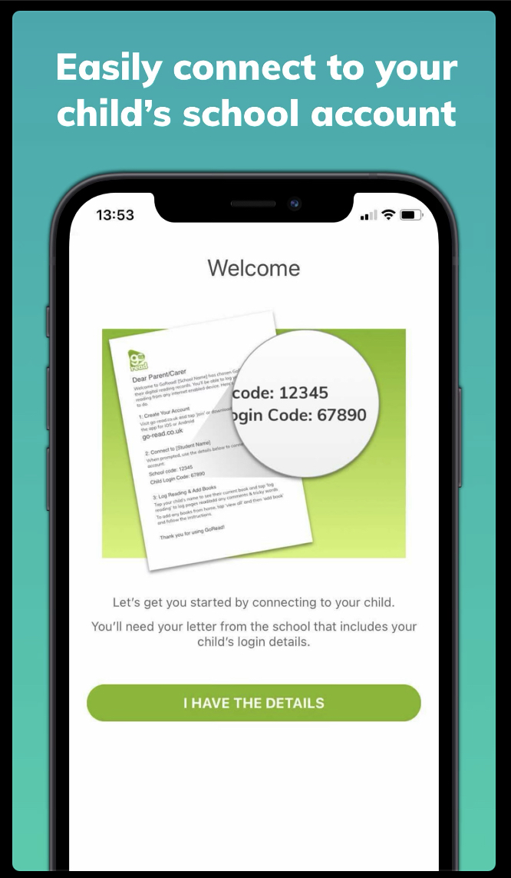
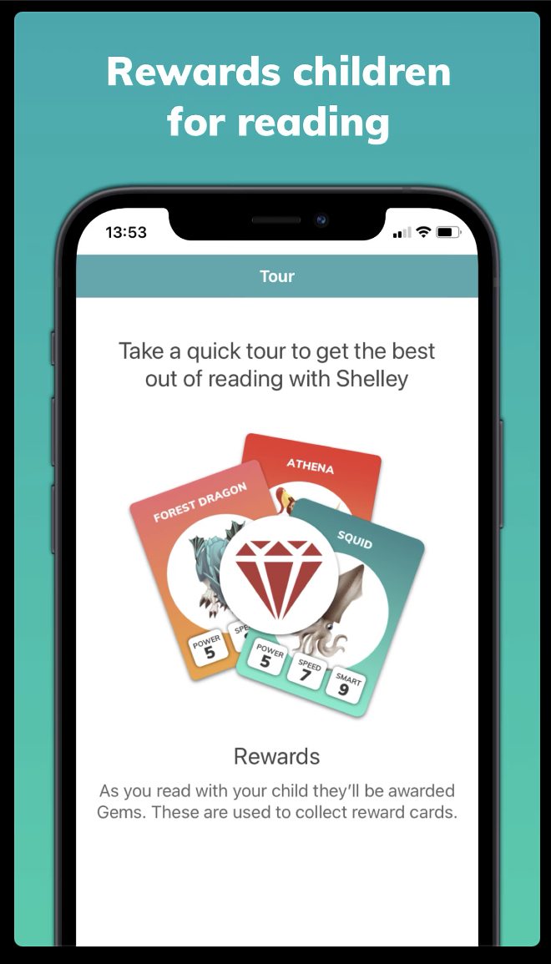
Here are some of the reasons why we have invested in this program.

Slide 3
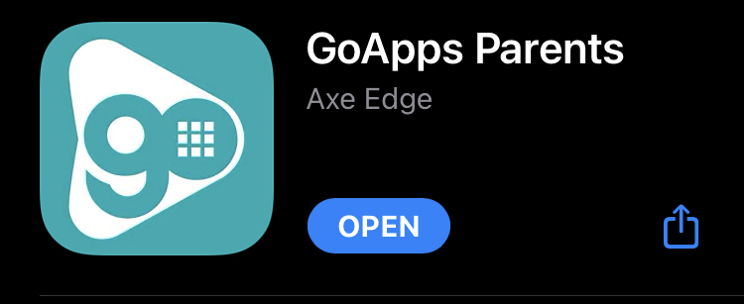
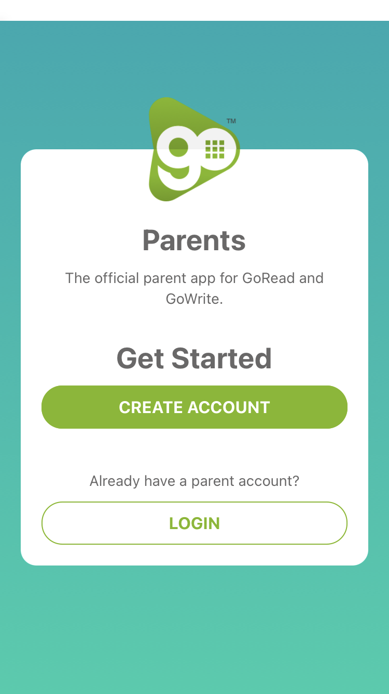
Download the app on your device.
Then click Create Account.

Slide 4
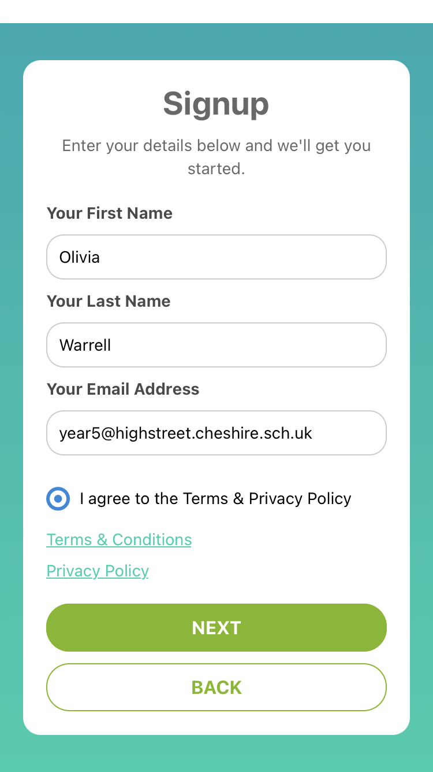
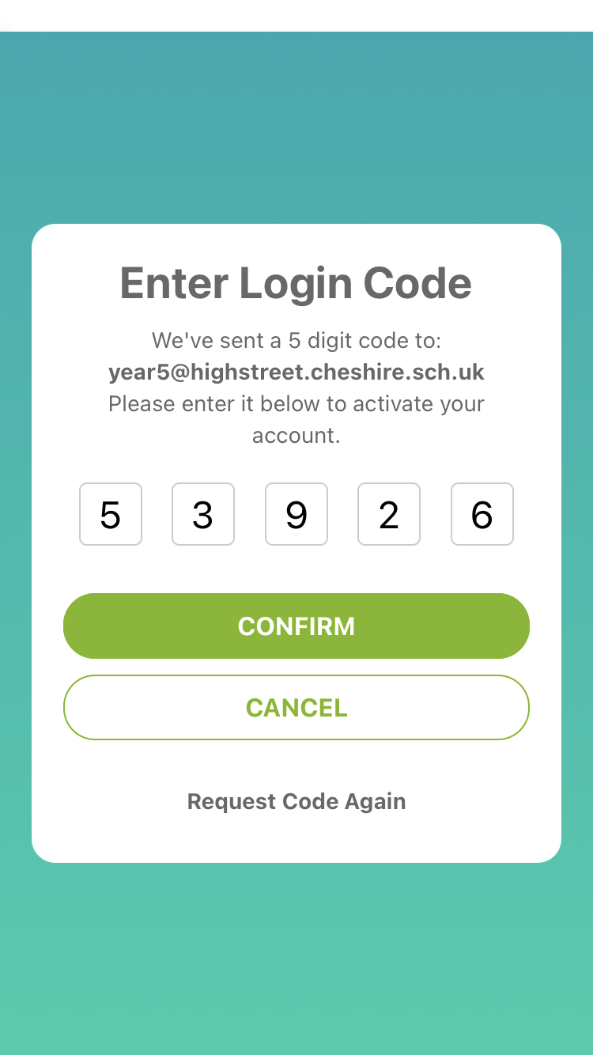
Enter your details and click Next.
Then you will receive a 5 digit code within 30 seconds.

Slide 5
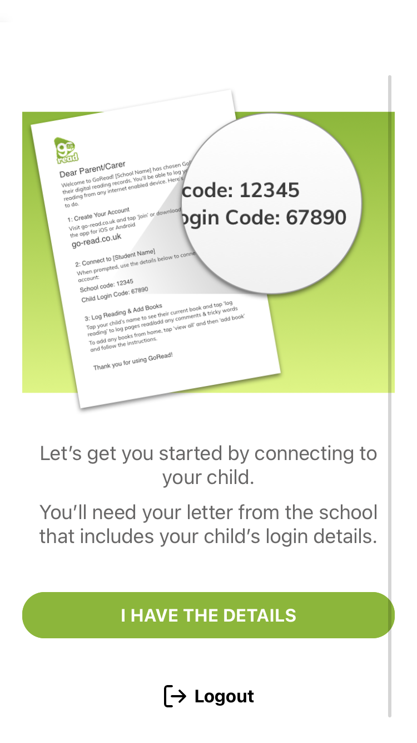
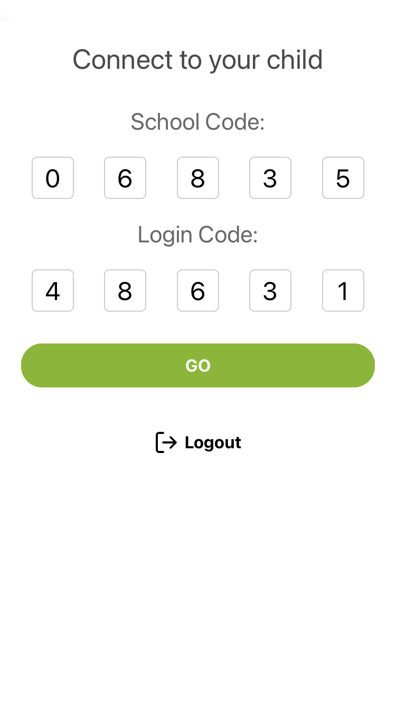
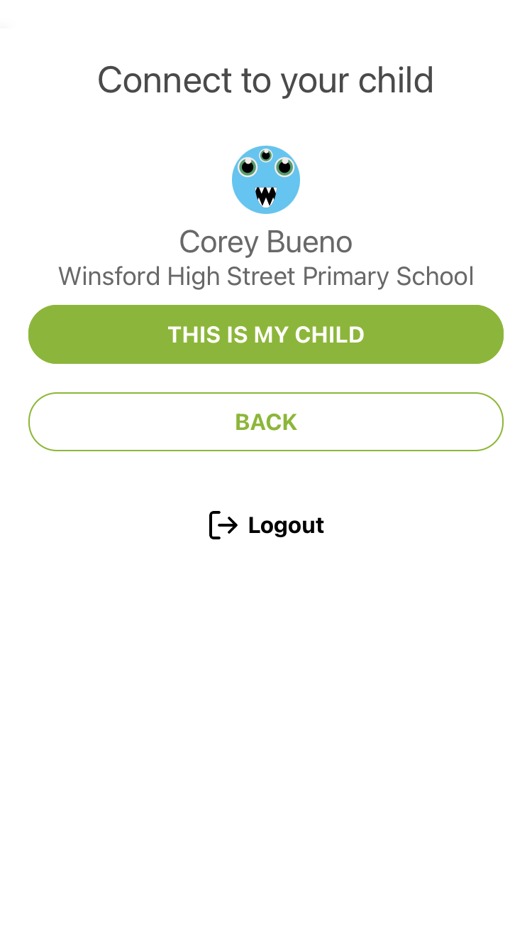
You should have all received your child’s login details.
Enter the school code: 06835 then your child’s specific code.

Slide 6
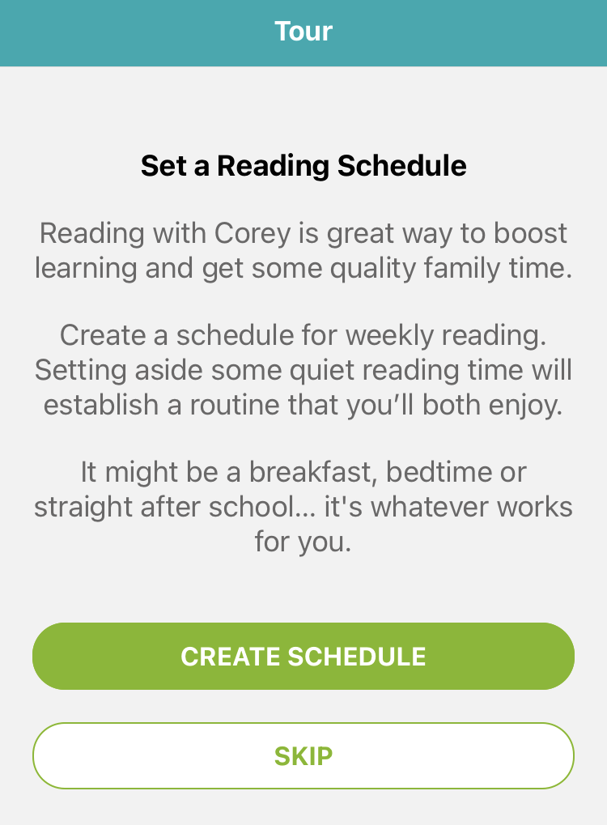
When you log in, you can set a Reading Schedule or skip this step if preferred.

Slide 7
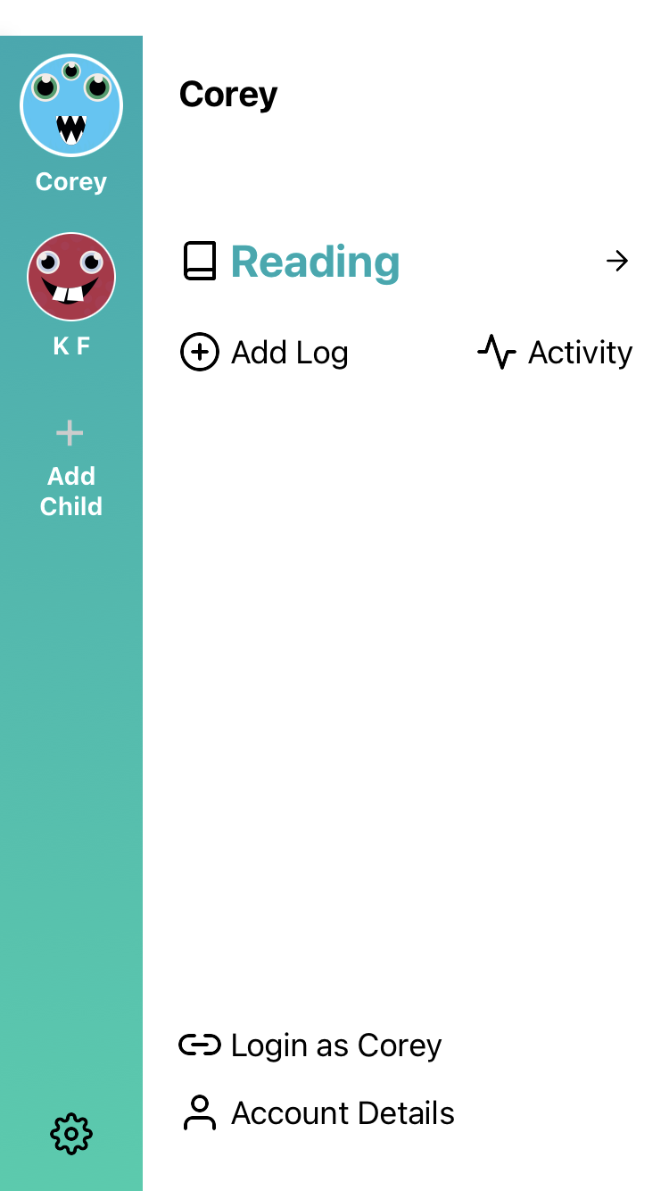
This is the screen you will see when you have logged in.
Here is the Add Child icon. All you need to do is click that.
Then input the school code: 06835 Then input your other child’s login code.
To make a reading record, all you need to do is click Add Log.

Slide 8
GoRead is new for all of us at High Street so please ask us if you are having any issues or problems using the app.
Please feel free to email us or ask after school for any support.

