Slide 1
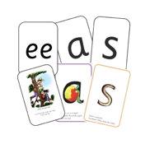

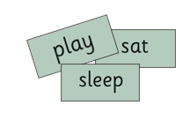
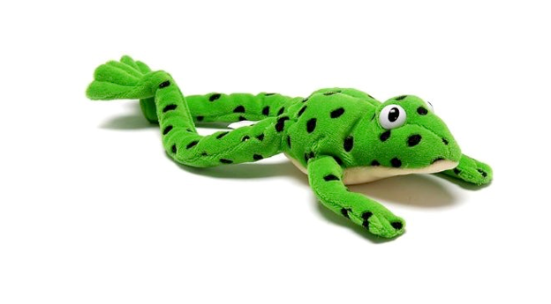
Read Write Inc
Wednesday 27th September 2023
Parent Information Session

Slide 2
What will we talk about tonight?
What is Read Write Inc. Phonics?
How your child will learn to read and write in school (Reception, Y1 and Y2)
Parent resources to support at home

Slide 3
Why Read Write Inc?
Read Write Inc teaches children to read in a systematic way
Resources used in the classroom are the same format from Reception to Year 2, the children are familiar with them and know the routines
High quality resources used in school and home
Wealth of parent resources to support you at home

Slide 4
RWI in Early Years

Slide 5
RWI in Early Years – Nursery
Children are introduced to ‘Fred the Frog’.
The children will initially learn to distinguish between different types of sounds and noises.
The children will begin to access the set 1 sounds through short, daily phonics sessions.
Children will learn how to recognise the initial sound in simple words and begin to blend sounds together to read simple words.
Letter formation will be modelled when appropriate

Slide 6
Reception - Fred Talk
Fred helps the children to blend
Fred says ‘put your hands on your l–e–g’
Fred says ‘ can you h-o-p?
Fred ‘likes to read a b–oo-k?

Slide 7
Reception - Fred Fingers
Children use Fred Fingers to help them spell words from the sound taught in the lesson.

Slide 8
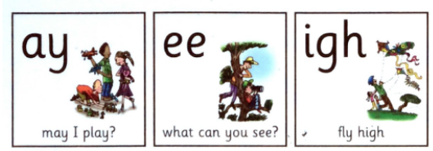
Special Friends
When 2 or 3 letters represent one sound

Slide 9


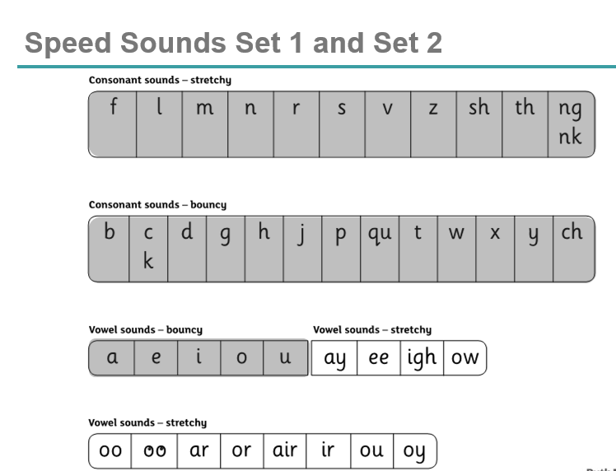

Set 1 and Set 2 Speed sounds are taught
Set 1
Called speed sounds because we aim for the children to have rapid recall of each sound.
Set 2
Notes:
We give children a hook to learn the sounds by using pictures in the same shape as the letter.
‘s’ looks like a snake.
‘d’ looks like a dinosaur.
‘m’ looks like a mountain.
‘a’ looks like an apple.
We teach the children to name the mnemonic pictures before they learn the sound.
This means that children learn to read and write the sounds really easily.

Slide 10
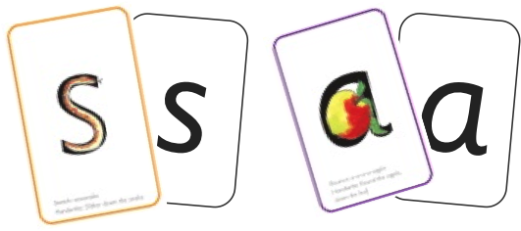

Word Time – blend sounds to read words and segment words into sounds in order to spell
+

Slide 11

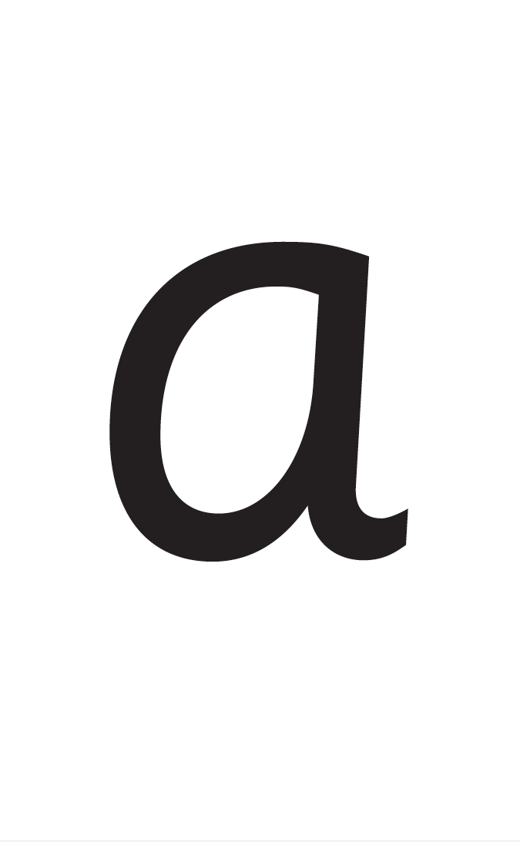



Slide 12
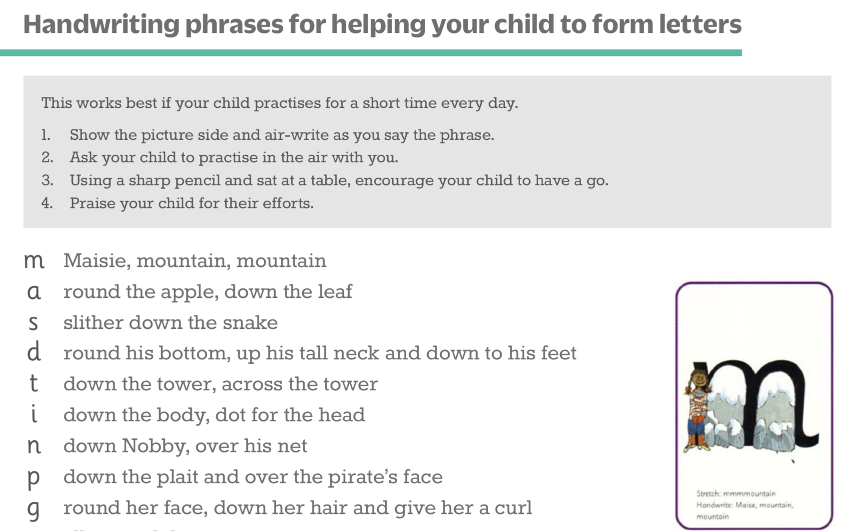
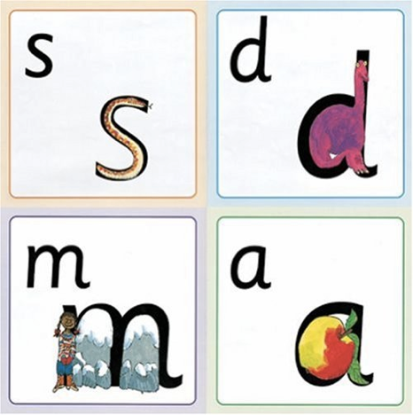
Letter formation
Notes:
Children use the picture mnemonic to learn to form letters correctly at the same time they learn to read each sound.
Each sound has a handwriting phrase e.g. down Maisie, and over the mountains.
Use these handwriting phrases when practising writing at home with your child.
Avoid using these to read the sound.
I will give you a handout of these handwriting phrases when you leave today.

Slide 13
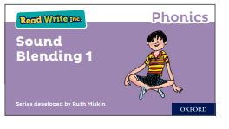
Reading at Home in Reception
Videos will be sent each week to practise at home.
When a child in Reception can:
quickly and accurately recognise the sound of the alphabet (not the letter name)
blend simple sounds to hear words ‘they make’
Then books will be sent home to practise.

Slide 14
Set 2 and Set 3 Sounds
Your child will learn the different ways of reading and writing the same sounds (poster visual)
Each sound has a rhyme to help the children learn/remember it

Slide 15
‘Three with us, four at home’
1 Accuracy – Children read words accurately and quickly
2 Fluency – Children read aloud with fluency using expression
3 Comprehension – Children can answer questions about the story
4 Read and enjoy at home – Practise at home after learning in school
Notes:
In our school, children read each Read Write Inc. Storybook three times in class with their partner.
Re-reading the same book helps children to become confident readers. Each time they re-read, they build their fluency/speed and comprehension.
They love reading and want to read because they can read all of the words in the Storybook.
We set a focus for each re-read in school.
(Click) The first read focuses on reading every word accurately.
(Click) The second on reading the story more quickly.
(Click) The third read on comprehension - understanding what they read.
Then your child brings the same book home to read and enjoy with you again and again at home.
It’s ‘three with me, four at home.’
We do not send stories home the children cannot read because we always want them to be set up to succeed in their reading.
We want to make sure they enjoy reading so that they want to read.
The more they read, the faster progress they will make.

Slide 16
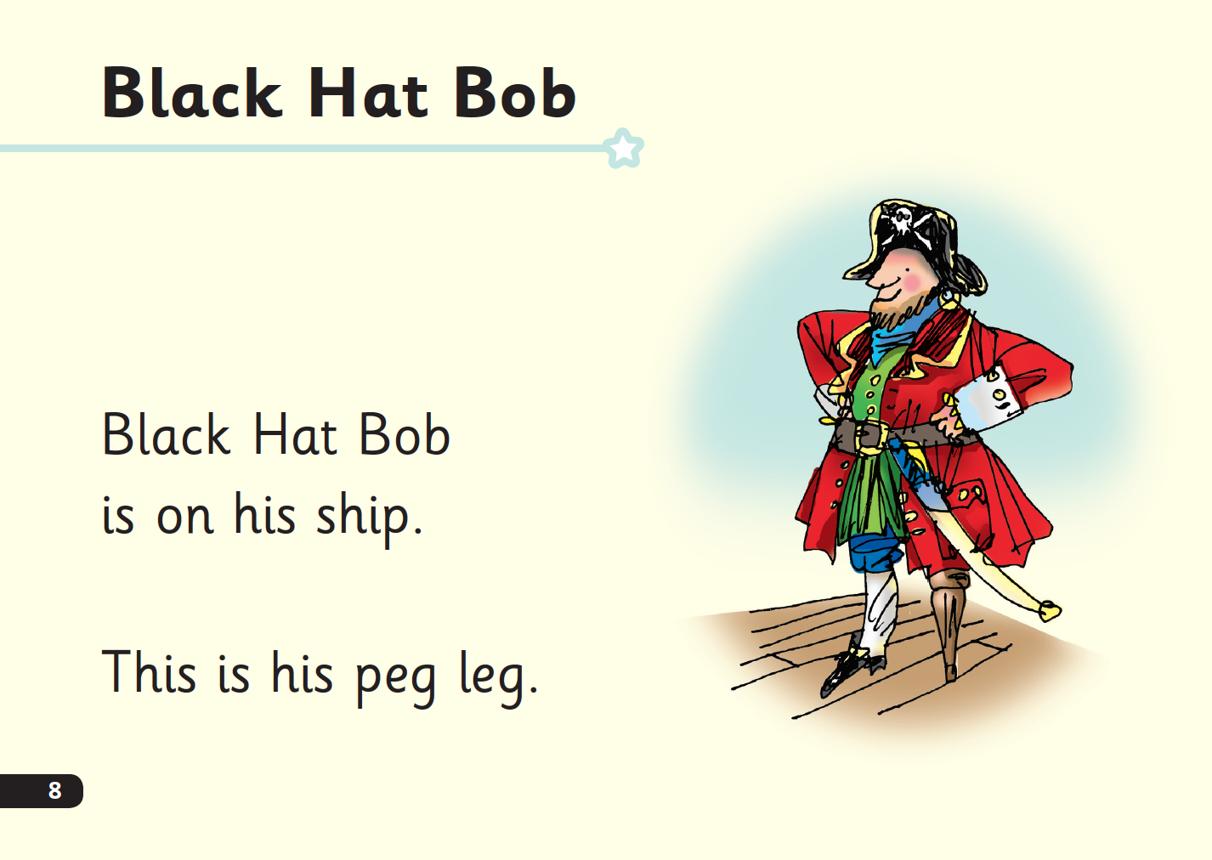

‘Special Friends’, ‘Fred Talk’, Read the word
Notes:
E Children will be able to read all of the words in the Storybook.
If they hesitate, remind them to read the word using ‘Special Friends, Fred Talk, read the word’.
For example, this means they spot the ‘sh’, then Fred Talk and blend to read the word e.g. sh, sh-i-p, ship.

Slide 17
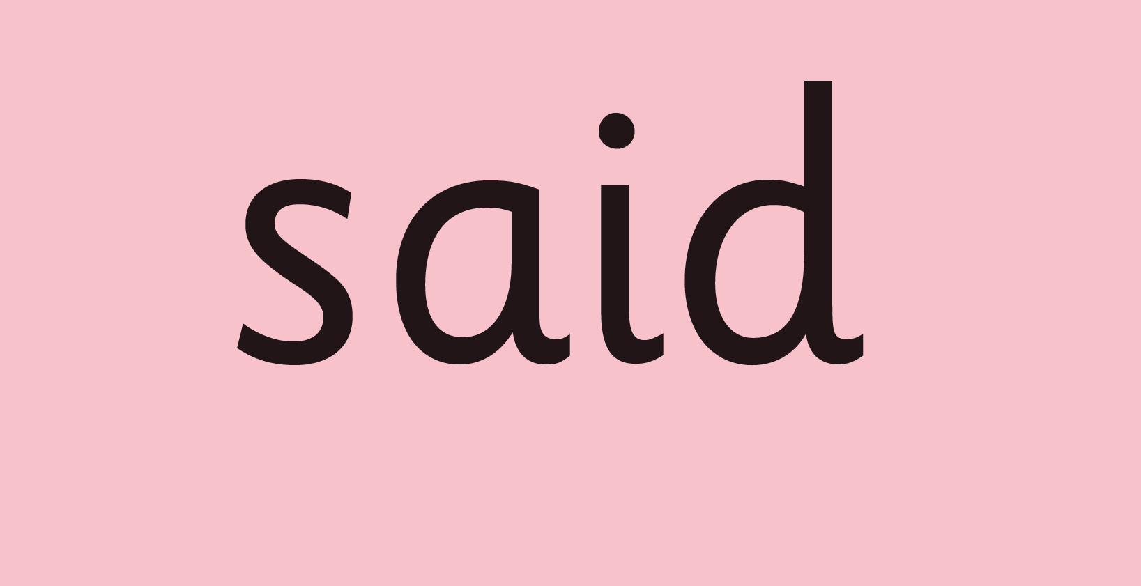
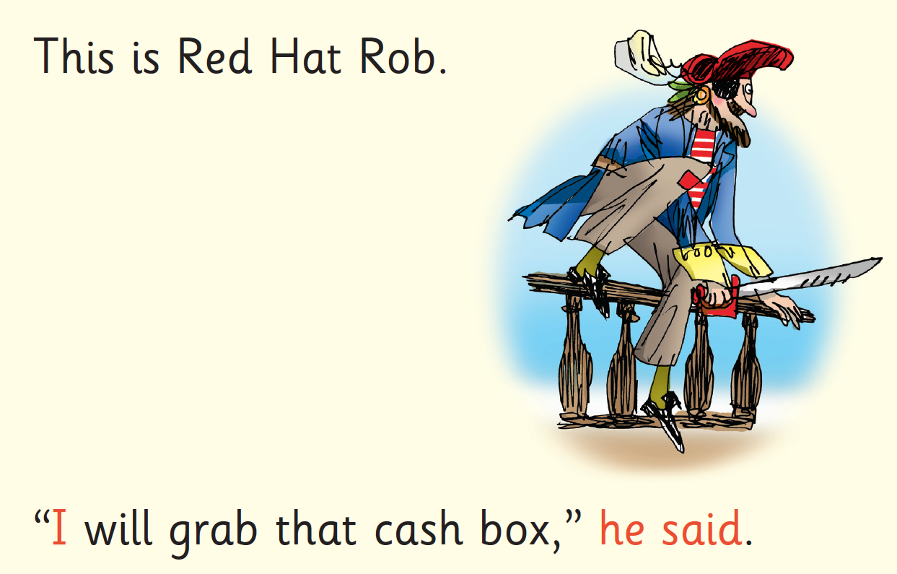
Red Words – contain letters that don’t match the sounds
We don’t use Fred Talk for red words
Notes:
Some words are ‘tricky’ because they contain letters that don’t match the sounds the child has been taught.
For example, ‘said’ has ‘ai’ making an ‘e’ sound.
We teach these common exception words as Red words.
In the early Storybooks, these words are printed in red text.
Remind your child not to use Fred Talk to read Red words but instead to stop and think. Tell them the word if needed.

Slide 18
Autumn Term 1
Daily phonics sessions learning letter sounds
Assessment to check how many sounds your child has learnt

Slide 19
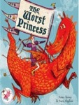
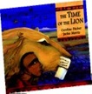



Which books will children bring home?
+
+
Storybook
Book bag book
Reading for Pleasure
Notes:
In your child’s book bag, they will bring home:
- the Storybook they have read in class to practise reading what they can already read.
- if applicable a ‘Last and past’ Storybook – a previously read RWI Storybooks for extra practice. The children enjoy re-reading stories they know well. Their fluency improves on every reading.
- if applicable a Book Bag Book. I’ll explain more about these in one moment.
A picture book to share with you which has already been read to them so they care about it. You can read the story to them or they can retell the story by looking at the pictures. They are not expected to read the story themselves.
We make sure that every book that goes into your child’s book bag is a well-loved book – one they know already and want to read again and again.

Slide 20
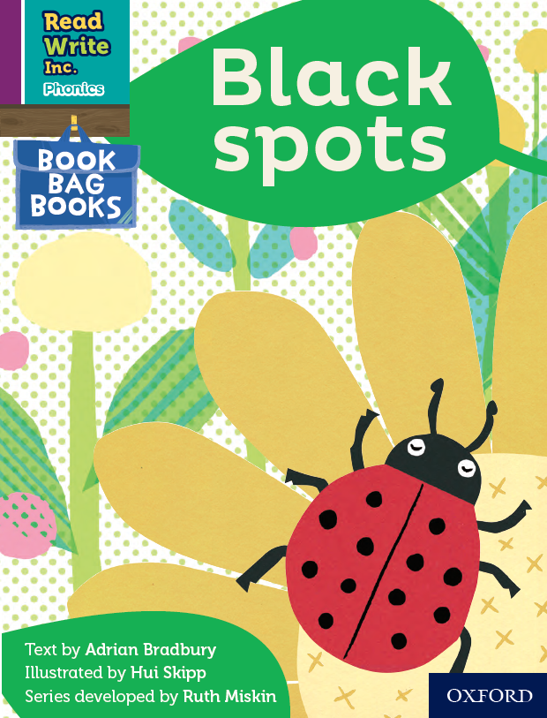
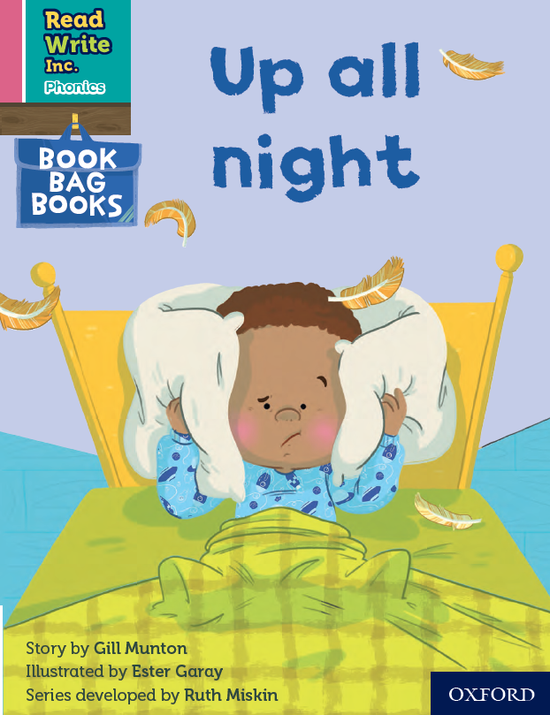
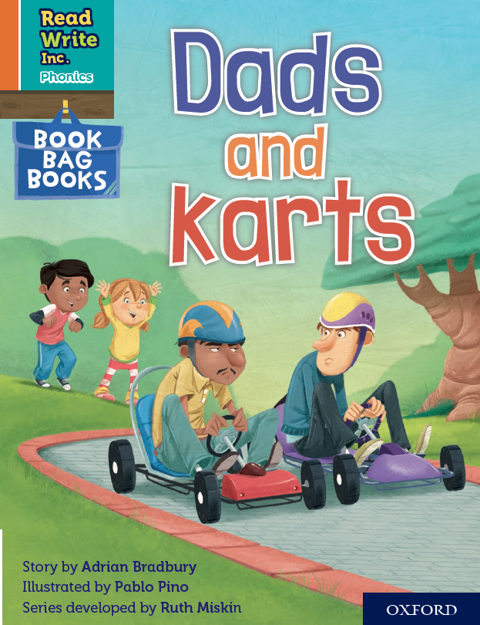

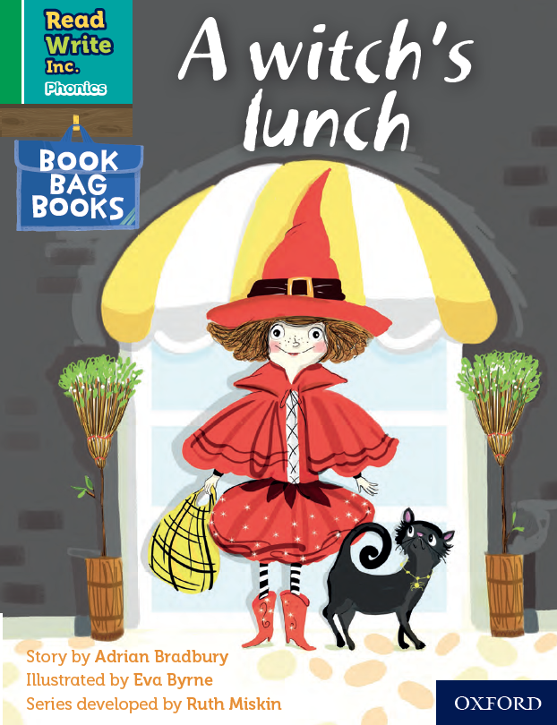
Book Bag Books
Extra reading practice at home
Uniquely matched to the Read Write Inc. Phonics Storybooks.
Reinforce children's learning of phonics at the appropriate level.
Helps to make even faster progress in reading.
Notes:
Only use this slide if you use Book Bag Books in your school.
We use Book Bag Books especially for home reading. They have guidance inside just for you as parents.
They are matched to the books children read in school so provide practice of the same sounds – extra practice at the right level for your child.
They include many of the same reading activities that we use in class.

