Slide 1

Welcome Meeting
Year 1
3rd September 2026

Slide 2

Year 1 Team
Welcome to Year 1!
Teachers:
Mr Allen (Wheelock)
Mrs McNeill (Dee)
Mrs Powell
Teaching Assistants:
Mrs Berry
Miss Taylor
Miss Lea
Mr Heatley

Slide 3
Responsibility
Increase children’s own responsibility
Look after themselves and own belongings
  Reading book/diary
  Change reading book
  P.E. kit
  Uniform and coats
  Water bottles

Slide 4
Transition into Year 1
This year we will be steadily introducing the Year 1 curriculum to the children, supported by the effective use of continuous provision.
Elements of Foundation Learning, such as some aspects of a play based curriculum will support us in achieving our key stage learning objectives, as we ease children into the increased expectations.
Each day basic skills will continue to be practised such as handwriting, writing of numbers and names, as well as, reading skills.

Slide 5

Daily Routine
Doors open: 8:45 am – Close: 8:55am – after this, entry will be through the office.
Mornings –
Fine- Motor, Phonics, Maths and English
Afternoons –
Science ,History, Geography, Art, D&T, PE, Music, RE, Computing, PSHE, Outdoor Learning.
Home time: 3:15 pm

Slide 6

Phonics
RWI sessions will be taught for 45 minutes each day.
Children will be taught in ability groups and the activities will be tailored to the children’s needs.
Phonics Screening Check (Around June)

Slide 7

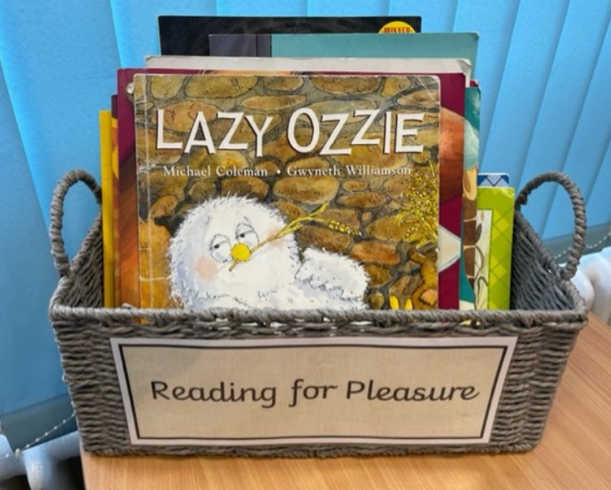
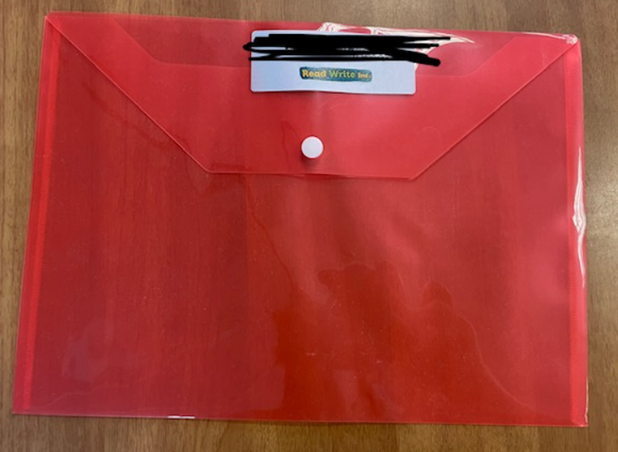
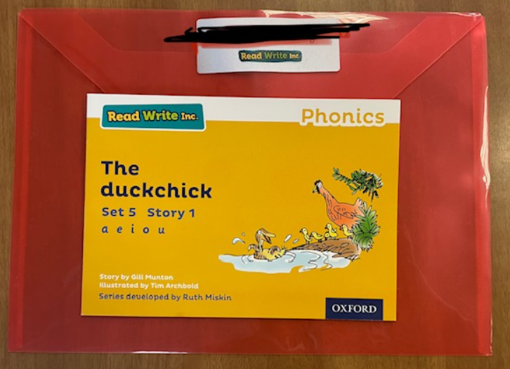
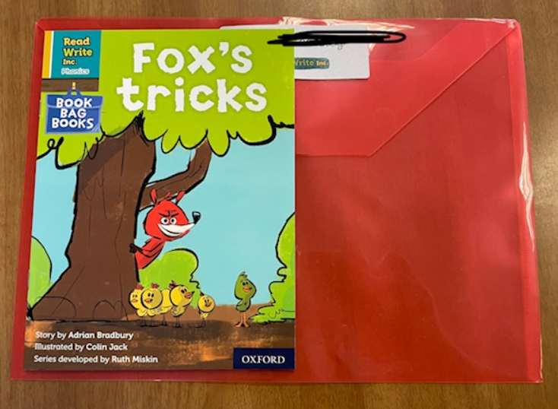
Reading
We will provide all children with a new named reading folder. These need to be brought in daily to support their learning.
1.Children will have a ‘Book bag book’. This will link directly to the phonics they have learnt in school and will have familiar sounds for them to decode words mostly independently.
2. Children will also have a Phonics book. These books are ready daily with them in phonics. If your child doesn’t bring this book in, they will not be able to use it in their phonics lesson to support their learning.
3. Children can have a reading for pleasure book. This is a story book that is not linked to their own reading abilities/phonic knowledge. It is a story for them to share with the family at home or enjoy on their own. They can swap these any day in school.

Slide 8
Reading
We will count the number of reads taken place over the week at home and progress will be displayed and celebrated in the classroom – there may also be the occasional prize!

Slide 9



Autumn Reading Challenge
The latest challenge has been launched in assembly this week.
We can count up to 7 reads each week.
Certificates and stickers will be sent home. A prize awarded to those who reach at least 70 reads by Christmas.
25
50
70
Sticker and certificate
Sticker and certificate
Certificate and reading treat

Slide 10
Residential
Residential
- We stop over for one night. This year, we will be visiting the Conwy in May.
- Sleeping arrangements – boys sleep in one room and the girls in the other. There is always a teacher close by if any support is needed.
-Children have the opportunity to develop their creative skills, team work and independence.
- The residential is a lovely start to their overnight experiences at High Street and children always come back excited to tell you what they have done!
Further details to follow.

Slide 11
Pupil Premium and Free School Meals
Pupil Premium and Free School Meals
From the start of the 2026/27 academic year (September 2026):
✔️All children in households receiving Universal Credit will become eligible for Free School Meals. (Expanded Free School Meals)
✔️The current earnings threshold (approximately £7,400 per year) will remain for additional benefits such as Pupil Premium eligibility. (Targeted Free School Meals)
✔️ This is a significant expansion and is expected to make many more families eligible!
What this means for your child…
Cheshire West and Chester Council has confirmed that:
✔️From September 2026, any family receiving Universal Credit will be entitled to apply for FSM.
✔️Please note, families must apply through the council - entitlement is not automatic.

Slide 12
Pupil Premium and Free School Meals
Why it is important to apply?​
​
Applying for FSM is important because:​
​
✔️ Your child will receive a free, nutritious meal each day at school​
​
✔️ You could save around £450–£500 per child each year on lunches​
​
✔️The school receives additional funding (Pupil Premium) for some eligible pupils, helping to provide extra support and opportunities.​
​
✔️ Even if your child is in Reception, Year 1 or Year 2 and already receives a universal free meal, registering for FSM remains essential if you are eligible.​
What you need to do…​
​
✔️ Apply for FSM if you are currently receiving Universal Credit, you do not need to reapply if have previously been eligible. ​
You can apply via Cheshire West and Chester Council:​
• Online: https://www.cheshirewestandchester.gov.uk/residents/education-and-learning/free-school-meals ​

Slide 13

Behaviour System
School Rules: Be Ready, Be respectful, Be safe
Rewards: Verbal praise, High Street Heroes, Work to be proud of/Wow wall, Dojo points
Reminder -> Warning -> Time out -> Reflection -> Repair
This gives children an opportunity to reflect on and change their behaviours.
We will continue to use ClassDojo this year. This is an app which allows us to reward positive behaviour which you can then see at home.

Slide 14
Uniform
School jumper/cardigan, shirt/polo shirt/ trousers/skirt/summer dress
Ties
Black school shoes
Coat
Hair bobbles/accessories- not too fancy/big
No nail varnish
Tie long hair back (reduce chances of head lice)
No jewellery (except stud earrings)
Names on all items

Slide 15
P.E.
PE kits to remain in school for a half-term.
Outdoor – blue t-shirt (or team colour), tracksuit bottoms, jumper, trainers.
Remove earrings for P.E. day or cover with plasters provided from home.
Our PE days are Monday and Friday.
Indoor kits – blue t-shirt (or team colour), black shorts, pumps.

Slide 16
Snacks
The children will get fruit and milk provided by the school in the mornings/afternoons.
Please provide your child with one small, healthy snack for morning break.
Please provide your child with a named water bottle, filled with water (not juice).

Slide 17
www.winsfordhighstreetprimary.co.uk
Curriculum what we are going to be learning about in Y1
Calendar, term dates, lunch choices etc.
School Website

Slide 18
Contact
If you would like any more information please speak to your child's class teacher at the beginning or end of a school day.
You can also contact us at: year1@highstreet.cheshire.sch.uk between 8am – 5pm.
Emails received after 5pm may not be responded to until the following day by one of the Year 1 Team.
Class Dojo will be our primary channel of communication and is the easiest way to contact your child’s class teacher. Please ensure that you are connected.

Slide 19
Any Questions?

