Slide 1
Author of the Month…
March

Slide 2

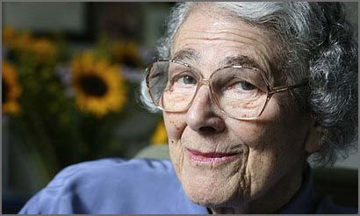
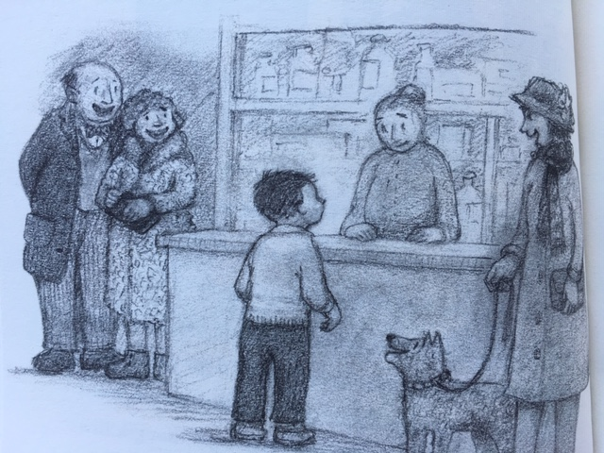
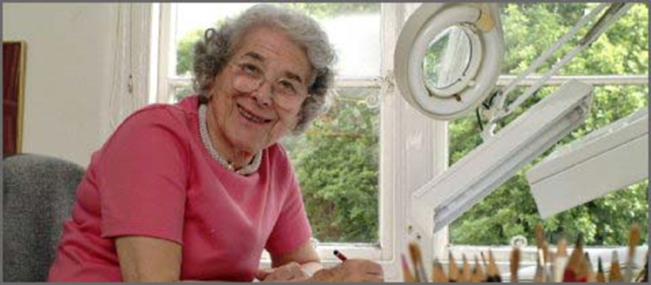
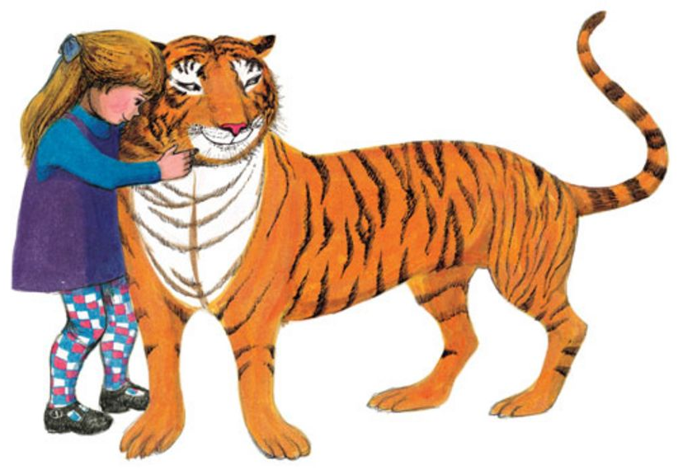
Judith Kerr, OBE (surname pronounced KAR 14 June 1923 – 22 May 2019) was a German-born British writer and illustrator. She was known for her Mog series and The Tiger Who Came to Tea. She also wrote novels for young adults such as When Hitler Stole Pink Rabbit, which gave a child's-eye view of the Second World War.
Kerr was born in Berlin, but moved to the United Kingdom before the Nazis rose to power because Kerr's father, openly a Nazi critic, was scared for his family's safety. Kerr later became a naturalized British subject.
Kerr died on 22 May 2019 from a short-illness at her home in Barnes, London at the age of 95.

Slide 3
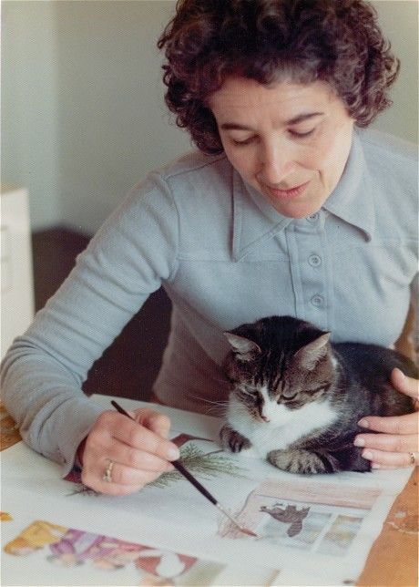
Judith Kerr not only wrote made-up stories, her own life was a big adventure in itself.
Judith Kerr was born in Berlin in Germany in 1923. Her parents were Jewish and her father had been very critical of Hitler and the Nazis before they took leadership of the country. (You may need to qualify this statement with a greater explanation, as appropriate.)
Judith’s father wrote many books, but when the Nazis came to power, Hitler was angry about the things her father had written and his books were burned in big protests. Judith’s family fled, scared of what might happen to her father. They eventually settled in England, which is where Judith grew up, got married and had two children, a son and a daughter.
One day, when Judith’s daughter was little, she took her to the zoo, where they both greatly admired the tigers and wanted to stroke them. Soon after, Judith made up a story where she imagined what might happen if a tiger came to tea. Her daughter asked her to tell it over and over again.
Later, over the course of a year, Judith wrote the story out and illustrated it. The Tiger Who Came to Tea became her first storybook and is now one of the bestselling children’s books of all time.
Judith wrote many other books for children, including the Mog stories. When her own children were older, she wrote another story called When Hitler Stole Pink Rabbit to help them understand what it was like for children living in Germany when Hitler came to power.

Slide 4
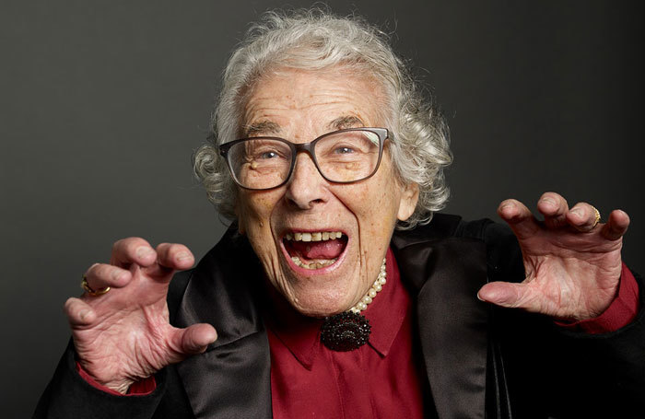
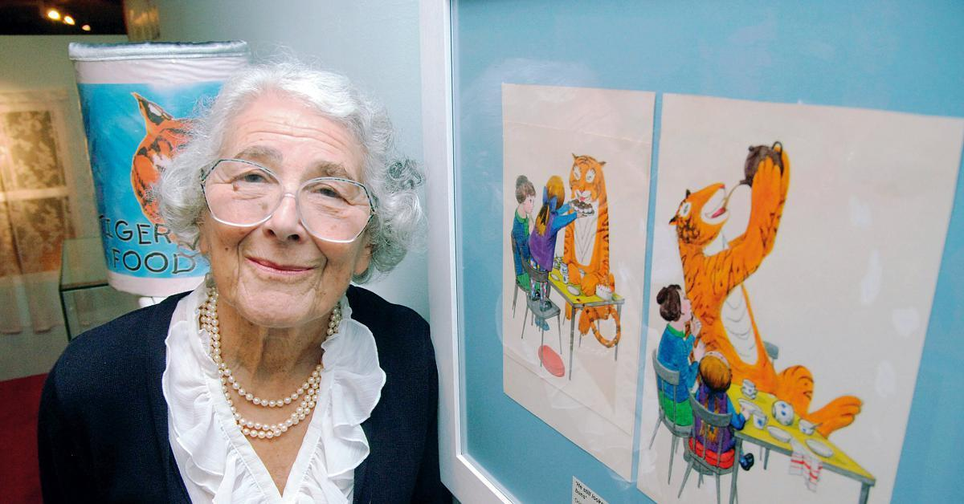
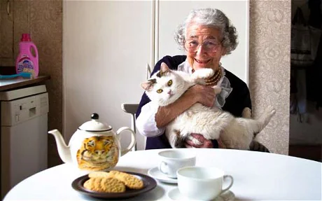
Judith Kerr was born in Berlin in 1923 but escaped from Hitler’s Germany with her parents and brother in 1933 when she was nine years old. Her father was a drama critic and distinguished writer whose books were burned by the Nazis, because he dared to speak out against the regime. The day after the family left Berlin, the authorities came to arrest them, and throughout the war there was a price on her father’s head. Judith and her family passed through Switzerland and France before finally arriving in England in 1936. Judith wrote about her experiences in her classic autobiographical story, When Hitler Stole Pink Rabbit.
Judith won a scholarship to the Central School of Arts in 1945, and since then has worked as an artist, television scriptwriter and, for the past thirty years, as an author and illustrator of children’s books. Judith was married to the scriptwriter Nigel Kneale, who died in 2006, most famous for the hit sci-fi series Quatermass. Her son is the writer Matthew Kneale who won the Whitbread Book Award for The English Passengers.
The Tiger Who Came to Tea was Judith’s first picture book and was published in 1968. She wrote it after telling the story at bedtime to her daughter Tracey and son Matthew. The Tiger Who Came to Tea was recently made into a stage play written by David Wood and produced by Nick Brooke, which has toured the UK.

Slide 5
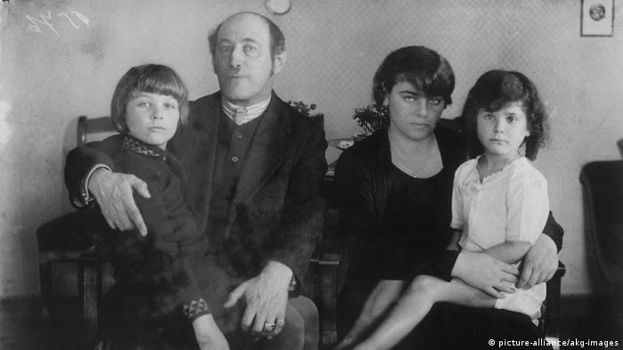
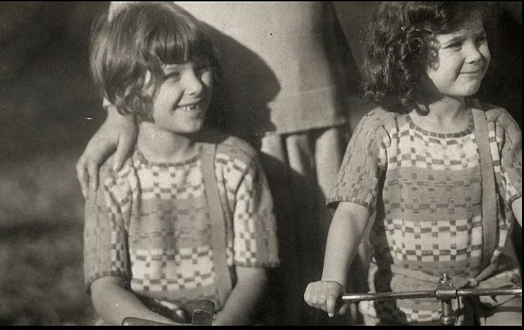
Judith Kerr OBE is a German-born British writer and illustrator
who has created both enduring picture books such as the
Mog series and The Tiger Who Came To Tea and acclaimed
novels for older readers.
She was born on 14 June 1923 in Berlin but escaped
from Hitler’s Germany with her parents and brother
in 1933 when she was nine years old. Her father was a
drama critic and a distinguished writer whose books were
burned by the Nazis. The family passed through Switzerland
and France before arriving finally in England in 1936.
Among the possessions left behind was a pink rabbit
which had been Judith’s comforter before it was displaced
in her affections by a woolly dog.
“We were allowed to take one toy each, and I decided on the dog.”
She never saw Pink Rabbit again, but neither did she forget it. Years later,
when she wrote the first of three novelised accounts of her childhood,
she called it When Hitler Stole Pink Rabbit. Humour is central to Kerr’s world,
though it comes shadowed by an awareness that reality is often not funny at all.
Kerr’s mother was much younger than her husband, a child of wealth and privilege
who had written two operas but had never cooked for herself. She is depicted in
Pink Rabbit struggling with scrambled eggs and valiantly attempting to knit.

Slide 6
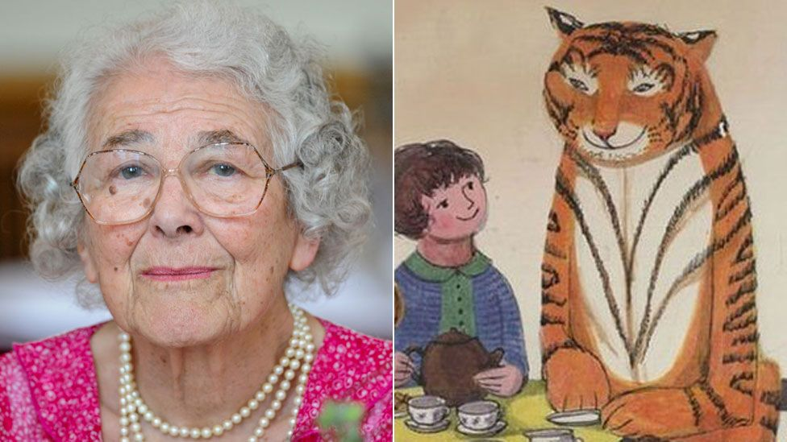
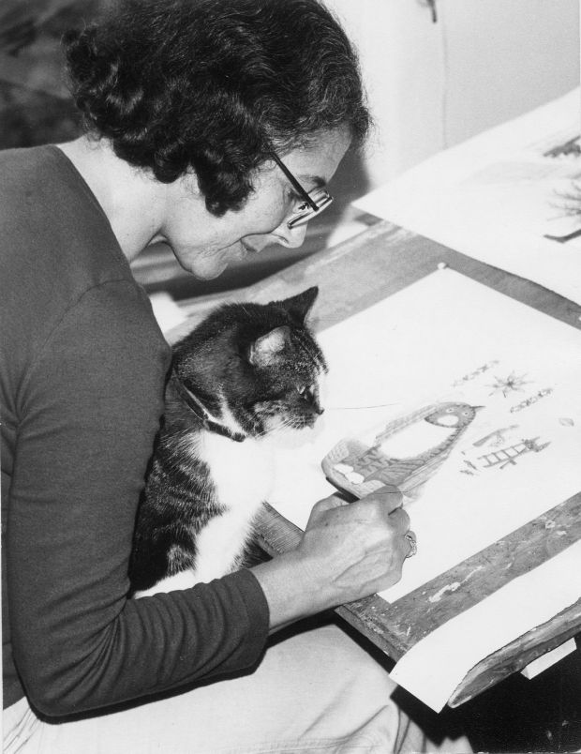
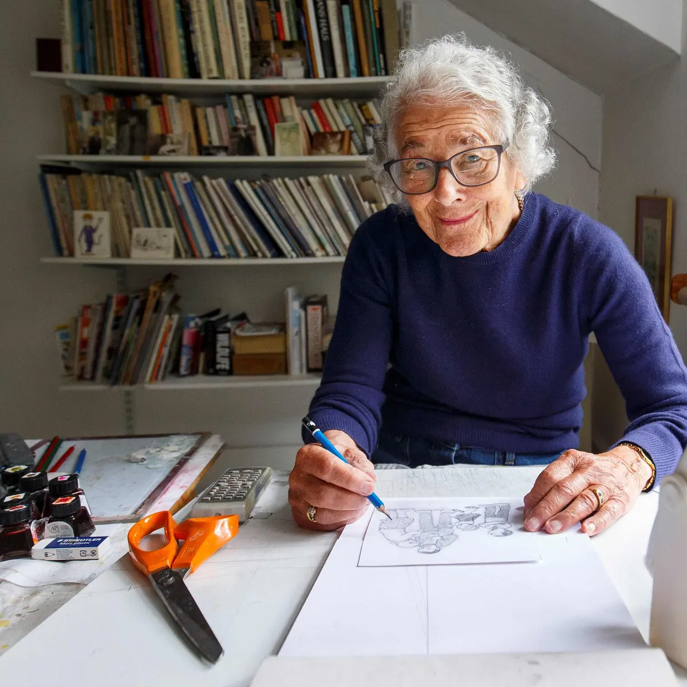
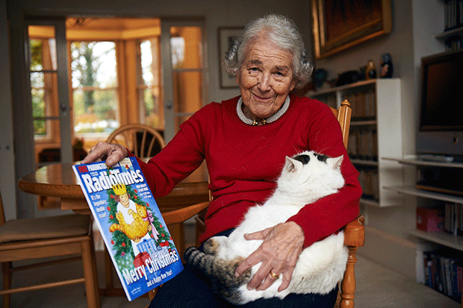
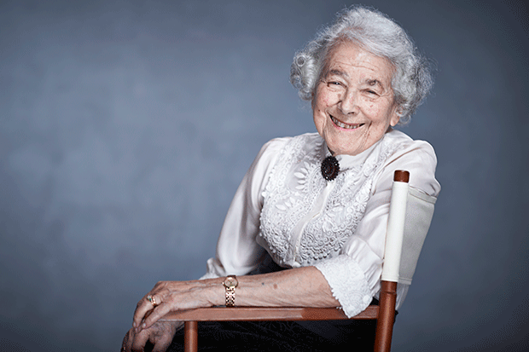
Judith Kerr went to eleven different schools, worked in the Red Cross during the war, and won a scholarship to the Central School of Arts and Crafts in 1945. Since then she has worked as an artist, a BBC television scriptwriter and, for the past thirty years, as author and illustrator of children’s books.
Her three autobiographical novels are based on her early wandering years (which against all the odds she greatly enjoyed), her adolescence in London during the war, and finally on a brief return to Berlin as a young married woman.
The stories have been internationally acclaimed and to the author’s considerable satisfaction, have done particularly well in Germany where they are sometimes used as an easy introduction to a difficult period of Germany history.

Slide 7
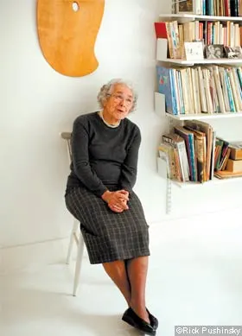
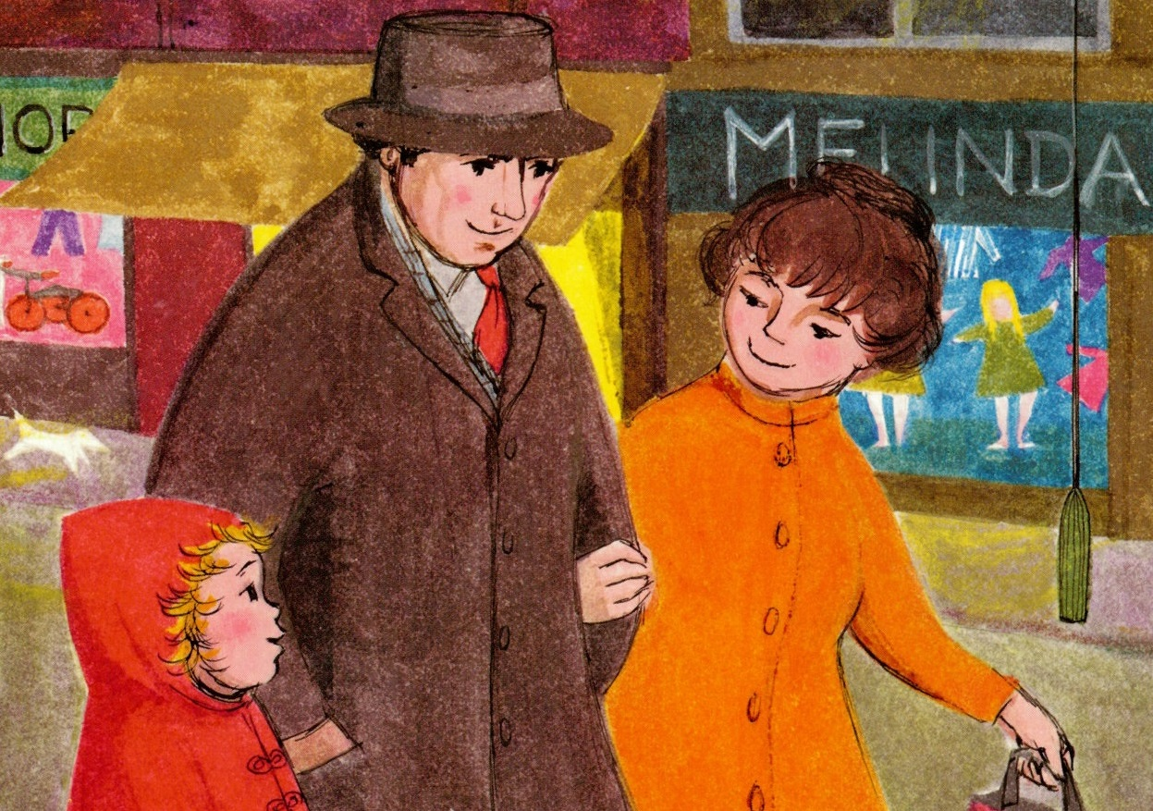
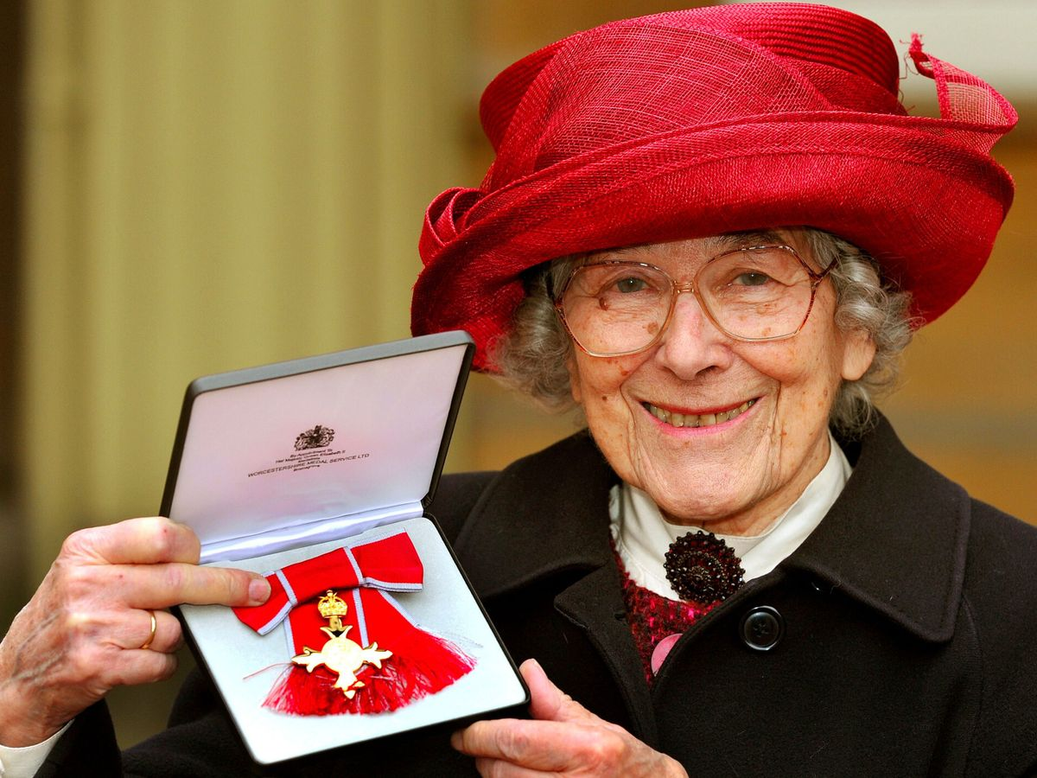
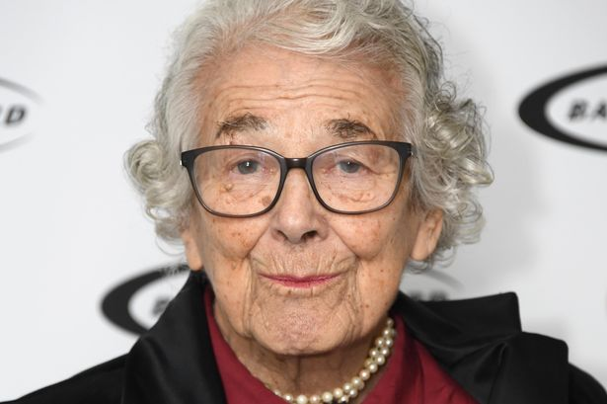
The Mog books were based on Kerr’s own cat. She gave the Thomas children her own children’s second names, while their surname comes from her husband Nigel Kneale’s middle name – he is always known as Tom in the family.
When the first Mog died and was duly replaced, Kerr found new stories emerging from her observations of the newcomers’ behaviour. Years later the ninth incarnation is a handsome white and brindle beast called Katinka who has demonstrated her inner Mog by making friends with a fox.
Judith has a daughter who is a designer and a son who is a novelist. She lives in London.

Slide 8


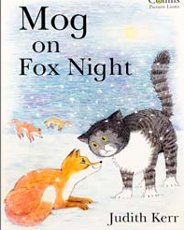







https://www.youtube.com/watch?v=RjcxZemAxNI
https://www.youtube.com/watch?v=XmjwKwelCJ8
https://www.youtube.com/watch?v=UQGLabvHBh0
https://www.youtube.com/watch?v=a1JWoNE-S4o
https://www.youtube.com/watch?v=NIKfRQrVhKc
https://www.youtube.com/watch?v=7fY7WywUMwE
https://www.youtube.com/watch?v=PkWq7smIBHA
https://www.youtube.com/watch?v=gCx5vGwN0zk
https://www.youtube.com/watch?v=zSEYddbGo90
https://www.youtube.com/watch?v=C3kySoLVAUs

