Slide 1



Key Stage 2 SATs
Presentation to Parents of Year 6 children at St. Wilfrid’s Church of England Primary Academy

Slide 2
This year’s key stage 2 tests are timetabled from Monday 13th May to Thursday 16th May 2019.

Slide 3
Assessment and Reporting
As of 2014, the ‘old’ national curriculum levels (e.g. level 3, 4, 5) were abolished as set out in government guidelines.
The 2014 curriculum is rigorous and sets noticeably higher expectations than previous curricula, which is why all schools have had to work hard to meet and adapt to it since its introduction.
Since 2016, test scores have been reported as ‘scaled scores’.

Slide 4
What is meant by ‘scaled scores’?
It is planned that 100 will always represent the ‘national standard’.
Each pupil’s raw test score will therefore be converted into a score on the scale, either at, above or below 100.
Using the scaled score, the lowest a child can score is 80, with the highest being 120.
A child who achieves the ‘national standard’ (a score of 100) will be judged to have demonstrated sufficient knowledge in the areas assessed by the tests.
Each pupil receives:
a raw score (number of raw marks awarded);
a scaled score in each tested subject;
confirmation of whether or not they attained the national standard.

Slide 5
Scaled Score Examples
On publication of the test results in July:
a child awarded a scaled score of 100 is judged to have met the ‘national standard’ in the area judged by the test;
If a child’s score is close to 120, they are working beyond (or above) the expected national standard.
a child’s score is close to 80, they are judged to have not yet met the national standard and performed below the expectation for their age.

Slide 6
Higher Attaining Pupils
In the past, Key Stage 2 tests were aimed at children achieving levels 3-5 (with a national expectation to reach at least level 4).
This meant that additional level 6 tests were produced for children who demonstrated higher than expected attainment (above level 5).
Under the new system, there are not any separate tests for the most-able children.
Instead, each test will have scope for higher-attaining pupils to show their strengths.
This means that some questions towards the end of the tests may be more difficult for many children but they should be encouraged to attempt as much of the test as they are able to.

Slide 7
The Tests
Key Stage 2 SATs take place nationally in the week commencing 13th May 2019.
Statutory tests will be administered in the following subjects:
Punctuation, Vocabulary and Grammar (45 minutes)
Spelling (approximately 15 minutes)
Reading (60 minutes)
Mathematics
- Paper 1: Arithmetic (30 minutes)
- Paper 2: Reasoning (40 minutes)
- Paper 3: Reasoning (40 minutes)
All tests are externally marked
Writing will be ‘Teacher Assessed’ internally, as in recent years against a criteria.

Slide 8
Timetable for KS2 SATs 2019
Monday 13th May 2019 | English grammar, punctuation and spelling test, Paper 1: questions English grammar, punctuation and spelling test, Paper 2, spelling.
Tuesday 14th May 2019 | English reading test
Wednesday 15th May 2019 | Mathematics Paper 1: arithmetic test. Mathematics Paper 2: reasoning.
Thursday 16th May 2019 | Mathematics Paper 3: reasoning.
If a child is absent on any/all of the above dates there will not be an opportunity for the test to be taken on another date.

Slide 9
Reading
The reading test consists of a single test paper with three unrelated reading texts. Children are given 60 minutes in total, which includes reading the texts and answering the questions.
A total of 50 marks are available.
Questions are designed to assess the comprehension and understanding of a child’s reading.
During the reading paper, a child’s inference and deduction skills are thoroughly tested. They will also be expected to answer a range of questions, for example, explaining why an author has chosen to use particular vocabulary, grammar and text features.
Some questions are multiple choice or selected response; others require short answers and some require an extended response or explanation

Slide 10
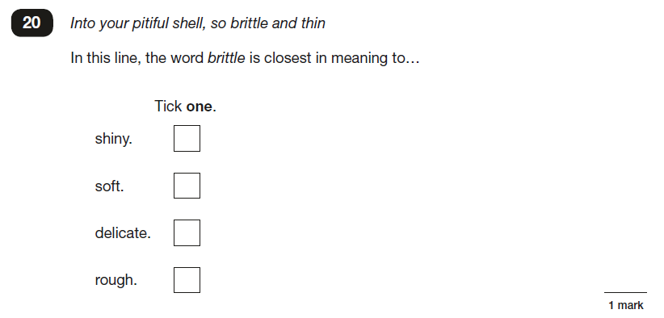
Reading
Some questions will test the children on their understanding of vocabulary.

Slide 11
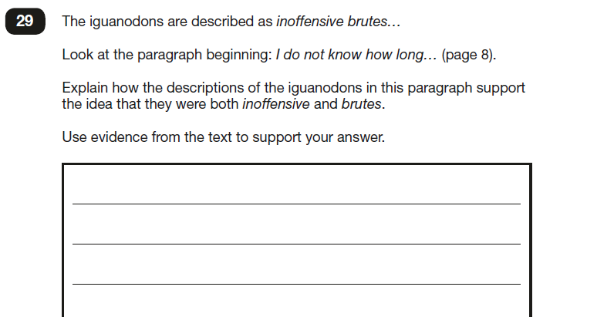
Others will require the children to deduce answers by using words or phrases as evidence.

Slide 12
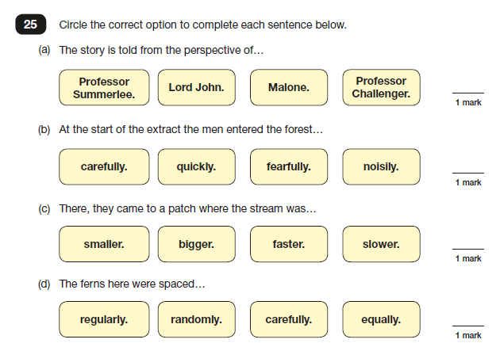
Some questions will ask the children to find literal answers from the texts.

Slide 13
English, Grammar, Punctuation and Spelling
A spelling test is administered containing 20 words, which lasts approximately 15 minutes.
A separate test is given on grammar, punctuation and vocabulary.
This test lasts for 45 minutes and requires short answer questions including some multiple choice.
Marks for these two tests are added together to give a total for grammar, punctuation and spelling.

Slide 14
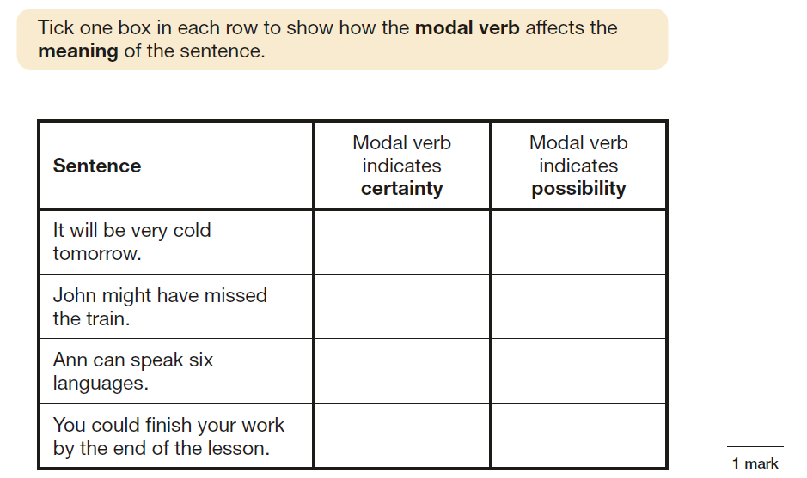
Grammar

Slide 15
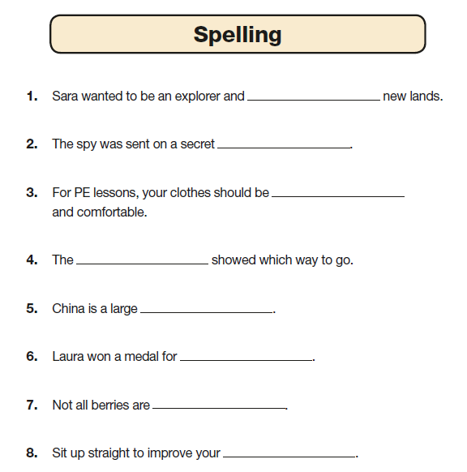
Spelling
There are 20 spelling sentences.
The spelling words are tested within the context of a sentence.
As the sentences are read out to the children, they fill in the correct spellings on their copy of the text.

Slide 16
Mathematics
The mathematics tests have undergone the biggest change in recent years.
Children will sit three tests: paper 1, paper 2 and paper 3.
Paper 1 is for arithmetic lasting for 30 minutes, covering calculation methods for all operations, including use of fractions, percentages and decimals.
Questions gradually increase in difficulty. Not all children will be expected to access some of the more difficult questions later in the paper.
Papers 2 and 3 cover problem solving and reasoning, each lasting for 40 minutes.
Pupils will still require calculation skills but will need to answer questions in context and decide what is required to find a solution.

Slide 17
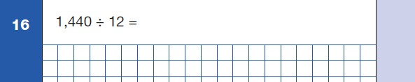
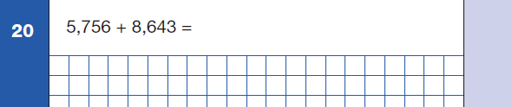
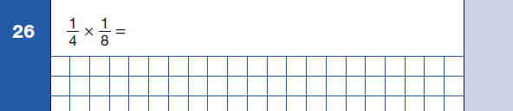
Questions taken from Paper 1 - Arithmetic

Slide 18
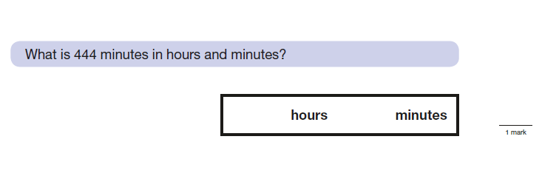
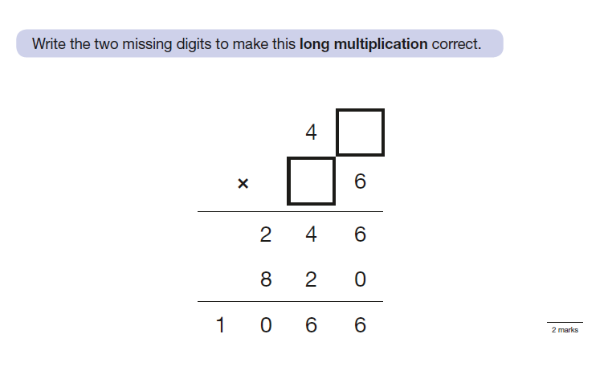
Questions taken from Paper 2 - Reasoning

Slide 19
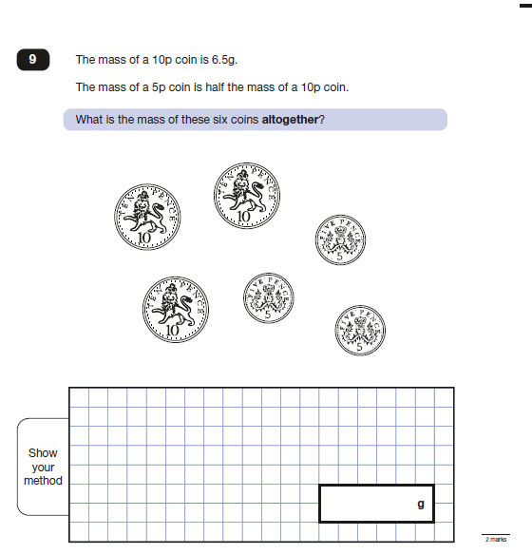
A question taken from Paper 3 - Reasoning

Slide 20
Revision Websites
http://www.bbc.co.uk/schools/revision/
This is an excellent site, providing revision help for KS2, KS3, KS 4 and KS5. This covers all subjects through activities and tests.
http://www.icteachers.co.uk/children/children_sats.htm
A wide range of KS2 SATs questions, from both past papers and their own team of teachers.
https://uk.ixl.com/promo?partner=google&campaign=1187&adGroup=Key+Stage+2&gclid=CPPa8teS_8kCFQbnwgodgOIB6A
IXL have separate pages of skills linked to individual Year group. The Y6 page has links to practise both English and Maths skills. Pages are then split into skills of which has a practise question for the children to think about.

Slide 21
How to help your child
First and foremost, support and reassure your child that there is nothing to worry about and that they should always just try their best. Praise and encourage!
• Ensure your child has the best possible attendance at school.
• Support your child with any homework tasks.
• Reading, spelling and arithmetic (e.g. times tables) are always good to practise.
• Talk to your child about what they have learnt at school and what book(s) they are reading (the character, the plot, their opinion).
• Make sure your child has a good sleep and healthy breakfast every day!

Slide 22


Thankyou for listening
Please do not hesitate to contact us at school if you have any questions or your child has any worries or concerns.

