Slide 1
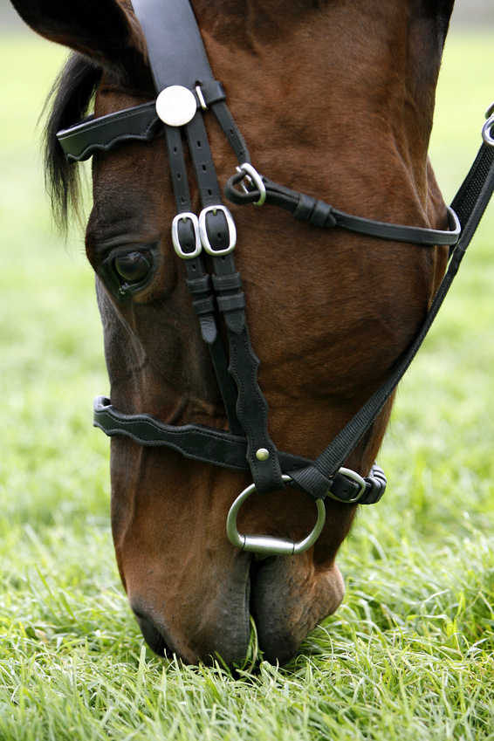
ough words
O!
U!
greedy
horse

Slide 2

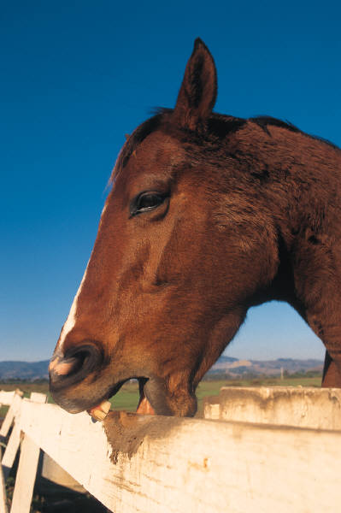
o-u-g-h
O- u-g-h
Found in lots of words but has several different sounds
Always the same 4 letters

Slide 3
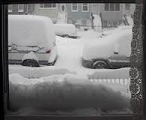
Can rhyme with snow/although
Although there was a snow storm the children still wanted to go outside in the garden.
a-l-t-h-o-u-g-h
although

Slide 4
Rhymes with snow/dough
The baker kneads the dough so that when the bread is cooked it will have a light airy texture.
d-o-u-g-h
dough

Slide 5
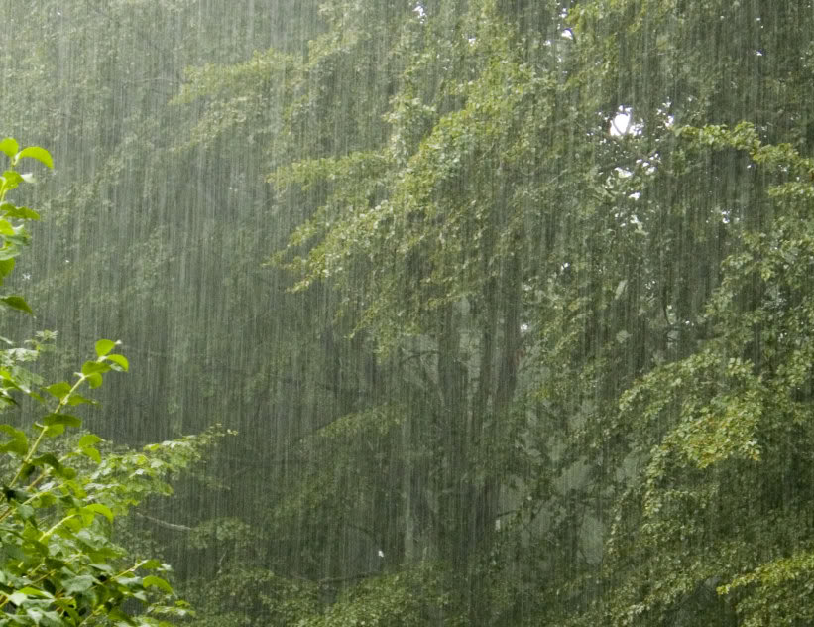
Can rhyme with stuff/tough
It was tough luck that we hadn’t got the right sort of stuff with us to make a shelter in the woods when it started to rain
t-o-u-g-h
tough

Slide 6
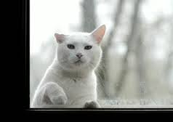
Can rhyme with shoe/ through
The cat looked through the window because it wanted to come inside.
t-h-r-o-u-g-h
through

Slide 7
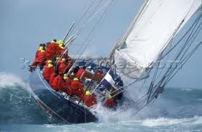
Also rhymes with stuff/rough/enough
Luckily when the sea got rough we had enough life jackets for everyone on board the boat.
r-o-u-g-h
rough

Slide 8

Rhymes with off/cough
The boy wanted to stay off school for the day as he had such a nasty cough.
C-o-u-g-h
cough

Slide 9
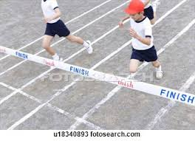
Rhymes with short/brought
All the children brought their shorts to school to wear for Sports Day.
b-r-o-u-g-h-t
brought

Slide 10

Rhymes with short/bought
The children bought a short bunch of flowers for their mum on mother’s day.
b-o-u-g-h-t
bought

Slide 11
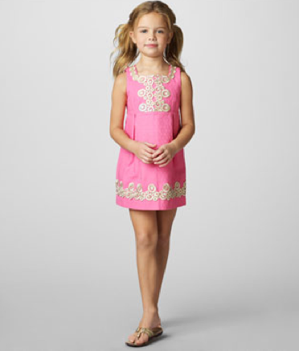
Rhymes with short/thought
Mum told her daughter that she thought that her dress was too short to wear to the party.
t-h-o-u-g-h-t
thought

