Slide 1

Bidmas
You think you can just do your sums in any order you like? THINK AGAIN! Listen up!

Slide 2
Think about this sum-
=35?
3 + 4 x 5
Nope!
When lots of things happen in a sum we can’t got left to right. Try this sum on a calculator
You should have 23
Your calculator knows the correct order to work in

Slide 3
Bidmas
To help us remember the order we use the word BIDMAS
B
I
D
M
AS
Brackets first
Then Indices (another name for powers e.g. 3²)
Then Division
Then Multiplication
Do adding and subtracting together at the end, going left to right

Slide 4
Here are some examples of how to use BIDMAS
A good tip is to underline the bit you are going to do, then write the answer under your line, along with the rest of the sum.

Slide 5

B
I
D
M
A
S
(3
4)
x 2
+
x 2
=
7
=
14

Slide 6
B
I
D
M
A
S
3
3
4
x 2
+
+
=
8
=
11

Slide 7
B
I
D
M
A
S
4
4
x 3²
x
=
9
=
36

Slide 8
B
I
D
M
A
S
3
3
4
- 2
+
x 3
- 2
=
+
12
=
13

Slide 9
B
I
D
M
A
S
3
3
x
(5
2
x
2
- 2
- 3)
- 2
=
x
2
- 2
3
4
- 2
12
=
10

Slide 10


6 + 4 x 3 =
30
72
x
Who do you agree with?

Slide 11
10 – 8 ÷ 2 =
6
1
x
Who do you agree with?

Slide 12
1 + 4 x 3² =
145
37
x
Who do you agree with?

Slide 13
20 - 4 + 10 =
26
6
x
Who do you agree with?

Slide 14

3 + 4 x 3 + 1 = 19
( )
Ralph’s sum is wrong
We can make it right be adding a pair of brackets. Where do they need to go?

Slide 15
Bidmas
  24
  3
  2
  20
  10
  1
  26
  22
  1
  19
  0
  2
  9
  5
  1
  26
  25
  20
  17
  5
  1
  1
  2
  A)
  (3 + 3 ) x 4
  4 x 2 – 5
  (5 + 7) ÷ 6
  5 x 3 + 5
  (9 – 4 ) + 5
  1 + 1 – 1
  2 x (15 – 2)
  (5 x 4 ) + 2
  (8 + 2 ) ÷ 10
  (21 x 1 ) – 2
  B)
  (1 + 14) – (5 x 3 )
  (10 + 6 ) ÷ (4 x 2)
  (1 + 2 ) x (6 – 3)
  (2 x 6 ) – (14 ÷ 2)
  (7 x 2) ÷ ( 20 – 6)
  (3 x 10) – (2 x 2)
  (9 x 5) – ( 2 x 10)
C)
(3 x 3 – 4 ) x (2 + 2)
2 x (13 – 4) – (23 ÷ 23)
3 x (1 + 4) – (5 x 2)
4 x (3 + 2) – ( 24 – 5)
7 x ( 4 ÷ 2 ) ÷ ( 3 x 5 -1 )
((9 + 7 x 3 ) ÷ 10) – 1

Slide 16
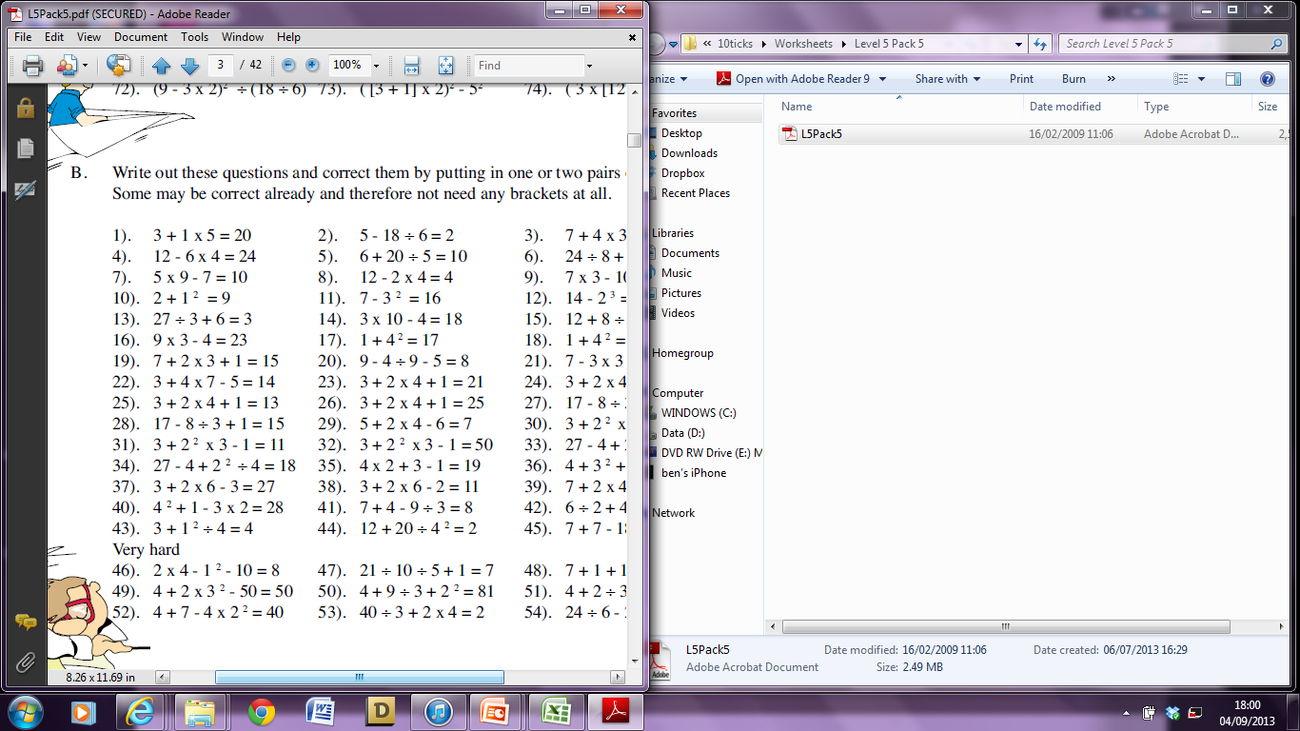
Where do we need to put the brackets?
Challenge Questions

