Slide 1
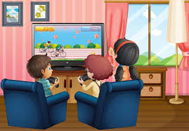
While You’re At Home
We are going to stay in touch
9th February 2021

Slide 2


Slide 3

Positive Message of the Week
Hi Everyone, we hope you have all had a great week and worked on staying positive, even though you maybe missing your friends and family.
This week we are going to be looking at Fire Safety and First Aid.
There will be a few activities to get involved with too.
Also meet the newest member of staff at Cheshire Police.
If you are worried about anything please remember to talk
to someone you trust.
Have a great week all.

Slide 4
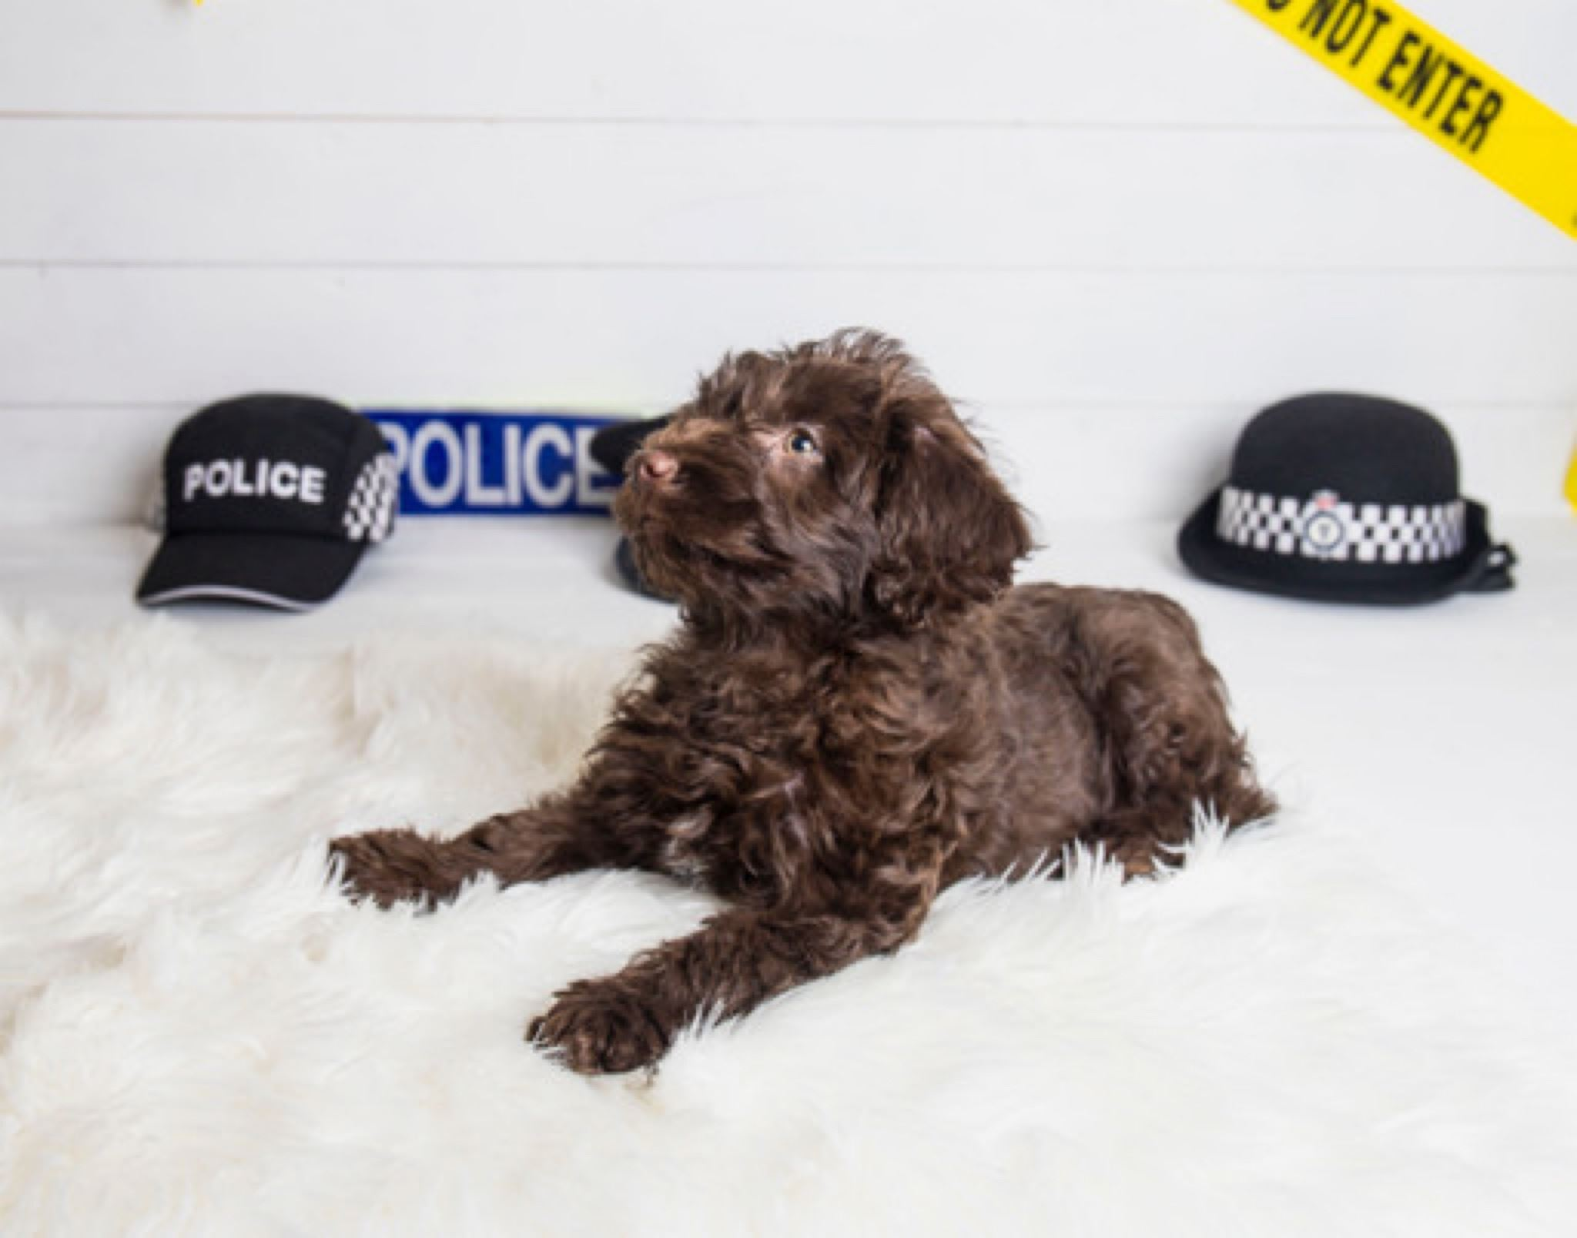


Say hello to Harley
Harley is the latest recruit for the Safer School Youth Partnership team. He is the first therapy dog for Cheshire Police and will be working in Runcorn and Widnes with his Police Officer Mum, Jane.
He is looking forward to updating you about his training and work helping young people like yourselves.
Follow his adventures on Instagram @harleyPTD
& @CheshireSSYP
Harley is a great listener and wants to help you feel safe.

Slide 5


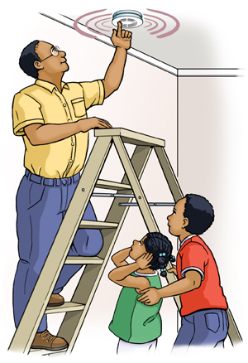

Fire Safety Around Your
Home
In case of a Fire
Know your emergency services
Test it Tuesday

Slide 6
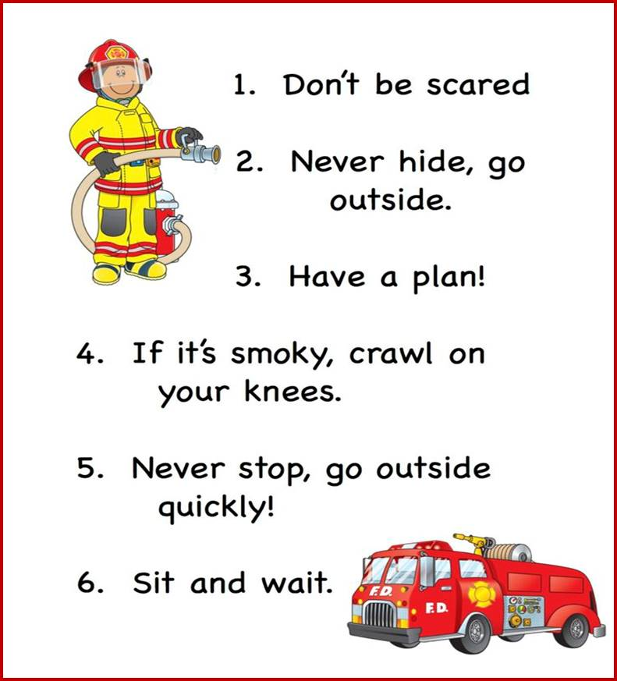
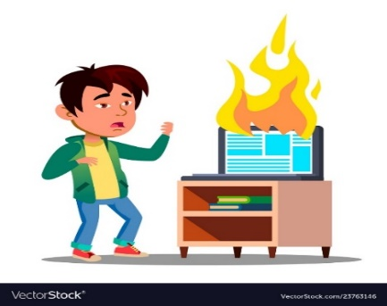
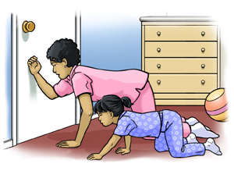
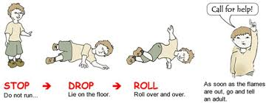
Have a plan in case of a fire
Stay low to the ground as smoke from a fire rises
What to do if your clothes catch fire

Slide 7
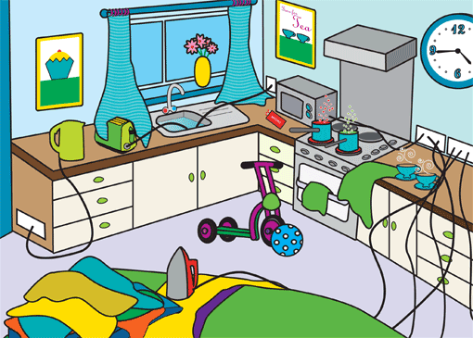
Can you spot the fire hazards?

Slide 8

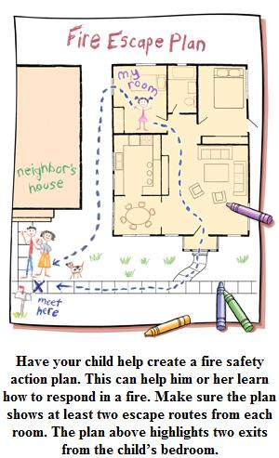
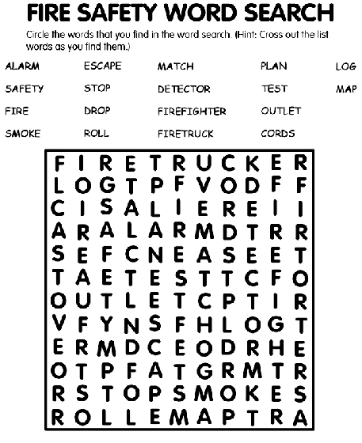
This weeks safety activity
Could you create your own Fire Escape Plan. You could ask an adult that you live with to help you.

Slide 9
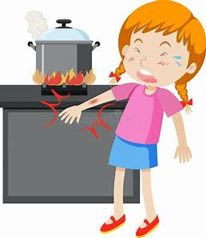

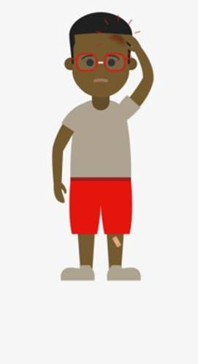

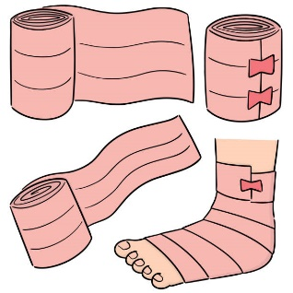


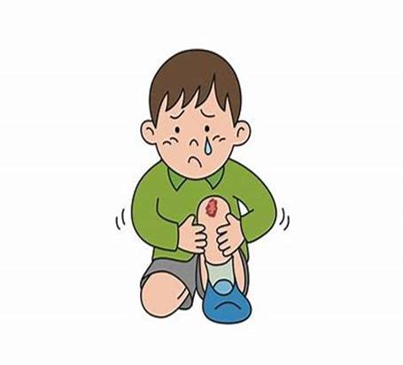




First Aid
Can you Help?
Connect the treatment to the injury
Burns
Cuts
Broken bones
Always tell an adult if you hurt yourself.

Slide 10


Useful Links and Services
NSPCC Helpline
0808 800 5000
https://www.o2.co.uk/help/nspcc/helpline
NHS 111
Your local
Doctors surgery
Childline
https://www.childline.org.uk
Get help and advice about a wide range of issues, call us on 0800 1111, talk to a counsellor online, send Childline an email or post on the message boards
Well-being
officer in School

Slide 11


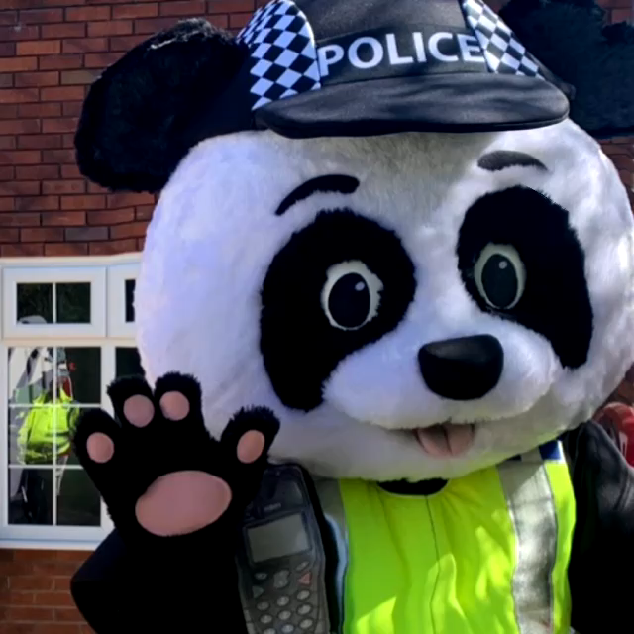

Slide 12
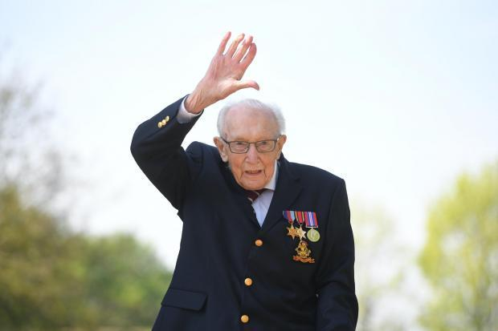
We want to offer our condolences to the family of
Captain Sir Tom Moore
A gentleman that lived his life to the fullest till the very end. How grateful we are for all you did.

Slide 13

Until next Time
16th February 2021
Keep washing your hands, remember Hands, Face and Space.
If you are feeling upset, worried or confused please speak to someone you trust.
Keep positive by reminding yourself, you are an Amazing Child.
Cheshire Police on Facebook
@CheshireSSYP on Twitter
www.cheshire.police.uk

