Slide 1
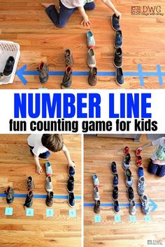
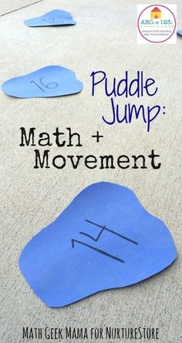
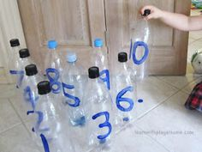
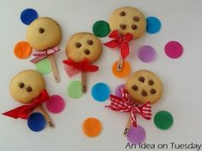
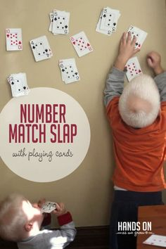
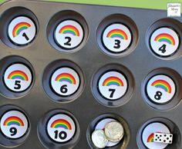
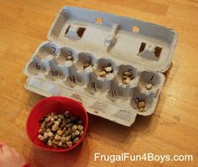
Number Games for in the House
Make a number line using toys/shoes/socks
Recognising numbers by jumping on numbers called out or finding hidden numbers around the house
Number bottle bowling
Egg box sorting
Baking-so many counting opportunities!
Use cake tins to sort items
Number match games with cards

