Slide 1
9 and 10
Week 2
Tuesday
with Mrs Barrett!

Slide 2
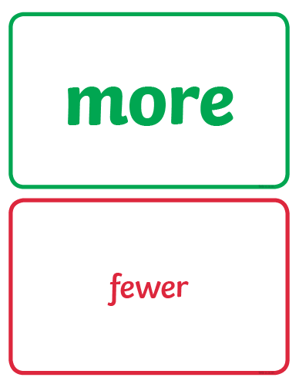
We are looking at these two special maths words…

Slide 3
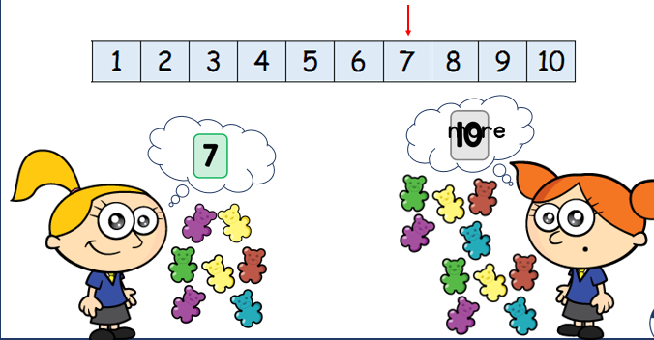
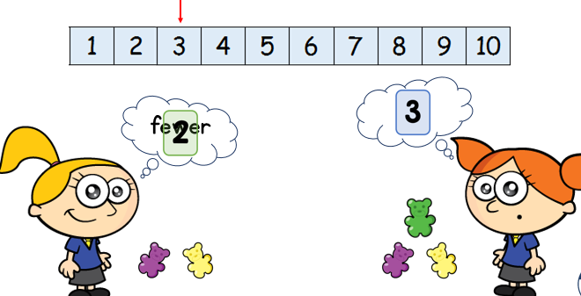
Miss Cooper was looking at more and fewer today. Two girls were taking turns to see who had more and fewer sweets.

Slide 4
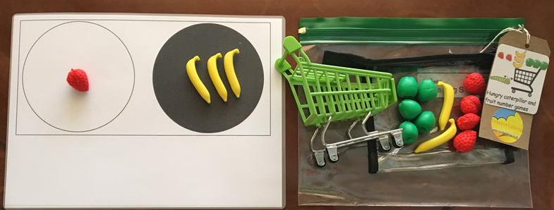
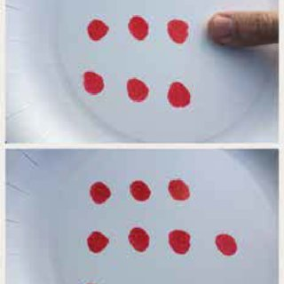
There are many ways you can show more and fewer…
Maybe with real fruit or toy fruit!
Or finger prints!

Slide 5

Here is a number track to help you!
(It’s on our Home Learning page)

Slide 6
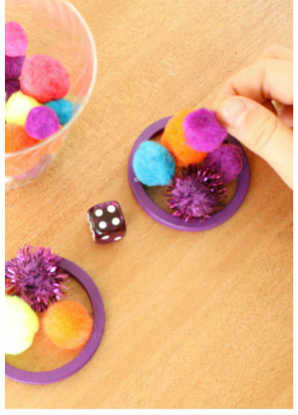
You could have a game with someone else and see who gets more or fewer counters, buttons or pompoms when you roll a dice?

Slide 7
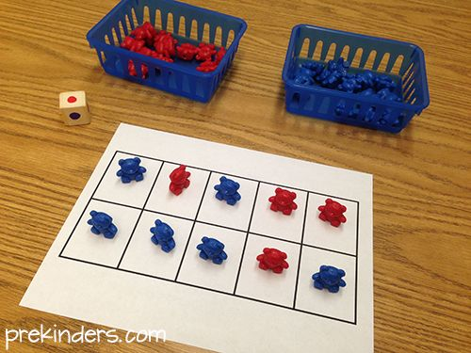
You could have a game with someone else and fill a tens frame with 2 colours of counting bears, lego bricks or counters?
Are there more red bears or blue bears in this tens frame?
Don’t forget to count and check!

Slide 8
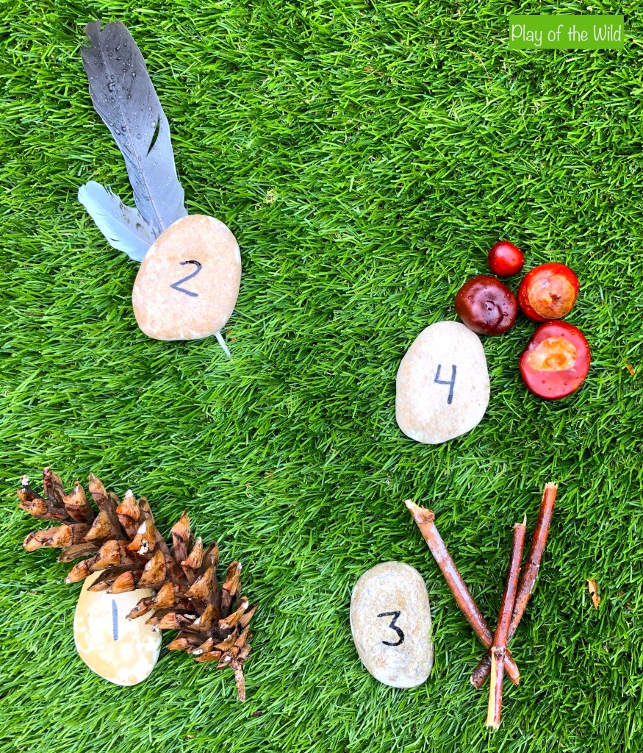
Or, as the weather has been so good lately, perhaps you’d like to do a ‘More & Fewer’ activity outside…
Are there more feathers or more sticks here?

Slide 9
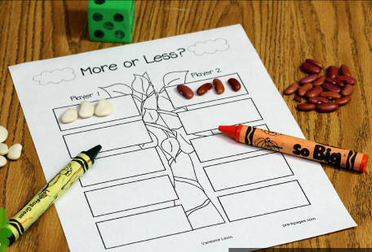
On our Home Learning page, there is a copy of this beanstalk game.
You can use real beans to play with if you like!

Slide 10
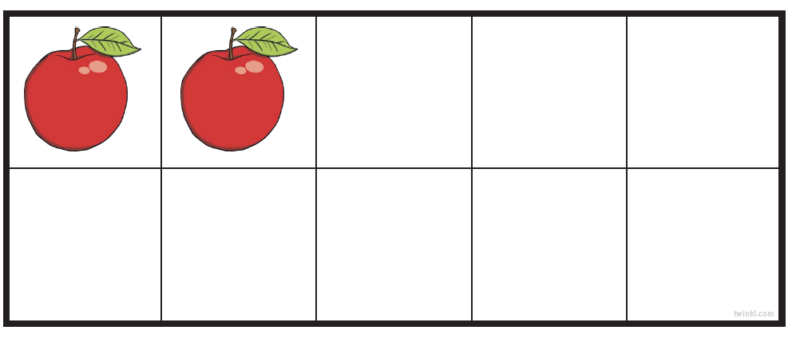
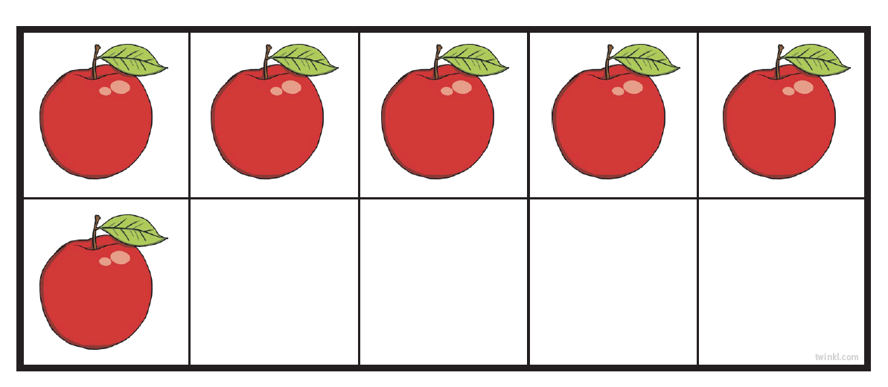
There is also a game with apples in tens frames on our Home Learning page, you can print out the cards to play the game with a partner if you like.
Take turns to pick a card and see who has more or fewer apples.
Which of these cards has more or fewer apples?

Slide 11
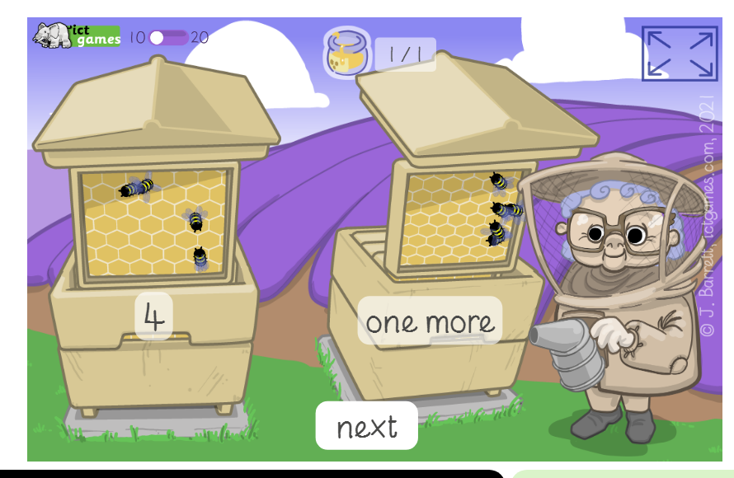
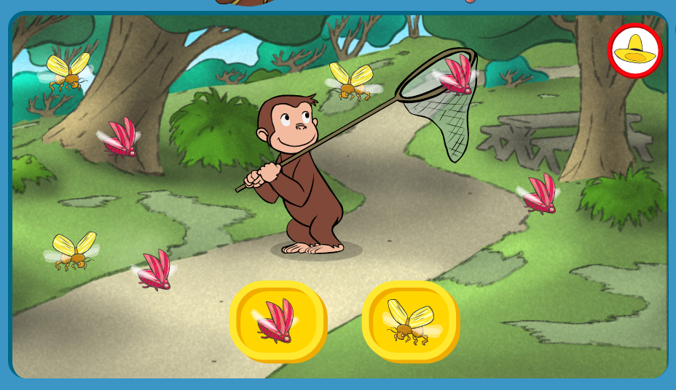
Here are two great online games for finding more and fewer:
https://www.ictgames.com/mobilePage/beeMoreOrLess/
https://pbskids.org/curiousgeorge/busyday/bugs/

Slide 12
have fun !

