Slide 1
9 and 10
Week 2
Wednesday
with Mrs Barrett!

Slide 2
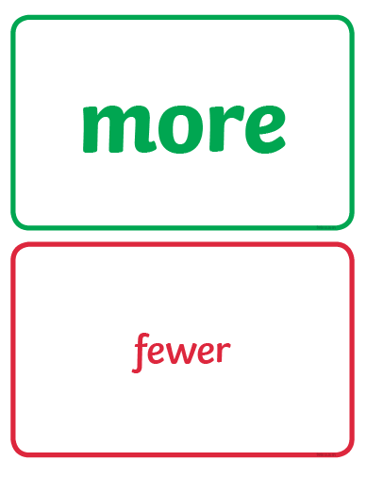
We are looking at these two special maths words again…

Slide 3
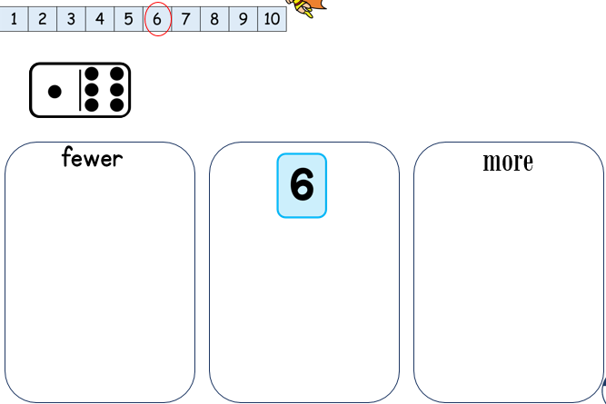
Miss Cooper was using dominoes to show more and fewer.

Slide 4
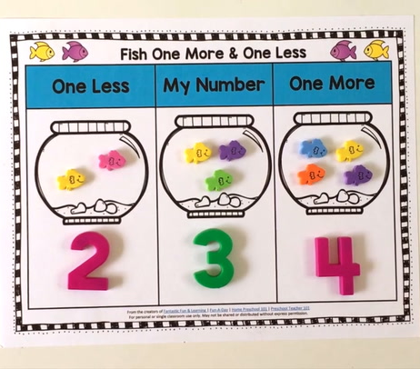
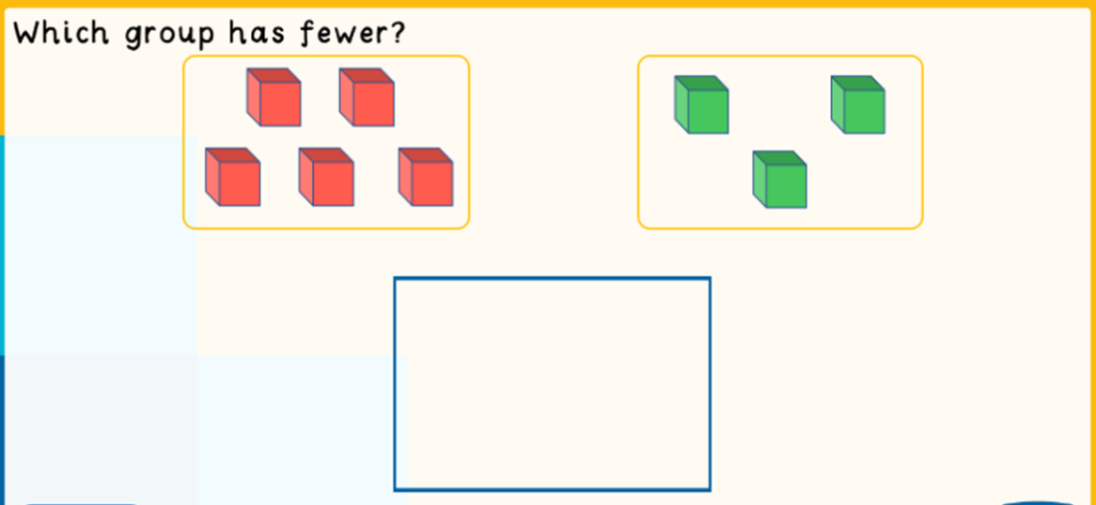
And there are other simple ways to show more and fewer...

Slide 5
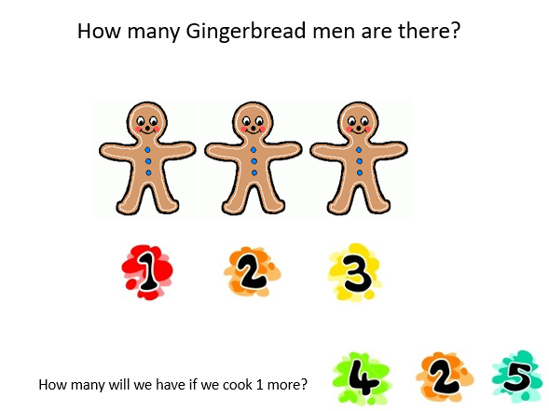
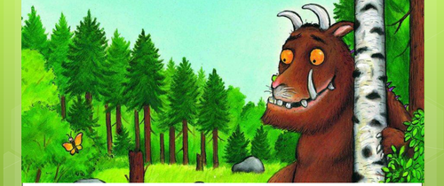
But today, we are going to find new ways to show more and fewer…
The Gingerbread Man…
and The Gruffalo are going to help us!

Slide 6

Here is a number track to help you too!
(It’s on our Home Learning page)

Slide 7
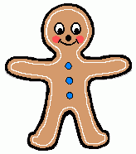





How many Gingerbread men are there?
How many will we have if we cook 1 more?

Slide 8


How many Gingerbread men are there now?
How many will we have if we cook 2 more?

Slide 9

How many Gingerbread men are there now?
How many will we have if I eat 1?

Slide 10
How many Gingerbread men are there now?
How many will we have if I eat 2?

Slide 11
Maybe you could bake some gingerbread men and practise finding more or fewer if you eat some!

Slide 12
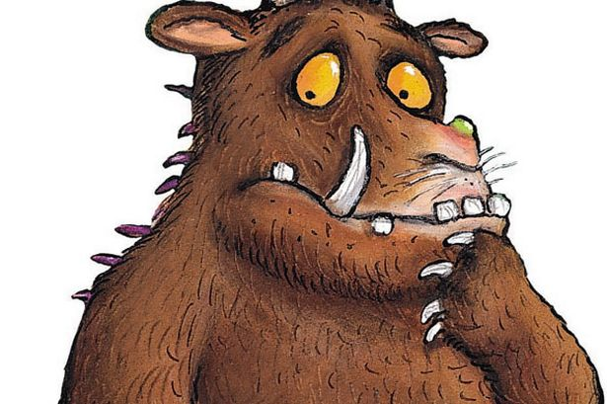
The Gruffalo is hungry…

Slide 13

…REALLY hungry!
Which plate has more food?
10
7

Slide 14
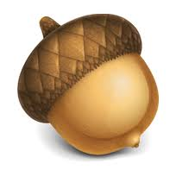
Mouse only has a small tummy…
Which plate has less food?
8
5

Slide 15
Gruffalo is still hungry!
Let’s give the Gruffalo 1 more mouse.
1 more than 5 is…
6

Slide 16
Mouse can’t eat all that!
Let’s give the Mouse 1 less nut.
5
1 less than 6 is…

Slide 17
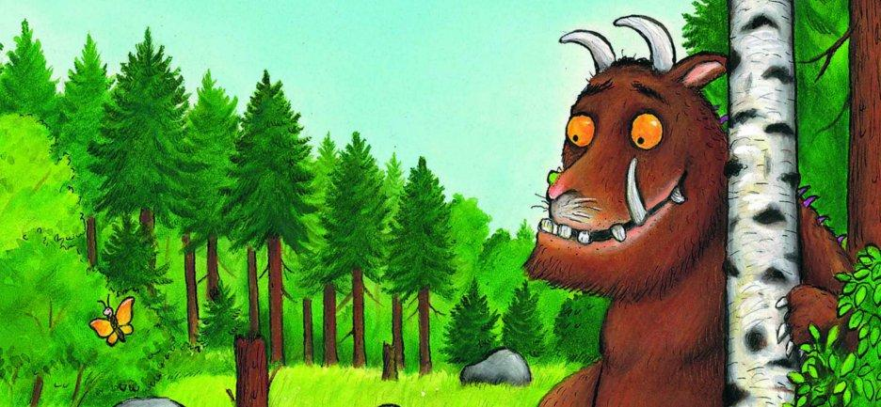
Now can you help the Gruffalo and Mouse get the right amount of food?

Slide 18
Give Mouse 2 less nuts…
2 less than 6 is…
6

Slide 19
Give Gruffalo 2 more mice…
2 more than 7 is …
7

Slide 20
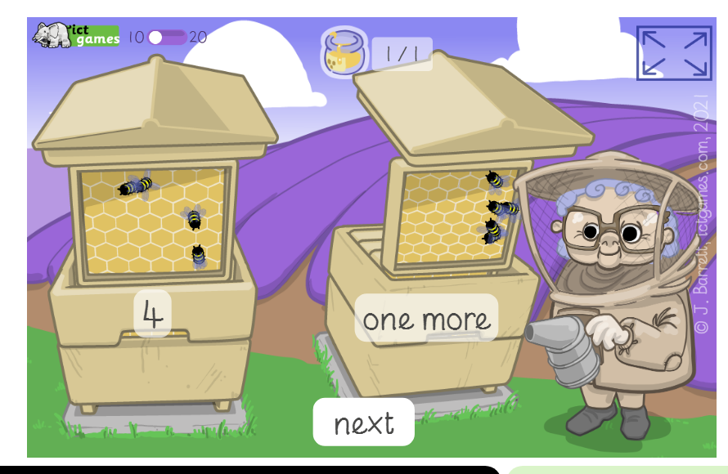
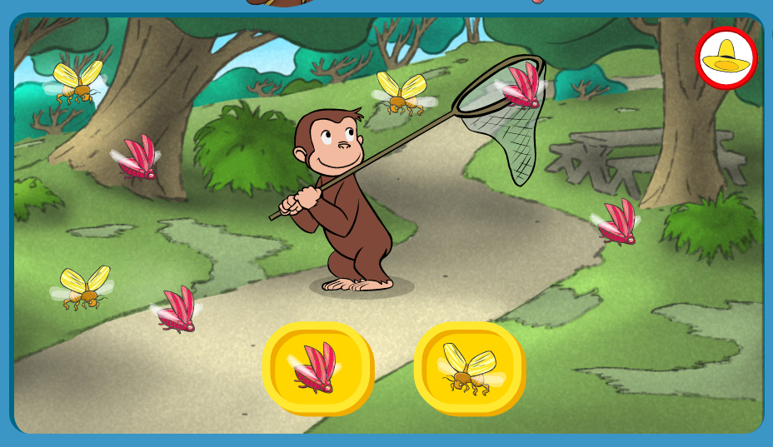
Don’t forget those two great online games for finding more and fewer:
https://www.ictgames.com/mobilePage/beeMoreOrLess/
https://pbskids.org/curiousgeorge/busyday/bugs/

Slide 21
have fun !

