Slide 1
9 and 10
Week 2
with Mrs Barrett!

Slide 2
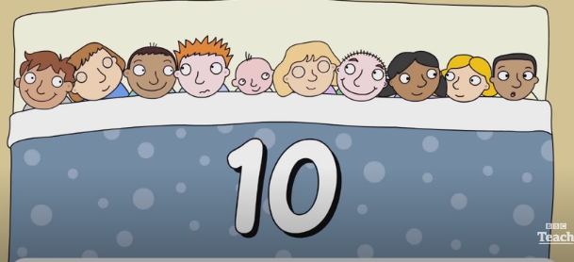
You may like to use Miss Cooper’s suggestion and learn the Ten in a Bed song for counting backwards from 10 to 1.
Here is a BBC video to help you with that…

Slide 3
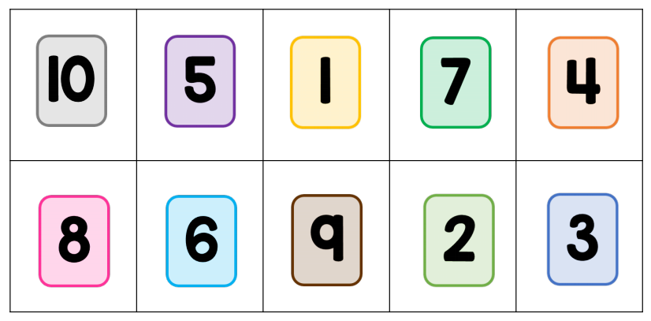
And here are the numerals to help you…

Slide 4
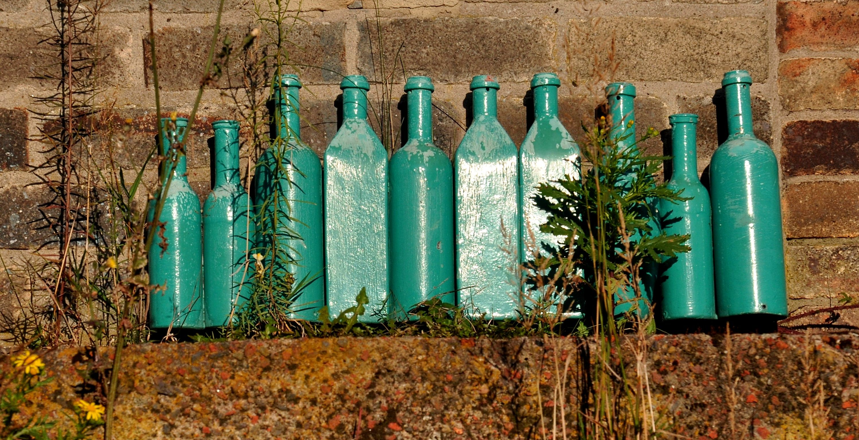
Here is another idea you could use to count backwards from 10 to 1…

Slide 5
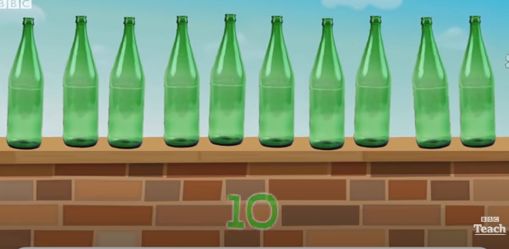
Watch the film and join in with the song…

Slide 6
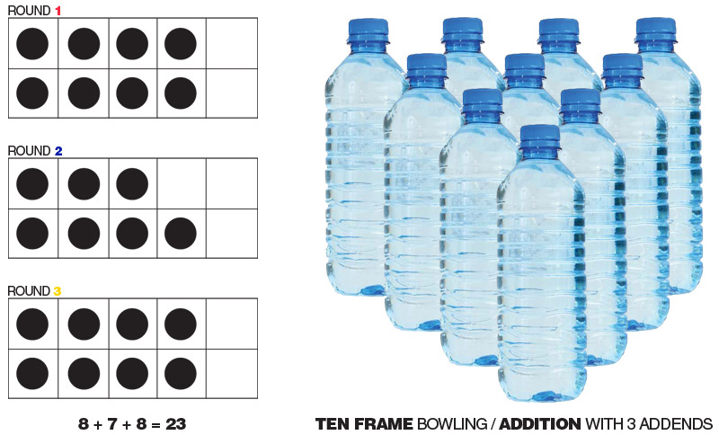

You could line up your own ten bottles and count down as you take each one away…

Slide 7
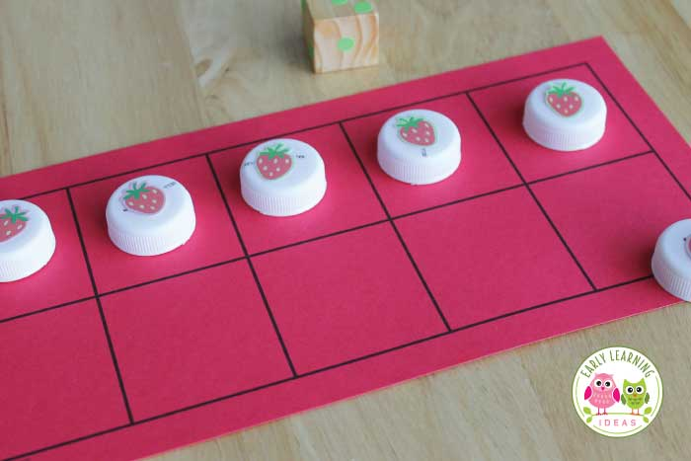
Maybe just using bottle lids is easier…
You could line up 10 lids then take one away each time as you count down…

Slide 8
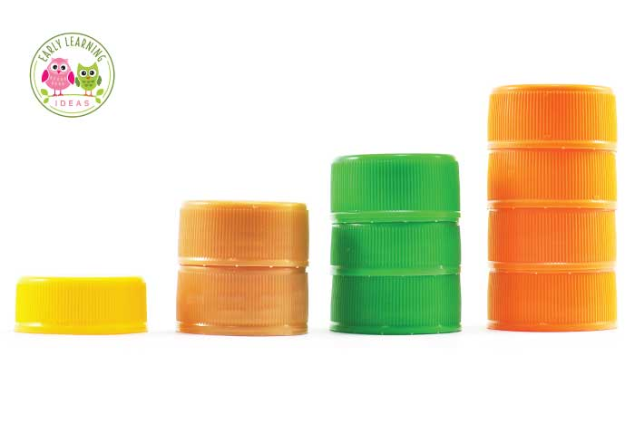
Or you could line up stacks of lids from 10 down to 1 if you have enough lids…

Slide 9
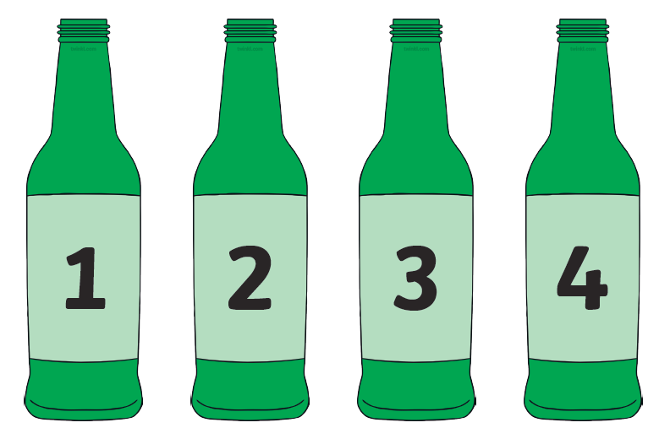
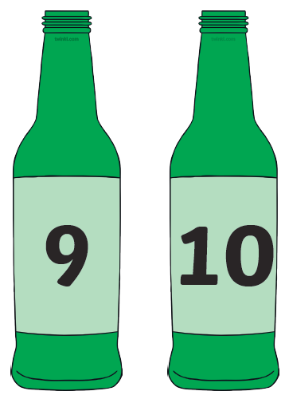
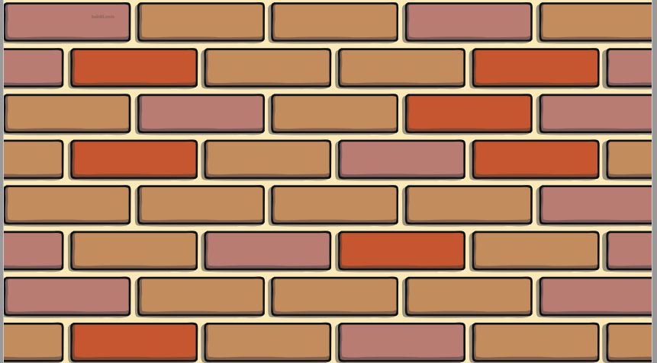
There are some files of ten green bottles and a wall, saved on the Reception Home Learning page of the school website for you to print and cut out, if you prefer…

Slide 10
have fun !

