Slide 1


Where does your fruit come from?

Slide 2
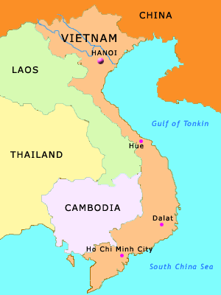

Where am I from?
Bananas
South East Asia!

Slide 3

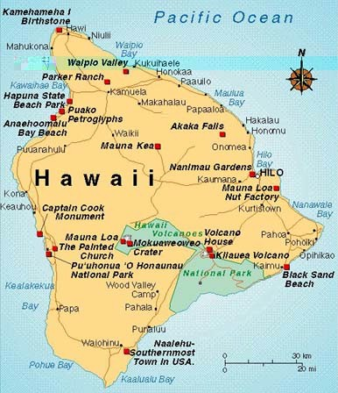
Where am I from?
Pineapple
Hawaii!

Slide 4
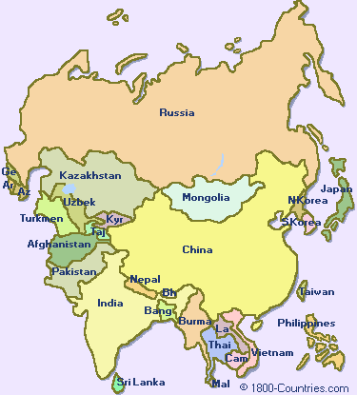
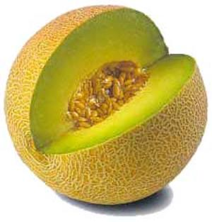
Where am I from?
Melon
Asia!

Slide 5
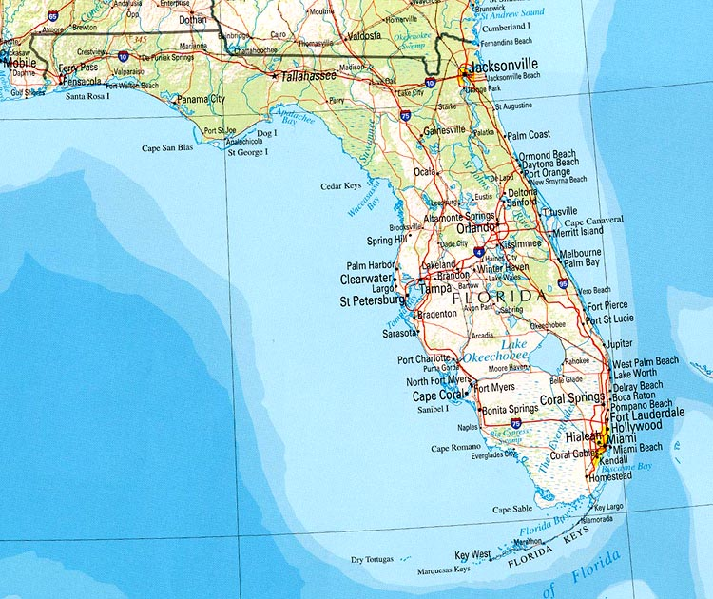

Where am I from?
Orange
Florida!

Slide 6
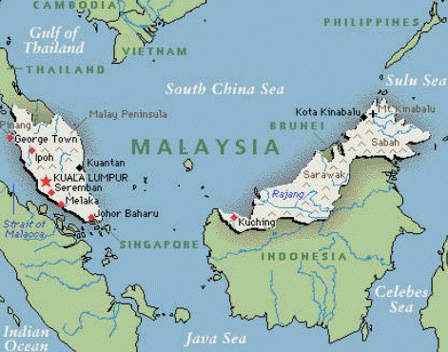
Where am I from?
Malaysia!
Coconut

Slide 7
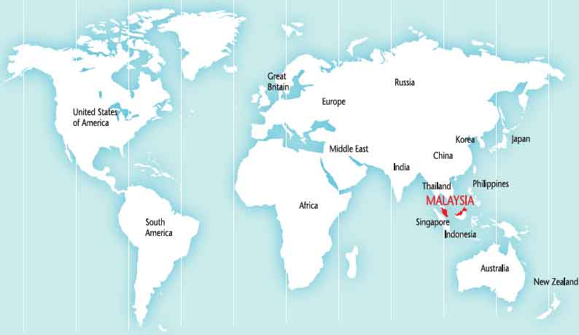
Look at how far the coconut travelled to get to Runcorn!

