Slide 1

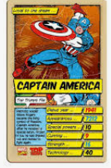
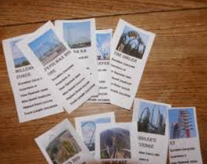
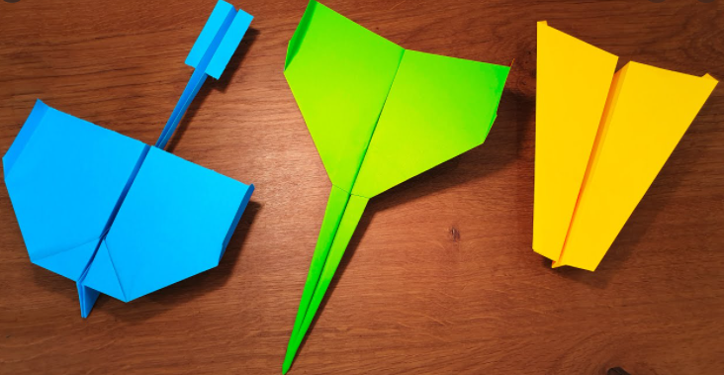
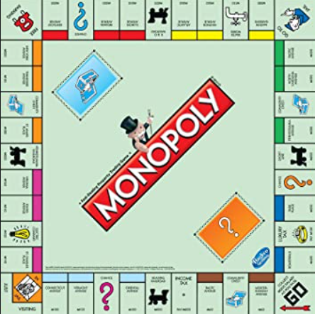
Wellbeing Wednesday
Throughout the current pandemic, we have been reminded more than ever of the importance of mindfulness and wellbeing.
At Darnhall Primary School, we are aware that the current need for schooling at home has potentially increased the amount of screen time your child is receiving. Add to that the strains, worries and concerns of changes in routines, missing friends and working differently, and sometimes it can all be too much.
With that in mind, we have created Wellbeing Wednesday, an afternoon given over to unplugged (non-screen) activities.
Tasks are being planned around art, craft, design, fitness and activities such as construction and nature. Home learners will be provided with the 4 week plan for this term so that they can plan and prepare for their choice of activity - teachers have been careful to plan a range of tasks that are close in nature to those being completed in school as we know not everyone has access to the same resources.
If it suits your family’s routine, please swap afternoons. You could have Mindful Monday or Thoughtful Thursday - catchy name optional!
Should you have children in more than one year group, please select just one activity for you all to complete. We do not want this to be a stressful time!
Year 4

Slide 2
Year 4
 | School Activity | Home Learners
Week 1 | Paper Aeroplane Contest Who can fly their paper airplane the furthest? Discuss the following questions: Do you think it matters on size? Do you think it matters on the material you use? Do you think it matters if you attach other paper to it? Make a paper airplane, test it out safely then see if you can improve it anyway, can anything change to make it go further? Test against the class in the hall, record results using metre sticks. Agree on some questions to ask - such as what is the difference between the longest and shortest throw? Why do you think this one travelled the furthest? | Paper Aeroplane Contest Who can fly their paper airplane the furthest? Discuss the following questions. Do you think it matters on size? Do you think it matters on the material you use? Do you think it matters if you attach other paper to it? Make a paper airplane, test it out safely then see if you can improve it anyway, can anything change to make it go further? Challenge someone in your house to beat you! If you have a story book or information book about Amy Johnson or planes, build a reading den and have a read, or sit in your favourite place. If you don’t have any books about planes, choose your favourite book to read instead. Ask a grown up what they know about Amy Johnson!
Week 2 | Top Trumps Can you create your own set of 24 top trumps? It could be anything you like! Cartoons, cars, footballers, favourite films! Once you have created your 24, challenge a group of friends and then test each other out! Read to the children a book of teacher’s choice - pick your favourite book! Maybe the children could act out a scene from it or draw a picture inspired by it. | Top Trumps Can you create your own set of 24 top trumps? It could be anything you like! Cartoons, cars, footballers, favourite films! Once you have created your 24, challenge a group of friends and then test each other out! If you have a story book or information (non fiction) book, build a reading den or sit in your favourite place and have a read. If you’re feeling creative, grab your colouring pencils and draw a picture from your book.

Slide 3
Year 4
 | School Activity | Home Learners
Week 3 | Monopoly Create your own Monopoly board. This could be local places in Winsford, or local villages if the children are familiar with them. Think of 22 different places - collate ideas as a class. They could be well know destinations such as Darnhall School, or maybe Nanna’s house or Aldi. You will also need to make- Property Cards Money Community Chest and Chance cards Colouring pencils | Monopoly Create your own Monopoly board. This could be local places in Winsford, or local villages if the children are familiar with them. Think of 22 different places - collate ideas as a class. They could be well know destinations such as Darnhall School, or maybe Nanna’s house or Aldi. You will also need to make- Property Cards Money Community Chest and Chance cards Colouring pencils
Week 4 | Finger Olympics Discuss what the Olympics is. What sort of activities might you expect to find? Draw the logo of the Olympics, what do the colours stand for? The colours represent at least one colour from every flag that takes part in the Olympics. Every child must create an event for the finger olympics. Every child then tests the olympics out and record the results for who wins. Diddy dots for those that come first, second and third. Make medals for the winners! | Home Olympics Discuss what the Olympics is. What sort of activities might you be expecting to find? Draw the logo of the olympics, what do the colours stand for? The colours represent at least one colour from every flag that takes part in the Olympics. Create a homemade event for the olympics - can you find household items to make it more fun? How good are you at throwing scrunched up paper into pans? What about the straw javelin? Roll up socks to make bowls! Can you beat your score?
These afternoons are about having time away from your computers, tablets and phones. We hope you find it relaxing and enjoyable.
Be sure to share photos of your work with us on Class Dojo & Facebook.

Slide 4
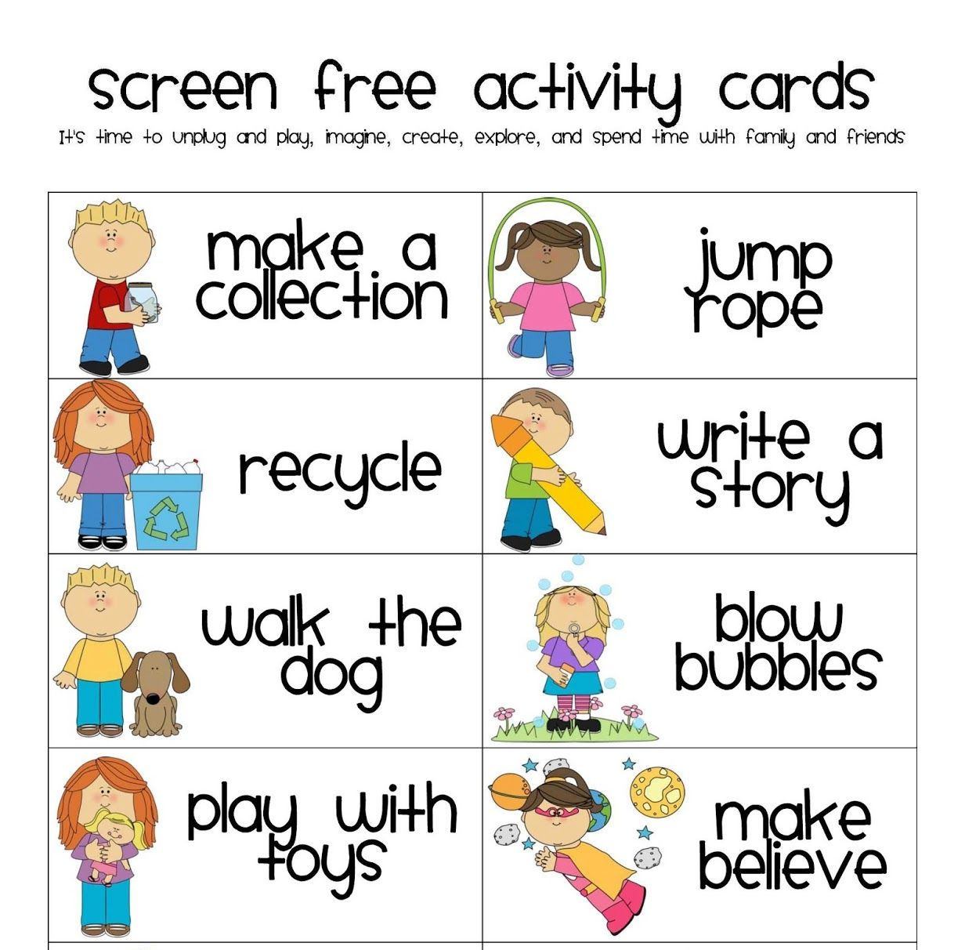
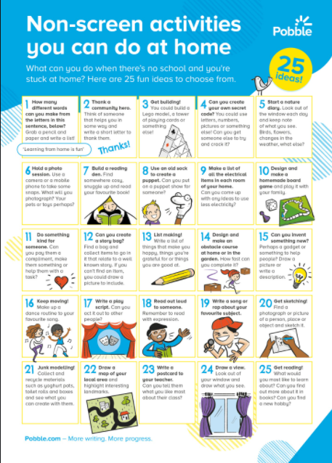
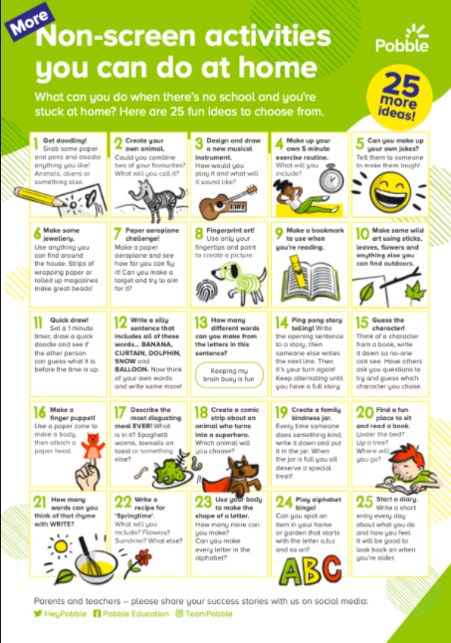
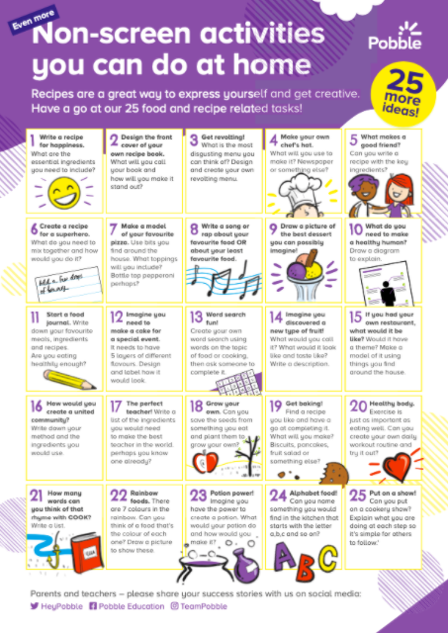
What else can we do?
You may feel that the activities suggested by the teacher are not suitable for your home, or even ‘do-able’ for you and your family. Please feel free to adapt the themes or ideas, or contact your class teacher for support.
Alternatively, home learners could:
complete alternative wellbeing activities as they see fit - have a browse through the ideas below.

