Slide 1
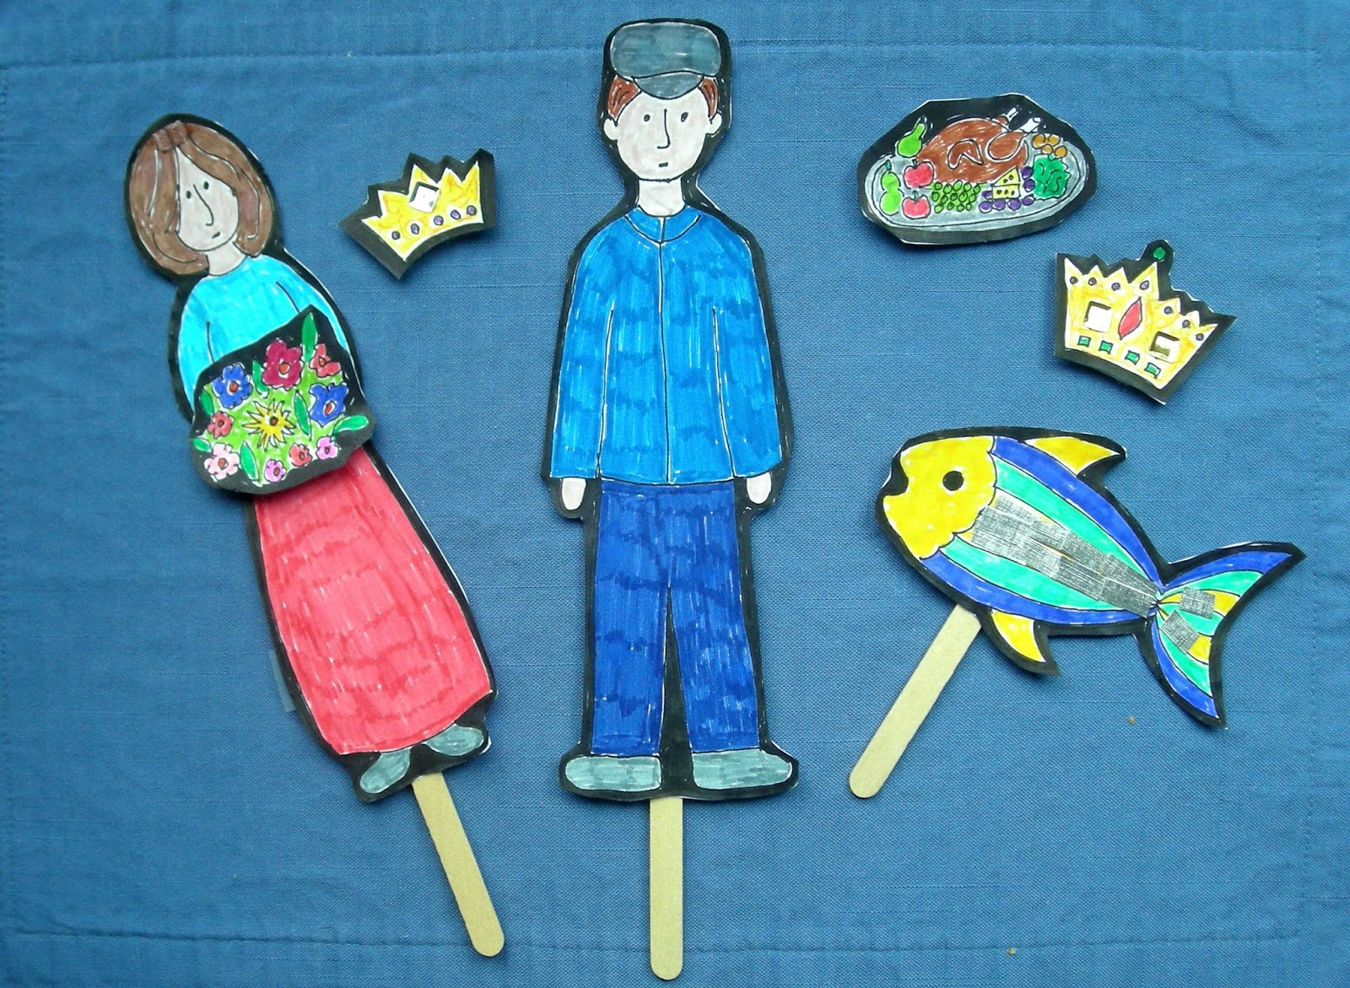
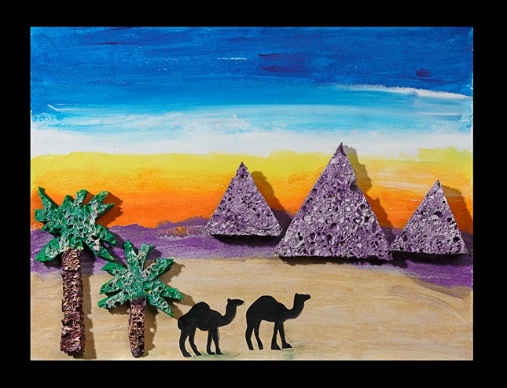
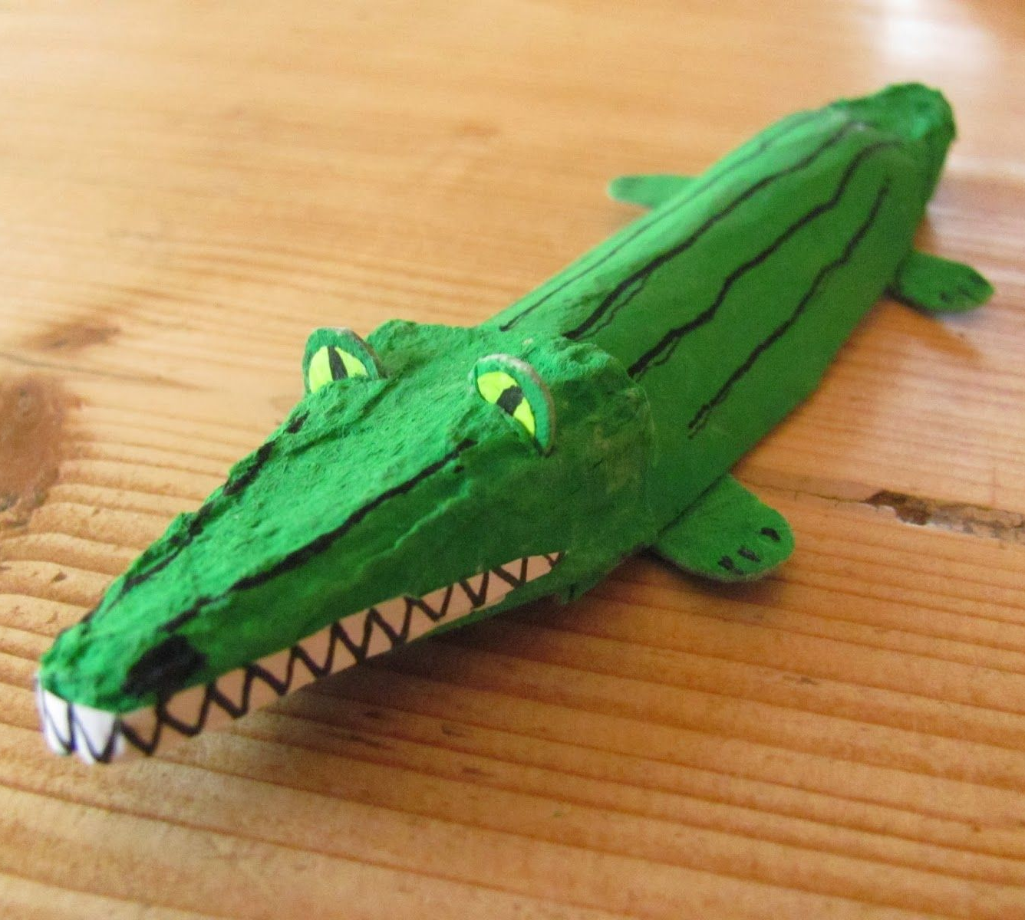
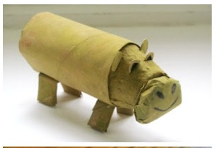
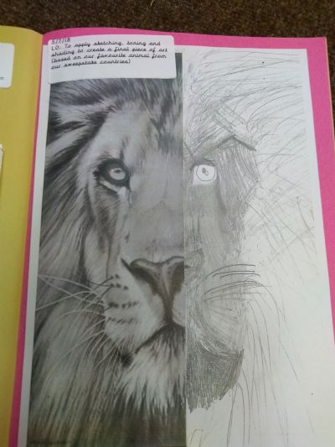
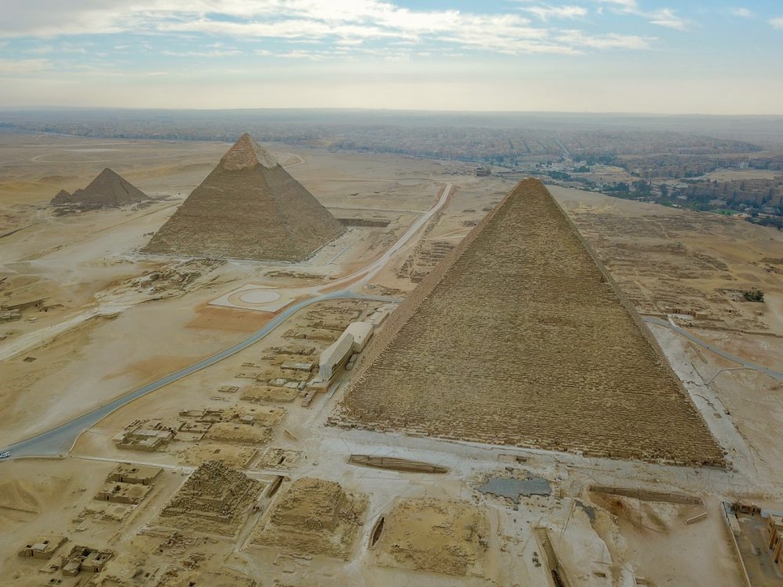
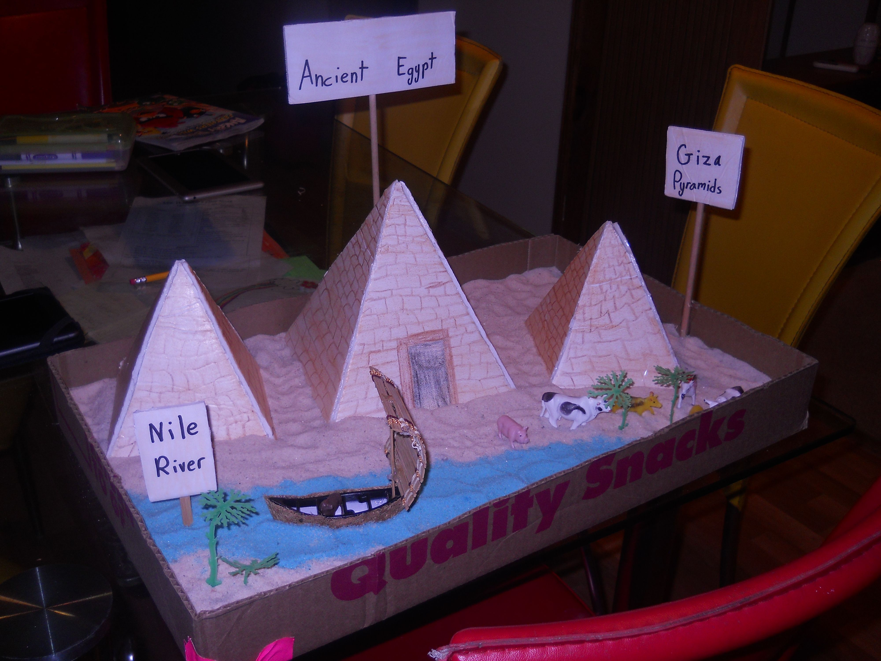
Wellbeing Wednesday
Throughout the current pandemic, we have been reminded more than ever of the importance of mindfulness and wellbeing.
At Darnhall Primary School, we are aware that the current need for schooling at home has potentially increased the amount of screen time your child is receiving. Add to that the strains, worries and concerns of changes in routines, missing friends and working differently, and sometimes it can all be too much.
With that in mind, we have created Wellbeing Wednesday, an afternoon given over to unplugged (non-screen) activities.
Tasks are being planned around art, craft, design, fitness and activities such as construction and nature. Home learners will be provided with the 4 week plan for this term so that they can plan and prepare for their choice of activity - teachers have been careful to plan a range of tasks that are close in nature to those being completed in school as we know not everyone has access to the same resources.
If it suits your family’s routine, please swap afternoons. You could have Mindful Monday or Thoughtful Thursday - catchy name optional!
Should you have children in more than one year group, please select just one activity for you all to complete. We do not want this to be a stressful time!
Year 3

Slide 2
Year 3
 | School Activity | Home Learners
Week 1 | Desert Sunset Discuss how we could recreate this sunset? Create the background/ floor using paints, colouring pens/pencils, crayons, chalk (anything available). Then cut out objects found in the desert such as animals, plants, pyramids using recycled materials. Once dry, glue together. Guided Reading Activity Can you draw a detailed drawing of a charcter from your favourite story using the book. Attach to a lollipop stick/ stick or anything similar. | Desert Sunset Discuss how we could recreate this sunset? Create the background/ floor using paints, colouring pens/pencils, crayons, chalk (anything available). Then cut out objects found in the desert such as animals, plants, pyramids using recycled materials. Once dry, glue together. Guided Reading Activity Can you draw a detailed drawing of a charcter from your favourite story using the book. Attach to a lollipop stick/ stick or anything similar.
Week 2 | Create a 3D Desert Animal/Plant Can you use recycled materials to create a desert animal? Desert animals/plants include; camel, scorpion, meerkat, iguana, rattlesnake, tarantula, fennec fox, cactus. | Create a 3D Desert Animal/Plant Can you use recycled materials to create a desert animal? Desert animals/plants include; camel, scorpion, meerkat, iguana, rattlesnake, tarantula, fennec fox, cactus.

Slide 3
Year 3
 | School Activity | Home Learners
Week 3 | Animal Drawing Draw a detailed Desert Animal, use either a half portrait of a desert animal or draw a full sketch. Guided Reading Activity Design a new outffit for your favourite story character. Can you label it? Make it as detailed as possible. You can create it however you like, drawn, made from other materials, sewn or from Lego. | Animal Drawing Draw a detailed Desert Animal, use either a half portrait of a desert animal or draw a full sketch. Guided Reading Activity See school activity
Week 4 | Replica of the Great Pyramids of Giza Create a replica of the Great Pyramids of Giza. Think about the size of each pyramid and where they are in relation to one and other. Can you add in any other human/ physical features of Egypt? | Replica of the Great Pyramids of Giza Create a replica of the Great Pyramids of Giza. Think about the size of each pyramid and where they are in relation to one and other. Can you add in any other human/ physical features of Egypt?
These afternoons are about having time away from your computers, tablets and phones. We hope you find it relaxing and enjoyable.
Be sure to share photos of your work with us on Class Dojo & Facebook.

Slide 4
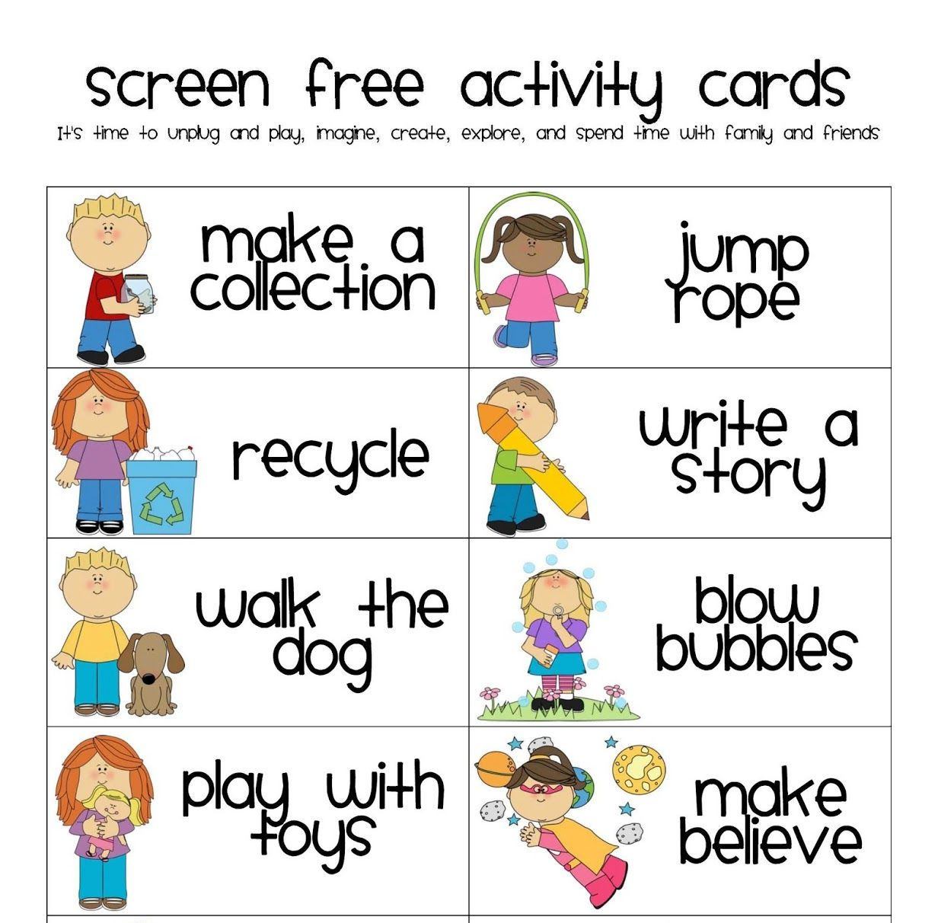
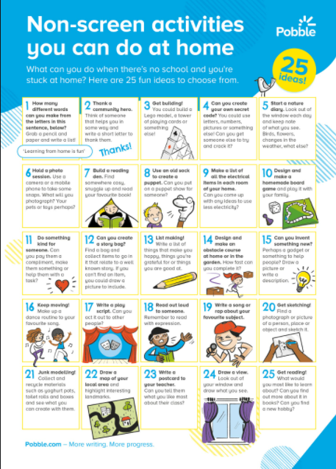
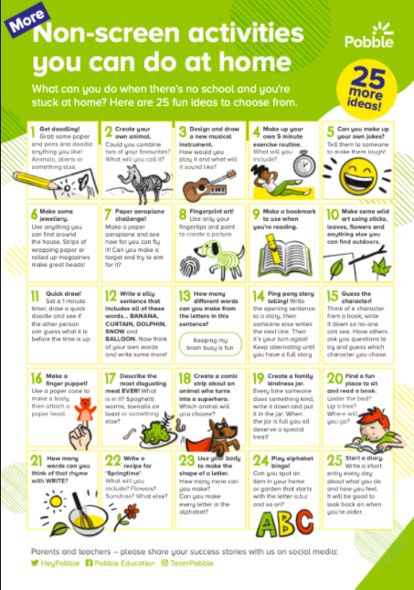
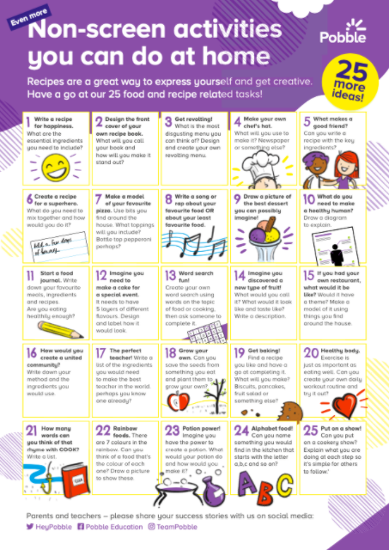
What else can we do?
You may feel that the activities suggested by the teacher are not suitable for your home, or even ‘do-able’ for you and your family. Please feel free to adapt the themes or ideas, or contact your class teacher for support.
Alternatively, home learners could:
complete alternative wellbeing activities as they see fit - have a browse through the ideas below.

