Slide 1
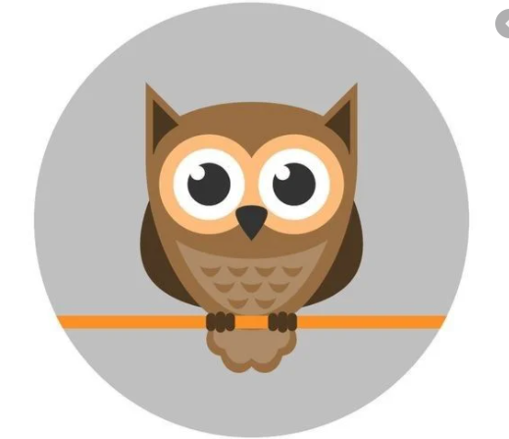
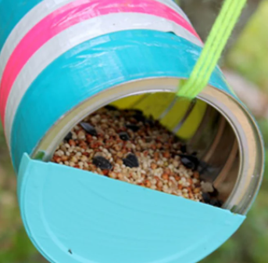
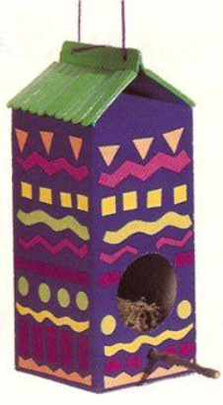
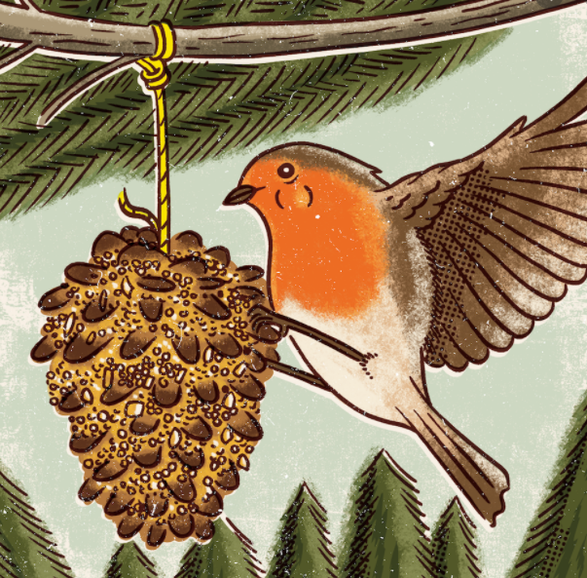
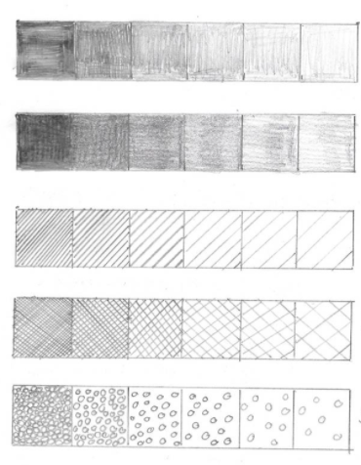
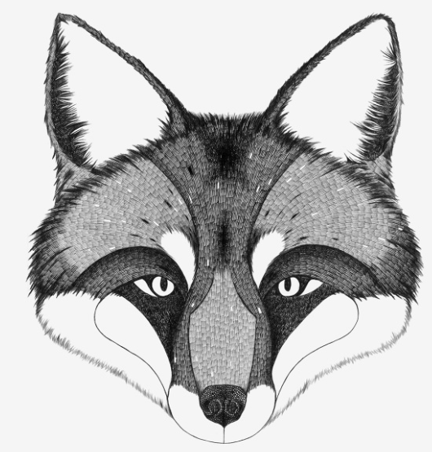
Wellbeing Wednesday
Throughout the current pandemic, we have been reminded more than ever of the importance of mindfulness and wellbeing.
At Darnhall Primary School, we are aware that the current need for schooling at home has potentially increased the amount of screen time your child is receiving. Add to that the strains, worries and concerns of changes in routines, missing friends and working differently, and sometimes it can all be too much.
With that in mind, we have created Wellbeing Wednesday, an afternoon given over to unplugged (non-screen) activities.
Tasks are being planned around art, craft, design, fitness and activities such as construction and nature. Home learners will be provided with the 4 week plan for this term so that they can plan and prepare for their choice of activity - teachers have been careful to plan a range of tasks that are close in nature to those being completed in school as we know not everyone has access to the same resources.
If it suits your family’s routine, please swap afternoons. You could have Mindful Monday or Thoughtful Thursday - catchy name optional!
Should you have children in more than one year group, please select just one activity for you all to complete. We do not want this to be a stressful time!
Year 2

Slide 2
Year 2
 | School Activity | Home Learners
Week 1 | Art Look at the printed sketches of owls. Discuss how to add tone - squint your eyes and look for the light and dark. Have a go at copying part of an owl (from the printed sketches) using a viewfinder and then add some tone to show a variety of light and dark areas. Owl Babies Story/Story Bag Read the story and chat about the 3 owls. Look at how they are drawn - how are they the same/different? How has the Illustrator used tone, different length of lines for feathers? Talk about the story and discuss your favourite part. Create a story bag - make the characters from the story and any props. Put them in a bag and then retell the story | Art Look at the printed sketches of owls which are attached. Squint your eyes and look for the light and dark on the sketch. Have a go at copying part of an owl and then add some tone to show a variety of light and dark areas. Reading Time/Story Bag Have a look through the books you have at home. Are any of them about owls? If you have a story book or information book about owls build a reading den and have a read of it in your favourite place. If you don’t have any books about owls, choose your favourite book to read instead. Create a story bag of your favourite story - make pictures/ props/ put objects into a bag and then use them to retell your chosen story.
Week 2 | Art Look at different shading techniques - printed out sheet and discuss how the artist has created them.Have a go at the different techniques using different sketching pencils. How many different ways can you find to shade? Mask Making Create a mask of your favourite bird or animal using a variety of materials. The challenge is to use shading on the beak or nose of your bird/animal. Put on a fashion show, complete with music of all the masks created. How many different animals or birds have been made? | Art Try out different shading techniques. Press lightly with a pencil, press hard, create lines going over each other, make dots, do short curved lines. How many different ways can you find to shade? Mask Making/Sock Puppet Create a mask of your favourite bird or animal using a variety of materials. The challenge is to use shading on the beak or nose of your bird/animal. Do a ‘fashion show’ wearing your mask - dance along to your favourite show whilst showing off your mask. Or you could make a sock puppet of your favourite animal - then put on a puppet show.

Slide 3
Year 2
 | School Activity | Home Learners
Week 3 | Art Look again at the different pictures of owls and choose one to base your sketch on. Make your own sketch of an owl using short and long strokes, show tone (light and dark), blocks of colour and some of the different sketching techniques. Start with an outline and build up the sketch - face/feathers/feet. Develop and improve your sketch. Once completed evaluate it. Bird Baking Make a bird cake to hang in the trees outside the classroom. Use lard/bird seed/yoghurt pots and string to set it in. | Art Look again at the different pictures of owls and choose one to base your sketch on. Make your own sketch of an owl using short and long strokes, show tone (light and dark), blocks of colour and some of the different sketching techniques. Start with an outline and build up the sketch - face/feathers/feet. Develop and improve your sketch. Bird Baking Make a bird cake to hang in the trees outside the classroom. Make some pretend bird food from Lego/construction toys/play foo/ paper. Have a bird ‘tea party’ with some of your toys.
Week 4 | Bird/Nature watch Have a look outside the window/go outside and see how many birds/creatures you can find. Do you recognise any? Keep a tally of how many birds you find. Make a bird box Use cardboard boxes/tubes to make a birdhouse. Think about what bird it is for and what your bird needs in it’s house. Go outside and find some leaves/twigs/moss to add a little bit of nature to your creation. | Bird/Nature watch Have a look outside the window/go outside and see how many birds/creatures you can find. Do you recognise any? Keep a tally of how many birds you find. Make a bird box Use cardboard boxes/tubes/any ‘junk material’/wood you can find to make a birdhouse. Think about what bird it is for and what your bird needs in it’s house. Go outside and find some leaves/twigs/moss to add a little bit of nature to your creation. Have fun creating your design.
These afternoons are about having time away from your computers, tablets and phones. We hope you find it relaxing and enjoyable.
Be sure to share photos of your work with us on Class Dojo & Facebook.

Slide 4
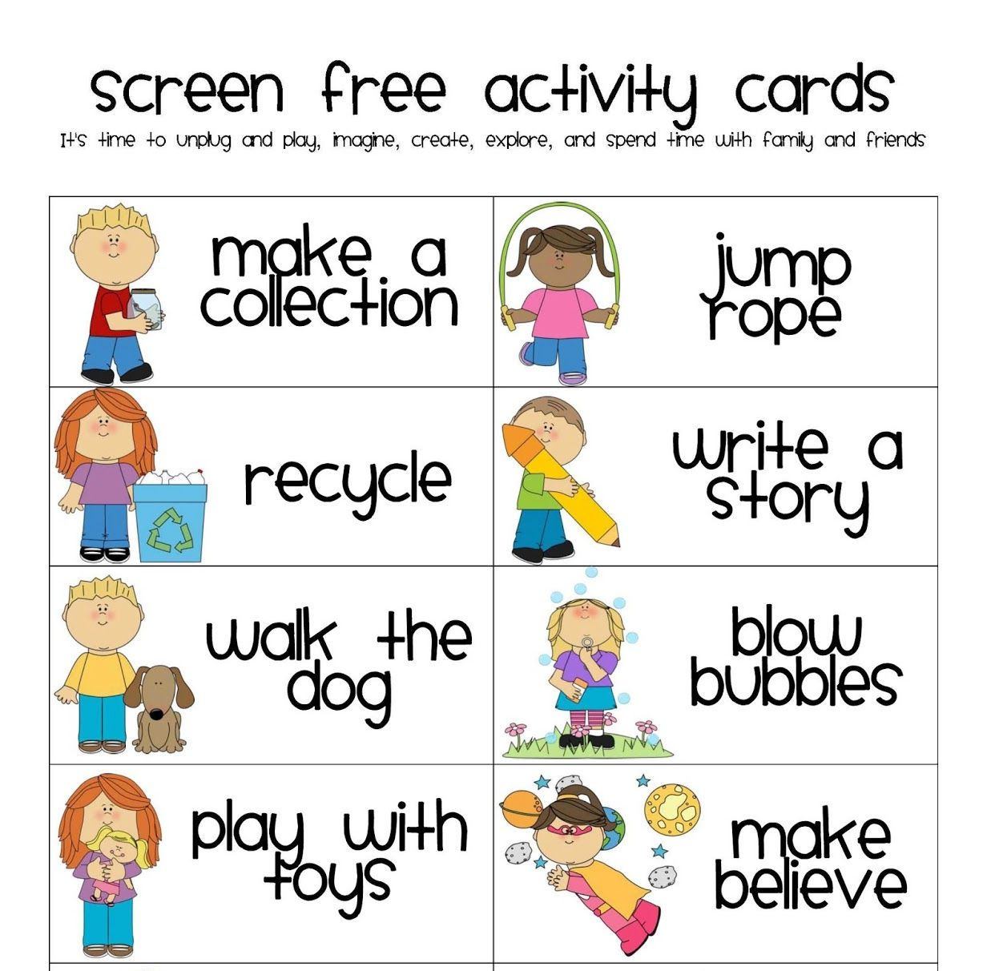
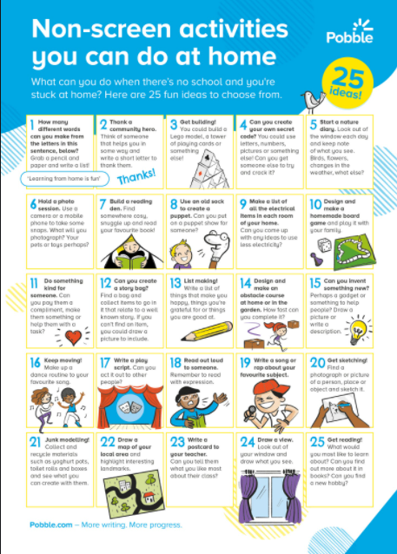
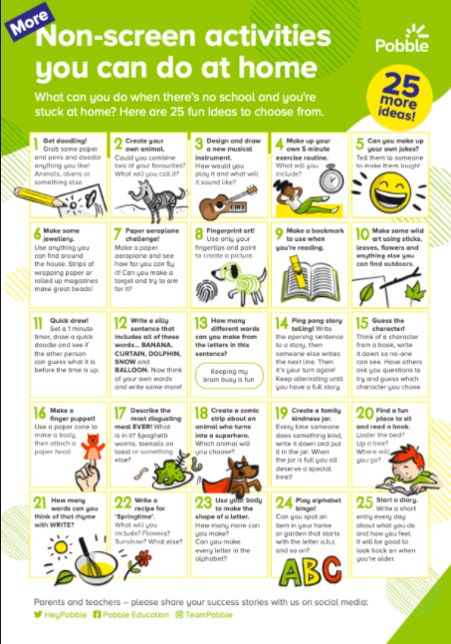
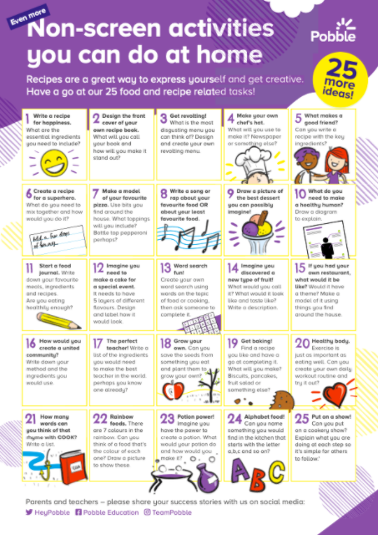
What else can we do?
You may feel that the activities suggested by the teacher are not suitable for your home, or even ‘do-able’ for you and your family. Please feel free to adapt the themes or ideas, or contact your class teacher for support.
Alternatively, home learners could:
complete alternative wellbeing activities as they see fit - have a browse through the ideas below.

