Slide 1
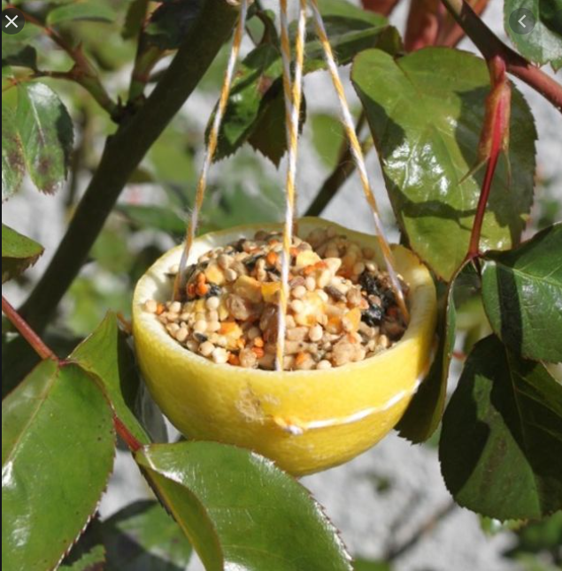
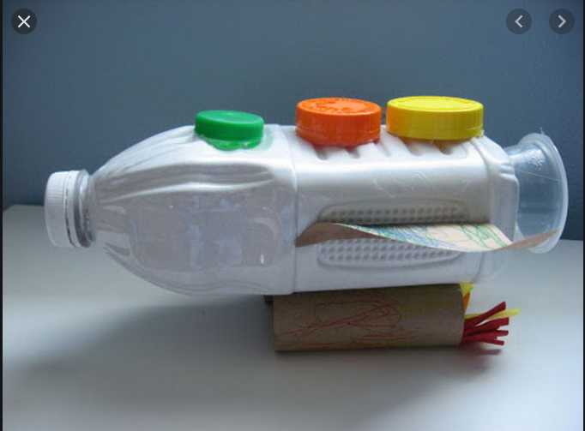
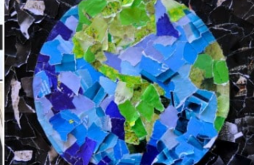
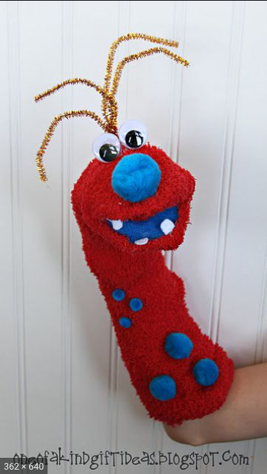
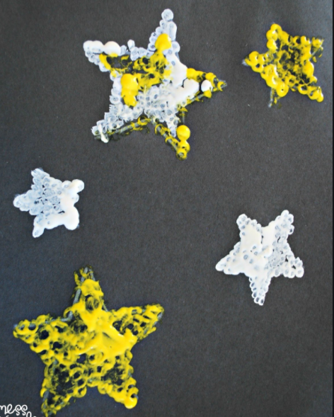
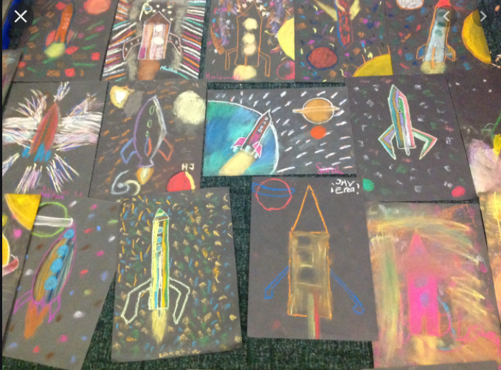
Wellbeing Wednesday
Throughout the current pandemic, we have been reminded more than ever of the importance of mindfulness and wellbeing.
At Darnhall Primary School, we are aware that the current need for schooling at home has potentially increased the amount of screen time your child is receiving. Add to that the strains, worries and concerns of changes in routines, missing friends and working differently, and sometimes it can all be too much.
With that in mind, we have created Wellbeing Wednesday, an afternoon given over to unplugged (non-screen) activities.
Tasks are being planned around art, craft, design, fitness and activities such as construction and nature. Home learners will be provided with the 4 week plan for this term so that they can plan and prepare for their choice of activity - teachers have been careful to plan a range of tasks that are close in nature to those being completed in school as we know not everyone has access to the same resources.
If it suits your family’s routine, please swap afternoons. You could have Mindful Monday or Thoughtful Thursday - catchy name optional!
Should you have children in more than one year group, please select just one activity for you all to complete. We do not want this to be a stressful time!
Year 1

Slide 2
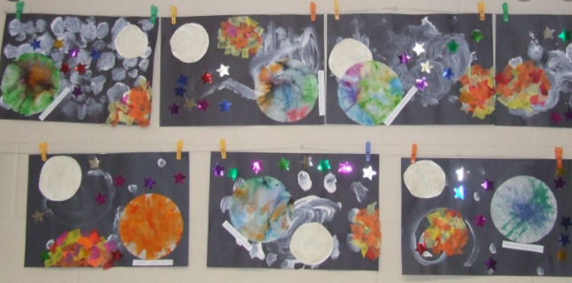
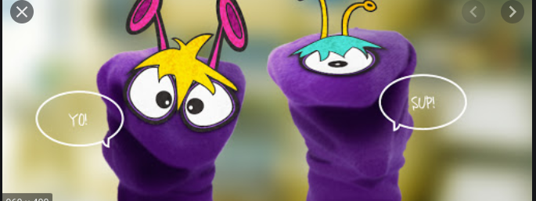
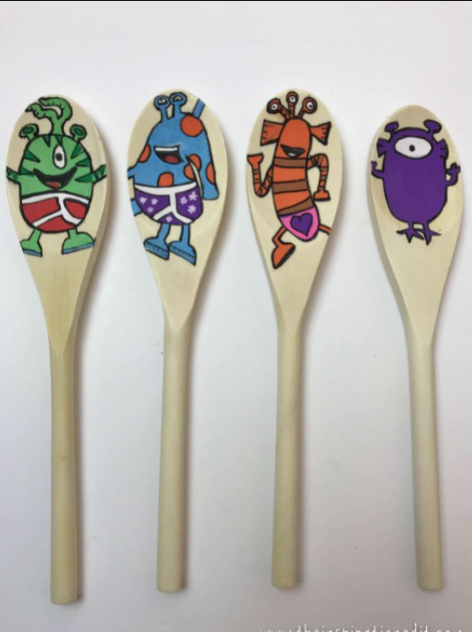
Year 1
 | School Activity | Home Learners
Week 1 | Space collage/ drawing or painting Using the stories that we have read about space and aliens so far in literacy children are to create a space scene using their imaginations. | Space collage/ drawing or painting Using the stories that we have read about space and aliens so far in literacy children are to create a space scene using their imaginations. Use what you have at home such as lids, tinfoil, string, paint, felt tips, pens etc. Instead you could try some space themed art, maybe try finger printing or stamping. What do you think Earth looks like from space?
Week 2 | Puppets using socks or wooden spoons Use an old sock or a wooden spoon to create your own alien. Make them with materials of your choice. | Puppets using socks or wooden spoons Use an old sock or a wooden spoon to create your own alien. Make them with materials of your choice. Use the puppets to tell a story - either one you know or make up your own. Give your puppet a name - it can be made up and as silly as you like!

Slide 3
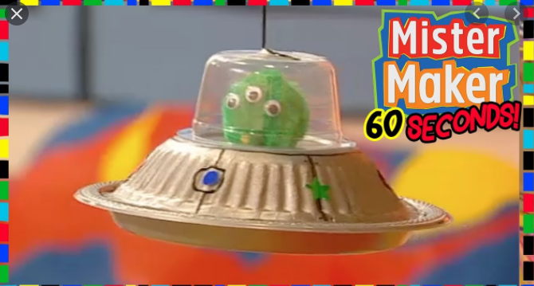
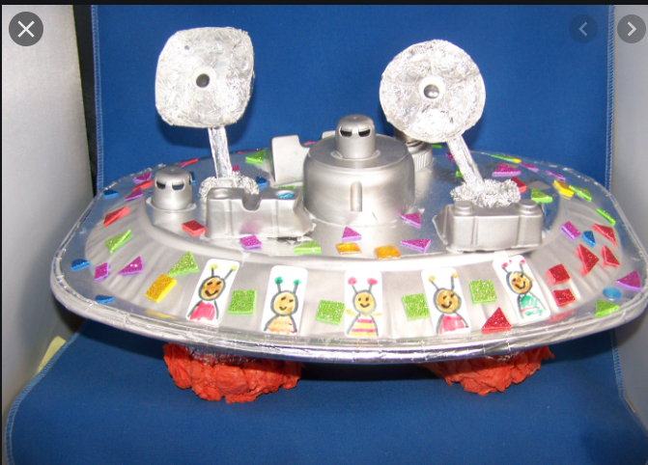
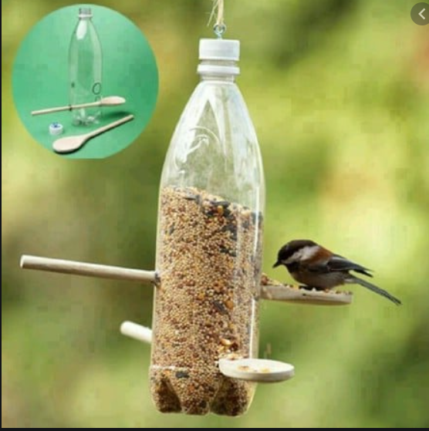
Year 1
 | School Activity | Home Learners
Week 3 | Make your own alien spaceship Use bottles/ card and any junk materials you can to make either a rocket or a spaceship. Let your imaginations run wild! | Make your own alien spaceship Use bottles/ card and any junk materials you can to make either a rocket or a spaceship. Let your imaginations run wild! Where will your space ship travel to? Does the planet have a name?
Week 4 | Make a Bird Feeder/ Go Bird Watching in the outdoor area Using cheerios and pipe cleaners children to make bird feeders and then watch in our outdoor area and make a tally chart of birds that visit. Children could also draw the birds they see. Use books to identify them | Make a bird Feeder/ Go bird watching in your garden Using cereal or bird seed/ see some ideas below make a bird feeder and watch birds in your garden at home. You could keep a tally of the birds you spot and draw pictures of the birds that visit.
These afternoons are about having time away from your computers, tablets and phones. We hope you find it relaxing and enjoyable.
Be sure to share photos of your work with us on Class Dojo or Facebook.

Slide 4
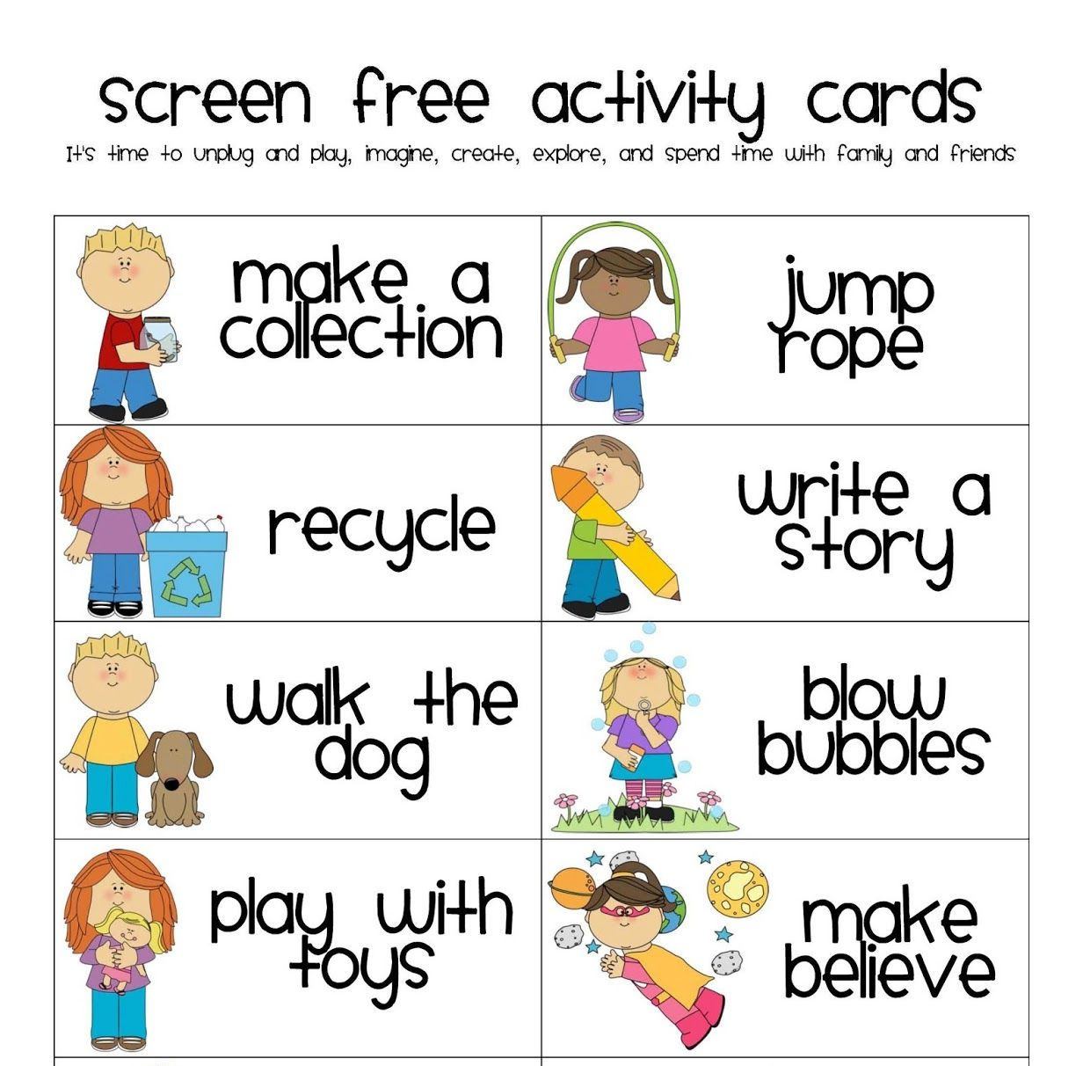
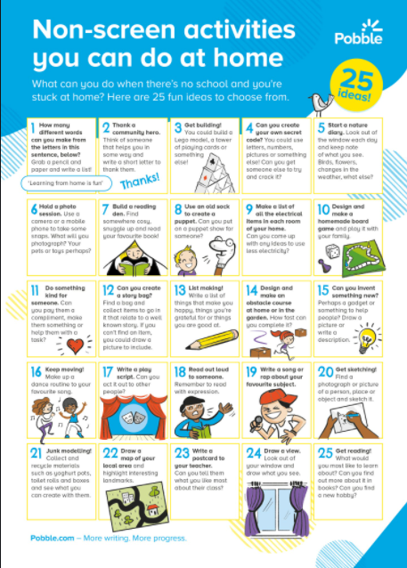
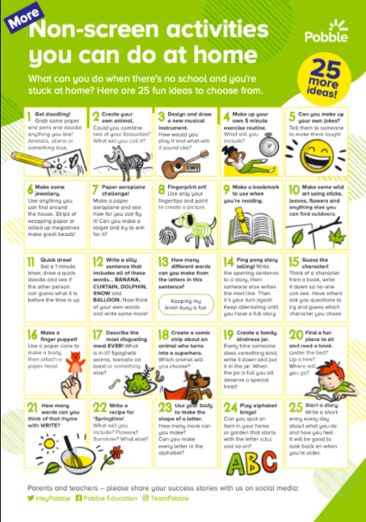
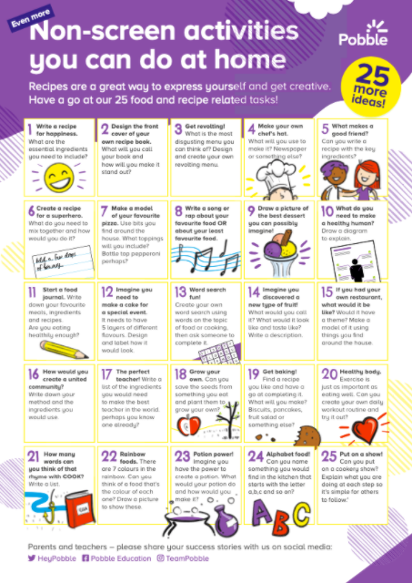
What else can we do?
You may feel that the activities suggested by the teacher are not suitable for your home, or even ‘do-able’ for you and your family. Please feel free to adapt the themes or ideas, or contact your class teacher for support.
Alternatively, home learners could:
complete alternative wellbeing activities as they see fit - have a browse through the ideas below.

