Slide 1

RWI Phonics Parent Meeting

Slide 2

Why Phonics?
A complete literacy programme - systematic and structured.
Meets the demands of the new national curriculum, giving your children the best chance of success
One-to-one tutoring - no child is left behind.
Storybooks align with the sounds learnt in class.

Slide 3
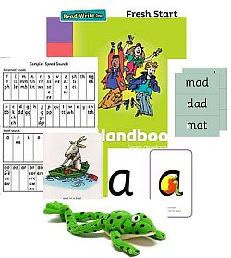
Who is Phonics for?
Phonics is a rigorous approach to teaching early reading and writing from Reception to year 2.
It is taught daily in small groups.

Slide 4
A bit of technical knowledge…
Phonics = the sounds in our language.
Phoneme = phonemes are the small units of sounds words are made up of.
Grapheme = A grapheme is a letter, or number of letters that represent a sound (phoneme).
2 letters that make a sound are called a digraph e.g. ai
3 letters that mare a sound are called a trigraph e.g. igh
We call these special friends
The sound pronunciation guide can be found on:
https://www.ruthmiskin.com/en/find-out-more/parents/

Slide 5
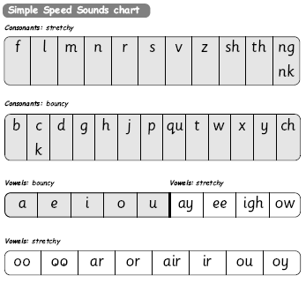

Slide 6
How does it work?
Children:
Learn 44 sounds and matching letters.
Learn to blend sounds to read words.
Read lots of specially written books.
This is decoding.

Slide 7
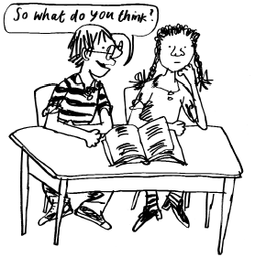
How does it work?
Children:
Talk a lot about what they have read to show they understand.
Listen to and discuss other ideas to deepen understanding.
This is comprehending.

Slide 8
The English language is a complex code…
It would be easy if we only had to learn Set 1 and Set 2 sounds.
ay | igh
play eight cake straight | right pie kite fly
Set 3 sounds

Slide 9
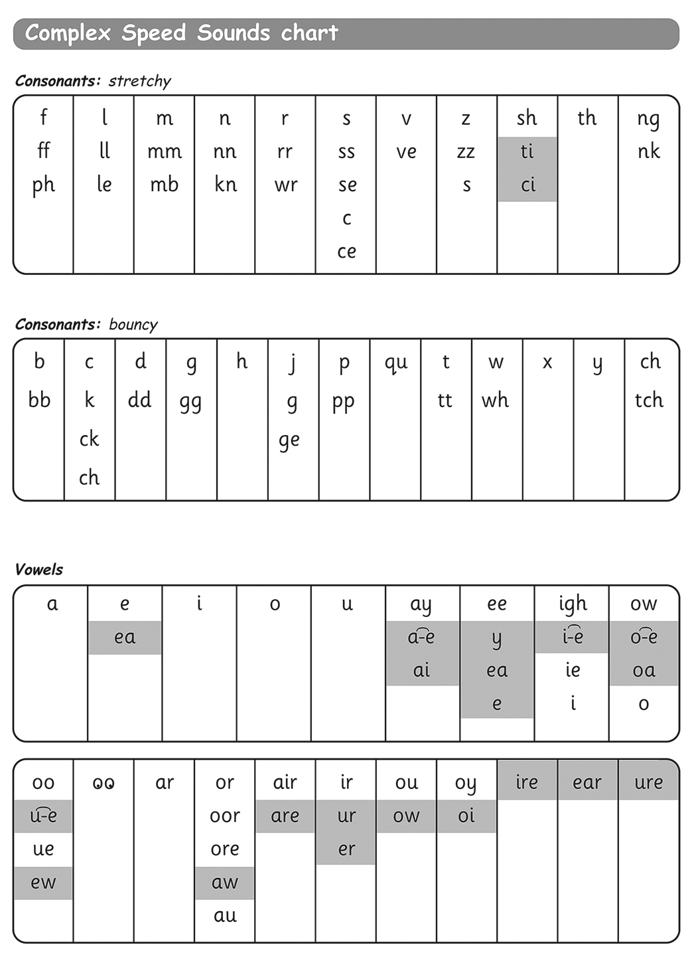

Slide 10

How do phonics help us read?
Say “hello” to Fred.
Fred can only talk in sounds...
He says “c_a_t.” Not cat.
We call this Fred Talk.
Watch Ruth Miskin explains Fred Talk.

Slide 11
Who supports our school?
Ruth Miskin Training provide whole-school training
in the Phonics programme.
The trainer continues to support us on in-school Development Days.

Slide 12

Children who read at home do well at school
Read fluently
Write confidently
Speak articulately

Slide 13
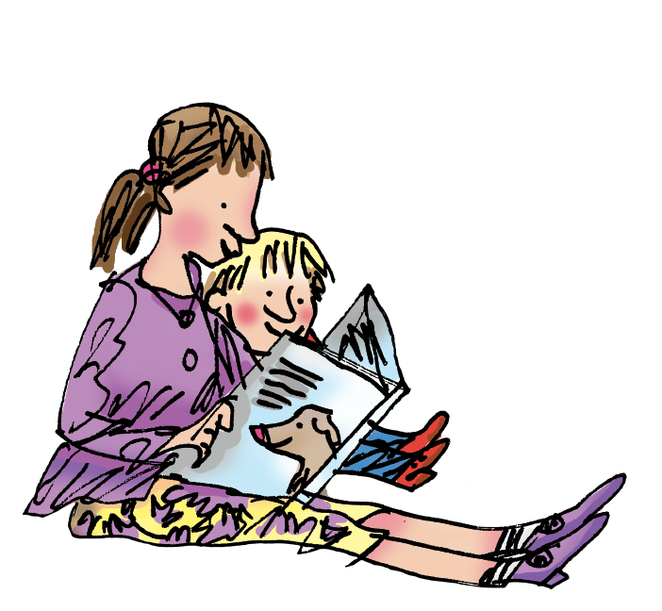
How to help your child at home…

Slide 14



Take home books
Black and white story books will be sent home and changed on a Monday and a Thursday, following the 3 day RWI cycle. Children will be able to read these aloud to a grown-up independently as they will have read these three times in school before taking them home.
In addition to this, each child will be given a colour book bag story book to read that week, which will be changed each Monday
Children are also welcome to choose a story book from our class libraries to read for pleasure.
These books link to the exact level the children are reading at and allow the children to read and re-read the sounds they already know. There should be no sounds or words in the book your child is unable to read, enabling children to be successful readers. Reading at home should be a celebration of reading and a chance for the children to teach you using the activities in the books!

Slide 15
You can read stories with your child
Read favourite stories over and over again.
Read some stories at a higher level than they can read themselves.
Listen to them reading their home reading books.
Notes:
View the Ruth Miskin Training suggested reading lists for great books to read with your children.
http://www.ruthmiskintraining.com/teacher-support/tag-44/index.html

Slide 16
And...
Asking lots of questions!
Use these prompts to help you:
What is that character thinking?
What do you think
happens next?
What is happening?
What do you
think that character is
feeling now?
What is the character saying?

Slide 17
And...
By talking to your child as much as possible and ‘feeding’ them new and different words:
“Let’s eat our lunch now.”
“Let’s munch our lunch now.”
“Let’s scoff our lunch now.”
“Let’s devour our lunch now!”

Slide 18
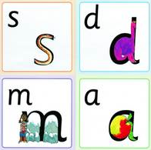
You can practice pronouncing sounds.
Remember no ‘fuh’ and ‘luh’!
Phonics sound cards can
be purchased from school
to be used at home
These are £5 per pack
There are 2 packs

Slide 19
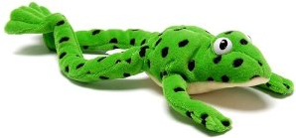
You can have fun with Fred Talk.
Make a your own Fred with your child. Use Fred talk regularly.
“What a tidy r-oo-m!”
“Where’s your c-oa-t?”
“Time for b-e-d!”

