Slide 1


Do you want to be able to keep up with your kids online? https://youtu.be/l3TWhM_ep2o

Slide 2
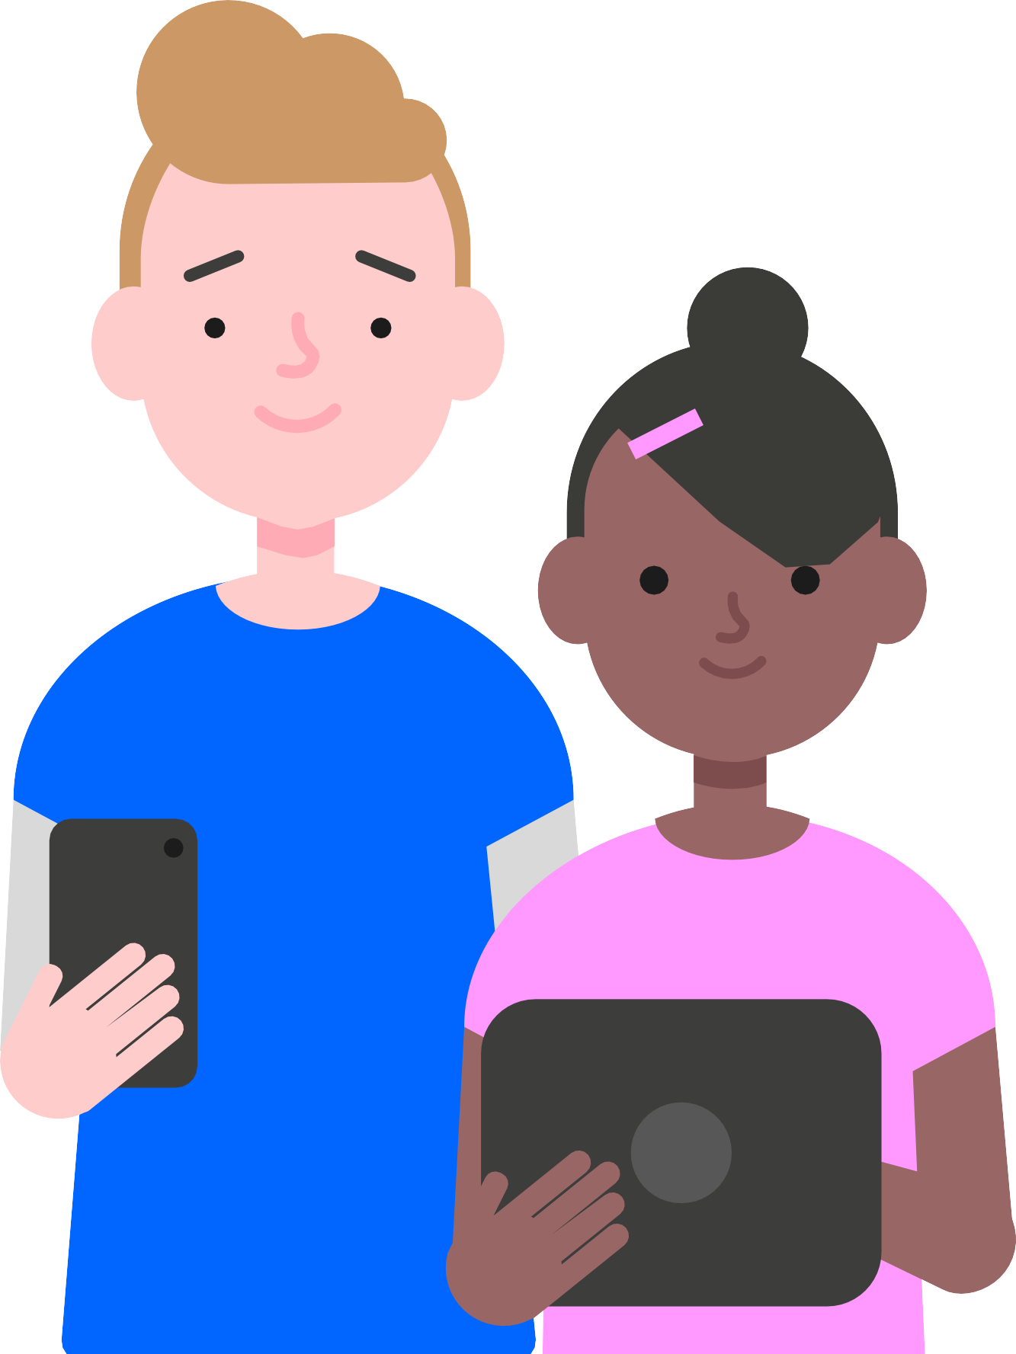
“My kids know more about the internet than I do…”

Slide 3




What happened in an Internet minute?
Google
4.1m search queries
Facebook
1.3m logged in
Instagram
698k scrolls
Twitter
194k tweets
WhatsApp & FB Messenger
59m messages sent
TikTok
1.4k downloads
Twitch
1.2m views
400k apps
downloaded
1.1m
spent online

Slide 4
There are lots of positives…
Online games can enhance teamwork and creativity
Add to the child’s store of knowledge
Households with computers perform better academically
Improve both visual intelligence and
hand-eye coordination
89% of 8-11 year olds said that using social media made them feel happy and 82% said it helped them to feel closer to their friends
2020 Ofcom

Slide 5
But technology can affect children’s development…
Sleep cycles are affected by blue light from screens
Screen-based entertainment increases central nervous system arousal
Children today are more forgetful than OAP’s
One study found that the more distracted you are, the less able you are to experience empathy
Gaming platforms use persuasive design in order to keep people using their product, and children are particularly vulnerable to these tactics.

Slide 6
Media usage by age
6 in 10 use
27% use a smartphone to go online and 63% use a tablet to do the same
66% play games online
74% who own a smartphone are allowed to take it to bed with them
any device to
go online
2% have their own tablet
62% play games for just over
6 hours a week
25% use a smart speaker in the home
81% use their phone to go online and 69% to do the same
3
4
5
6
7
8
9
10
11
12
13
14
15
16
36% more
35% play games online
45% use a smartphone to go online and 72% use a tablet to do the same
98% spent over 11 hours of streaming from a device per week
likely to watch
streams on a
mobile device
51% use YouTube in 2019
compared to 37% in 2016
5% have their own smartphone
37% own their own smartphone
83% have their own smartphone
Reference: Ofcom (2019) https://www.ofcom.org.uk/ data/assets/pdf_file/0023/190616/children-media-use-attitudes- 2019-report.pdf

Slide 7
And there are risks…
High-Risk Online Scenarios
Risks | Contact | Content | Conduct | Cyber scams | Overall risk – all 4Cs’ together
Vulnerabilities
Special Educational Needs | Predicts contact risks. Includes sexting under pressure, coercion, blackmail, or threats to send more images |  |  |  | Significantly higher score for basket of all high-risk online scenarios
Communication |  |  | Predicts conduct risks. More likely to visit gambling sites and chat rooms | May struggle to understand T&Cs - can leave them more susceptible to scams | Significantly vulnerable to the basket of all high-risk online scenarios
Family / Social (care-experienced) |  | Higher exposure to harmful content |  | Particularly susceptible to cyber scams. This can link to being a victim of online aggression. | High overall risk for the basket of all high-risk online scenarios
Mental health difficulties |  |  |  |  | Significantly high risk for the basket of all high-risk online scenarios
Physical disabilities |  |  | Predicts conduct risks. More likely to visit sites with adult content. |  | Significantly more likely to experience a basket of all high-risk online scenarios

Slide 8

Risks parents are concerned about
Concerns | % of parents
Encouraging self-harm | 62%
Privacy and data collection 50%
Cyberbullying | 45%
Radicalisation 41%
Excessive screen time | 25%
Reference: Ofcom (2021) https://www.ofcom.org.uk/ data/assets/pdf_file/0025/217825/children-and-parents-media-u se-and-attitudes-report-2020-21.pdf

Slide 9
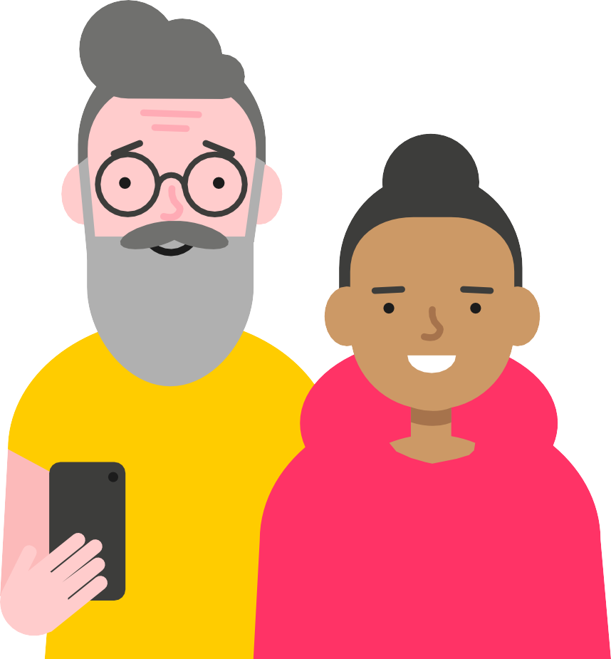
Risk is not harm
Positive action can limit risks becoming harmful. Here are 5 tips for parents:
1 4
Understand the risks
Agree on helpful mediation strategies
2
Communicate regularly
5
Develop coping strategies that foster resilience
3
Keep the risks in proportion

Slide 10
Dealing with inappropriate CONTENT
4.7
11
years
1/3
million
URL’s showing pornographic content –
more than 12% of the internet
Average age to first view porn online
of children have seen explicit images by age of 10

Slide 11
Dealing with inappropriate CONTENT
What to talk about
They can come to you if they see anything that upsets them
If they have seen pornography… that it presents an unrealistic image of sex and relationships
The importance of respect for each other and the meaning of consent
Top tips / tools to use
Parental controls on home broadband
Content lock on mobile networks
Safe search on Google (& other browsers) & YouTube; child–friendly search engines

Slide 12
Dealing with inappropriate CONTACT
48%
48%
of secondary school children have talked to strangers on social media
of 11 year olds have a social media profile

Slide 13
Dealing with inappropriate CONTACT
What to talk about
Sometimes people hide behind fake profiles for dishonest reasons
Agree how they will respond to requests from people they don’t know in real life
Never ever to meet up with anyone they don’t know in real life
Top tips / tools to use
Set up safe social media profiles
that don’t share personal information
Turn off geolocation settings on devices
Use the strongest privacy settings on social media
Learn how to report/block/mute

Slide 14


Dealing with inappropriate CONDUCT
25%
50%
of children will experience cyberbullying
of children say someone has been nasty online

Slide 15
Dealing with inappropriate CONDUCT
What to talk about
Talk to a trusted adult if they experience anything upsetting online
Think carefully about sharing images of others
Be responsible online, remembering they are creating their own digital footprint
Top tips / tools to use
Report inappropriate posts/content to the social media providers
Think carefully about using monitoring apps that identify inappropriate behaviour

Slide 16
Dealing with ‘SEXTING’
What to talk about
It’s hard to control where images might be shared
It’s illegal to create or share a sexual image of a child under 18
Top tips / tools to use
The T-shirt test – if you wouldn’t wear the picture on your T-shirt, don’t share it online
If your child is involved in sexting, contact CEOP & Childline who can help to remove images
15-
40%
of young people are involved in sexting
Threat comes mostly from peers and
is often coercive

Slide 17
What are children taught in school?
KS1
Use technology safely and respectfully, keeping personal information private; identify where to go for help and support when they have concerns about content or contact on the internet or other online technologies
KS3
Understand a range of ways to use technology safely, respectfully, responsibly and securely, including protecting their online identity and privacy; recognise inappropriate content, contact and conduct,
and know how to report concerns
KS2
Use technology safely, respectfully and responsibly; recognise acceptable/unacceptable behaviour; identify a range of ways to report concerns about content and contact
KS4
Understand how changes in technology affect safety, including new ways to protect their online privacy and identity, and how to report a range of concerns

Slide 18

In addition, schools embed it across…
ICT
curriculum
Curriculum and safeguarding
assessed as part of Ofsted framework
Appropriate filters and monitoring system
PSHE
lessons

Slide 19

Controlling tech time
Your children will be watching the way you use technology and they will copy; make sure there is some consistency in how you role model good behaviour:
1
Turn off notifications on apps to avoid that constant ‘ping’
4
'No phones at the table' rule or 'no phones between 6 and 7' rule
2
Buy an alarm clock so you don’t have devices in the bedrooms
5
Family tech- free days!
3
Keep phone on silent in your pocket or bag when you pick the kids from school

Slide 20
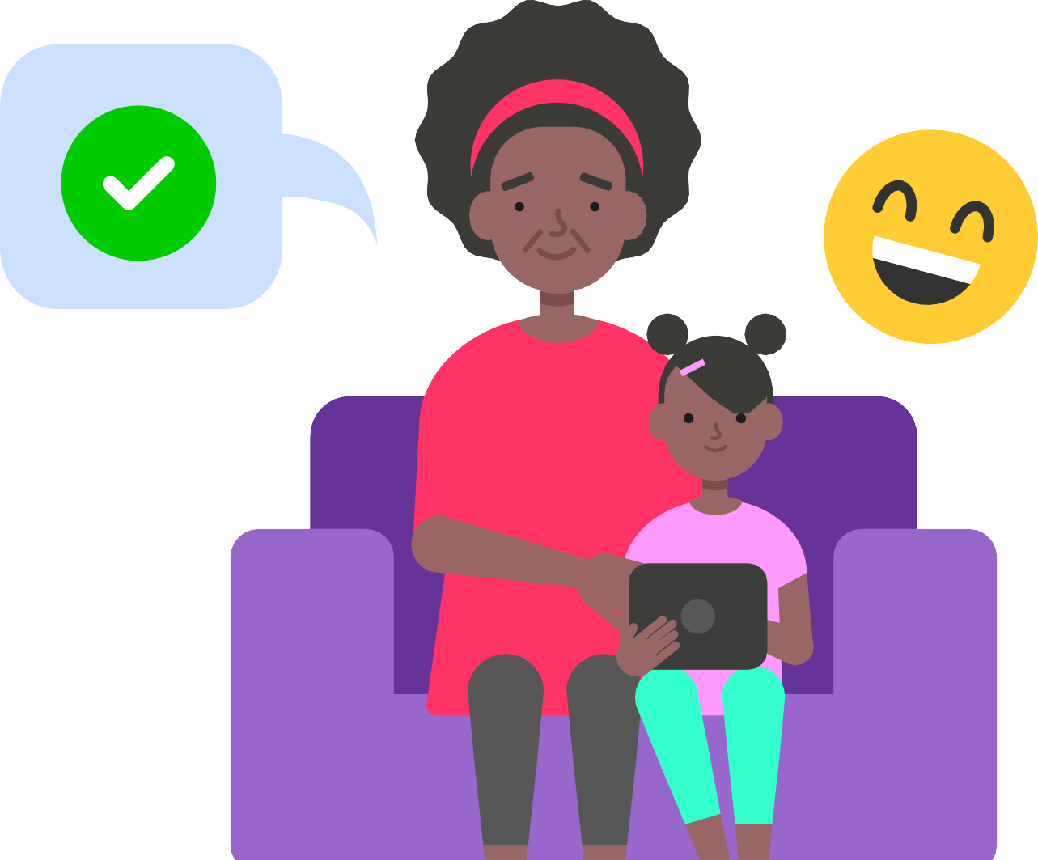
Controlling tech time
And there are tactics you can put in place to help manage their screen time….
1
Set a good example
5
Use technology/apps to help manage screen time e.g.
Forest App
2
Talk together about the time spent online
3
Agree on appropriate length of time they can use their device
4
Get the whole family to unplug & create screen-free zones

Slide 21
Three things to teach your child
Be a confident communicator
Be a critical thinker
Be a capable tools user

Slide 22
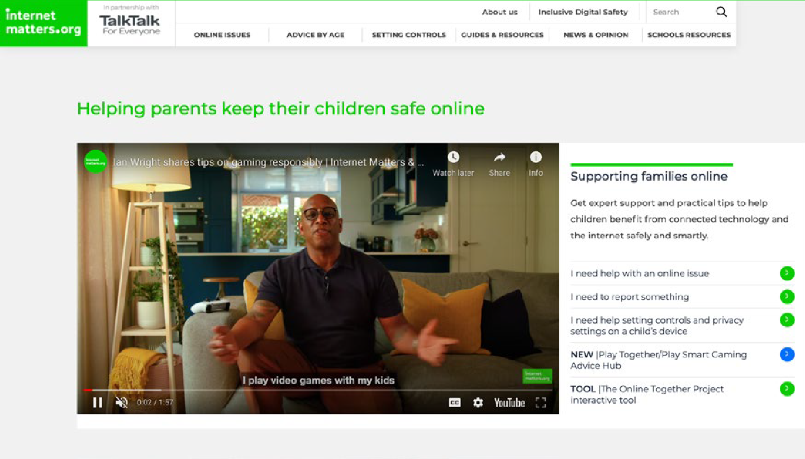
Internet Matters
Our vision is to motivate & educate parents to guide their children to stay safe online
InternetMatters internetmatters @im_org

Slide 23



Other useful support services
Child Exploitation & Online Protection Centre
NSPCC Net Aware
Childline 0800 1111
A guide to social networks that children use
net-aware.org.uk
24 hour free helpline service for children and young people
For concerns about online sexual abuse or the way someone has been communicating online ceop.police.uk/CEOP- Reporting/

