Slide 1

E-safety Awareness
for
Parents and Carers

Slide 2
Aims of the presentation
Positive aspects of being online
Social Networking
Managing Risks
Child Exploitation and Online Protection Centre (CEOP)
Technologies your children might use –Gaming, Instant Messaging, Mobiles etc
Parental Controls
Tips for protection
Advice and help (including useful websites)
Questions

Slide 4
Why are we here?
•This picture shows the speed at which the internet is changing the world.
•The sites we saw are becoming overwhelmingly popular for both adults and children.
•The online world is increasingly integrated into our daily lives.
•As little as 10 years ago the internet was not integrated in this way and there would have been no need for a session such as this.

Slide 5
Websites
Which sites do your children use online?

Slide 6
The online world
•Children are natives in the online world, most are unaware of life without:
–IPhone
–Games consoles
–Google
–Emails
–Facebook
•They feel confident using new sites and technologies, moving from site to site with ease.

Slide 7
Statistic:
“70% of parents of children aged 12 –15 feel that their children know more about the internet than they do”
(Ofcom Media Literacy 2011)

Slide 8
The Online World
There are may positive aspects of being online.
• What skills do you think your children are learning whilst they are online, whether networking, gaming or doing homework?

Slide 9


Slide 10
Social Media
“ Today, social media are all around us; making it simpler to communicate and make contacts, opening doors to new exciting opportunities for creativity and education.”
CEOP 2011

Slide 11
Social Networking
Social networking has exploded into our lives, with many of us feeling pressure to join in or miss out.
Examples of social networking include: Facebook, Twitter, Youtube, KiK, ooVoo, and Wayn.
These sites allow us to reconnect with long lost friends and communicate in ways we never dreamed possible.

Slide 12
Facebook
Who here has a Facebook profile?
Have any of you been pestered by your child to let them have a FB or social networking account?
Can anyone tell me how old you have to be to sign up for a FB account?
13 years old.
Are any of you friends with any of your children on Facebook?

Slide 15
Security Tips
Security settings need to be set to “Friends only”, that includes -comments, posts and photos
These "Friends” need to be people they know and trust in the real world
Content -Only post content and photos they wouldn't mind showing you!
Try your very best to be “Friends” with your child on Facebook
Learn how to report an issue directly to Facebook –discussed further later

Slide 16
Security Tips
Help set up their profile
Add your email as the main contact (if possible)
Set the privacy settings to “friends” only and ensure they are children you know
‘Like’ the Click CEOP page –more CEOP details to come later
Check in and keep updated If you have any questions which relate directly to Facebook, please visit their family safety centre for help and advice –www.facebook.com/safety-see next slide

Slide 18
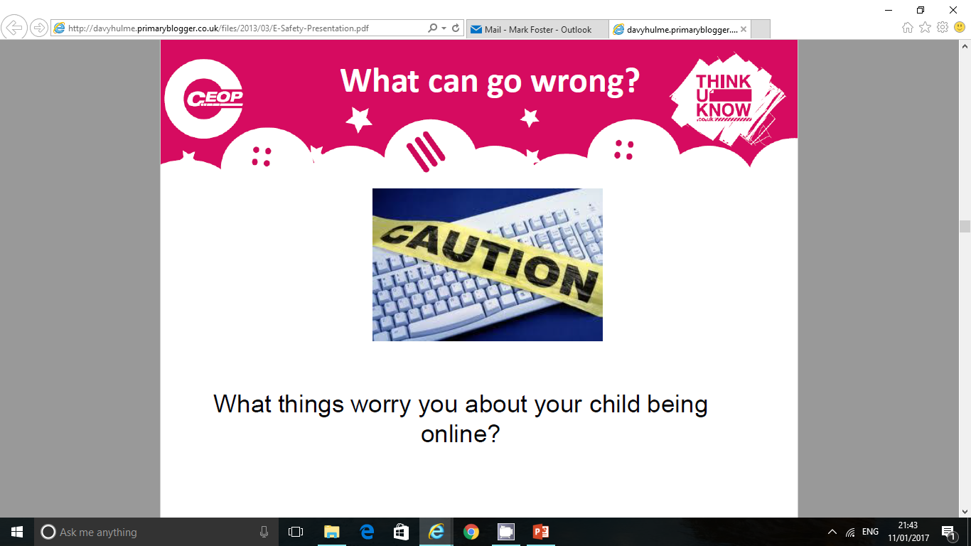

Slide 19
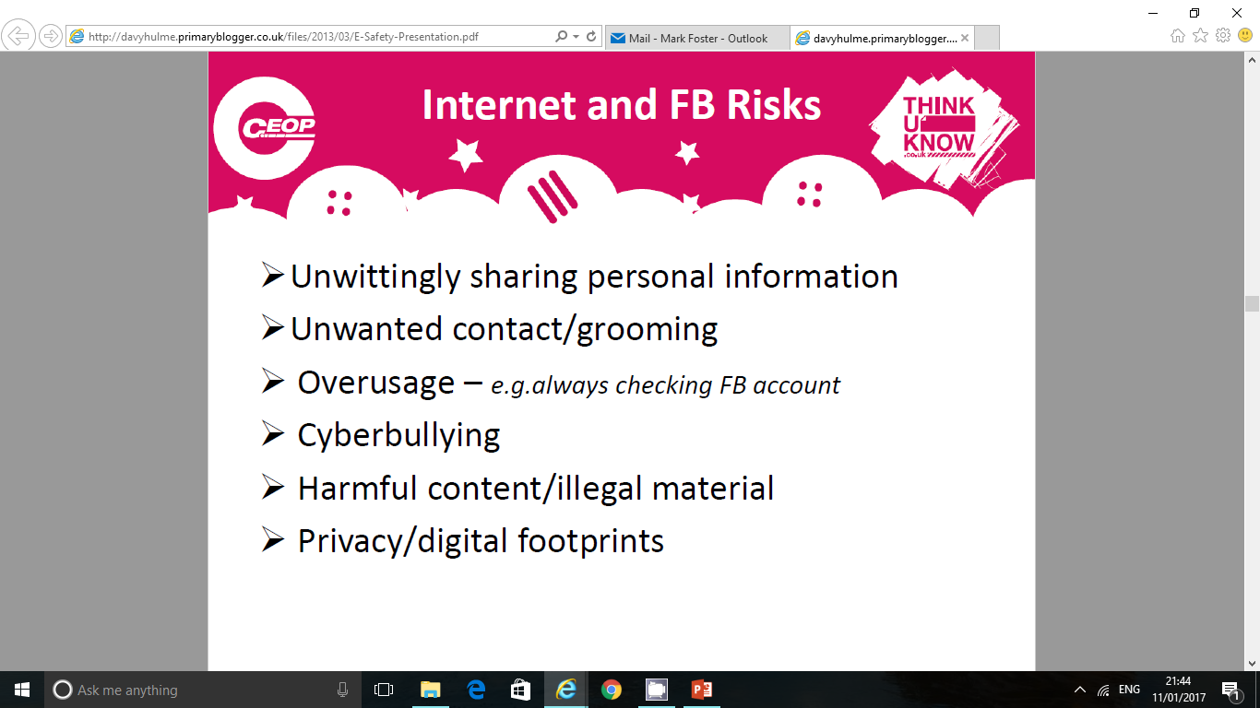

Slide 20
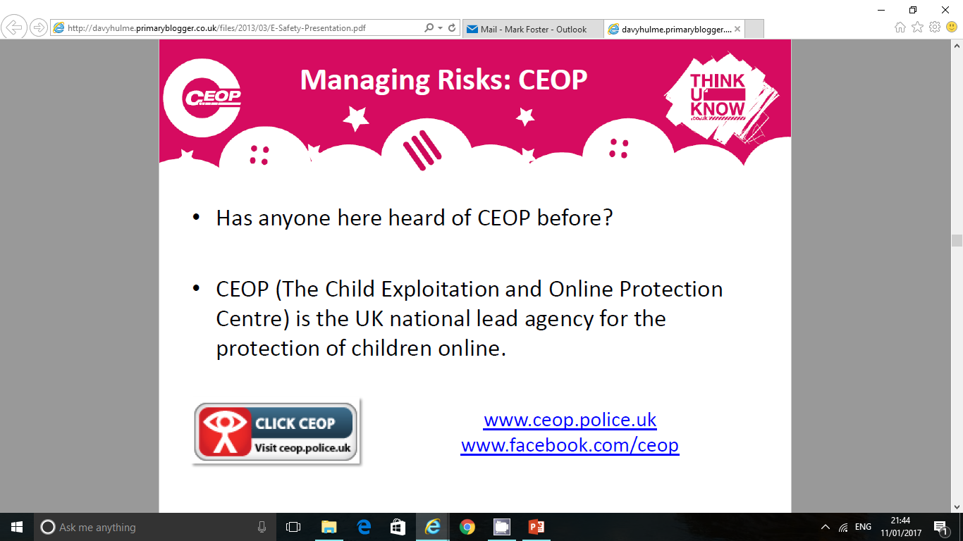
www.ceop.police.uk
www.facebook.com/ceop

Slide 21
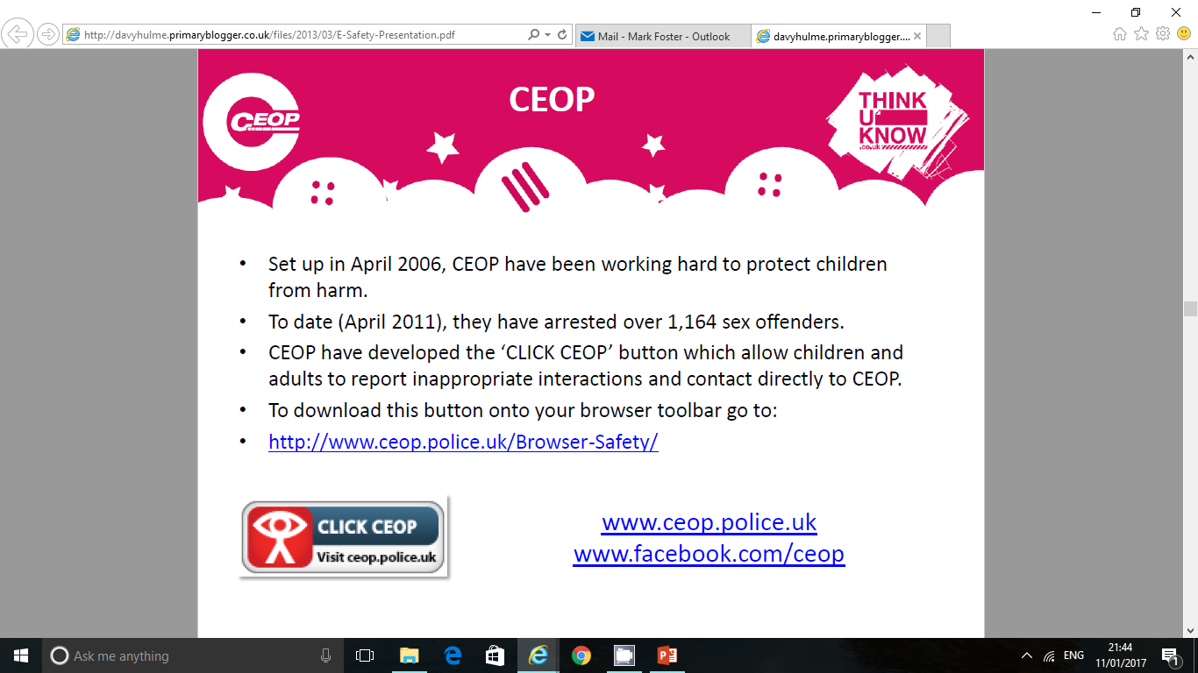
www.ceop.police.uk/Browser-Safety
www.ceop.police.uk
www.facebook.com/ceop

Slide 22
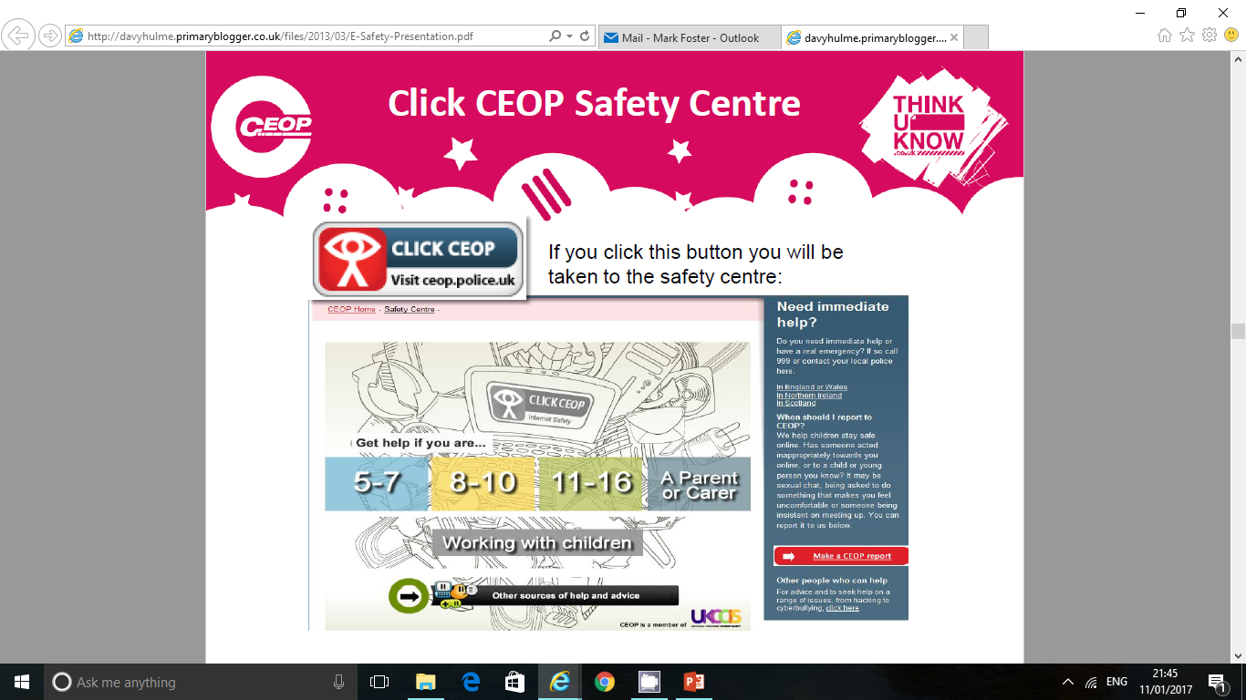

Slide 23
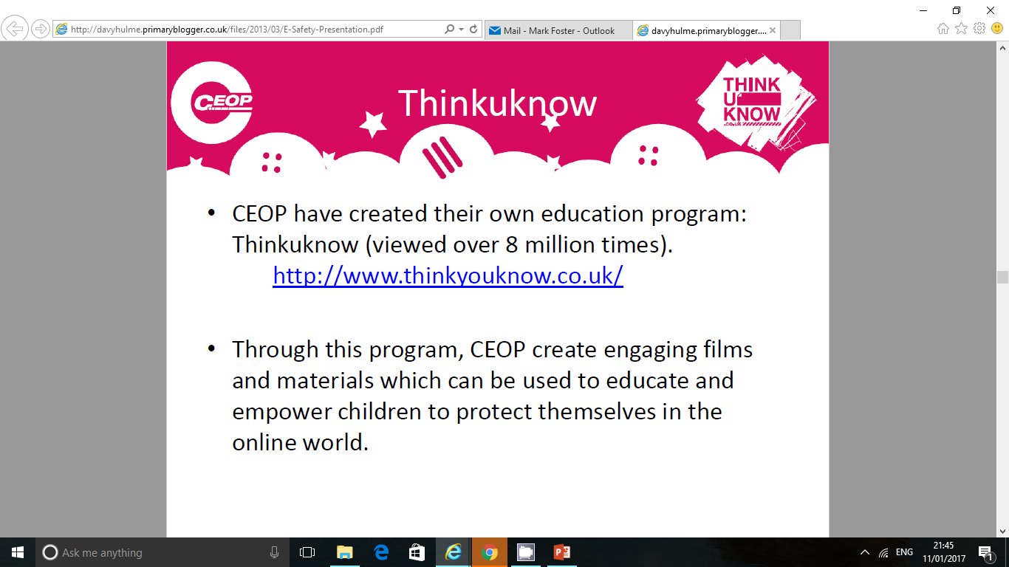
www.thinkuknow.co.uk/parents

Slide 24
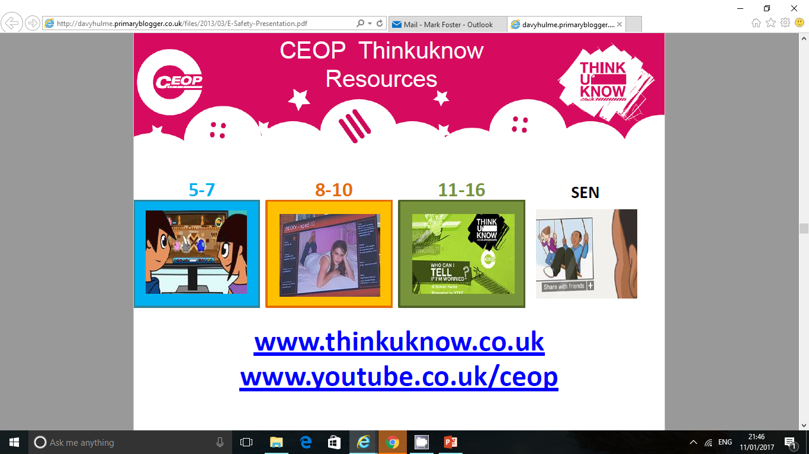

Slide 25
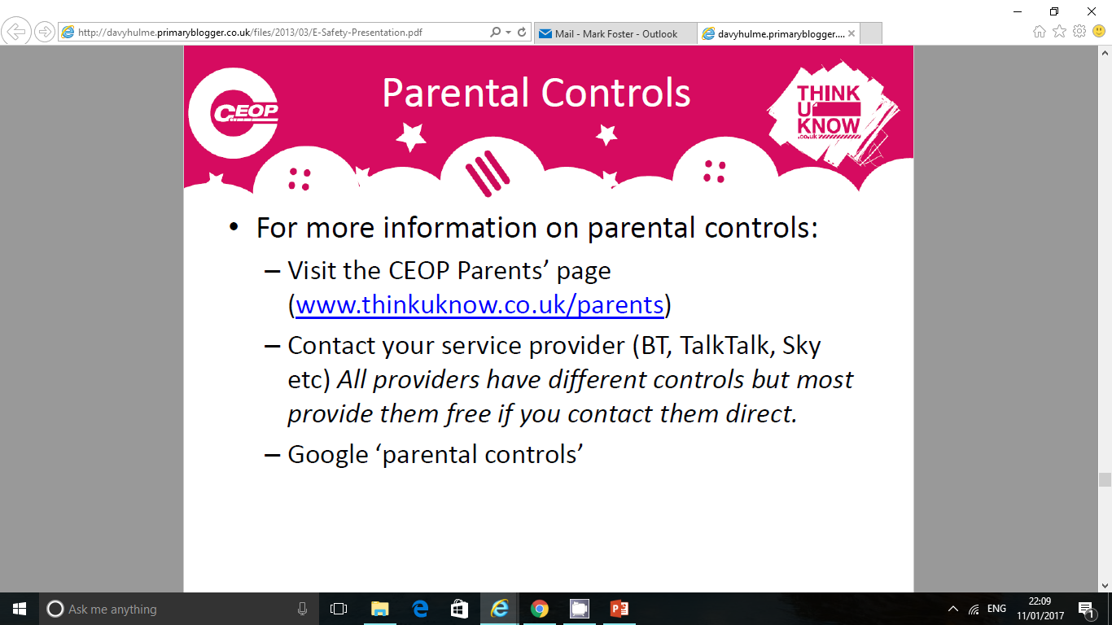
www.thinkuknow.co.uk/parents

Slide 26
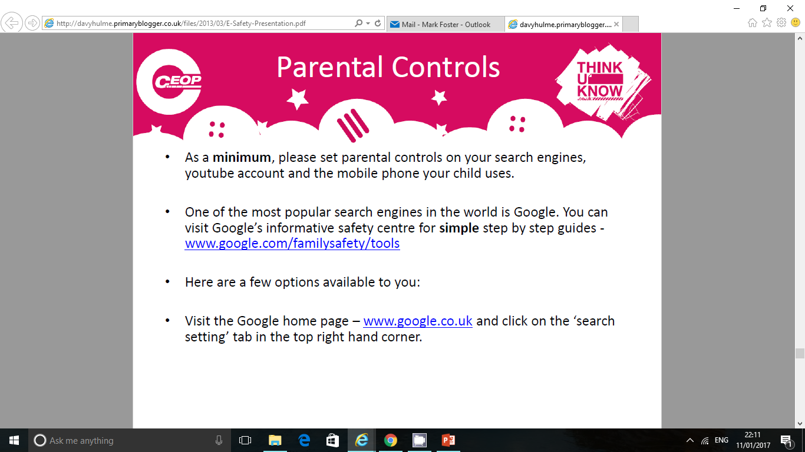
www.google.com/familysafety/tools
www.google.com

Slide 27
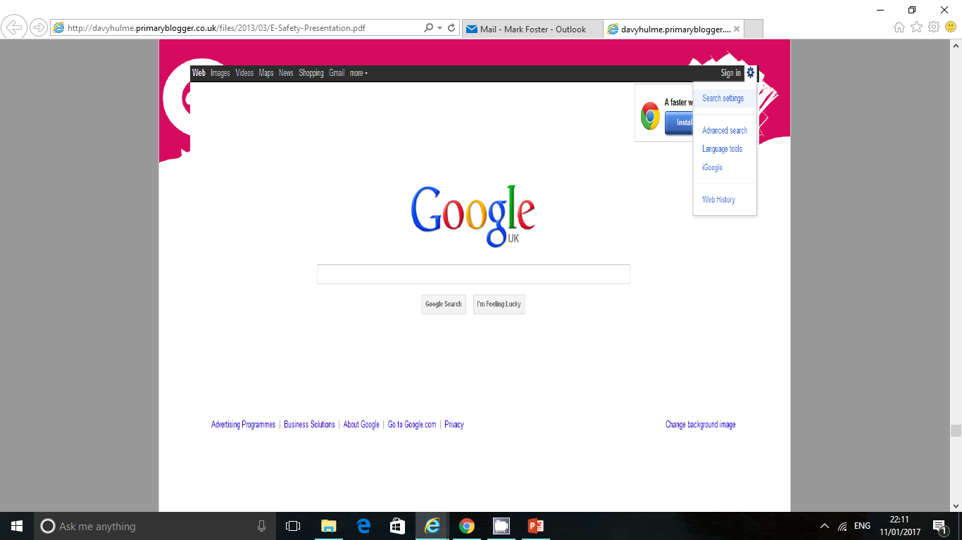

Slide 28
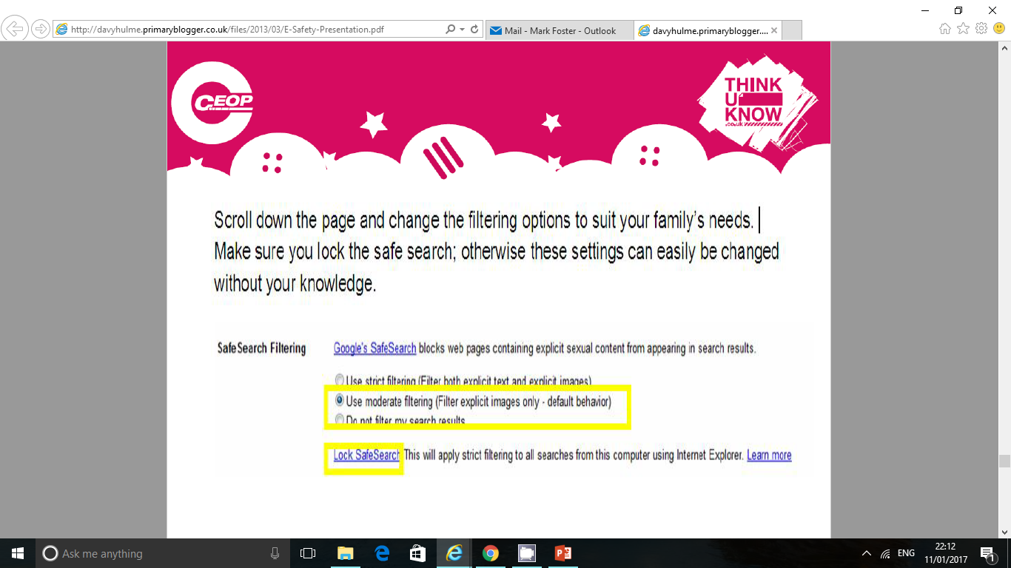

Slide 29
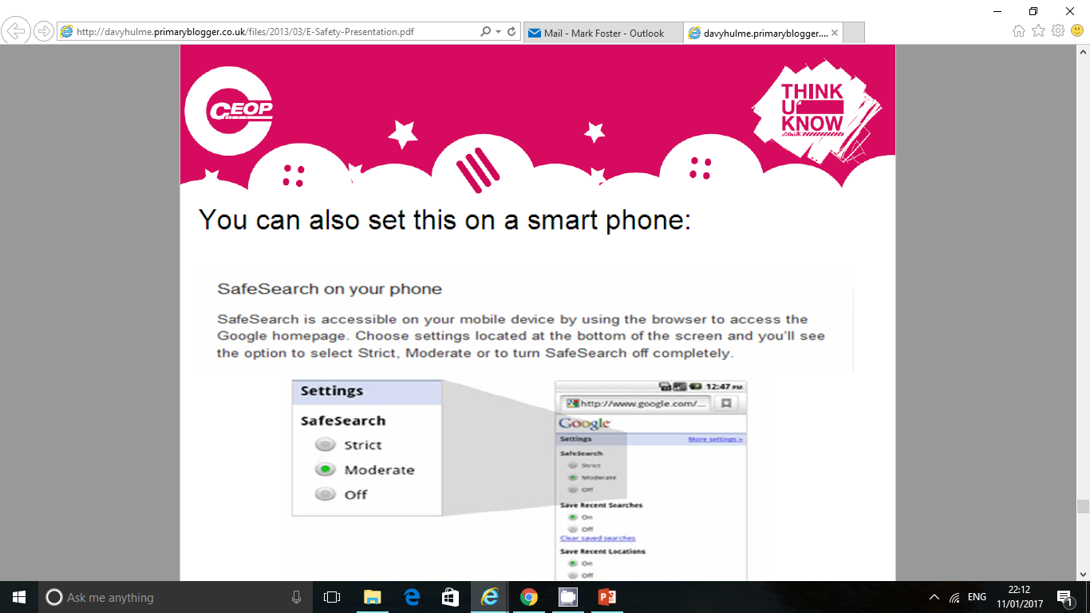

Slide 30
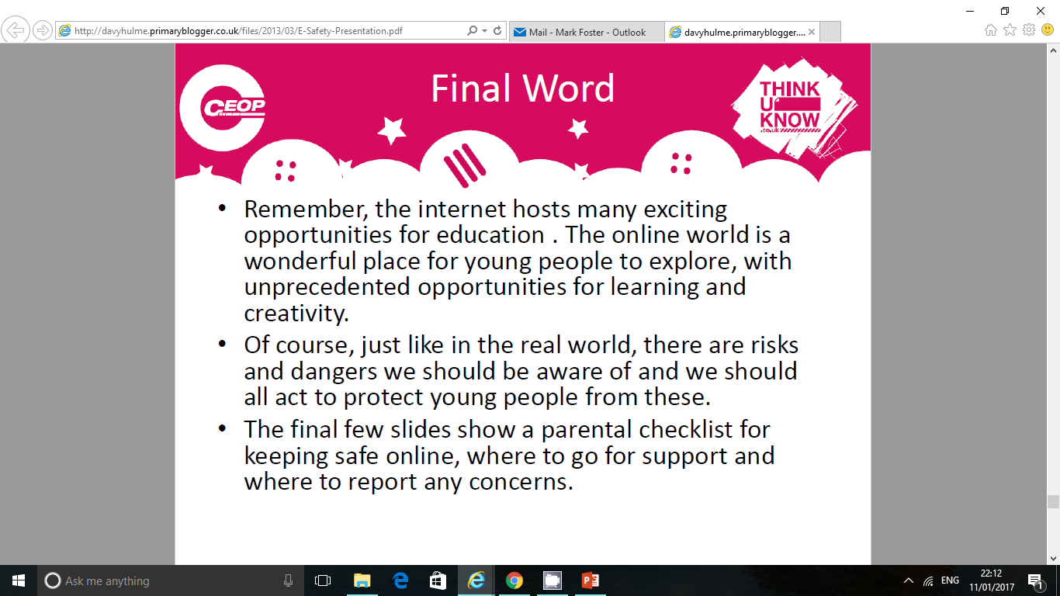

Slide 31
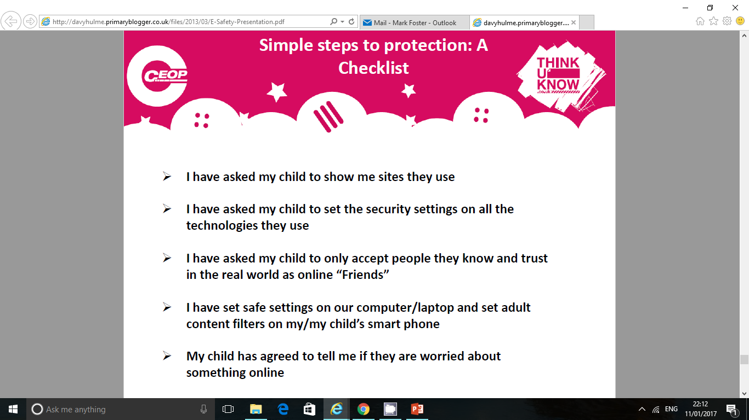

Slide 32

www.ceop.police.uk
www.cybermentors.org.uk

Slide 33
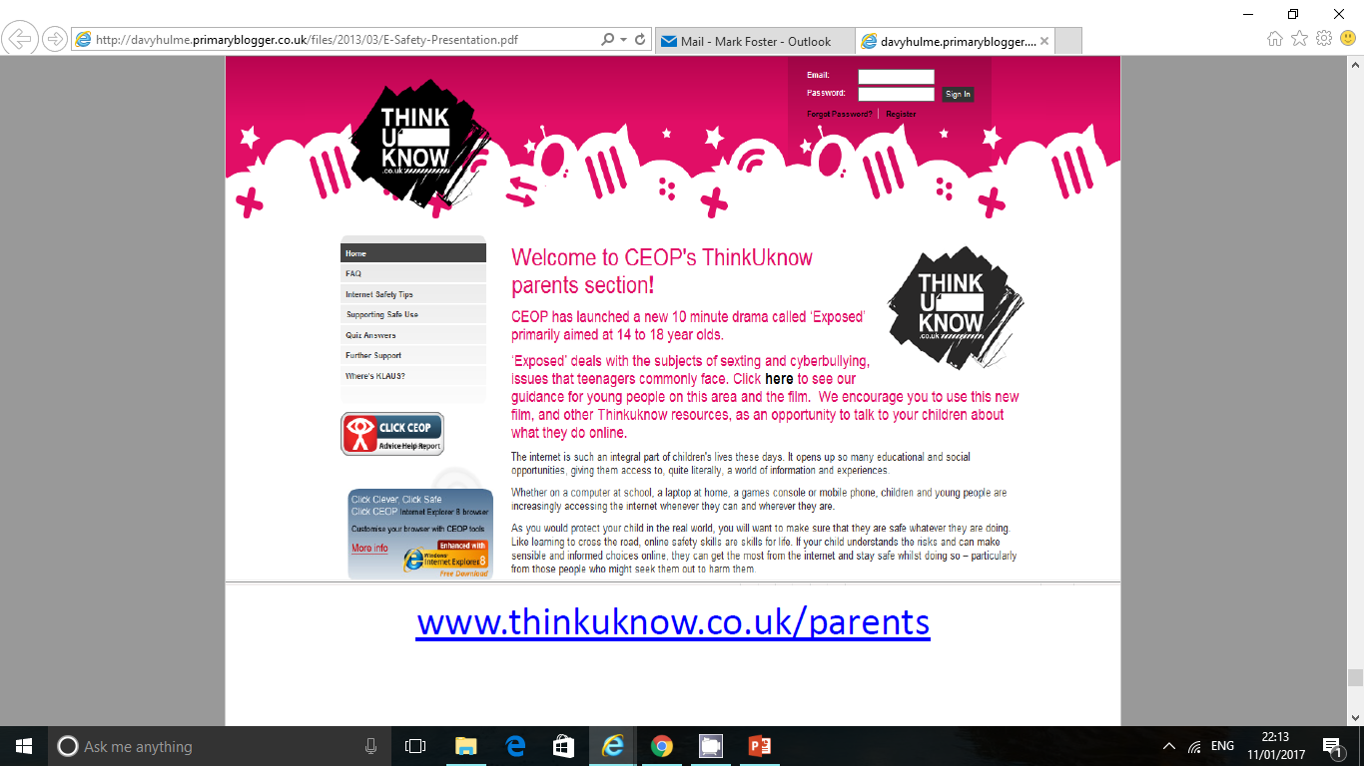
www.thinkuknow.co.uk/parents

Slide 34
Useful Websites
•
Internet Safety:
www.thinkuknow.co.uk/parents
http://www.direct.gov.uk/en/Parents/Yourchildshealthandsafety/Internetsafety/index.htm
http://www.iwf.org.uk/
Facebook
http://www.facebook.com/safety/

Slide 35
Parental Control Software:
http://www.which.co.uk/baby-and-child/child-safety-at-home/guides/parental-control-software/
Useful safe websites for links across the curriculum, including games and general resources:
http://www.bbc.co.uk/schools/parents/
http://www.topmarks.co.uk/
http://www.woodlands-junior.kent.sch.uk/Games/
http://www.bgfl.org/bgfl/15.cfm?s=15&p=251,index
http://www.bbc.co.uk/schools/
http://durham.schooljotter.com/coxhoe/Curriculum+Links

