Slide 1

Meet the Teacher

Slide 2
Class Teacher
Mrs Priestman
Meet our Team
Interventions
Mrs Boddy/
Mrs Smith
PPA
Mrs Ainsworth
Swimming
Music

Slide 3
The Year 3 Classroom Routine
Daily:
Reading books will be changed once they have been completed (maximum once a week - specific day to be determined based on staffing).
Books should be brought in daily so that your child can read with an adult when necessary.
A morning task will then be undertaken whilst the register is completed.
Children will arrive through the playground communal door between 08:45 – 08:55 and walk down to their classroom.
Break - 10:30 – 10:45
Lunch - 12:15 – 13:15
End of day – 15:25
PE: Wednesday
Swimming: Friday
Whole school Worship:
Monday – 09:05 – 09:30
Tuesday – 09:05 – 09:30
Wednesday – Class Worship
Thursday – 09:05 – 9:30
Celebration Worship:
Friday – 14:45 – 15:15

Slide 4
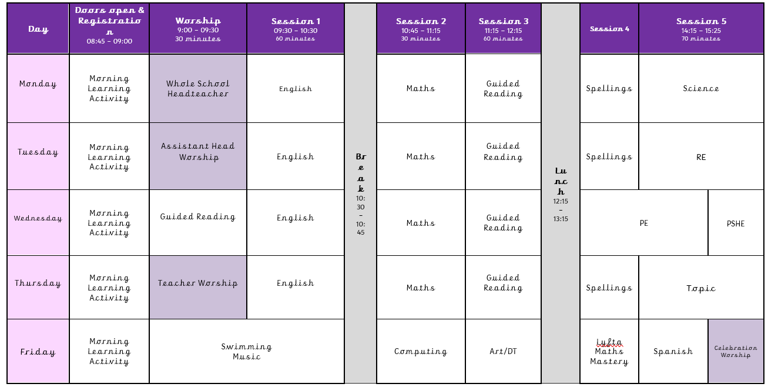
The Year 3 Timetable
Please note that this may change in light of set themed days/trips

Slide 5
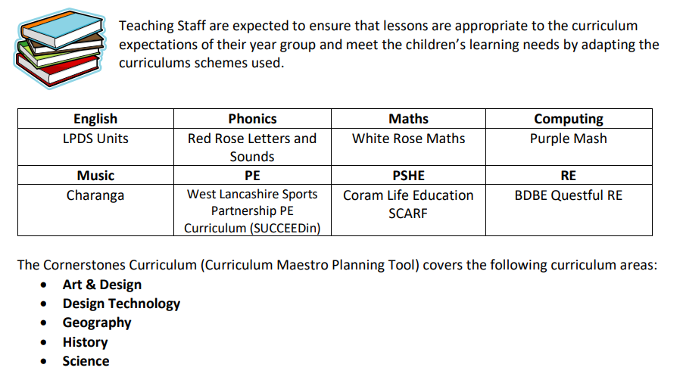
The Year 3 Curriculum
2BeSafe Online Safety
NEW
Oak National Academy
Notes:
v

Slide 6
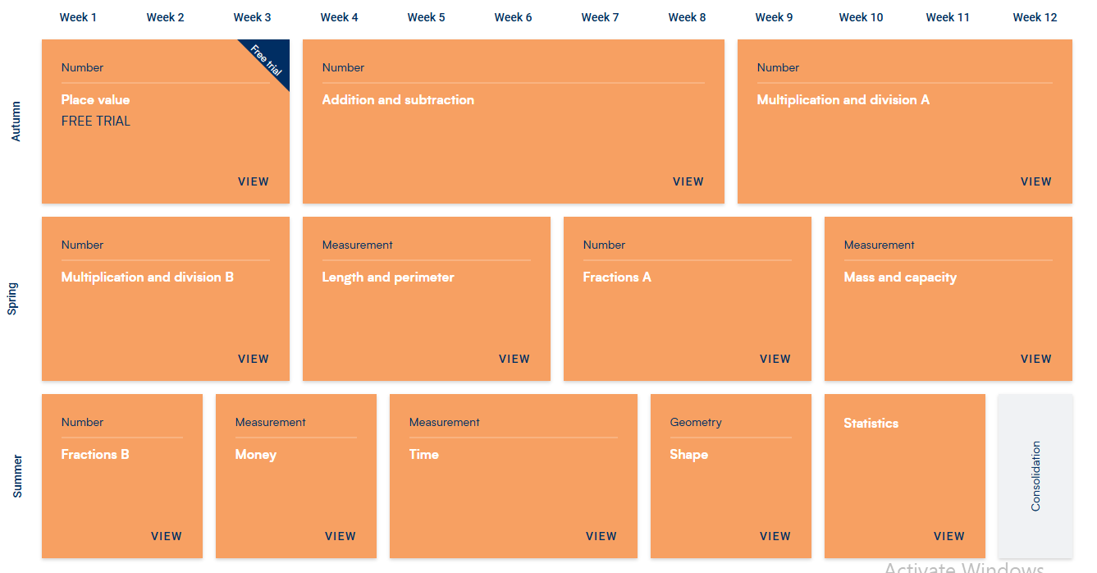
The Year 3 Maths Curriculum

Slide 7

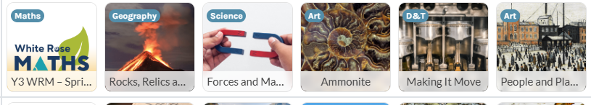

The Year 3 Cornerstones Topics
Autumn
Spring
Summer

Slide 8

Reading
Please listen to your child read for at least 10 minutes, 5 times per week, preferably every day.
Please sign their diary to inform us of what page your child is up to / if they have finished their book.
In order for your child to take part in our 100 Club reading challenge, please ensure that you sign the chart at the front of their diaries every time they read, even if it’s just a couple of pages.
Please read to your child as well, read for enjoyment and interest. Be a reading role model.
In school children read during daily guided reading sessions in small groups as well as 1:1 reading sessions.
Notes:
Evidence suggests that there is a positive relationship between reading frequency, reading enjoyment and attainment.
Reading enjoyment has been reported as more important for children’s educational success, rather than their family’s socio-economic status.
There is a positive link between positive attitudes towards reading and scoring well on reading assessments.
Regularly reading stories or novels outside of school is associated with higher scores in reading assessments.
International evidence supports these findings’; US research reports that independent reading is the best predictor of reading achievement.
Other benefits to reading for pleasure include: text comprehension and grammar, positive reading attitudes, pleasure in reading in later life, increased general knowledge.

Slide 9
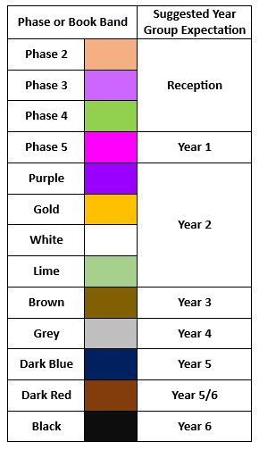
Reading Phase & Book Bands
In the infants, children are given reading books which are phonetically decodable aligned to the Red Rose Letters and Sounds phonics scheme trajectory. It may be that in order for gaps in your child’s phonic knowledge to be bridged a books with the focus grapheme will be sent home from a previous phase to ensure confidence and fluency in word reading.
They may be reading a more challenging book in school during guided reading and when I feel they are confident at this in school, I will then move them up at home too.
When children are more fluent readers, they are able to recognise many words on sight and are able to use their phonic knowledge to segment and blend more complex words. The focus now becomes more on understanding of a text and comprehension. When listening to your child read, please also focus on discussion of the text, new vocabulary and understanding of characters thoughts and feelings.

Slide 10




Home Learning
Spelling home learning will be sent home on a Friday and tested on Friday of the following week. Short, sharp bursts of regular practise will help spellings to “stick” better.
A maths practise activity will also be sent home on a Friday and should be returned on the Wednesday of the following week. It will then be marked, ready for new home learning to be set.
An additional topic / themed homework may also be set from time to time.
Reading is an on-going non-negotiable. We expect home reading to take place at least three times a week. Please sign your child’s reading diary to let us know what page you’re up to / if the book is finished. As well as this, please sign the 100 club record at the front of the diary.
All log-in details for our on-line subscriptions will be found in the front of your child’s yellow reading diaries.

Slide 11
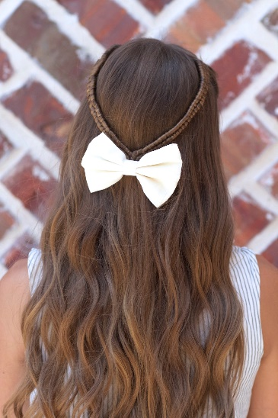

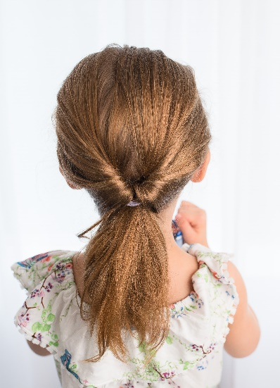

School Uniform
Children should wear their smart school uniform on Mondays, Tuesdays, Thursdays and Fridays.
Please make sure that long hair is always fully tied back using hair accessories in school colours.
Children are allowed to wear small earrings and an analogue watch on Mondays, Tuesdays and Thursdays.
On our PE day (Wednesdays) children should wear their P.E. kit (purple shorts and white T-Shirt); they may wear plain black tracksuit top/bottoms.
They should not wear a watch and earrings should be removed. Plain bobbles please in long hair.

Slide 12

Swimming
On Fridays (swimming day) children should wear their normal uniform
No watches
No earrings
Long hair tied back with plain accessories
Children should bring:
  Named bag
  Towel
  Swimming hat (all children)
  Swimming Costume or Trunks (no bikinis or shorts)
  Goggles

Slide 13


Healthy School
We will do our best to ensure the healthy growth and development of our learners. We will do all that we can to build healthy eating and drinking patterns so that our learners thrive and lead healthy active lives.
We provide healthy and balanced school meals that, where possible, contain sustainable and locally sourced produce.
All children can bring in a healthy snack e.g. fruit for morning play or parents can pay for toast through Parent Pay.
All children should bring a drinks bottle to school which contains water.

Slide 14
What do I need to bring to school?
Reading Book, Reading Record and Bag
Water bottle
Packed Lunch bag as required
Snack as required
Coat (especially as the term progresses!)
What should I leave at home?
Toys/teddies
Pencil Cases
Lip Gloss/balms

Slide 15

School Assessments
At Hesketh-with-Becconsall All Saints Church of England Primary School, we believe that assessment should place the child at the centre of their learning, encouraging them to let their light shine and that it should raise achievement for all. We focus on the progress of each individual child. We believe that assessment should be thorough, manageable and relevant. Assessment for learning (AfL) is embedded throughout the school.
“AfL is the single most powerful tool we have for both raising standards and empowering lifelong learners.”Assessment Reform Group
Assessment at Hesketh-with-Becconsall All Saints Church of England Primary School involves:
Setting Targets – sharing achievable but challenging targets, objectives and success criteria with children, and allowing children to set their own targets with guidance.
Tracking – teacher and children evaluating progress in relation to these targets over the course of a lesson, unit of work, term, year or key stage.
Active Interventions – teacher (with involvement of SLT, SENCO, TAs and parents where relevant) planning appropriate learning to support children in meeting these targets based on information gained from tracking.
Reviewing – teacher, child and other adults reviewing whether targets have been met and progress has been made.
The most valuable form of assessment is formative and is determined by daily interactions and questioning of pupils and marking of books to ascertain their starting points and next steps.
Teachers adapt teaching according to their assessment of pupils and to meet pupil needs, even if this means deviating from a planned lesson.
Three more formal assessment cycles take place during the year, at the end of each term.

Slide 16
Parents’ Evening: 5th October 2026
Let’s Go Sing: Spring 2027
Dance Festival: 29th June 2027
Upcoming Events

Slide 17

Any Questions?
Website: https://www.allsaintshwb.co.uk/class/year-3
Email: priestmanh@hesketh-with-becconsall.lancs.sch.uk

